Slide 1
Sue Peters
American Monetary Institute monetary.org
Alliance for Just Money monetaryalliance.org
Green Party US GreensForMonetaryReform.org
Henry George School
149 East 38th St.
MONEY TALKS:
Debating Monetary Reform – A Hard Look at MMT
Saturday, May 4, 2019 1:30 to 4:00 pm

Slide 2



Slide 3
WHAT IS THE DEFINITION OF ‘GOVERNMENT’?
CONGRESS + EXECUTIVE BRANCH includes TREASURY (AMI)
VS.
“PUBLIC SECTOR”
(CONGRESS + EXECUTIVE BRANCH, TREASURY, FEDERAL RESERVE BANKS, OTHER STATE BODIES.…)
(MMT)

Slide 4
FEDERAL RESERVE SYSTEM

Slide 5
IS THE FEDERAL RESERVE SYSTEM….
PRIVATELY CONTROLLED (AMI)
VS
PART OF OUR GOVERNMENT (MMT) ?

Slide 6
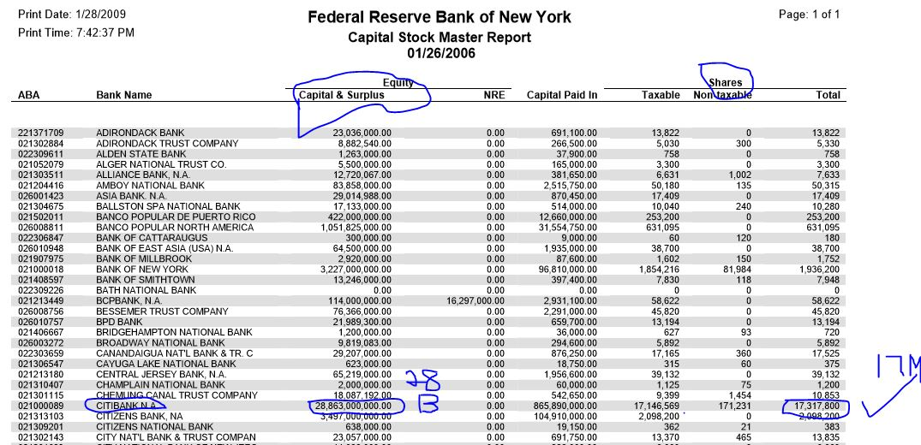

Slide 7
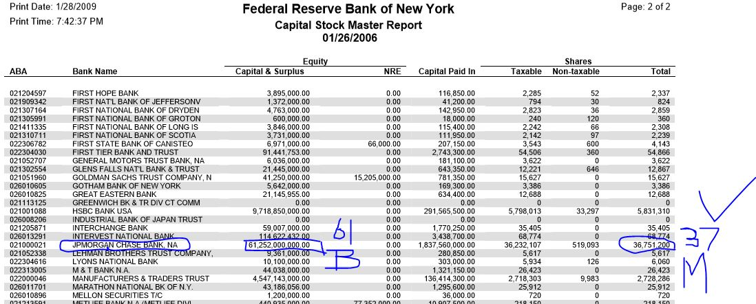

Slide 8
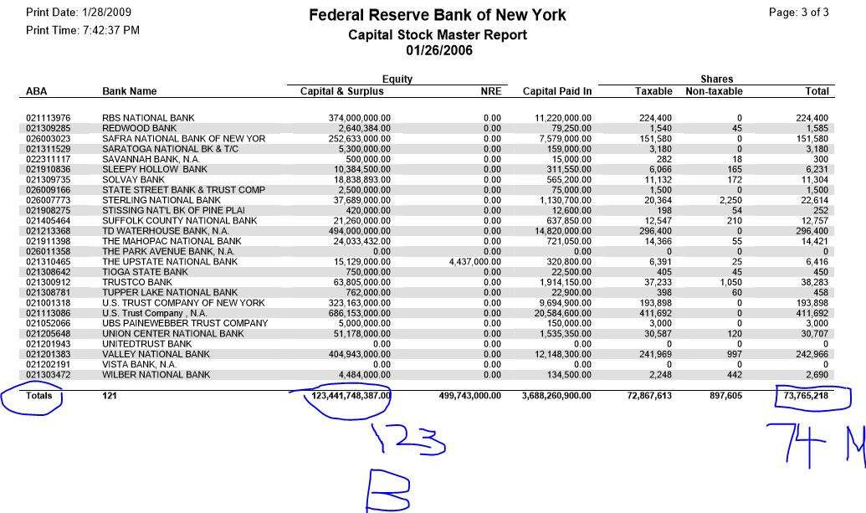

Slide 9
PRIVATE COMMERCIAL BANKS

Slide 10
WHAT IS THE ROLE OF BANKS ?
THEY HAVE THE POWER TO CREATE OUR MONEY AND DECIDE WHO GETS IT (AMI)
VS.
“LET’S NOT LOOK AT THEM...
GOVERNMENT IS THE PROBLEM.” (MMT)

Slide 11
WHO CREATES MONEY?
PRIVATE COMMERCIAL BANKS
buying securities or making ‘loans’ (AMI)
VS
OUR GOVERNMENT
paying out its expenses (MMT) ?

Slide 12
WHO OWNS THE BIGGEST PILE OF U.S. NATIONAL DEBT?
BANKS AND FINANCIAL INSTITUTIONS (AMI)
VS.
THE NATIONAL DEBT =
PRIVATE SECTOR FINANCIAL ASSETS =
NOT ‘REAL DEBT’ =
“NO PROBLEM” (MMT)

Slide 13

QUESTION FOR MMT:
If it is true that government creates the money to fund its expenses,
and does not use taxes or bond sales….
Why originate bonds at all?
Why levy taxes at all?

Slide 14
WHO CREATES MONEY FOR FINANCIAL MARKETS?
PRIVATE COMMERCIAL BANKS (AMI)
VS.
“I DON’T SAY” (MMT) ?

Slide 15
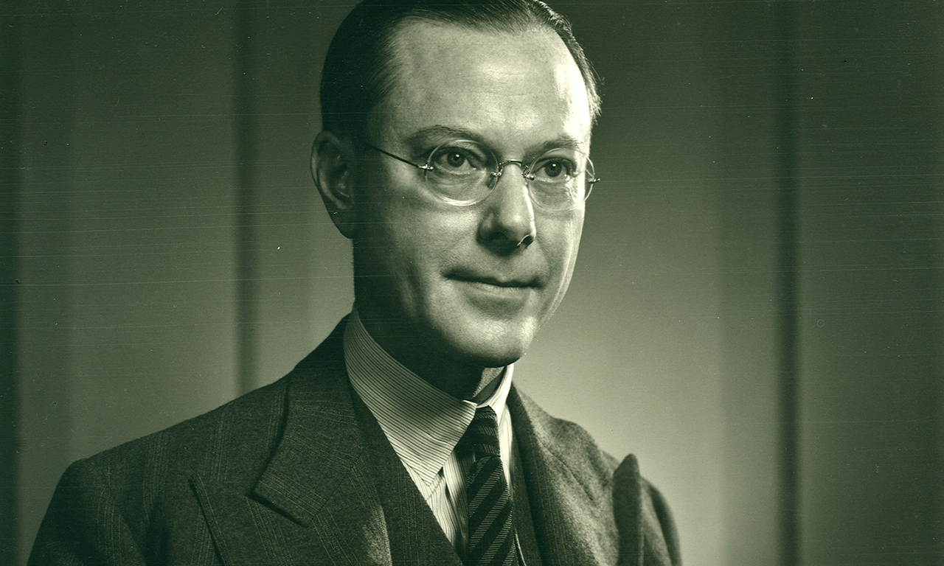
1939 – TESTIMONY OF GRAHAM TOWERS, GOVERNOR OF THE BANK OF CANADA (1934-54)
(before Canadian Select Standing Committee on Banking and Commerce)
Question: "But there is no question about it, that banks create that medium of exchange?"
[i.e., bank deposits]
Towers: "That is right. That is what they are for."
Question: "And they issue that medium of exchange when they purchase securities or make loans?"
Towers: "That is the banking business, just in the way that a steel plant makes steel." (p. 287)

Slide 16
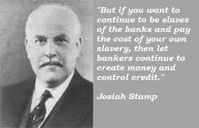
President of the Bank of England in the 1920's, the second richest man in Britain

Slide 17
CORPORATE POWER

Slide 18
WHO EMPOWERS MULTI-NATIONAL CORPORATIONS?
PRIVATE COMMERCIAL BANKS (AMI)
VS.
“I DON’T SAY” (MMT)

Slide 19
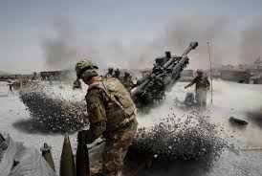

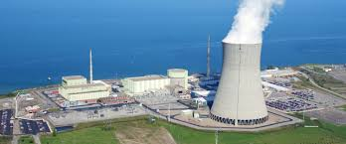

PRIVATE BANKS EMPOWER CORPORATIONS…..
Every time a commercial bank buys a security or makes a ‘loan’, money is created.
Jean Giblette, who worked at a multinational bank in New York City for 10 years:
“As I saw with my own eyes in 10 years at the Banque, the largest corporations are topped off, even underwater, in debt and utterly dependent on the next loan. The banks won’t let them go under, they would have to write off billions in losses, so they just restructure the loans...
“This unholy entanglement is what’s keeping all kinds of earth-destroying systems in place...endless war (constant new loans to military contractors), a fossil fuel industry (... propped up with Wall St speculation), nuclear power..., lethal pharma and the cancer industry. Not to mention a propaganda machine that makes Pravda look like the Weekly Reader.”
war
Fossil fuels
Nuclear power
Pharma companies

Slide 20
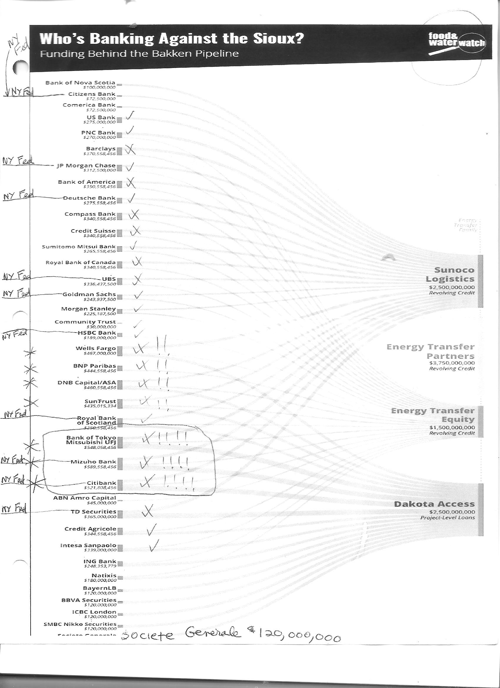
FUNDING
PIPELINES

Slide 21
HOW DID WE GET HERE?

Slide 22
IN WORLD HISTORY, WHAT WAS USED AS MONEY?
DEBT-FREE CREATION AND ISSUANCE OF MONEY
BY GOVERNMENT (AMI)
VS.
“I DON’T TALK ABOUT HISTORY” (MMT)

Slide 23
INTRODUCTION
Money has been debt-free through most of recorded history,
and issued by public authority.
“From the remotest time to the seventeenth century of our aera, the right to coin money and to regulate its value (by giving it denominations) and by limiting or increasing the quantity of it in circulation, was the exclusive prerogative of the State.” Alexander Del Mar, A HISTORY OF MONETARY CRIMES, p. 7
4,500 BC_____________________1500-1000 BC____800 BC______________________630 BC_______________510 BC __________________27 AD_____________>
BABYLON (TEMPLE PRIESTS) LYCURGUS OF SPARTA SOLON OF ATHENS ROMAN REPUBLIC ROMAN EMPIRE
SILVER BY WEIGHT GOLD (FIAT) IRON PELLETS (FIAT MONEY) GOLD, SILVER BRONZE (FIAT) GOLD (copper)
_______________330 AD__________________________1204 AD _________________________________1284 AD _______________________________________>
BYZANTINE EMPIRE FALL OF CONSTANTINOPLE CITY OF VENICE
GOLD COMMODITY (G:S RATIO) MONEY POWER TO EUROPEAN KINGS FIRST GOLD COIN, STATE BANK
1585-1750 AD __________________1604 AD______________________________1666 AD____________________1688 AD_______________1694 AD__________>
AMSTERDAM ENGLISH MIXT MONEY CASE ENGLISH FREE COINAGE WILLIAM I BANK OF ENGLAND
GOLD, SILVER, PUBLIC BANK MONARCH HAS MONEY ISSUE GLORIOUS REVOLUTION
Notes:
<number>

Slide 24
WHAT ABOUT U.S. MONEY HISTORY?

Slide 25
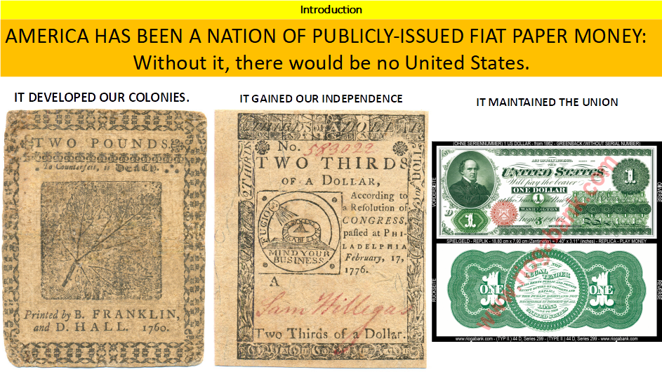

Slide 26
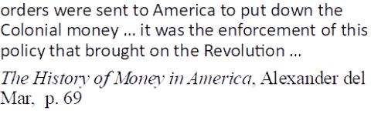
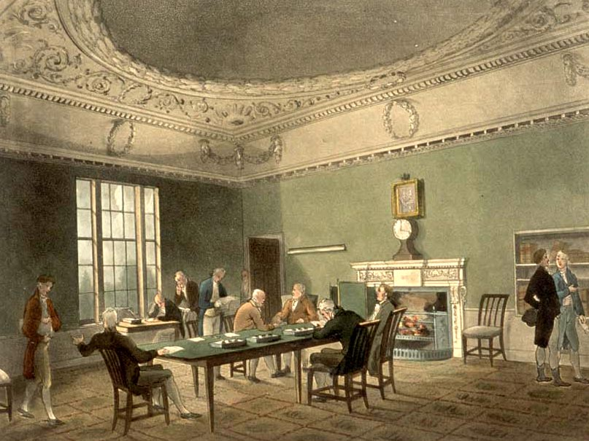
British Lords of Trade in London

Slide 27
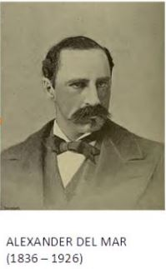
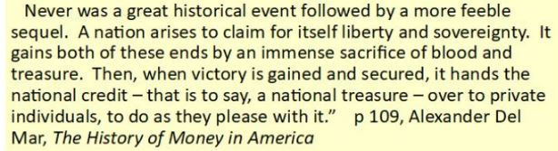
Battle over control of money has raged for millenia….
Public versus Private

Slide 28
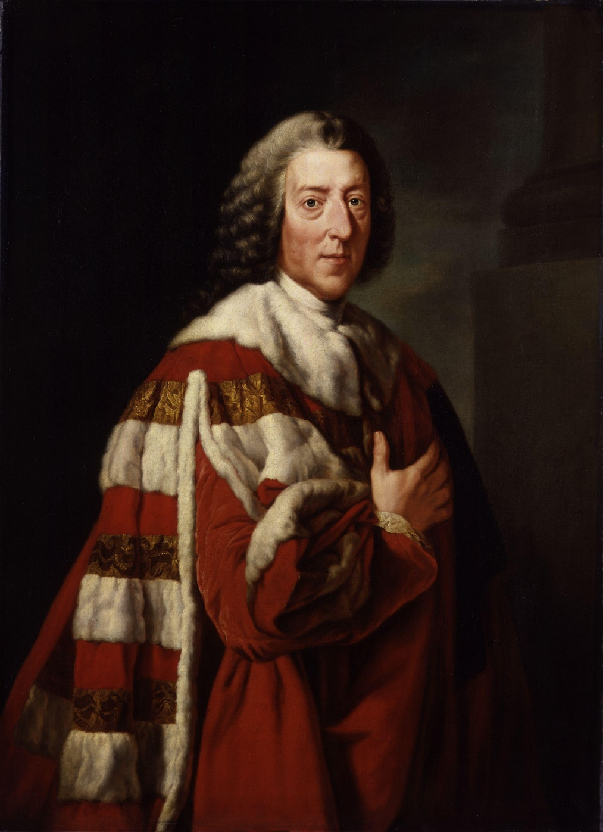
THE MONEY POWER VS THE U.S. CONSTITUTION
WILLIAM PITT, FIRST EARL OF CHATHAM
“Let the Americans adopt their funding
system, and go into their Banking institutions,
and their boasted independence will be
a mere phantom.”
Notes:
<number>

Slide 29
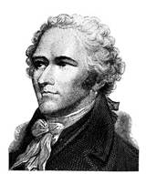
Each bank had been chartered by the state’s legislature,
but the management was private.
Alexander Hamilton’s definition of a bank
to President Washington in 1791 - Hammond, p. 69:
“For the simplest and most precise idea of a bank is a deposit of coin or other property as a fund for circulating a credit upon it which is to answer the purpose of money.”
HAMILTON
Notes:
<number>

Slide 30
“Soon … banks were serving not only merchants but “mechanics,”
on whose skills the Industrial Revolution was progressing, and farmers.”
Hammond, p. 147
YEAR #STATE
CHARTERED
____ ____BANKS___
1791 3
29
90
250 !!!
300
1837 788
“In 1791 American business had been concerned mainly with foreign commerce;
by 1816 it was concerned mainly with a greatly diversified internal economy …
Hammond, pp. 148-149
THESE ARE ALL PRIVATE BANKS….

Slide 31
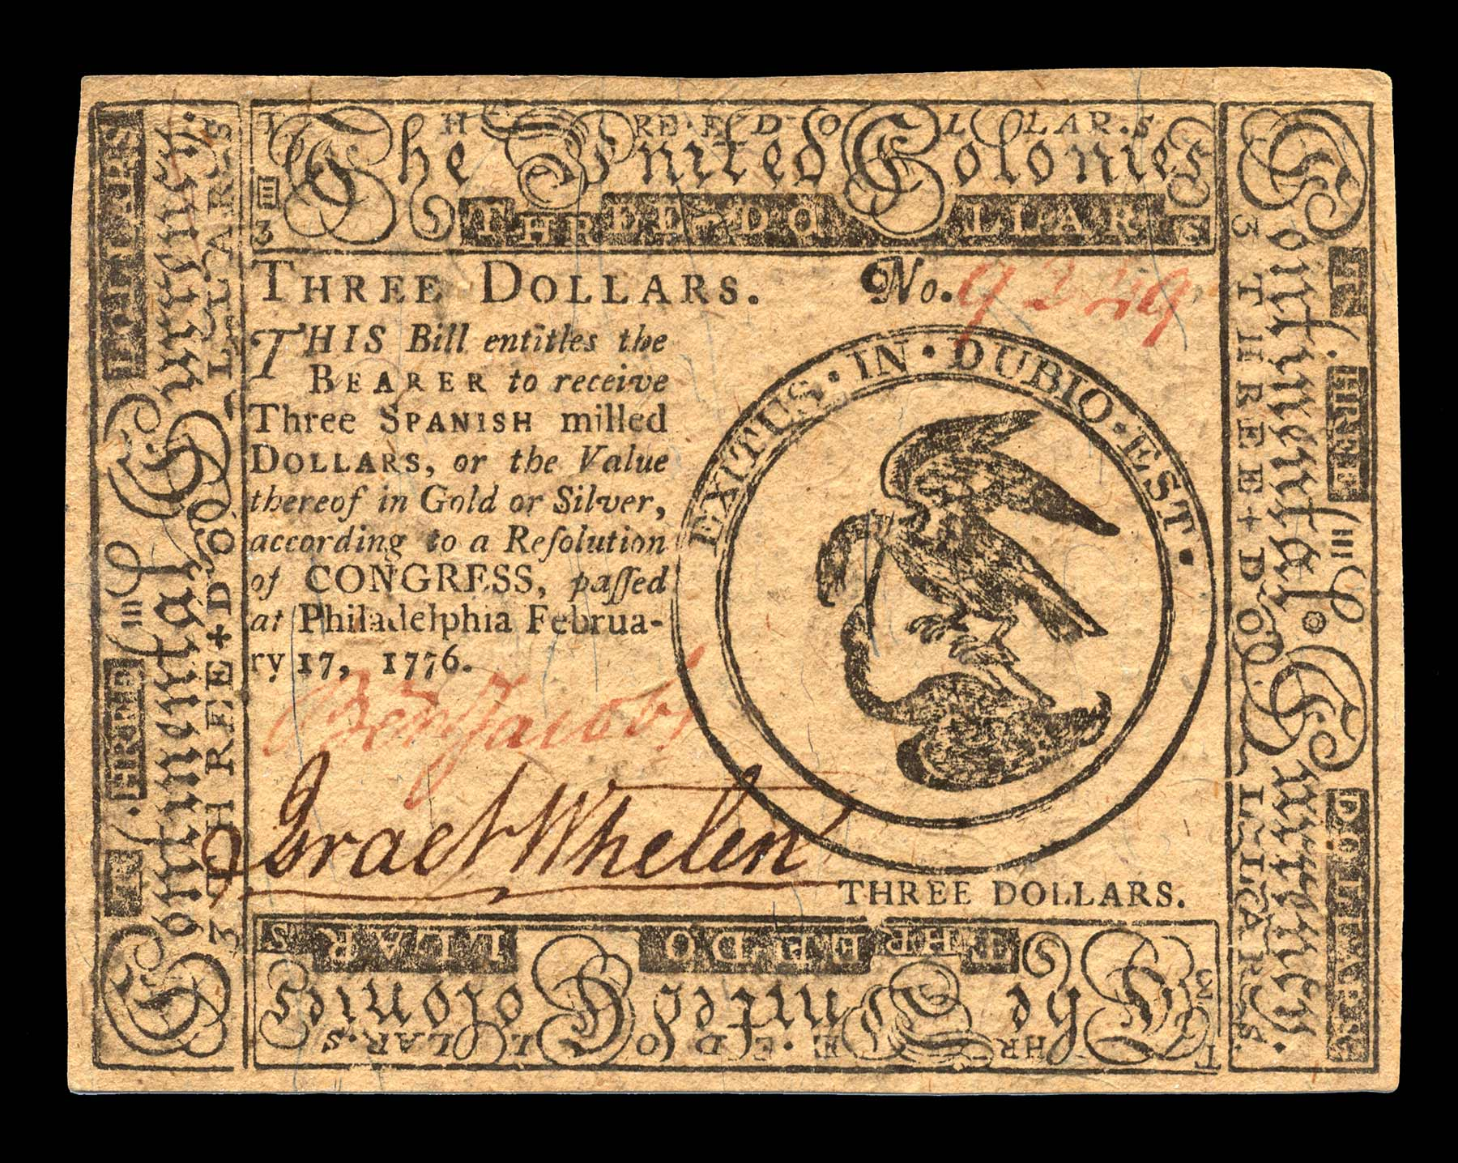
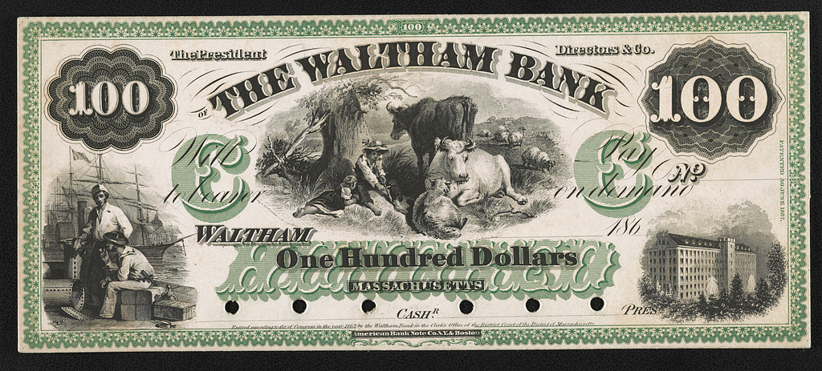
COMMENTS ON STATE BANK NOTES -- BY BRAY HAMMOND
“When the Constitution was fresh … people were familiar with [colonial or state] bills of credit and with [private] bank notes as quite distinct things… But twenty or more years later … as … circulating [bank] notes came to provide a volume of currency which before could not have been imagined, the fact that the notes were money became obvious, and its unexpected implications began to emerge.”

Slide 32
WHAT ABOUT THE U.S. GREENBACK?

Slide 33
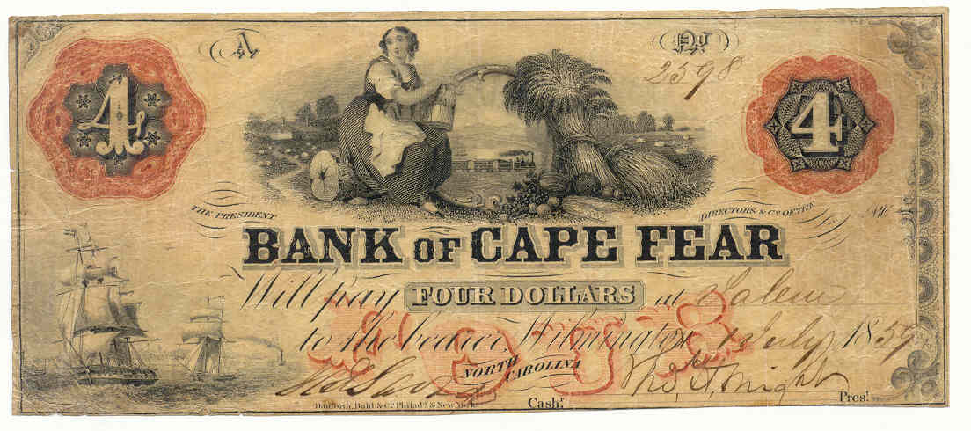
BEFORE THE U.S. CIVIL WAR
“The banking business was conducted by 1,600 state banks, each going its own merry way; 7,000 different kinds of bank notes circulated, with more than half being spurious. “ Studenski & Krooss, Financial History of the U.S., p. 137-138.
Notes:
<number>

Slide 34
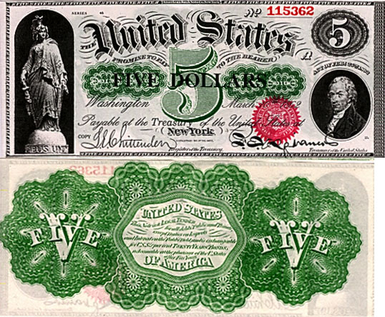
CONGRESS TAKES THE INITIATIVE: The Greenback Legal Tender Note
FEBRUARY 25, 1862: LEGAL TENDER ACT SIGNED BY LINCOLN –
GREENBACK MONEY (AKA U.S. NOTES)
Unbacked by gold or silver…
Legal tender for all debts, public and private…
except duties on imports and interest on the public debt
Previous treasury notes issued from 1812 were always later redeemable in metal. But the Greenbacks were not paper promises to pay “money” later. The Greenbacks were themselves the money.
There was no interest payment on them and they did not add to the national debt.
Notes:
<number>

Slide 35
WHAT IS THE FED?

Slide 36
THIS BANK CREDIT (DEBT-MONEY) SYSTEM
WAS IMPLEMENTED BY THE 1913 FEDERAL RESERVE LAW
NEW YORK FEDERAL RESERVE BANK:
OWNED BY ITS MEMBER BANKS
COMMERCIAL BANKS:
OWNERS OF NY FED BANK
NEW YORK FEDERAL RESERVE BANK
GOLDMAN SACHS
BANK OF
AMERICA
CITIGROUP
J.P.MORGAN
CHASE
DEUTSCHE BANK
HSBC
UBS
ETC.

Slide 37
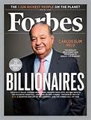
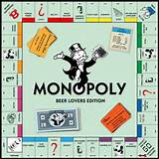





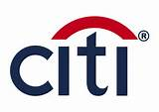
WHAT’S GONE WRONG?
OBSCENE CONCENTRATION OF WEALTH

Slide 38
WHAT CAN WE DO?

Slide 39
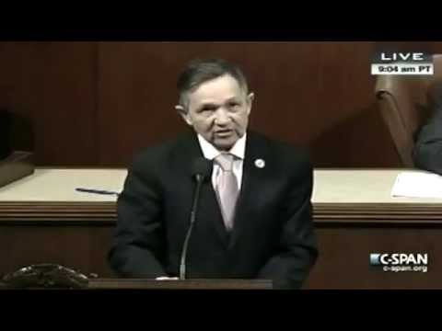
U.S. MONETARY REFORM – 1996 TO THE PRESENT
In 2010 and 2011, Representative Dennis Kucinich entered into Congress THE NEED ACT (HR2990).
This act was based on the work of the AMI and Stephen Zarlenga.
This act was totally for the PUBLIC GOOD, not for the banks.

Slide 40
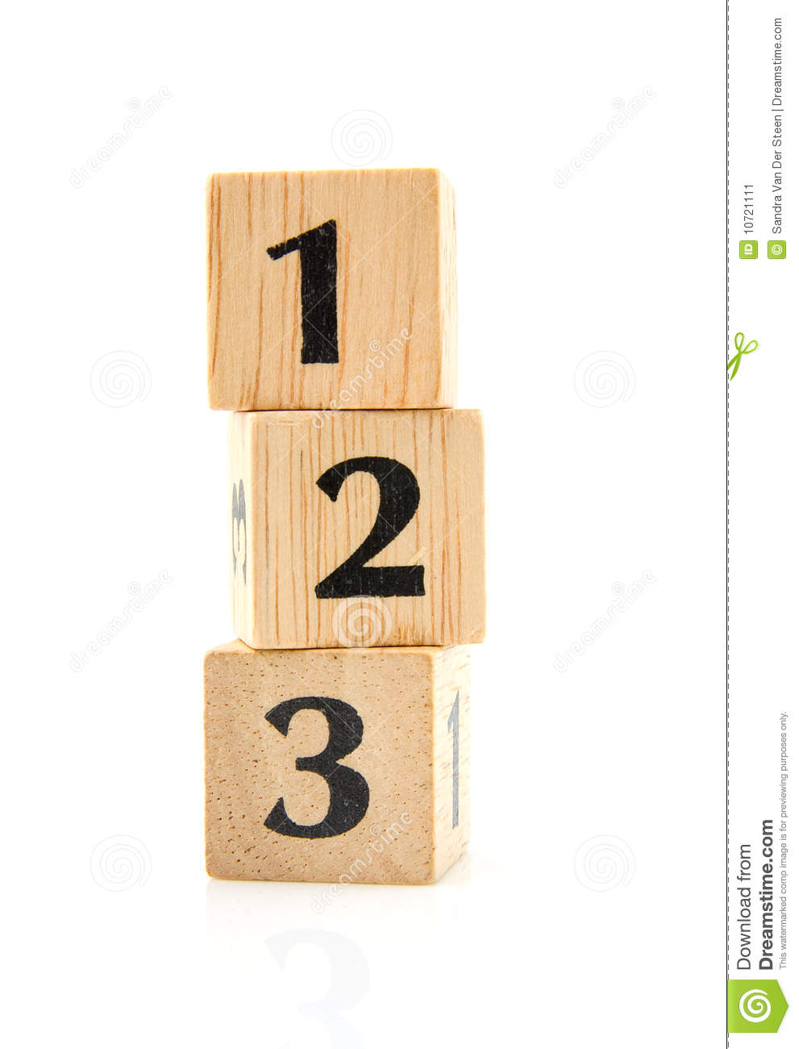
MONETARY REFORM FOR THE PEOPLE
THE NEED ACT has 3 parts.
All 3 parts must be enacted at the same time, for monetary reform to succeed.
All 3 parts must be in place together, or the Private Money Power will take
back control, as they have done over recorded history.
NATIONALIZE THE FEDERAL RESERVE BANKS
STOP BANKS CREATING WHAT WE USE AS MONEY
SPEND SOVEREIGN MONEY INTO ECONOMY

Slide 41
THE END

