Slide 1

GPUS National Meeting
Salt Lake City, 2018
Sue Peters, Speaker
PARITY ECONOMY:
THE NATURAL LAWS OF AN ECONOMY

Slide 2
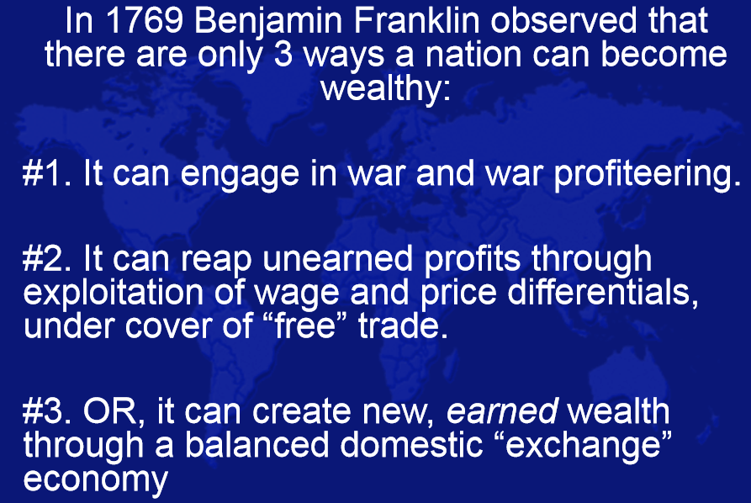
#1 Make war -- take the wealth by force
#2 Trade – to be profitable requires cheating
#3 Or… it can profit through agriculture,
whereby planting a seed creates
new wealth as if by a miracle

Slide 3

A friend said to me about ‘TRADE’:
“ Look at the World Trade Center in New York. It’s all about cheating.
The world’s traders have built a showcase – a theater - to make us
think this is where wealth comes from.“
“It’s the guy who is working down here on the farm that’s created
our wealth. Just hard work.”

Slide 4

My friend told me about:
The National Organization for Raw Materials
normeconomics.org
I discovered:
  NORM has knowledge that is PROVABLE (not theory)
  about how an economy works and how money can be distributed
  as widely as possible to the owners and workers of
  private enterprise. They discovered natural laws.
  Their teaching of PARITY AGRICULTURE was official policy from 1942 to 1950. Then neoliberal economics slowly took over public and official discourse.

Slide 5

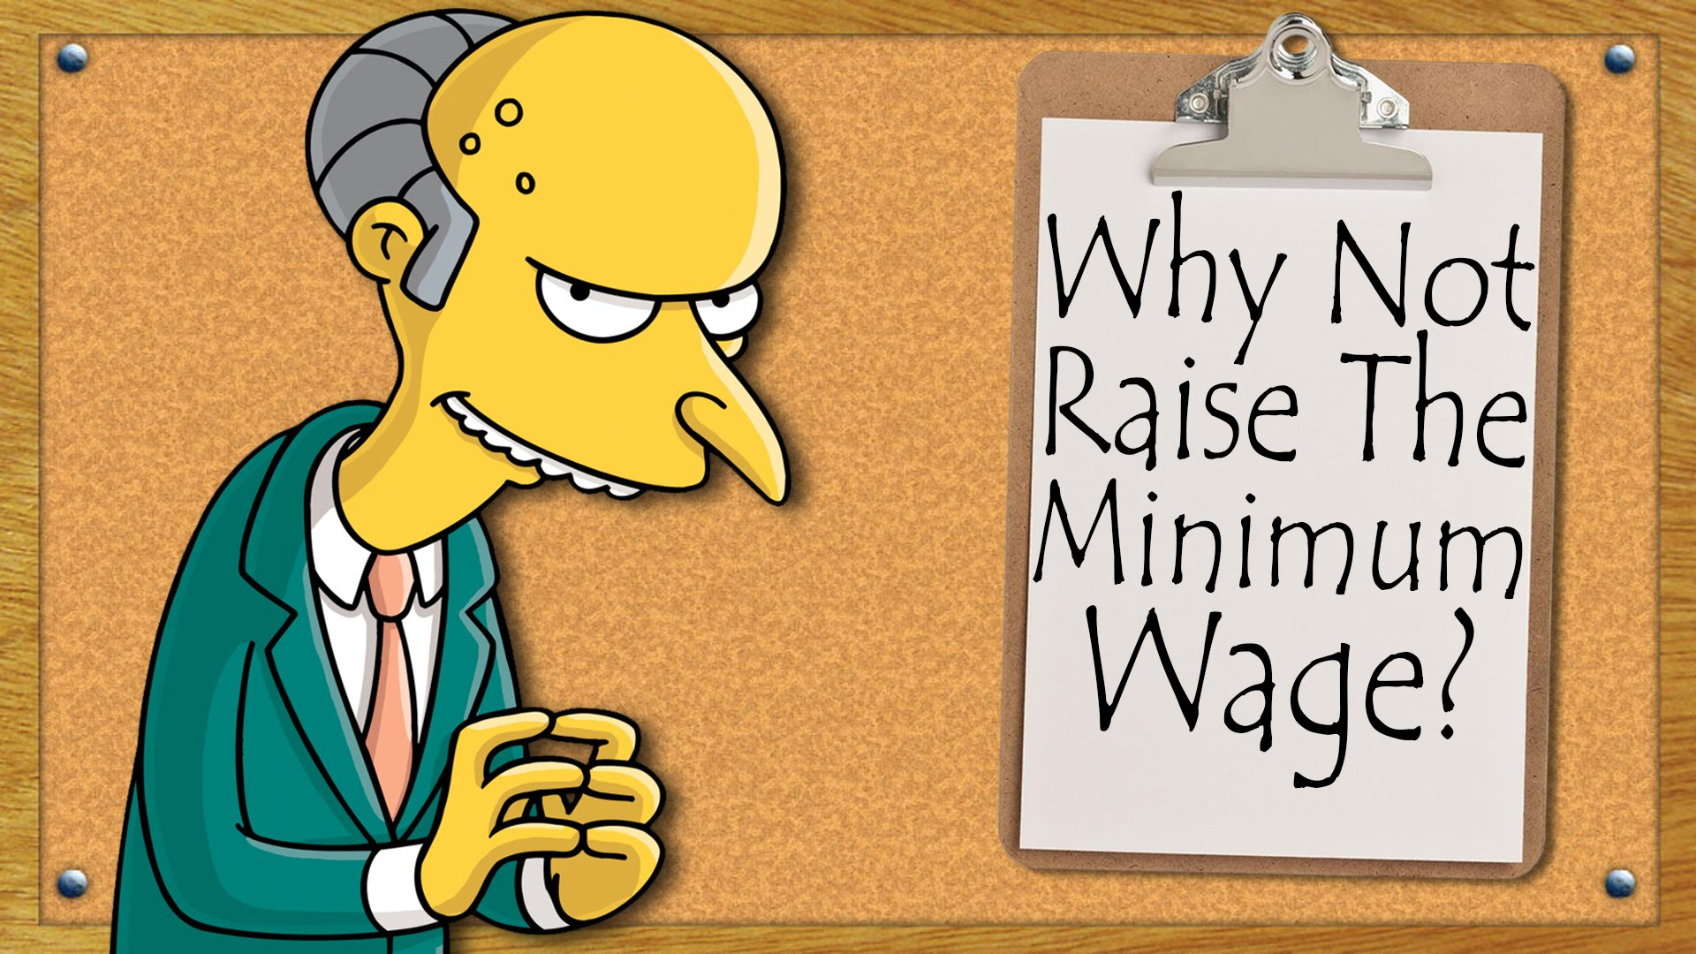
I asked myself the question:
WHY HAVEN’T I BEEN TAUGHT ABOUT THIS IN MY EDUCATION?

Slide 6
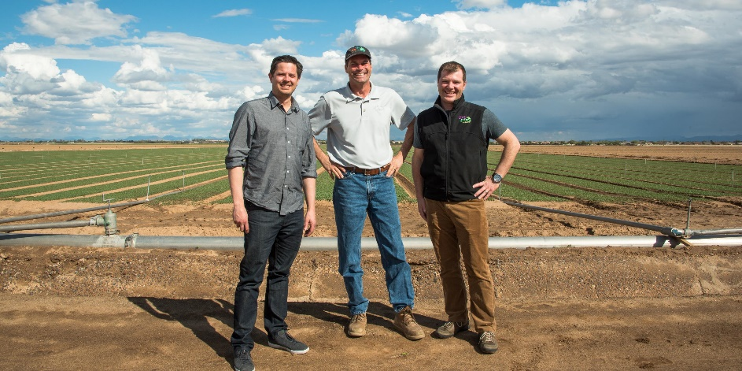
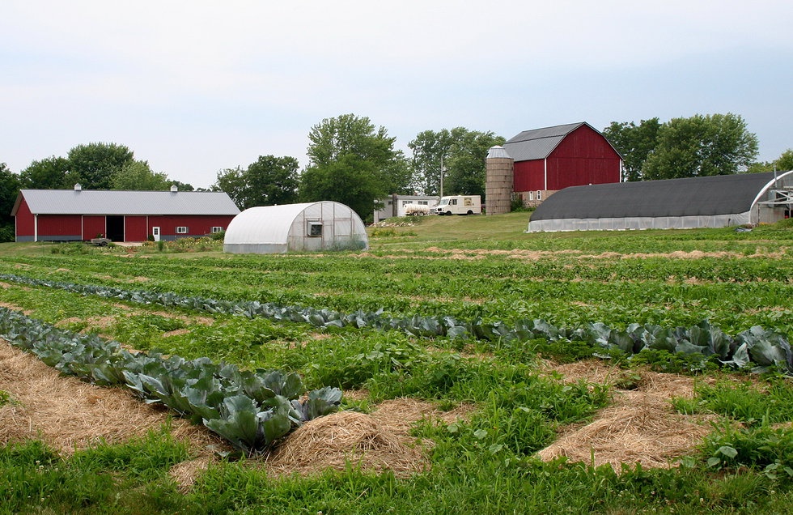
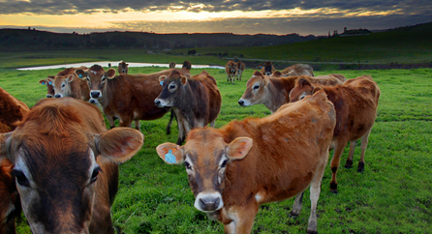
Agriculture must be considered the foundation of the economy of the United States:
  it is the nation’s largest industry
  it creates the biggest share of the raw material input of new wealth in any accounting period

Slide 7



Wild berries feed no one until someone picks them. New wealth is created by the application of human labor to natural resources.

Slide 8
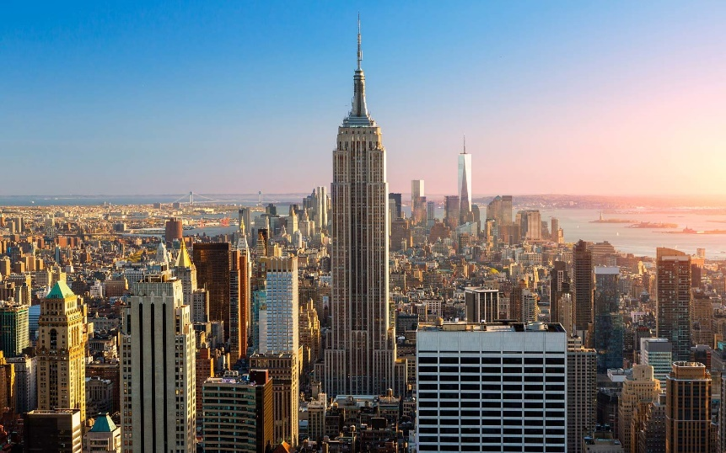
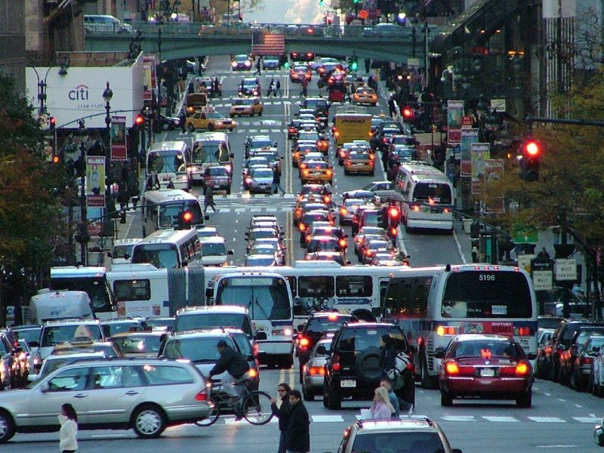
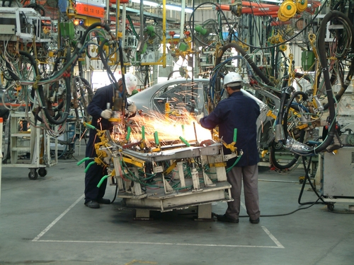
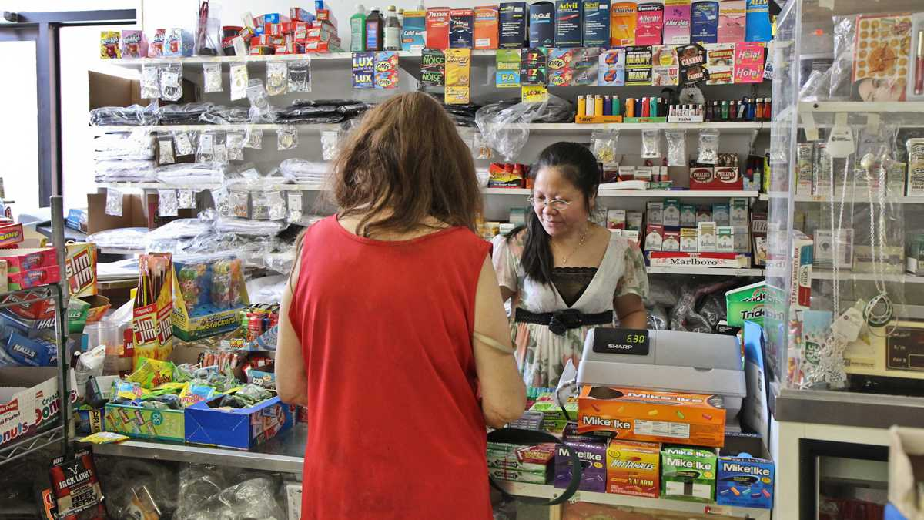
Our cities, industries, and small businesses would not exist without the work of the farmers.

Slide 9
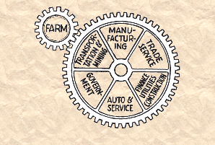
A PARITY PRICE FOR RAW MATERIALS
PARITY PRICES keep agriculture in balance with the costs of labor and capital in the rest of the economy.
Parity ensures that EARNED INCOME will be DISTRIBUTED throughout the economy as widely and as fairly as possible.

Slide 10
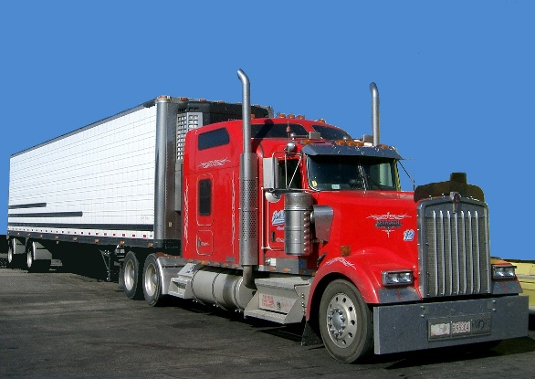
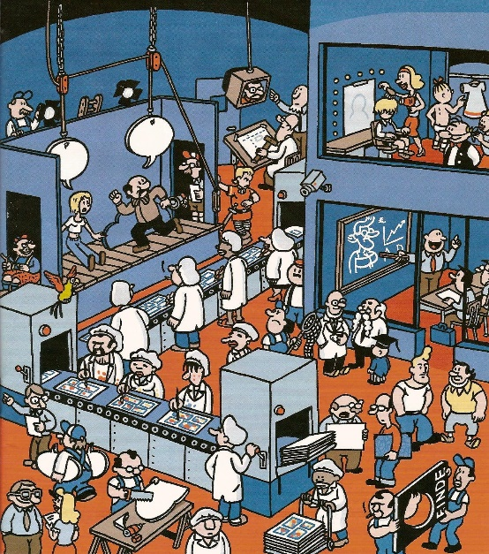
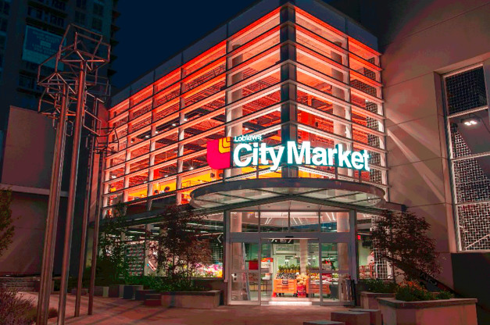

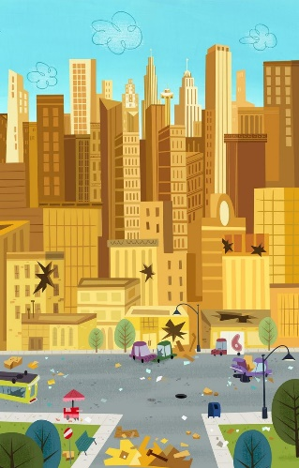


Gross farm income generates earned national income.
If earned national income is too low to avoid deficits (debts),
ag prices are below parity.

Slide 11
With parity, gross farm income will multiply as it is spent through the domestic economy at least 7 times.

Slide 12
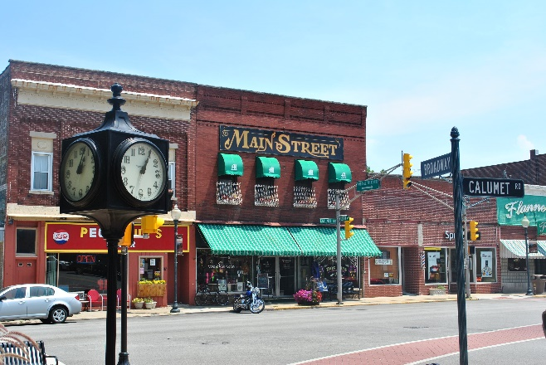

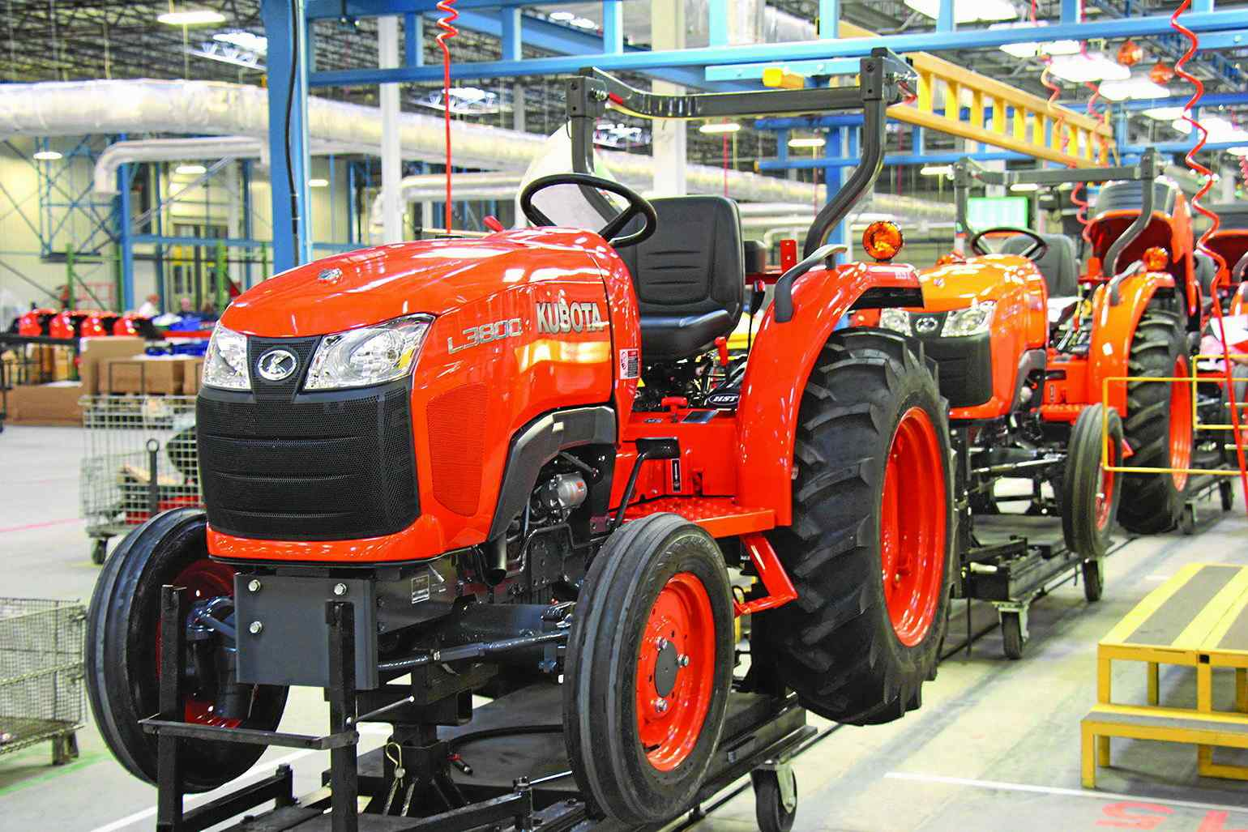
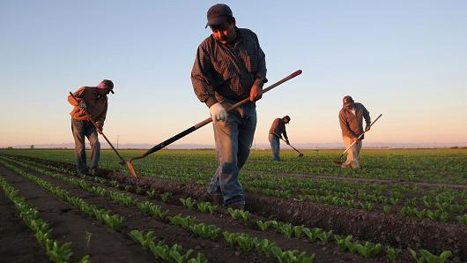
With parity, earned income will be fairly distributed to owners and workers throughout our private enterprise economy = PROSPERITY. With no debt creation!
PARITY PRICES
BUY FROM RURAL STORES
PURCHASE TRACTORS & MORE
PAY WORKERS GOOD WAGES

Slide 13

Both the Green Party and NORM want a just world, where all citizens have the opportunity for a decent life.
And both want to get public U.S. money into the hands of our citizens.
GreensForMonetaryReform.org
Congress will create and distribute new public U.S. money
into the economy for infrastructure, education, health care.
This will happen with ‘Greening the Dollar’ in the Green
Party national platform.
A parity price will fairly distribute public U.S. money
as earned income to owners and workers
throughout our private enterprise economy.

Slide 14

NORM’S EQUITABLE TRADE
In addition, NORM has proposed Equitable Trade. Not the current ‘free, cheating’ trade!
With Equitable Trade, the standard of living of the poorer countries will be encouraged
to come up to our standard.
Middlemen, international traders, and bankers cannot make a profit off of this trade.
Equitable trade takes place between importers/exporters in each country.

Slide 15
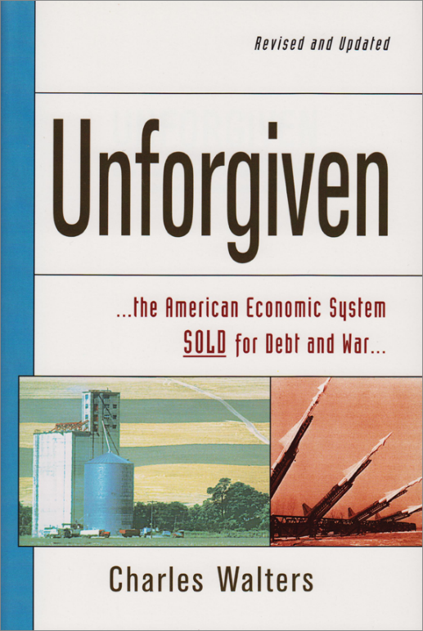
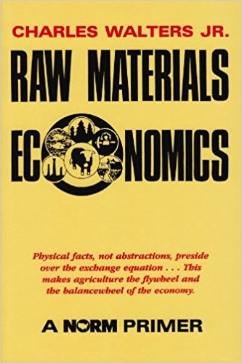
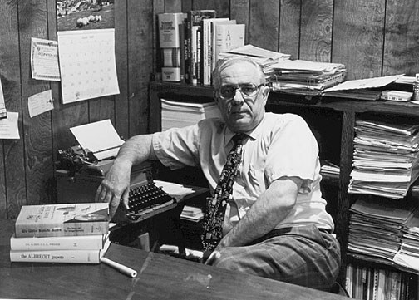
THAT WAS ALL I NEEDED!
I READ….
      I ASKED QUESTIONS…..
I JOINED NORM AS A MEMBER…. http://normeconomics.org/
I PARTICIPATE EVERY WEEK IN THEIR MEMBER CONFERENCE CALLS.
CHARLES WALTERS
economist, eco-farmer, author

