Slide 1
PANEL: HENRY GEORGE AND THE POVERTY PUZZLE
Talk: Land Value and the “Money Power”
by Sue Peters
American Monetary Institute, Green Party US,
Alliance for Just Money, NYC Labor Chorus

Slide 2
PART 1
Henry George and the Role of Government

Slide 3
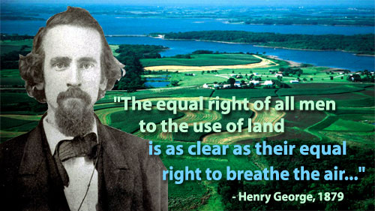
Henry George: The Functions of Government
In Social Problems, Henry George defined the first and main purpose of government:
“It is to secure to men those equal and unalienable rights with which the Creator has endowed them… the first of these unalienable rights – the equal right to land…”

Slide 4


Henry George: The Functions of Government
In Social Problems, Henry George continues with the cooperative functions of government:
“As society develops in obedience to that law of integration and increasing complexity… it becomes necessary in order to secure equality that other regulations should be made and enforced… what may be called cooperative functions…”

Slide 5
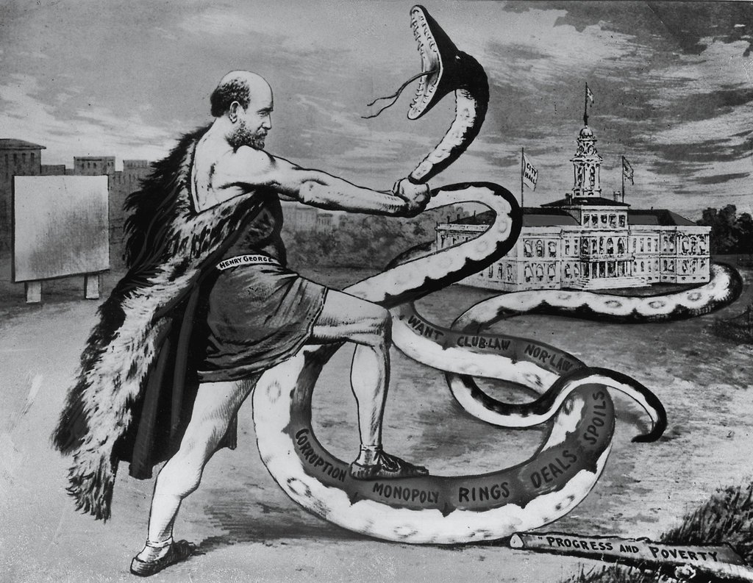
Henry George: The Functions of Government
In Social Problems, Henry George adds to the function of government to regulate and establish monopolies:
“…the concentration that results {as society gets more complicated} operates more and more to the restriction and exclusion of competition, and to the establishment of complete monopolies.
“The primary purpose… of government being to secure the natural rights and equal liberty of all, all businesses that involve monopoly are within the necessary province of governmental regulation, and businesses that are in their nature complete monopolies become properly functions of the state.”

Slide 6
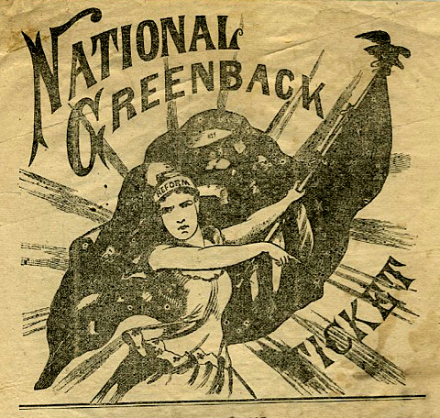
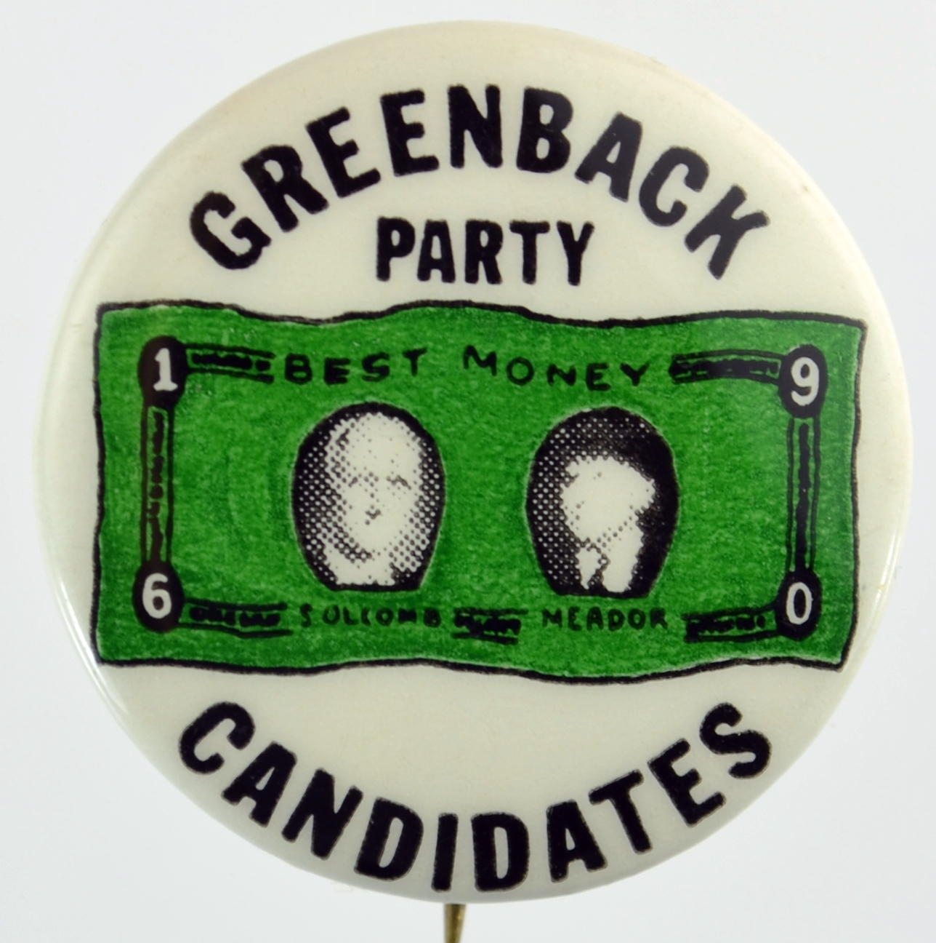
Henry George: The Functions of Government
Henry George was against privilege and recognized the money creation privilege.
He supported the Greenback, government issued sovereign money.
Social Problems: “…it is the business of government to issue money… by leaving to them {private banks}, even in part and under restrictions and guaranties, the issuance of money, the people of the Unites States suffer.. loss of millions of dollars and sensibly increase the influences which exert a corrupting effect upon their government.”

Slide 7


Henry George: His Advanced Views of Money
Henry George recognized that money is an abstract social power embedded in law.
The Science of Political Economy: “It is important that this purely representative character of money should be thoroughly understood and constantly kept in mind, for from the confusion resulting from the confounding of money with wealth have flown the largest and most pernicious results.” pp. 493-4
The application of labor upon natural resources
using capital {such as a plow} creates wealth.
Money is not wealth, but a ticket to obtain wealth.

Slide 8

Henry George: His Advanced Views of Money
Henry George recognized that the private “money power” actively confused the nature of money and wealth, to keep the power in private hands.
The Science of Political Economy: “The confusion of the term is one of the effects of the influence upon thought of the same special interest…” pp. 141, 142

Slide 9


Henry George: His Advanced Views of Money
The Money Power has removed whole curricula from our high schools and colleges.
Richard Krug wrote a two-volume study of the American high school. Krug’s work describes the 1894 meeting of the National Education Association committee to determine high school curriculum. One of its members was Woodrow Wilson, then a 36-year old professor of history. Wilson proposed the resolution that “excluded formal instruction in political economy from school programs”. (Krug, 1964, p. 54). It passed unanimously.
In short, Americans… have been stupefied regarding money and the relations of production and exchange between and among us and with our ecosystem.

Slide 10

Henry George: His Advanced Views of Money
The Money Power has removed whole curricula from our high schools and colleges.
In the current book, Lies My Teacher Told Me: Everything Your American History textbook got wrong, the author James Loewen never even mentions money or the monetary system.
He mentions the Federal Bureau of Investigation but never the Federal Reserve System.
He mentions Disney enterprises but never dollars.

Slide 11
PART 2
Impact of the Private Money System
on New York City Real Estate Development
CITY DEBT

Slide 12
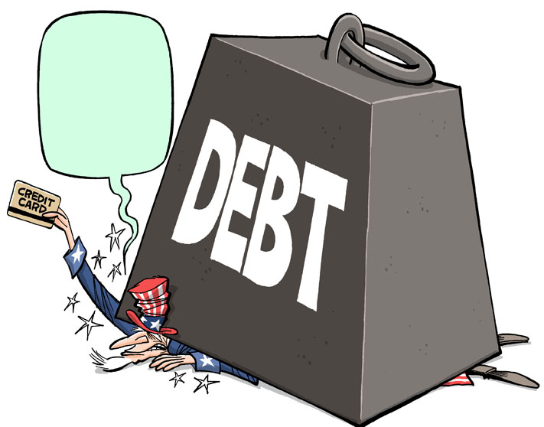
Private Money Creation System funds NYC Real Estate
The MONOPOLY of the CREATION and ISSUANCE of money, which is in the
hands of the private banks, is used to cripple our governments, at all levels,
with their of debt. The interest on the debt pays the banks well.
At the end of fiscal year 2017, New York City debt outstanding grew to $116 billion.
…total NYC debt has grown—
by 107% since 2002…
City debt service costs were about 11 percent of tax revenues in fiscal year 2017.
Citizens Budget Commission

Slide 13
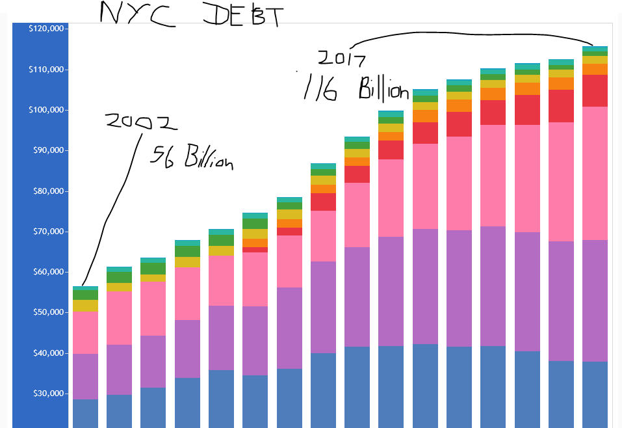
This debt is BOND DEBT.
NYC sells its bonds to banks
or broker dealers
called UNDERWRITERS.

Slide 14
FUNDING HUDSON YARDS
WHO BUYS THE CITY’S DEBT?
UNDERWRITERS
WHO ARE UNDERWRITERS?
Underwriters make profits from the difference
between the ‘buy’ and ‘sell’ price (THE SPREAD),
plus FEES.

Slide 15
FUNDING HUDSON YARDS
FEDERAL RESERVE MEMBER BANKS & UNDERWRITERS
of New York City General Obligation Bonds
(all banks are members of the NY Federal Reserve Bank, unless noted otherwise)
Senior Managers
Morgan Stanley
Bank of America (Richmond FED)
Merrill Lynch
J.P. Morgan Securities
Citigroup Global Markets Inc
Senior Co-Managers
Barclays Capital
Goldman, Sachs & Co.
PNC Capital Markets LLC (Cleveland FED)
RBC Capital Markets, LLC
(Royal Bank of Canada; not FED member)
Wells Fargo Securities, LLC (San Francisco FED)
When these banks buy the NYC bonds, they use money
they create and issue.
Co-Managers
TD Securities (USA), LLC
Selling Group
BNY Mellon Capital Markets, LLC
Deutsche Bank Securities Inc.
HSBC Securities (USA) Inc.
U.S. Bancorp (Minneapolis Fed)

Slide 16
PART 3
Impact of the Private Money System
on New York City Real Estate Development
HUDSON YARDS

Slide 17
FUNDING HUDSON YARDS
HYIC
HUDSON YARDS INFRASTRUCTURE CORPORATION
HYIC has been given the authority to issue bonds,
backed by these sources of revenue:
HY reduced property taxes for 19 years (PILOT PAYMENTS)
(TAXES that would have gone to the City)
HY mortgage recording tax
(TAXES that would have gone to the City)
interest payments from the City, until private revenue kicks in (see above)
paid from city tax revenues.

Slide 18
FUNDING HUDSON YARDS
HYIC
HUDSON YARDS INFRASTRUCTURE CORPORATION
The people of NYC are subsidizing the private real estate developers.
They pay less taxes into our operating budget.
We will end up paying more.

Slide 19
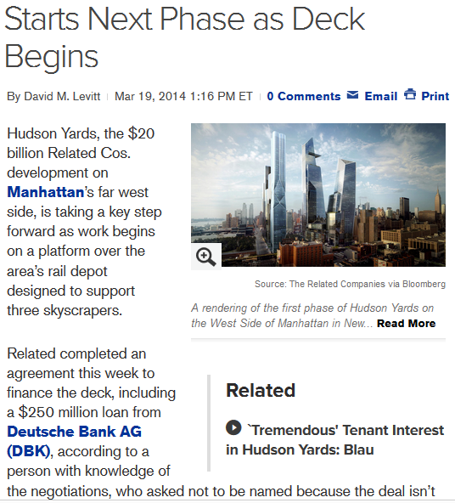
FUNDING HUDSON YARDS
HUDSON YARDS is a joint Related/Oxford venture.
The funding for the private developers is kept confidential, but several tentative loan agreements have come out in the public press.

Slide 20
FUNDING HUDSON YARDS
HUDSON YARDS is a joint Related/Oxford venture.
The funding for the private developers is kept confidential, but several loan agreements have come out in the public press.
“Related has a tentative commitment with Bank of America Corp. (BAC) and other lenders for about $400 million of financing on the $1.2 billion tower, said the person, who asked not to be identified because talks are private. The financing package should be completed by the end of the year, the person said.”

Slide 21
FUNDING HUDSON YARDS
HUDSON YARDS is a joint Related/Oxford venture.
The funding for the private developers is kept confidential, but several loan agreements have come out in the public press.
Starwood Property Trust said in a release that it “led the origination of $475 million” for the overall construction loan of the first phase of the project and that it will fund $350 million. The remainder will be contributed by Oxford and the United Brotherhood of Carpenters and Joiners.
Equity investors were advised by J.P. Morgan Asset Management, which is also providing $100 million.

Slide 22
FUNDING HUDSON YARDS
THE PRIVATE DEBT-MONEY BANKS
ARE ALSO BEHIND THE PRIVATE EQUITY MONEY
“Goldman, Starwood Near a Deal on Financing for Extended Stay
By Lingling Wei -- May 10, 2010
… Goldman Sachs Group Inc. is close to a deal to provide $2.2 billion in financing to a group led by Starwood Capital Group in its bid for hotel chain Extended Stay Inc …
About $1 billion of the money would come from Goldman's partner in the deal, Citigroup Inc., the people said.”

Slide 23
PART 4
THE FEDERAL NEED ACT:
ALTERNATIVE
INTEREST-FREE
FINANCING

Slide 24
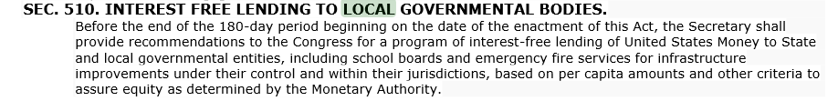
FUNDING HUDSON YARDS
NEED ACT
INTEREST FREE LENDING

Slide 25

FUNDING HUDSON YARDS
NEED ACT
PRIVATE BANKS CANNOT CREATE MONEY –
ONLY LOAN EXISTING DEPOSITS
With a simple accounting change, the private commercial banks
will no longer be able to CREATE and ISSUE money.
They will have to loan already existing money.

Slide 26
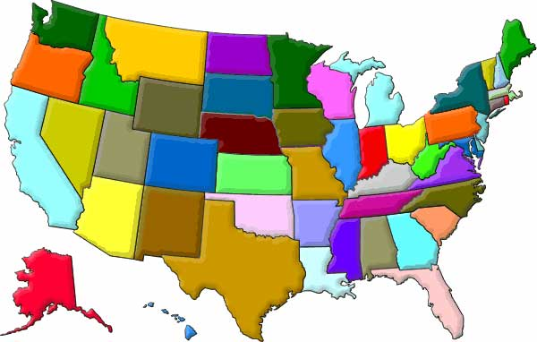
FUNDING HUDSON YARDS
NEED ACT
25% OF NEW FEDERAL MONEY WILL BE
GIVEN TO STATE GOVERNMENTS AS GRANTS
TO BE USED AS THE STATE SEES FIT

Slide 27
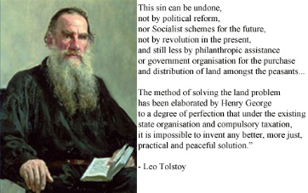
Henry George: The Functions of Government
THE END

