Slide 1
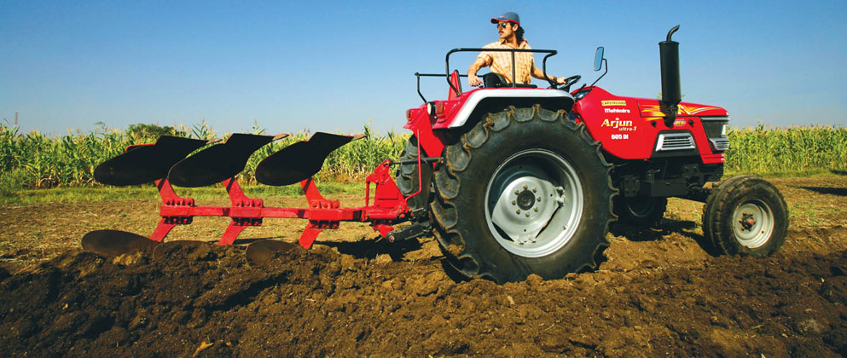
PARITY FOR AGRICULTURE
Ann Webre
Fed Group of Upper West Side

Slide 2
Part 1:
THE IMPORTANCE OF AGRICULTURE

Slide 3
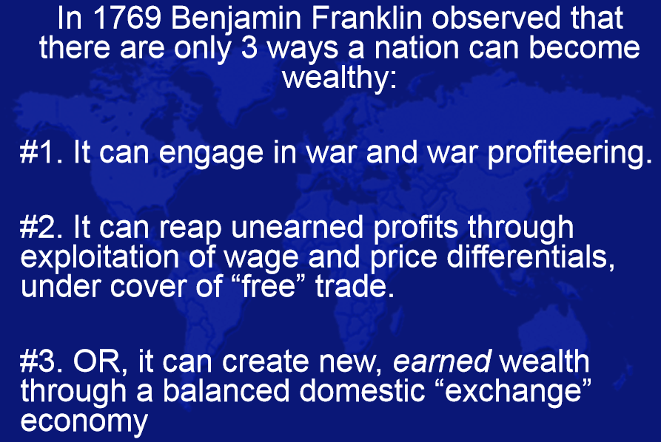
#1 Make war -- take the wealth by force
#2 Trade – to be profitable requires cheating
#3 Or… it can profit through agriculture,
whereby planting a seed creates
new wealth as if by a miracle

Slide 4

When I asked my friend Will, what he thought about Ben Franklin’s choices of how a country can become wealthy, he said:
Will: “Well, we all know about the wars we’re in. And about #2 Trade?
Look at the World Trade Center in New York. It’s all about cheating.
The world’s traders have built a showcase – a theater - to make us
think this is where wealth comes from.“
“It’s the guy who is working down here on the farm that’s created
our wealth. Just hard work.”
Norman, Oklahoma
WILL

Slide 5
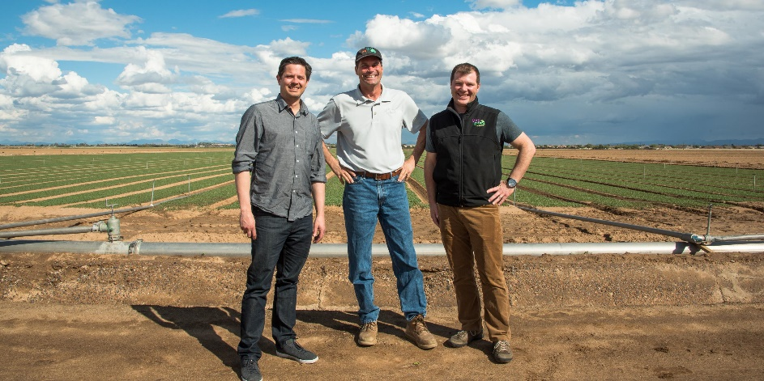
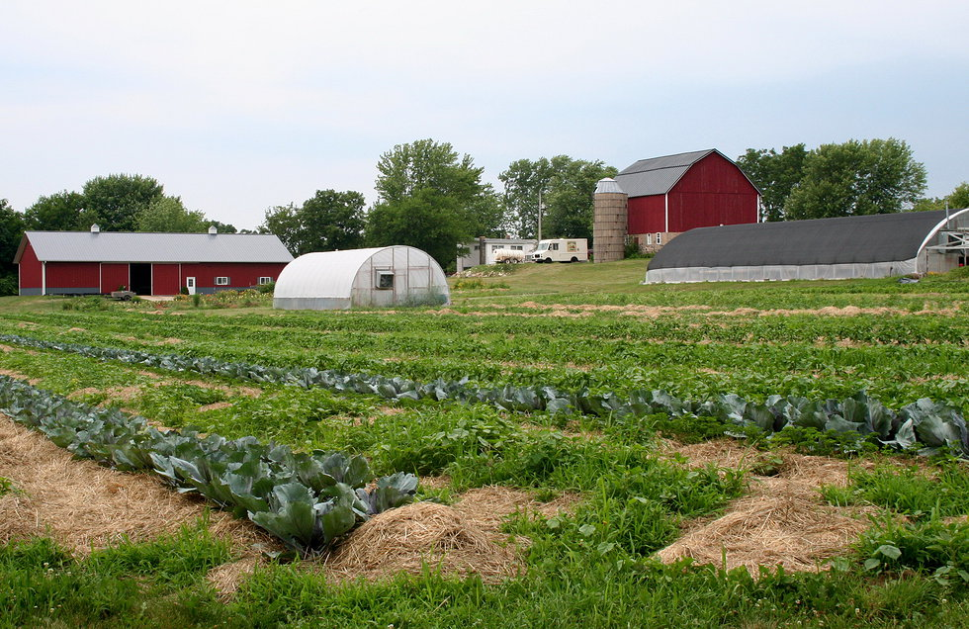
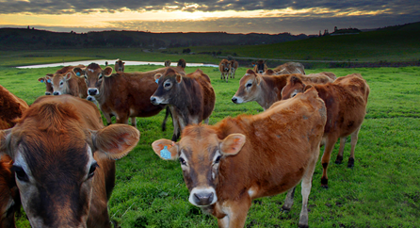
Agriculture must be considered the foundation of the economy of the United States – it is the nation’s largest industry:
  70% of all transactions in the economy come from agriculture
  its capital investment is 2/3rd that of all productive enterprise
  it creates the biggest share of the raw material input of new wealth in any accounting period

Slide 6

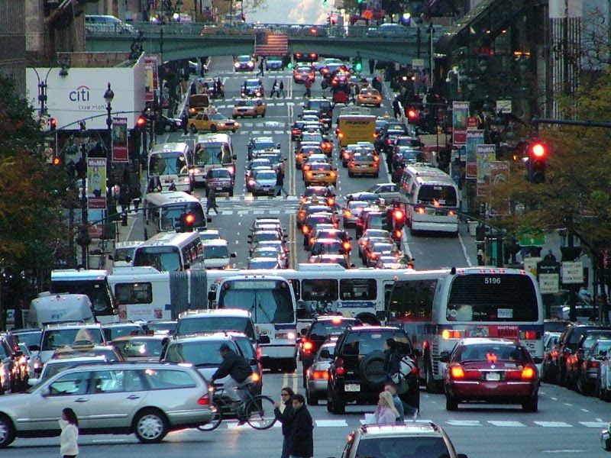

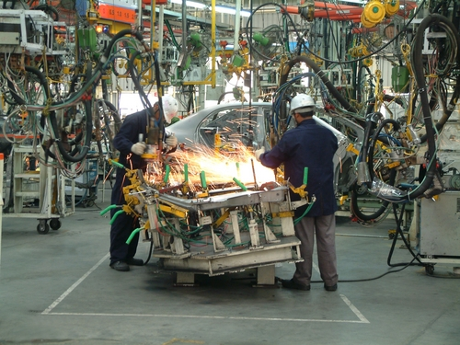
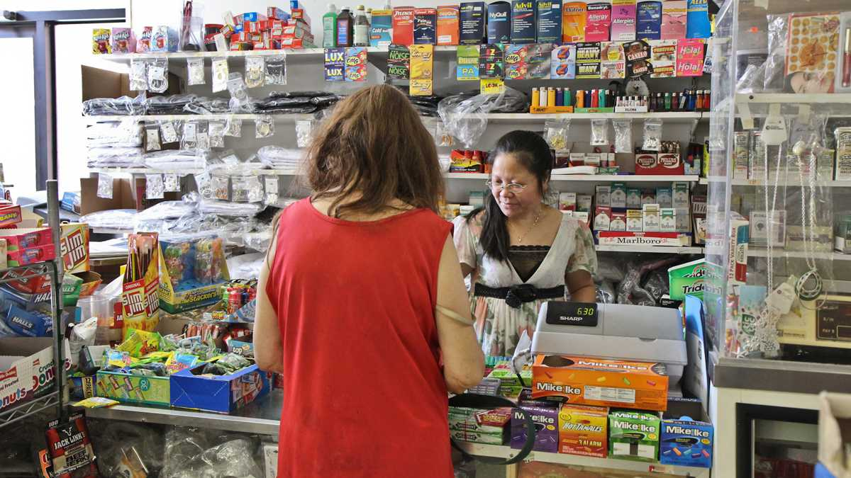
Our cities, industries, and small businesses would not exist without the work of the farmers.

Slide 7
Part 2: Parity Prices

Slide 8
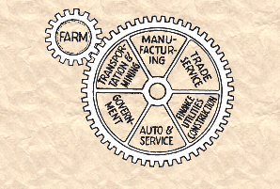
A PARITY PRICE FOR RAW MATERIALS
The PARITY PRICE is the buying power of a crop on par with the buying power of factory labor, services, professions, taking these things in terms of broad spectrum averages.
With parity, when a farmer grows and sells his crop, he pays for all his expenses. He pays for seeds, machinery, labor, and so forth, and has money left over as income.
When he pays for his expenses, this is income to the other sectors of the economy: manufacturing, distribution, services, and retail.
Parity ensures that EARNED INCOME will be DISTRIBUTED throughout the economy as widely and as fairly as possible, without debt.

Slide 9
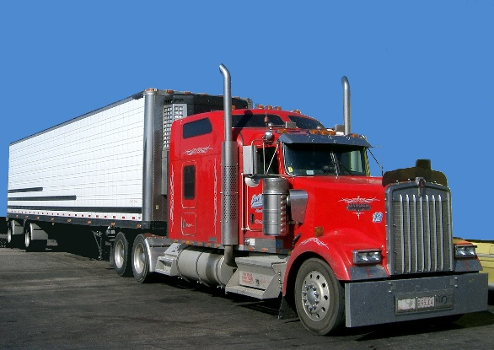
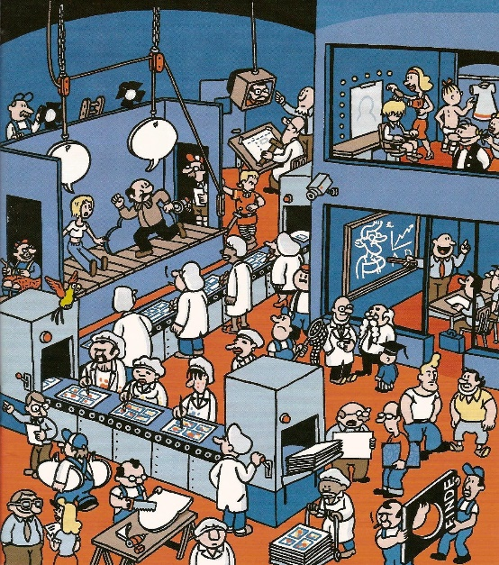
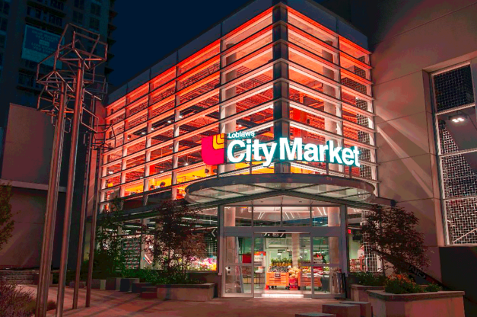




Gross farm income generates earned national income.
If earned national income is too low to avoid deficits (debts),
ag prices are below parity.

Slide 10
With parity, gross farm income will multiply at least 7 times, as it is spent through the domestic economy.

Slide 11


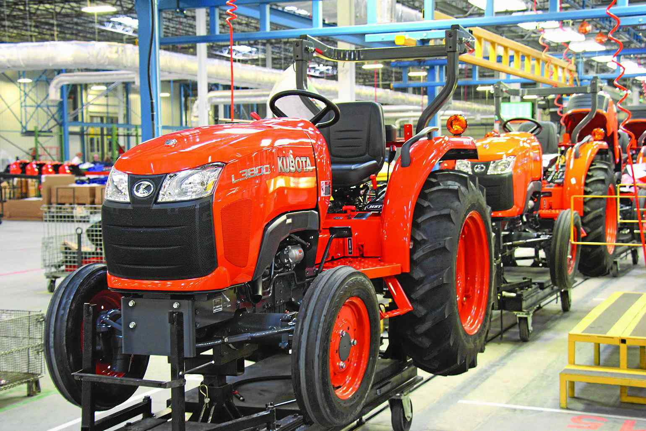
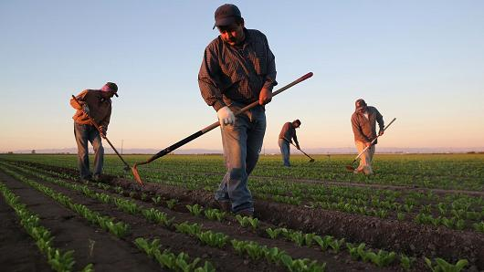
With parity, we will have PROSPERITY. Earned income will be fairly distributed to owners and workers throughout our private enterprise economy – without creating debt.
PARITY PRICES
BUY FROM RURAL STORES
BUY TRACTORS & MORE
PAY WORKERS FAIR WAGES

Slide 12
Part 3: When Prices Are Below Parity

Slide 13
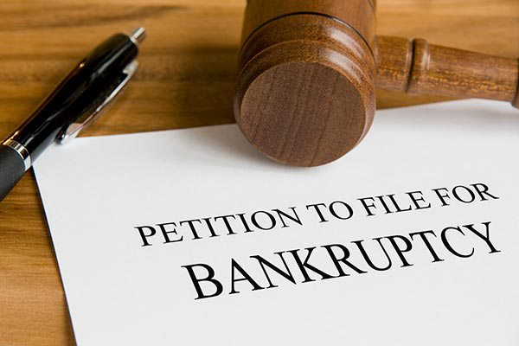
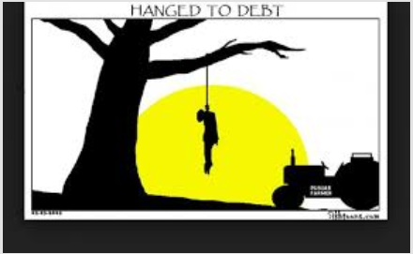
WHEN A FARMER RECEIVES A BELOW-PARITY PRICE FOR HIS CROP
The farmer can’t afford to cover all his expenses, so he borrows.
If he can’t repay the loan, he may lose his farm.
Farmers are encouraged by land grant universities to take advantage of economies of scale and expand the size of their farms, usually with debt.
Even then, farmers may not be able to repay.
For over 60 years, farmers have been leaving agriculture; many commit suicide – at higher rates than any other occupation.

Slide 14
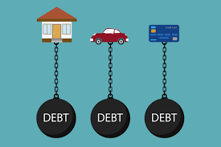
WHEN A FARMER RECEIVES A BELOW-PARITY PRICE FOR HIS CROP
The other sectors of the economy are affected.
The other sectors have less purchasing power and also go into debt.

Slide 15
Part 4: Equitable Trade

Slide 16

EQUITABLE TRADE
With Equitable Trade, the standard of living of the poorer countries will be encouraged
to come up to our standard.
Middlemen, international traders, and bankers
cannot make a profit off of this trade.
Equitable trade takes place between
importers/exporters in each country.

Slide 17
WHAT IS EQUITABLE TRADE?
ENCOURAGES DOMESTIC PRODUCTION

Slide 18
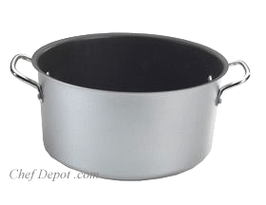
HOW?
$5
IMPORT-EXPORT
TARIFF FUND
The Equitable Trade account* is owned by the importers and exporters of the country;
it is not owned by the governments.
*NORM has proposed that any funds sitting in this private fund for over a year and not
used, should be turned over to the governments.

Slide 19





EQUITABLE TRADE FUND
$5
WHOLESALE
PRICE
CHINESE COMPUTER
$5
$5
U.S. IMPORTER buys Chinese computer:
pays: $5 into fund +
$5 to Chinese exporter
IMPORT-EXPORT
EQUITABLE TRADE FUND
$10
WHOLESALE PRICE
$5
$5
CHINESE IMPORTER buy American computer:
pays: $5 from fund +
$5 to U.S. exporter
AMERICAN COMPUTER

Slide 20
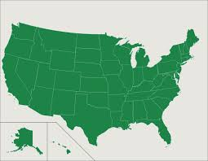

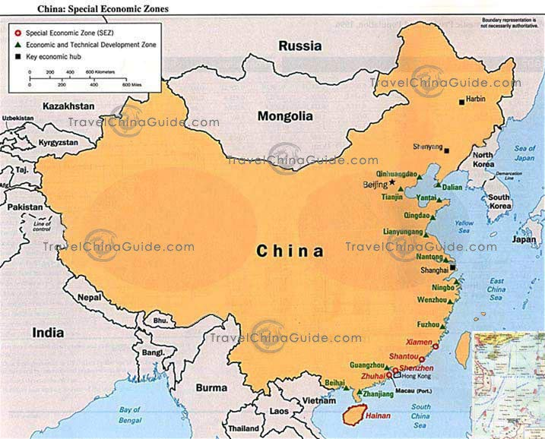
EQUITABLE TRADE
‘FREE’ TRADE IMPORTER:
NOW THAT THE CHINESE WHOLESALE PRICE IS THE SAME AS THE U.S. PRICE ….
I AM GOING TO BUY FROM MY U.S. PRODUCERS
U.S. IMPORTER
$10
REVENUE
AMERICAN
GOOD
$5
$5
IMPORT-EXPORT
TARIFF FUND
CHINA
$10 IS MADE IN U.S.
$10 OF U.S. MONEY WAS CIRCULATED IN OUR ECONOMY

Slide 21
EQUITABLE TRADE
‘FREE’ TRADE IMPORTER:
SINCE THERE IS MONEY IN THE EQUITABLE TRADE FUND, I CAN USE IT TO REDUCE MY COST FOR THAT AMERICAN GOOD. I WILL BUY FROM THE U.S.
AMERICAN GOOD
CHINESE IMPORTER
$5
$10
REVENUE
$5
CHINA
IMPORT-EXPORT
EQUITABLE TRADE FUND
$10 OF U.S. MONEY WAS GAINED BY OUR ECONOMY

Slide 22

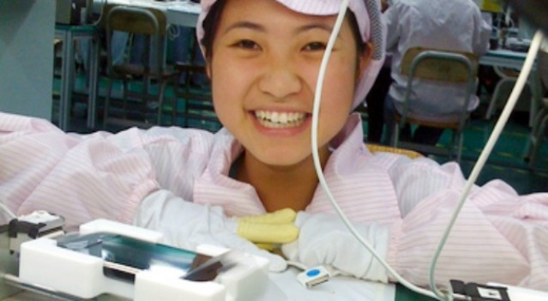

WHAT IS EQUITABLE TRADE?
HAPPY AMERICAN WORKERS
HAPPY CHINESE WORKERS

