Slide 1
5H. “What’s Money Got to Do With It? Women and Monetary Reform”
Presentation by Sue Peters, Mary Sanderson, Bo-Young Lim, and Lucille Eckrich—
sisters in the movement for monetary reform, members of the American Monetary Institute (AMI) and the newly-forming Alliance For Just Money
Saturday, April 14, 2018, at the 3rd Annual 4W Summit on Women, Gender and Well-being, and the 41st Wisconsin Women and Gender Studies Conference
Conference theme:
“Our Bodies, Our Earth: Voice, Violence, and Peacemaking”

Slide 2

What does money have to do with “our bodies and our earth’’? What does money have to do with “voice, violence, and peacemaking”?
Our thesis is that usurious modern money leverages our bodies and our earth; it silences our voices; and it wages war -- all to serve private interests. But we can change it!
To put it musically…

Slide 3


What’s money got to do, got to do with it?
What’s money but a means of exchange.
What’s money got to do, got to do with it?
Our money is debt and we don’t even know it!
What’s money got to do, got to do with it?
What’s wrong with our money and the banks?
What’s money got to do, got to do with it?
Bank-issued money keeps everyone enslaved!
What’s money got to do, got to do with it? What's money but a unit of account.
What’s money got to do, got to do with it?
Let's transform our money before it's too late!

Slide 4
What’s your experience of money?
What talk or dynamic was there about money in your family growing up?
What did you learn about the monetary system in school?
Do you talk openly about money with anybody, even now?

Slide 5
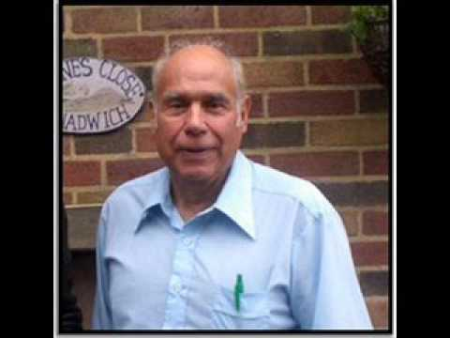
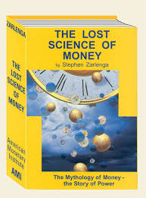
“Over time, whoever controls the money system, controls the nation.” Stephen Zarlenga (1941 – 2017)
With his founding of the American Monetary Institution (AMI) in 1996 and the publication of his book, THE LOST SCIENCE OF MONEY, in 2002, Stephen Zarlenga began the 21st century American Monetary Reform Movement for sovereign money.
Thank you, Stephen!
Stephen brilliantly defined “usury” as “the structural misuse of society’s money system” (pp. 186, 202, 230, 278, 336, 340, 508).

Slide 6
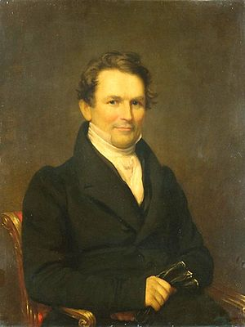
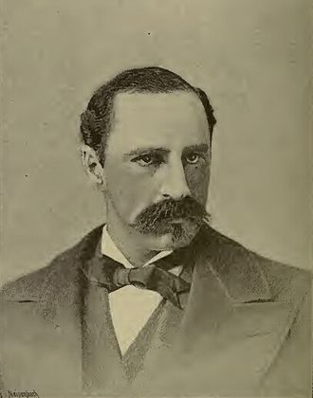
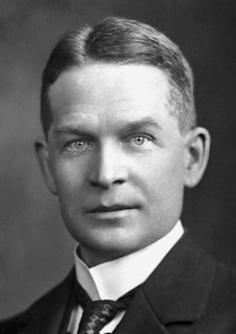
Ignorance of and consent to our own oppression by the “money power” keep it going.
They deepen what Freire (1970) called our “internalized oppression” and “submerged consciousness.” But it was not always so and need not remain so….
“Continentals” created by the Continental Congress to wage our Revolution
“Greenbacks” created to wage the Civil War and unify us after
Edward Kellogg, 1790-1858,
A New Monetary System (1861)
Historian Alexander Del Mar
1836-1936
Frederick Soddy, 1877-1956,
The Role of Money

Slide 7
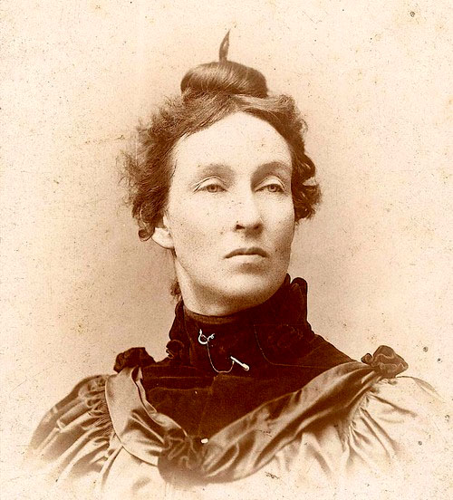
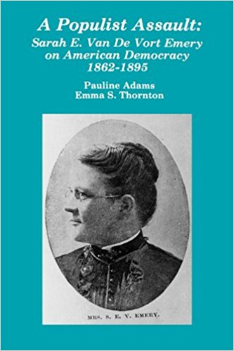
Mary Elizabeth Lease – farmer, wife, mother, Georgist, suffragist, and orator, known as “Queen of the Populists” railed against the “monied men”
Sarah E. V. Emery – teacher, wife, mother, Populist orator, and author of 1887 Seven Financial Conspiracies Which Have Enslaved the American People. Monetary plank in 1892 platform. Why cede this history to Trump “populists”?

Slide 8
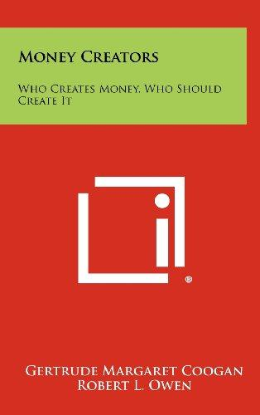
Sarah Gertrude Coogan – first woman to earn a masters in economics and finance from Northwestern University and author of 1935 Money Creators: Who Creates Money? Who Should Create Money?
https://www.hathitrust.org/
What happened such that we’ve largely lost this critical literacy and historical knowledge about money???
UW-M historian of the American high school gave me a tip on the origins of our stupefaction: Story of young W. Wilson & other “school men.”

Slide 9

PART 1 THE SYSTEM PART 2 ITS CONSEQUENCES for our bodies, our earth, our voices, and our peacemaking.
Hi! I’m going to talk about two things:

Slide 10
PART 1 THE SYSTEM
Listen up!

Slide 11
Private banks create the money we need…
Meet the system!

Slide 12


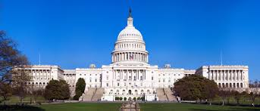

Private banks create our money! Not our government?
I don’t believe it… It’s too hard to believe…
You don’t have to believe me. Here… listen to others ➔ ➔ ➔ ➔

Slide 13
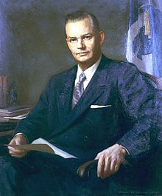
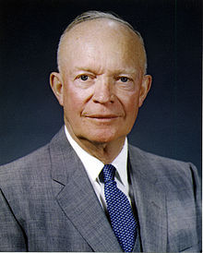
Robert B. Anderson, Secretary of the Treasury under President Eisenhower:
"When a bank makes a loan it simply adds to the borrower’s deposit account in the bank by the amount of the loan.
The money is not taken from anyone else's deposit…
It's new money, created by the bank for the use of the borrower.“
Robert B. Anderson
Secretary of the Treasury, 1957-1961
President Dwight D. Eisenhower
1953-1961

Slide 14
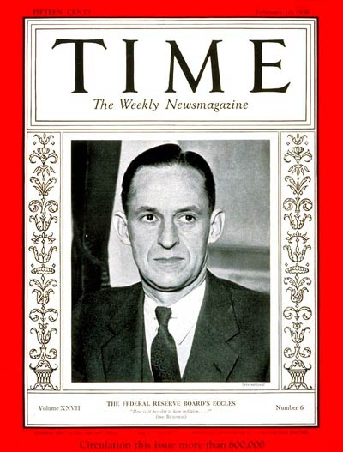
“That is what our money system is. If there were no debts in our money system, there wouldn’t be any money.”
Mariner S. Eccles
Chairman, Federal Reserve
under President Franklin D. Roosevelt

Slide 15
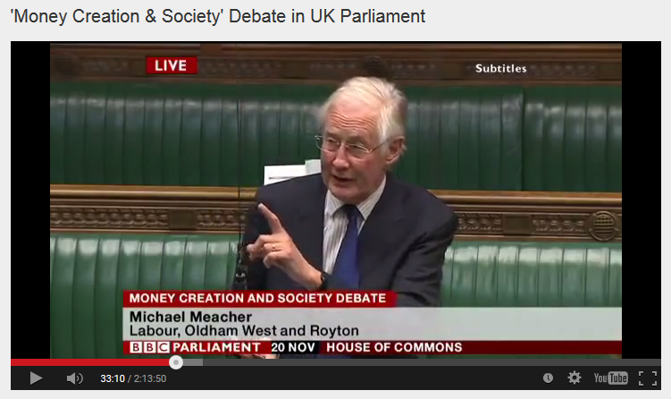
British House of Commons, Nov 2014, Mr. Michael Meacher, Labour MP (Member of Parliament):
“It is unfortunate… that it is so little understood by the public that money is created every time by the banks when they make loans.”
“And it is the banks – the banks – which determine how money is allocated across the economy.”

Slide 16
Let’s look at the money system.
How does it work?

Slide 17
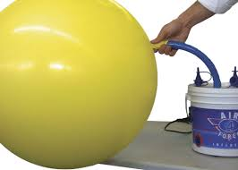


#1
When someone borrows from a bank, the money put into their checking account is created by the bank.
(The money supply grows.)
When the borrower repays the bank, the MONEY DISAPPEARS.
(The money supply shrinks.)
What! This can't be! We all need that money! It mustn’t go away!

Slide 18
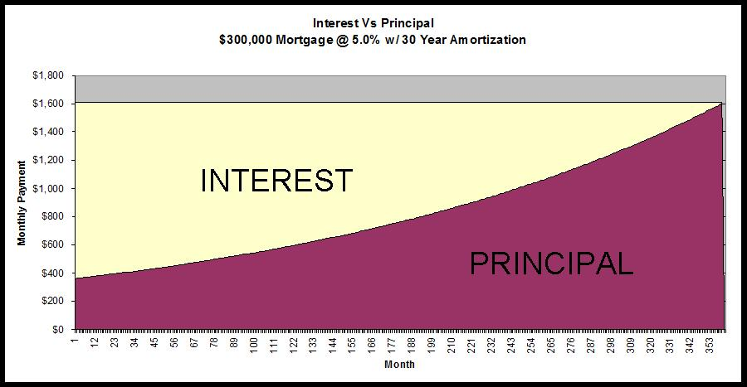
#2
Of course, we know that every borrower must pay interest.
What many don’t realize is that banks NEVER CREATE THE MONEY FOR THE INTEREST. Only for the principal of the loan.
Oh, my goodness.
This is getting really confusing.
Why not create the interest?
NEVER CREATED➔

Slide 19
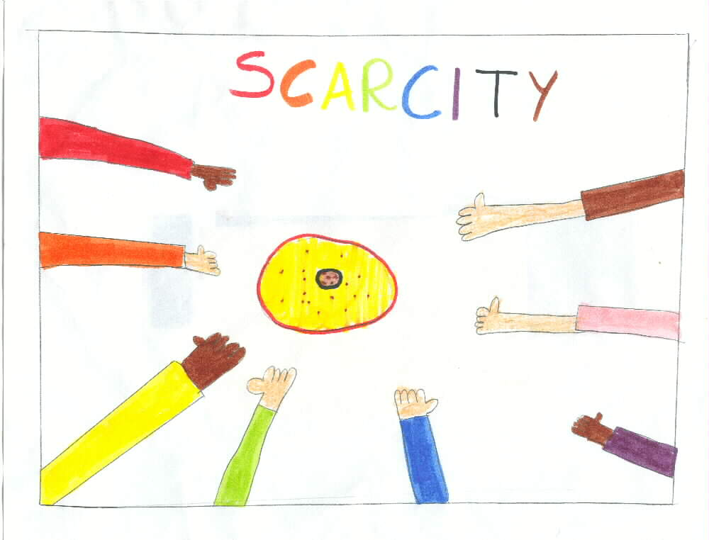
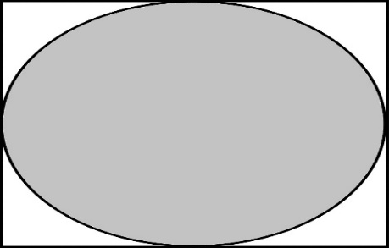

Since the money for interest is never created, money is always SCARCE.
Where will I get the money to pay the interest !!!
PRINCIPAL ONLY
LOOK HERE ➔ ➔

Slide 20







With more loans!!!
CREDIT CARD DEBT
CAR LOAN DEBT
STUDENT DEBT
HOME MORTGAGE DEBT

Slide 21
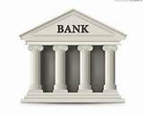
Or the bank gets the wealth -- ah -- excuse, me –
I meant ‘collateral.’
DEBT SLAVE

Slide 22
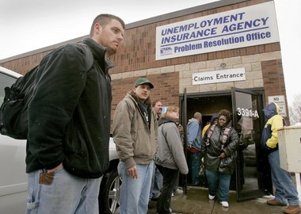
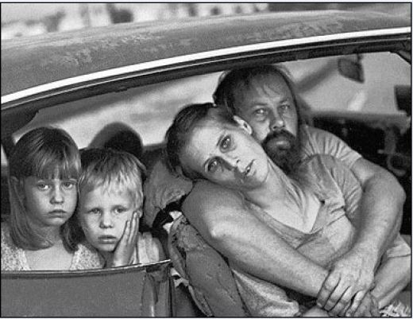
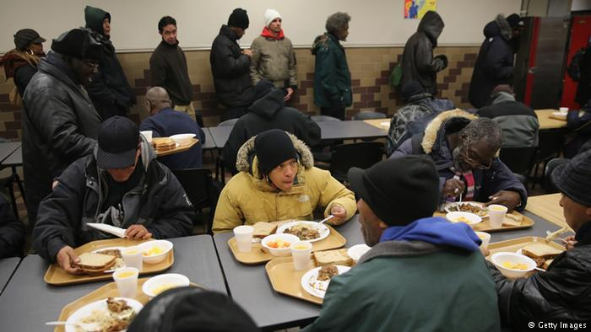
The SYSTEM DEMANDS that more loans be created, or else the money supply will be inadequate and there will be defaults, foreclosures, bankruptcies, and unemployment, recessions, depressions…
All the while the banks and top 1% become richer…. Remember 2008? And that’s just the most recent of many so-called recessions.

Slide 23


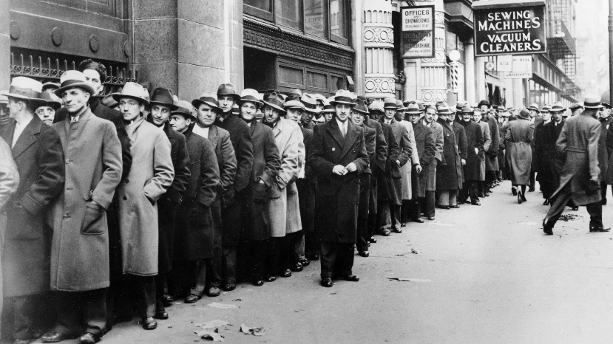
TRUTH: A private bank corporation is a
unique and abnormal corporation.
If they decide to stop making loans or call in loans, our economy DIES. Does it have to be this way???
If the banks give loans,
our economy has LIFE (or at least subsists).

Slide 24
The banking system decides… …who gets the money, …and how much.
Umm. I don’t like the sound
of this….

Slide 25
THE SYSTEM CONCENTRATES WEALTH
The private banks get interest on our money supply
HOUSEHOLDS:
MORTGAGE LOANS,
STUDENT LOANS,
CAR LOANS, ETC.
SMALL
BUSINESS
LOANS
INTEREST
INTEREST
PRIVATE
BANKS
INTEREST
INTEREST
GOVERNMENT LOANS:
FEDERAL,
STATE, LOCAL
CORPORATE
LOANS

Slide 26
THE SYSTEM EMPOWERS THE Military-Industrial COMPLEX
PRIVATE
MILITARY COMPANIES
WEAPONS
MANUFACTURERS
PRIVATE COMMERCIAL BANKS:
GOLDMAN, CITI, MORGAN CHASE, BoA, ETC.
CREATE MONEY FOR
UNIVERSITIES FOR
MILITARY RESEARCH

Slide 27
THE SYSTEM EMPOWERS FINANCIAL SPECULATION
STOCKS & BONDS
TREASURY
MARKET
PRIVATE COMMERCIAL BANKS:
GOLDMAN, CITI, MORGAN CHASE, BoA, ETC.
CREATE MONEY FOR
CURRENCY
MARKET
HEDGE FUNDS
DERIVATIVES
MARKETS

Slide 28
THE SYSTEM HIDES ITSELF FROM THE PUBLIC
MEDIA CORPORATIONS
that confuse or distract the public
PRIVATE COMMERCIAL BANKS:
GOLDMAN, CITI, MORGAN CHASE, BoA, ETC.
CREATE MONEY FOR
HISTORY DEPARTMENTS
that ignore
monetary history
ECONOMICS DEPARTMENTS
that obscure the nature of money

Slide 29
THE SYSTEM CORRUPTS OUR GOVERNMENTS
LOBBYISTS
CREATE MONEY FOR
PRIVATE COMMERCIAL BANKS:
GOLDMAN, CITI, MORGAN CHASE, BoA, ETC.
SUPER
PACS
DARK MONEY IN ELECTIONS

Slide 30

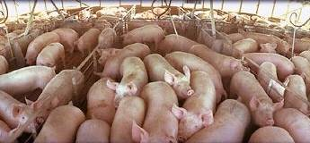
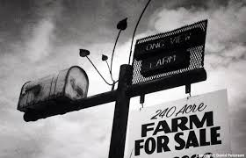

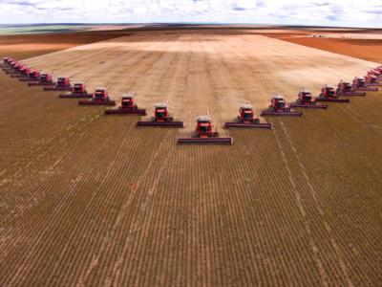
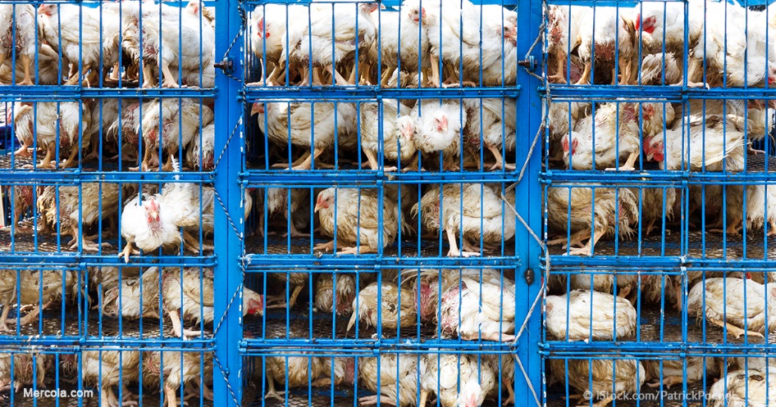
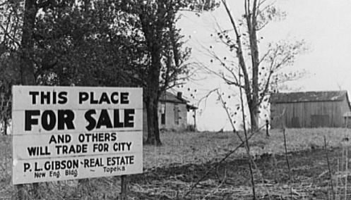
EMPOWERS factory farming –
over small farmers

Slide 31
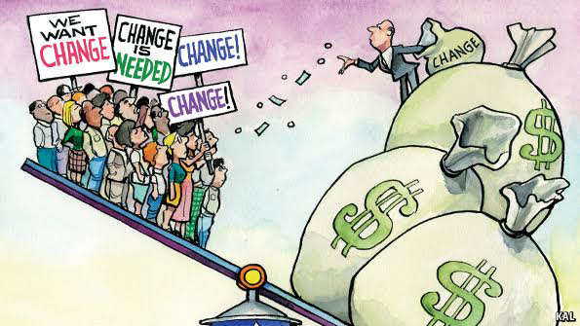

The private bankmoney system is the
ROOT CAUSE and DRIVER of …
CORPORATE CAPITALISM
The essential feature of CAPITALISM is
the misuse of the money system.
This is capitalism’s most essential feature and completely missing from the study and definition of capitalism.

Slide 32

THIS SYSTEM CAN BE CHANGED!
Remember that!
HERE’S HOW !!!

Slide 33
Three legs of our monetary platform:
1. Our government creates all new money, at a rate that maintains its stable value, meaning its purchasing power.
Congress exercises its constitutional power to create and issue all new money responsibly, transparently, and for the common good, consistent with Article 1, Section 8, Clause 5 of the United States Constitution.
2. End the privilege of private banks to create money
New law eliminates commercial banks’ legalized privilege to create and issue what we use as money. Private banks will continue to provide basic banking services (accounting, transactions, and savings & loan intermediation). This law nationalizes the money system, not the banking system.
3. Our government buys all shares in the 12 Federal Reserve Banks and transfers their operations to the U.S. Treasury
See its 2011 predecessor, H.R. 2990 (the NEED Act), @ https://www.congress.gov/

Slide 34
Building a US movement for monetary reform:
Alliance For Just Money

Slide 35
Some of our partners in the US & globally:
American Monetary Institute @ http://www.monetary.org/
New Abolitionism Campaign @ https://www.newabolitionism.org/
Greens for Monetary Reform @ http://greensformonetaryreform.org/
US Money.US @ https://usmoney.us/
Center for Progressive Economics @ http://cpe.us.com/
Alpheus: Site for Critical History @ http://www.alpheus.org/
Sovereign Money @ https://www.sovereignmoney.eu/
International Movement for Monetary Reform (and its 27, & growing, member organizations) @ https://internationalmoneyreform.org/
Swiss Vollgeld Initiative @ https://www.vollgeld-initiative.ch/english/ Look for June vote!
UK’s Positive Money @ http://positivemoney.org/
Canada’s COMER-Committee on Monetary & Economic Reform: http://www.comer.org/

Slide 36
Join us! Questions and suggestions welcome!
Sue Peters @ peters.s@startmail.com
Mary Sanderson @ mhsanderson@hotmail.com
Lucille Eckrich @ llteckrich@gmail.com
Bo-Young Lim @ monetarycoffeehouse@gmail.com
THANK YOU for being with us today!
"A luta continua, vitória é certa“:
"The struggle continues, victory is certain!"

