Slide 1
THE NEED FOR
MONETARY REFORM
Don Butterfield
Member, American Monetary Institute

Slide 2
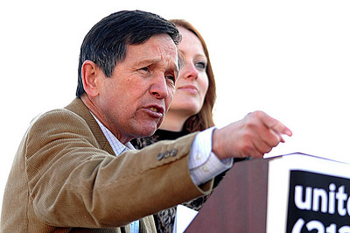
THE NEED ACT
NATIONAL EMERGENCY EMPLOYMENT DEFENSE ACT

Slide 3
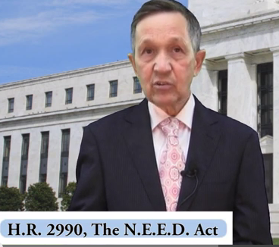
THE SOLUTION: DEBT-FREE MONEY
THE GOVERNMENT BUYS ALL THE SHARES OF THE 12 FEDERAL RESERVE BANKS FROM THE MEMBER COMMERCIAL BANKS.
THE COMMERCIAL BANKS REMAIN PRIVATELY OWNED,
AND LEND ONLY DEPOSITED MONEY.
CONGRESS SPENDS THIS DEBT-FREE GOVERNMENT MONEY ON PHYSICAL INFRASTRUCTURE, EDUCATION, HEALTH CARE - CREATING JOBS.
THE DEBT-FREE MONEY IS SPENT AT ALL LEVELS OF GOVERNMENT – FEDERAL, STATE, & MUNICIPAL
DENNIS KUCINICH
THE NEED ACT 2011-2012

Slide 4




#3 SPEND DEBT-FREE MONEY FOR THE
BENEFIT OF ALL CITIZENS
Congress spends to CREATE JOBS and REAL WEALTH
for all people in the country, not the few.
  Build infrastructure -- trains, dams, bridges, levees
  Education
  Health Care

Slide 5
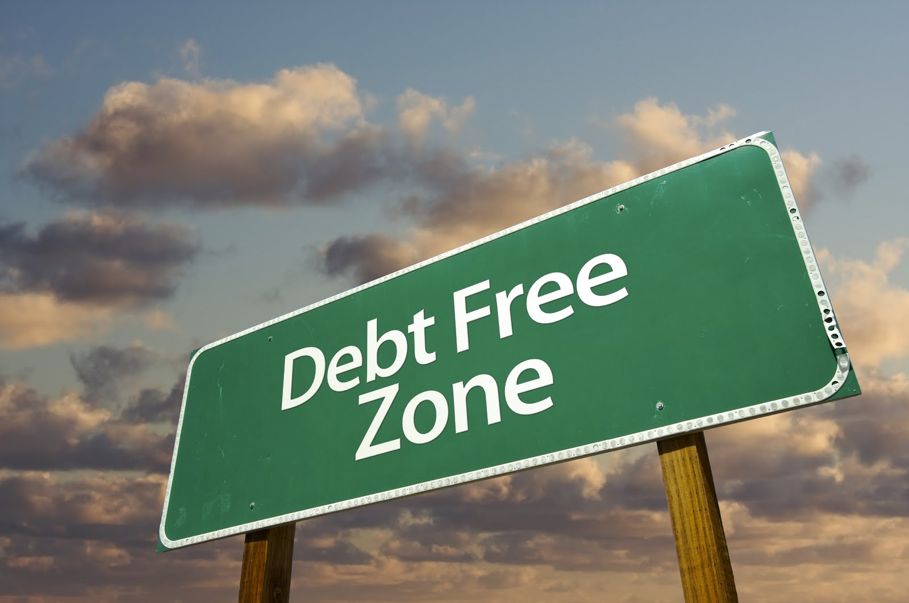
THE END

