Slide 1
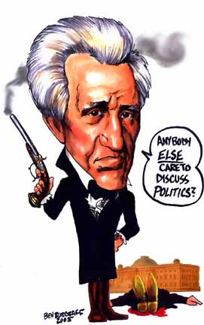
President Andrew Jackson Versus
THE SECOND BANK OF THE UNITED STATES
A War Over
Control of the ‘Money Power’

Slide 2
FOR MOST OF RECORDED HISTORY:
MONEY WAS ISSUED BY THE SOVEREIGN

Slide 3
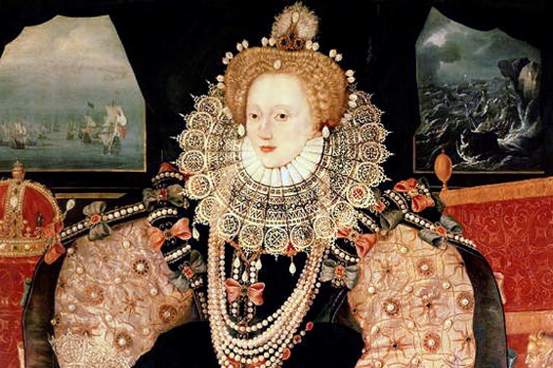
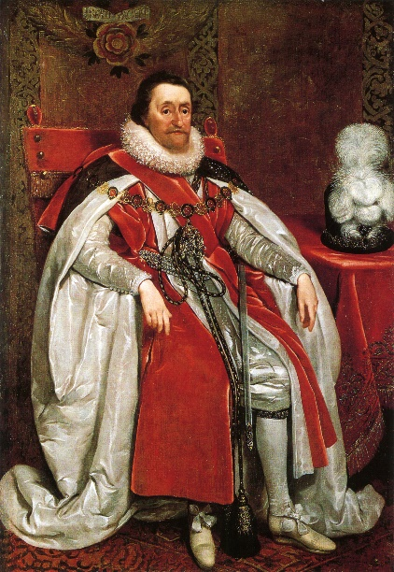
1604 - The World Famous ‘Mixed Moneys Case’ of England
English court rules that sovereign governments possess the power to create, regulate, limit and define money
FOR MOST OF RECORDED HISTORY:
MONEY WAS ISSUED BY THE SOVEREIGN
ELIZABETH I
“Money was a public measure, and like other publik measures it was necessary in the public welfare that its dimensions or volume should be limited, defined and regulated by the state.
Whatever material the state declared was money was money.”
JAMES I

Slide 4

FOR MOST OF RECORDED HISTORY:
MONEY WAS ISSUED BY THE SOVEREIGN
Edward Kellogg, 1861, A New Monetary System:
“The most important fundamental law in any nation is that which institutes money; for money governs the distribution of property, and thus affects in a thousand ways the relations of man to man.”

Slide 5
THE NATURE OF MONEY PURPOSELY
HAS BEEN KEPT SECRET AND CONFUSED

Slide 6
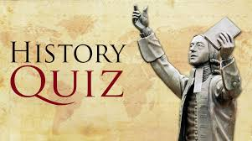
THE NATURE OF MONEY PURPOSELY
HAS BEEN KEPT SECRET AND CONFUSED
“In all the writings of these great and practical scholars, the workings of that mighty engine which injects the unit of exchange amongst the peoples [money], and without which no civilization as we know it can come to be, is only indicated by a profound silence.”
David Astle, THE BABYLONIAN WOE (ARCHEOLOGIST)

Slide 7
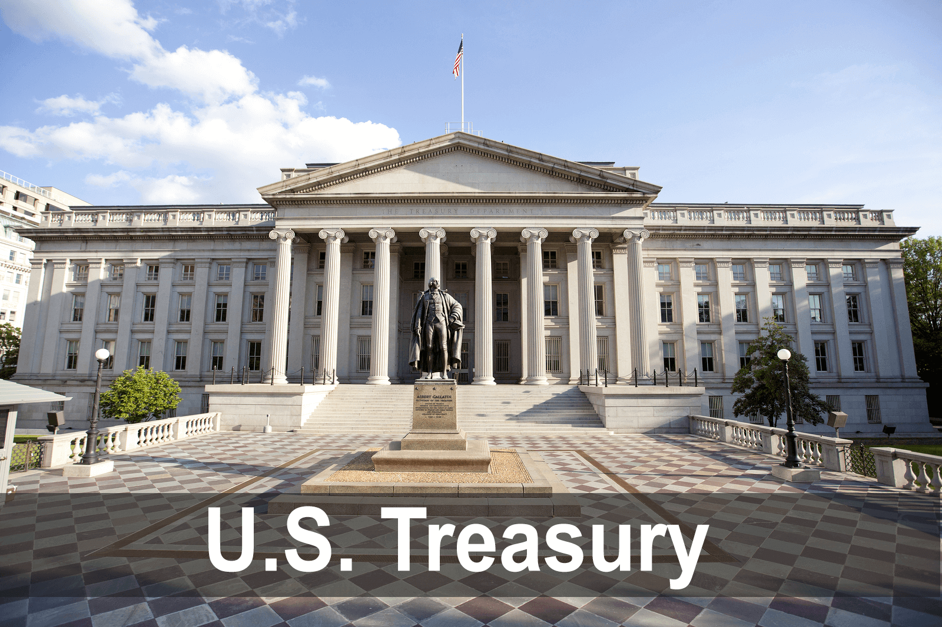
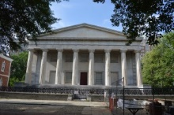

The battle to control the Money Power has raged for millennia:
PUBLIC CONTROL vs. PRIVATE CONTROL
THE NATURE OF MONEY PURPOSELY
HAS BEEN KEPT SECRET AND CONFUSED
U.S. TREASURY
Second Bank of the United States
Philadelphia, PA.

Slide 8
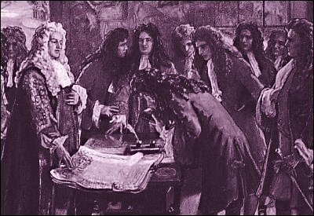
THE NATURE OF MONEY PURPOSELY
HAS BEEN KEPT SECRET AND CONFUSED
The privately-owned Bank of England was chartered by Parliament in 1694.
Hidden in the charter was the unusual power given to the Bank to issue [create] its own private bank notes and loan them out to the public with interest.
Banks are not depositories. They are banks of issue.
1694
Signing of the charter of the
Bank of England.
William Patterson, founder of the Bank of England
“All this while, the very name of a bank or corporation was avoided, though the notion of both was intended…”

Slide 9
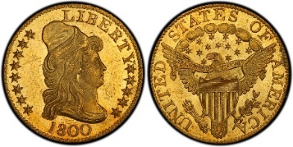
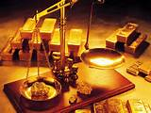
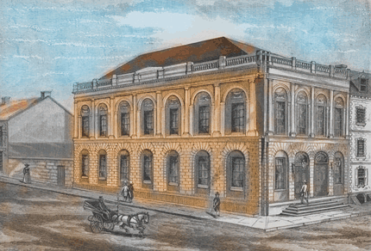
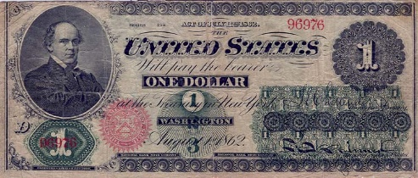
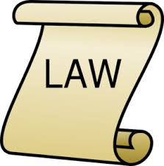
THE NATURE OF MONEY PURPOSELY
HAS BEEN KEPT SECRET AND CONFUSED
How a society defines money determines who controls it
WEALTH
(for wealthy)
* PRIVATE BANK CREDIT
(for profit of shareholders)
* PUBLIC LEGAL POWER
(for the general welfare)
‘COMMODITY MONEY’
‘BANK MONEY
(DEBT)’
‘SOVEREIGN MONEY
(MONEY)’

Slide 10
U.S. EXPERIENCE
WITH GOVERNMENT ISSUED MONEY

Slide 11
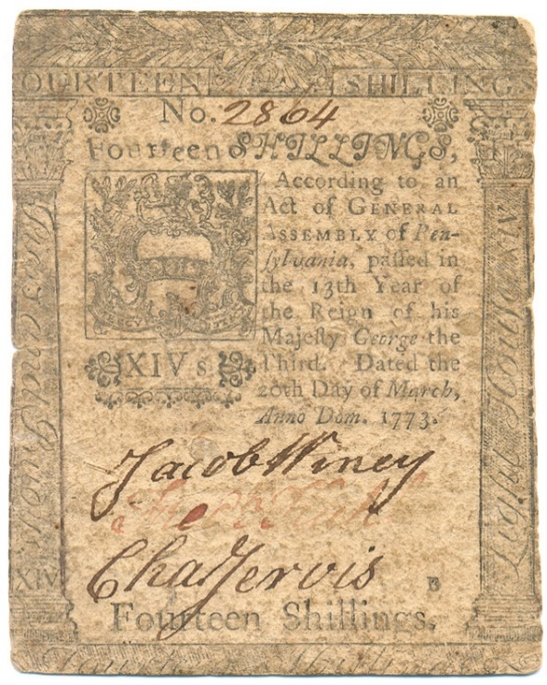
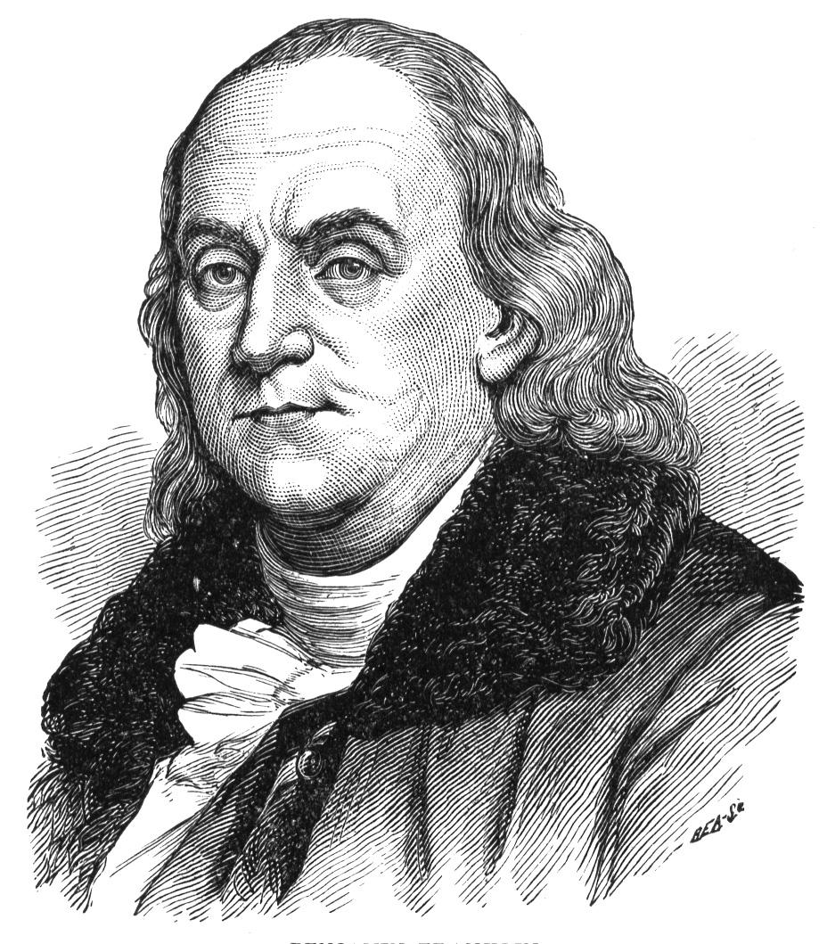
U.S. EXPERIENCE WITH GOVERNMENT ISSUED MONEY
COLONISTS FELT AN AVERSION TO PRIVATE BANK MONEY…
ALL COLONIAL LEGISLATURES ISSUED THEIR OWN SOVEREIGN MONEY
(Paper Script or “Bills of Credit”)
Franklin notes that … internal trade, employment, new construction, and the number of inhabitants in the province all increased… when Pennsylvania issued paper
money in 1723.
PENNSYLVANIA
BILL OF CREDIT

Slide 12
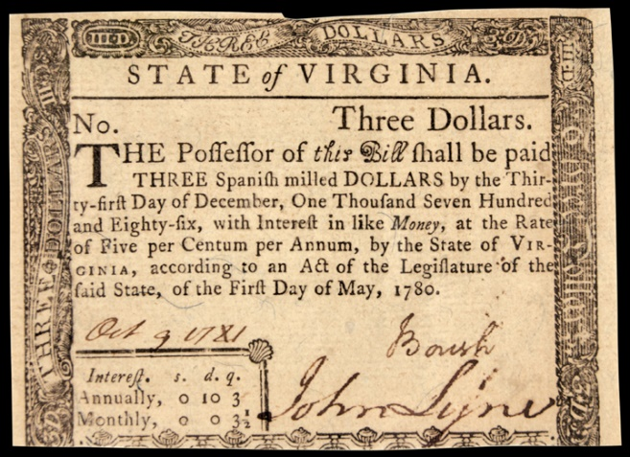
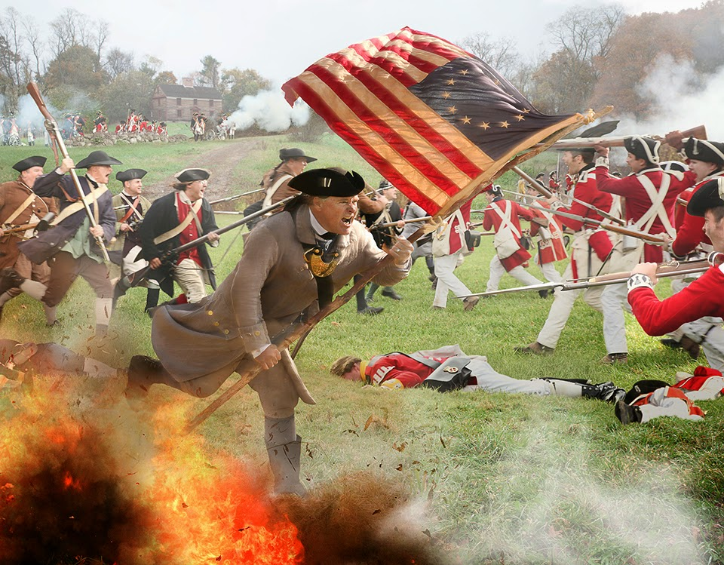
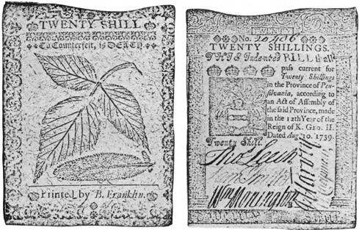
U.S. EXPERIENCE WITH GOVERNMENT ISSUED MONEY
By the beginning of the Revolutionary War, all the colonies were issuing sovereign money. Franklin said the colonies’ sovereign money was the real cause of the War.
PENNSYLVANIA

Slide 13
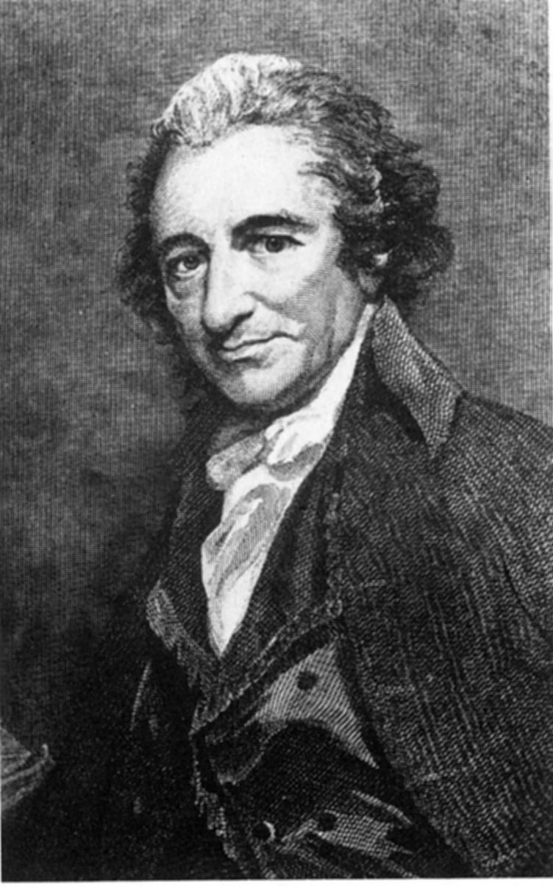
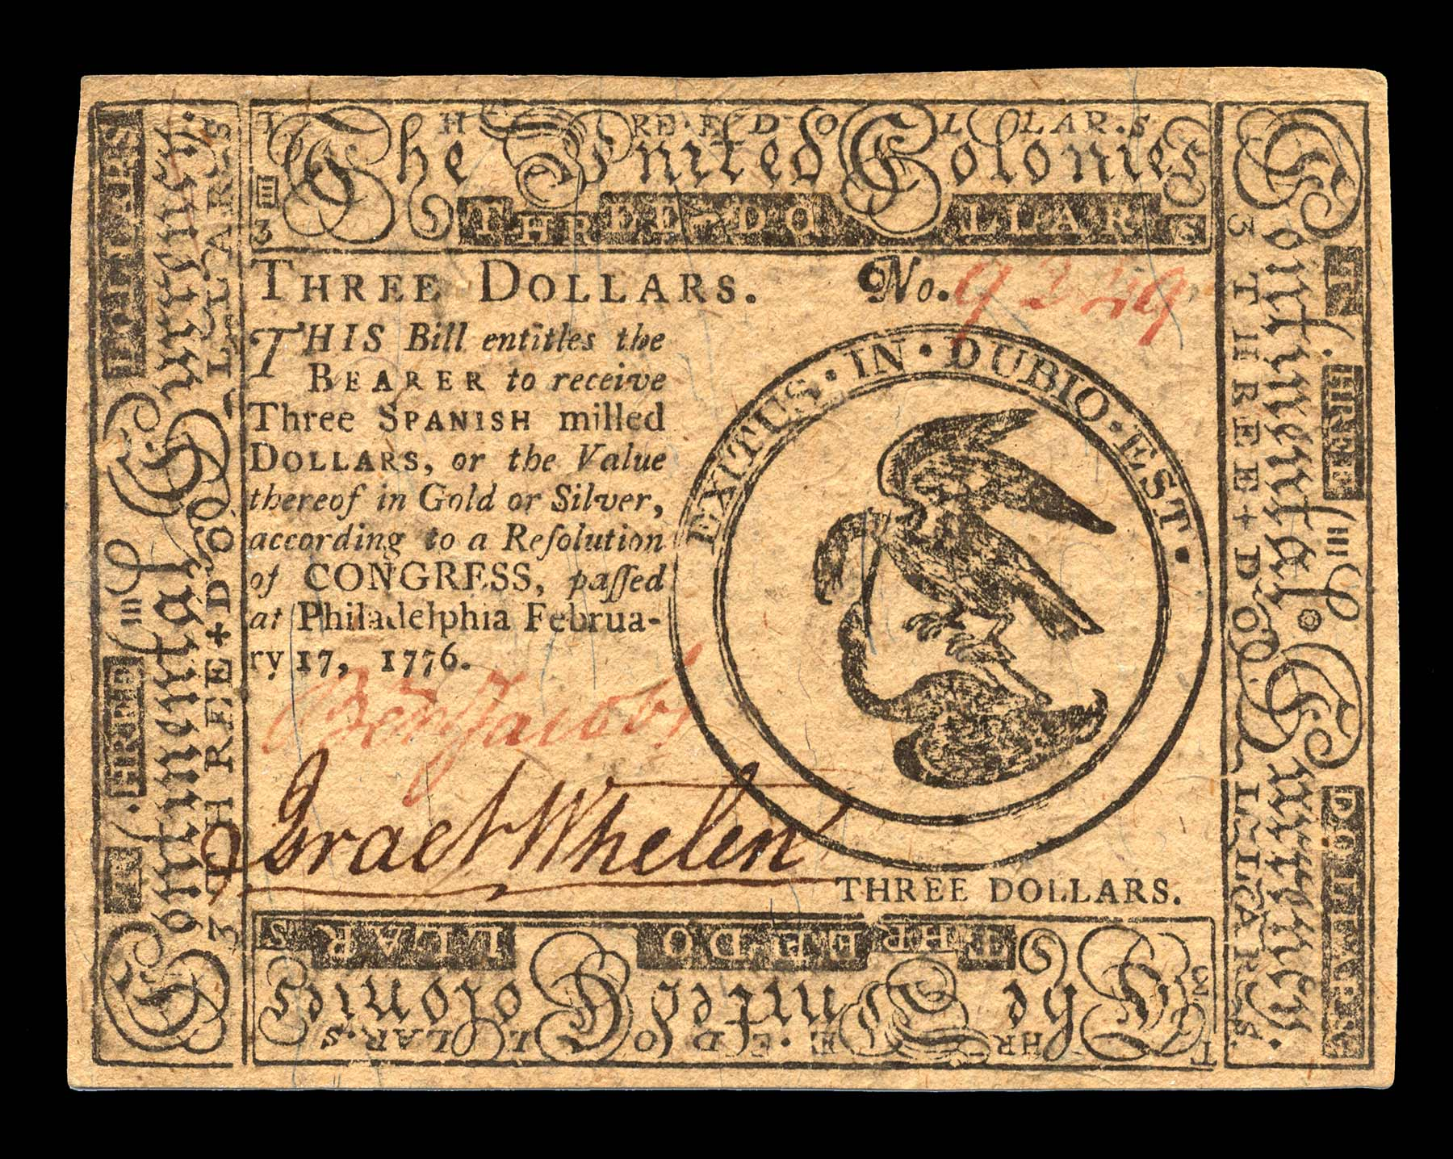
U.S. EXPERIENCE WITH GOVERNMENT ISSUED MONEY
DURING THE REVOLUTION,
THE CONTINENTAL CONGRESS ISSUED ‘CONTINENTALS’ [SOVEREIGN MONEY]
But this was a corner-stone [Continental paper money], and its usefulness cannot be forgotten…”
Writings of Thomas Paine
CONTINENTAL
THOMAS PAINE

Slide 14
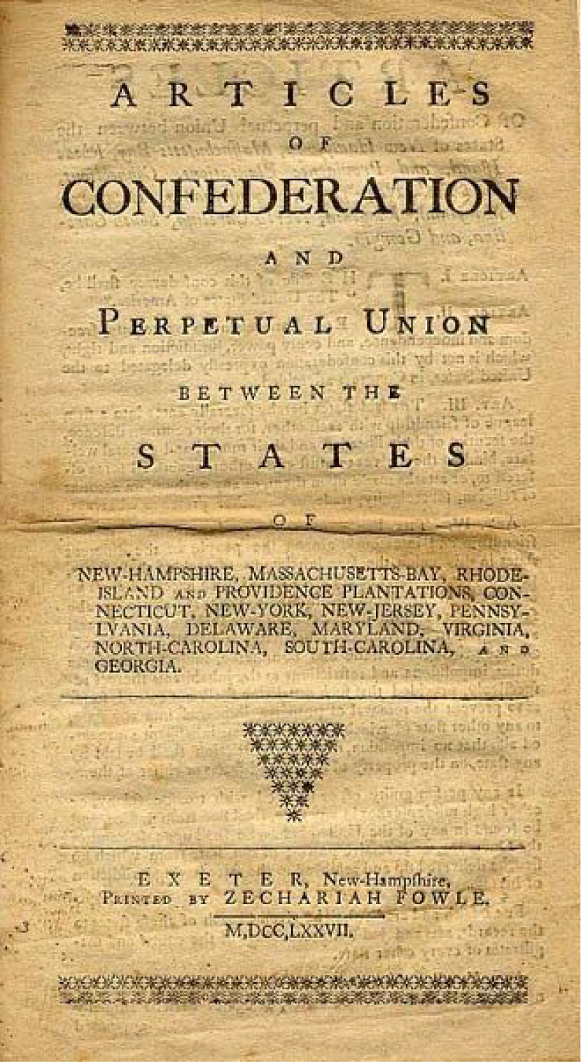
U.S. EXPERIENCE WITH GOVERNMENT ISSUED MONEY
THE ARTICLES OF CONFEDERATION: 1781-1788
PLACED THE MONEY POWER IN THE HANDS OF THE CENTRAL GOVERNMENT
“The United States in Congress assembled shall have authority …
… emit bills on the credit of the United States {SOVEREIGN PAPER MONEY}”

Slide 15
WHO WOULD ISSUE (CREATE) MONEY –
PRIVATE BANKS OR THE GOVERNMENT?

Slide 16
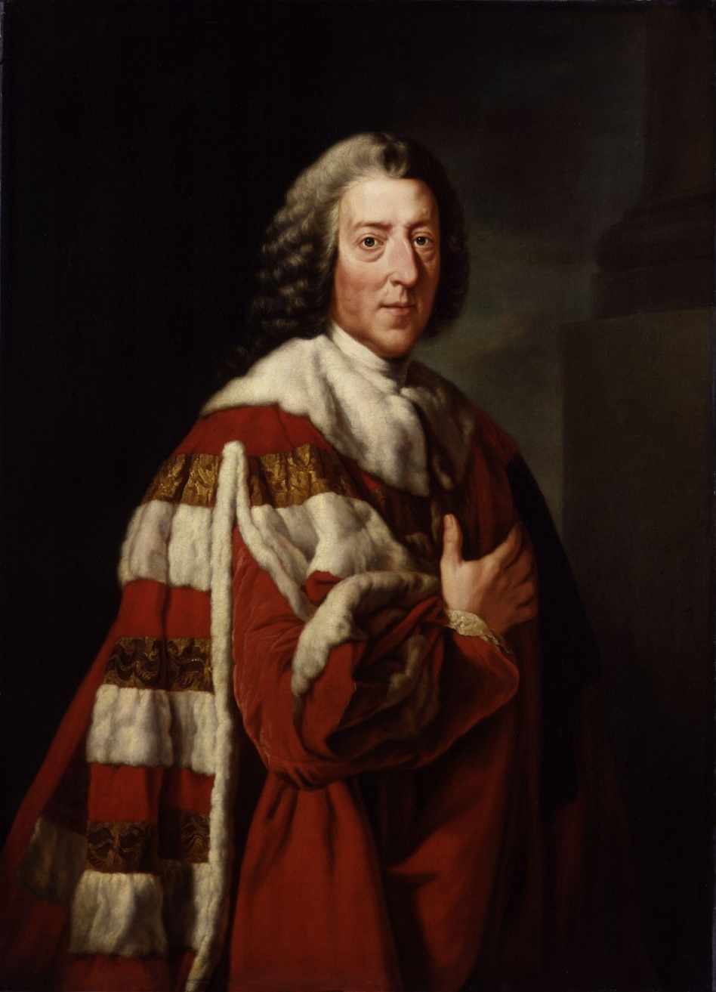
WHO WOULD CREATE MONEY – PRIVATE BANKS OR THE GOVERNMENT?
The Elder WILLIAM PITT, FIRST EARL OF CHATHAM
“Let the Americans adopt their funding
system, and go into their Banking institutions, and their boasted independence will be a mere phantom.”
1708 – 1778

Slide 17
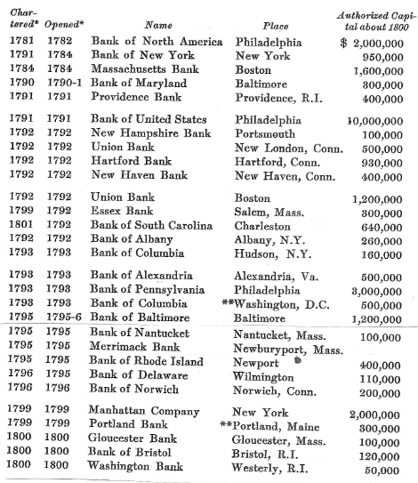
WHO WOULD CREATE MONEY – PRIVATE BANKS OR THE GOVERNMENT?
“The decade of 1781 to 1791 was followed by one in which the number {of banks} grew so rapidly that contemporaries spoke of a rage for banks – a ‘bancomania.’ “ Hammond, p. 72
← 29 BANKS IN BUSINESS BY 1800 !!!

Slide 18
U.S. CONSTITUTION:
Monetary Power Left Undefined

Slide 19
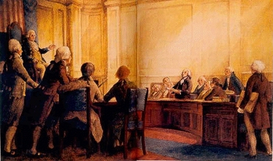
U.S. CONSTITUTION: Monetary Power Left Undefined
THE ‘MONEY INTEREST’ TRIED TO INSERT A CLAUSE FORBIDDING ‘BILLS OF CREDIT’…. BUT FAILED
BUT…. WON A VOTE (9 TO 2) TO NOT INCLUDE THE PHRASE ‘BILLS OF CREDIT’.
THE CONSTITUTION (Art. 1, Sec. 8)
gives the power to Congress:
“To coin {to make} Money*, regulate the Value thereof, “

Slide 20
1st Nationally Chartered Private Bank

Slide 21
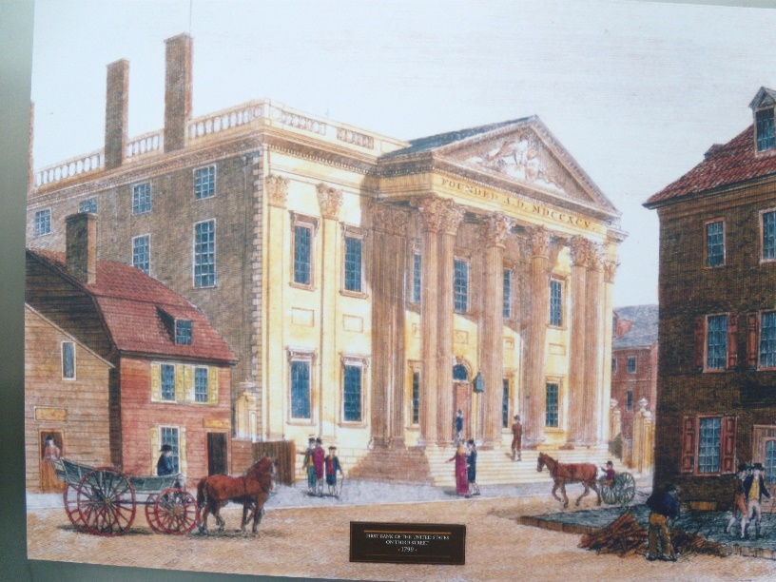
1st Nationally Chartered Private Bank
1st Bank of the United States (1791-1811)
The federally-chartered bank was controversial.
Three-fourths of the shares were foreign owned.
Its charter was not renewed.

Slide 22
THE WAR OF 1812 & STATE BANKS

Slide 23
THE WAR OF 1812 & STATE BANKS
The private state bank response to the removal of the 1st Bank of the U.S. and the war of 1812 was not honorable:
A SPIRIT OF SPECULATION TAKES OVER
YEAR #STATE
CHARTERED
____ BANKS
90
250 !!!
1820 300
“… even companies incorporated for the purpose of constructing bridges, departed from the spirit of their charters, converted themselves into Banks, and emitted notes for circulation.” Gouge, p. 56
A general stoppage of specie by state banks in the south and west, except New England … “after which the country wallowed in irredeemable paper for several years.” White, Money and Banking, p. 264

Slide 24
THE FIRST PAPER MONEY ISSUED BY THE
U.S. GOVERNMENT

Slide 25
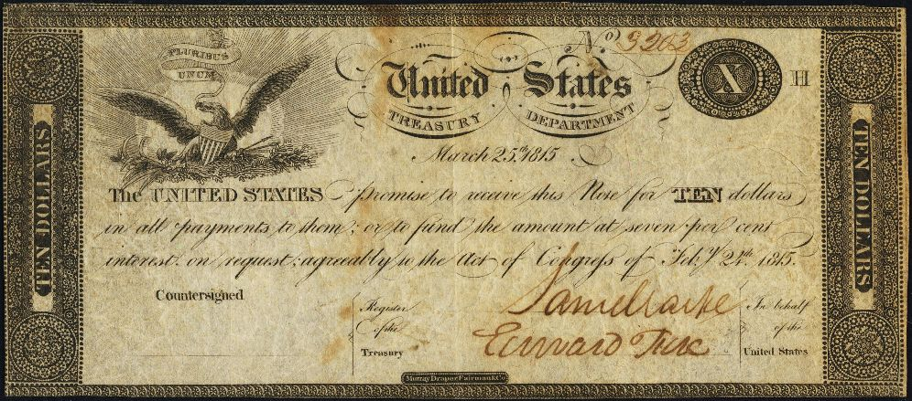
THE FIRST PAPER MONEY ISSUED BY THE U.S. GOVERNMENT
TREASURY NOTES: 1812-1817
The expiration of the charter of the First Bank of the U.S., the War of 1812, and the suspension of specie by state banks in September 1814:
all caused the Treasury to issue Treasury Notes – responsibly and within legislative limits
Authorized: $60.5 million
Issued: $36.7 million
(about $3.5 million
in small notes)
Stephen Zarlenga
Lost Science of Money
p. 415
The notes were spent into circulation, by paying them to government creditors willing to accept them at full value.
They were receivable for taxes and fees.
Holders could convert them into 7% interest bearing securities, on request.

Slide 26
2ND BANK OF THE U.S.

Slide 27


2ND BANK OF THE U.S.
BANK CREATES CRIMINALLY INSANE EXPANSION!
… AND THEN CRIMINALLY INSANE CONTRACTION!
EXPANSION
April 1817 Bank begins
July 1817 19 branch offices
$52.0 mill in loans
9.0 mill in circ currency
2.5 mill in gold/silver reserves
WILD, SPECULATIVE BOOM
CONTRACTION
1819
$12.0 mill in loans (cut 40.0 million)
3.5 mill in circ currency (cut 5.5 million)
PANIC OF 1819
bankruptcies
South & West hit hardest
real assets seized as collateral
farmers & artisans moved West
public outrage

Slide 28
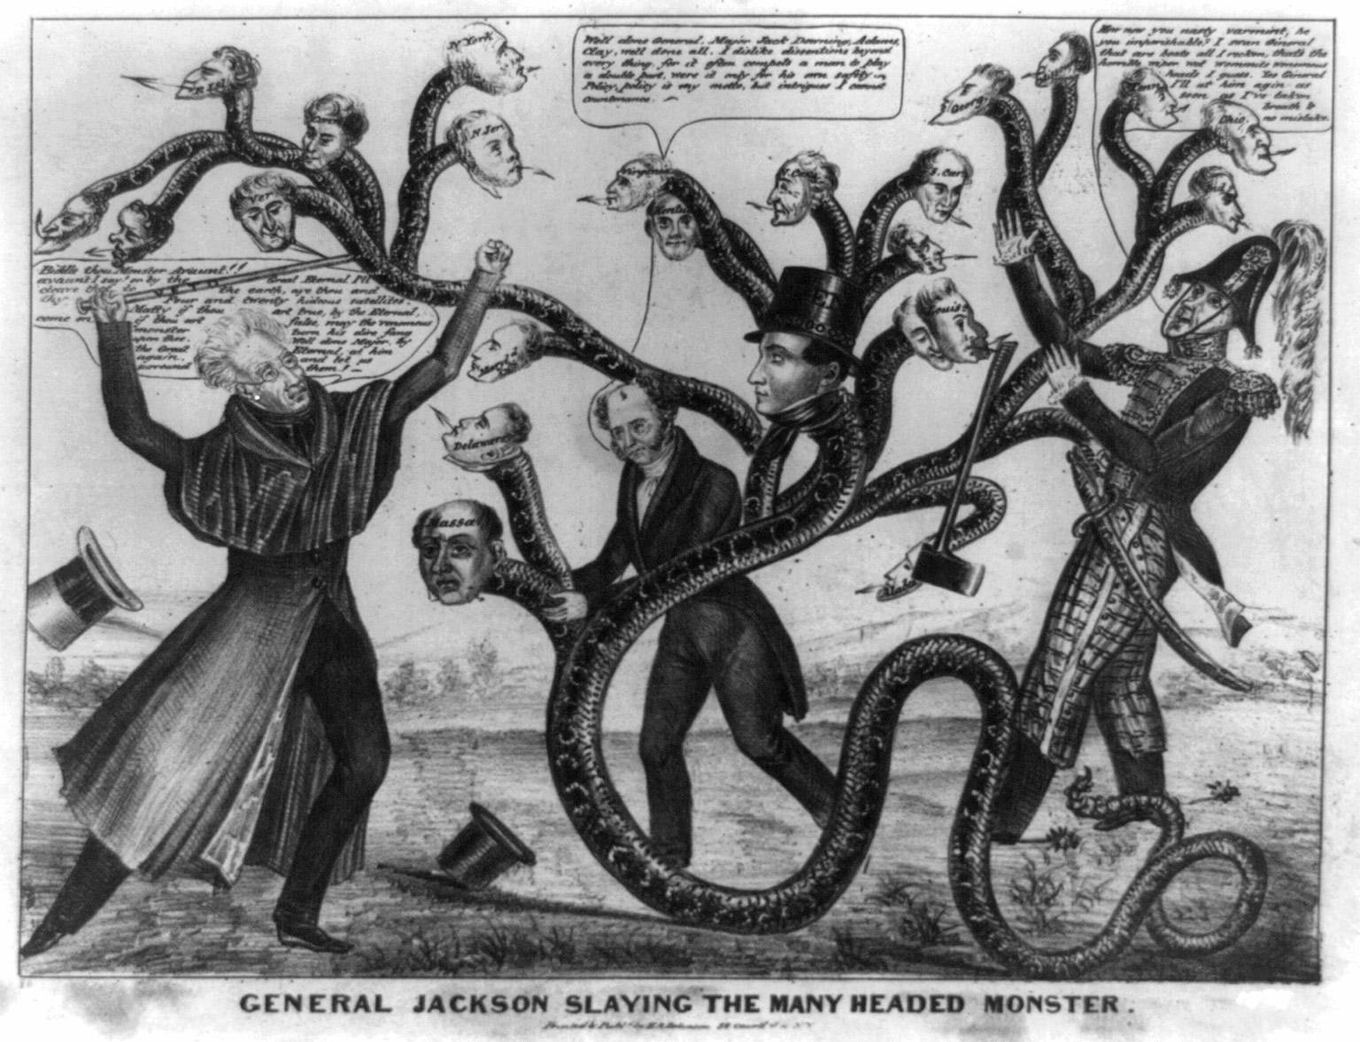
JACKSON’S WAR WITH THE BANK
VETO OF RE-CHARTER
JULY 1832,
during the election of 1832

Slide 29
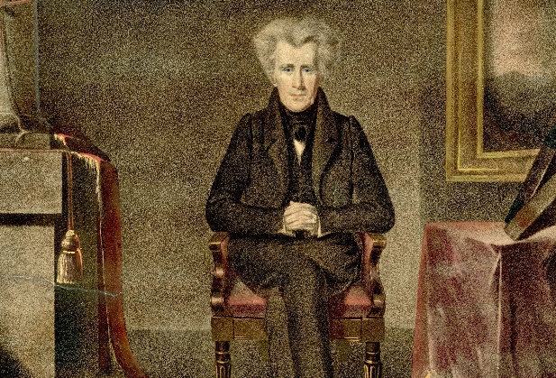
JACKSON’S WAR WITH THE BANK
JULY 10, 1832: BANK RE-CHARTER BILL PASSES CONGRESS - JACKSON VETOES IT
Jackson’s veto message aroused popular feeling and he was re-elected for a second term on the issue of re-chartering the Bank.
The veto was based on:
the bank’s monopoly was unfair
of $28 million in bank stock, $8.4 million were owned by foreigners
JACKSON’S VETO
“…. deeply impressed with the belief that some of the powers and privileges possessed by the existing bank are unauthorized by the Constitution, subversive of the rights of the States, and dangerous to the liberties of the people, I felt it my duty at an early period of my Administration to call the attention of Congress to the practicability of organizing an institution combining all its advantages and obviating these objections. I sincerely regret that in the act before me I can perceive none of those modifications of the bank charter which are necessary, in my opinion, to make it compatible with justice, with sound policy, or with the Constitution of our country.”

Slide 30
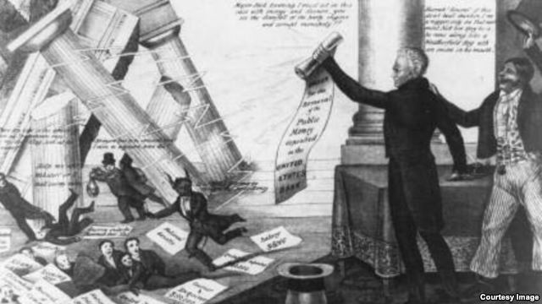
JACKSON’S WAR WITH THE BANK
OCTOBER 1, 1833
JACKSON BEGINS TO REMOVE PUBLIC MONIES FROM THE BANK
Jackson’s next step was to remove the government deposits from the Bank, and, ultimately, destroy the Bank.
Jackson requested his Treasury Secretary to slowly remove public funds from the Bank, and deposit them into ‘pet’ state banks.
Two Treasury Secretaries refused. Both were removed. Finally, Roger Taney agreed to do so.
October 1, 1833, the United States officially switched from National banking to state banking.
A Democratic cartoon from 1833 showing Jackson destroying the bank with his "Order for the Removal," to the approval of the Uncle Sam like figure to the right, and the annoyance of the bank's president, shown as the Devil himself. Numerous politicians and editors who were given favorable loans from the bank run for cover as the financial temple crashes down.

Slide 31
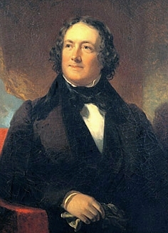
JACKSON’S WAR WITH THE BANK
BIDDLE AND BANK CREATE DEFLATION
BIDDLE REACTS: Biddle called in $18 million in the Bank’s loans!
The resulting financial panic was Biddle's way of trying to twist Jackson's arm and get him to restore the deposits to the Bank.
Petitions for the return of the deposits and re-charter poured into Jackson.
Biddle makes rash statements: “My course is decided … all the other banks and all the merchants may break, but the Bank of the U.S. shall not break!” Catterall, p. 331
Jackson held firm. Biddle was eventually forced to relax the bank’s credit policies
NICHOLAS BIDDLE
(1786 – 1844)

Slide 32
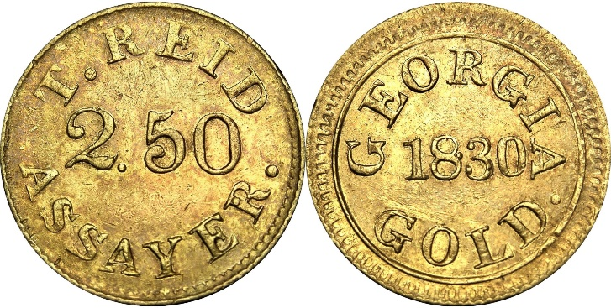

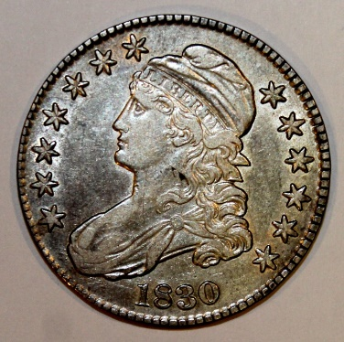
JACKSON’S WAR WITH THE BANK
JULY 11, 1836
JACKSON ISSUES ‘SPECIE CIRCULAR’
The state banks, facing little regulation, freely loaned paper money to virtually anyone who asked for it. A flurry of land speculation and inflation followed.
To curtail these alarming trends, Jackson issued the Species Circular on July 11, 1836. The executive order meant that federal land could no longer be bought with paper money, but only with gold or silver.

Slide 33
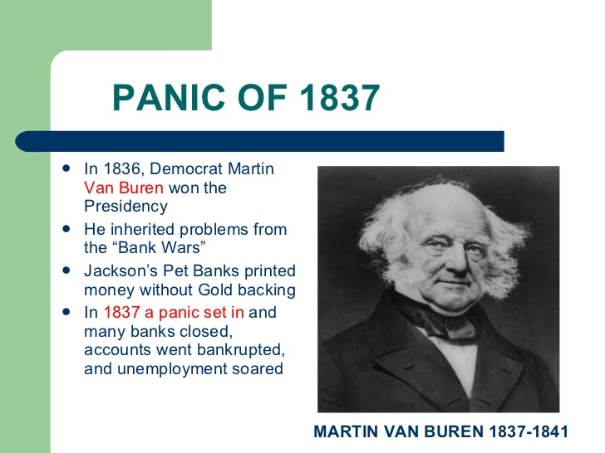

JACKSON’S WAR WITH THE BANK
BAD AS STATE BANK NOTES WERE, THEY STILL FUNCTIONED AS MONEY
The state banks had issued:
1830 $61 million
1837 $149 million
Once the state bank notes were no longer accepted by the government, their circulation was cut back dramatically. This caused a huge deflation. THE PANIC OF 1837 ENSUED.
1837 $149 million
1843 58 million

Slide 34
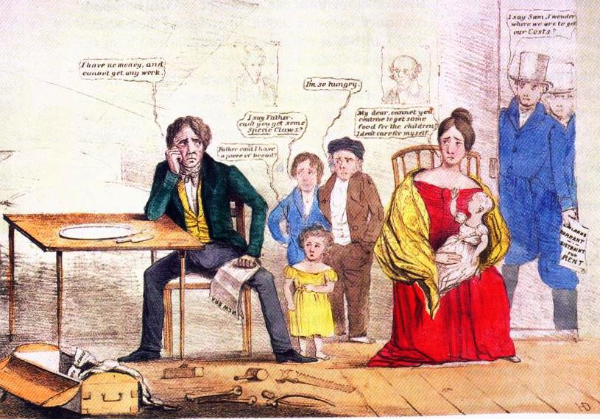
THE DEPRESSION OF 1837

Slide 35

THE END

