Slide 1
THE PROBLEM:
Private Bank Debt-Money
& Private Prison Corporations
How the money system creates
PRIVATE PRISON CORPORATIONS

Slide 2


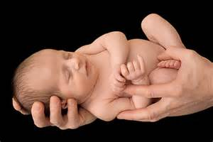
Where does our money come from?
Well, I earn mine from my job.
No, no. What I mean is, who creates the dollars? Where do the dollars get born?

Slide 3

Oh, that’s easy. Everybody knows our government creates the money.
The government spends too much,
my taxes are way too high,
and it’s all the government’s fault!
Uum…that’s interesting but doesn’t make sense.
What do you mean, doesn’t make sense?

Slide 4

Think of this.
If our government is the creator of our money,
why is our government $19 trillion in debt?
Ah…. ah…. well….
I never thought about this!

Slide 5

LOOK ME STRAIGHT IN THE EYE….
Okay…..
REPEAT AFTER ME….
Okay…..

Slide 6


Our money is created by PRIVATE, COMMERCIAL BANKS,
whenever they make a loan or buy a stock or bond for themselves.
…our money is created? … by PRIVATE, COMMERCIAL BANKS? …
whenever they make a loan? ….
or buy a stock or bond for themselves!
Ah….not quite sure what this means …

Slide 7
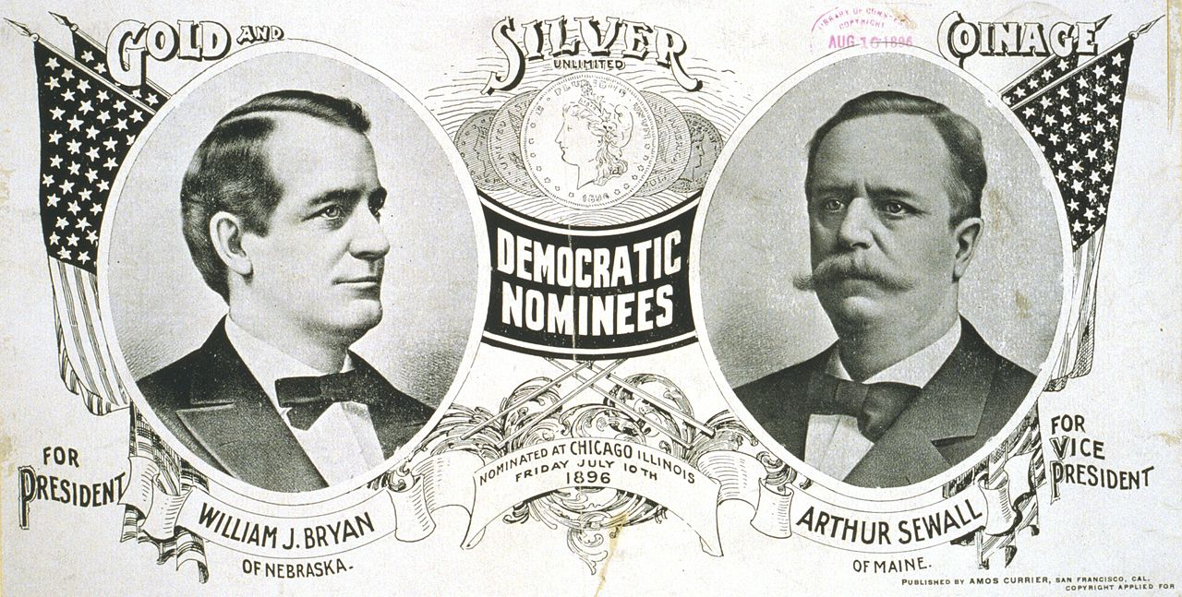
Our nation’s history of money creation has been kept from us.
By whom?
When?
Where?
Since the 1930’s, the issue of who creates our money has actually disappeared from public discourse.
We don’t talk about it.

Slide 8
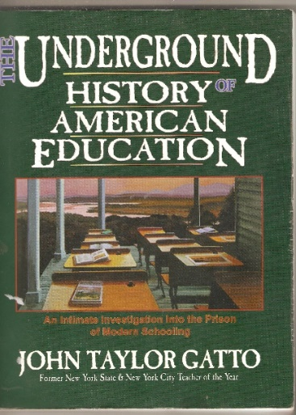
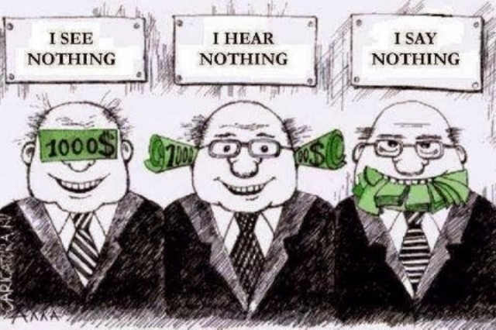

WHOEVER CONTROLS THE MONEY, CONTROLS THE SOCIETY…
EDUCATION GOVERNMENT PRESS

Slide 9
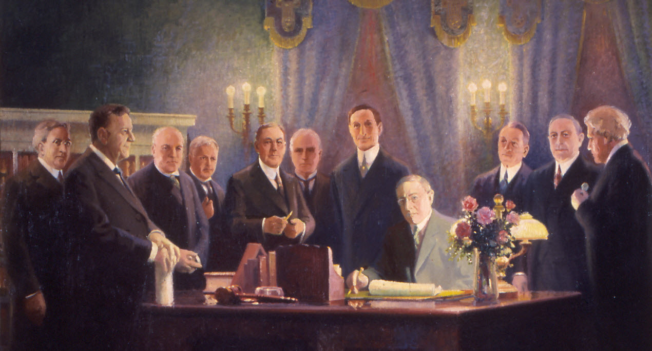
Federal Reserve Bill, 1913, created a central bank system, owned by its member commercial banks.
The member commercial banks were legally allowed to create money ‘out of thin air’. They call it ‘bank credit’.
We are led to believe the banks ‘lend’ money they already have.

Slide 10
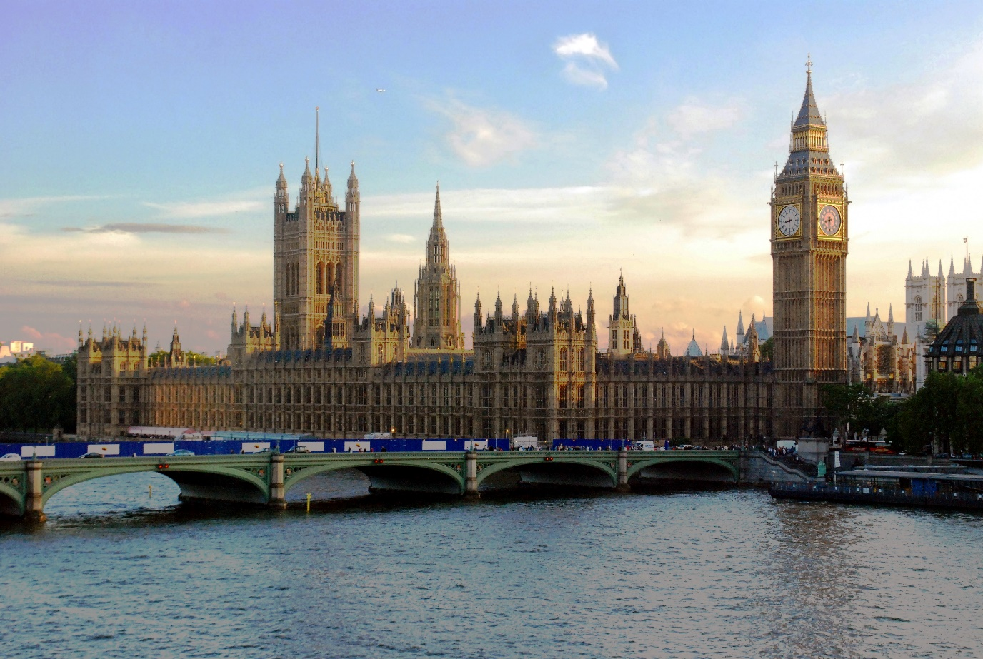
I don’t believe it… It’s too hard to believe.
You don’t have to believe me. Here… listen to a member of Parliament.

Slide 11
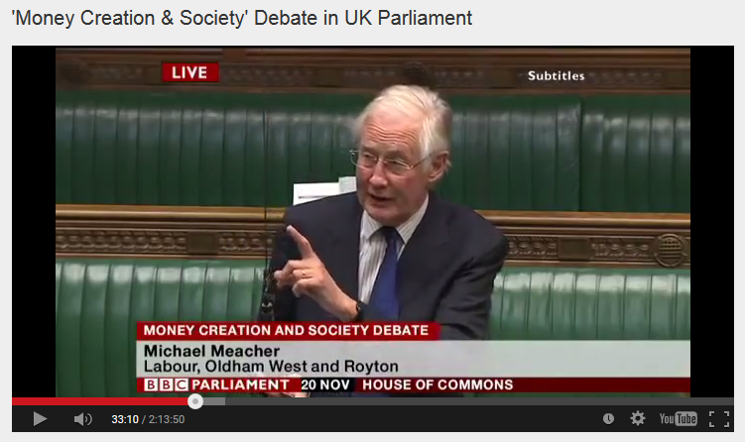

House of Commons, Nov. 20, 2014, Mr. Michael Meacher, MP:
“It is unfortunate… that it is so little understood by the public that money is created every time by the banks when they make loans.”
“And it is the banks – the banks – which determine how money is allocated across the economy.”

Slide 12
How does this hidden system work?

Slide 13

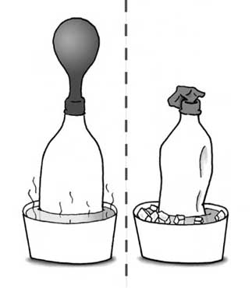
#1:
When a private commercial bank makes a loan, it CREATES MONEY.
The money supply grows.
When the loan is repaid, the MONEY DISAPPEARS.
The money supply shrinks.
What! This can't be!
Whoever heard of such a thing!
BANKS MAKE
LOANS
BANKS STOP
MAKING LOANS

Slide 14
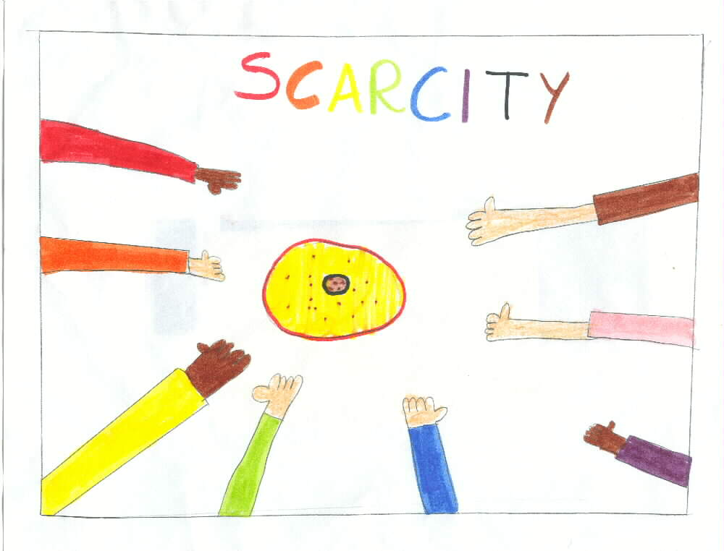
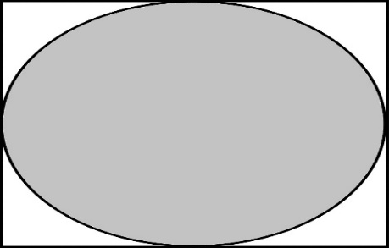
Day by day, loans are always being repaid, so the money supply is always shrinking.
NO INTEREST
PRINCIPAL ONLY

Slide 15
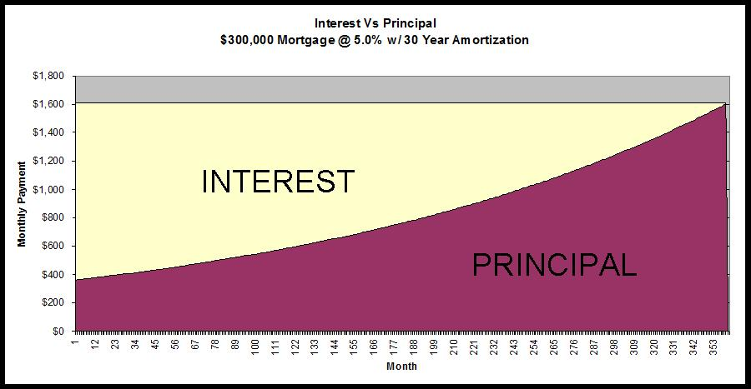
#2:
Of course, we know that every borrower must pay interest.
What is not known, is that banks NEVER CREATE THE MONEY FOR THE INTEREST. Only for the principal of the loan.
Oh, my goodness.
This is getting really confusing. Why not create the INTEREST?
NEVER CREATED➔

Slide 16
Since interest is never created in the money supply, money is always SCARCE.
NO INTEREST
PRINCIPAL ONLY

Slide 17
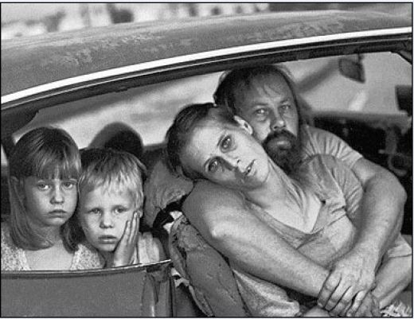
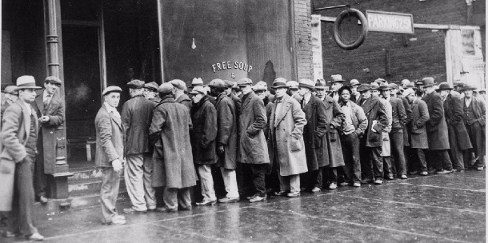
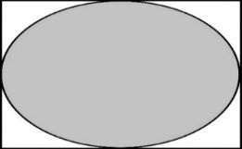
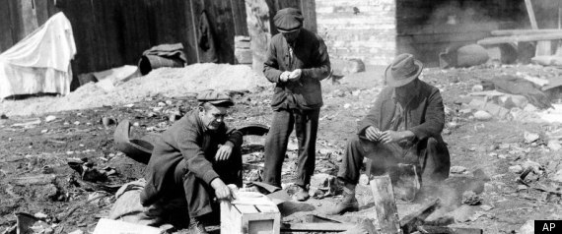
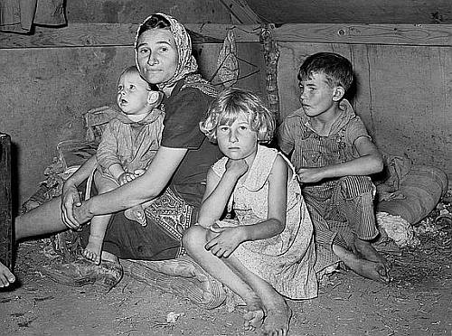
The system DEMANDS THAT MORE LOANS BE CREATED, otherwise, the money supply will shrink and there will be defaults, foreclosures, bankruptcies, unemployment, recessions, depressions, complete economic collapse.
PRINCIPAL ONLY

Slide 18
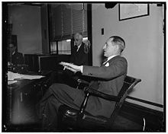

Mariner S. Eccles
Chairman, Federal Reserve
under President Franklin D. Roosevelt
“That is what our money system is.
If there were no debts in our money system,
there wouldn’t be any money.”

Slide 19


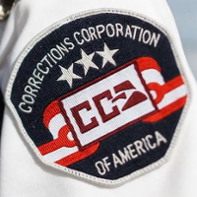


#3:
The banks decide the nature of our society,
because they decide who gets loans (debt-money).
WAR & WEAPONS
PRIVATE PRISON
CORPORATIONS
AGRIBUSINESS

Slide 20

What does our monetary system have to do with the privatization of prisons in our country?

Slide 21
Since the DEBT-MONEY system funds the private prison corporations,
if we change the monetary system, we could stop the
power of CCA and GEO Group, no?
Yes.

Slide 22

Let’s look at CCA’s balance sheet.
This will tell us WHO IS FUNDING CCA.
What’s a balance sheet?
Let me explain.

Slide 23

Every company in the world has a balance sheet.
It shows what it OWNs and what is OWEs.
The difference between the two is the value of the company’s shares.
COMPANY BALANCE SHEET
OWN
OWE
= VALUE OF COMPANY’S SHARES

Slide 24


Here is the balance sheet of CCA, the largest private prison corporation
in the U.S.
Let’s see where they get their money….
CCA
OWNED
OWED
own 73 facilities
$900 M BANK CREDIT FACILITY
BANKS (CREDIT CARD)
= VALUE OF COMPANY’S SHARES
BANKS (MILLION SHARES CLUB)

Slide 25
So, who is funding CCA?
The banks!!!
Yes, the banks who create money whenever they make a loan or buy a stock or bond.
BANKS (CREDIT CARD)
BANKS (MILLION SHARES CLUB)

Slide 26
What is CCA doing with this money?
Besides lobbying for laws to incriminate more and more people….
They are using this money to get bigger and bigger….

Slide 27
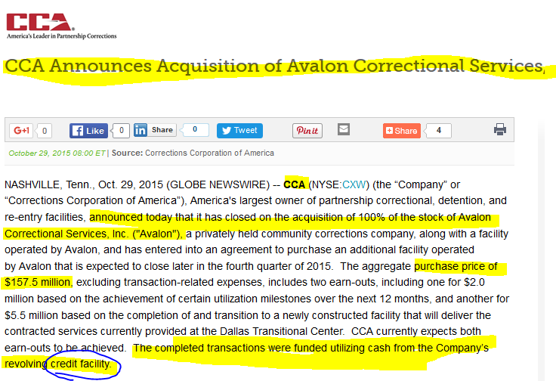
CCA uses its BANK LOAN to buy up smaller PRIVATE PRISON corporations and get even larger. In 2015….

Slide 28
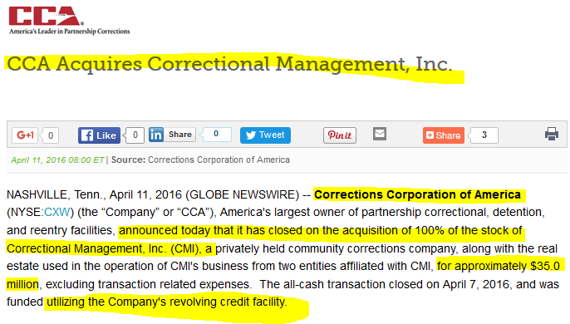
And, again, a year later. 2016…

Slide 29


This is how the debt-money system creates
PRIVATE PRISON CORPORATIONS

Slide 30
THE END

