Slide 1
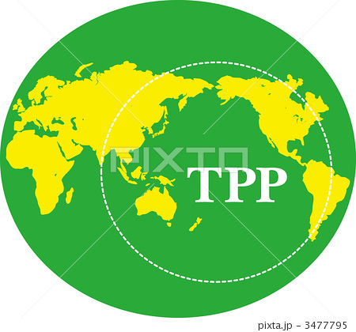

Our Debt-Money System:
Trans Pacific Partnership (TPP)
Transatlantic Trade & Investment Partnership (TTIP)
Session 5: SUN 10:00 am – 11:50 am

Slide 2
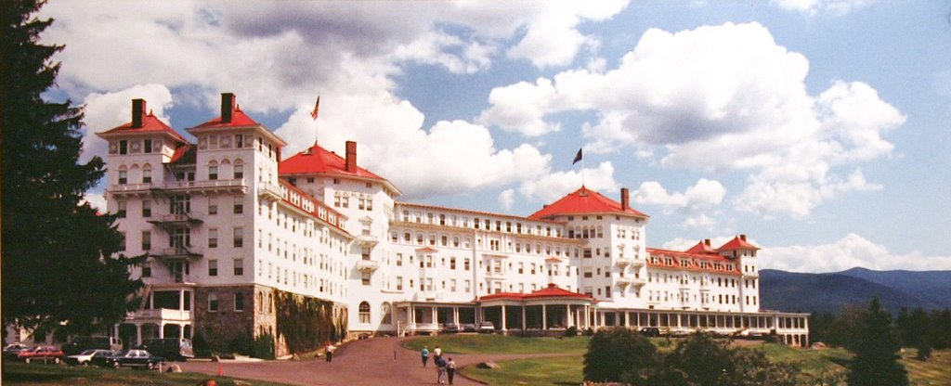
Origin of Today’s International Trade System:
BRETTON WOODS CONFERENCE 1944
44 representatives of the Allied Nations in World War II
met at Bretton Woods, N.H., in July 1944

Slide 3
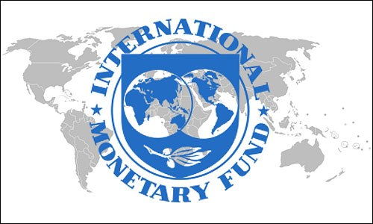

DEBT-MONEY & International Trade System
The American plan was accepted:
a country needing money, would be
given a loan (DEBT)
The IMF & World Bank were set up

Slide 4
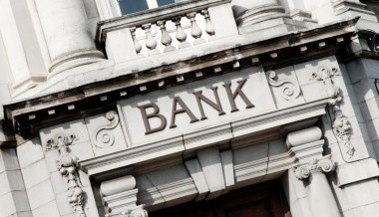
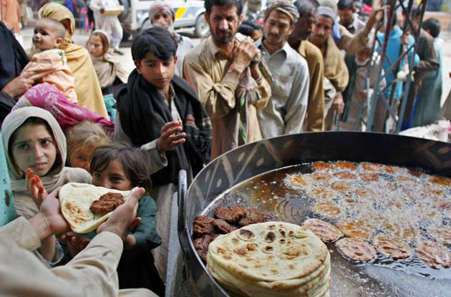
DEBT-MONEY & World Bank
1
Debt-money
is loaned to
poor nations
3
World Bank
sells bonds
Banks create
debt-money &
buy bonds
2
DEBT
Private Commercial Banks
in Rich Nations
Third World Nations

Slide 5
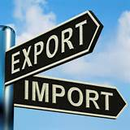
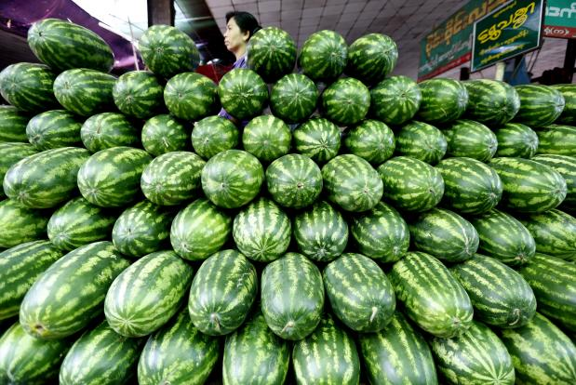
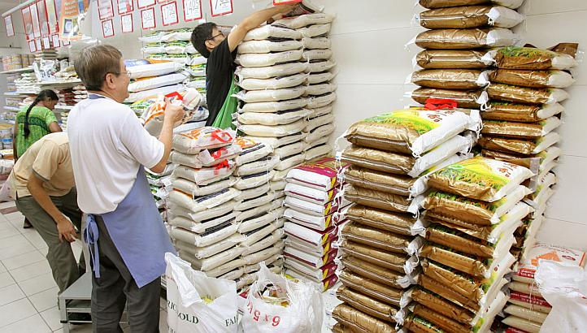
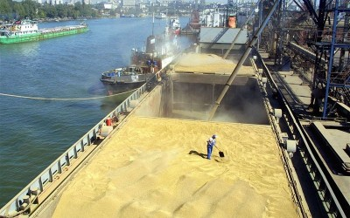
DEBT-MONEY & Third World Nations
To repay their international debts, poor nations must earn dollars.
They compete against other poor countries, all who export similar products, glut the market, and drive down prices
They compete against the wealthy nations, who strive to maximize exports and minimize imports, because they too have massive public and private debts
ALL NATIONS
ARE IN DEBT !!!!

Slide 6

WHAT IS TPP? TTIP?

Slide 7
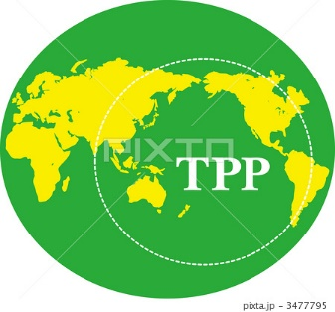
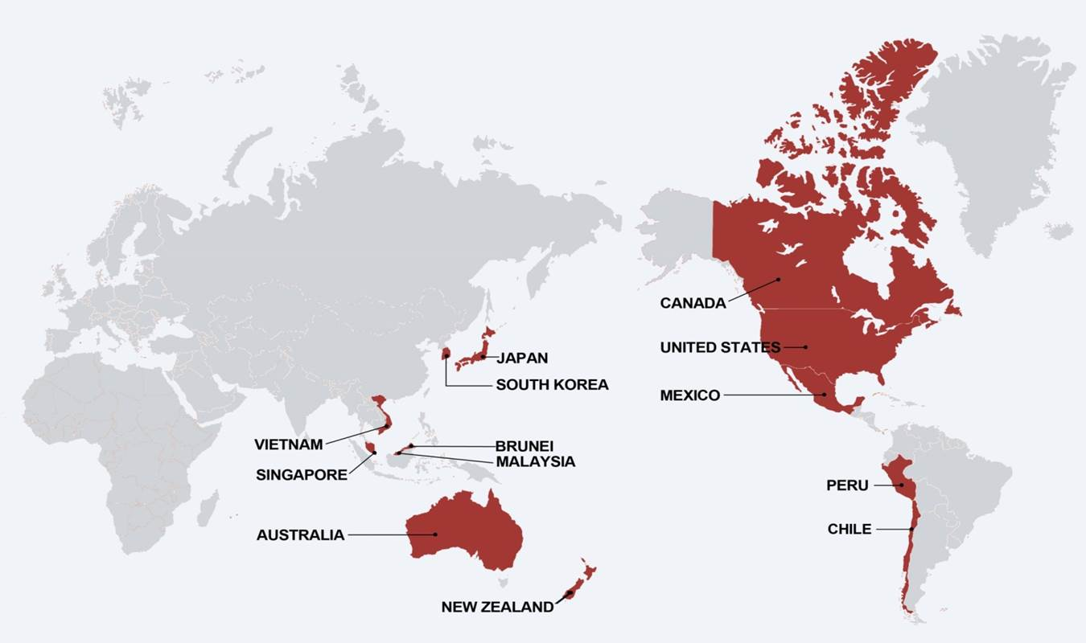
The Trans Pacific Partnership is called a “Free Trade” Agreement, purportedly to regulate trade relations among the US and 11 other Pacific Rim Countries:
Mexico
Canada
Japan
Singapore
Vietnam
Australia
New Zealand
Chile
Peru
Malaysia
Brunei
This agreement covers more than
40% of the global economy.

Slide 8
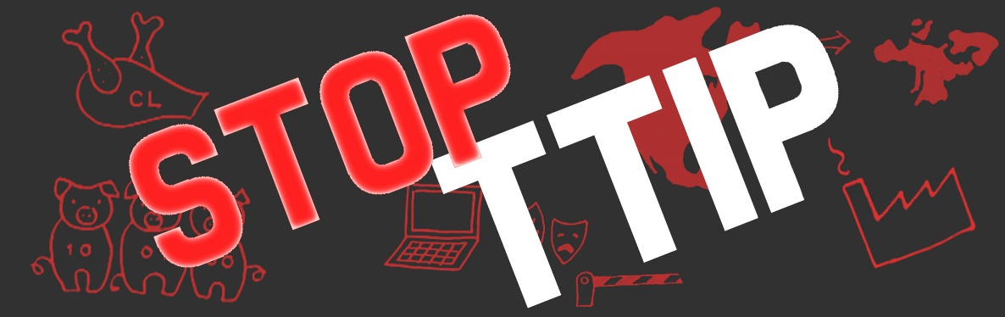
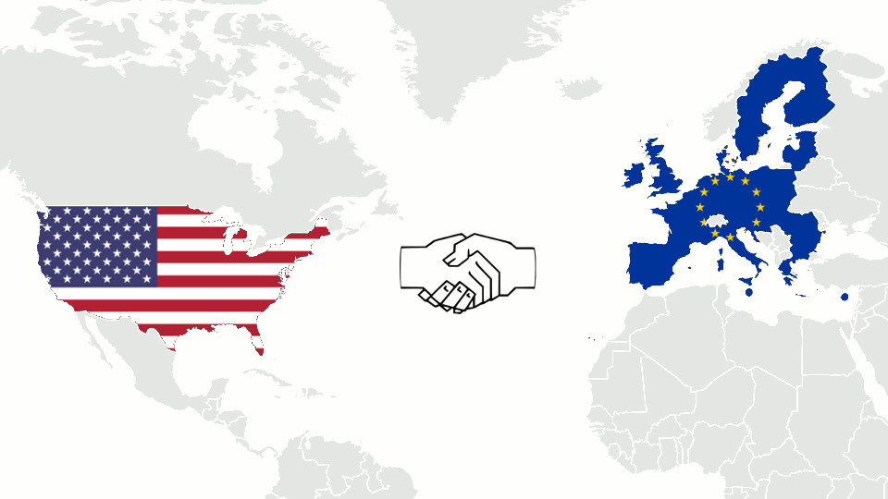
The Transatlantic Trade & Investment Partnership is called a “Free Trade” Agreement, purportedly to regulate trade relations between the U.S. and the European Union.
This agreement covers more than
60% of global GDP.

Slide 9
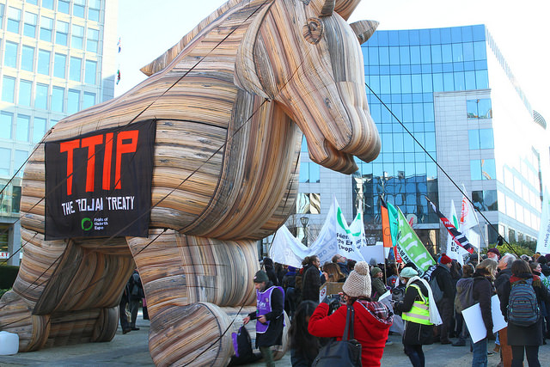
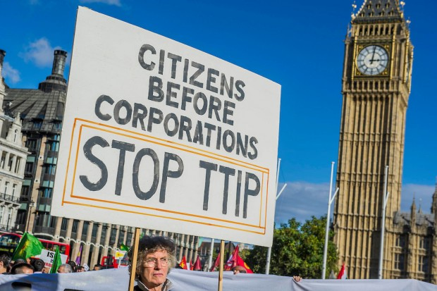
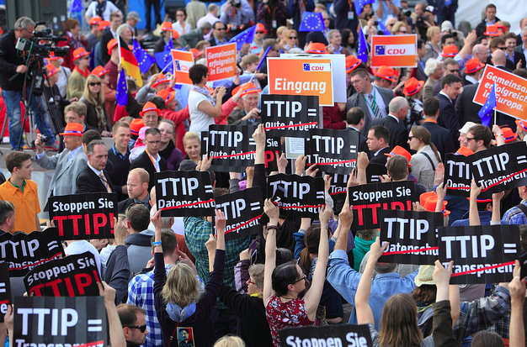
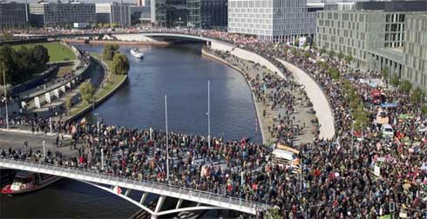
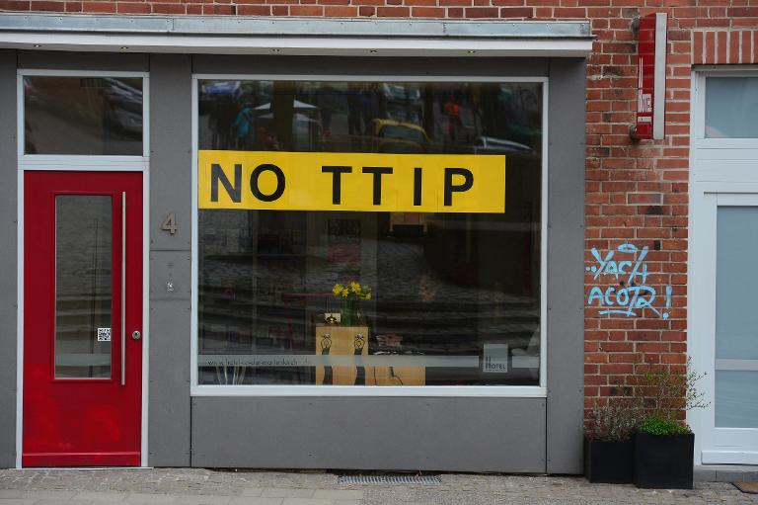
EUROPEAN DEMONSTRATIONS AGAINST THE TTIP

Slide 10
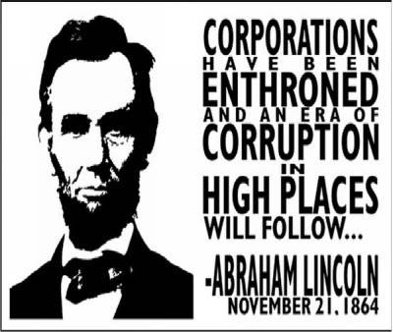
They say they are ‘trade agreements’, but they are WAY MORE!!!!
THERE ARE MANY CHAPTERS BUT VERY FEW OF THEM ARE ON TRADE…
IT IS AN AGREEMENT TO PROMOTE CORPORATE POWER…
SOME OF THE AREAS COVERED:
INTELLECTUAL PROPERTY (COPYRIGHT
AND PATENTS)
ENVIRONMENTAL POLICY
FINANCIAL SERVICES
PROCUREMENT
INVESTMENT – ‘ISDS’
INTERNET ACCESS
MEDICATIONS
LABOR RIGHTS
BANKING REGULATIONS
FARM POLICY/AGRICULTURE

Slide 11
TRADE NEGOTIATIONS
THE TPP & TTIP ARE BEING NEGOTIATED IN SECRET BY U.S. TRADE REPRESENTATIVES (Part of the Executive Office of the President).
2. THERE ARE MOSTLY CORPORATE LOBBYISTS, ACTING AS “ADVISORS,” WITH SECURITY CLEARANCE, ALLOWED TO SEE THE TEXT OF THE AGREEMENT.
3. SOME MEMBERS OF CONGRESS HAVE VIEWED THE TEXT.

Slide 12
HISTORY
BEFORE CONGRESS PASSED NAFTA (NORTH ATLANTIC FREE TRADE AGREEMENT) IN 1994, TRADE AGREEMENTS COVERED ONLY QUOTAS AND TARIFFS.
STARTING WITH NAFTA, THE SO-CALLED “FREE TRADE” AGREEMENTS HAVE EXPANDED THE AREAS COVERED – LIKE INTERNET ACCESS, INTELLECTUAL PROPERTY, ENVIRONMENT, ETC.
SINCE 1994, THERE HAVE BEEN MULTIPLE FREE TRADE AGREEMENTS… MOST HAVE INCLUDED A CLAUSE CALLED: ISDS -- INVESTOR STATE DISPUTE SETTLEMENT.

Slide 13
ISDS
INVESTOR STATE DISPUTE SETTLEMENT CLAUSE
THIS CLAUSE ELEVATES CORPORATIONS TO THE STATUS OF A STATE…
IT ALLOWS FOREIGN CORPORATIONS TO SUE SOVEREIGN GOVERNMENTS…
AND WIN HUGE MONETARY AWARDS, BASED ON THE LOSS OF EXPECTED FUTURE PROFITS DUE TO DOMESTIC LAWS, SUCH AS LAWS PROTECTING THE ENVIRONMENT, WORKERS, HEALTH AND SAFETY…
ALL OF OUR PROTECTIVE LEGISLATION IS IN JEOPARDY.
THE NUMBER OF ISDS CASES HAS DRAMATICALLY INCREASED SINCE 1994.

Slide 14
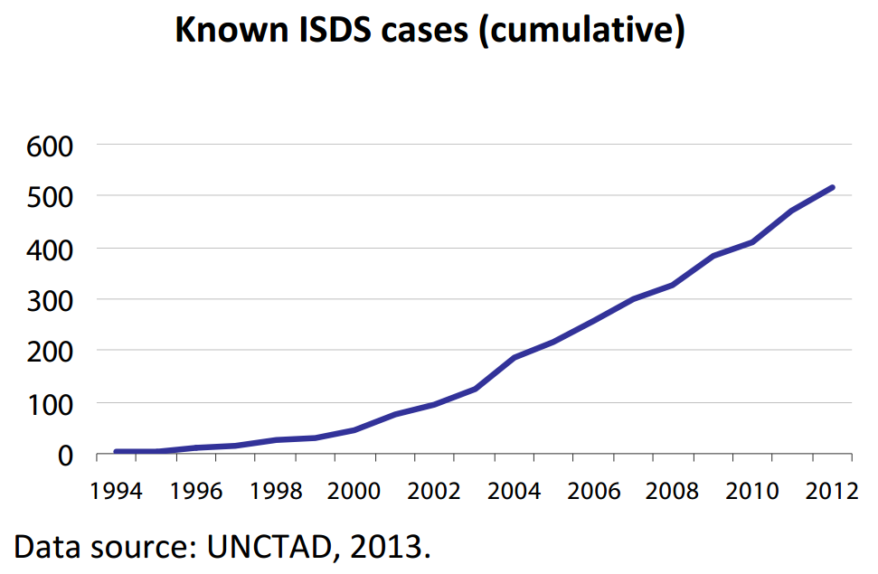

Slide 15
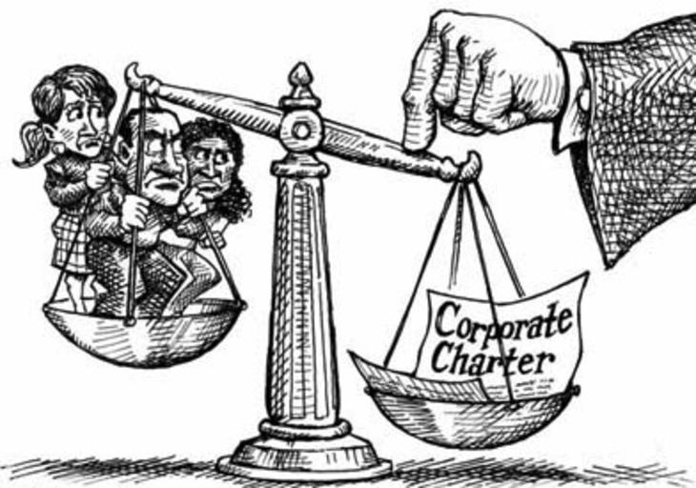
ISDS EXAMPLES
NATIONAL SOVEREIGNTY

Slide 16
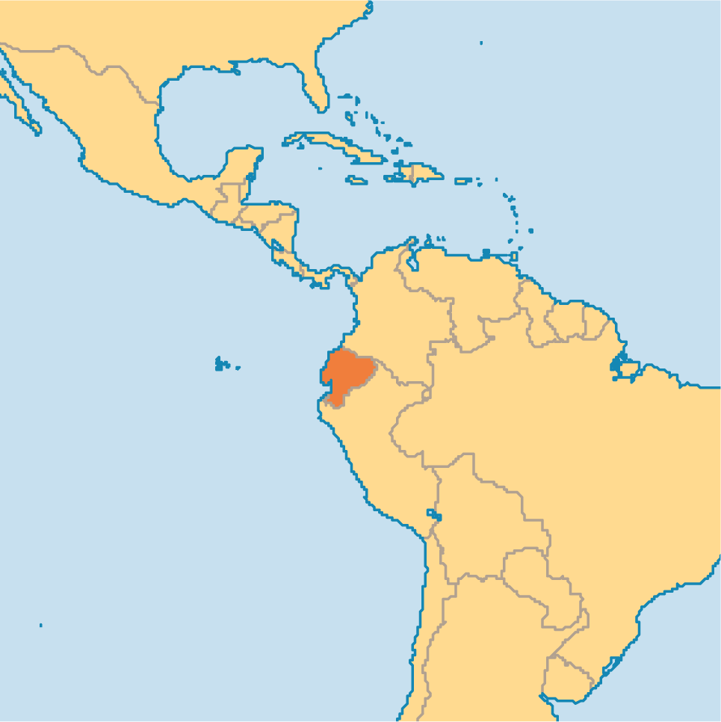

ISDS EXAMPLE #1:
THE HIGHEST REWARD SO FAR IS 3.2 BILLION $
GIVEN TO OCCIDENTAL OIL CO.
OCCIDENTAL SUED EQUADOR OVER EQUADOR’S TERMINATION OF AN OIL CONCESSION CONTRACT, EVEN THOUGH THE TERMINATION WAS APPARENTLY LEGAL.

Slide 17
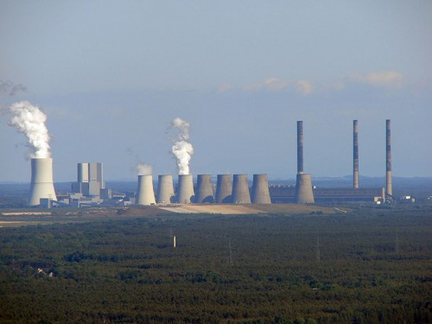
ISDS #2: NUCLEAR
IN 2012, VATTENFALL, A SWEDISH UTILITY OPERATING 2 NUCLEAR PLANTS IN GERMANY, SUED THE GERMAN FEDERAL GOVERNMENT, AFTER GERMANY DECIDED TO SHUT DOWN THEIR NUCLEAR POWER INDUSTRY, FOLLOWING FUKUSHIMA.
THIS IS STILL IN ARBITRATION.
VATTENFALL

Slide 18
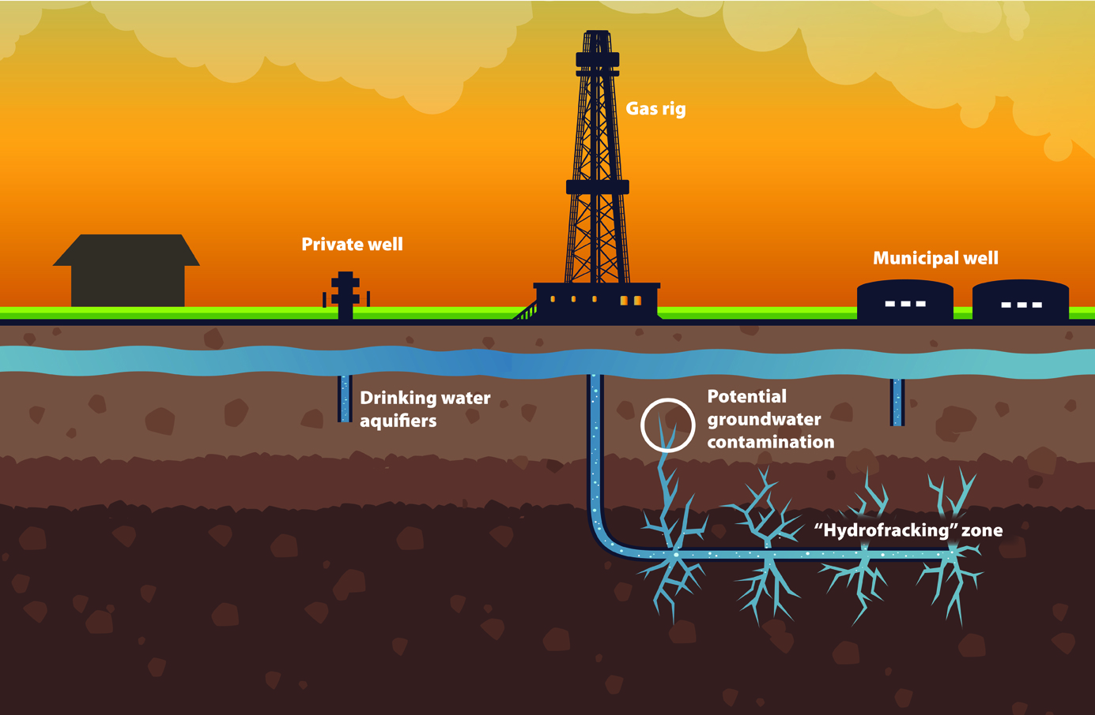
ISDS #3 FRACKING
IN 2013, U.S. MINING COMPANY, LONEPINE RESOURCES INC. SUED CANADA BECAUSE THE PROVINCE OF QUEBEC PUT A MORATORIUM ON FRACKING, DUE TO ENVIRONMENTAL CONCERNS.

Slide 19
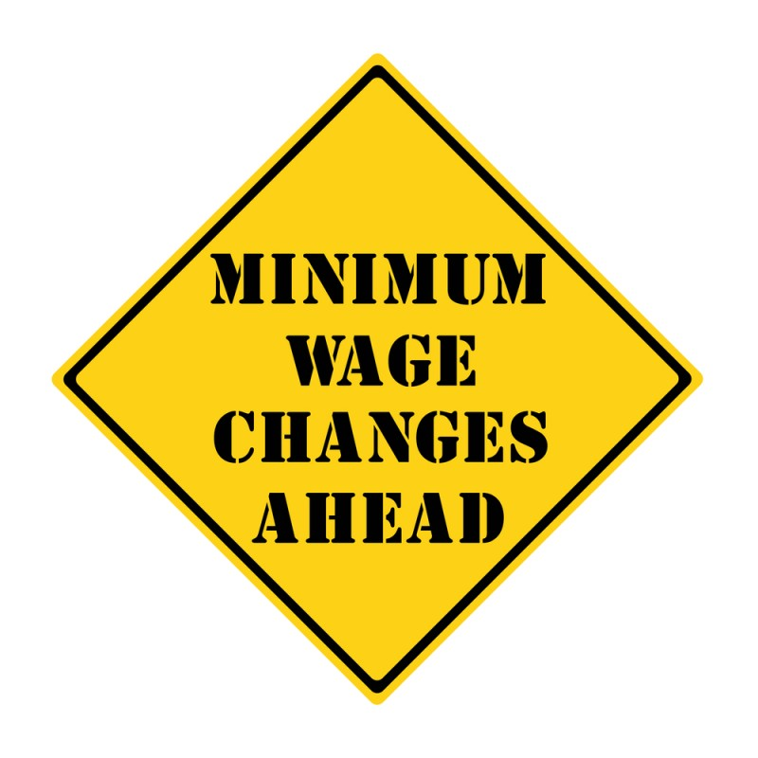
#4 ISDS EXAMPLE: MINIMUM WAGE
A FRENCH MULTI-NATIONAL, VEOLIA GROUP, IS SUING EGYPT, CONTESTING INCREASES IN EGYPT’S MINIMUM WAGE.

Slide 20
HOW DOES THE ISDS OPERATE?

Slide 21

A PANEL OF THREE JUDGES
THE JUDGES ARE CORPORATE ATTORNEYS.
PROCEEDINGS ARE SECRET.
THERE IS NO APPEAL.
THE JUDGES ONLY CONSIDER THE LOSS OF “EXPECTED FUTURE PROFITS”,
BUT NOT THE RIGHT TO
A CLEAN ENVIRONMENT,
FAIR LABOR STANDARDS,
HEALTH AND SAFETY OF POPULATION,
GENERAL WELFARE

Slide 22
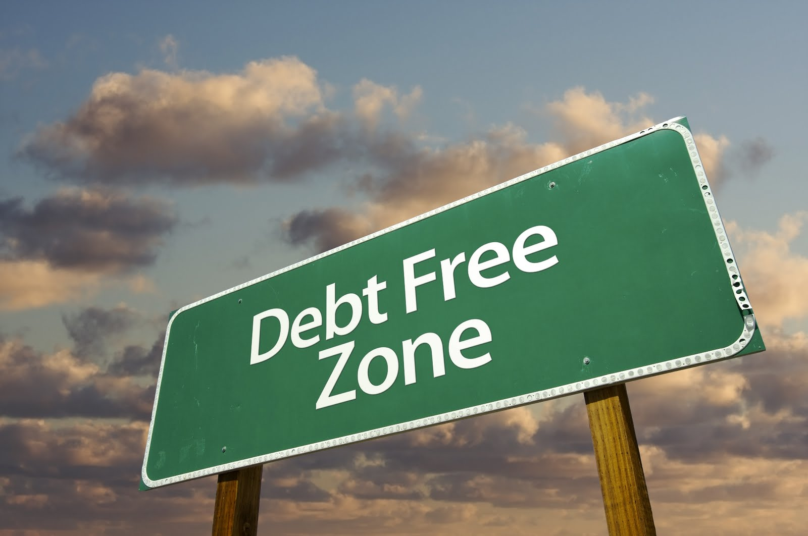
THE END

