Slide 1
Private Bank Debt-Money
& International Trade
Where does money come from?
What gives corporations their power?

Slide 2
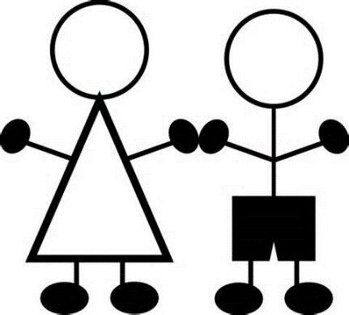

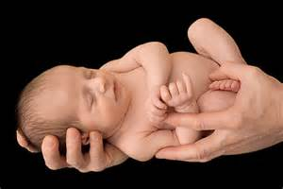
Where does our money come from?
Well, I earn mine from my job.
No, no. What I mean is, who creates the dollars? Where do the dollars get born?

Slide 3

Oh, that’s easy. Everybody knows our government creates the money.
The government spends too much,
my taxes are way too high,
and it’s all the government’s fault!
Uum…that’s interesting but doesn’t make sense.
What do you mean, doesn’t make sense?

Slide 4

Think of this.
If our government is the creator of our money,
why is our government 19 trillion dollars in debt?
Ah…. ah…. well….
I never thought about this!

Slide 5

LOOK ME STRAIGHT IN THE EYE….
Okay…..
REPEAT AFTER ME….
Okay…..

Slide 6

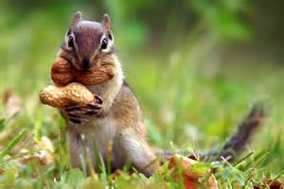
Our money is created by PRIVATE, COMMERCIAL BANKS,
whenever they create a loan or buy a stock or bond.
…our money is created … by PRIVATE, COMMERCIAL BANKS …
whenever they create a loan …. or buy a stock or bond.
Ah….not quite sure what this means …

Slide 7
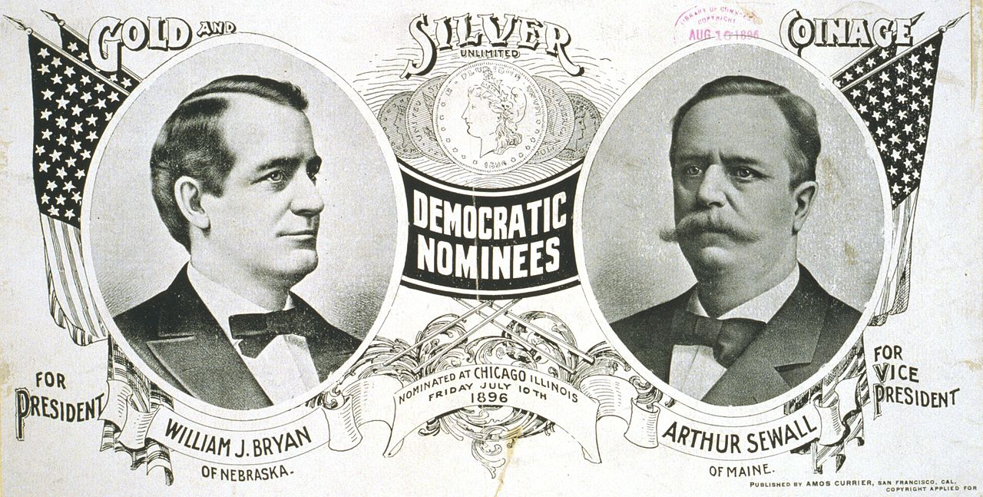
The History of Money Creation - Suppressed
By whom?
When?
Where?
Since 1930’s, the discussion of who creates our money has disappeared from public discourse

Slide 8

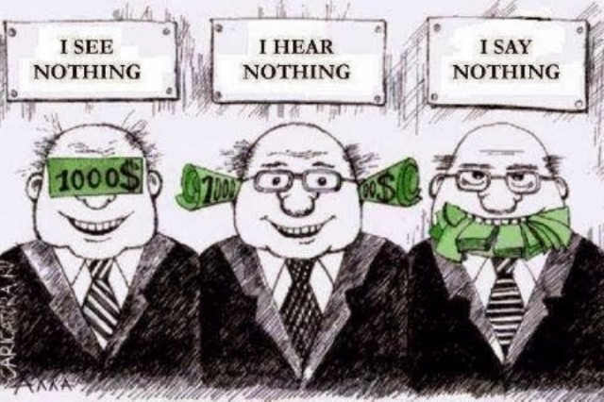

WHOEVER CONTROLS THE MONEY, CONTROLS THE SOCIETY…
EDUCATION GOVERNMENT PRESS

Slide 9
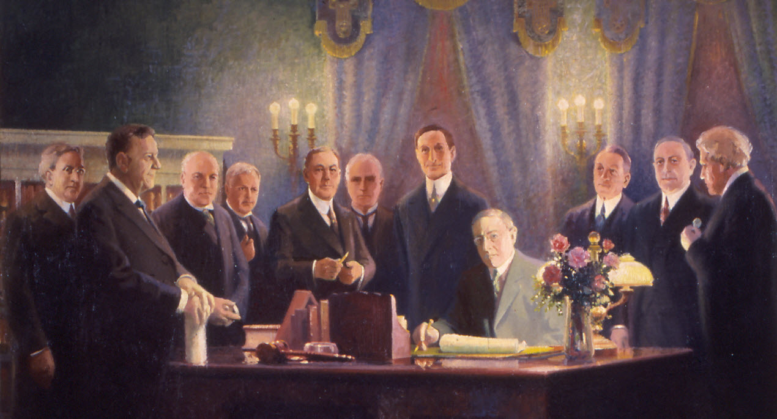
Federal Reserve Bill, 1913, created a private central bank system.
The member commercial banks were legally allowed to create money ‘out of thin air’.
We are led to believe the banks ‘lend’ money they already have.

Slide 10
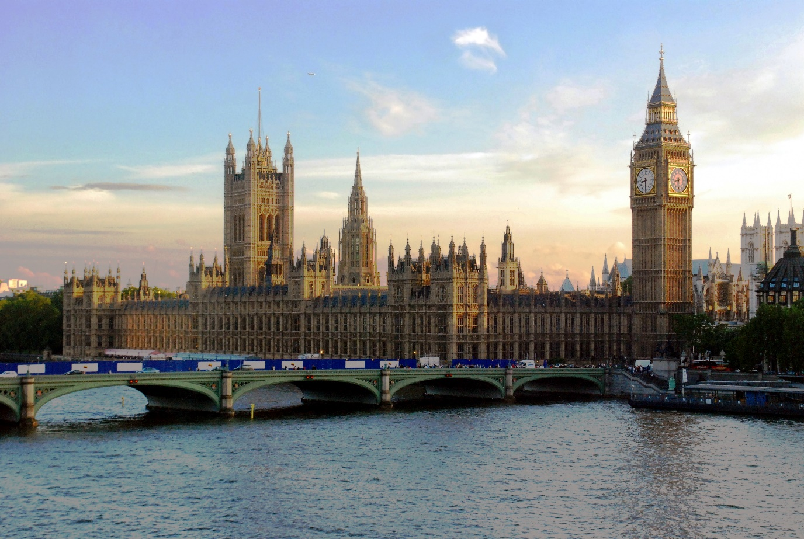
I don’t believe it… It’s too hard to believe.
You don’t have to believe me. Here… listen to a member of Parliament.

Slide 11
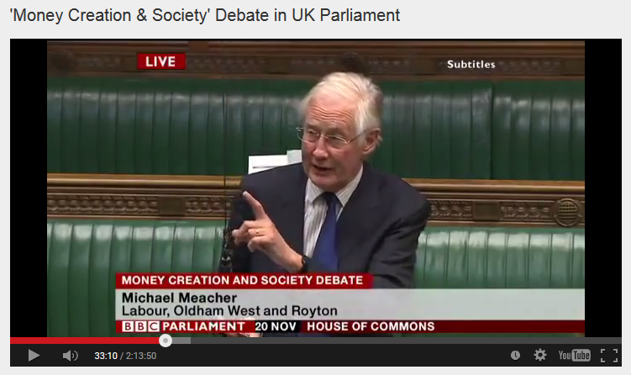

House of Commons, Nov. 20, 2014, Mr. Michael Meacher, MP:
“It is unfortunate… that it is so little understood by the public that money is created every time by the banks when they make loans.”
“And it is the banks – the banks – which determine how money is allocated across the economy.”

Slide 12
How does this hidden system work?

Slide 13

#1:
When a private commercial bank makes a loan, it CREATES MONEY.
The money supply GROWS.
When the loan is repaid, the MONEY DISAPPEARS.
The money supply SHRINKS.
What! This can't be!
Whoever heard of such a thing!

Slide 14
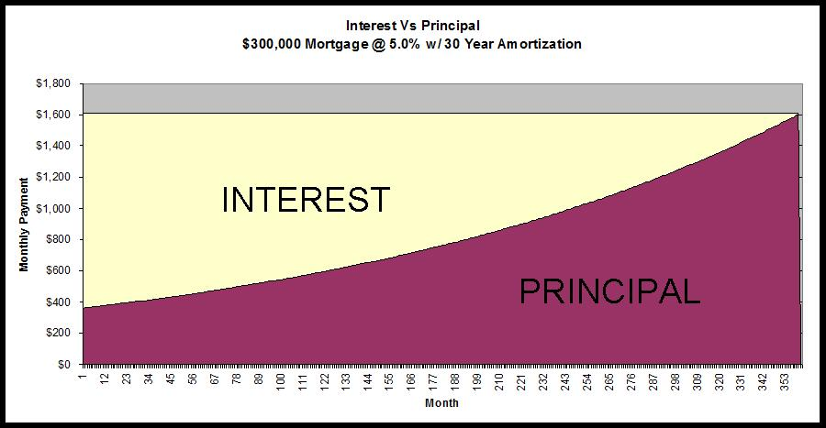
#2:
Of course, we know that every borrower must pay interest.
What is not known, is that banks NEVER CREATE THE MONEY FOR THE INTEREST. Only for the principal of the loan.
Oh, my goodness.
This is getting really confusing. Why not create the INTEREST?
NEVER CREATED➔

Slide 15
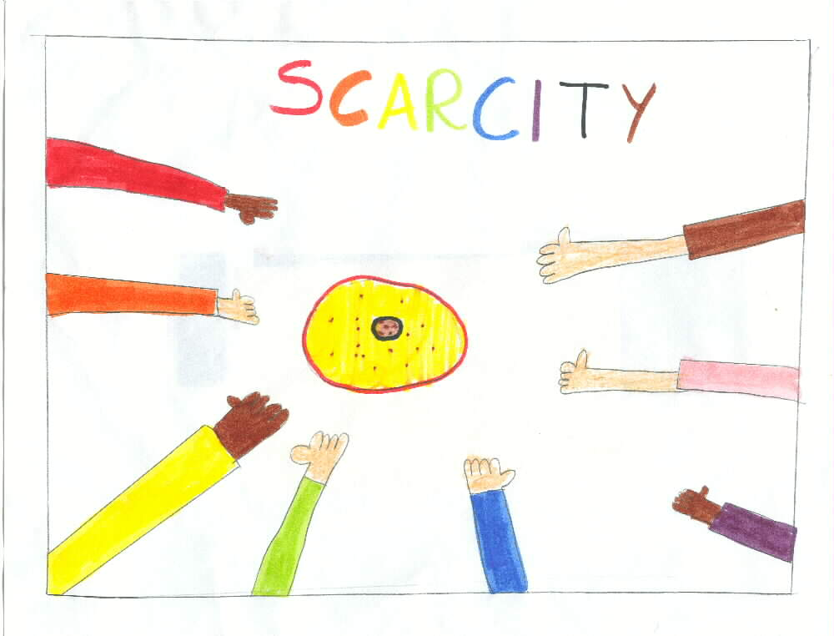
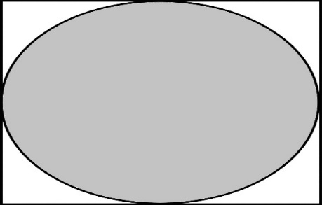
Since the money for interest is never created, money is always SCARCE. There is never enough money.....
NO INTEREST
PRINCIPAL ONLY

Slide 16
Day by day, loans are always being repaid, so the money supply is always shrinking. So, someone always must go into debt…to create money.
WHAT !!!!
NO INTEREST
PRINCIPAL ONLY

Slide 17
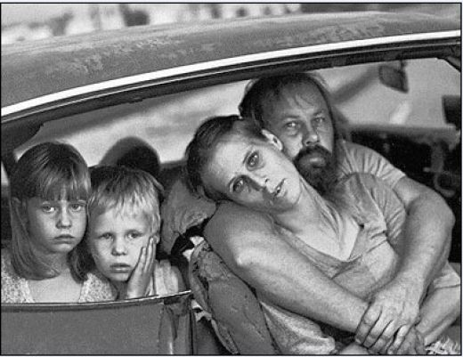
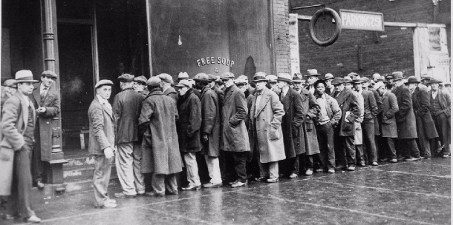
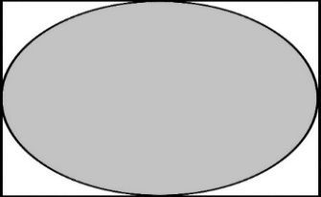
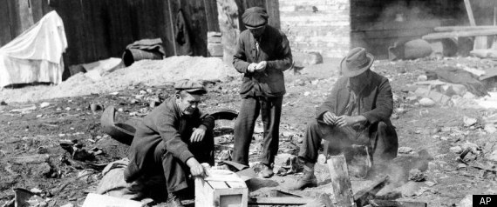
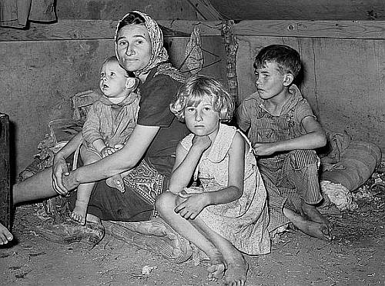
Thus, the system DEMANDS THAT MORE LOANS BE CREATED, else the money supply will shrink and there will be defaults, foreclosures, bankruptcies, unemployment, recessions, depressions, complete economic collapse.
DAMN!
NO INTEREST
PRINCIPAL ONLY

Slide 18




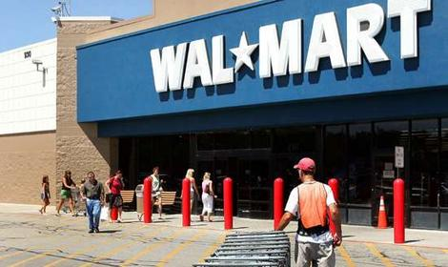
#3:
The banks decide the nature of our society,
because they decide who gets loans (debt-money).
AGRIBUSINESS
FOSSIL FUELS
WAR & WEAPONS
DEPARTMENT STORES &
GROCERY STORES

Slide 19
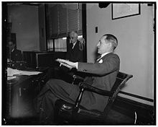

Mariner S. Eccles
Chairman, Federal Reserve
under President Franklin D. Roosevelt
“That is what our money system is.
If there were no debts in our money system,
there wouldn’t be any money.”

Slide 20
How does this system empower
multinational corporations to
dominate international trade?

Slide 21
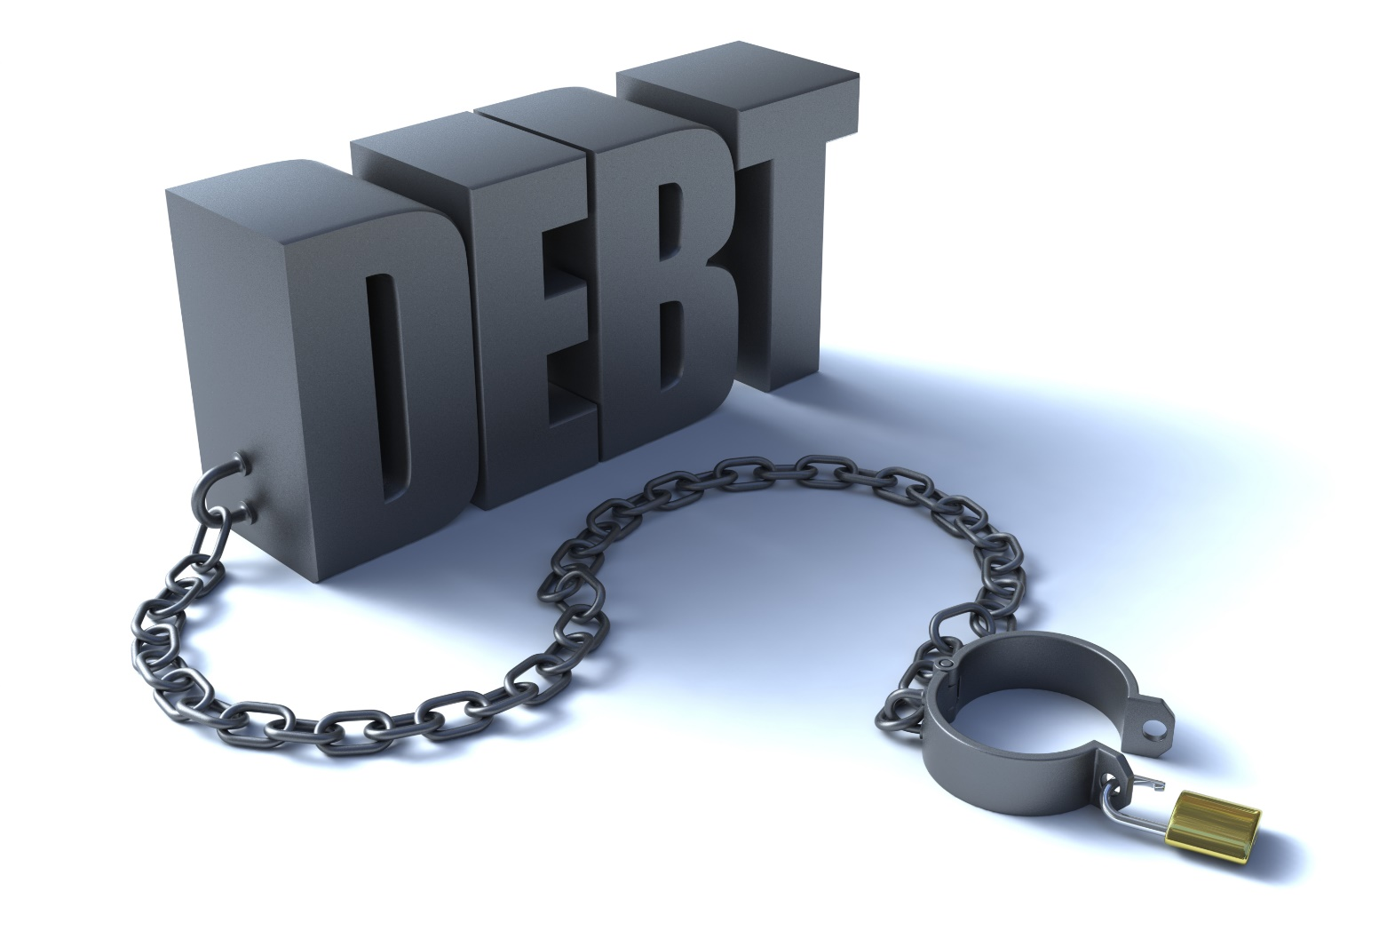
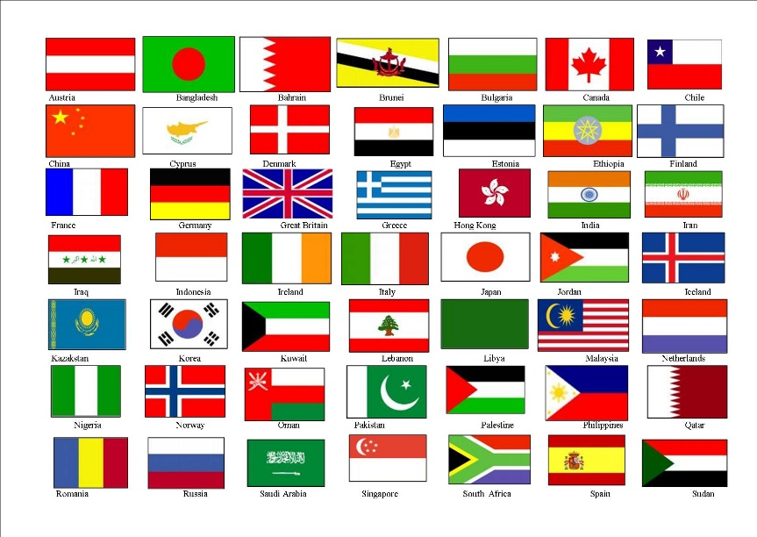
The BANK DEBT-MONEY system has spread to every country.

Slide 22

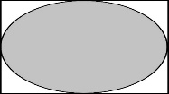


In each country, the DEBT-MONEY system causes:
#1
PRINCIPAL
SCARCE MONEY
#2
LACK OF PURCHASING POWER
#3
WAGE DEPENDENCY

Slide 23


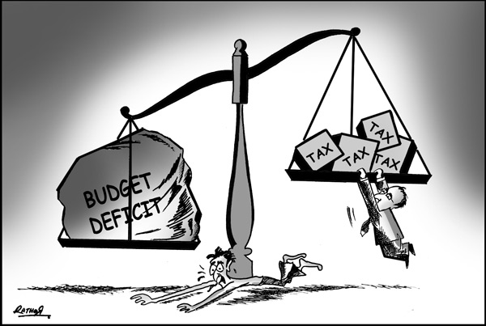
#1
SCARCE MONEY:
Money supply = DEBT.
It is constantly disappearing as the debt is paid down. Money is always SCARCE.
Consumers borrow
to buy
Industry borrows
to invest
Government borrows
to pay expenses

Slide 24
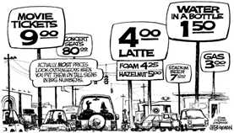



#2
LACK OF CONSUMER PURCHASING POWER
Because prices are elevated by business debt and
incomes are reduced by consumer debt,
business cannot sell all its products and services.

Slide 25




WAGE DEPENDENCY
A person with a 25 year mortgage, confronted with goods priced out
of his reach, and taxed to the eyeballs, will do anything to keep his job
and will do any job.
#3
I have to keep my job or I will be homeless and hungry.

Slide 26
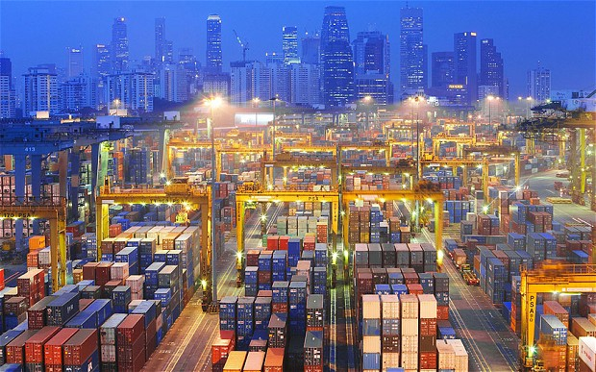
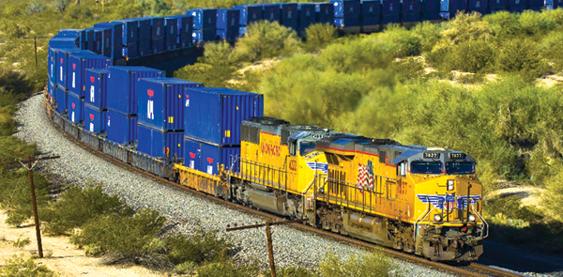
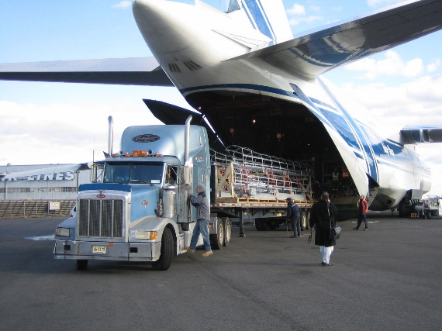

Business is FORCED TO EXPORT to sell all their goods.
ECONOMIC GROWTH IS FORCED BY THE MONEY SYSTEM.
That makes no sense! The same goods are
being sent back and forth across the world?
Yes.

Slide 27
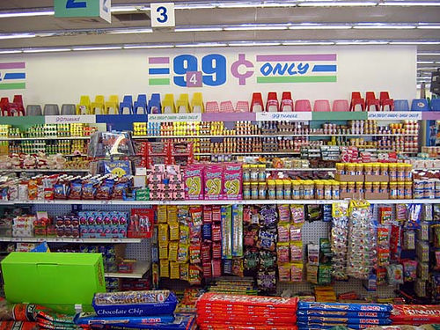

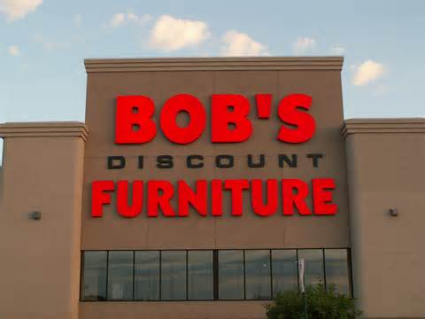

Because of their low disposable income,
consumers are FORCED TO BUY cheap, shoddy goods.
Advantage is given to low priced goods.
“If I had money, I would eat local,
organic foods. I just can’t afford it.”

Slide 28
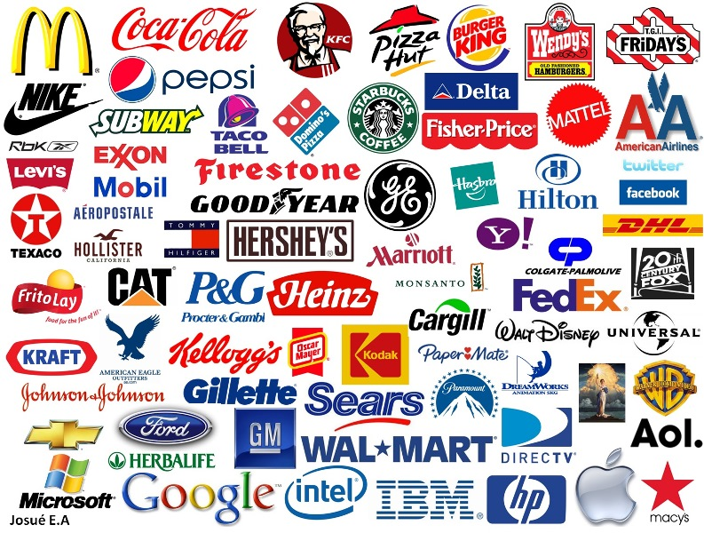

So, DEBT-MONEY grants unfair advantage to
multinationals, who can mass produce cheap goods,
bulk transport them, use the large wholesale & retail networks.
What?

Slide 29
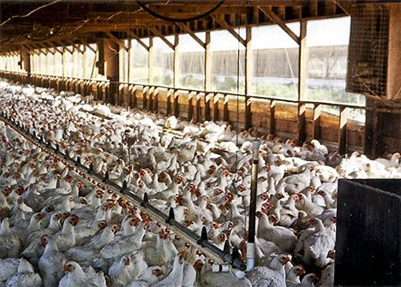
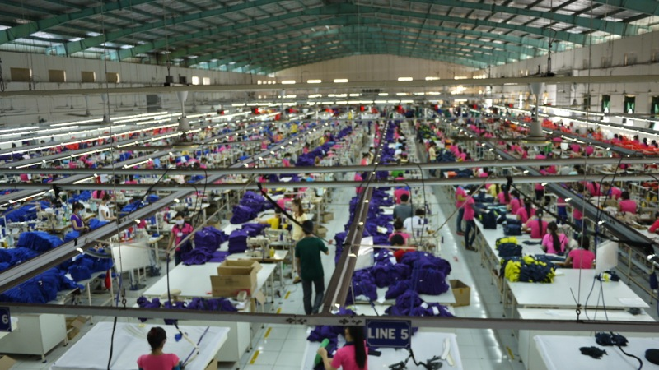
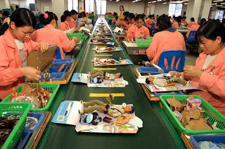
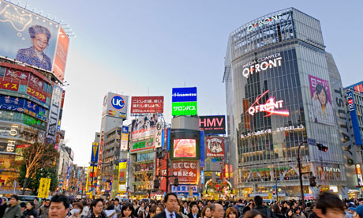
Because of their size, multinationals succeed in the fierce business competition created by DEBT-MONEY
This deadly competition forces multinationals
on a ceaseless search for new products, services,
and cheap labor. The goods have short lifespans and declining quality, but they keep people employed.
The deadly competition forces the use of market manipulation of human emotion via advertising.

Slide 30
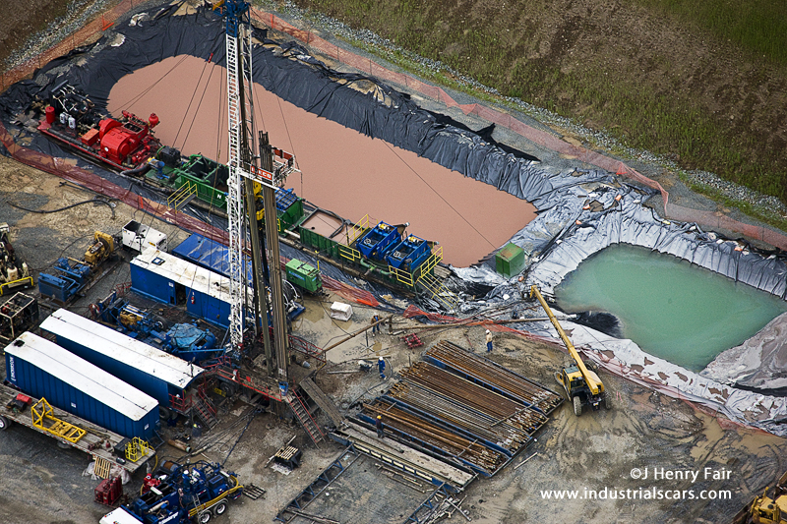
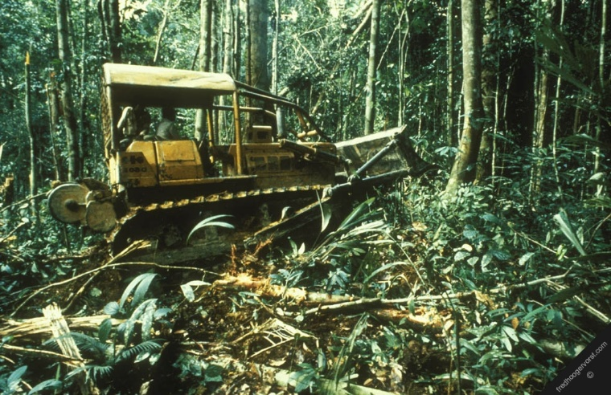
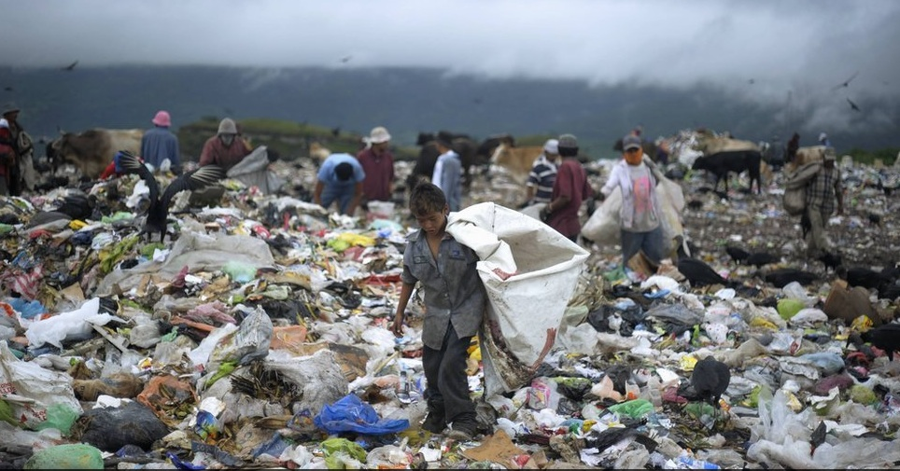
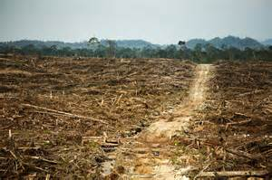
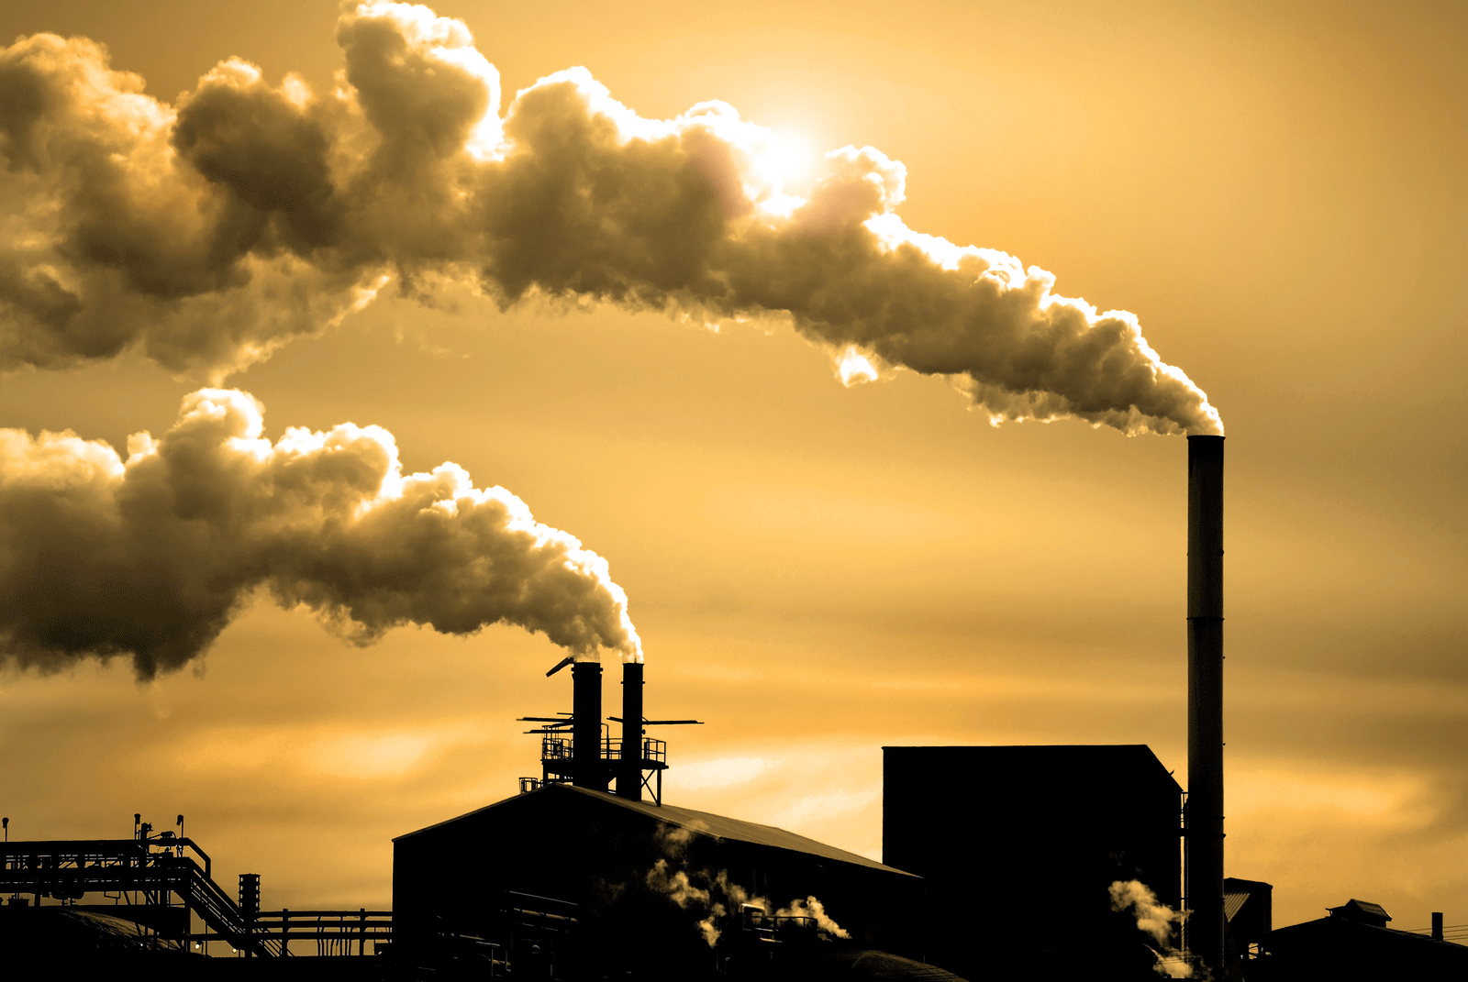
DEBT-MONEY’s forced growth wastes natural resources and human beings:
The multinationals' cheap products end up in landfills, are produced again & again,
each time wasting the earth’s resources, destroying the environment and people.

Slide 31
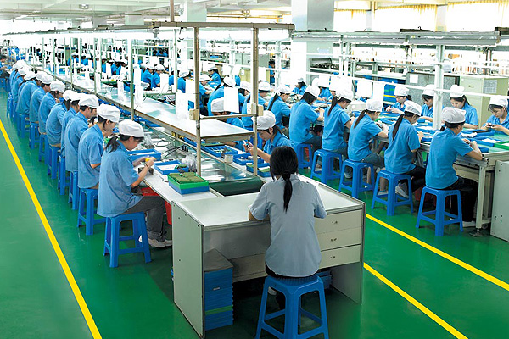
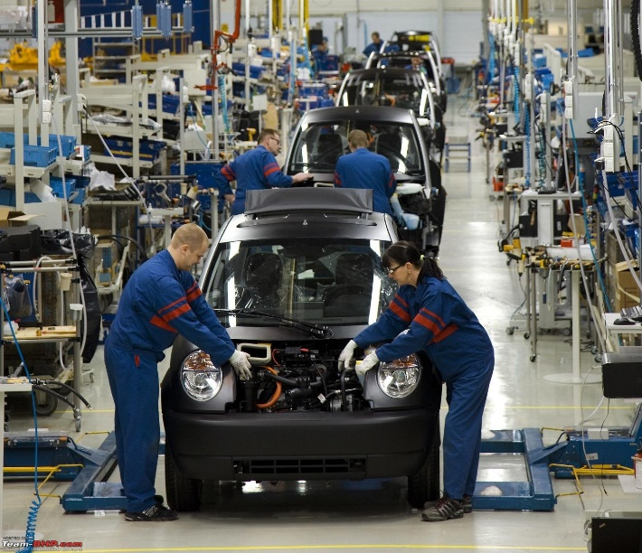

Creating cheap goods over and over again offers continuous employment.
If people’s houses were secure and their incomes adequate,
they would welcome a reduction in the need to work the long
hours currently demanded.

Slide 32
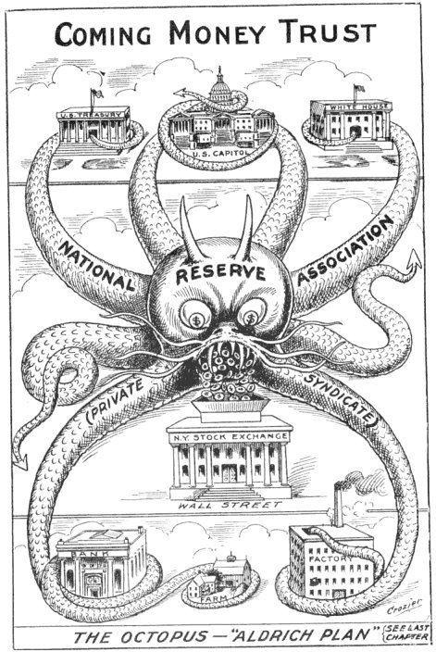
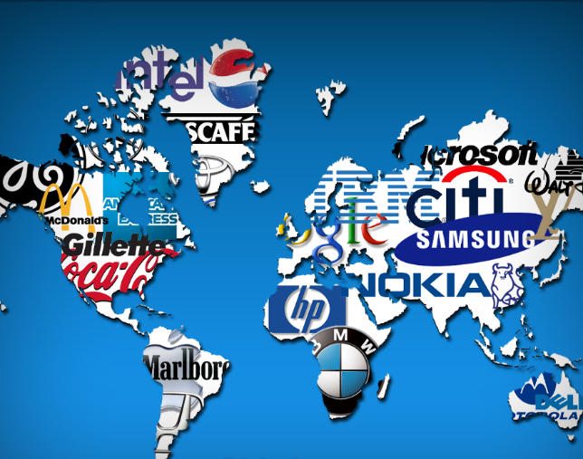
Multinationals are the ultimate creations of debt-money

