Slide 1
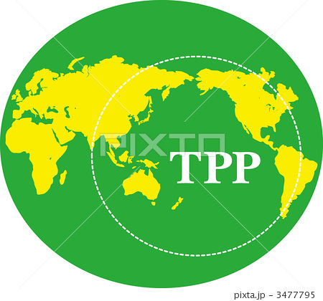
Corporate Dominance:
Our Debt-Money System and the Trans Pacific Partnership (TPP)
Session 3: Sat 03:15pm - 05:00pm in Room 1.101

Slide 2

WHAT IS THE TPP?

Slide 3
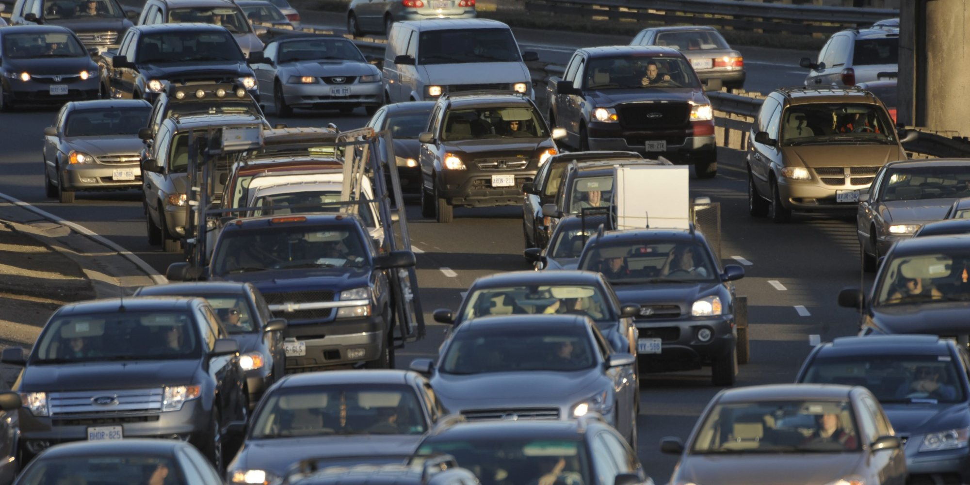
ISDS: EXAMPLE #2 ENVIRONMENT
Under NAFTA, Ethyl Corporation sought $251 million from Canada because Canada implemented a ban on the import and transport of a toxic gasoline additive, MMT.
Canada settled with Ethyl.
The terms required the Canadian government to pay Ethyl $13 million in damages and legal fees, to revoke the ban and to post advertising saying that MMT was safe.

Slide 4
WHAT ARE THE EFFECTS
OF THE DEBT-MONEY SYSTEM…
ON THE INTERNATIONAL ECONOMY?

Slide 5
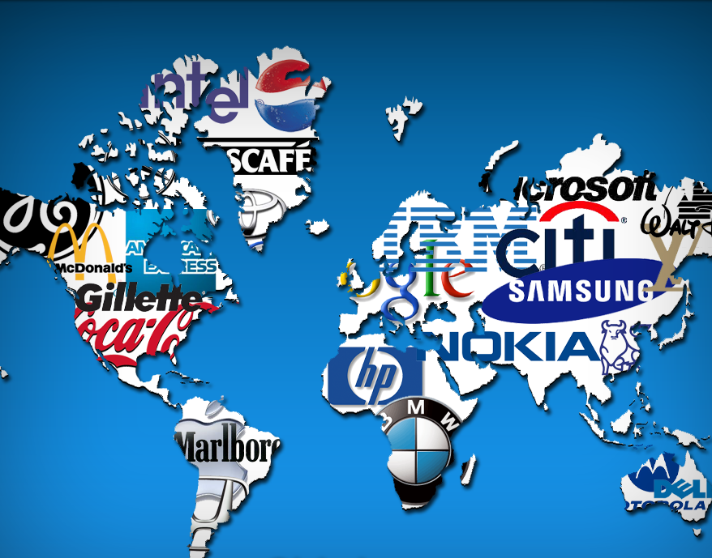
THE DEBT-MONEY SYSTEM FUELS THE GROWTH
OF MULTI-NATIONAL CORPORATIONS
In an economy riddled by debt, and with people lacking disposable income, low-price goods win over costlier good-quality products that last longer.
This spells success for mass production and big business.

Slide 6
THE DEBT-MONEY SYSTEM FUELS THE GROWTH
OF MULTI-NATIONAL CORPORATIONS
Multi-nationals are also in debt.
But they generally are able to obtain credit more easily and at lower rates of interest.

Slide 7
THE DEBT-MONEY SYSTEM FUELS THE GROWTH
OF MULTI-NATIONAL CORPORATIONS
Multinationals are the ultimate creations of debt-money: the culmination of the unfair advantage given to big business in a debt economy.
  mass production
  cost cutting
  employment shedding, outsourcing
  bulk transport
  extensive marketing
  constant change
  poor product quality and durability

Slide 8
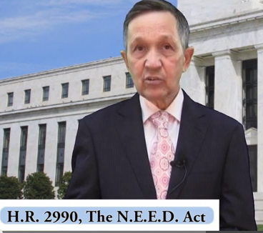
THE SOLUTION: DEBT-FREE MONEY
THE GOVERNMENT BUYS ALL THE SHARES IN THE FEDERAL RESERVE BANKS
THE BANKS CANNOT CREATE DEBT-MONEY. THEY MUST LEND ALREADY EXISTING DEPOSITS.
CONGRESS SPENDS THE DEBT-FREE GOVERNMENT MONEY ON PHYSICAL INFRASTRUCTURE, EDUCATION, HEALTH CARE. IN THE PROCESS, JOBS ARE CREATED.
DENNIS KUCINICH
THE NEED ACT 2011-2012

Slide 9


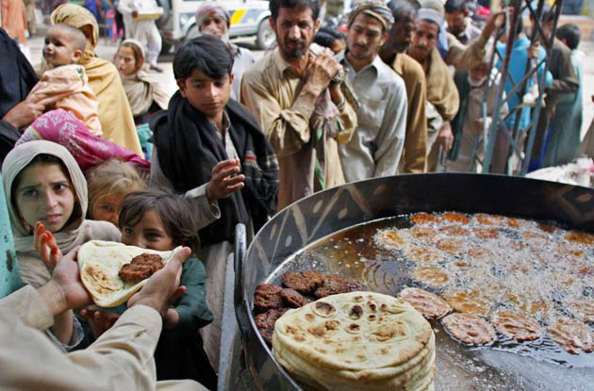
THE DEBT-MONEY SYSTEM DRIVES
RIGGED TRADE WORLD WIDE
1
Debt-money
is loaned to
poor nations
3
World Bank
sells bonds
Banks create
debt-money &
buy bonds
2
DEBT
Private Commercial Banks
in Rich Nations
Third World Nations

