Slide 1
PRIVATE POWER vs. PUBLIC RIGHTS
Why do Fracking and other Fossil Fuel Corporations
Have So Much Power?"

Slide 2
Overview
Goals
Explore historical roots of why large corporations in the energy industry have so much power to threaten our environment and our health
Understand how the money system empowers the owners of the fossil fuel economy
Uncover the hidden structures of the banking system that underpin the power of large corporations
Suggest some possible solutions to the underlying problems
Share some grass-roots actions that are challenging the power of the banking system to finance fossil fuel expansion and prevent alternative economies

Slide 3
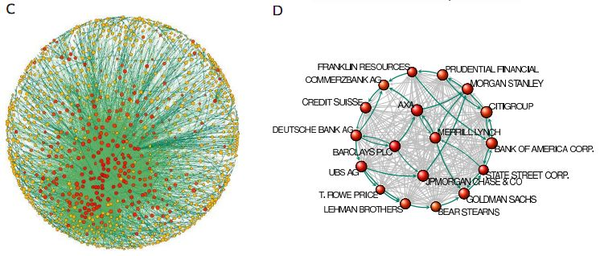
Graphic of Global Capitalist Network: Banks at the core
revealed--the-capitalist-network-that-runs-the-world.html

Slide 4
Is it any coincidence that banking licenses are central to the largest holdings dominating the world economy?
Is it any coincidence that banking licenses are central to the largest holdings dominating the world economy?
1300+ Transnational Corporations, with interlocking ownerships to thousands more, control 20% of the global economy
“They collectively own through their shares the majority of the world's large blue chip and manufacturing firms - the "real" economy - representing a further 60 per cent of global revenues.”
147 “super-entities” control even more
"In effect, less than 1 per cent of the companies were able to control 40 per cent of the entire network," says Glattfelder.
Most were financial institutions. The top 20 included Barclays Bank, JPMorgan Chase & Co, and The Goldman Sachs Group.
Source: http://www.newscientist.com/article/mg21228354.500-revealed--the-capitalist-network-that-runs-the-world.html

Slide 5
How do bank loans enable fossil fuels?
All corporations need bank credit to run their operations -- Fossil fuel corporations are no different
They actually use a small amount of shareholder money, as little as possible, and borrow the rest
They chase returns that beat the interest rate, this is a motive force for constant growth
Banks create money for them
A quick look at SEC filings of balance sheets reveals this dependency

Slide 6
How do bank loans enable fossil fuels: HALLIBURTON
Security and Exchange Act of 1934, FORM 10-K
HALLIBURTON COMPANY
Guarantee agreements. In the normal course of business, we have agreements with financial institutions under which approximately $1.9 billion of letters of credit, bank guarantees, or surety bonds were outstanding as of December 31, 2012, including $277 million of surety bonds related to Venezuela. p.33
The counterparties to our forward exchange contracts and interest rate swaps are global commercial and investment banks. p.47
U.S. $2,000,000,000 Five Year Revolving Credit Agreement among Halliburton, as Borrower, the Banks party thereto, and Citibank, N.A., as Agent (incorporated by reference to Exhibit 10.1 to Halliburton’s Form 8-K filed February 23, 2011, File No. 1-3492). p. 93
Underwriting Agreement, dated November 8, 2011, among Halliburton and Citigroup Global Markets Inc., Deutsche Bank Securities Inc., HSBC Securities (USA) Inc., RBS Securities Inc., Credit Suisse Securities (USA) LLC, Morgan Stanley & Co. LLC and the several other underwriters identified therein (incorporated by reference to Exhibit 1.1 to Halliburton’s Form 8-K filed November 14, 2011, File No. 1-3492). p.93

Slide 7
How do bank loans enable fossil fuels: PEABODY ENERGY
Security and Exchange Act of 1934, FORM 10-K
PEABODY ENERGY
Our available liquidity as of December 31, 2011 was $2.3 billion, which included cash and cash equivalents of $0.8 billion, $1.5 billion available for borrowing under the Revolver… p.51
The Macarthur Corporate Funding Facility has a $130.0 million Australian dollar sub-limit for bank guarantees, leaving an available capacity of $200.0 million Australian dollars at December 31, 2011. Letters of credit and cash-backed bank guarantees totaling $65.0 million Australian dollars were outstanding as of December 31, 2011. p.51
On October 28, 2011, the Company entered into the 2011 Term Loan Facility that provides for borrowings up to $1.0 billion. The Company borrowed $1.0 billion under the 2011 Term Loan Facility to finance, in part, the acquisition of Macarthur.
Indenture, dated as of March 19, 2004, between the Registrant and U.S. Bank National Association, as trustee (Incorporated by reference to Exhibit 4.12 of the Registrant's Quarterly Report on Form 10-Q for the quarter ended March 31, 2004).

