Slide 1
PANEL:
The Secret Pillars of Capitalism - Land Control and Debt-Money:
Two Systems That Enslave Us and How We Can Change Them
SUNDAY, JUNE 1
10:00am - 11:50am
(Room 9.68)
PART 4: BANK DEBT-MONEY AND HUDSON YARDS
LAND-MONEY STUDY GROUP

Slide 2
HUDSON YARDS …
#2
FUNDED (FINANCED)
BY THE PRIVATE DEBT-MONEY BANKING SYSTEM

Slide 3
OUR CITY BUDGET & DEBT
#2

Slide 4
FUNDING HUDSON YARDS
HOW DO THE WORKING PEOPLE OF NYC PAY FOR THEIR CITY AND ITS SERVICES?
DAILY OPERATIONS paid by TAXES
$69 BILLION IN 2013
SPENT ON, such things as:
general gov 91%
  education
  social services
  police, fire, etc.
  pension & fringe benefits
debt service 9%
(interest & principal on
outstanding debt)
------
100%
PAID BY:
taxes 63%
fed & state categorical grants 27%
Other non-tax 10%
-------
100%
WHAT IS THE ‘DEBT SERVICE’ THE PEOPLE ARE PAYING FOR OUT OF THEIR TAXES? ? ? ?

Slide 5
FUNDING HUDSON YARDS
HOW DO THE WORKING PEOPLE OF NYC PAY FOR THEIR CITY AND ITS SERVICES?
INFRASTRUCTURE BUILDING - - paid by BORROWING
2013-2016: $34.4 Billion
SPENT ON INFRASTRUCTURE FOR:
Education, Environmental Protection,
General Services, Health, Social Services,
Housing, Parks, Libs, Public Safety, Sanitation,
Transportation, etc.
PAID BY:
BOND BORROWING BY NYC
‘DEBT SERVICE’ is used to pay the interest on the OTHER BUDGET:

Slide 6
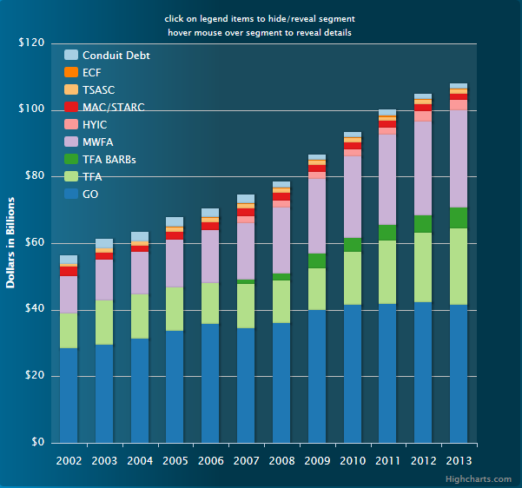
FUNDING HUDSON YARDS
2013: TOTAL OUTSTANDING BOND DEBT - $106 BILLION)
Total debt outstanding has grown - by 92 percent since 2002

Slide 7
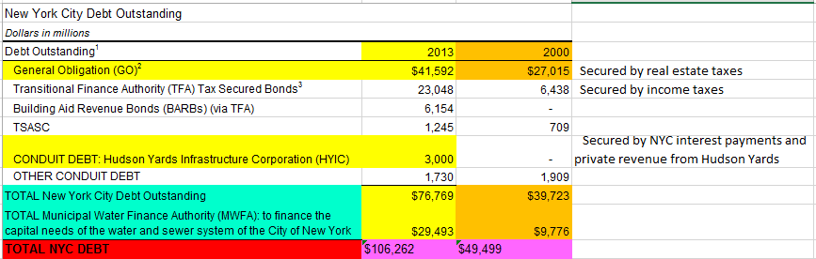
FUNDING HUDSON YARDS
2013: TOTAL OUTSTANDING BOND DEBT - $106 BILLION)

Slide 8
FUNDING HUDSON YARDS
2013: TOTAL OUTSTANDING BOND DEBT - $106 BILLION)
At the end of fiscal year 2011, New York City reached a milestone:
the amount of debt outstanding passed $100 billion.
Total debt outstanding has grown by 92 percent since 2002.
This means higher debt service costs -- projected to be 14 percent of tax revenues in 2015.
http://www.cbcny.org/sites/default/files/NYCDebt.html

Slide 9
FUNDING HUDSON YARDS
WHO BUYS THE CITY’S DEBT?
UNDERWRITERS
WHO ARE UNDERWRITERS?
Underwriters make profits from the difference
between the ‘buy’ and ‘sell’ price (THE SPREAD),
plus FEES.

Slide 10
FUNDING HUDSON YARDS
FEDERAL RESERVE MEMBER BANKS & UNDERWRITERS
of New York City General Obligation Bonds
(all banks are members of the NY Federal Reserve Bank, unless noted otherwise)
Senior Managers
Morgan Stanley
Bank of America (Richmond FED)
Merrill Lynch
J.P. Morgan Securities
Citigroup Global Markets Inc
Senior Co-Managers
Barclays Capital
Goldman, Sachs & Co.
PNC Capital Markets LLC (Cleveland FED)
RBC Capital Markets, LLC
(Royal Bank of Canada; not FED member)
Wells Fargo Securities, LLC (San Francisco FED)
Co-Managers
TD Securities (USA), LLC
Selling Group
BNY Mellon Capital Markets, LLC
Deutsche Bank Securities Inc.
HSBC Securities (USA) Inc.
U.S. Bancorp (Minneapolis Fed)

Slide 11
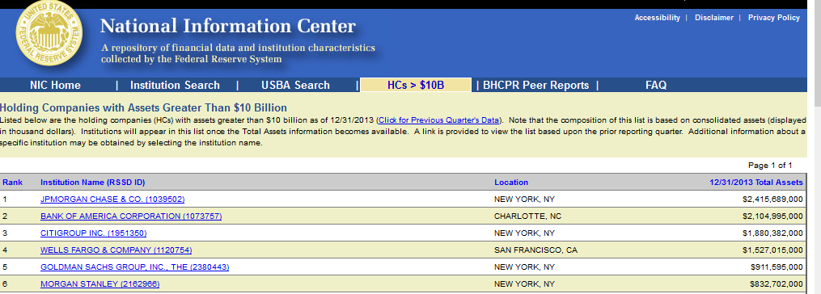
FUNDING HUDSON YARDS
THESE UNDERWRITERS ARE SOME
OF THE BIGGEST BANKS IN THE WORLD

Slide 12
NEW YORK CITY’S INFRASTRUCTURE:
HY FINANCING & DEBT
#3

Slide 13

FUNDING HUDSON YARDS
WHAT IS HYIC?
HUDSON YARDS INFRASTRUCTURE CORPORATION
http://nycbonds.org/HYIC/html/hyic_disclaimer.html

Slide 14
FUNDING HUDSON YARDS
HYIC
HUDSON YARDS INFRASTRUCTURE CORPORATION
“a local development corporation” created in 2005 by the NYC under the Not-For-Profit Corporation Law of NYS.
created to finance … acquisition and infrastructure work, including extension of the No. 7 subway line, HY public parks and boulevards…

Slide 15
FUNDING HUDSON YARDS
HYIC
HUDSON YARDS INFRASTRUCTURE CORPORATION
HYIC has been given the authority to issue bonds,
backed by these sources of revenue:
HY reduced property taxes for 19 years (PILOT PAYMENTS)
(TAXES that would have gone to the City)
HY mortgage recording tax
(TAXES that would have gone to the City)
interest payments from the City, until private revenue kicks in (see above)
paid from city tax revenues.

Slide 16
FUNDING HUDSON YARDS
HYIC
HUDSON YARDS INFRASTRUCTURE CORPORATION
The people of NYC are subsidizing the private real estate developers.
They pay less taxes into our operating budget.
We will end up paying more.

Slide 17
FUNDING HUDSON YARDS
WHAT ARE THE HYIC BONDS
THAT WILL PAY FOR THE CITY’S INFRASTRUCTURE IN HY?

Slide 18
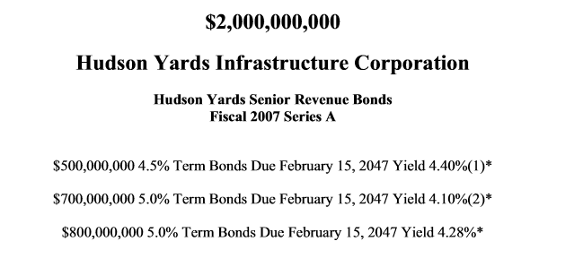
FUNDING HUDSON YARDS
WHO ARE THE UNDERWRITERS? ? ?

Slide 19
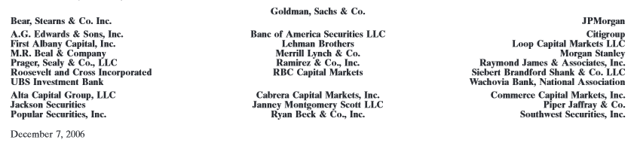
FUNDING HUDSON YARDS
UNDERWRITING BANKS

Slide 20
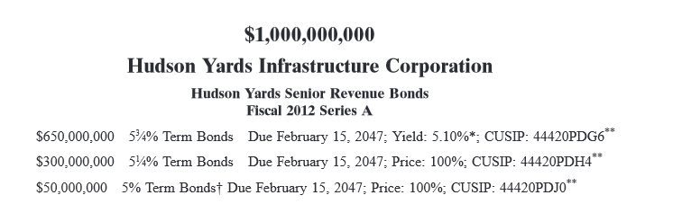
FUNDING HUDSON YARDS
WHO ARE THE UNDERWRITERS? ? ?

Slide 21
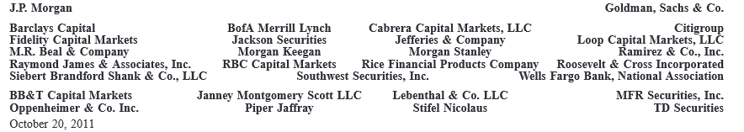
FUNDING HUDSON YARDS
UNDERWRITING BANKS

Slide 22
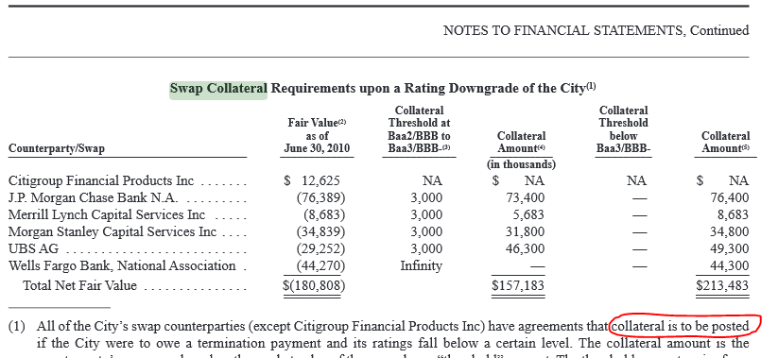
FUNDING HUDSON YARDS
THESE SAME UNDERWRITING BANKS ARE ALSO
IN DERIVATIVE DEALS WITH THE CITY OF NEW YORK

Slide 23
PRIVATE DEVELOPERS’ INFRASTRUCTURE:
HY FINANCING & DEBT
#4

Slide 24
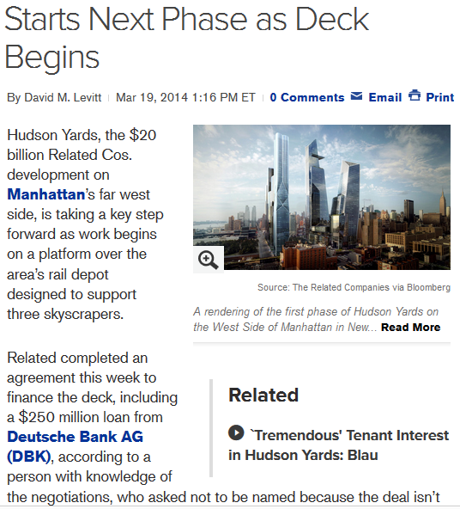
FUNDING HUDSON YARDS
HUDSON YARDS is a joint Related/Oxford venture.
The funding for the private developers is kept confidential, but several tentative loan agreements have come out in the public press.

Slide 25
FUNDING HUDSON YARDS
HUDSON YARDS is a joint Related/Oxford venture.
The funding for the private developers is kept confidential, but several loan agreements have come out in the public press.
“Related has a tentative commitment with Bank of America Corp. (BAC) and other lenders for about $400 million of financing on the $1.2 billion tower, said the person, who asked not to be identified because talks are private. The financing package should be completed by the end of the year, the person said.”

Slide 26
FUNDING HUDSON YARDS
HUDSON YARDS is a joint Related/Oxford venture.
The funding for the private developers is kept confidential, but several loan agreements have come out in the public press.
Starwood Property Trust said in a release that it “led the origination of $475 million” for the overall construction loan of the first phase of the project and that it will fund $350 million. The remainder will be contributed by Oxford and the United Brotherhood of Carpenters and Joiners.
Equity investors were advised by J.P. Morgan Asset Management, which is also providing $100 million.

Slide 27
FUNDING HUDSON YARDS
THE PRIVATE DEBT-MONEY BANKS
ARE ALSO BEHIND THE PRIVATE EQUITY MONEY
“Goldman, Starwood Near a Deal on Financing for Extended Stay
By Lingling Wei -- May 10, 2010
… Goldman Sachs Group Inc. is close to a deal to provide $2.2 billion in financing to a group led by Starwood Capital Group in its bid for hotel chain Extended Stay Inc …
The financing package … is a sign that big banks like Goldman are trying to flex their muscles in commercial real-estate lending as the market struggles to recover from its worst trough in decades.
About $1 billion of the money would come from Goldman's partner in the deal, Citigroup Inc., the people said.”

Slide 28
THE FEDERAL NEED ACT:
ALTERNATIVE
INTEREST-FREE
FINANCING
#5

Slide 29
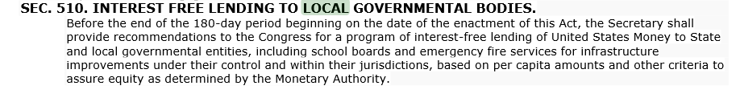
FUNDING HUDSON YARDS
NEED ACT
INTEREST FREE LENDING

Slide 30
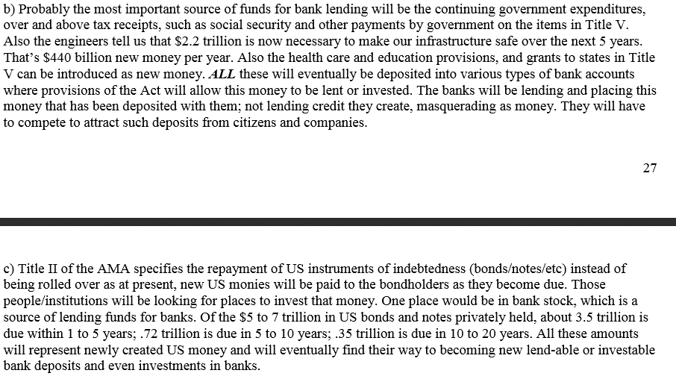
FUNDING HUDSON YARDS
NEED ACT
PRIVATE BANKS CANNOT CREATE MONEY –
ONLY LOAN EXISTING DEPOSITS

Slide 31
FUNDING HUDSON YARDS
NEED ACT
25% OF NEW FEDERAL MONEY WILL BE
GIVEN TO STATE GOVERNMENTS AS GRANTS
TO BE USED AS THE STATE SEES FIT

Slide 32
FUNDING HUDSON YARDS
THE END

