Slide 1
#2 EXAMPLE:
FUNDING NUCLEAR WEAPONS

Slide 2
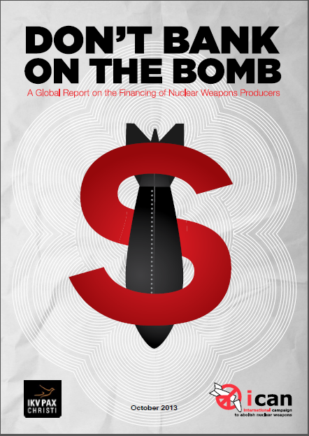
BY PAX CHRISTI,
DUTCH PEACE ORGANIZATION,
THE NETHERLANDS
2013

Slide 3
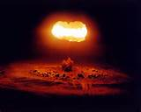
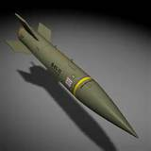
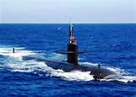
THE BANKS FINANCING AND INVESTING
IN NUCLEAR WEAPONS
ARE TIED TO THE FEDERAL RESERVE SYSTEM

Slide 4
Financial Institutions most heavily invested in nuclear weapon producers
North America
State Street invests USD 20,441.16 millions
2. Capital Group of Companies invests USD 19,490.53 millions
3. Blackrock invests USD 19,239.67 millions
Europe
Royal Bank of Scotland (United Kingdom) invests USD 5,635.70 millions
2. BNP Paribas (France) invests USD 5,366.37 millions
3. Deutsche Bank (Germany) invests USD 4,764.43 millions
Asia
Mitsubishi UFJ Financial (Japan) invests USD 4,033.90 millions
2. Life Insurance Corporation of India (India) invests USD 2.697.34 millions
3. Sumitomo Mitsui Banking (Japan) invests USD 1,462.80 millions
MEMBER – N.Y. FEDERAL RESERVE
MEMBER – N.Y. FEDERAL RESERVE
MEMBER – KANSAS CITY FEDERAL RESERVE
MEMBER – N.Y. FEDERAL RESERVE
MEMBER – S.F. FEDERAL RESERVE

Slide 5
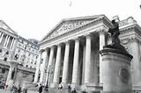
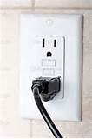

NOTICE THE POWER SUPPLY TO THE CORPORATIONS ---
N.Y. FED RESERVE
MEMBER BANKS
RAYTHEON CORPORATION
DEBT-MONEY LOANS
DO YOU NOTICE THAT CORD?
LOCKHEED MARTIN
EVERY CORPORATION REQUIRES
BANK LOANS TO EXIST.
BOEING
GENERAL DYNAMICS

Slide 6
THE FOLLOWING 3 BANKS
HAVE ALL GIVEN LOANS TO
AND INVESTED IN
NUCLEAR WEAPONS PRODUCERS

Slide 7
THE FOLLOWING 3 BANKS
ARE ALL OWNERS OF THE
NEW YORK FEDERAL RESERVE BANK

Slide 8
THE FOLLOWING 3 BANKS
ARE THE LARGEST OWNERS
OF FINANCIAL DERIVATIVES
IN THE WORLD

Slide 9
THE FOLLOWING 3 BANKS
WERE BAILED OUT BY THE
U.S. TAXPAYERS IN 2008

Slide 10
THE FOLLOWING 3 BANKS
ARE ALL CONSIDERED
TBTF – TOO BIG TO FAIL

Slide 11
J.P. MORGAN CHASE
MEMBER AND OWNER, NEW YORK FEDERAL RESERVE BANK

Slide 12
JP Morgan Chase
JP Morgan Chase currently has an estimated USD 11,880.22 million invested or available for the nuclear weapon producers identified in this report.
Loans
In October 2012, Boeing entered into a USD 4,600 million revolving credit facility.
The proceeds were used for refinancing bank debt and general corporate purposes.
JP Morgan Chase was one of … syndicate of four banks, providing an estimated amount of USD 1,380 million.553
In September 2011, Northrop Grumman secured a revolving credit facility with a value of USD 2,000 million
The proceeds were used for general corporate purposes.
JP Morgan Chase participated in the 11 bank syndicate, committing an estimated amount of USD 200 million.565
Investment banking
In November 2012, General Dynamics issued bonds with a total value of USD 2,400 million.
The proceeds were used for reduce indebtedness and general corporate purposes.
JP Morgan Chase participated in the 18 bank syndicate, underwriting an amount of USD 336 million.578

Slide 13
CITIBANK
MEMBER AND OWNER, NEW YORK FEDERAL RESERVE BANK

Slide 14
Citi
Citi currently has an estimated USD 8,145.40 million
invested or available for the nuclear weapon producers
identified in this report.
Loans
In December 2010, BAE Systems secured a five-year revolving credit facility with a value of £ 2,000 million (USD 3,161 million).
The proceeds were used for refinancing and general corporate purposes.
Citi was part of the 24 bank syndicate,
committing an estimated amount of USD 132 million.265
In June 2013, Bechtel signed a five-year revolving credit facility with a value of USD 3,000 million.
The proceeds would be used for refinancing and general corporate purposes.
Citi was one of … syndicate of eight banks, and committed an estimated amount of USD 300 million.268
In November 2011, Boeing entered into a USD 4,600 million revolving credit facility.
The proceeds were used for refinancing bank debt and general corporate purposes.
Citi was one of … syndicate of 35 banks, providing an estimated amount of
USD 920 million.270

Slide 15
GOLDMAN SACHS
MEMBER AND OWNER, NEW YORK FEDERAL RESERVE BANK

Slide 16
GOLDMAN SACHS
Goldman Sachs currently has an estimated USD 6,570.93 million
invested or available for the nuclear weapon producers
identified in this report.
Loans
In December 2010, BAE Systems secured a five-year revolving credit facility with a value of £ 2,000 million (USD 3,161 million).
The proceeds were used for refinancing and general corporate purposes.
Goldman Sachs was part of the 24 bank syndicate, committing an estimated amount of USD 132 million.438
In November 2011, Boeing entered into a USD 4,600 million revolving credit facility.
The proceeds were used for refinancing bank debt and general corporate purposes.
Goldman Sachs participated in the syndicate of 35 banks, providing an estimated amount of USD
83.6 million.441
Investment banking
In April 2013, EADS issued new shares, raising € 2,261.2 million (USD 2,946.9 million).
Goldman Sachs participated in the syndicate of two banks,
underwriting an estimated amount of USD 1,473.5 million.453

