Slide 1
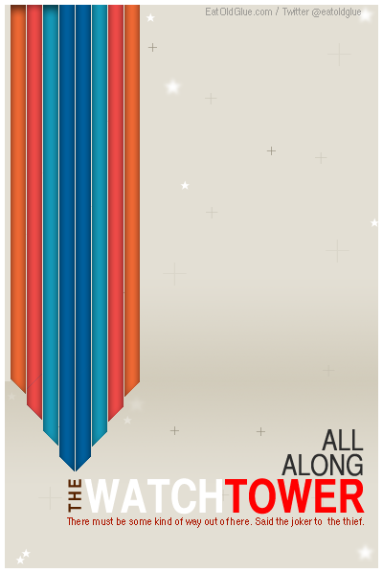
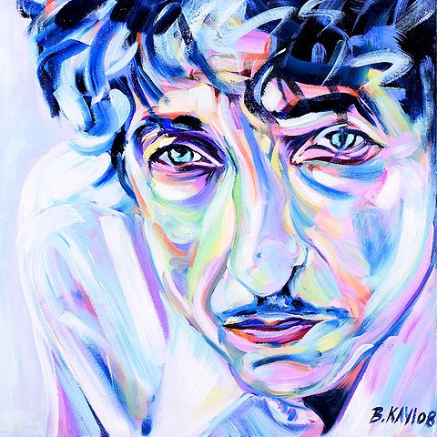
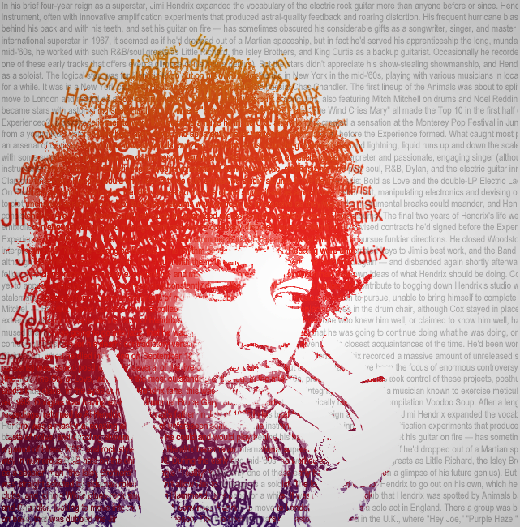
All Along the Watchtower

Slide 2

The Core of Today's Broken Capitalism:
Privatized Debt-Money of the Banks
Follow on @stoptheinterest

Slide 3
Money Is?

Slide 4
Money $$$
Aristotle (384 BC-322BC)
“it exists not by nature, but by law”

Slide 5
Forms Of Money
Gold is the money of kings
Silver is the money of gentlemen
Barter is the money of peasants, but
Debt is the money of slaves. -Norm Franz
Money and Wealth in the New Millennium (2001).

Slide 6
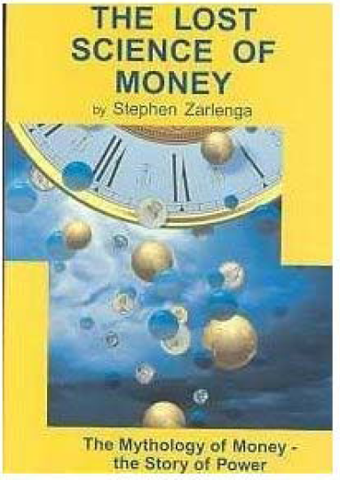

Slide 7
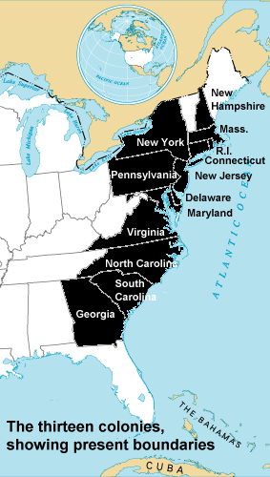
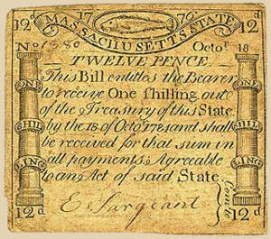
Colonial Scrip

Slide 8
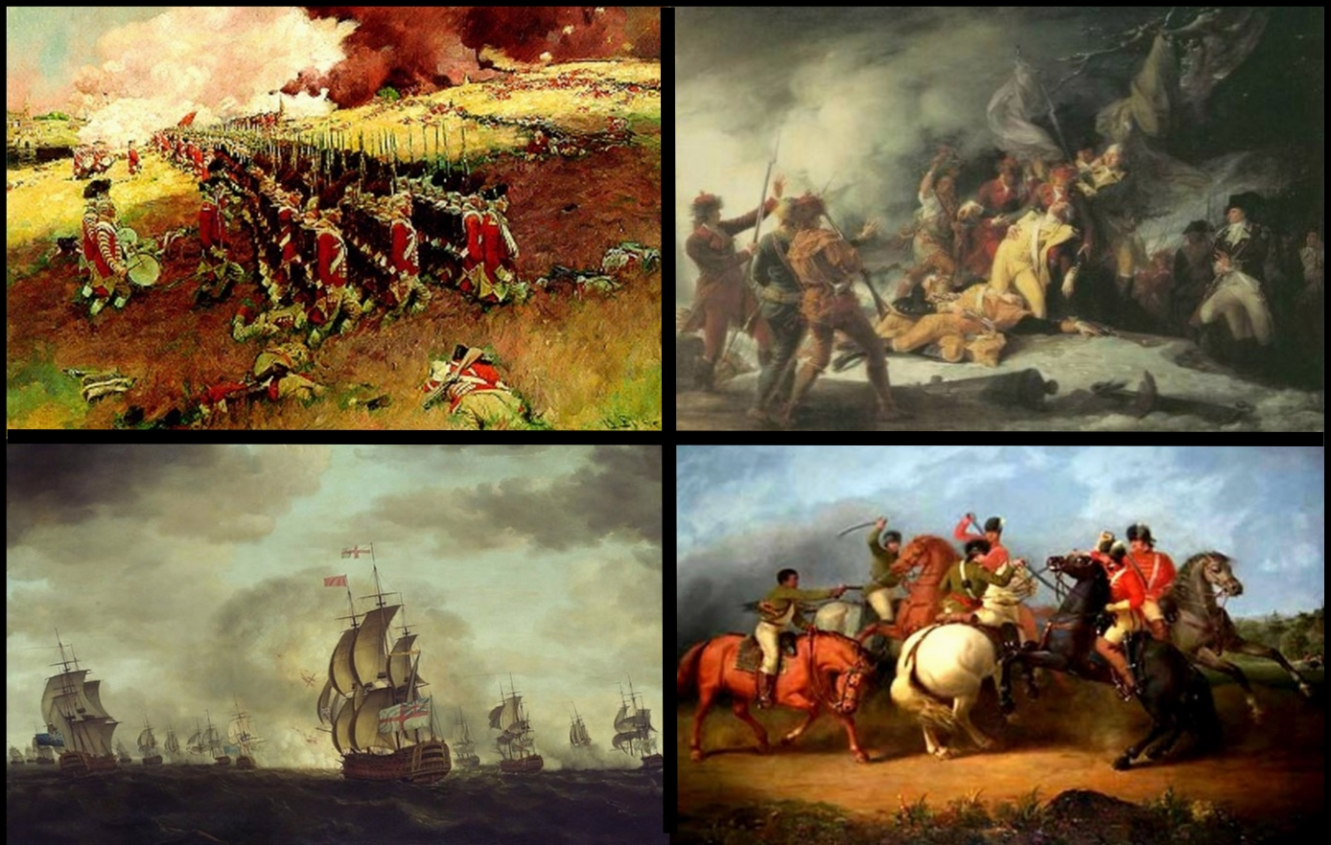
Independence

Slide 9
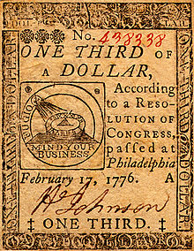
Continental Currency

Slide 10
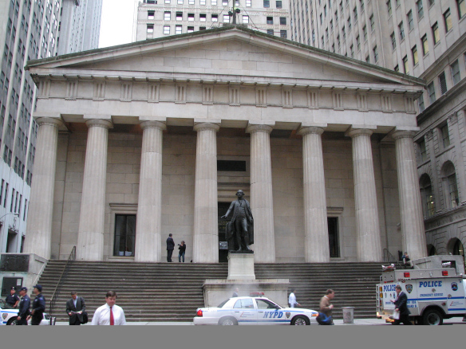
1775

Slide 11
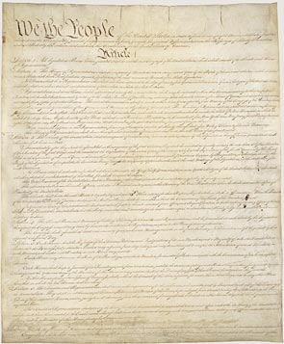
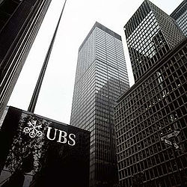
PUBLIC CONTROL VS.
PRIVATE CONTROL
The Congress shall have power to coin money
Let Us Have The Power

Slide 12
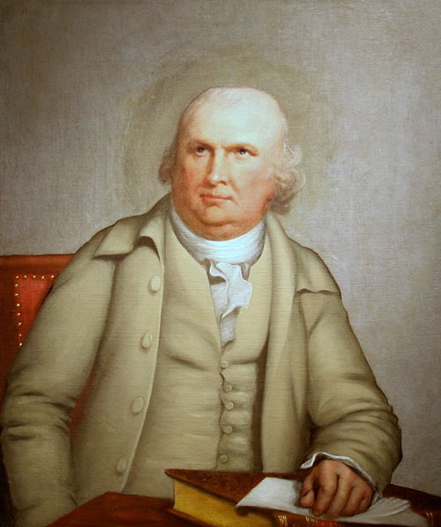
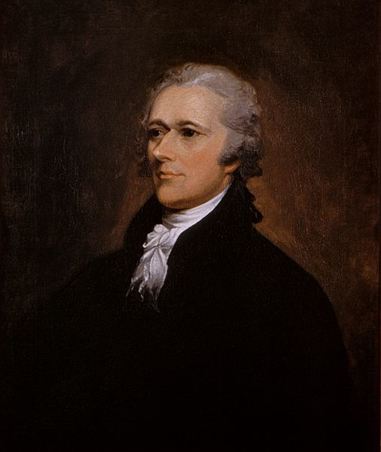

Slide 13
Hamilton Cooks The Books
Every loan a bank makes, is a credit to the borrower on its books, the amount of which it stands ready to pay in gold or silver, but in a great number of cases no actual payment is made in either.
The borrower by a check frequently transfers his credit to some other person.

Slide 14
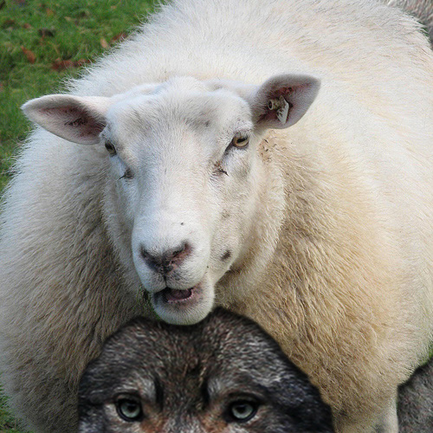

Slide 15
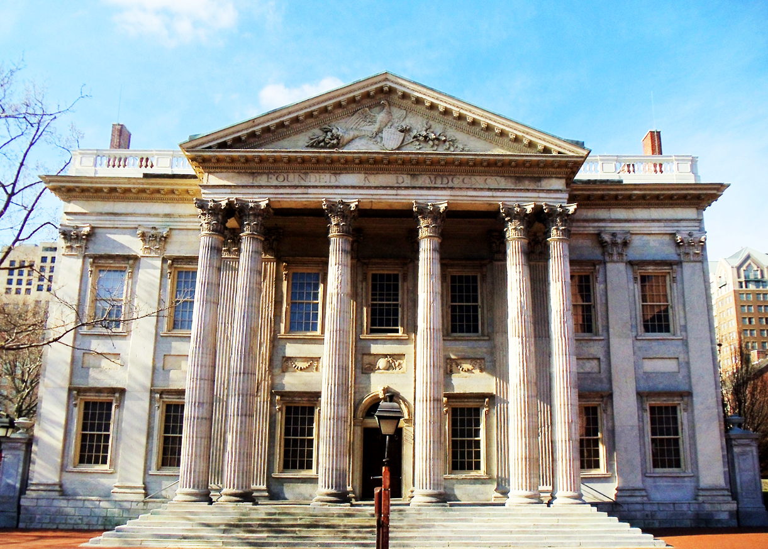
First Bank of the United States 1791

Slide 16
If we run into such debts… as the people of England are, our people, like them, must come to labor sixteen hours in the twenty-four, give the earnings of fifteen of these to the government for their debts and daily expenses; and
the sixteenth being insufficient to afford us bread, we must live, as they now do, on oatmeal and potatoes; have no time to think, no means of calling the mismanagers to account; but be glad to obtain subsistence by hiring ourselves out to rivet their chains on the necks of our fellow-sufferers.[ 124]
Still, Bill (2012-04-23). No More National Debt (Kindle Locations 3326-3328). Reinhardt & Still Publishers. Kindle Edition.
.

Slide 17
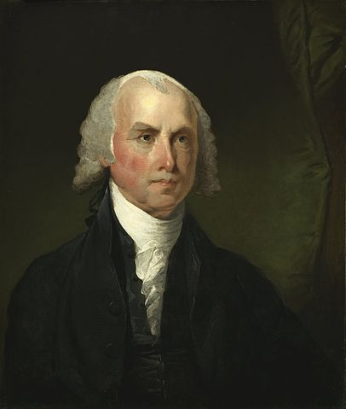

Slide 18
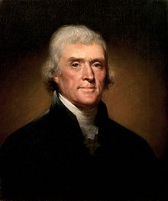
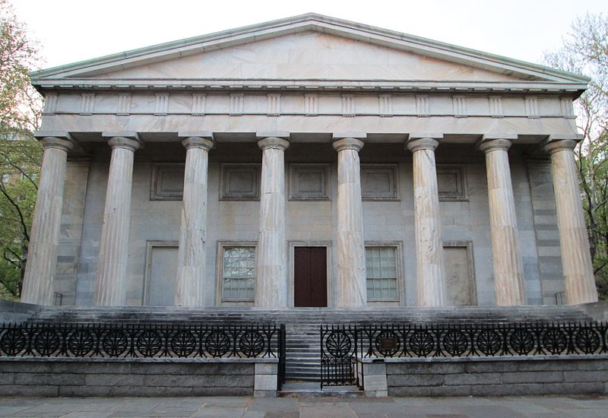
Thomas Jefferson Votes No on The Second Bank
*
.

Slide 19
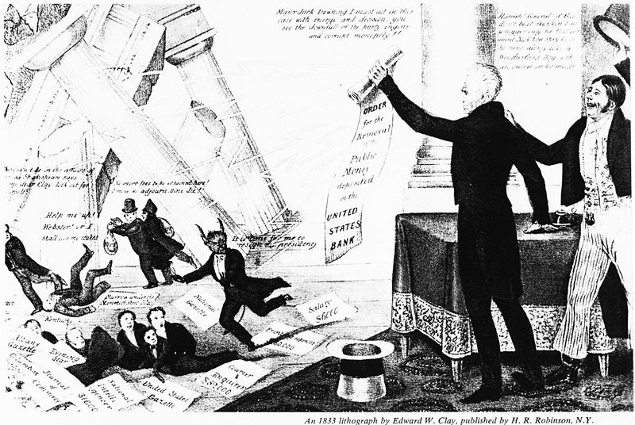

Slide 20
Jackson explained the ongoing battle for the hearts and minds – and votes – of Congress. I have no hesitation to say if they can re-charter the bank, with this hydra of corruption they will rule the nation and its charter will be perpetual and its corrupting influence destroy the liberty of our country. When I came into this administration… I had a majority of 75. Since then it is now believed it has bought [votes in Congress] by loans, discounts, etc. until… there were 2/ 3 for re-chartering it.[ 134]
Still, Bill (2012-04-23). No More National Debt (Kindle Locations 3431-3437). Reinhardt & Still Publishers. Kindle Edition.

Slide 21
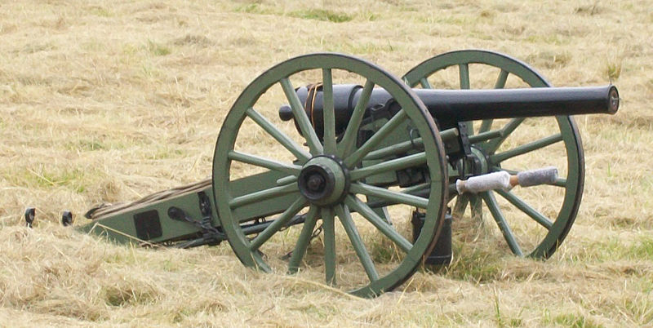

Slide 22
Supreme Court Confirms Greenbacks
Legal Tender
Knox v. Lee, 79 U.S. 457 (1871),
Greenback as legal tender did not conflict with Article One of the United States Constitution.
Constitution Article 1 Section 8
To coin [make] Money, regulate the value thereof, and of foreign Coin, and fix the Standard of Weights and Measures

Slide 23
Panic of 1907 – Woodrow Wilson
All this trouble (the 1907 depression) could be averted if we appointed a committee of six or seven public-spirited men like J.P. Morgan to handle the affairs of our country.
— a man who would soon be his financial benefactor as well.
Still, Bill (2012-04-23). No More National Debt (Kindle Locations 4920-4933). Reinhardt & Still Publishers. Kindle Edition.

Slide 24
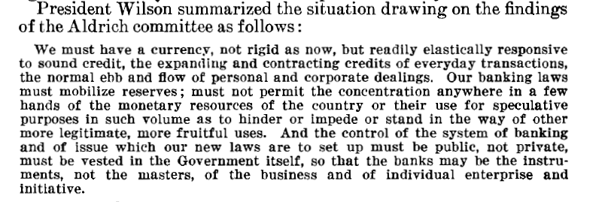
Woodrow Wilson

Slide 25
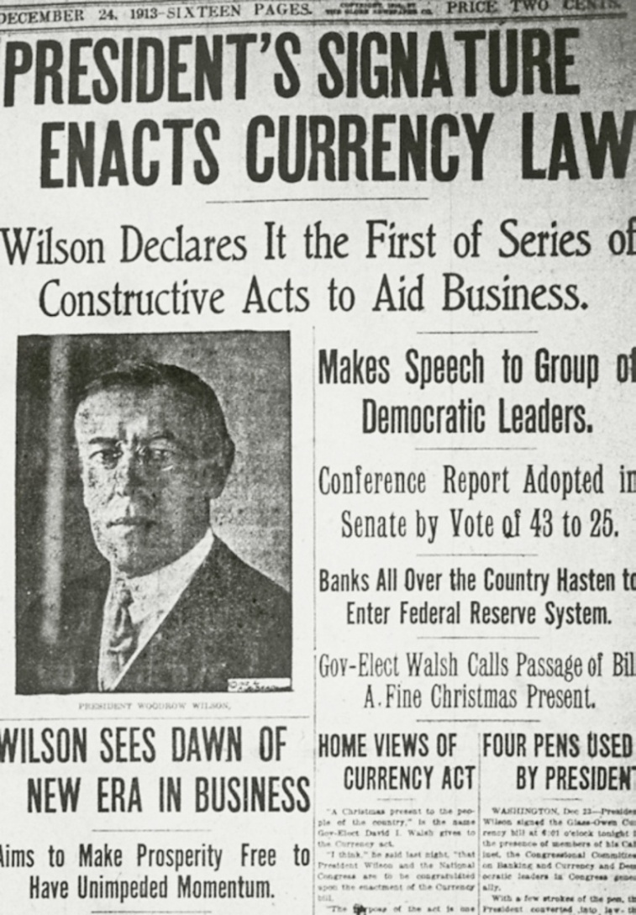
Christmas Present To Private Bankers

Slide 26
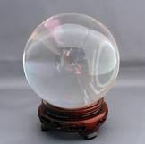
Consequences - Jefferson’s
The real economy: farmers, producers, small businesses have to suffer with oppressive interest costs, while the financial community is flush
The government borrows at an interest, when it could issue money interest free
Economic downturns are far worse
Inflation: money buys less, steals wealth - trickle up transfer
Mutated Capitalism -Broken & Debt Addicted

Slide 27
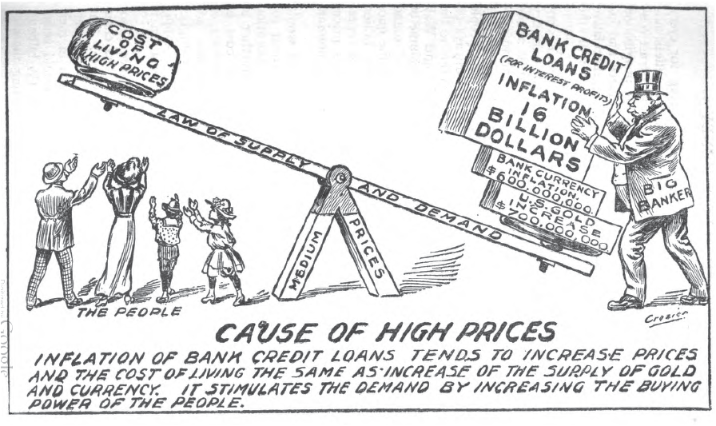
U.S. Money vs. Corporation Currency, “Aldrich plan.” 1912 Alfred Owen Crozier

Slide 28
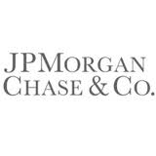
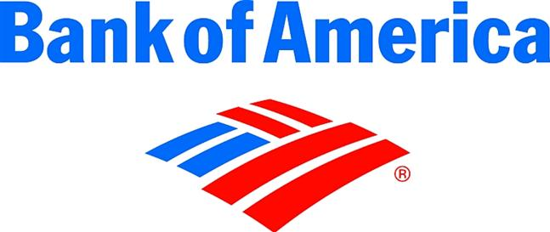
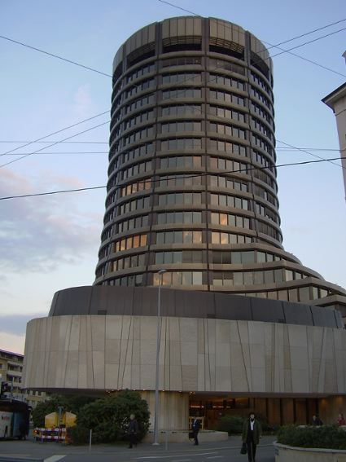
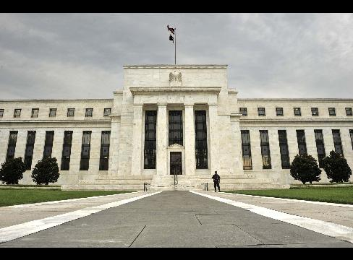
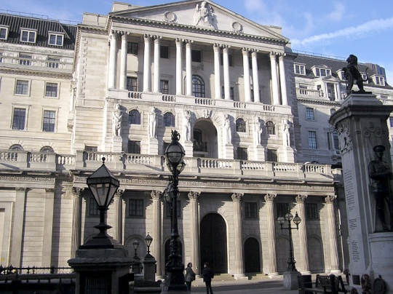
Banks

Slide 29
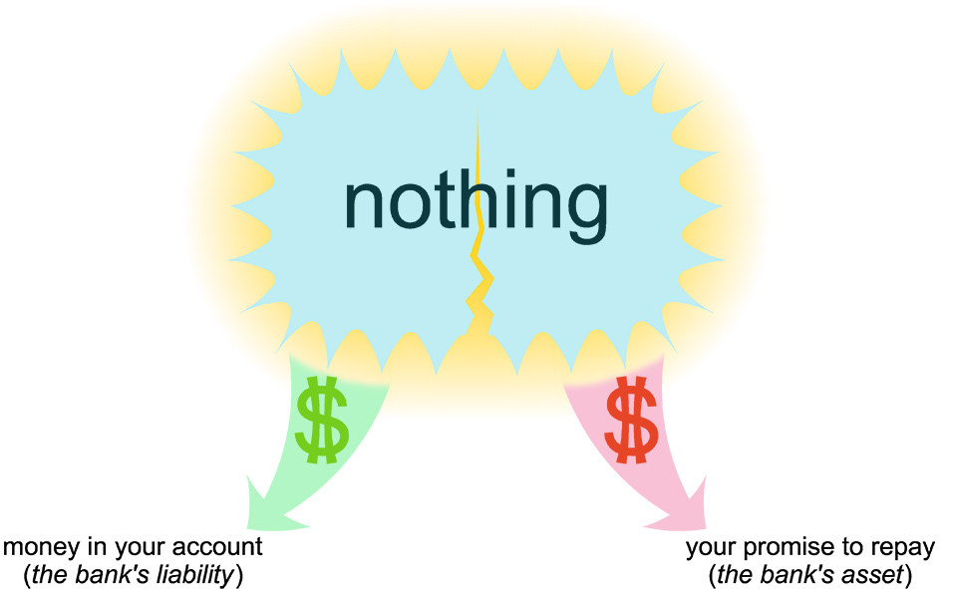
http://choosethefuture.jimdo.com

Slide 30
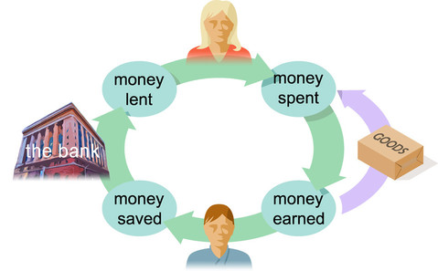
How Money is Created Today
http://choosethefuture.jimdo.com

Slide 31
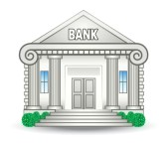
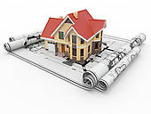

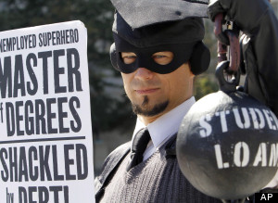
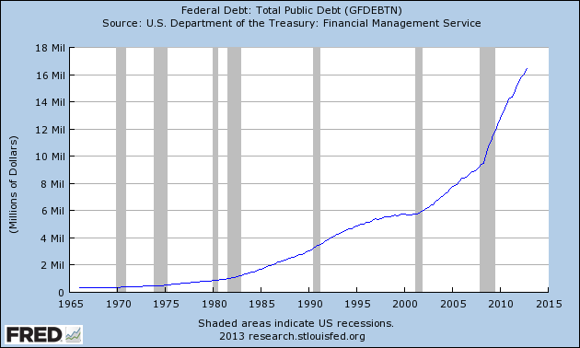
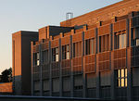
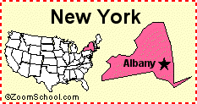
Bank Earning Assets – America’s Debt
CREDIT CARDS
$ .8 TRILLION
MORTGAGES
$13 TRILLION
STUDENTS
$ 1 TRILLION +
CORPORATE
$ 8.7 TRILLION
FEDERAL
$ 16.4 TRILLION
STATE & LOCAL
$ 3 TRILLION
SOURCE: http://research.stlouisfed.org/fred2/

Slide 32
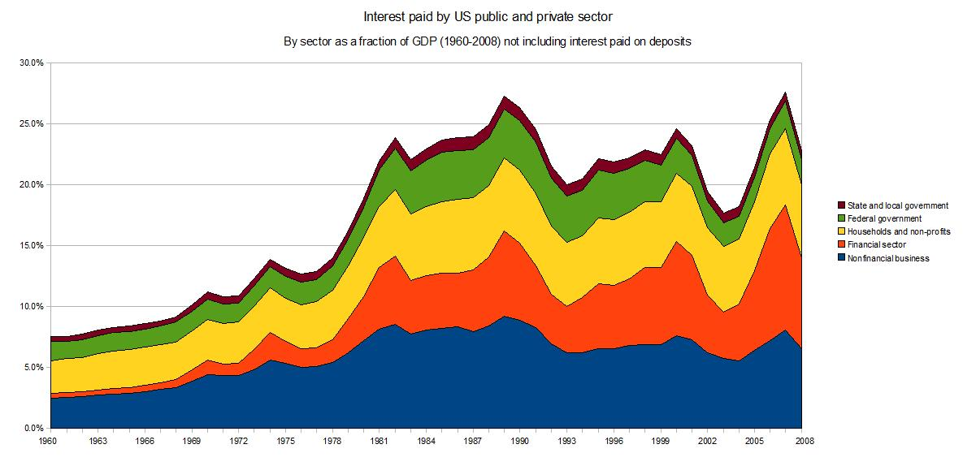
Interest – The Hidden Cost
20-25% Of GDP

Slide 33
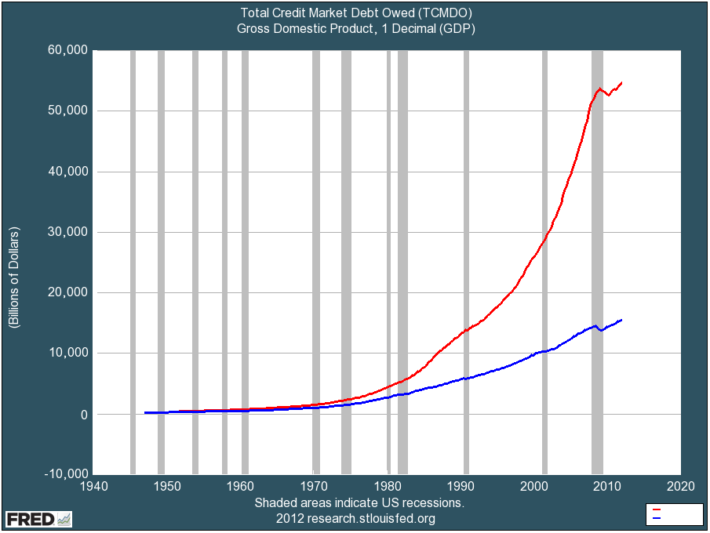
USA $56 Trillion In Owed

Slide 34
Economists
NON SEQUITUR © 2011 Wiley Miller Ink, Inc. Used by permission of Universal Uclick. All rights reserved.

Slide 35
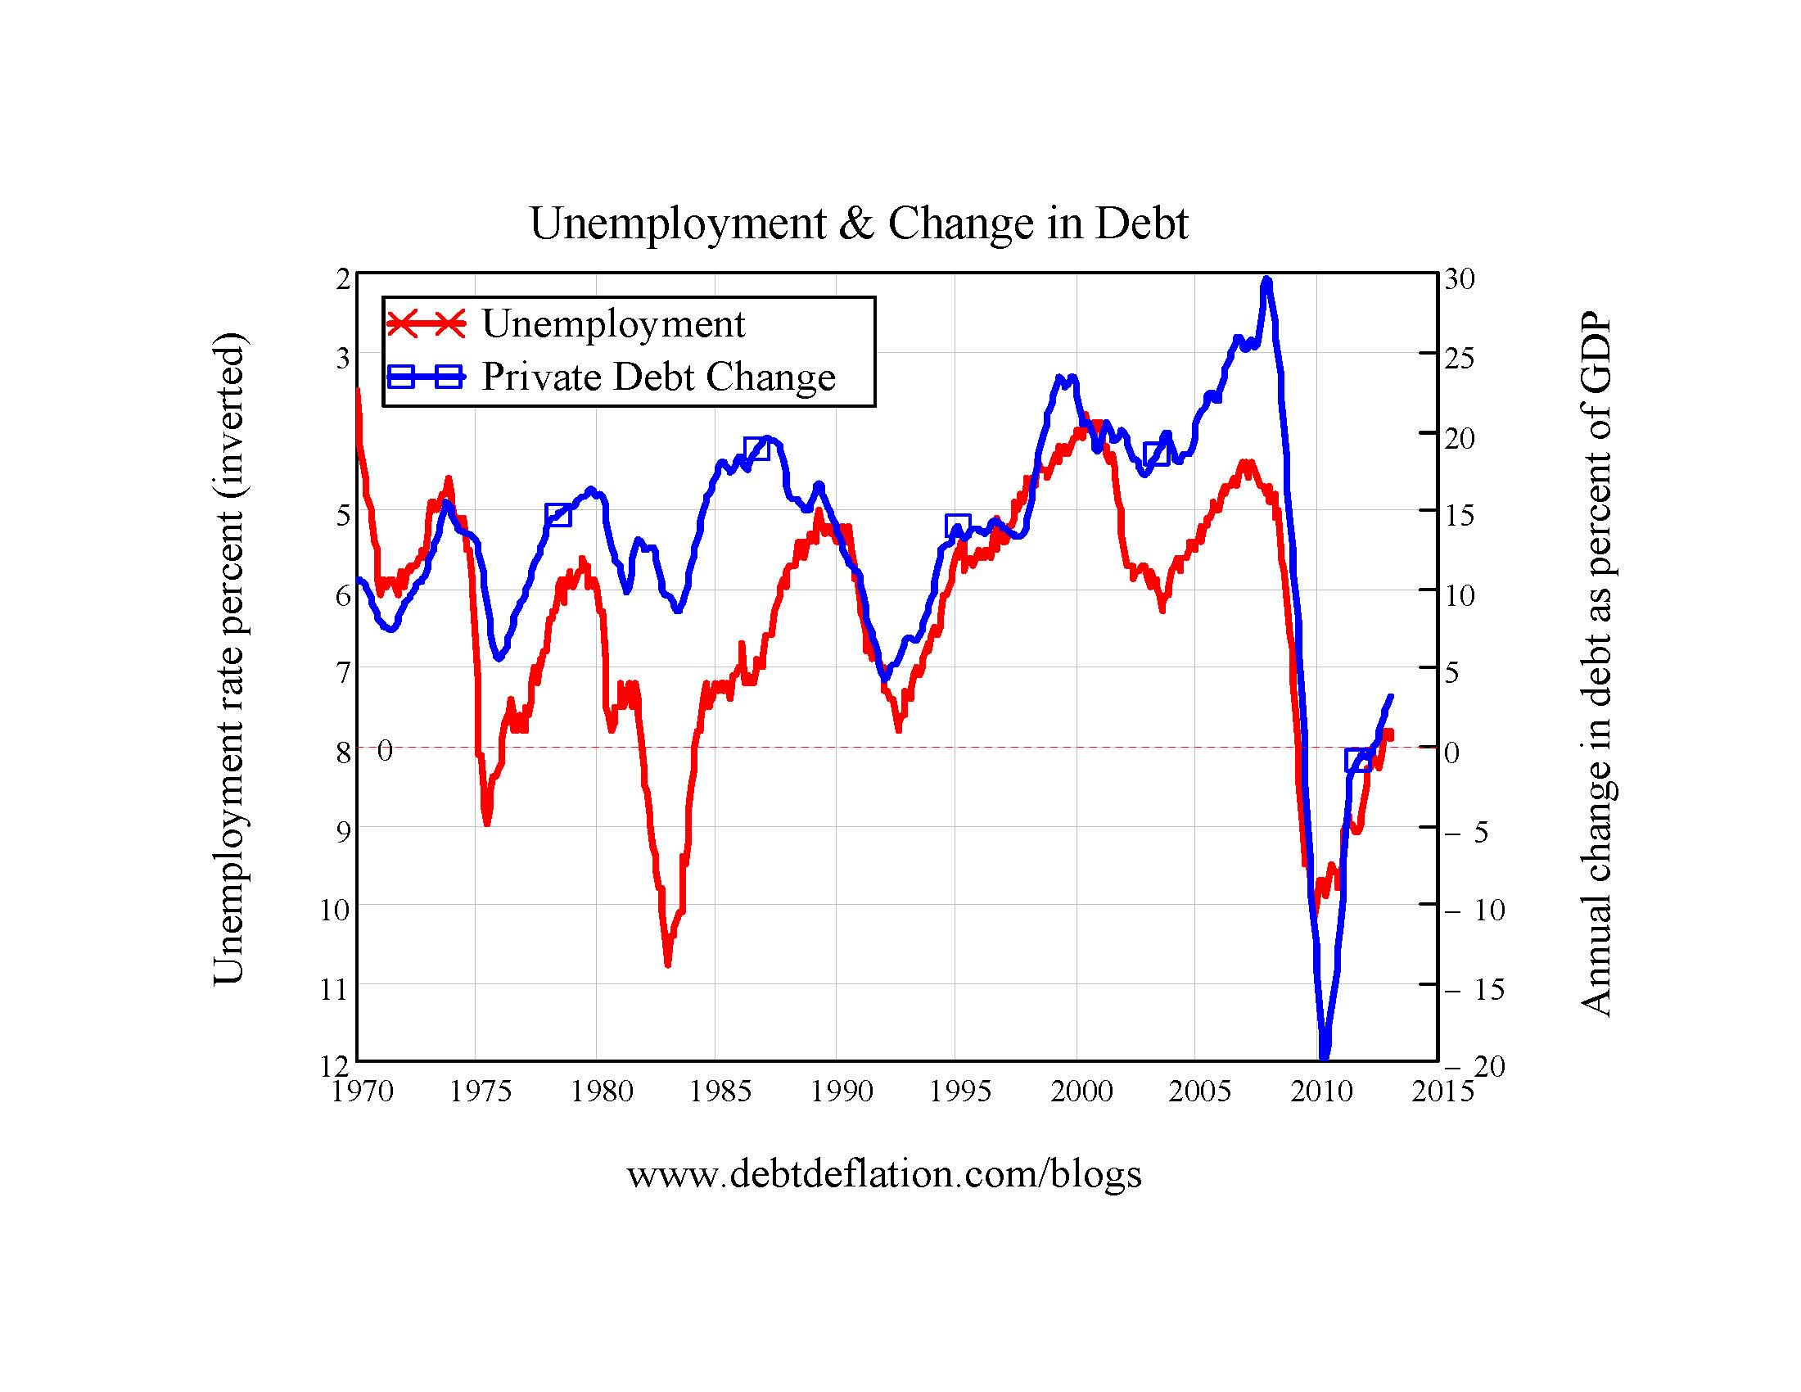
No Borrowing No Jobs

Slide 36
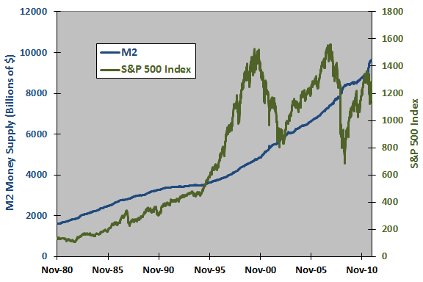
Stock Market Compared to Money
www.cxoadvisory.com

Slide 37
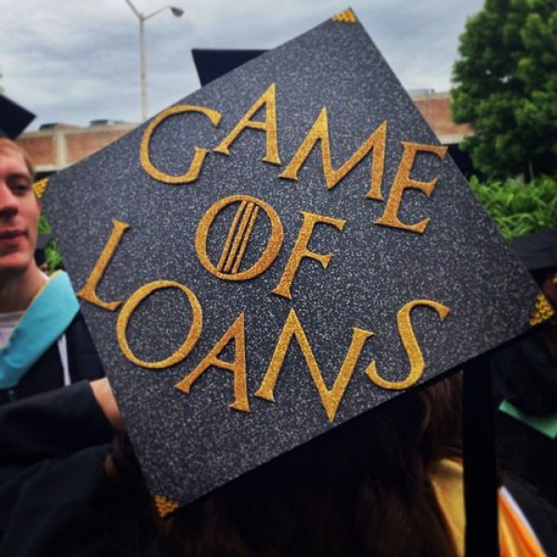
Our Economy Is A

Slide 38
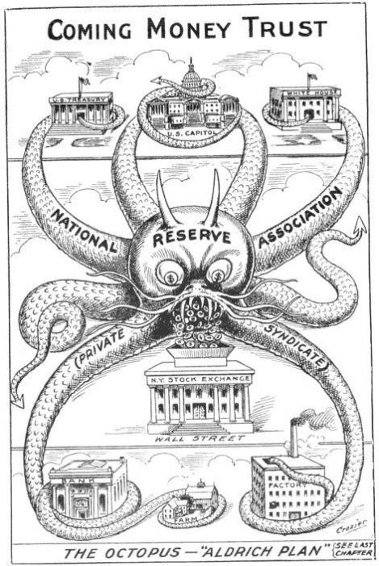
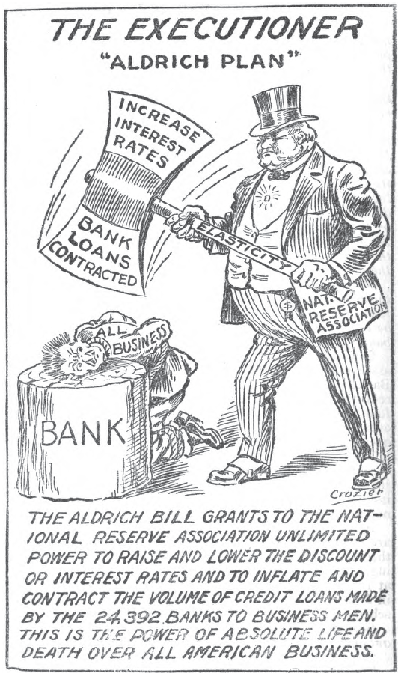
Are Small Groups Of People
Owning Everything?
U.S. Money vs. Corporation Currency, “Aldrich plan.” 1912 Alfred Owen Crozier

Slide 39
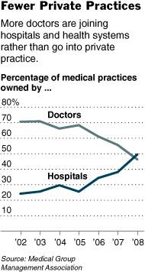

Slide 40
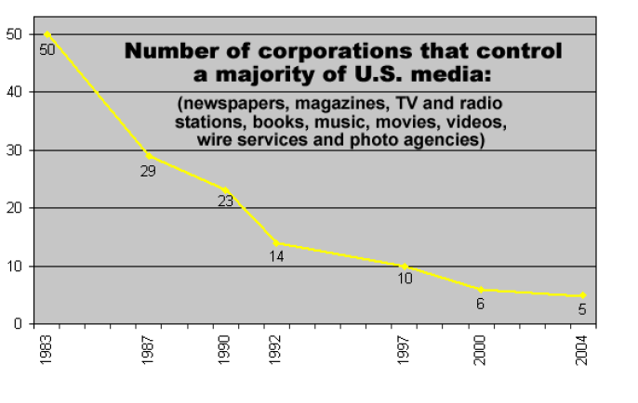
5 Major Media Companies From 50

Slide 41
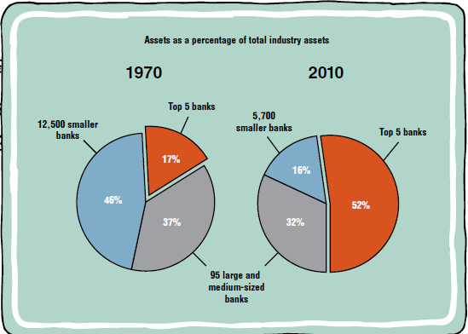
Banks Don’t Compete – You Lose
Source: Dallas Federal Reserve

Slide 42
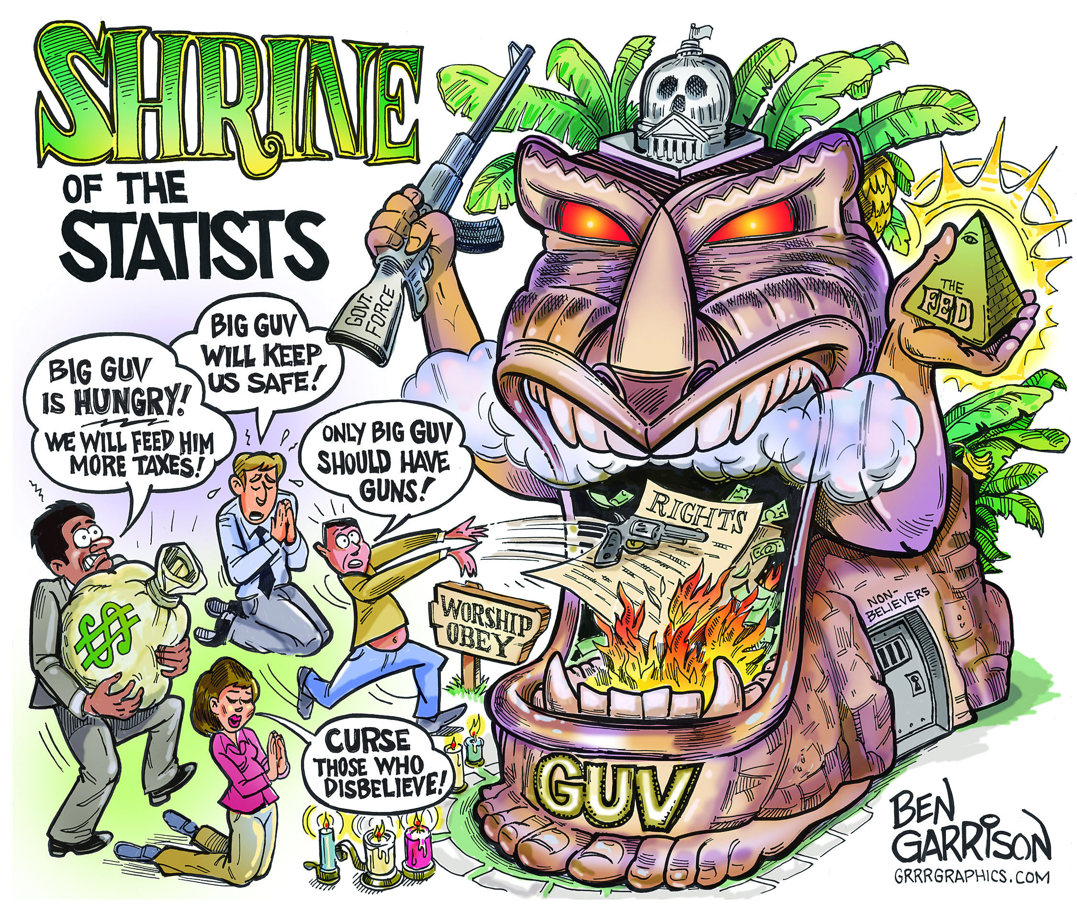
Government Should Not Run Banks

Slide 43
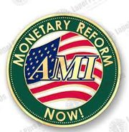
Reform : Talk to Your Friends & Members of Congress
Restore Constitutional Public Power of Money Creation – Interest Free
Take the power to create money away from banks
Reduce dependence of economy on debt
www.monetary.org

Slide 44
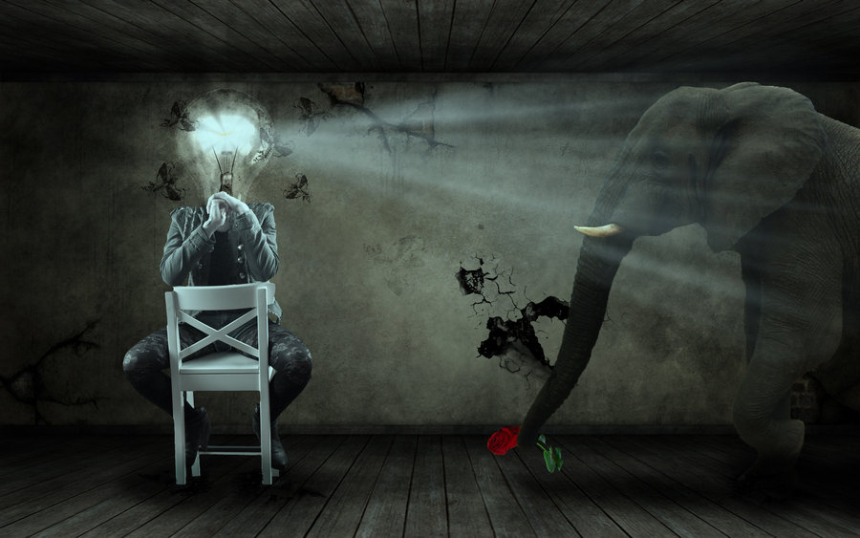
@stoptheinterest

