Slide 1
BIRTH OF THE
FEDERAL RESERVE PRIVATE BANKING SYSTEM

Slide 2
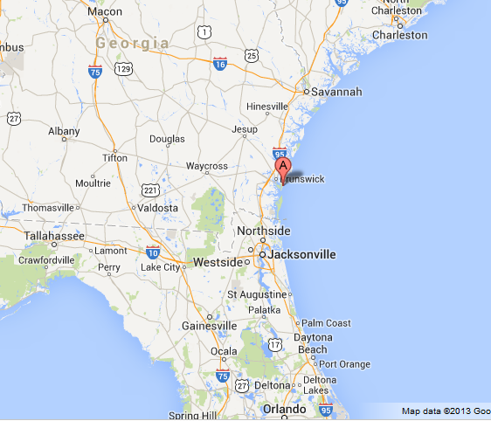
JEKYLL ISLAND, GEORGIA
BIRTH OF THE
FEDERAL RESERVE PRIVATE BANKING SYSTEM
The Federal Reserve Bill was secretly written
by Wall Street Bankers in November of 1910.
The bankers went to Jekyll Island, Georgia,
by private railway car. While on the island,
new servants were hired and the bankers
used only first names between themselves
to keep anonymity.

Slide 3
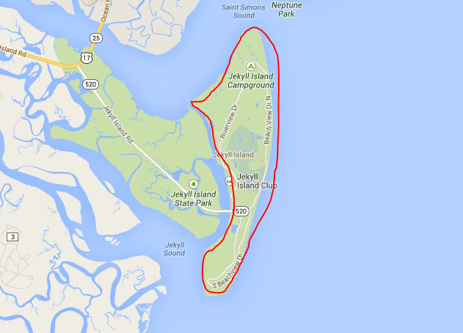
JEKYLL ISLAND, GEORGIA
Jekyll Island was
isolated from the
mainland and
privately owned.

Slide 4
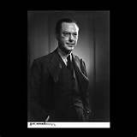
WHY IS THE CREATION OF THE FEDERAL RESERVE BANKING SYSTEM DANGEROUS?
GRAHAM TOWERS
GOVERNOR, BANK OF CANADA, 1934-54
"Each and every time a bank makes a loan, new bank credit is created - new deposits - brand new money."
With interest to the private banks……
Why do private corporations have this power ? ? ? ?

Slide 5
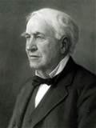
1921
THOMAS EDISON QUOTE IN THE NEW YORK TIMES
If our nation can issue a dollar bond*, it can issue a dollar bill**. The element that makes the bond good makes the bill good... it is the people who constitute the basis of Government credit.
* DEBT
** MONEY – DEBT FREE, INTEREST FREE
WHY DOES OUR GOVERNMENT BORROW…
WHEN IT CAN CREATE DEBT-FREE INTEREST-FREE MONEY ? ? ? ?

Slide 6

WHAT THE PUBLIC WAS TOLD
To fool the public, the system was divided into twelve regional Federal Reserve Banks.
But, given the concentration of money and credit in New York, the Federal Reserve Bank of New York controlled the system, making the regional concept initially nothing but a ruse.

Slide 7
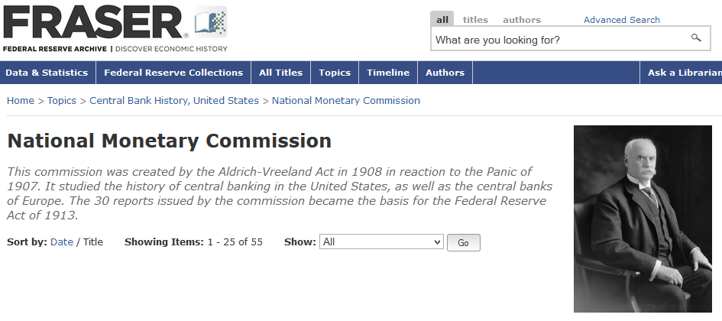
WHAT THE PUBLIC WAS TOLD
The National Monetary Commission “wrote” the Aldrich Plan
which formed the basis for the Federal Reserve system.

Slide 8
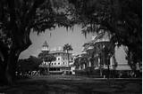
THE TRUTH November, 2010
“On the night of November 22, 1910, a group of newspaper reporters stood disconsolately in the railway station at Hoboken, New Jersey. They had just watched a delegation of the nation’s leading financiers leave the station on a secret mission. It would be years before they discovered what that mission was, and even then they would not understand that the history of the United States underwent a drastic change after that night in Hoboken.”
The Secrets of the Federal Reserve, by Eustace Mullins

Slide 9
Accompanying Senator Aldrich and
A. Piatt Andrew, Asst. Sec. of the Treasury, to Jekyll Island were:
ROCKEFELLER
Frank Vanderlip – president, National City Bank of New York (today, CITIBANK)
MORGAN
Henry P. Davison - senior partner, J.P. Morgan Company (today, J.P.MORGAN CHASE)
Charles D. Norton – president, First National Bank of New York (Morgan)
Benjamin Strong - a lieutenant of J.P. Morgan
KUHN, LOEB & WARBURG GERMAN BANK
Paul Warburg - recent German immigrant, partner Kuhn, Loeb and Company, New York and Warburg Bank of Hamburg & Amsterdam. Warburg directed the proceedings and wrote the primary features of what would be called the Aldrich Plan.

Slide 10
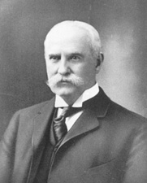
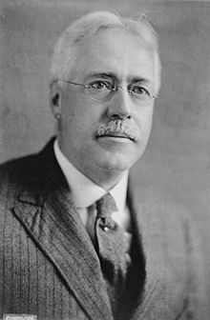
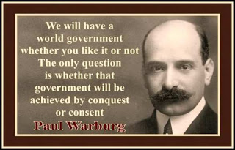
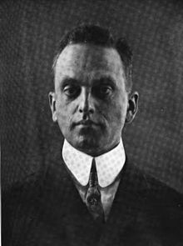
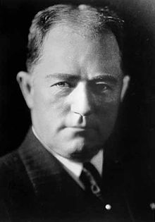
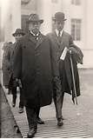
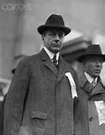
If the public had realized
that the Federal Reserve Act
was parented by the same
industry it was supposed to
control, there would have
been great opposition to it,
and it never would have been
enacted into law.
ROCKEFELLER
Aldrich
ROCKEFELLER
KUHN, LOEB, EUROPE
Andrew
Vanderlip
Warburg
Davidson
Norton
Strong
MORGAN????
ROCKEFELLER????
KUHN, LOEB, EUROPE????
MORGAN
MORGAN
MORGAN

Slide 11
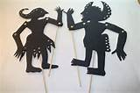
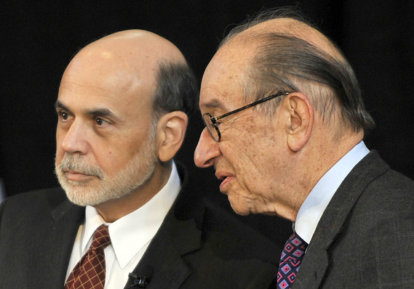
Ben S. Bernanke, chairman of the
Federal Reserve and former Fed Chairman
Alan Greenspan chat before taking the stage.
On November 5–6, 2010, Ben Bernanke stayed on Jekyll Island to commemorate the 100-year anniversary of this original meeting. The Conference was the first official confirmation of the secret meetings by the banking elites that wrote the Federal Reserve Bill.

Slide 12
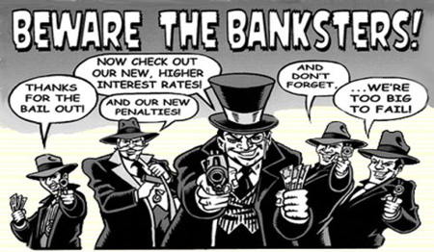
THE FEDERAL RESERVE LAW OF 1913
GAVE THE GOVERNMENT’S POWER TO CREATE MONEY TO
PRIVATE BANK CORPORATIONS

Slide 13
Q & A

