Slide 1
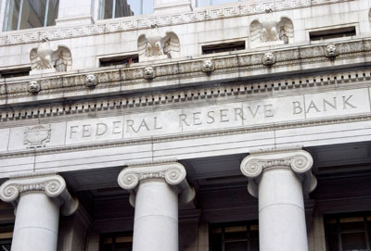
TRANSITION:
We Buy all Shares ... in the 12 Fed Banks

Slide 2
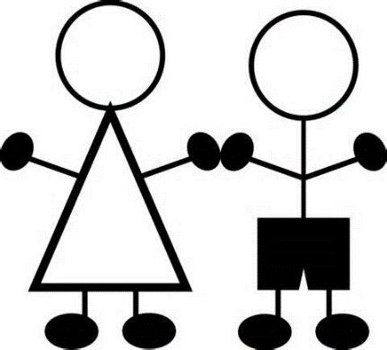

Jeremy! Jeremy! WHERE ARE YOU!
Calm down, calm down,
what’s up?

Slide 3
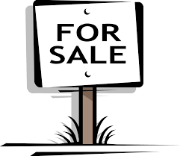
Nothing’s wrong. But I just figured out
how ordinary people will be helped when
the government buys the 12 Federal Reserve Banks!
What’s this?
We’re buying the FED banks?
Why for God’s sake?

Slide 4
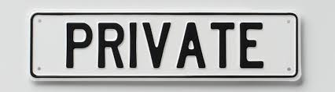
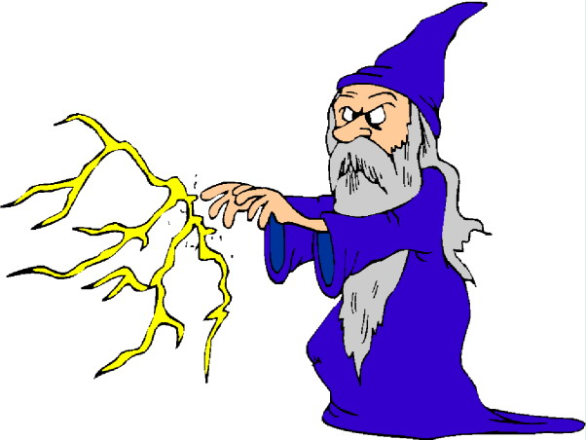
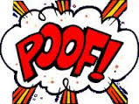
Well, you see. It’s part of passing the NEED Act in Congress,
to give the power of money creation back to our government.
Oh, yes. I remember.
The NEED Act makes sure the commercial
banks can’t create money any more...
out of nothing!

Slide 5
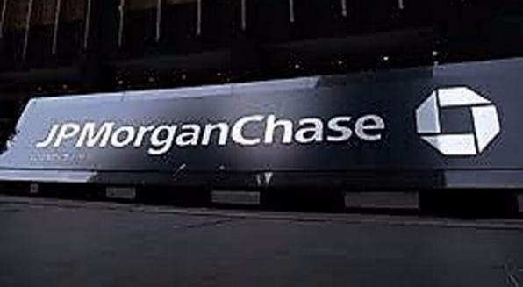
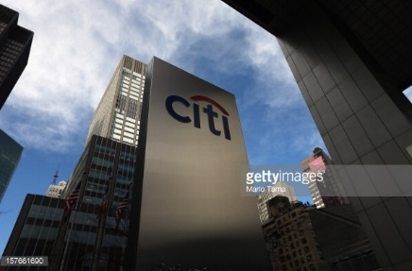
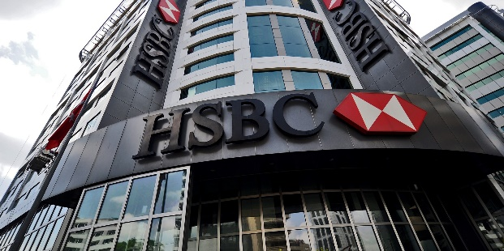
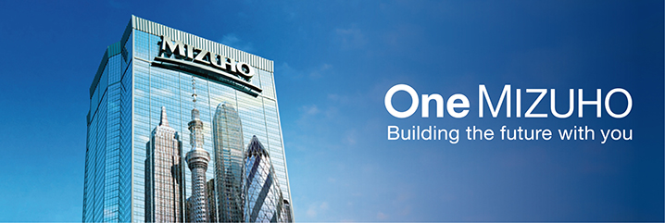

Right now, ONLY commercial banks
who are Fed members own shares.
So the NEED Act includes our government buying all the shares from the member banks and making the 12 Federal Reserve banks public.
A FEW OF THE
MEMBER BANKS
Hold on! Now I remember real well. The 12 Fed banks are private.
p.s.: their websites say .org (not .gov) –
www.newyorkfed.org

Slide 6
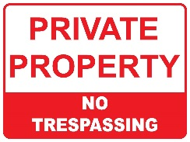
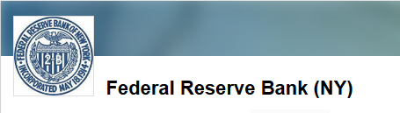
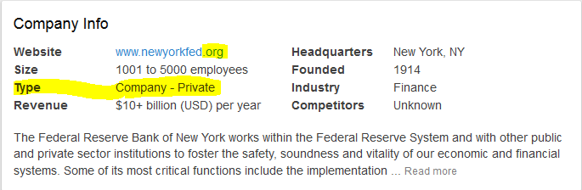
And… if you search the internet for a job at the NY Fed,
you apply for a private job, not a government job!

Slide 7
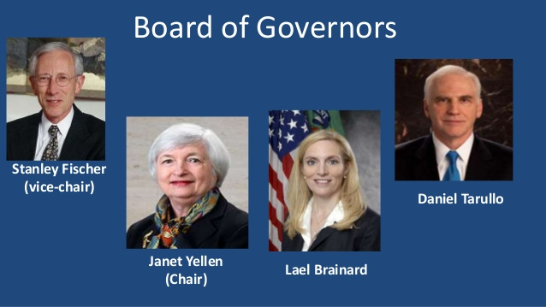
Yes, the Board of the Federal Reserve is the only part
of the Fed system owned by the government.
But there is no money there – it’s all in the 12 Fed banks.
Bejesus! Our central bank is not owned by us!

Slide 8
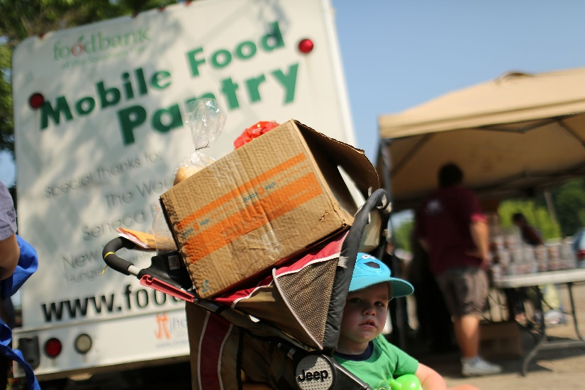
Yes, exactly!
Could that be why our economy
keeps having crisis after crisis?
Well, this system is, of course, rigged for the 1%.
Every crisis, the 1% get more and more of the wealth.
People get more and more....
Poorer!

Slide 9

But now we can
change it!
So tell me how.
I want to do something.
Here, like I said, our government in the NEED Act
will buy ALL the shares of the 12 Federal Reserve Banks.
How many shares?
What do they cost?
This sounds impossible!

Slide 10
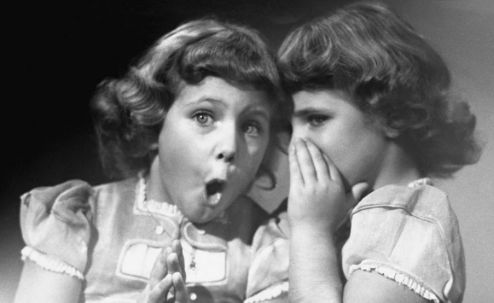
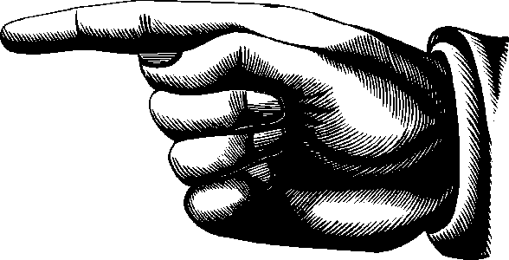
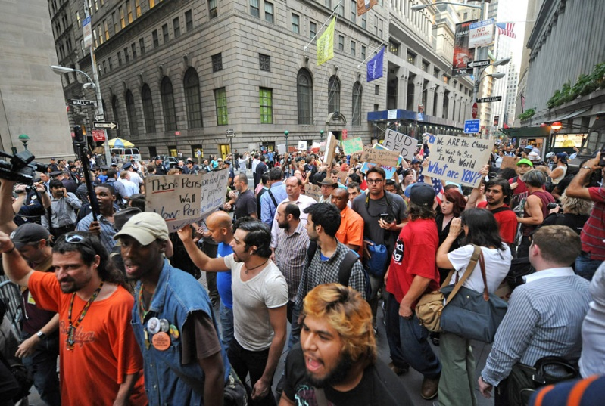
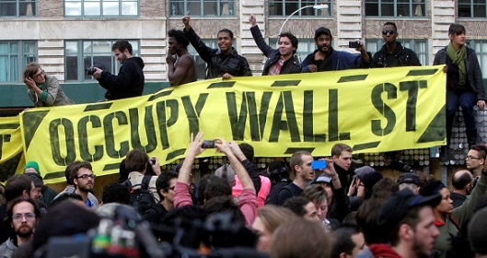
Well ... I just happen to have a report of the New York Federal Reserve Bank as of 2006.
The New York Fed is the most powerful of the 12 Fed Banks. It owns more than half of the assets and liabilities of the Fed system. It maintains the U.S. Treasury’s account.
Occupy Wall Street pointed the finger
at the New York Fed Bank.
The owners of the New York Fed Bank
are all the huge multi-national banks.

Slide 11

The 2006 report shows all the member banks,
how much money they paid for their shares,
and how many shares they bought.
The bigger the bank, the more shares they are required to buy.
The money to buy the shares is called ‘paid-in capital’.
So in 2006, which banks owned the NY Fed Bank?

Slide 12

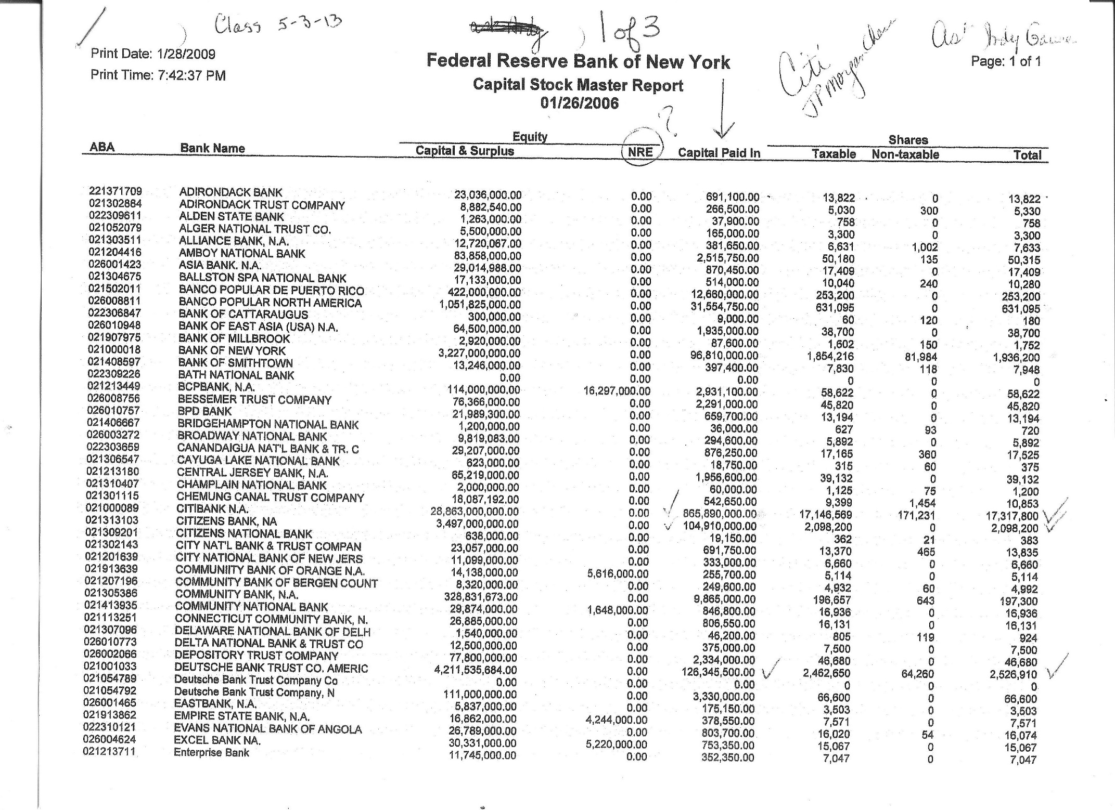
LOOK AT THIS. CITIBANK is the second largest owner of the NY Fed.
Citi paid $866 million for 17.3 million shares (23%).
PAGE 1 of 3
CITIBANK

Slide 13
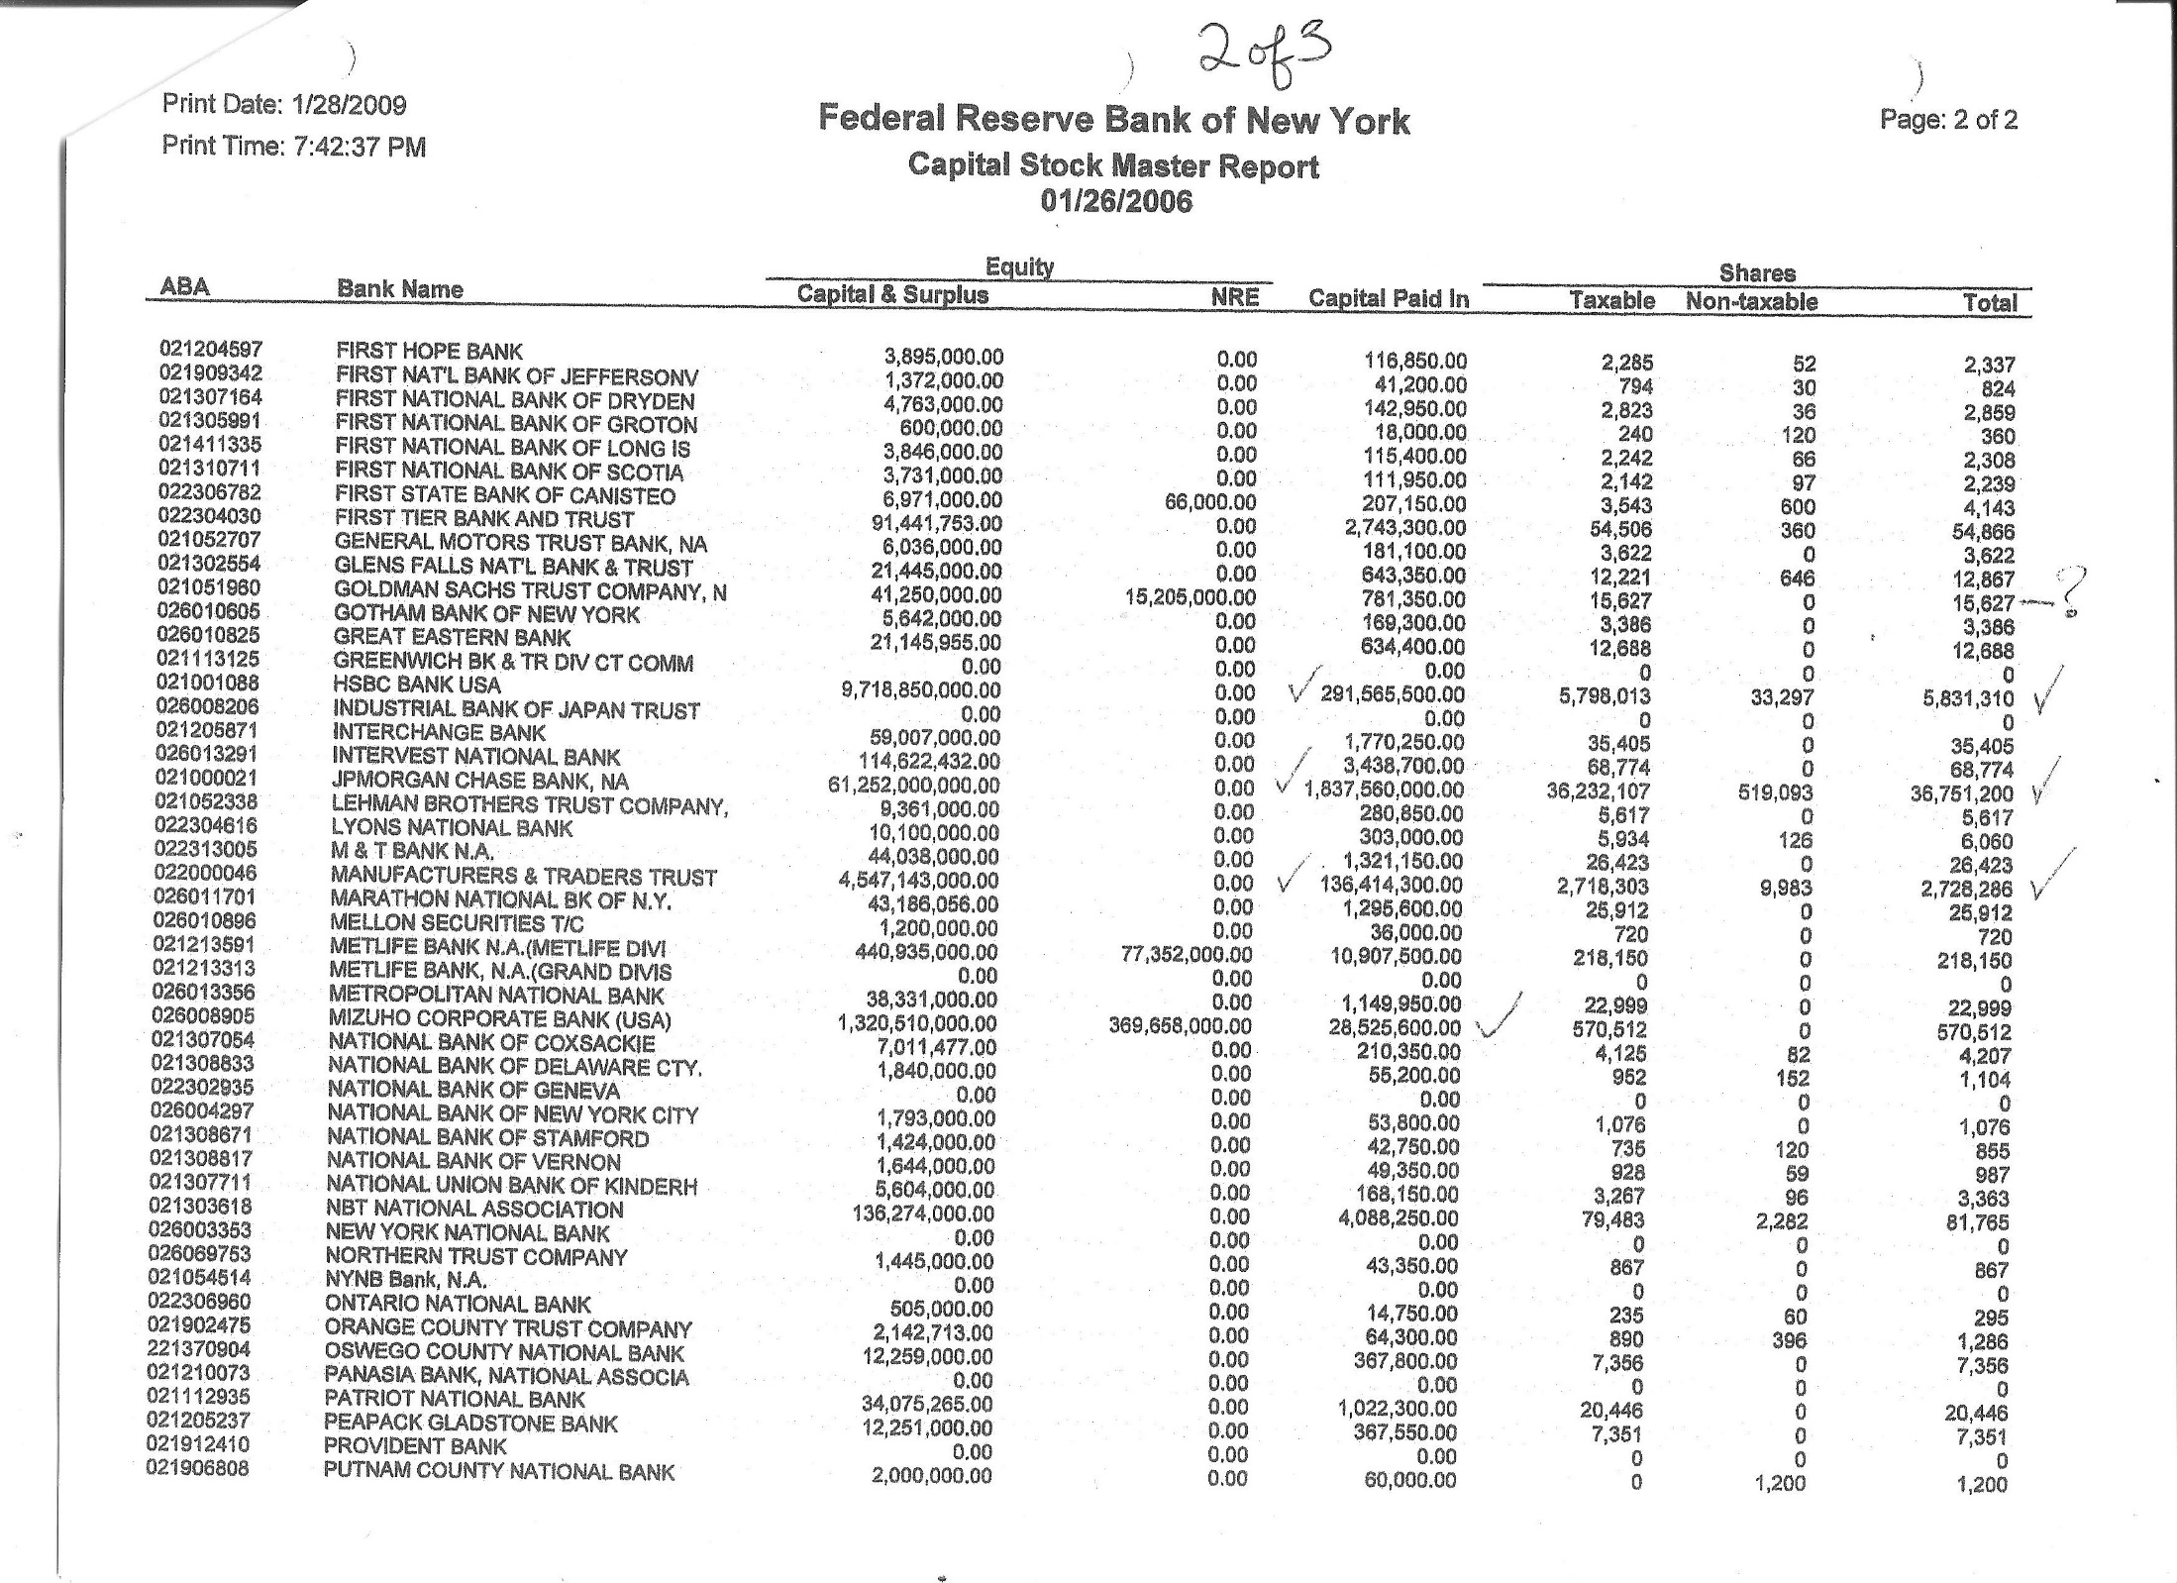
LOOK AT THIS. J.P. MORGAN CHASE ... $1.8 billion for 36.8 million shares,
or 50% of the shares of the NY Fed Bank!
CHASE

Slide 14

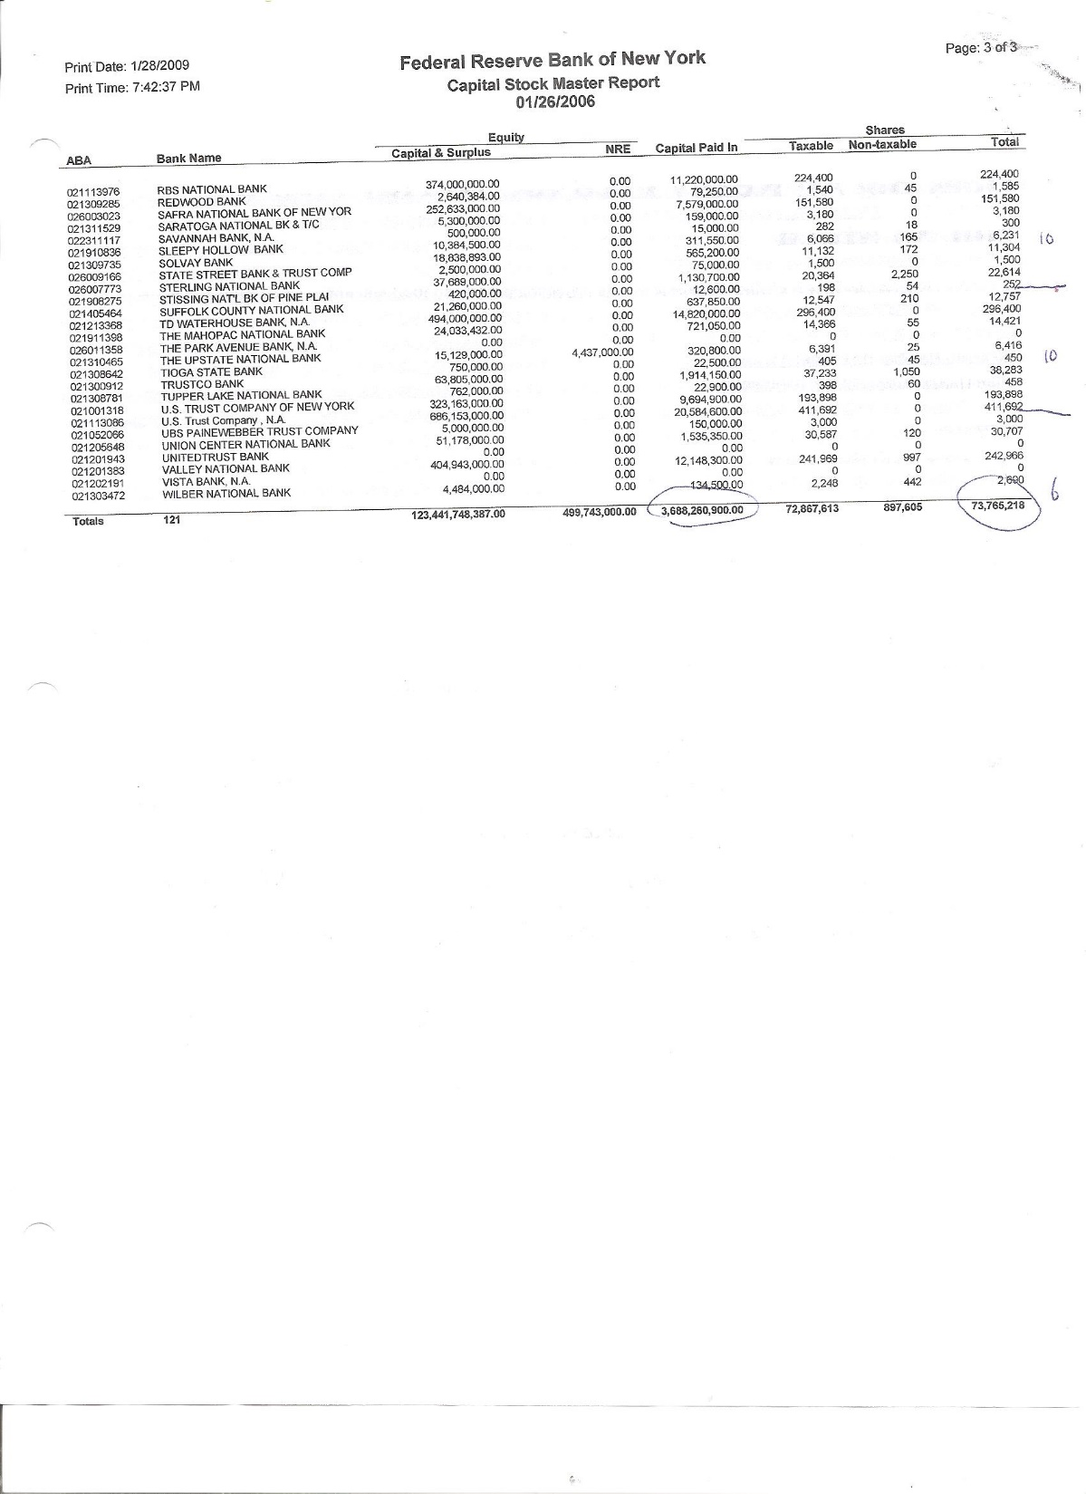
Each member bank gets a dividend also!
How much?
Each year, the member gets, tax-free, 6%
of their paid-in capital.
And Americans are losing food stamps!
TOTALS 121 Banks =
$3.7 billion
paid-in capital
73.8 million shares

Slide 15

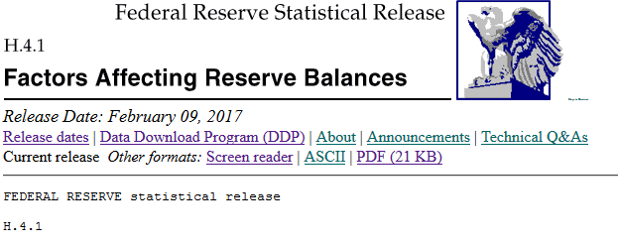
Let’s look at the amount of paid-in capital
all 12 Fed banks have today – in 2017!
How do we do that!
If you have a computer with access to the internet,
you can find a weekly report from the New York Fed with this info – it’s called ‘H.4.1’.
Let’s do it!

Slide 16
Type this internet address into your search engine.
https://www.federalreserve.gov/releases/h41/current/
And look for the report that says:
Statement of Condition of Each Federal Reserve Bank
In that report, look for the paid-in capital amount:
Capital paid in 30.5 billion dollars
So, our government could buy all the shares in the 12 Fed banks
for only 30.5 billion dollars!
Our 12 Fed banks will cost us only 30.5 billion dollars!!!!

Slide 17
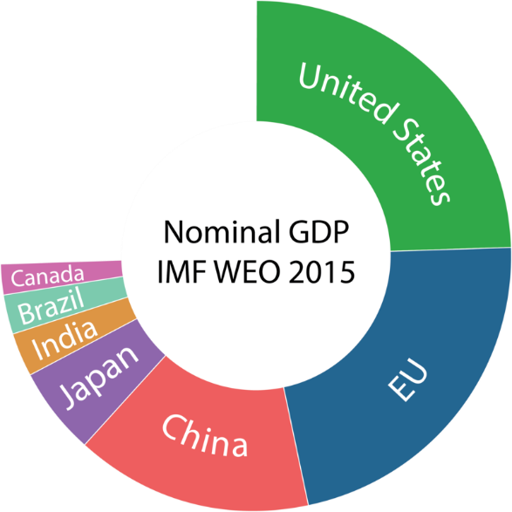
And remember, the Fed is the central bank of the most important economy of the world ... the U.S. accounts for 25 percent of the world’s GDP –
the market value of all final goods and services produced.

Slide 18
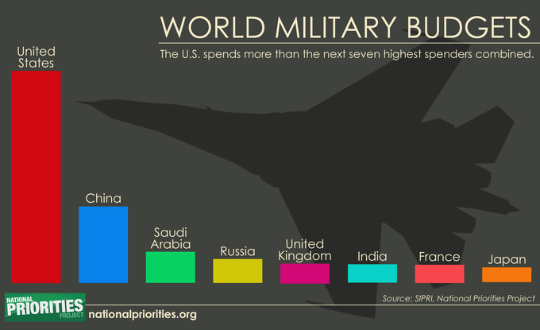
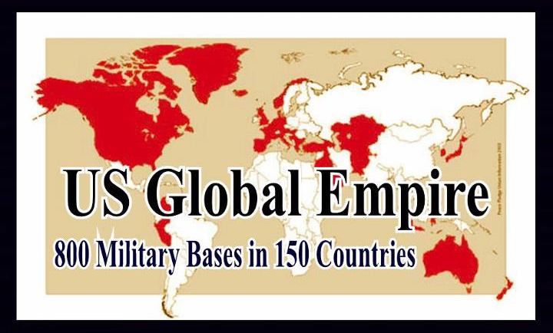

And the U.S. maintains the largest military in the ENTIRE HISTORY OF THE WORLD ... which Fed member banks support with their
loans of billions and billions of dollars to the arms industry.
The U.S. is the largest exporter of arms to the world.

Slide 19
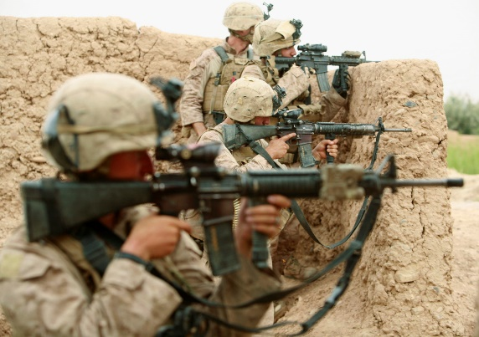
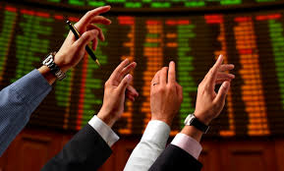
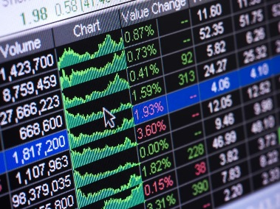
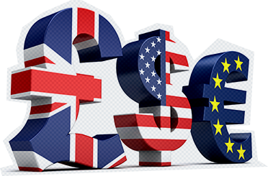
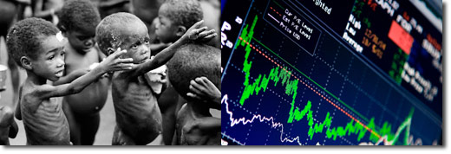
Well, yes, the FED member banks support this empire.
But, remember, when the government buys the 12 Fed banks ...
at the same time, the Fed member banks will not be allowed to
create their bank credit out of thin air anymore,
but must find real money to loan.
Yeah! Less war, less war, less war.
Less speculation in the stock market ...
and in all the massive financial markets.
Less of everything that hurts ordinary people.
stocks
bonds
Foreign currencies
commodities
FINANCIAL MARKETS

Slide 20

Yes yes yes !!!
Ok, let’s get on with buying these 12 Fed banks.
Who gets paid? How much?

Slide 21
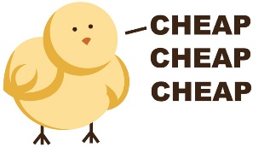
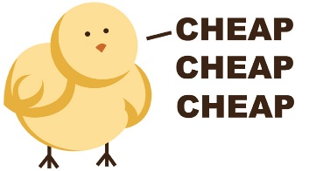

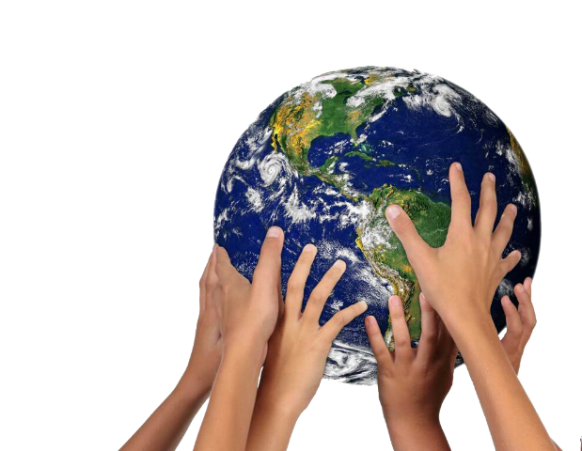
The Treasury Department buys ALL the shares ...
and pays a TOTAL of 30.5 billion dollars!
That’s dirt cheap!
For the central bank of the largest empire in world history....
the largest economy in the world....
Yeah! And besides making the world safer for people,
guess what else we get for this.
What?

Slide 22
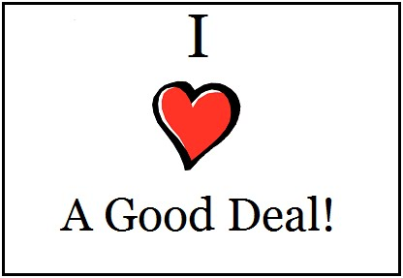
Well, the 12 Fed banks own assets worth 4.3 Trillion dollars:
2.5 Trillion dollars of U.S. Treasury Bonds
1.8 Trillion dollars of Mortgage Backed Security Bonds
------------------------
4.3 Trillion dollars Total
Seems like a real good deal for all of us 99%!
For 30.5 Billion dollars, we get assets worth
4.3 Trillion!
You bet! And when the government owns these
4.3 trillion dollars worth of assets, you know what?
What?

Slide 23

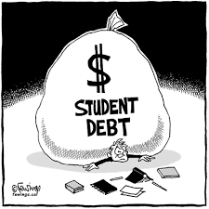
Our Treasury Department does not need these assets sitting there.
Our Treasury can sell them back into the market and
provide funding for the needs of the ordinary person.
Yes. Like a onetime tax-free dividend to all
citizens living in the U.S. That’s in the NEED
Act too.
Let’s free people from some economic insecurity.
You bet!
Like using this money to pay off all student debt –
not only what is still owed but also what has
already been paid!
Yes. Our students should not have to be debt slaves
to get an education.

Slide 24

Like funding single payer health care for ALL!
Yeah! Yeah! Yeah!
And....
Wait... wait.... I have to calm down.
So much is changing! Wow! Wow!

Slide 25

What a glorious change!
For all of us.

Slide 26
THE END

