Slide 1
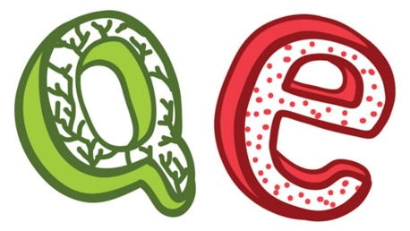

QEP – For the People?
Welcome to the Central Bank

Slide 2
Central bank vs commercial bank –
our two-tier monetary system

Slide 3


QE COMES FROM THE CENTRAL BANK
Hey, I heard our government was
going to start something like QEP?
Sounds really weird.
Well, it’s not the government.
It’s the central bank.
Central bank? You mean the bank
in the center of the town?

Slide 4
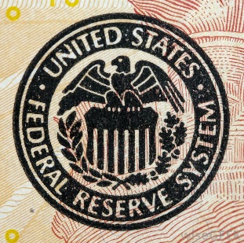
QE COMES FROM THE CENTRAL BANK
No, no. Don’t you know the
difference between a central
bank and a commercial bank?
Ah… I only know about my
bank – TD Bank.
My money is in there.
No, no. Have you ever heard of
the Federal Reserve System?
Sure. Everybody has heard of the FED.
It’s part of the government.
In Washington D.C.
The news is always talking about the FED.

Slide 5
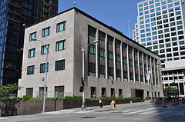
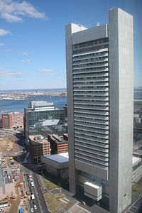
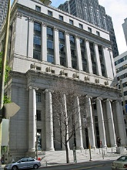

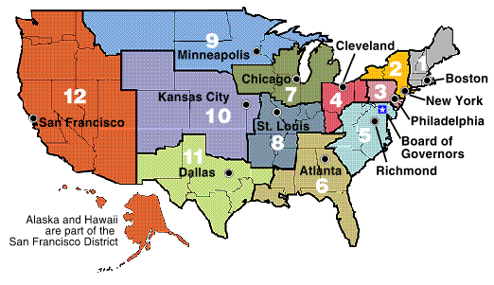
QE COMES FROM THE CENTRAL BANK
The government does not own the Federal Reserve Banks. There are 12 Federal Reserve Banks, and they are privately owned.
Private?
What do you mean private?
It’s the U.S. central bank, no?
All shares of the 12 Fed banks are owned by their members, which are private commercial
banks, like Bank of America or Citibank.

Slide 6
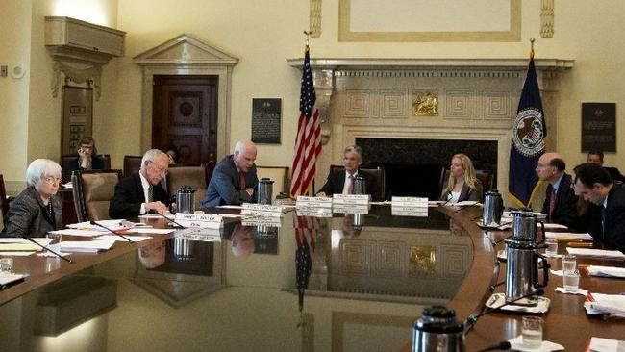
QE COMES FROM THE CENTRAL BANK
But where does the government
come into this?
There is a Federal Reserve Board
in Washington D.C.
The Board is not a bank. There is
no money there. The Board makes
policy, like controlling the reserve
requirement for member banks.

Slide 7
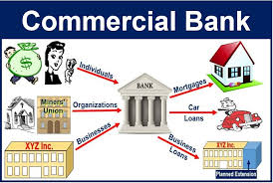
QE COMES FROM THE CENTRAL BANK
I can’t own a share of the Fed bank?
I can’t open an account there?
You don’t know how our banking system
works?
All I learned in school was …
Ah… well… we all put our savings
in a bank and then the bank lends
out the money to people who
need it.

Slide 8

QE COMES FROM THE CENTRAL BANK
No, banks don’t work like that.
No?

Slide 9

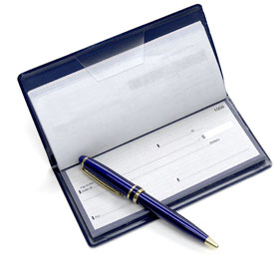

QE COMES FROM THE CENTRAL BANK
Banks work like this….
When you sign a loan contract with a commercial bank,
the bank CREATES ‘bank money’ (also called ‘bank credit’)
by typing a deposit into your account.
Bank money is an ​IOU for cash from the bank. You need to go into your bank and ask for cash (the real money) if you want it.​

Slide 10
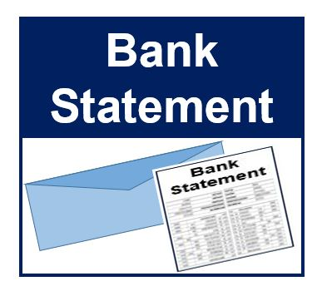
QE COMES FROM THE CENTRAL BANK
The bank doesn't 'lend' reserve money – the real money?
The bank lends you their IOU by creating a deposit in your bank account. You can spend this 'checkbook money' in most places in the country, though a business can refuse to accept checks and ask for cash (the real money).
IOU FOR CASH
BORROWERS BANK DEPOSIT ACCT
BEFORE LOAN
AFTER LOAN
$ .00
$ 50,000.00

Slide 11
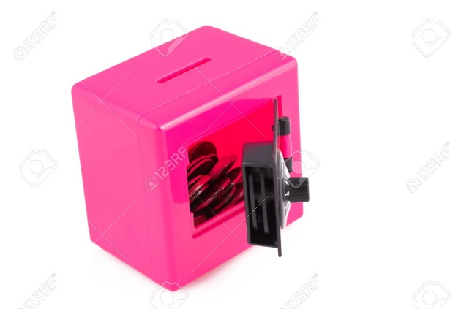
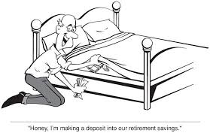
QE COMES FROM THE CENTRAL BANK
Don’t worry! The commercial bank has
reserves – real money – in the central bank.
Wow, I’m glad you said that.
I was just about to go down to TD
and take out all my ‘bank money’ in cash
and put it under my mattress!
By law, the Fed requires that around 10% of bank deposits
be held either in cash in the banks' vaults
or at the local Federal Reserve bank.

Slide 12
QE COMES FROM THE CENTRAL BANK
10% !? But.. but..
That’s not enough if a lot of people want to take
their ‘bank money’ out of the bank?
Don’t worry about the details!
We’re here to discuss the central bank’s
QEP program, right?
Ok… um… sure….

Slide 13

QE COMES FROM THE CENTRAL BANK
Is that why the Occupy movement
was called Occupy Wall Street?
‘Wall Street’ were the PRIVATE banks
creating ‘iou bank money’?
Well…. yes…. but let’s not discuss
Occupy. Let’s get back to QEP.
Okay. So the central bank
is doing QEP?

Slide 14
QEP – QE for the People

Slide 15
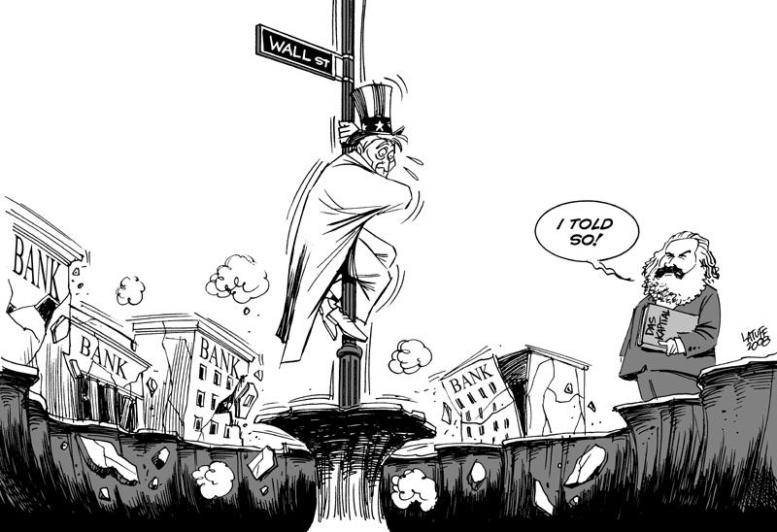
QE COMES FROM THE CENTRAL BANK
After the 2007-2008 worldwide banking crisis,
the economy had not gotten very good,
even with many policies implemented by the FED.
So the Fed decided to do ‘quantitative easing’.
This was brand new!
What is QE?

Slide 16



QE COMES FROM THE CENTRAL BANK
The Fed banks ‘create’ reserve money.
For QE, the Fed banks created reserve money and
bought financial assets – bonds – from the commercial banks.
Well…. the banks had some Mortgage Back Securities – bonds -
which are going down in value, so the bank was in trouble.
The Fed banks bought the bonds from the banks.

Slide 17




QE COMES FROM THE CENTRAL BANK
Well, the economy was still not working too well.
So the FED also started creating reserve money and going out and buying government bonds from insurance companies and pension funds.

Slide 18

QE COMES FROM THE CENTRAL BANK
But I thought the FED could not give reserve money – the real money - to anyone but their member banks?
Yes, correct. Good for you. But you see, the way it works is … the banks got the reserve money, and the pension funds and insurance companies got the IOUs of the banks – bank deposits.

Slide 19
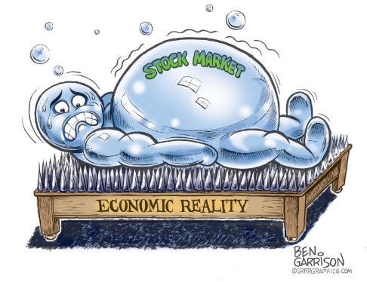
QE COMES FROM THE CENTRAL BANK
It seems all we the people get are IOUs?
So did this help ‘we, the people’?
The newly created money went into the financial markets, boosting bond and stock markets nearly to their highest level in history.
And how does that help ‘the people’ when the majority of the stock market is owned by the 1% !

Slide 20
QE COMES FROM THE CENTRAL BANK
Well… it will get better… we could have a ‘QE for the People’!
QEP?

Slide 21

QE COMES FROM THE CENTRAL BANK
Yes, the Federal Reserve Banks could create reserve money and give that money to the government! And the government will spend that money for us – the people. Build infrastructure.
The government will not have to borrow money or raise taxes to have money and help the people.
So when the government spends the reserve money, we the people will finally get real money?

Slide 22
QE COMES FROM THE CENTRAL BANK
Well… well… no.
No?
You see, it will work this way. Say the government wants to build a bridge. The construction company will receive a bank deposit IOU to build the bridge, and the company’s bank will get the reserves from the government.
Is it legal for the Fed to create reserves for the government?

Slide 23
QE COMES FROM THE CENTRAL BANK
Well, we will have to change the Federal Reserve Law, since this isn’t allowed now.
But to help our economy… the people..
One last question…

Slide 24
QE COMES FROM THE CENTRAL BANK
It appears to me that all this QE or QEP reserve money will always end up being given by the PRIVATE Fed Banks to their PRIVATE commercial banks, who own the FED?
They get the real money and WE GET IOUs from the bank. Many… many… many more IOUs than there is reserve money.
Well, yes… but that is our system….

Slide 25
      SOVEREIGN MONEY

Slide 26
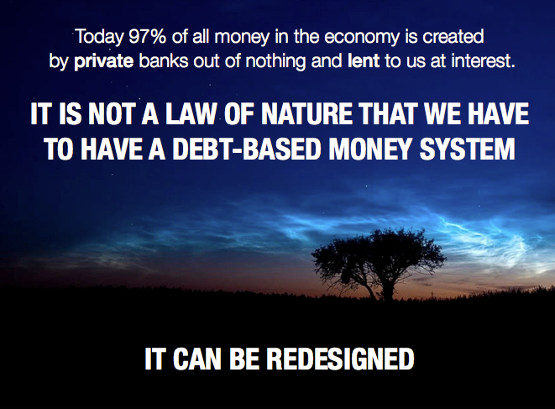
SOVEREIGN MONEY
We need to change our system to sovereign money.
Well, yes… but this is not a good idea.

Slide 27
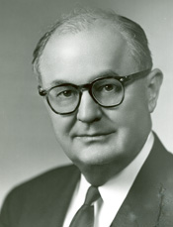
SOVEREIGN MONEY
Government will no longer borrow, but will create the real money and spend it into the economy for our needs and creating good jobs. All money will be real money – sovereign money.
Banks will not longer be allowed to create their IOU money and lend it with interest. The banks will have to have sovereign money to invest and lend.
Sovereign money is debt-free. We, the people, will not be charged interest by private banks just to have a money supply!
And if a bank fails, our sovereign money does not disappear!
"I have never yet had anyone who could, through the use of logic and reason, justify the Federal Government borrowing the use of its own money.“
Wright Patman, TX Democrat,
Chair, US House Committee on Banking and Currency (1965-75)
Well, yes… but this is not a good idea.

Slide 28

SOVEREIGN MONEY
But our constitution says our government can create debt-free sovereign money. Our constitution does not mention this system of ‘reserve money with bank IOUs’.
Well, yes… but this is not a good idea.

Slide 29
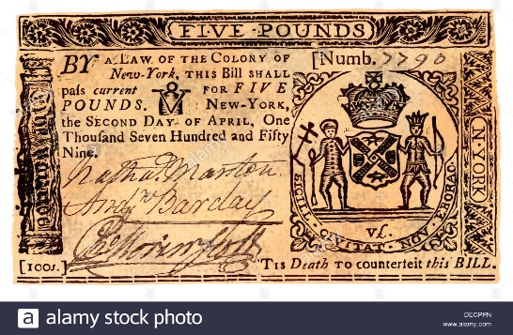
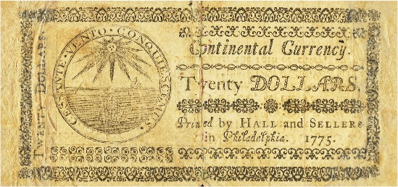
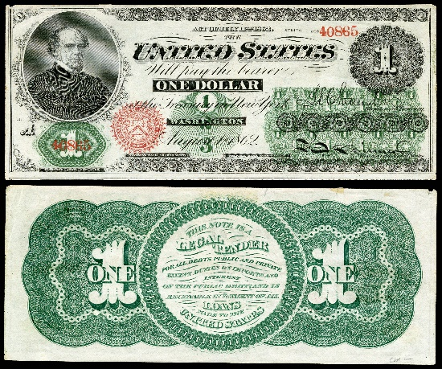
SOVEREIGN MONEY
Why isn’t this a good idea?… Our country has successfully issued debt-free sovereign money numerous times.
All our colonies issued DEBT-FREE money called scrip, our revolutionary congress issued DEBT-FREE money called Continentals, and Lincoln convinced the Congress to issue Greenback dollars, DEBT-FREE?
SCRIP
CONTINENTAL
GREENBACK
Well, yes… but that would cause INFLATION !!!!

Slide 30
SOVEREIGN MONEY
Wait one BIG MOMENT! The government did not abuse this power to issue money.
That’s what the banks want us to think. That is what the banks say without revealing the actual history of Scrip, Continental, and Greenback.
The colonial scrip brought prosperity to the colonies. The Continental was the cornerstone of the Revolution, and only lost value when the British counterfeited billions! The Greenback worked so well people would not turn them in for gold.
SCRIPT
CONTINENTAL
GREENBACK
Well, yes… but this is not a good idea.

Slide 31

SOVEREIGN MONEY
So, what’s wrong with Monetary Reform?
But… but… the banks will not be in control….
Sounds like a good idea to me….

Slide 32

SOVEREIGN MONEY
Monetary Reform for the People
It’s found in the Green Party’s Platform called
“Greening the Dollar”.
It’s also found in Dennis Kucinich’s bill, called the NEED ACT, HR2990, of the 112th Congress.

Slide 33

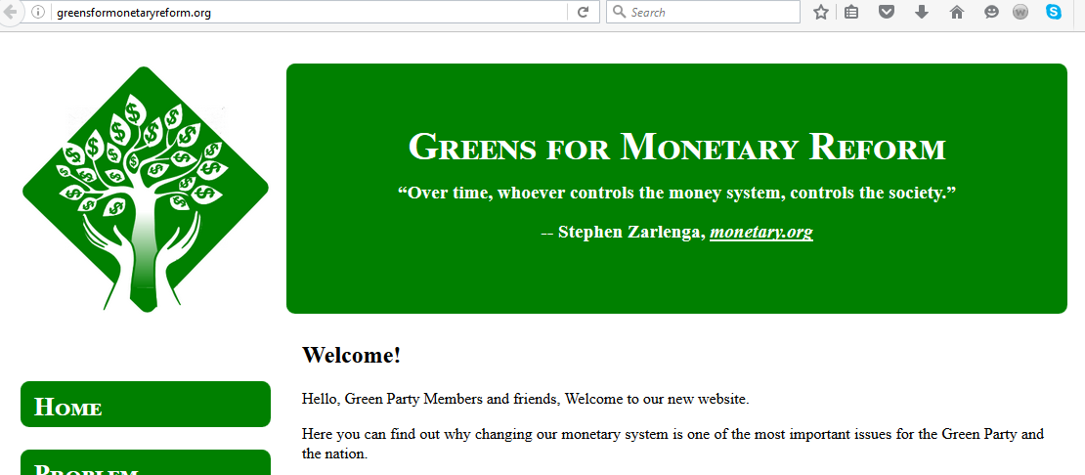
GreensForMonetaryReform.org

Slide 34
THE END

