Slide 1
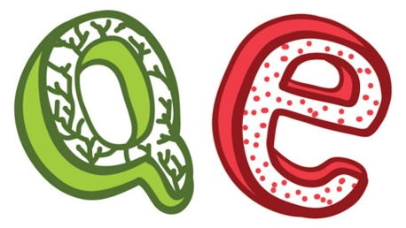
IS QE MONETARY REFORM?
Or What?
Welcome to the Central Bank

Slide 2
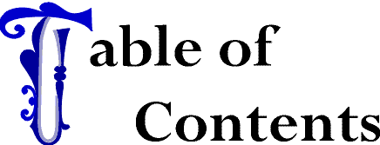
      IOU MONEY
      QE
      SOVEREIGN MONEY

Slide 3
IOU MONEY – BANK DEBT-MONEY

Slide 4
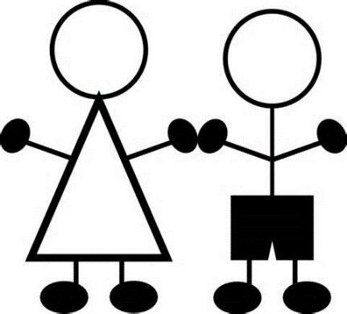
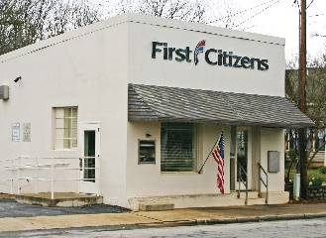
IOU MONEY
Hey, I heard our government was
going to start something like QE?
Sounds really weird.
Well, it’s not the government.
It’s the central bank.
Central bank? You mean the bank
in the center of the town?

Slide 5
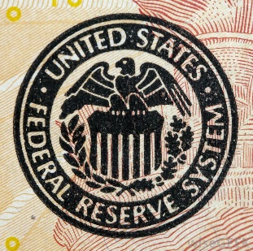
IOU MONEY
No, no. Don’t you know the
difference between a central
bank and a commercial bank?
Ah… I only know about my
bank – TD Bank.
My money is in there.
No, no. Have you ever heard of
the Federal Reserve System?
Sure. Everybody has heard of the FED.
It’s part of the government.
In Washington D.C.
The news is always talking about the FED.

Slide 6
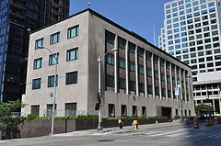
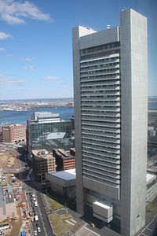
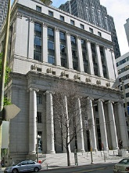

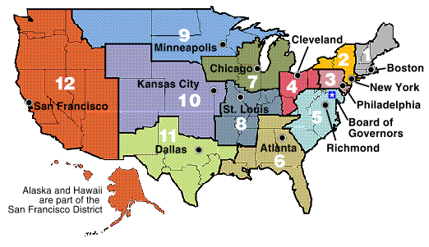
IOU MONEY
The government does not own the Federal Reserve Banks. There are 12 Federal Reserve Banks, and they are privately owned.
Private?
What do you mean private?
It’s the U.S. central bank, no?
All shares of the 12 Fed banks are owned by their members, which are private commercial
banks, like Bank of America or Citibank.

Slide 7
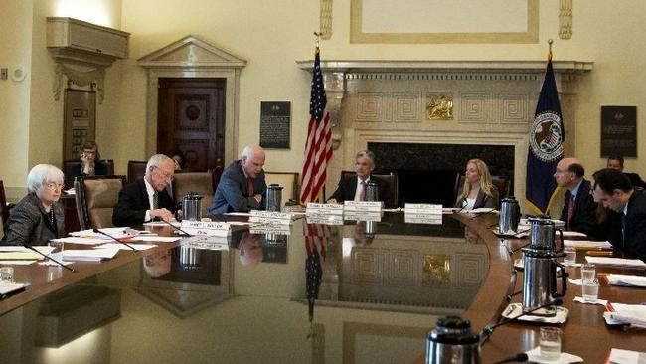
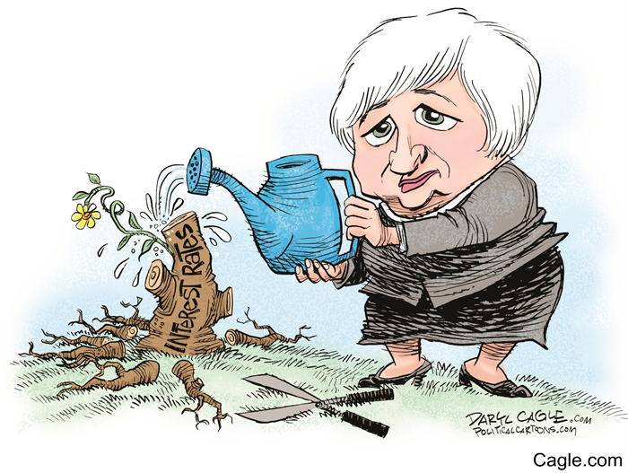
IOU MONEY
But where does the government
come into this?
There is a Federal Reserve Board
in Washington D.C.
The Board is not a bank. There is
no money there. The Board makes policy, like controlling the interest
rate banks charge each other for lending to each other.
Janet Yellin,
Chairwoman,
Fed Reserve Board

Slide 8
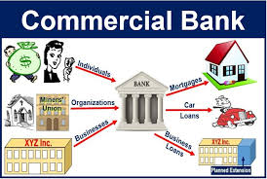
IOU MONEY
I can’t own a share of the Fed bank?
I can’t open an account there?
You don’t know how our banking system
works?
All I learned in school was …
Ah… well… we all put our savings
in a bank and then the bank lends
out the money to people who
need it.

Slide 9

IOU MONEY
No, banks don’t work like that.
No?

Slide 10
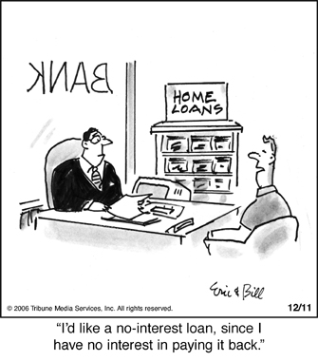

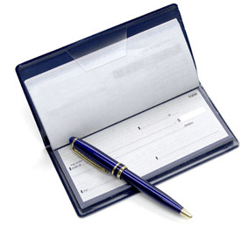
IOU MONEY
Banks work like this….
When you sign a loan contract with a commercial bank,
the bank CREATES ‘bank money’ (also called ‘bank credit’ or ‘checkbook money’) by typing a deposit into your account. Our money supply is privately owned and we pay interest for it…
“I’d like a no-interest loan, since I
have no interest in paying it back.”

Slide 11
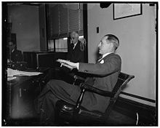
IOU MONEY
But that means to have money
we have to be in debt to private banks?
“That is what our money system is.
If there were no debts in our money system,
there wouldn’t be any money.”
  Mariner S. Eccles
  Chairman, Federal Reserve
  under Franklin D. Roosevelt

Slide 12
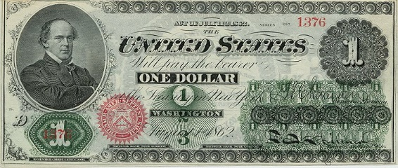
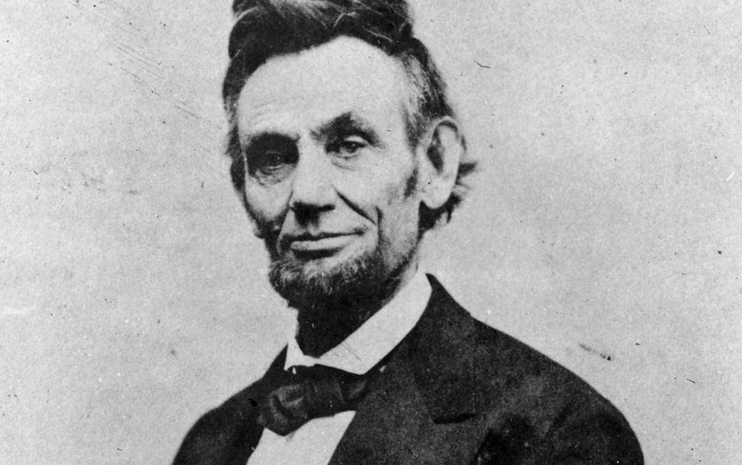
GREENBACK CURRENCY
IOU MONEY
But whatever happened to our
Constitution, Article 1, Section 8?
“The Congress shall have Power …
to coin Money, regulate the Value thereof…”
ABRAHAM LINCOLN:
“The original issue of money should be maintained as the exclusive monopoly of national government.
Money will cease to be the master and become the servant of humanity.”

Slide 13
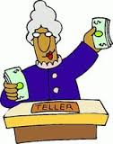
IOU MONEY
Don’t worry about all that. Congress passed the Federal Reserve Bill in 1913 to give us a stable monetary system.
‘Bank money’ is an ​IOU for cash from the bank. You need to go into your bank and ask for cash (the real money) if you want it.​

Slide 14
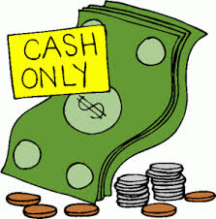
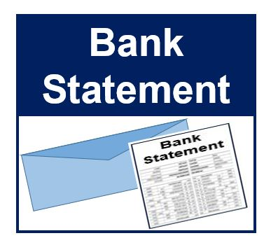
IOU MONEY
The bank doesn't 'lend' reserve money – the real money?
The bank lends you their IOU by creating a deposit in your checking account. You can spend this 'checkbook money' in most places in the country, though a business can refuse to accept checks and ask for cash (the real money).
BORROWERS CHECKING ACCOUNT
BEFORE LOAN
AFTER LOAN
IOU FOR CASH
$ .00
$ 50,000.00

Slide 15
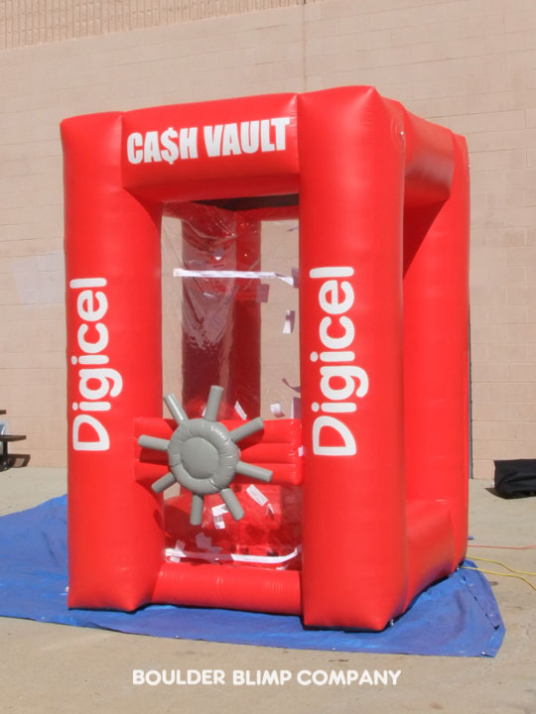
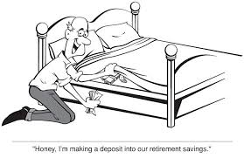
IOU MONEY
Don’t worry! The commercial bank has
reserves – real money – in the central bank.
Wow, I’m glad you said that.
I was just about to go down to TD
and take out all my ‘bank money’ in cash
and put it under my mattress!
CENTRAL BANK RESERVES
ARE DIGITAL & CASH
By law, a commercial bank is required to hold 10%
of its customers’ deposits either
in cash in the bank’s vaults or
as reserves at its local Federal Reserve bank.

Slide 16
IOU MONEY
10% !? But.. but..
That’s not enough if a lot of people want to take
their ‘checkbook money’ out of the bank?
Don’t worry about the details!
We’re here to discuss the central bank’s
QE program, right?
Ok… um… sure….

Slide 17
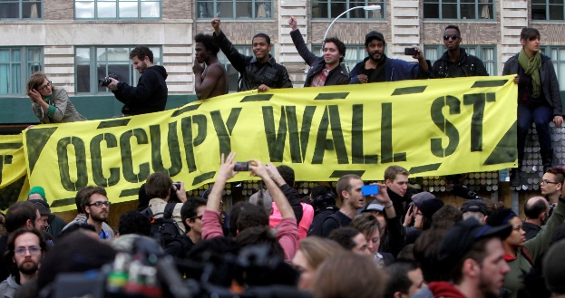
IOU MONEY
Is that why the Occupy movement
was called Occupy Wall Street?
‘Wall Street’ were the PRIVATE banks
creating ‘IOU checkbook money’?
Well…. yes…. but let’s not discuss
Occupy. Let’s get back to QE.
Okay. So the central bank
is doing QE?

Slide 18
QE – To create central bank money
(also called ‘reserves’)

Slide 19
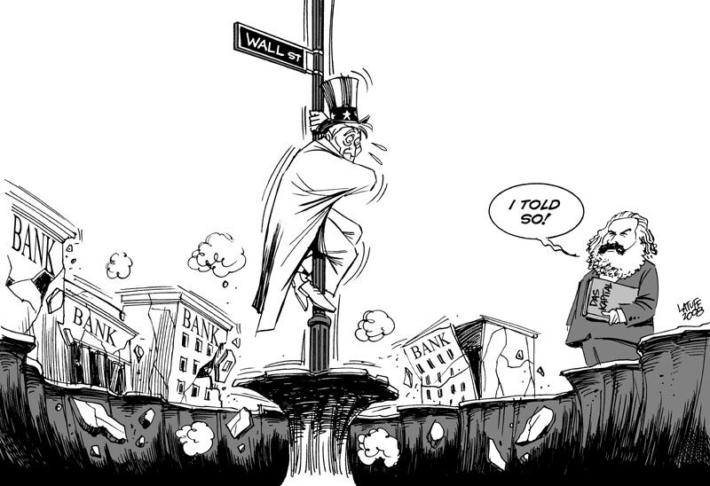
QE COMES FROM THE CENTRAL BANK
Okay. Here we go!
QE began after the Banking Crisis of 2007-2008.

Slide 20
QE COMES FROM THE CENTRAL BANK
After the 2007-2008 worldwide banking crisis,
the economy had not gotten very good,
even with many policies implemented by the FED.
So the Fed decided to do ‘quantitative easing’.
This was brand new!
So what is it?

Slide 21
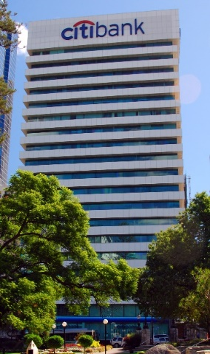
QE COMES FROM THE CENTRAL BANK
The Fed banks ‘create’ reserve money, and add it
to a banks’ reserve account.
BEFORE
AFTER
CITIBANK
RESERVE
ACCOUNT
CITIBANK
RESERVE
ACCOUNT
$ .00
$ 100,000.00
Umm… Why do this?
Why give the banks reserve money?

Slide 22
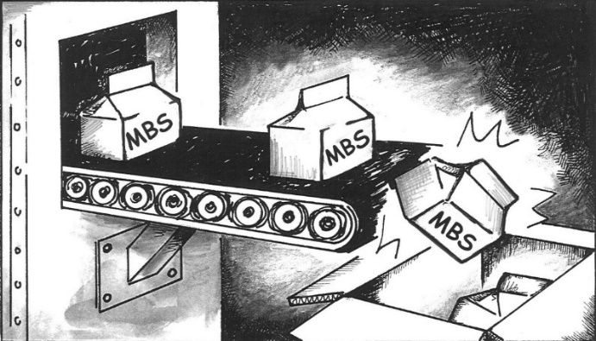


QE COMES FROM THE CENTRAL BANK
The Fed Bank created the reserve to buy financial assets –
bonds – from the commercial banks.
Umm… Why do that?
Well…. the banks had some Mortgage Back Securities – MBS bonds -
which are going down in value, so the bank was in trouble.
We had to make sure the banks were solvent.

Slide 23
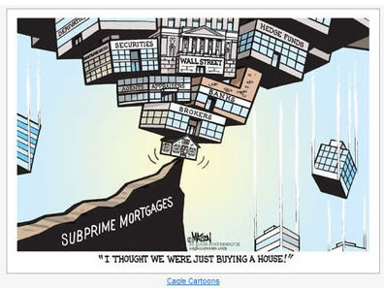
QE COMES FROM THE CENTRAL BANK
“I THOUGHT WE WERE JUST BUYING A HOUSE!”
Umm… Why do the banks own these MBS bonds?
Well, that’s another story…
So the Central Bank buys the MBS bonds from
the commercial banks to help them out.
Umm… How much?

Slide 24


QE COMES FROM THE CENTRAL BANK
You really want to know how much reserve money
was created by the FED?
Q
A
Umm… Yeah, how much reserve money was created by the FED to buy bonds from the banks –the crappy MBS bonds?
Well… okay…. here…. The FED created about 1.74 Trillion reserves dollars.
MBS Securities Owned by Fed Reserve Banks
2007
0.0 Trillion
2016
1.7 Trillion

Slide 25

QE COMES FROM THE CENTRAL BANK
Umm…
Umm… WHAT!
1.7 TRILLION!! RESERVE DOLLARS!
…. FREAKING TRILLIONS!!??

Slide 26
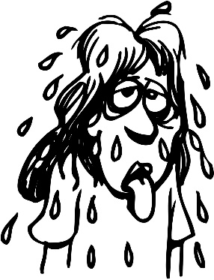
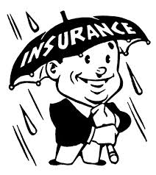

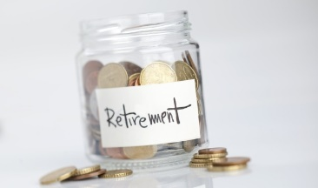
QE COMES FROM THE CENTRAL BANK
And how does this help ‘the people’?
Well, this made sure the banks were solvent so our money in the banks was safe. That certainly helped all of us!
And, well, also… you see, to help the economy to create jobs and help ‘the people’, the FED also started creating reserve money and going out and buying government bonds from insurance companies and pension funds.

Slide 27

QE COMES FROM THE CENTRAL BANK
But I thought the FED could not give reserve money – the real money - to anyone but their member banks?
Yes, correct. Good for you. But you see, the way it works is … the banks got the reserve money, and the pension funds and insurance companies got the IOUs of the banks – bank deposits.

Slide 28
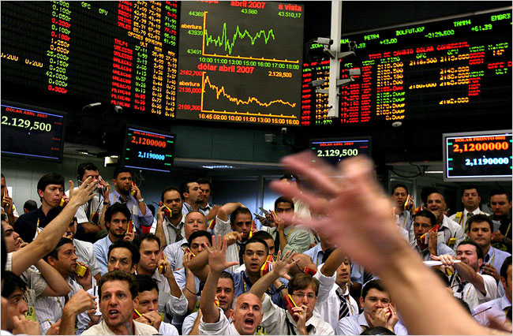
QE COMES FROM THE CENTRAL BANK
It seems all we the people get are IOUs?
So did this help ‘we, the people’?
Well, the idea was that these companies would then take that bank-money and buy more stocks and bonds for their pensioners and insured. This would stimulate our economy.

Slide 29
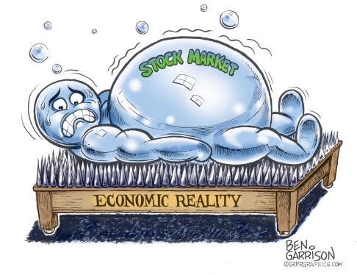
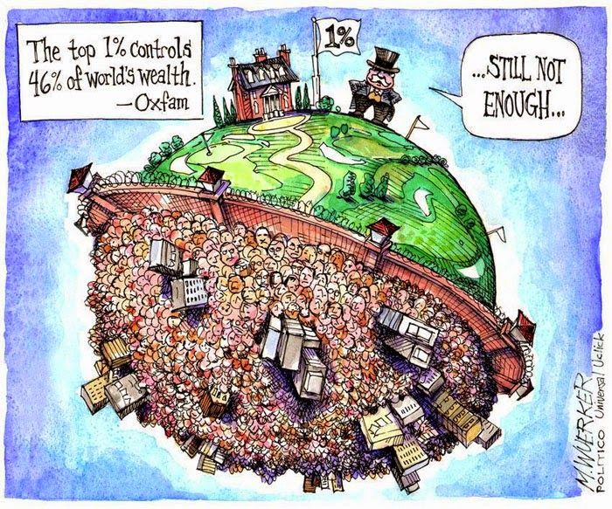
QE COMES FROM THE CENTRAL BANK
The newly created money went into the financial markets, boosting bond and stock markets nearly to their highest level in history.
And how does that help ‘the people’ when the majority of the stock market is owned by the 1% !
Well …

Slide 30
QE COMES FROM THE CENTRAL BANK
Umm… how much government debt was bought by the FED?
Well …
Umm… How much?
Treasury Debt Owned by Fed Reserve Banks
2007
0.8 Trillion
2016
2.5 Trillion

Slide 31
QE COMES FROM THE CENTRAL BANK
Umm… WHAT!
ANOTHER 1.7 TRILLION !!
RESERVE DOLLARS !!
Umm… That’s a total of 3.5 TRILLION DOLLARS
….3.5 FREAKING TRILLION !! ??

Slide 32
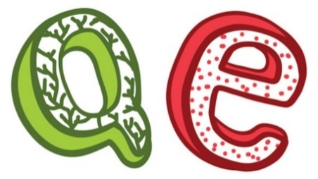
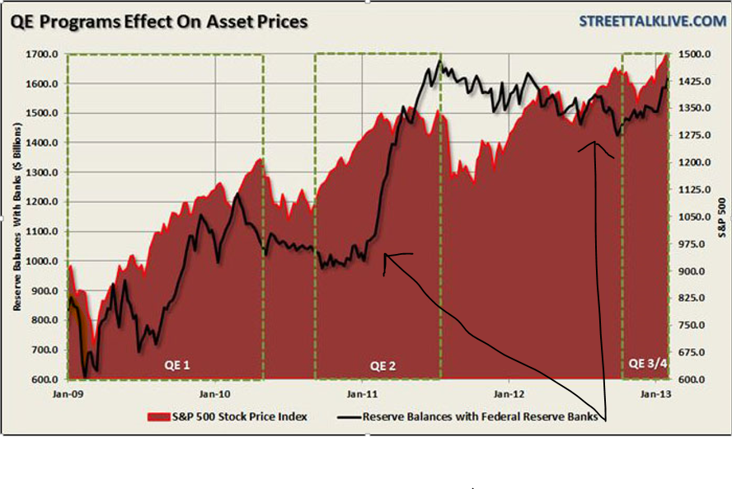
QE COMES FROM THE CENTRAL BANK
What did the PRIVATE banks do with all their reserve money?
Well, in 2008 the FED started paying interest on reserve balances of the member banks. So, a lot of the new reserve money was left in the Federal Reserve Banks collecting interest.
---RESERVE BALS WITH
FED RESERVE BANKS

Slide 33
QE COMES FROM THE CENTRAL BANK
How much bank reserves are earning interest?
Well….
Reserve Balances of Member Banks
2008
0.1 Trillion
2016
2.3 Trillion
2.3 Trillion dollars of reserves
collecting interest. For who?
Well… well…. for the member banks…
the owners of the Fed…
Of course….

Slide 34
QE COMES FROM THE CENTRAL BANK
It appears to me that all this QE reserve money always ends up being given by the PRIVATE Fed Banks to their PRIVATE commercial banks, who own the FED?
They get the real money and WE GET IOUs from the bank. Many… many… many more IOUs than there is reserve money. And all of these IOUs come with INTEREST!
Well, yes… but that is our system….

Slide 35
SOVEREIGN MONEY – DEBT-FREE MONEY

Slide 36
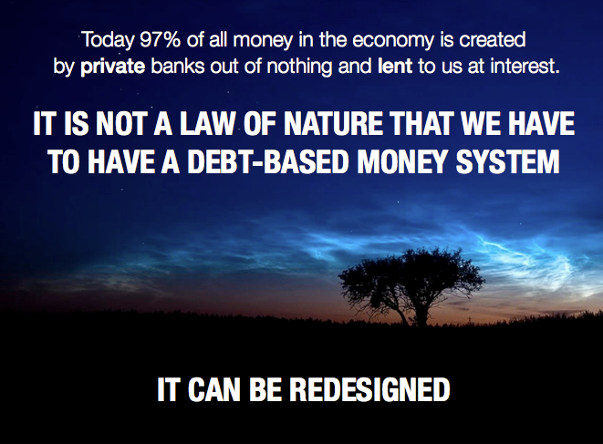
SOVEREIGN MONEY
We need to change our system to sovereign money.
Well, yes… but this is not a good idea.

Slide 37
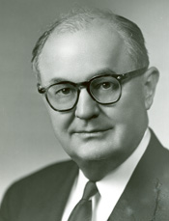
SOVEREIGN MONEY
There will no longer be a dual system of RESERVES and BANK IOU’S. There will only be one type of money – sovereign money – for the central bank, commercial banks, and people.
Government will no longer borrow, but create sovereign money and spend it into the economy for our needs and creating good jobs.
Banks will no longer create their IOU money, but lend sovereign money from their accounts.
Our money in banks will not disappear if a bank fails! The bank will disappear but not our money! Aha!
"I have never yet had anyone who could, through the use of logic and reason, justify the Federal Government borrowing the use of its own money.“
Wright Patman, TX Democrat,
Chair, US House Committee on Banking and Currency (1965-75):
Well, yes… but this is not a good idea.

Slide 38
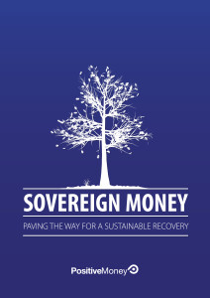
SOVEREIGN MONEY
But our constitution says our government can create debt-free sovereign money. Our constitution does not mention this system of ‘reserve money with bank IOUs’.
Well, yes… but this is not a good idea.

Slide 39
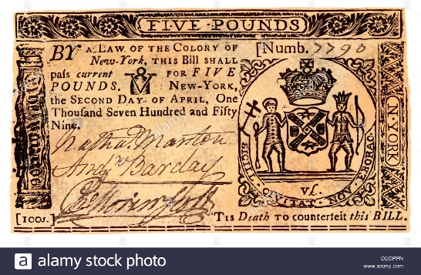
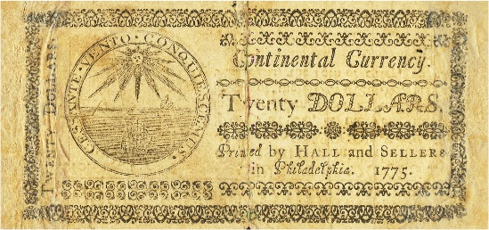
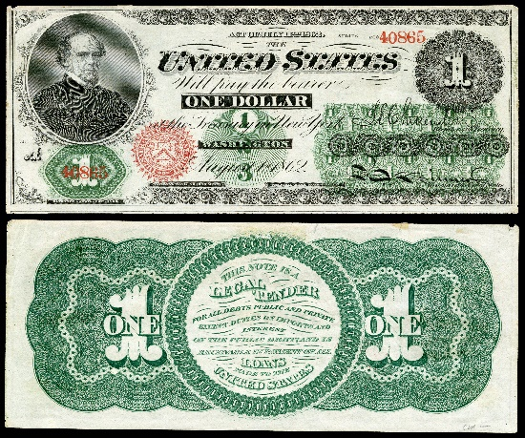
SOVEREIGN MONEY
Why isn’t this a good idea?… Our country has successfully issued debt-free sovereign money numerous times.
All our colonies issued DEBT-FREE money called scrip, our revolutionary congress issued DEBT-FREE money called Continentals, and Lincoln convinced the Congress to issue Greenback dollars, DEBT-FREE?
SCRIP
CONTINENTAL
GREENBACK
Well, yes… but that would cause INFLATION !!!!

Slide 40
SOVEREIGN MONEY
Wait one BIG MOMENT!
That’s what the banks want us to think. That is what the banks say without revealing the actual history of the scrip, Continental, and Greenback.
The colonial scrip brought prosperity to the colonies. The Continental was the cornerstone of the Revolution, and only lost value when the British counterfeited billions! The Greenback worked so well people would not turn them in for gold. The government did not abuse this power to issue money.
SCRIPT
CONTINENTAL
GREENBACK
Well, yes… but this is not a good idea.

Slide 41

SOVEREIGN MONEY
So, what’s wrong with Monetary Reform?
But… but… the banks will not be in control….
Sounds like a good idea to me….

Slide 42

SOVEREIGN MONEY
Monetary Reform for the People
It’s found in the Green Party’s Platform called
“Greening the Dollar”.
It’s also found in Dennis Kucinich’s bill, called the NEED ACT, HR2990, of the 112th Congress.

Slide 43

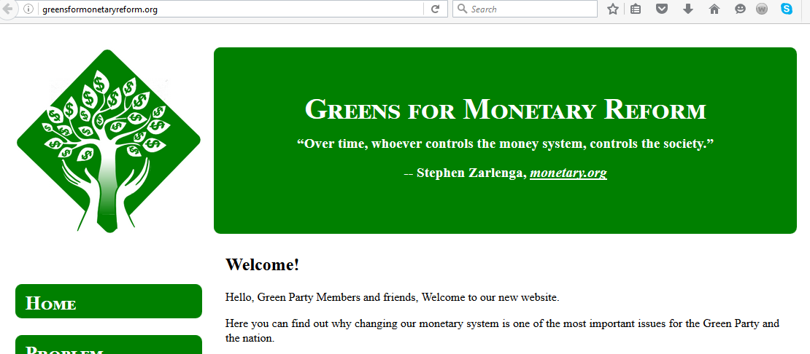
GreensForMonetaryReform.org

Slide 44
THE END

