Slide 1
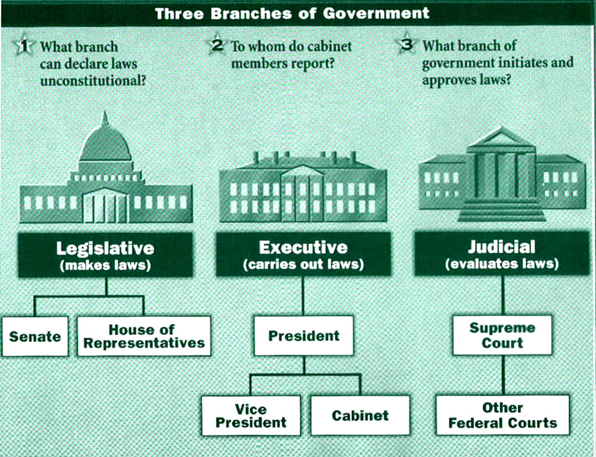

The Lost Science of Money
CHAPTER 24 – Part 2
PROPOSALS FOR U.S. MONETARY REFORM:
Toward a Fourth Branch of Government
Fourth Branch
Monetary
(creates money)
Monetary Authority

Slide 2
THEMES OF LOST SCIENCE OF MONEY BOOK
Primary importance of the money power (power to create money and regulate it)
Nature of money purposely kept secret and confused
How a society defines money determines who controls the society
Battle over control of money has raged for millennia: public vs private
The misuse of the monetary system causes tremendous misery and suffering for the ordinary people. Will & Martin, February 2014
Whenever the public has owned a significant fraction of the money power, great public benefit has ensued: Sparta, the Roman Republic, the American Colonies in the 18th century, GREENBACKS after the Civil War, Canada after the Great Depression, British experience after World War II. Martin, July 2014.

Slide 3
PARTS OF PRESENTATION
Reform #1: Nationalization of the Federal Reserve
What Does Debt-Free Government-Issued Money Look Like?
How Does the Plutocracy Respond?
Nearly All Citizens Would Gain
The Face of Evil
Reform #2: Ending Fractional Reserve Banking and Instituting the 100% Reserve Solution
Avoiding Banking System Panics and Collapses
Soddy and Simons Develop the 100% Reserve Solution
100% Reserve Solution Need Not Be Deflationary
De Fremery Kept the 100% Reserve Solution Alive
Reform #3: Institute Anti-Deflation Programs and Beware of Deflation
The Usury Problem Remains
Financiers Will Try to Sabotage Reform
Don’t Allow Economists to Direct Monetary Reform
Obstacles to Monetary Reform
  The banking and media establishments
  Poor monetary and economic thought
  Any Rand and the Libertarian free market theology
  Dangers to civil liberty from the “War on terrorism”
What Can Be Done Now?
The Next Big Thing?

Slide 4
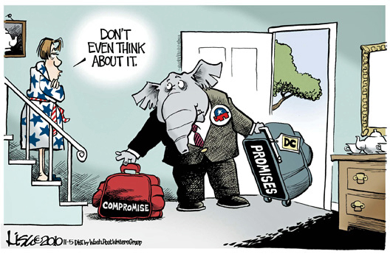
Reform #1: Nationalization of the Federal Reserve
“The American Monetary Institute’s strategy for monetary reform is to concentrate on three minimal reforms that place time on the side of justice… These minimal reforms should be agreeable to thoughtful, honest observers; but on these three points there should be no compromise.” Zarlenga, LSM, p. 663
REFORM #1: Nationalization of the Federal Reserve
REFORM #2: Ending Fractional Reserve Banking and Instituting the 100% Reserve Solution
REFORM #3: Institute Anti-Deflation Programs and Beware of Deflation
PROMISES
COMPROMISE

Slide 5
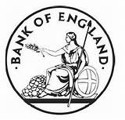
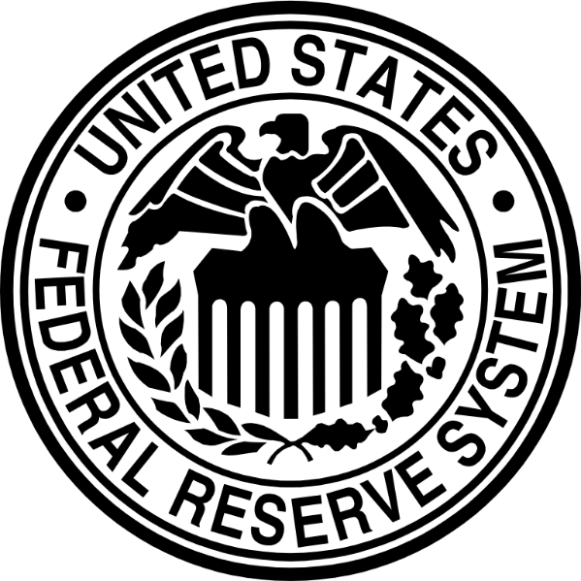
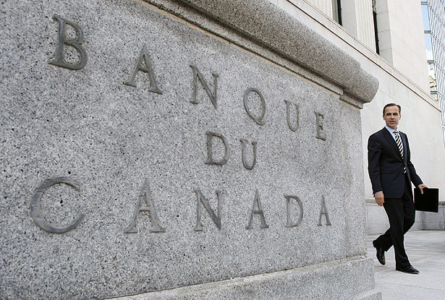
Reform #1: Nationalization of the Federal Reserve
The government, with political support, should nationalize the Federal Reserve System, by buying all the shares of the twelve Federal Reserve Banks from the private commercial banks who own them. This is not new. England did the same in 1946 and nationalized the Bank of England. And Canada did the same in 1938 when it bought all the private shares of the Bank of Canada.
NEXT TO BE NATIONALIZED?

Slide 6

Reform #1: Nationalization of the Federal Reserve
“Several past Chairmen of the House Banking Committee have introduced bills to do away with the private Federal Reserve System…” Zarlenga, LSM, p. 664
Wright Patman, chairman of the House Committee on Banking and Currency 1965-75, introduced bills to remove the Federal Reserve System.
“Now, I believe the system should be changed. The Constitution of the United States does not give the banks the power to create money. The Constitution says that Congress shall have the power to create money, but now, under our system, we will sell bonds to commercial banks and obtain credit from those banks… I believe the time will come when people will demand that this be changed. I believe the time will come in this country when they will actually blame you and me and everyone else connected with this Congress for sitting idly by and permitting such an idiotic system to continue. I make that statement after years of study.”
Wright Patman
(1893 – 1976)

Slide 7
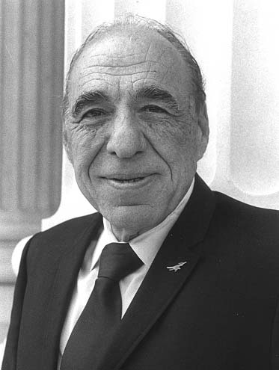
Reform #1: Nationalization of the Federal Reserve
“Several past Chairmen of the House Banking Committee have introduced bills to do away with the private Federal Reserve System…” Zarlenga, LSM, p. 664
Henry Gonzales, Chairman of the House Banking and Currency Committee,
introduced legislation to repeal the Federal Reserve System almost every year.
The legislation was always defeated and the media remained silent.
Henry Gonzalez
1916 - 2000

Slide 8
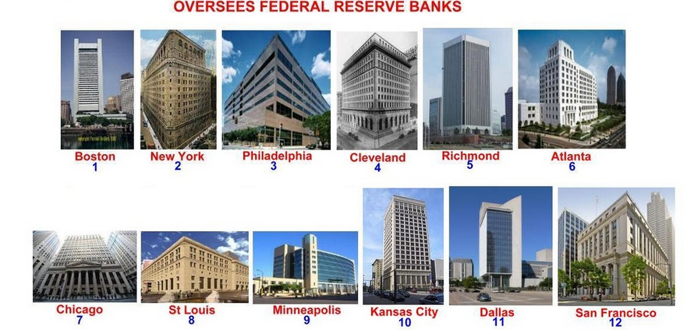

Reform #1: Nationalization of the Federal Reserve
THE 12 FEDERAL RESERVE BANKS ARE NATIONALIZED
AND FUNCTION AS PART OF THE TREASURY DEPARTMENT.
THE 12 FEDERAL RESERVE BANKS BRING ADMINISTRATIVE EXPERIENCE
AND VALUABLE PAYMENT SYSTEMS TO THE TREASURY.

Slide 9
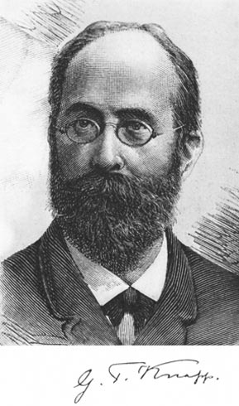
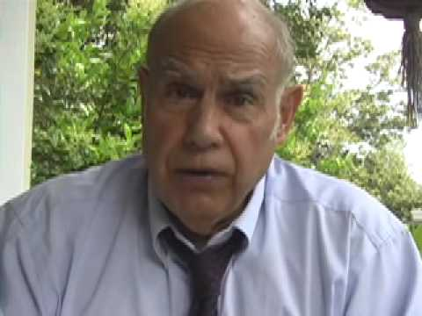
Reform #1: Nationalization of the Federal Reserve
“The process of reform starts with an understanding of money’s nature as a legal institution…
legislation nationalizing the Fed… [must have] an accurate definition of money.”
Zarlenga, LSM, p. 665
Georg F. Knapp, The State Theory of Money, p. 40:
“If we have already declared in the beginning that money is
a creation of law, this is not to be interpreted in the narrower
sense that it is a creation of jurisprudence, but in the larger
sense that it is a creation of the legislative activity of the State, a creation of legislative policy.”
Stephen Zarlenga, LSM, p. 657:
“Money’s essence is an abstract social power embodied in law, as an unconditional means of
payment.”

Slide 10
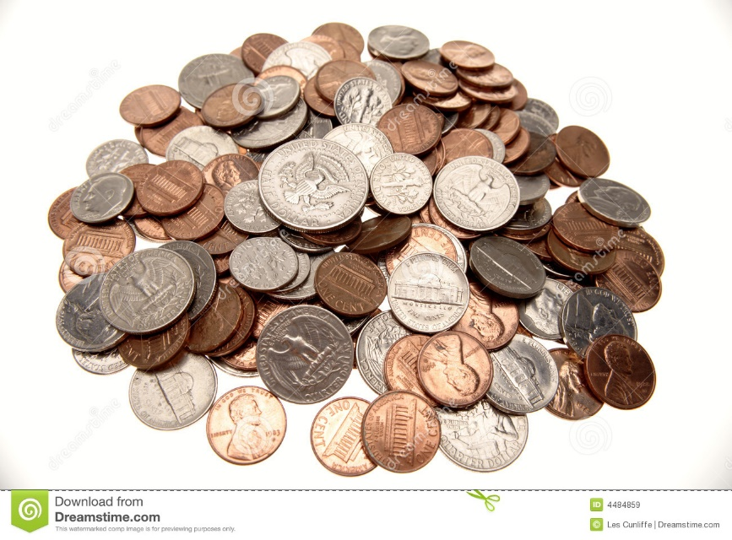
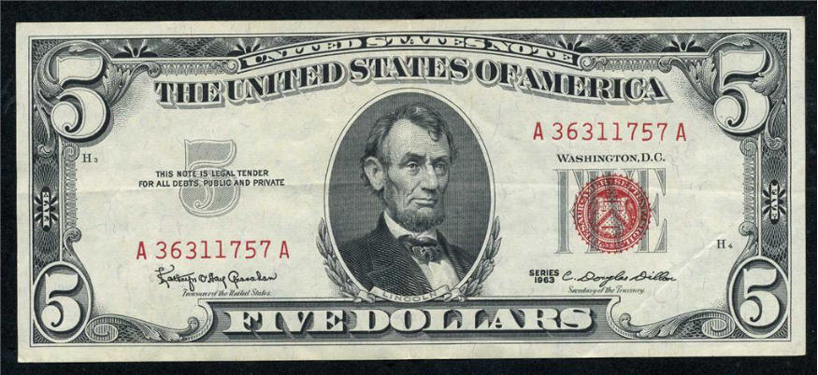

What Does Debt-Free Government-Issued Money Look Like?
COINS
Debt-Free Government-Issued Money could take many
forms: coins, paper, checking accounts.
The nature of this money, however, is all the same:
issued by the government, without creating any debt,
and spent by acts of Congress on the needs of the
American people.
The money circulates, passing from hand to hand,
ending up in people’s checking accounts.
The money does not disappear like bank credit, but
can be removed from circulation by the government
through government taxing authority.
U.S. PAPER NOTES
CHECKBOOK MONEY

Slide 11
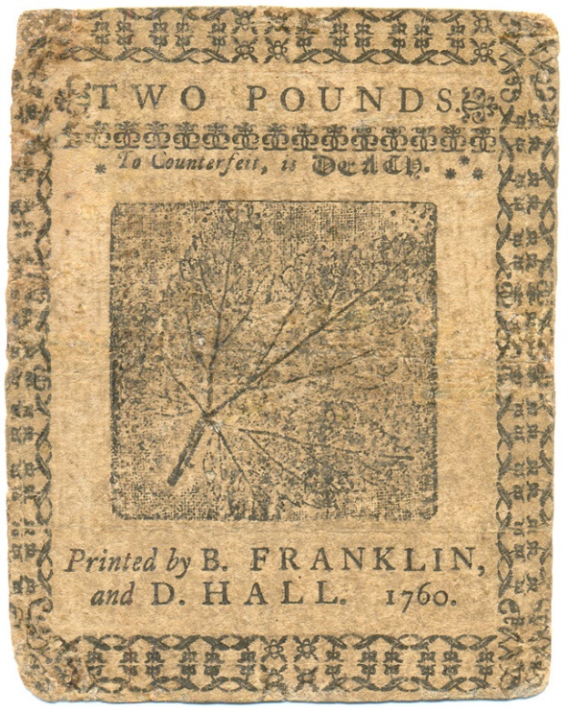
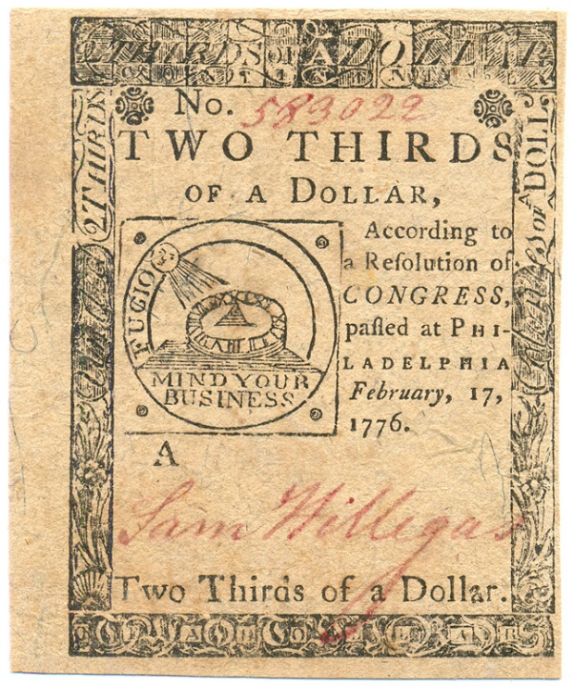
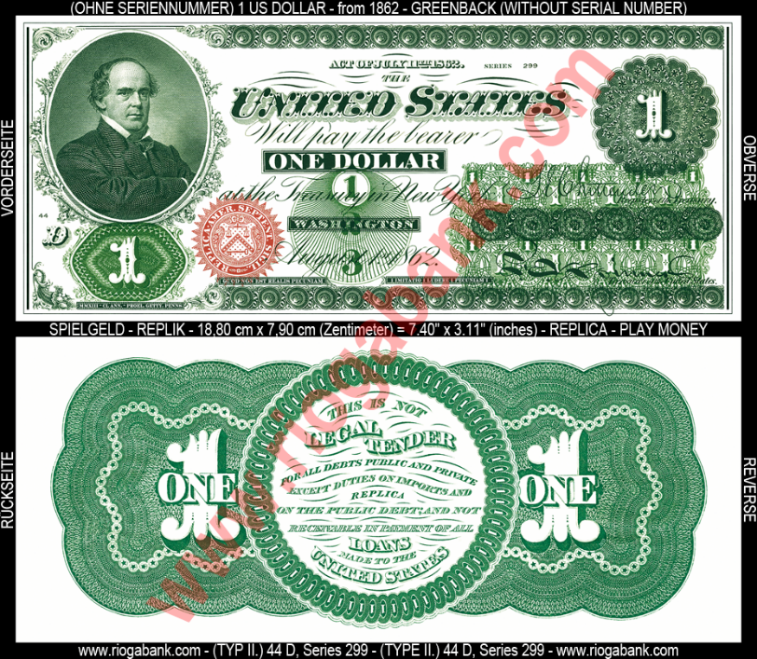
How Does the Plutocracy Respond?
“Those holding the money power have promoted a two century smear campaign against government to raise the fear of inflation under such a system, even though the evidence clearly shows greater monetary abuse by privately controlled money systems than by government ones. That’s why economists are steered away from the study of history.” Zarlenga, LSM, p. 666
OUR GOVERNMENT NEVER OVER-ISSUED ITS MONEY,
BUT ALL WERE ATTACKED: by Britain and by Private Bankers
IT DEVELOPED OUR COLONIES
(Colonial Bills of Credit)
IT GAINED OUR INDEPENDENCE
(Revolutionary War Continentals)
IT MAINTAINED THE UNION
(Greenbacks)

Slide 12



How Does the Plutocracy Respond?
“… the Plutocracy’s [government’s] inflation theme is ‘the big lie.’ ”
Zarlenga, LSM, p. 667
The banks, not the government, fueled the 1920’s:
Banks financed the financial bubble from 1921 to 1929
LOANS FOR SECURITIES
increased 121%
LOANS FOR REAL ESTATE
increased 178%
LOANS FOR INVESTMENTS
increased 67%

Slide 13

Nearly All Citizens Would Gain…
“… the type of corporate predators now in charge would find most of their funding and power cut off.” Zarlenga, LSM, p. 668
There would be
smaller government –
no need to fight
the unjust money system
There would be less
abuse of government –
private money creation
will not be available to
buy the government
There would be less
government control –
no need to fight
the unjust money system

Slide 14

The Face of Evil
“Some economists will scoff at being characterized as evil for merely making deductions from their beloved theoretical premises that they place their faith in, for merely acting as good priests of their hallowed market god.
But they truly serve an evil deity and the fruits of their theories grow monotonously bitter.
Somehow their theories always manage to reserve the current benefits for wealthy predators, parasites really, who in the main part fund their salaries.” Zarlenga, LSM, p. 668

Slide 15

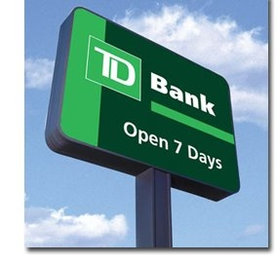

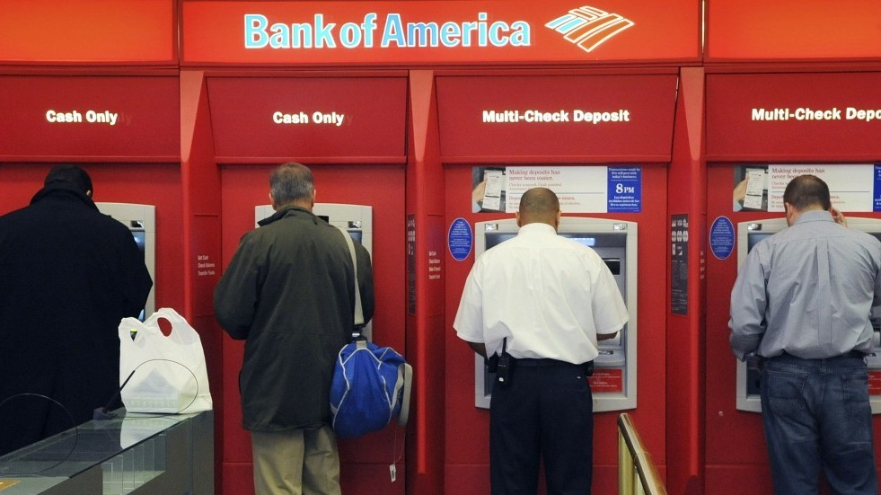

Reform #2:
Ending Fractional Reserve Banking and Instituting the 100% Reserve Solution
= where private commercial banks CREATE money when they ‘lend’

Slide 16
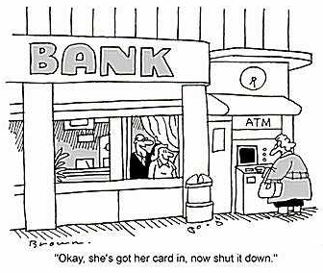
Reform #2:
Ending Fractional Reserve Banking and Instituting the 100% Reserve Solution
There is not one private commercial bank
that has ‘lent’ their depositor’s money to
a borrower.
Every private commercial bank CREATES
money when they ‘make a loan’.

Slide 17
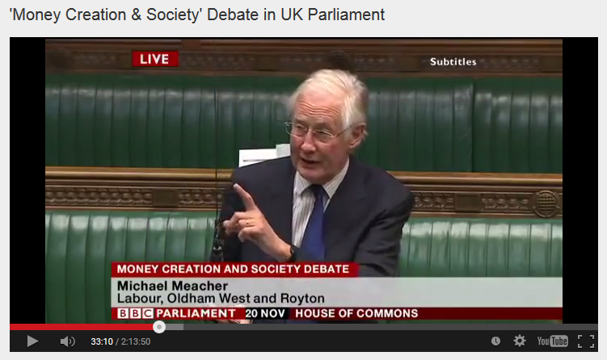

Reform #2:
Ending Fractional Reserve Banking and Instituting the 100% Reserve Solution
House of Commons, Nov. 20, 2014, Mr. Michael Meacher, MP:
“It is unfortunate… that it is so little understood by the public that money is created every time by the banks when they make loans.”
“And it is the banks – the banks – which determine how money is allocated across the economy.”

Slide 18
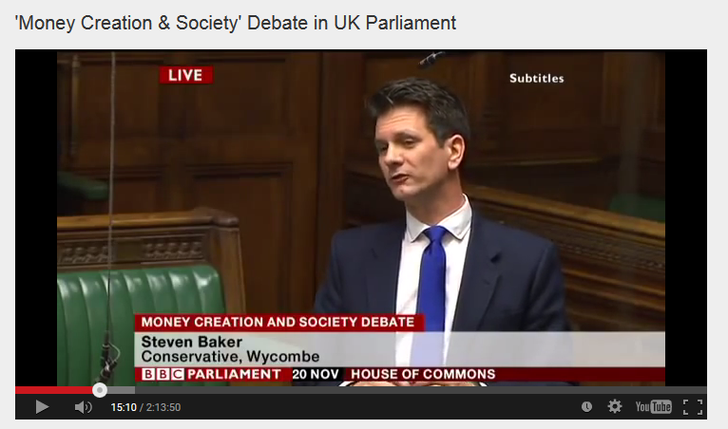
Reform #2:
Ending Fractional Reserve Banking and Instituting the 100% Reserve Solution
House of Commons, Nov. 20, 2014, Mr. Steven Baker, MP:
“Whenever a bank makes a loan it simultaneously makes a matching deposit in the borrower’s bank account, thereby creating new money.”

Slide 19
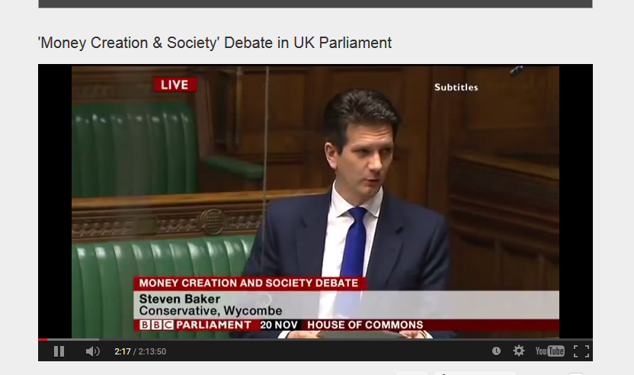
Reform #2:
Ending Fractional Reserve Banking and Instituting the 100% Reserve Solution
House of Commons, Nov. 20, 2014, Mr. Steven Baker, MP:
“The explanation is actually taken from the Bank of England article ‘Money Creation in the Modern Economy’. It seems to me rather hard to dismiss.”

Slide 20
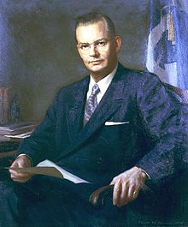
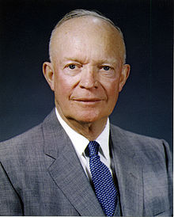
Reform #2:
Ending Fractional Reserve Banking and Instituting the 100% Reserve Solution
Robert B. Anderson, Secretary of the Treasury under President Eisenhower:
"When a bank makes a loan it simply adds to the borrowers’ deposit account in the bank by the amount of the loan. The money is not taken from anyone else's deposit; it was not previously paid in to the bank by anyone. It's new money, created by the bank for the use of the borrower.“

Slide 21
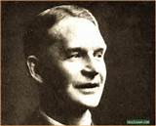
Reform #2:
Ending Fractional Reserve Banking and Instituting the 100% Reserve Solution
Dr. Frederick Soddy, THE ROLE OF MONEY
“The “money-power” … is … nothing more nor less than a new technique designed to create and destroy money by adding and withdrawing figures in bank ledgers, without the slightest concern for the interests of the community….”

Slide 22
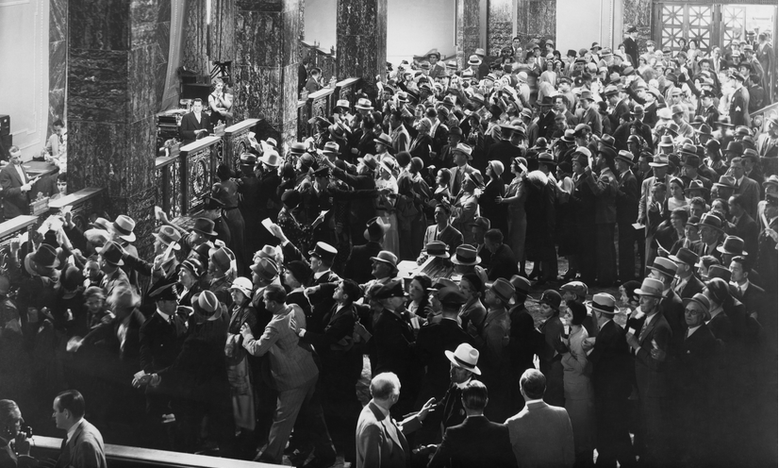
Avoiding Banking System Panics and Collapses
“Main Cause for Bank Panics
It is difficult to understand why anybody should be in doubt as to the main cause of bank panics. When men engage in a ‘run on a bank,’ … They’re afraid that if they don’t withdraw the money they have a right to withdraw, they may lose it altogether. And their fear is perfectly justified under a system of fractional reserve banking. Their money is not there – nor is it anywhere. Only a small fraction of their money has an actual physical existence. All the rest of it is nothing but book entries against which the depositors can draw checks.” Robert De Fremery, Rights vs. Privileges, pp. 58-59

Slide 23
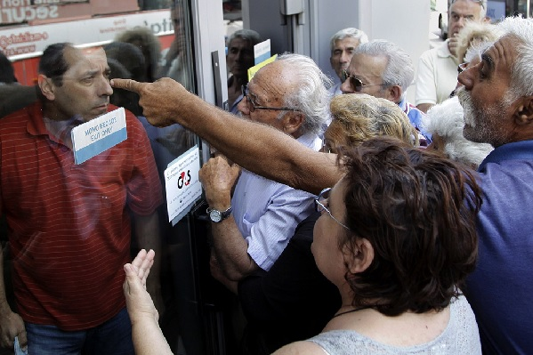
Avoiding Banking System Panics and Collapses
“Our banks have the privilege of creating such book entries and lending them to the public so long as they maintain a certain minimum cash reserve... The creation and lending of fictitious deposits is not a sound method of banking.“
Robert De Fremery, Rights vs. Privileges, p. 59, p. 61
GREEK BANK RUN

Slide 24
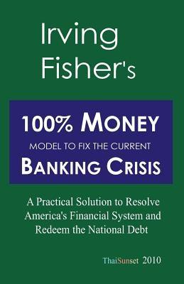
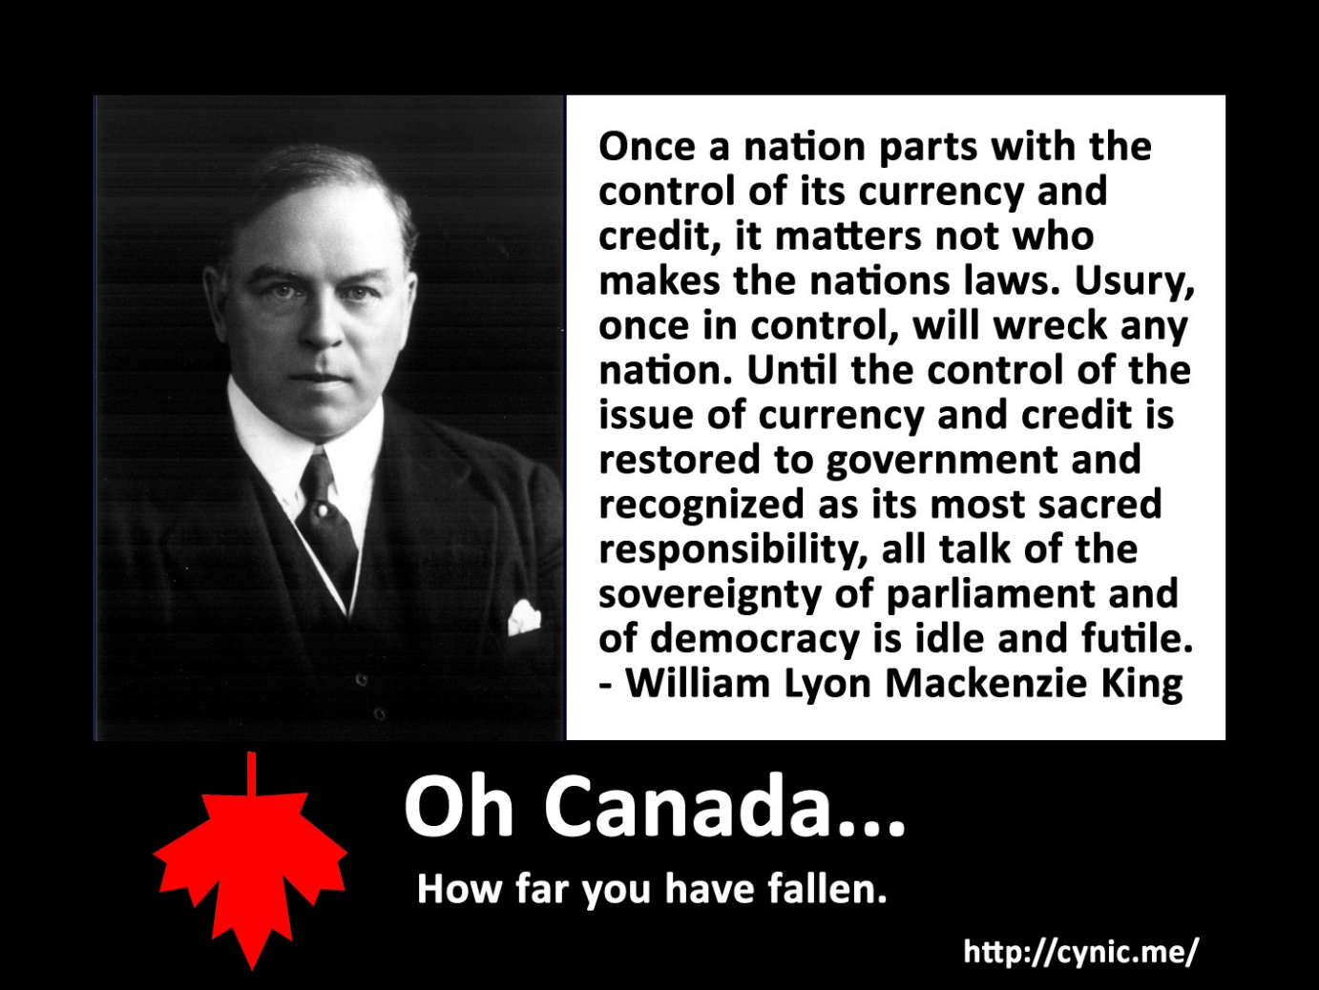
Avoiding Banking System Panics and Collapses
“When one understands the nature of money as an abstract legal power, it clearly becomes possible for the government to create and substitute such trusted real money for the already existing, suspect bank credit. Thus we are not held hostage to preserving the existing flawed banking system…” Zarlenga, LSM, pp. 670-671

Slide 25
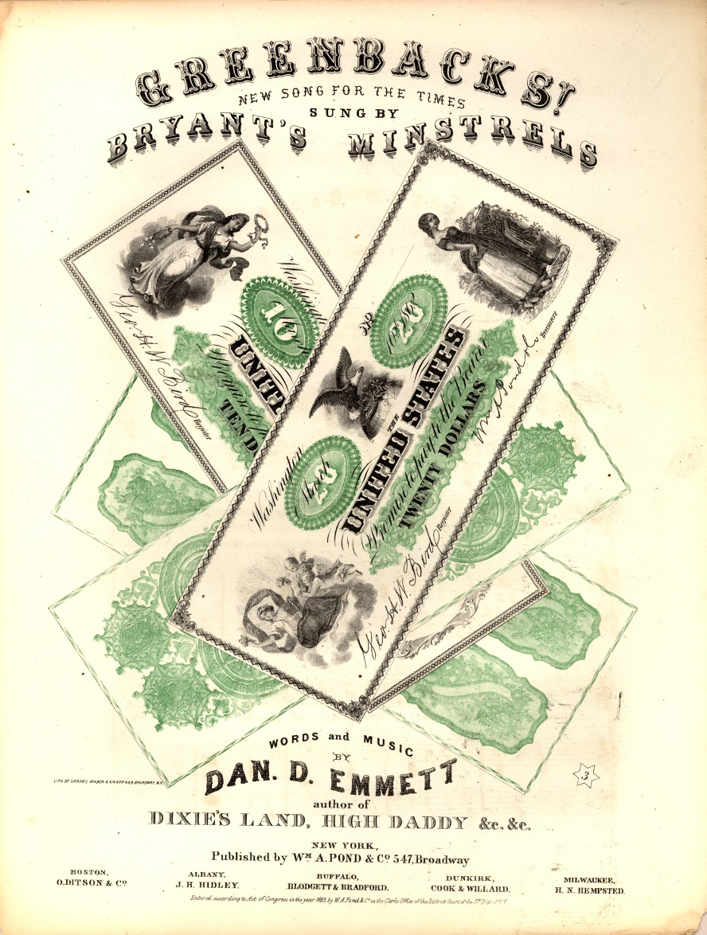
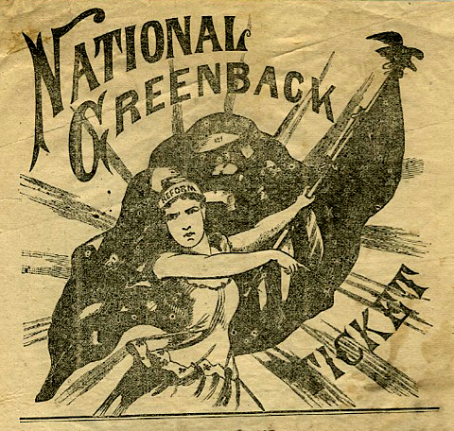
Avoiding Banking System Panics and Collapses
The history of government-issued money in the U.S. is a good one. Our government has never created more than the amount authorized by our Congress. And the money was debt-free and interest-free. Spent by the government on the needs of the nation. Never adding to our national debt.
On the other hand, the bankers
have abused their ill-gotten legal privilege to create money as loans. By over issuing their ‘bank credit’ money out of thin air, they have caused depressions and asset bubbles, causing great suffering to the people of the nation.
Why do we let it continue?

Slide 26
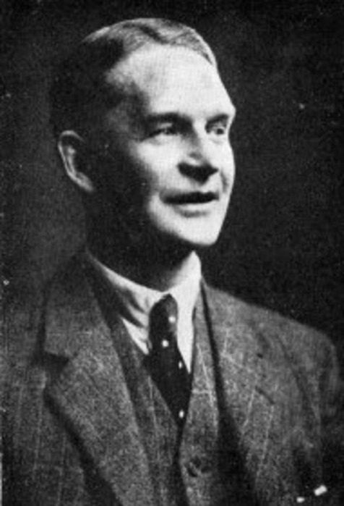
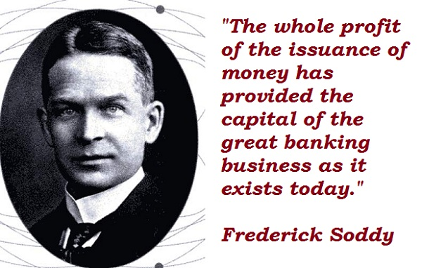
Soddy and Simons Develop the 100% Reserve Solution
Frederick Soddy: “A 1921 Nobel laureate in chemistry for his work on radioactive decay, he foresaw the energy potential of atomic fission as early as 1909. But his disquiet about that power’s potential wartime use, combined with his revulsion at his discipline’s complicity in the mass deaths of World War I, led him to set aside chemistry for the study of political economy…”
Eric Zencey, “Mr. Soddy’s Ecological Economy”, April 11, 2009, New York Times
English
(1877 – 1956)
Frederick Soddy, WEALTH, CAPITAL AND MONEY: A Resume of My Theories, p. 292:
“Poverty now is maintained artificially to maintain the old type of civilization, wherein the many were governable by fear of want and of insecurity of livelihood….
The nation alone is to have the right and power to issue all money which in the nation is legal tender, and to prevent and utterly suppress the practice of private organisations of issuing new money for which something in wealth is received without any one … giving up anything at all.”

Slide 27

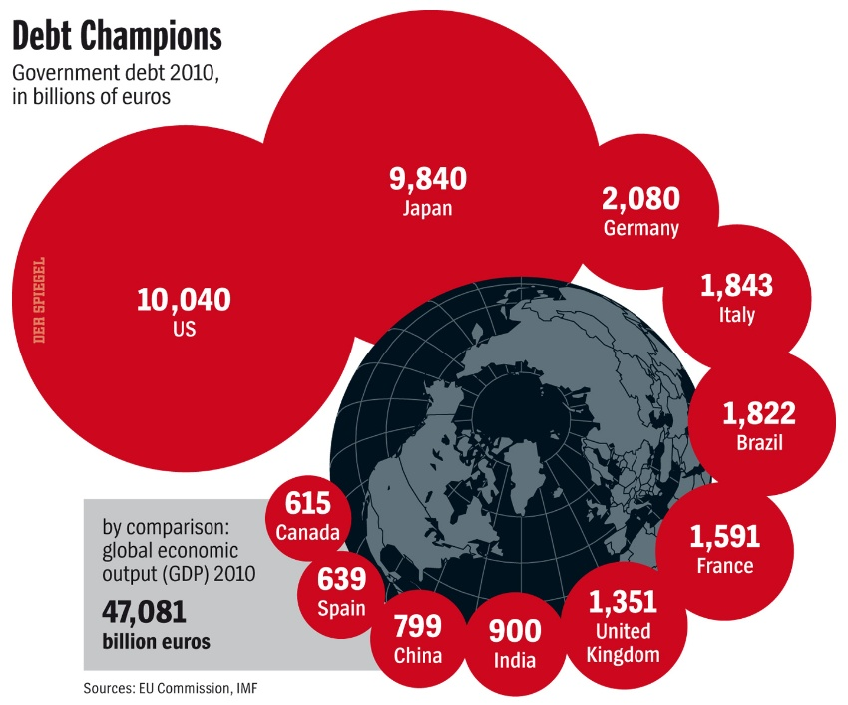
Soddy and Simons Develop the 100% Reserve Solution
OUR ENVIRONMENT VERSUS DEBT
“Soddy criticized the prevailing belief of the economy as a perpetual motion machine, capable of generating infinite wealth…
The amount of wealth that an economy can create is limited by the amount of … energy that it can sustainably suck from its environment — and by the amount of … effluent … that the environment can sustainably absorb…
Debt, being imaginary, has no such natural limit. It can grow infinitely, compounding at any rate we decide.
’The ruling passion of the age,’ Soddy said, ‘is to convert wealth into debt’ — to exchange a thing with present-day real value … for something immutable and unchanging, a claim on wealth that has yet to be made.
It’s like musical chairs — in the wake of some shock… holders of abstract debt suddenly want to hold money or real wealth instead. But not all of them can. One person’s loss causes another’s, and the whole system cascades into crisis.”
Eric Zencey, “Mr. Soddy’s Ecological Economy”, April 11, 2009, New York Times

Slide 28


Soddy and Simons Develop the 100% Reserve Solution
“The concept behind the 100% Reserve Solution was discovered by … Frederick Soddy in 1926. During the Great Depression, Henry C. Simons was a professor at the University of Chicago, my alma mater. Simons independently rediscovered the 100% principle in 1933, and proposed it as the way to end the depression and prevent future banking panics.”
Zarlenga, LSM, p. 672
Henry C. Simons
1899 - 1946
“Reform of the banking system was also necessary, and he urged that the money supply be based on a 100 per cent reserve of government obligations. Also, he argued the case for a statutory rule of monetary policy that would govern the conduct of the monetary authorities. Which of several reasonable rules was chosen was less important than the existence of some objective standard known to the public and binding on the authorities.”
"Simons, Henry C." International Encyclopedia of the Social Sciences. 1968. Encyclopedia.com. 19 Sep. 2015 <http://www.encyclopedia.com>.
UNIVERSITY OF CHICAGO
SOUTH CHICAGO, ILL.

Slide 29
Soddy and Simons Develop the 100% Reserve Solution
HISTORY OF
THE CHICAGO PLAN
The Chicago plan was a collection of banking reforms suggested by University of Chicago economists in the wake of the Great Depression. A six-page memorandum on banking reform was given limited and confidential distribution to about 40 individuals on March 16, 1933.
The plan generated much interest and discussion among lawmakers but the suggested reforms, such as the abolition of the fractional reserve system and imposition of 100% reserves on demand deposits, were set aside and replaced by watered down alternative measures: The Banking Act of 1935 institutionalized Federal deposit insurance and the separation of commercial and investment banking. It successfully restored the public's confidence in the banking system and ended discussion of banking reform.
After apparent recovery in the mid-1930s, America entered the Recession of 1937-1938 and the key elements of the Chicago plan resurfaced in a July 1939 draft proposal titled A Program for Monetary Reform but did not result in any new legislation.

Slide 30
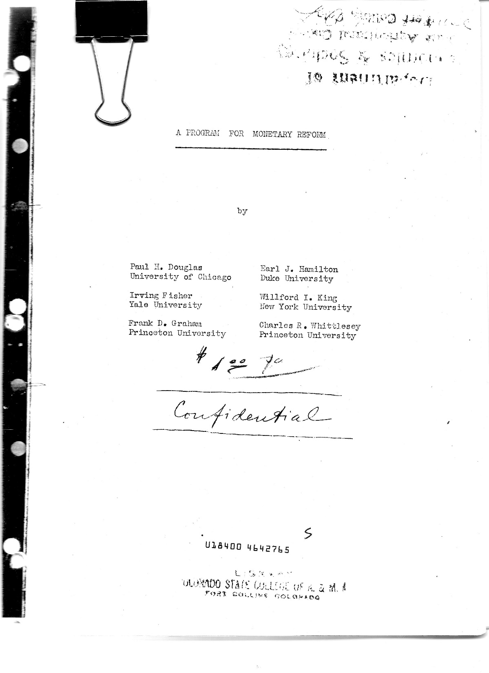
Soddy and Simons Develop the 100% Reserve Solution
A Program for Monetary Reform, July 1939
A PROGRAM FOR MONETARY REFORM
The following proposal was put forward by American economists in 1939 as an alternative to the private fractional reserve bank system:
“A PROGRAM FOR MONETARY REFORM”, 1939
by Paul H. Douglas Earl J. Hamilton
Irving Fisher Willford I. King
Frank D. Graham Charles R. Whittlesey
“… it is desirable that any bank or other agency holding deposits subject to check (demand deposits) be required to keep on hand a dollar of reserve for every dollar of such deposit, so that, in effect, deposits subject to check actually represent money held by the bank in trust for the depositor.”

Slide 31
Soddy and Simons Develop the 100% Reserve Solution
A Program for Monetary Reform, July 1939
A PROGRAM FOR MONETARY REFORM
“The Fractional Reserve System
(9) A chief loose screw in our present American money and banking
system is the requirement of only fractional reserves behind demand
deposits. Fractional reserves give our thousands of commercial banks
the power to increase or decrease the volume of our circulating medium
by increasing or decreasing bank loans and investments. The banks thus
exercise what has always, and justly, been considered a prerogative of
sovereign power. “ A Program for Monetary Reform, 1939, p. 19
“The 100% reserve system was the original system of deposit banking, but
the fractional reserve system was introduced by private Venetian bankers
not later than the middle of the Fourteenth century… But what thus began
as a breach of trust has now become the accepted and lawful practice.”
A Program for Monetary Reform, 1939, p. 19
“(13) The 100% reserve requirement would, in effect, completely
separate from banking the power to issue money. The two are now
disastrously interdependent. Banking would become wholly a business
of lending and investing pre-existing money.”
A Program for Monetary Reform, 1939, p. 29

Slide 32


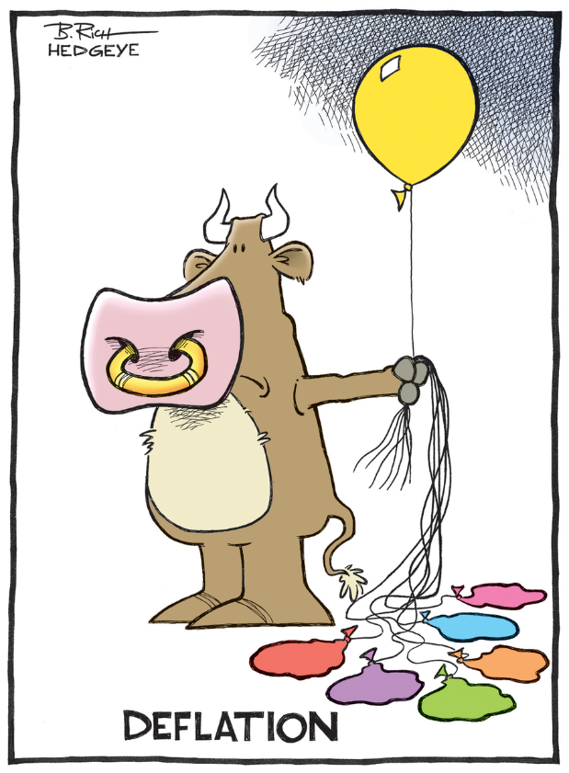
100% Reserve Solution Need Not Be Deflationary
WHAT DOES IT MEAN ‘TO ESTABLISH 100% RESERVES’?
The U.S. Treasury loans freshly created U.S. money to the
the banks to bring their cash reserves up to 100%.
Thus, all the bank credit money created out of thin air
through fractional reserve banking is changed into
real, honest money. There is no deflation.
As the current loans are paid off, the repaid principal
does not ‘disappear’, which would happen under the
old fractional reserve system. The repaid principal would be
paid by the banks to the U.S. Treasury, to repay the loans
to the banks in the conversion to 100% Reserves.
Telling the banks they could not lend unless they have 100% reserves for
each dollar they lent.
This would cause an incredible DEFLATION.
The economy would crash, and banking reform discredited!

Slide 33
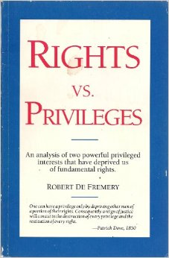
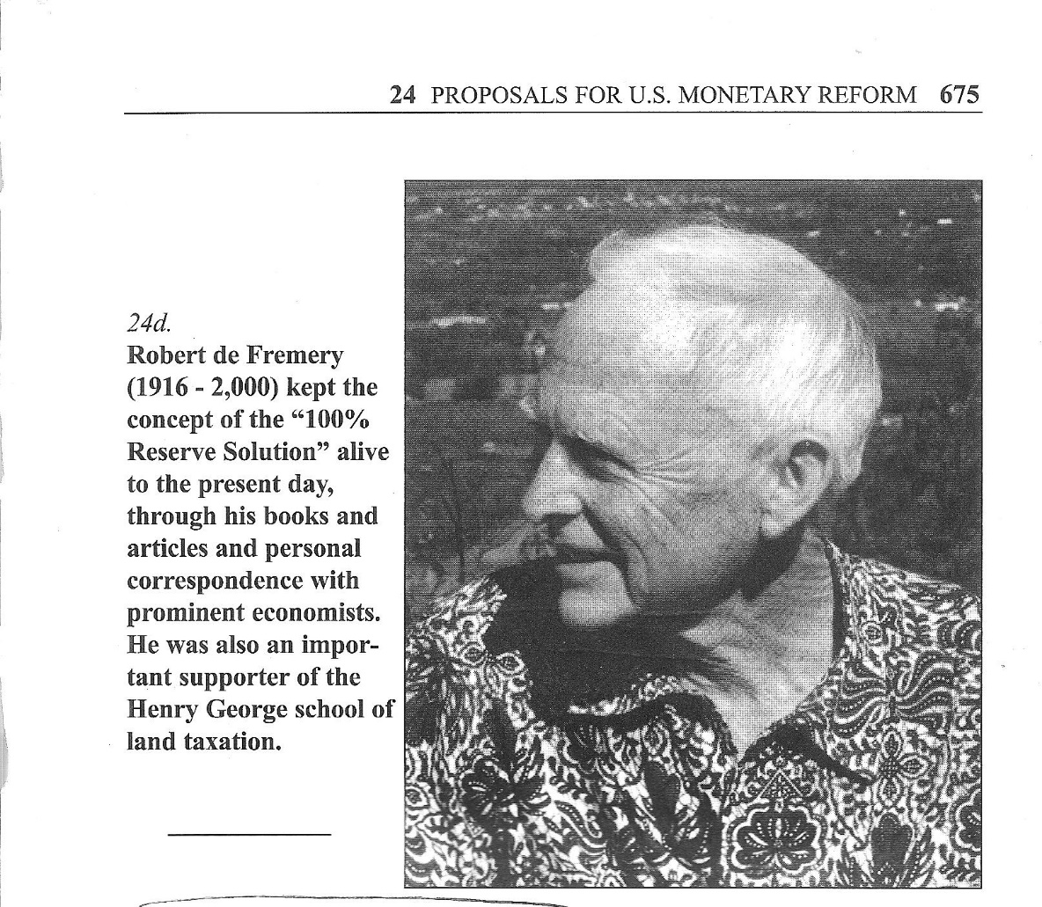
De Fremery Kept the 100% Reserve Solution Alive
LAND
MONEY
One can have a privilege only by depriving other men of
a portion of their rights. Consequently a reign of justice
will consist in the destruction of every privilege and the
restitution of every right. -Patrick Dove, 1850

Slide 34
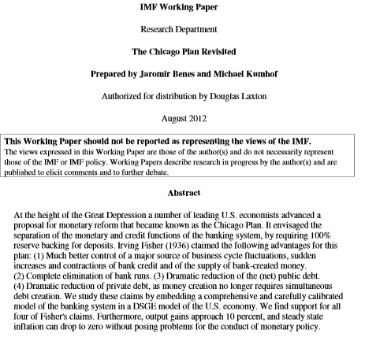


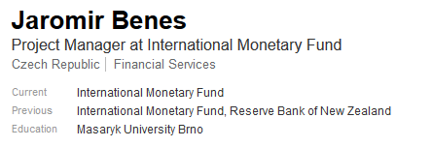
De Fremery Kept the 100% Reserve Solution Alive
THE 100% RESERVE SOLUTION
CAME ALIVE AGAIN IN 2012

Slide 35

Reform #3:
Institute Anti-Deflation Programs and Beware of Deflation
Beware of those public figures who advocate money reform but truly want either deflation or inflation, to repudiate the reform.
“Therefore limitations on the bankers’ power to create money must not only be accompanied by clearly defined powers for the government to take their place, but also specific programs requiring money creation…” (re-build infrastructure, pay for Social Security and a national health care system) to avoid deflation, and specific controls over the amount of money created to avoid inflation.
Zarlenga, LSM, p. 674

Slide 36
The Usury Problem Remains
The problems of usury and interest are complicated.

Slide 37

The Usury Problem Remains
John Whipple (1836) demonstrated the impossibility of long term interest, at moderate rates!
“If 5 English pennies… had been… at 5 per cent compound interest from the beginning of the Christian era until the present time, it would amount in gold of standard fineness to 32,366,648,157 spheres of gold each eight thousand miles in diameter, or as large as the earth.”
THAT IS 32 BILLION EARTH-SIZE BALLS !!!
WHAT DOES INTEREST DO TO SOCIETY?
WHAT DOES INTEREST DO TO NATURE?

Slide 38
The Usury Problem Remains
“Some steps could be taken immediately.”
Zarlenga, LSM, pp. 675-676
nationalize debt-free money creation in government hands
set an immediate national legal limit of 8% annual interest (most U.S. states had this limit in 1980)
no interest paid on checking accounts
cumulative interest should not exceed the amount loaned
“Regarding the international debt problem, Pope John Paul II, is the best economist. His call for a ‘Jubilee’ to forgive much of the debt – to write it off makes much more sense than most of them do.” Zarlenga, LSM, p. 676

Slide 39
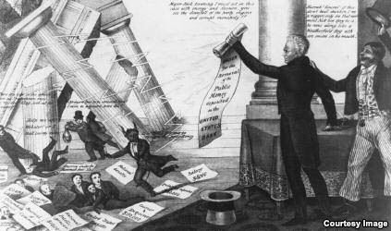
Financiers Will Try to Sabotage Reform
We should not be surprised if bankers and financiers try to disrupt our economy – to disrupt effective monetary reform. Remember the fight by the Second Bank of the United States against President Jackson’s campaign to end its bank charter. As Jackson said, it was a fight to the death. It was going to be either Jackson or the Bank! But Jackson saw them as a ‘den of vipers’ and he wanted to rout them out.
“The bank president, Nicholas Biddle, fought with all his power to keep the bank open. He demanded that borrowers immediately repay their loans. Businesses struggled without the bank's assistance. Workers lost their jobs.
Biddle blamed President Jackson for the financial panic. And critics of Jackson’s bank policy called him “King Andrew the First.” But as time passed, business people began to see that the Bank of the United States was being much tighter in its money policy than was necessary. They began to feel that it was the bank’s president — not Jackson — who was responsible for the serious economic situation in the country.”
The Making of a Nation
Andrew Jackson Takes on the Bank of the US
learningenglish.voanews.com

Slide 40
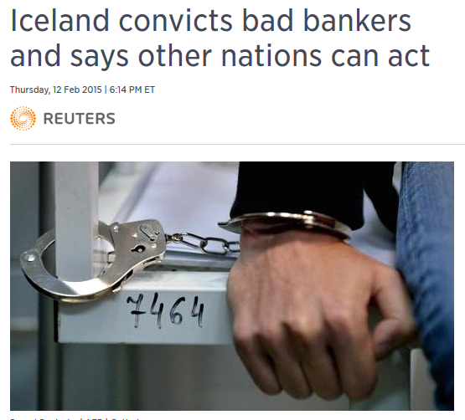

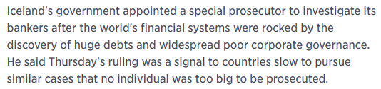
Financiers Will Try to Sabotage Reform
And remember that the country of Iceland put their bankers in jail!

Slide 41
Don’t Allow Economists
to Direct Monetary Reform
Don’t Allow….
Don’t Allow Economists
to Direct Monetary Reform
Don’t Allow….
Don’t Allow Economists
to Direct Monetary Reform
Don’t Allow Economists
to Direct Monetary Reform
PLEASE !!!!

Slide 42
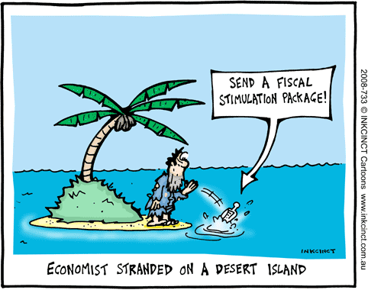

Don’t Allow Economists
to Direct Monetary Reform
“Such reform is a legal, moral and political matter more than an economic one.
Economists have no training in those areas…
Their indoctrination leads them to erroneously assume that the market process
best resolves such questions.” Zarlenga, LSM, p. 676

Slide 43

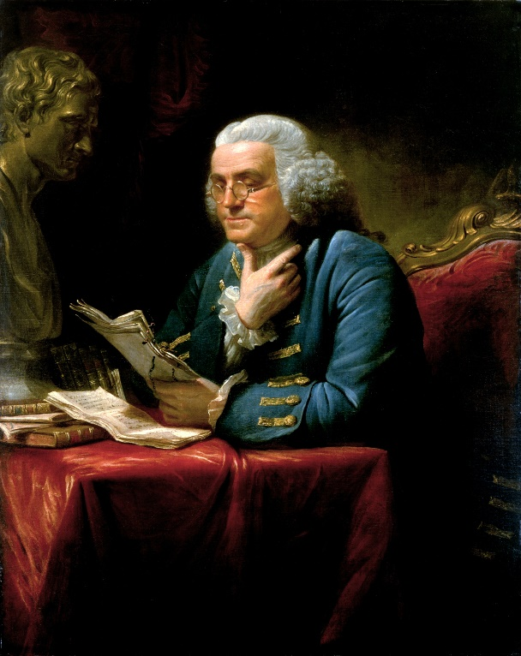
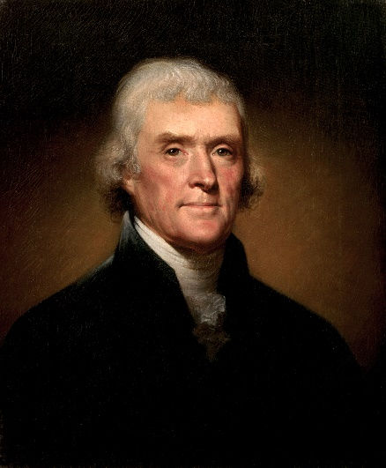
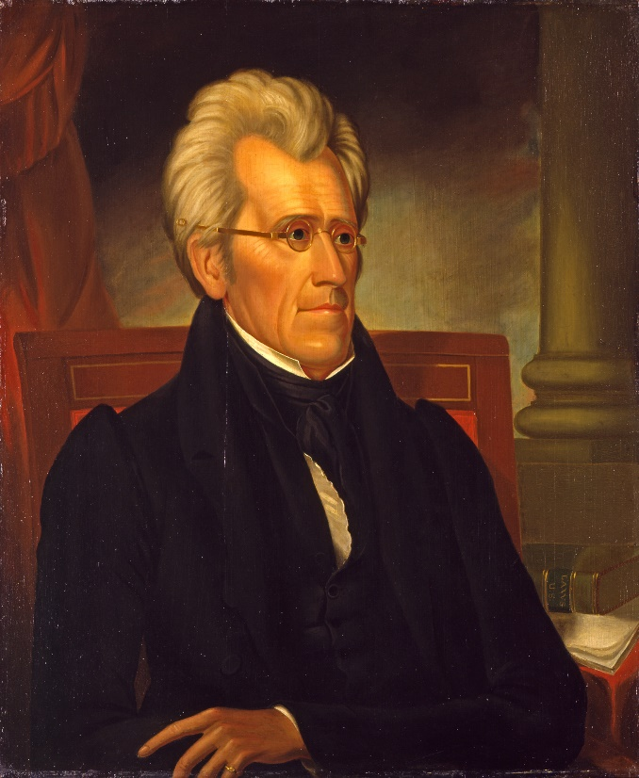


Don’t Allow Economists
to Direct Monetary Reform
“Such reform is a legal, moral and political matter more than an economic one.”
Zarlenga, LSM, p. 676
FRANKLIN
JEFFERSON
JACKSON

Slide 44

Obstacles to Monetary Reform
  The banking and media establishments
“The financial power of the bankers, related financiers, and their lobbying power in the U.S. Congress is a formidable obstacle. The dependence and interlocking of the banks with the major media and universities means that except for accidents, the message for meaningful monetary reform will not likely reach the citizenry through major television and radio stations, major newspapers and magazines, or Hollywood films.” Zarlenga, LSM, p. 676-677
THEREFORE, MONETARY REFORM NEEDS
ALTERNATIVE METHODS OF COMMUNICATING INFORMATION

Slide 45



Obstacles to Monetary Reform
  The banking and media establishments
GRASSROOTS ORGANIZING
OCCUPY THE NEED ACT
NEW YORK CITY

Slide 46

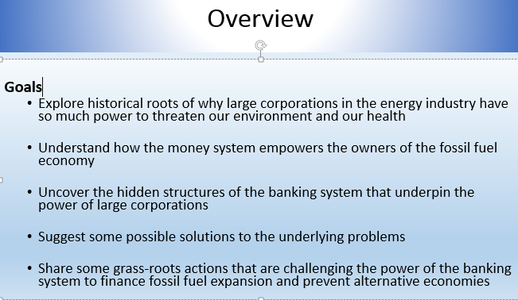

Obstacles to Monetary Reform
  The banking and media establishments
INFORM OTHER GROUPS & SHOW RELEVANCE OF MONETARY REFORM FOR THEIR CAUSE

Slide 47
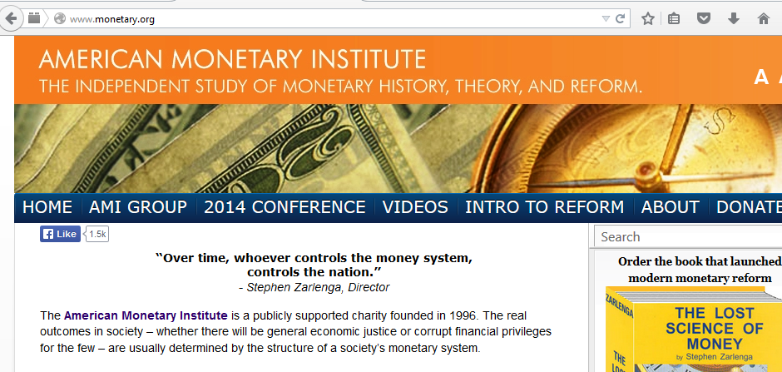
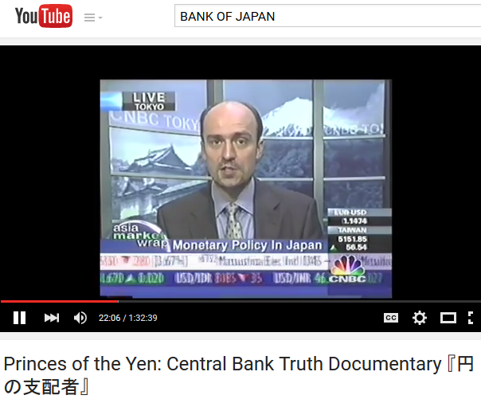

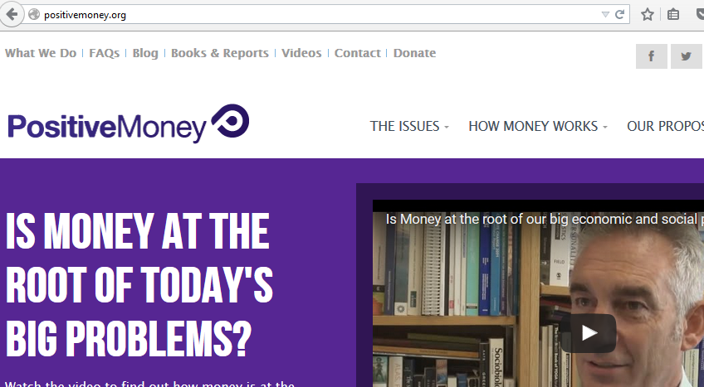

Obstacles to Monetary Reform
  The banking and media establishments
ALTERNATIVE MEDIA CAN REACH PEOPLE WITH THE TRUTH
WEBSITES
DOCUMENTARY FILMS

Slide 48
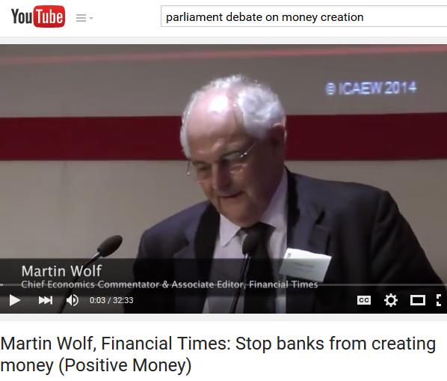




Obstacles to Monetary Reform
  The banking and media establishments
Support public figures, academics, and politicians who offer public validation for monetary reform. They will have access, although limited, to mainstream media.
Dennis Kusinich introduced the NEED ACT
into Congress 2011

Slide 49


Obstacles to Monetary Reform
  Poor monetary and economic thought
The economics profession contains many ‘schools of economic thought’, but most are not based on the history of money or the facts about money’s nature.
For example, the Austrian School of Economics
The Austrian economist Ludwig Von Mises wrote in his Theory of Money and Credit:
“The concept of money as a creature of law and the State is clearly untenable. It is not justified by a single phenomenon of the market.”
“That single statement brands him as either dishonest or foolish. It is clear from history that money is a creature of the law and the state. We have documented case histories that prove him wrong, in many of our chapters.” Zarlenga, LSM, p. 677
U.S. COLONIAL LEGISLATURES ISSUED PAPER
DEBT-FREE MONEY CALLED BILLS OF CREDIT.

Slide 50


Obstacles to Monetary Reform
  Anti-government aspect of most economists is the problem
“For decades in America, as part of a free market theology, they [economists] have attacked the one organizational form with the potential to stand up against the Plutocracy on behalf of the people – our government.” Zarlenga, LSM, p. 678
“The Libertarians are merely the latest group to be
captured by this ideology and to be convinced that they
represent something new, rather than an old plutocratic
viewpoint.” Zarlenga, LSM, p. 678

Slide 51

Obstacles to Monetary Reform
  Anti-government aspect of most economists is the problem
“No doubt some readers wince at the thought of instituting the monetary power in our government. The reason is that for over two centuries, a poisoning of our attitude toward government has been underway... Significantly, such anti-government propaganda was intimately connected with monetary proposals.” Zarlenga, LSM, p. 680
1694 The first concern of the privately owned Bank of England,
after receiving its charter from Parliament, was to create money and bribe Parliament. The government was the only power that could take its charter away from it.
1776: The purpose of Adam Smith’s attack on government, in large part, was to keep the money-issuing power out of the hands of government and in private hands.
By putting our government into debt, the private money power
cripples it. Then blames it. And hides how the private money
system functions to concentrate wealth into the hand of the Plutocracy.

Slide 52



Obstacles to Monetary Reform
  Anti-government aspect of most economists is the problem
“To effect meaningful reform, a change in attitude is needed, to recognize the proper relation of the individual to society… The kind of personal freedom being advocated has a hollowness to it reminiscent of the ‘freedoms’ that the oriental cults promoted as they swept into Rome from the 3rd century BC, discussed in Chapter 2.” Zarlenga, LSM, p. 680
James Frazer’s Golden Bough – how eastern cults destroyed Rome’s social fabric:
“Greek and Roman society…set the safety of the commonwealth as the supreme aim of conduct, above the safety of the individual… All this was changed by the spread of Oriental religions which inculcated the communion of the soul with God and its eternal salvation as the only object worth living for… A general disintegration of the body politic set in. “

Slide 53


Obstacles to Monetary Reform
  Anti-government aspect of most economists is the problem
“They [economists] pretend the ‘market’ offers a valid, workable ‘morality’ for the guidance of society. But only people who have not seen the inner workings of markets would entertain such a foolish idea.” Zarlenga, LSM, p. 681

Slide 54

Obstacles to Monetary Reform
  Dangers to civil liberty from the “War on terrorism”
“A precondition for monetary reform is that we keep our political freedoms intact. Unfortunately, the destruction of the World Trade Center… has placed our Constitutional Republic and Bill of Rights in more jeopardy than at any time since WWII…
Consider how quickly our Constitutional Republic would permanently be changed into a type of police state in futile attempts to stop ‘terrorism’ ” Zarlenga, LSM, pp. 681-682

Slide 55


  What Can Be Done Now?
“… if we are to succeed with monetary reform it will require that a lot more Americans understand both the historical background and the essentials needed for a just money system… That’s the purpose of this book… help support AMI’s continuing research.” Zarlenga, LSM, p. 683
WWW.MONETARY.ORG

Slide 56

  What Can Be Done Now?
“The measures needed for reform must be accurately and simply distilled into the form of proposed non-partisan legislation as a focal point for political action. This will require the assistance of trained legal, accounting and political minds…” Zarlenga, LSM, p. 683
“THE NEED ACT”

Slide 57



  What Can Be Done Now?
“Widespread political support is possible because of the highly positive effects a just money system would have on almost everyone…” Zarlenga, LSM, p. 683
The OCCUPY WALL STREET movement pointed a finger at the right place – THE WALL ST BANKS. OCCUPY WALL STREET, however, did not know the system that keeps the private commercial banks ruling our world ➔ the private debt-money banking system.
Educating the public is important for the next wide-spread social movement for change that comes.

Slide 58

  What Can Be Done Now?
“The reform becomes politically achievable each time the financiers run the world’s economies into the wall. If at such a time, the legislation is among the bills introduced in Congress, and solid, thoughtful public support exists for it, it has a chance.
This underlines the importance of not compromising the legislation in order to make it palatable to special interests.” Zarlenga, LSM, p. 683
Do not give up the three needed steps for real monetary
reform. Without all of these, all efforts to empower the
people with a just money system will fail and the private
money power will rise again:
Nationalize the Federal Reserve Banks
Take the power to issue money away from private
commercial banks
The government issues money for creation of
infrastructure and jobs: physical infrastructure,
education, healthcare, etc.

Slide 59


  What Can Be Done Now?
A 4th needed step for keeping monetary reform – from generation to generation, educate the people with the true history of money and nature of money. This knowledge must never be lost.

Slide 60
  THE NEXT BIG THING?
“As long as there are unused resources available, such as unemployed and under-employed people, or unused plant and equipment and natural resources, and there are needs to be filled, society has the monetary power to employ those factors without resorting to taxation or borrowing.
Hopefully this book has provided enough of the monetary background and solutions to help start us moving toward a brighter future. ” Zarlenga, LSM, p. 684

Slide 61
Q & A
WILL’S CONCLUSION:
THE CONTROL OF MONEY -- WITHOUT CONTROL FROM THE PUBLIC -- LEADS TO
CORRUPTION … USURPATION … SLAVERY.

