Slide 1
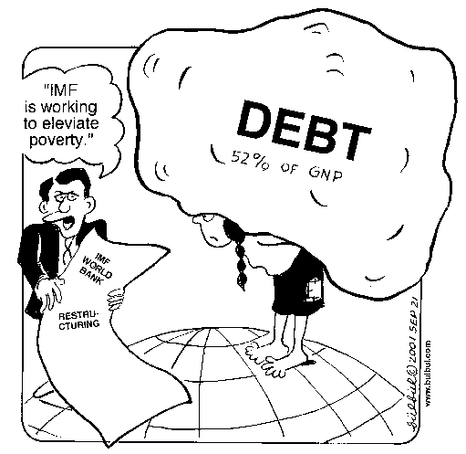
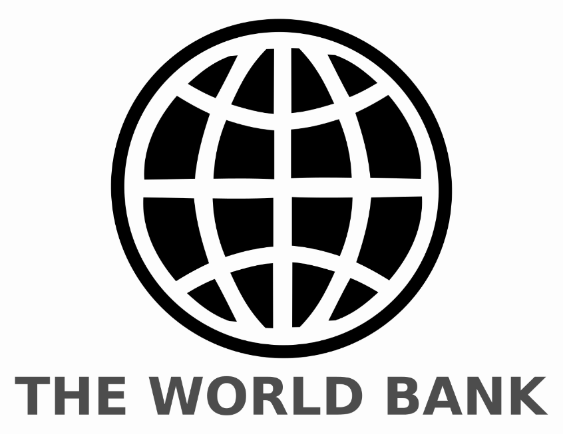
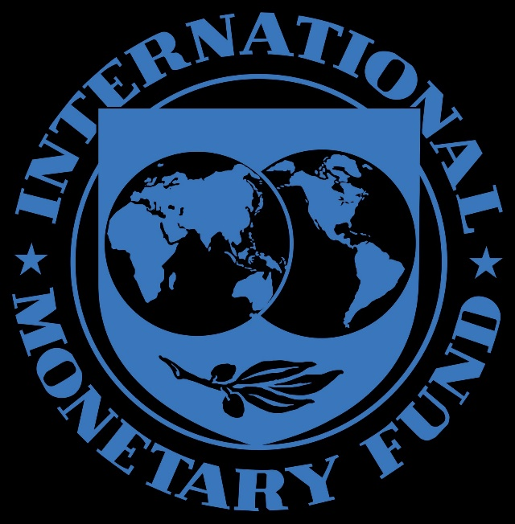
The Lost Science of Money
CHAPTER 22 – Part 2
INTERNATIONAL
MONETARY
ORGANIZATIONS

Slide 2
THEMES OF LOST SCIENCE OF MONEY BOOK
Primary importance of the money power (power to create money and regulate it)
Nature of money purposely kept secret and confused
How a society defines money determines who controls the society
Battle over control of money has raged for millennia: public vs private
The misuse of the monetary system causes tremendous misery and suffering for the ordinary people. Will Decker & Martin Dunn, February 2014
Whenever the public has owned a significant fraction of the money power, great public benefit has ensued: Sparta, the Roman Republic, the American Colonies in the 18th century, GREENBACKS after the Civil War, Canada after the Great Depression, British experience after World War II. Martin Dunn, July 2014.

Slide 3
PARTS OF PRESENTATION
1971: END OF BRETTON WOODS BUT IMF CONTINUES
Speculators Undermine the IMF
Floating Rates
IMF’s Money Creation Powers: Reserves
IMF’s Money Creation Powers: Quotas including SDR’s
Question of the IMF: UNFAIR “CONDITIONALITY”
The World Bank: Bretton Woods 1944 – “Free Trade”
The World Bank: Third World Debt
Debt-Money System Drives “Free Trade”
World Bank
IMF
Private Commercial Banks
World Bank Affiliates:
1956: The International Finance Corporation (IFC)
1960: The International Development Association (IDA)
Islamic Monetary Developments: Echoes of Scholasticism
Summary: It is U.S. Monetary Reform That Is Needed

Slide 4
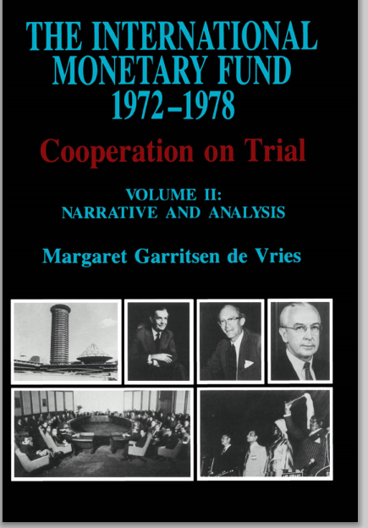
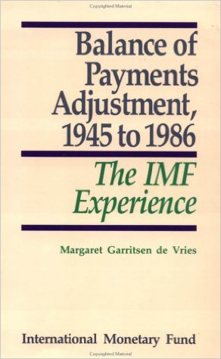
1971: END OF BRETTON WOODS BUT IMF CONTINUES
Speculators Undermine the IMF
“… by the IMF’s reckoning, large capital flows by major speculators severely harmed the system, which had been designed not for their speculative games but to facilitate production and trade between nations.” Zarlenga, LSM, p. 614
Margaret de Vries, the IMF’s official historian:
“The extreme volatility of capital flows (e.g. around $200 billion in 1976), in response to interest rate difference or anticipation of exchange rate changes, was in large part responsible for undermining the international monetary order that existed until the late 1960s.”

Slide 5

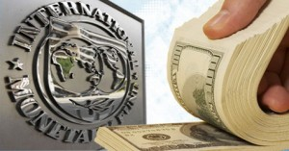
1971: END OF BRETTON WOODS BUT IMF CONTINUES
Speculators Undermine the IMF
“It surrendered without a fight, subjecting its operations to the notion that ‘free markets’ in currency and interest rate speculation take precedence over all else.”
Zarlenga, LSM, p. 614
“The early 1970s were a critical moment for the IMF. Which would take precedence, the ability of corporate or other speculators to shift huge amounts of capital overnight without warning, in order to take advantage of a 1/20th of a percent interest rate differential between currencies, or the ability of producers to create and trade goods, upon which the world’s peoples depended?” Zarlenga, LSM, p. 614

Slide 6

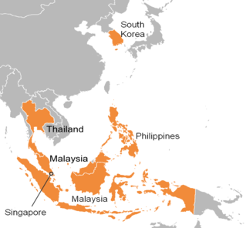
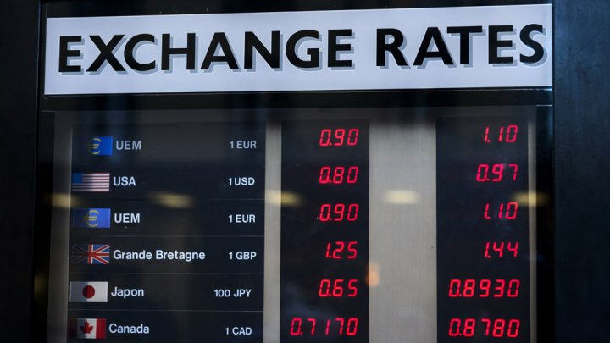
1971: END OF BRETTON WOODS BUT IMF CONTINUES
Speculators Undermine the IMF
Stephen Zarlenga proposes the following to reduce speculators’ manipulation of national currencies:
place a small tax on speculative currency transactions (but this won’t stop large currency manipulations)
identify currencies that are vulnerable (i.e., Southeast Asia during the 1997 crisis) and allow no short selling or allow only low positions
settle futures and forward currency contracts in kind, not in ‘cash’. If speculators have to buy back the physical currency (rather than settle in dollars), their purchases push the price of the currency back up and they could get caught losing money.
Asian Crisis 1997

Slide 7
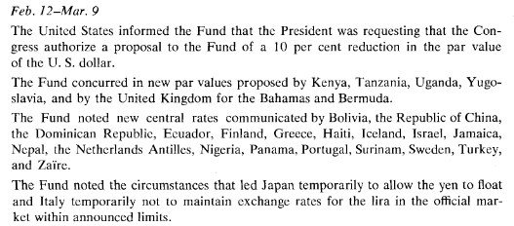
1971: END OF BRETTON WOODS BUT IMF CONTINUES
Floating Rates
From March, 1973, the exchange rates of various major industrial currencies floated, with smaller countries’ currencies pegged to larger ones.
From IMF 1973 ANNUAL REPORT
Source: imf.org

Slide 8
1971: END OF BRETTON WOODS BUT IMF CONTINUES
Lending to its troubled members became the IMF’s primary activity in the second half of the 1970’s
(especially to the U.S. and Britain)
IMF’s Money Creation Powers: Reserves

Slide 9
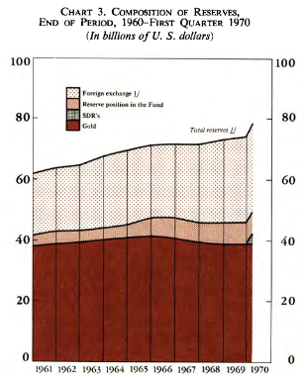
1971: END OF BRETTON WOODS BUT IMF CONTINUES
IMF’s Money Creation Powers: Reserves
“Originally the primary money creation mechanism of the IMF was the use of dollars as a reserve on which other currencies were created. U.S. balance of payments deficits could fuel monetary creation in countries such as Germany, which obtained the dollar reserves through foreign trade surpluses. But this was an automatic structural feature, not a discretionary power.”
Zarlenga, LSM, p. 615
INTERNATIONAL RESERVES, 1970
Source: IMF 1970 Annual Report
imf.org

Slide 10
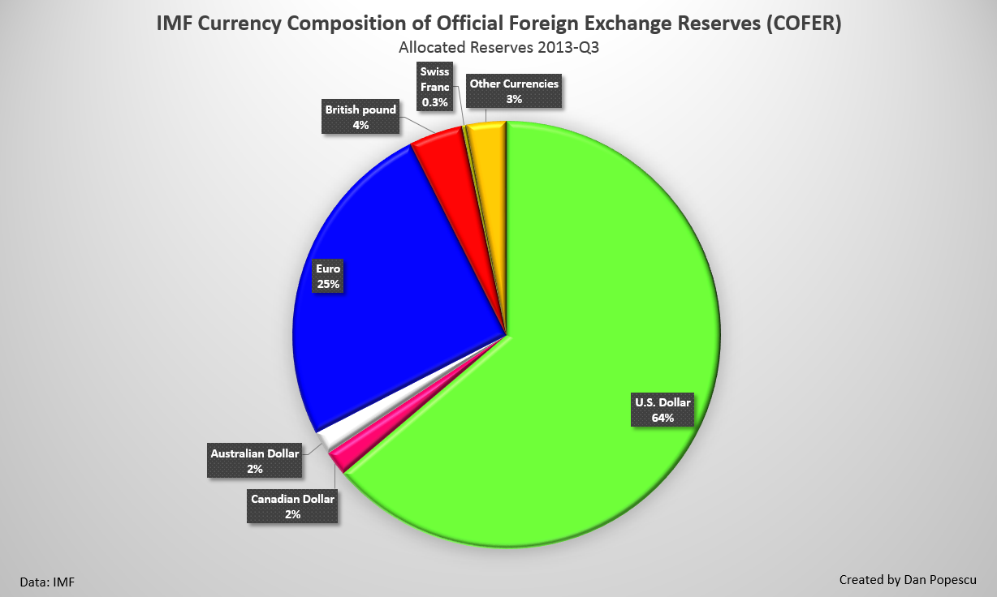
1971: END OF BRETTON WOODS BUT IMF CONTINUES
IMF’s Money Creation Powers: Reserves
From 1975, leading industrial currencies, besides the US$, became usable as reserves: Deutschmarks
Yen
Swiss Franc
Pound Sterling

Slide 11
1971: END OF BRETTON WOODS BUT IMF CONTINUES
IMF’s Money Creation Powers:
Member Quotas as Loan Fund

Slide 12
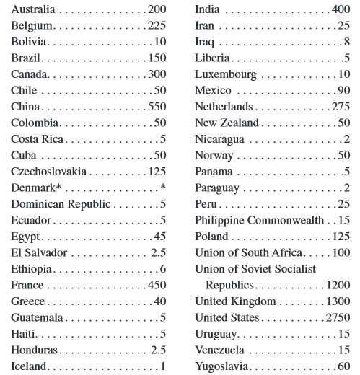
1971: END OF BRETTON WOODS BUT IMF CONTINUES
IMF’s Money Creation Powers: Member Quotas as Loan Fund
IMF MEMBER QUOTAS
In millions of U.S. Dollars
Source: IMF 2014 Annual Report
imf.org
“The IMF can also create limited liquidity by extending loans to members. The source of the funds are the reserve quotas that the members deposit with the IMF. Countries in trouble can borrow up to three times their quota; however, from 1982, the members limited the total amount that could be loaned out to 60% of the total of all IMF reserves.” Zarlenga, LSM, p. 616

Slide 13
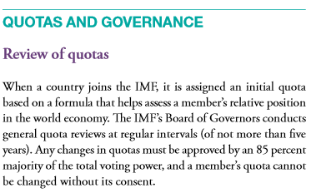
1971: END OF BRETTON WOODS BUT IMF CONTINUES
IMF’s Money Creation Powers: Member Quotas as Loan Fund
IMF QUOTA REVIEW
2014 ANNUAL REPORT OF IMF

Slide 14
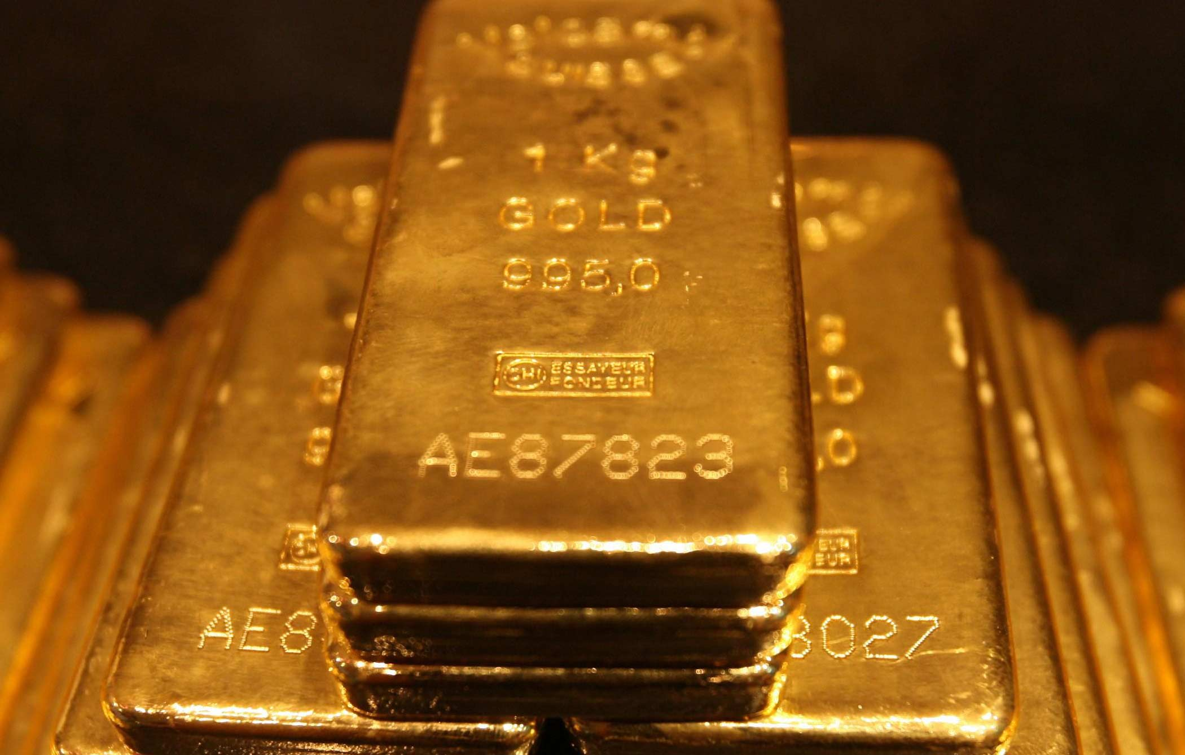
1971: END OF BRETTON WOODS BUT IMF CONTINUES
IMF’s Money Creation Powers: Member Quotas as Loan Fund
“The IMF presents itself as a financial pool – an international reserve of money built up with contributions (known as quotas) from subscribing nations, that is, most nations of the world. However, credit creation accompanies almost every aspect of IMF funding.” Rowbotham, Goodbye America!, pub. 2000, p. 100
#1 Rowbotham, Goodbye America!, p. 100:
25% of each nation’s IMF quota is paid in the form of gold. This is the only component of the IMF money creating powers that does not create new debt.

Slide 15
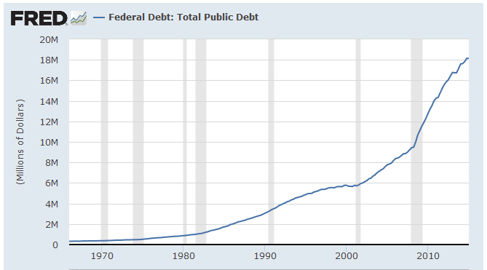
1971: END OF BRETTON WOODS BUT IMF CONTINUES
IMF’s Money Creation Powers: Member Quotas as Loan Fund
“The IMF presents itself as a financial pool – an international reserve of money built up with contributions (known as quotas) from subscribing nations, that is, most nations of the world. However, credit creation accompanies almost every aspect of IMF funding.” Rowbotham, Goodbye America!, pub. 2000, p. 100
#2 Rowbotham, Goodbye America!, p. 100
The 75% of a nation’s quota payable in national currency is today invariably funded by the government concerned through the sale of bonds, thus adding to that nation’s national debt.
This involves the sale of government bonds to commercial banks, leading to money creation by those banks. This source of revenue forms the main fund of IMF monies available to developing nations.

Slide 16

1971: END OF BRETTON WOODS BUT IMF CONTINUES
IMF’s Money Creation Powers: Member Quotas as Loan Fund
“The IMF presents itself as a financial pool – an international reserve of money built up with contributions (known as quotas) from subscribing nations, that is, most nations of the world. However, credit creation accompanies almost every aspect of IMF funding.” Rowbotham, Goodbye America!, pub. 2000, p. 100
#3 Rowbotham, Goodbye America!, p. 101
In 1979, the IMF instituted Special Drawing Rights (SDRs). These SDRs were avowedly created as an additional international currency.
Although they are ‘credited’ to each nation’s account with the IMF, if a nation borrows these SDRs (defined in dollars) it must repay this amount, or pay interest on the loan.
SDRs are actually a credit facility, just like a bank overdraft – if they are borrowed, they must be repaid.
Thus, the IMF is now creating and issuing money, created in parallel with an equivalent debt. The IMF ‘reserve’ being the original pool of quota funds.
http://www.imf.org/external/np/exr/facts/sdr.htm

Slide 17
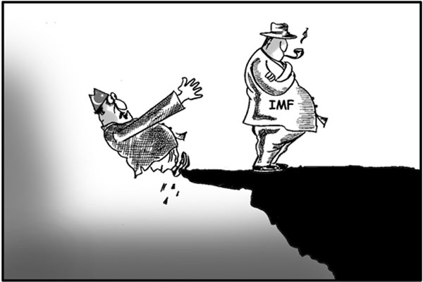
1971: END OF BRETTON WOODS BUT IMF CONTINUES
IMF’s Money Creation Powers: Member Quotas as Loan Fund
“The IMF presents itself as a financial pool – an international reserve of money built up with contributions (known as quotas) from subscribing nations, that is, most nations of the world. However, credit creation accompanies almost every aspect of IMF funding.” Rowbotham, Goodbye America!, pub. 2000, p. 100
#4 Rowbotham, Goodbye America!, p. 101
The quota demands by the IMF have reached the point where (so-called) creditor nations such as America and Britain are reluctant to undertake yet more bond issues and further national debt to supply these funds. Therefore, in recent years, the IMF has begun to circumvent the restrictions of its overall quota.
The IMF administers ‘loan packages’ made up in part from its own quotas and in part from commercial sources.
For example, of the $56 billion loan advanced under the auspices of the IMF to South Korea in the wake of the Asian crisis, only $20 billion was actually contributed by the Fund itself, the remaining $36 billion being arranged by direct co-operation with international commercial banks who created money for the purpose.

Slide 18
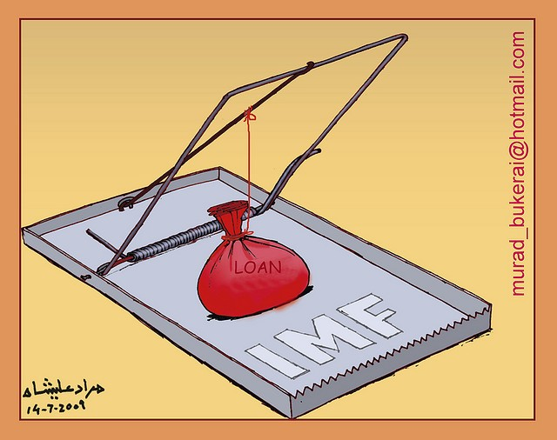
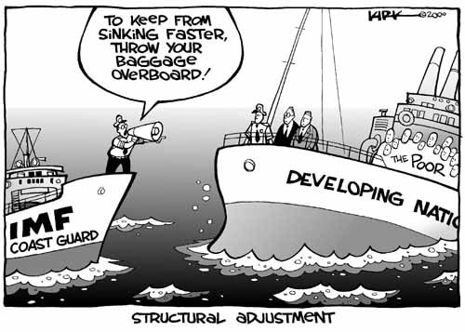
1971: END OF BRETTON WOODS BUT IMF CONTINUES
Question of the IMF: UNFAIR “CONDITONALITY”
“…the IMF has come under some of its harshest criticism, and engaged in some of its most questionable actions in the area of “conditionality” – the terms it sets for the debtor nation to receive assistance.” Zarlenga, LSM, p. 617

Slide 19

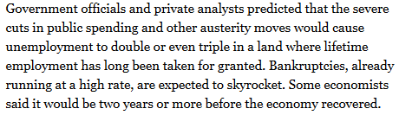

1971: END OF BRETTON WOODS BUT IMF CONTINUES
Question of the IMF: UNFAIR “CONDITONALITY”
NEW YORK TIMES

Slide 20

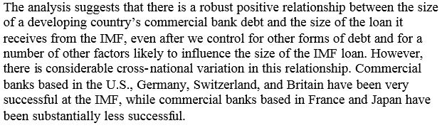

1971: END OF BRETTON WOODS BUT IMF CONTINUES
Question of the IMF: UNFAIR “CONDITONALITY”
“When lesser developed countries needed bailing out of loans
improperly advanced to them by the world’s largest private banks,
the IMF has served to bail out the bankers, generally shifting
their costly errors onto the average citizens of the member states.”
Zarlenga, LSM, p. 617

Slide 21
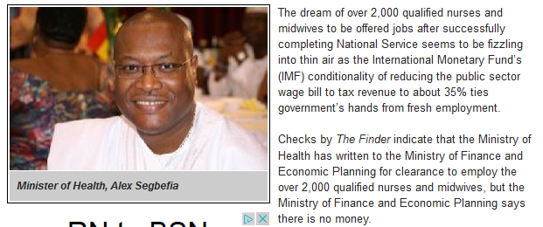


1971: END OF BRETTON WOODS BUT IMF CONTINUES
Question of the IMF: UNFAIR “CONDITONALITY”
BRAZIL, 1982-83
“In the Brazilian bailout, the IMF insisted on cutting Brazil’s public expenditure by 50% from 1982 to 1983, then another 50% in 1985. Imagine the effect of cutting 75% of public expenditure in America, Germany or Switzerland in four years!” Zarlenga, LSM, p. 617
GHANA, 2015

Slide 22
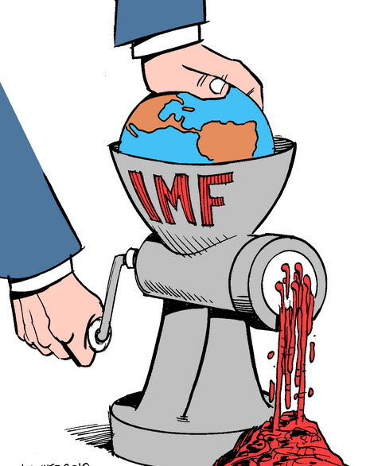
1971: END OF BRETTON WOODS BUT IMF CONTINUES
Question of the IMF: UNFAIR “CONDITONALITY”
“The danger arises when reasonableness, proportionality and balance are cast aside; where the basic purpose of the monetary system is subverted to a near sociopathic greed; where under cover of one ideology or another, currency institutions and mechanisms, upon which the livelihood of millions of people depends, are destroyed without a second thought. That must be stopped – it is a form of cannibalism.”
[italics author’s] Zarlenga, LSM, p. 618

Slide 23
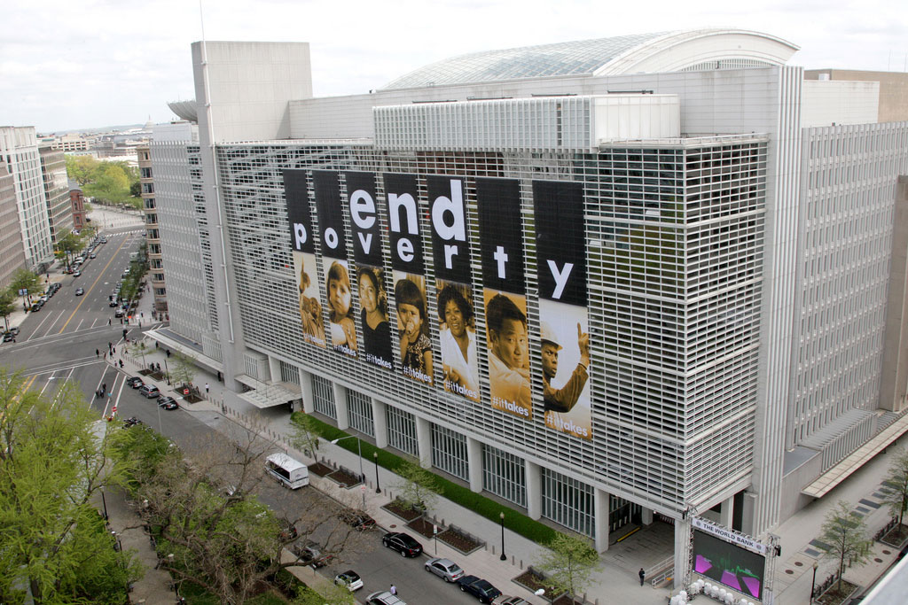
The World Bank: Bretton Woods 1944 – “Free Trade”
The World Bank came out of the same conflict at Bretton Woods as the IMF. The World Bank is also known as the IBRD – International Bank for Reconstruction and Development.
The Bank's first loans were extended during the late 1940s to finance the reconstruction of the war-ravaged economies of Western Europe. When these nations recovered some measure of economic self-sufficiency, the Bank turned its attention to assisting the world's poorer nations, known as developing countries, to which it has since the 1940s loaned more than $330 billion.
World Bank headquarters in Washington D.C. The IMF is also located there.
The location of Washington D.C. was disputed at Bretton Woods by the 44 member countries attending.

Slide 24
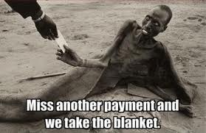

The World Bank: Bretton Woods 1944 – “Free Trade”
“… the fate of the Third World was
determined before a single loan was
issued.”
Rowbotham, Goodbye America!, p. 46
“Institutions designed to redress trade imbalances, which would have supported the Third World in its efforts to escape from debt, were deliberately omitted at Bretton Woods. Instead, “free trade” was given the highest priority.
Both the IMF and World Bank had, written into their charter, the requirement that they promote the free trade of goods and services throughout the world and, through their activities, endeavor to remove all restrictions to trade.
Countries were placed under no obligation to maintain a balance of trade with other nations, but were permitted to seek a persistent trade surplus.”
Rowbotham, Goodbye America!, p. 46

Slide 25
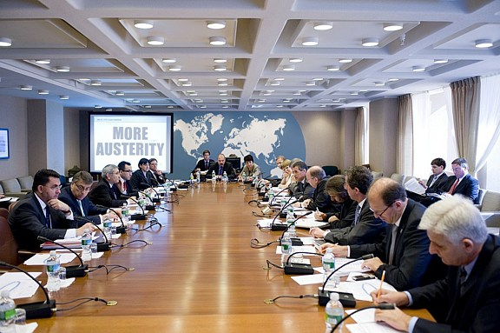
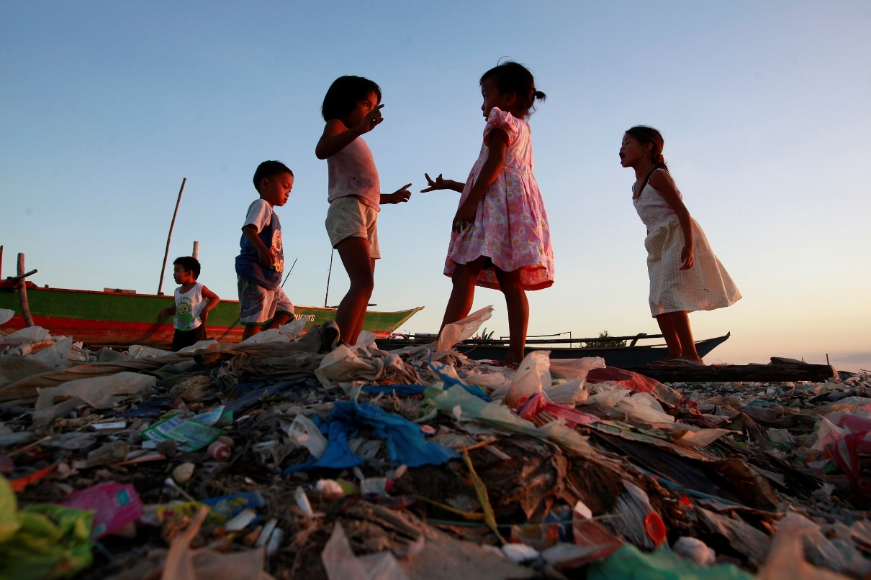
The World Bank: Bretton Woods 1944 – Third World Debt
“…it is worth dispelling one of the great myths about Third World debt – that the poor nations ‘owe money to’, or are ‘in debt to’, the rich nations. This is categorically not the case. At least 90% of the $2.3 trillion owed by the poorer nations are owed to commercial banks and lending institutions - the World Bank, the IMF...
… the debts of developing nations… record an obligation… to banks – not to other countries.” Rowbotham, Goodbye America!, p. 27
WORLD BANKERS
THIRD WORLD CHILDREN

Slide 26
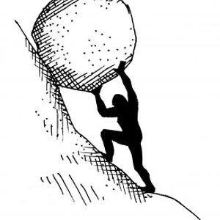
The World Bank: Bretton Woods 1944 – Third World Debt
WHAT ABOUT ALL THE OTHER COUNTRIES OF THE WORLD?
The Banker’s Debt-Money System at Work
The World’s 60 Poorest Countries:
From 1970: owed $ 25 B
To 2002: owed $ 523 B
to IMF and World Bank: $153 B
to commercial banks: $370 B
Total $523 B
From 1970-2002:
$550 B has been paid on $540 B of loans
$523 B debt remains

Slide 27
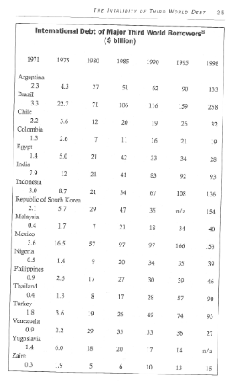
The World Bank: Bretton Woods 1944 Third World Debt – for 30 years
1971 1975 1980 1985 1990 1995 1998
⬅ ARGENTINA – from 2.3 to 133 B
International debt is the total debt a country owes to foreign creditors:
private commercial banks or
international financial institutions
such as IMF and World Bank.
⬅ BRAZIL – from 3.3 to 258 B
⬅ REPUBLIC OF S. KOREA – from 2.1 to 154 B
⬅ MEXICO – from 3.6 to 153 B

Slide 28
DEBT-MONEY SYSTEM DRIVES “FREE TRADE”
THE INTERNATIONAL DEBT-MONEY SYSTEM:
WORLD BANK,
IMF,
PRIVATE COMMERCIAL BANKS

Slide 29
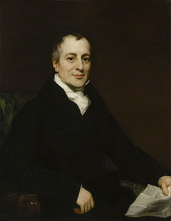
Political Economist DAVID RICARDO Supported Free Trade: His Four Conditions Make Free Trade Work
DEBT-MONEY SYSTEM DRIVES “FREE TRADE”
In 1817 David Ricardo, advancing the theory of comparative advantage, set forth 4 conditions:
Do not move capital over borders from a high wage
to a low wage country.
2. Balance trade between participating countries.
3. Trade only between countries with full
employment.
4. Open competition: no monopolies or oligopolies.

Slide 30
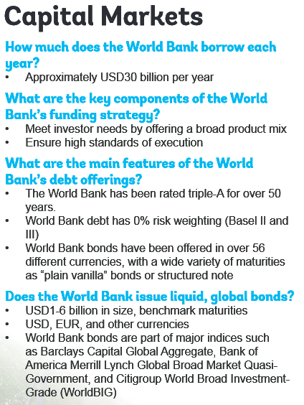
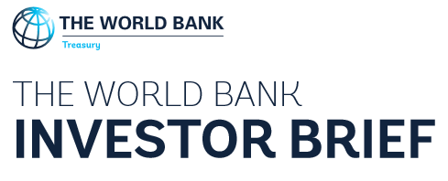
DEBT-MONEY SYSTEM DRIVES “FREE TRADE”: World Bank
The World Bank is owned by it mem-ber governments. Each government has committed an amount of ‘capital’ to the bank, but only a small part has been paid in, the remaining ‘on call’.
The money loaned by the World Bank is raised by World Bank bonds.

Slide 31

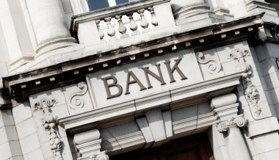
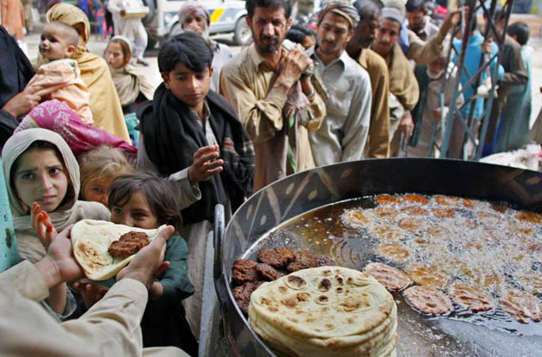
DEBT-MONEY SYSTEM DRIVES “FREE TRADE”: World Bank
1
Debt-money
is loaned to
poor nations
3
World Bank
sells bonds
Banks create
debt-money &
buy bonds
WHERE DOES THE WORLD BANK GET THE MONEY
TO LEND TO THIRD WORLD NATIONS?
2
DEBT
Private Commercial Banks
in Rich Nations
Third World Nations

Slide 32
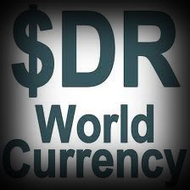
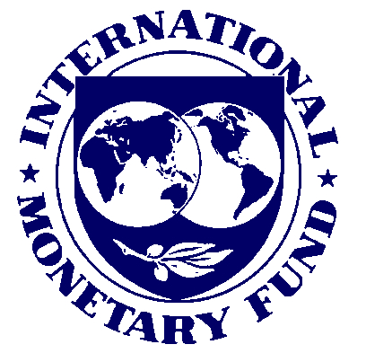
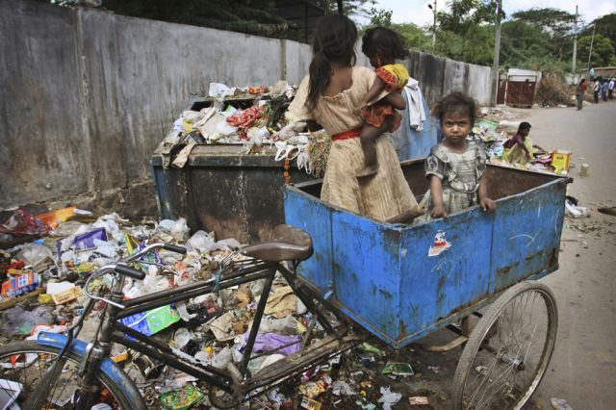
DEBT-MONEY SYSTEM DRIVES “FREE TRADE”: IMF
WHAT DOES
THE IMF LOAN?
SDR = Special Drawing Rights
are an IMF world currency that it
creates when it makes loans to
poor countries – it is ‘debt-money’
DEBT
DEBT IS A
WEAPON

Slide 33
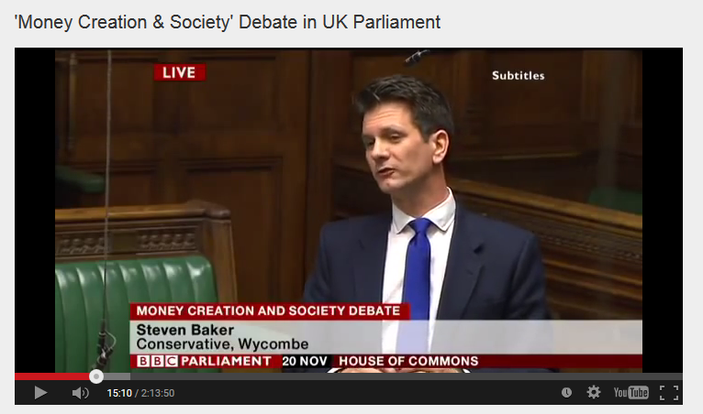

DEBT-MONEY SYSTEM DRIVES “FREE TRADE”:
Private Commercial Banks
House of Commons, Nov. 20, 2014, Mr. Steven Baker, MP:
“Whenever a bank makes a loan it simultaneously makes a matching deposit in the borrower’s bank account, thereby creating new money.”

Slide 34
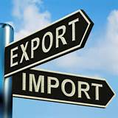
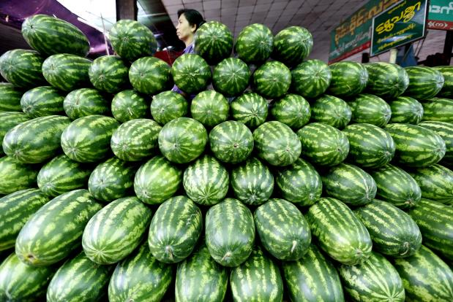
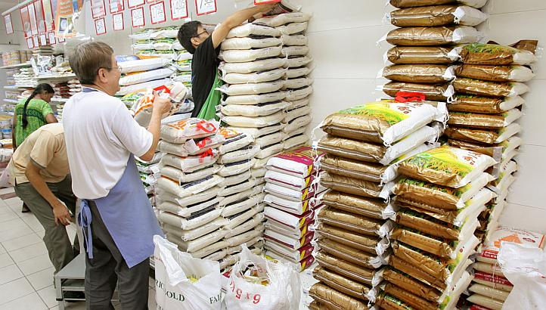
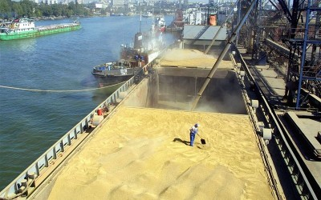
DEBT-MONEY SYSTEM DRIVES “FREE TRADE”
To repay their international debts, poor nations must earn dollars.
They compete against other poor countries, all who export similar products, glut the market, and drive down prices
They compete against the wealthy nations, who strive to maximize exports and minimize imports, because they too have massive public and private debts
ALL NATIONS ARE IN DEBT &
SEEK, NOT A TRADE BALANCE,
BUT A TRADE SURPLUS…to export

Slide 35
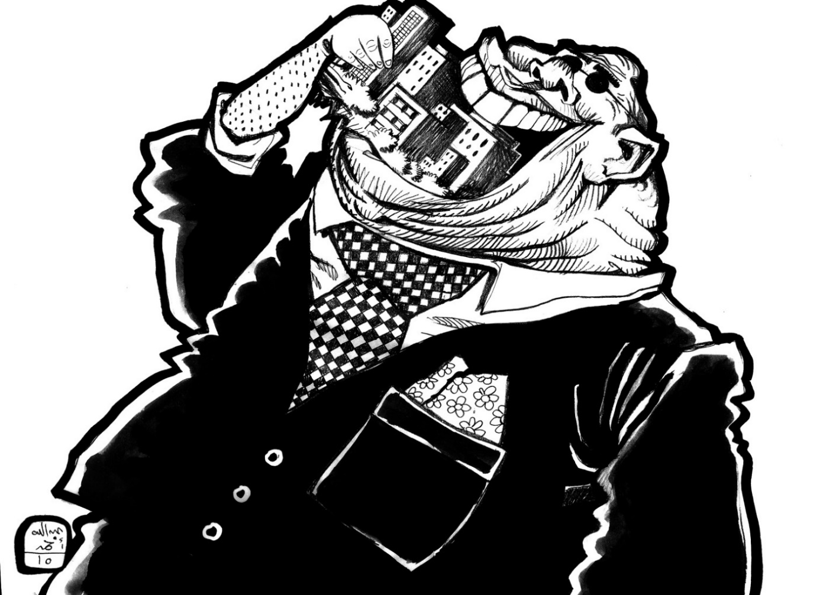
DEBT-MONEY SYSTEM DRIVES “FREE TRADE”
Poor nations are not earning enough money to repay their loans, and so the private banks seize the assets – land, minerals, buildings, and food – of the poor nations.
“YUM, YUM”
says the
international
banker

Slide 36
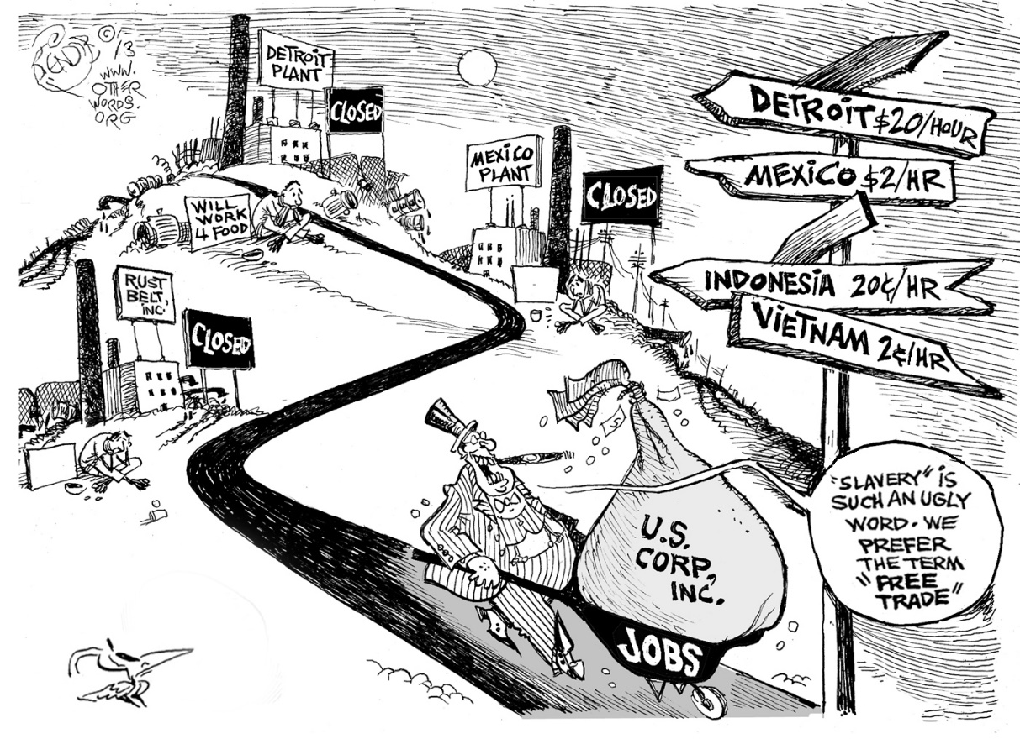
Today’s Situation: None of the necessary conditions for free trade, to produce mutual benefits, apply anywhere in today’s world
DEBT-MONEY SYSTEM DRIVES “FREE TRADE”
Instead, all nations try to pursue an imbalance of trade, where they profit the most.
Multinational banks rig trade to their profit at the expense of third world nations, while calling it “free” trade.
This Free Trade sham has been accepted and promoted by powerful financial and legal world agencies: World Bank, IMF, GATT, WTO, OECD, the UN and governments of the strongest nations.
PRIVATE
BANKING
SYSTEM

Slide 37
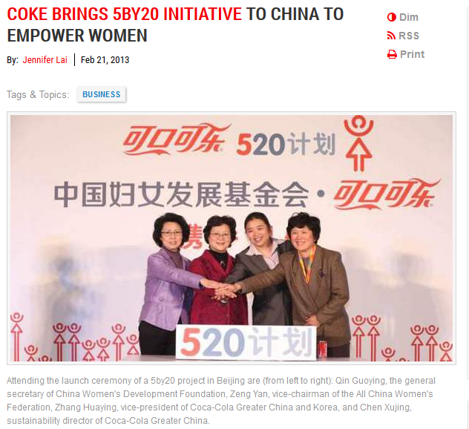

World Bank Affiliates:
1956: The International Finance Corporation (IFC)
The International Finance Corporation (IFC) is an affiliate
of the World Bank, and the only one that invests in private
sector projects in developing countries.
The IFC management, shareholders and Articles of
Agreement are independent from the rest of the World
Bank Group. Its share capital is provided by its 173 member countries, and it raises most of its funds by issuing bonds.

Slide 38
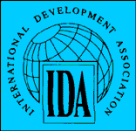

World Bank Affiliates:
1960: The International Development Association (IDA)
The IDA “is proudly put forward as the ‘good deeds’ work of the bank, because it makes 35 to 40-year interest-free loans to really poor countries.” Zarlenga, LSM, p. 622
Member countries replenish its funds through contributions in addition to supplementary funds provided by the World Bank and IFC.
“Critics say that the IDA was only formed when there was a
threat that the United Nations was going to set up its own
lending agency (The Special UN Fund – SUNFUND…).
Eugene Black, President of the World Bank at the time, admitted that the IDA ‘was really an idea to offset the urge
for SUNFUND.’ “ Zarlenga, LSM, p. 622

Slide 39
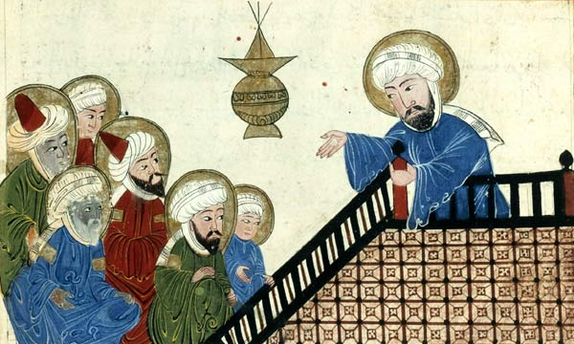
Islamic Monetary Developments: Echoes of Scholasticism
“While the Old Testament had strong prohibitions against usury, it was slightly ambiguous regarding the practice of usury against non-Jews… But the Koran is very clear that all usury is forbidden:” Zarlenga, LSM, p. 623
Muhammad: ‘God has permitted trade but forbidden usury.
Profit is the result of initiative, enterprise and efficiency –
value creation. Not so with usury…’ The Koran

Slide 40
Islamic Monetary Developments: Echoes of Scholasticism
“Mohammed understood the nature of money as a legal creation, and taught his followers that nominally valued copper coinage was to be as acceptable as gold and silver.” Zarlenga, LSM, p. 624
“According to Muhammad, the property of currency attaches
to circulating fulus (copper coins)… They are in his view
suitable for partnership investment like all other absolute
currencies, viz., dirhams (silver) and dinars (gold).” Kasani, 6:59-60

Slide 41
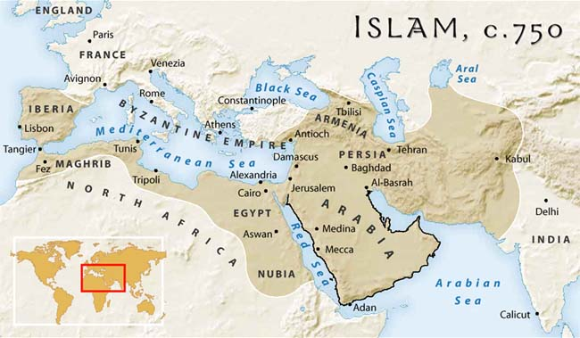
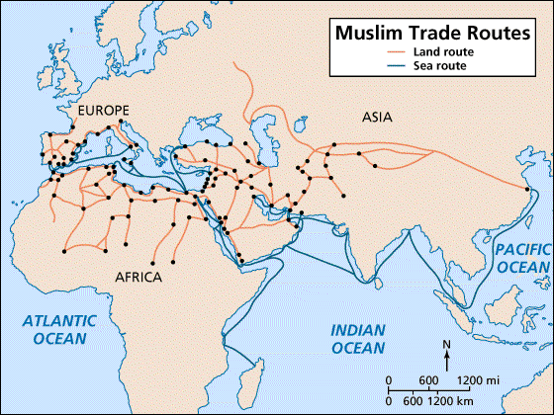
Islamic Monetary Developments: Echoes of Scholasticism
“The Koran forbade the taking or paying of interest, and when the interdiction was first imposed in the 7th century, business flourished.” Zarlenga, LSM, p. 624
However, by the 11th century a person conducting “commerce in accordance with the law was looked upon as ridiculous by all other merchants”.
Hurgronge, quoted by Abraham L. Udovitch, Partnership and Profit in Medieval Islam, pub. 1970

Slide 42
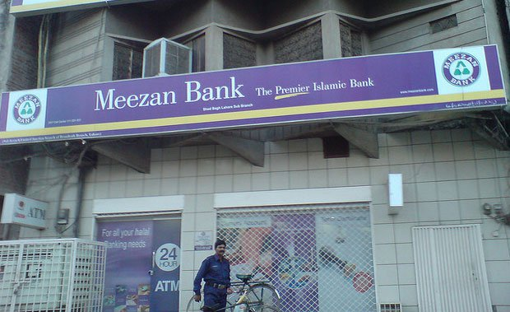
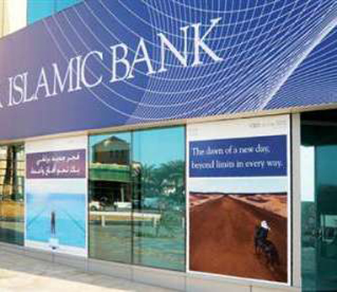

Islamic Monetary Developments: Echoes of Scholasticism
“Moslem countries over the last two centuries gradually adopted an interest-based money and banking system, under the influence of colonialism. But that is now beginning to change.” Zarlenga, LSM, p. 624
But since the 1930’s there has been an Islamic economic revival. M. Umer Chopra, Toward a Just Monetary System, pub. 1985, describes three phases:
1930’s: re-evaluation and re-affirmation of classical Moslem values
1965+: Moslem economists analyzed ideas
1985+: efforts to develop interest-free banking and financial institutions

Slide 43


Islamic Monetary Developments: Echoes of Scholasticism
On January 1, 1980, approximately 7,000 interest-free counters were opened at all the nationalized commercial banks, making Pakistan the first country in the Muslim world with Islamic banking.
Acts that are haram are typically prohibited in the religious texts of the Holy Quran and the Sunnah. The category of haram is the highest status of prohibition
The night view of Shah Faisal Mosque.
The Mosque occupies a unique and cultural significance in Pakistan.

Slide 44


Islamic Monetary Developments: Echoes of Scholasticism
MONEY AND BANKING IN ISLAM
Institute of Policy Studies, Islamabad & International Centre for Research in Islamic Economics, 1983
(reviewed by Medhat Hassanein, The American University, Cairo

Slide 45

Summary: It is U.S. Monetary Reform That Is Needed
“… over time the IMF degenerated into a strong arm collection agency for the major banks, applying biased economic theory to maintain the power of the super-wealthy…
The author suggests that international reform will follow quickly from U.S. reform. Therefore reforming our own money system should be the primary focus of Americans desiring a fair international system.” Zarlenga, LSM, p. 627

Slide 46



Summary: It is U.S. Monetary Reform That Is Needed
“Because of the dominant position of the United States and the dollar in the international monetary arena, real reform of the U.S. money system would automatically solve many of the most pressing international monetary problems. Zarlenga, LSM, p. 619
Regarding the difficulties of the un-payable debt burdens of the lesser developed countries, Pope John Paul 2nd is the best economist: debt forgiveness, plain and simple, makes sense in most of those cases.” Zarlenga, LSM, p. 619

Slide 47
Q & A
WILL DECKER’S CONCLUSION:
THE CONTROL OF MONEY -- WITHOUT CONTROL FROM THE PUBLIC -- LEADS TO
CORRUPTION … USURPATION … SLAVERY.

