Slide 1
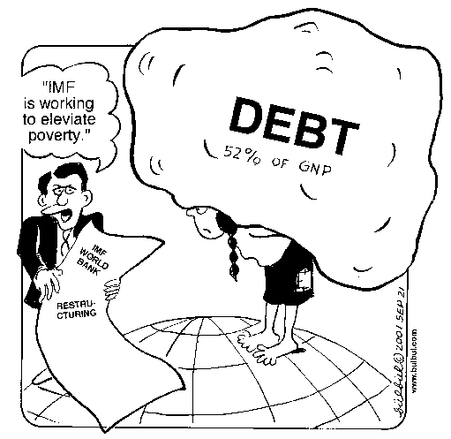


The Lost Science of Money
CHAPTER 22 – Part 1
INTERNATIONAL MONETARY
ORGANIZATIONS

Slide 2
THEMES OF LOST SCIENCE OF MONEY BOOK
Primary importance of the money power (power to create money and regulate it)
Nature of money purposely kept secret and confused
How a society defines money determines who controls the society
Battle over control of money has raged for millennia: public vs private
The misuse of the monetary system causes tremendous misery and suffering for the ordinary people. Will Decker & Martin Dunn, February 2014
Whenever the public has owned a significant fraction of the money power, great public benefit has ensued: Sparta, the Roman Republic, the American Colonies in the 18th century, GREENBACKS after the Civil War, Canada after the Great Depression, British experience after World War II. Martin Dunn, July 2014.

Slide 3
PARTS OF PRESENTATION
Introduction
The Problem of International Payments
Earlier Examples of International Payments
The International Gold Standard, 1860-1931: THE THEORY
The Gold Standard Gives Foreign Bankers Local Control
1930: BIS
  World War I Leads to the Bank for International Settlements (the BIS)
  Ownership and Control of the BIS
  Some History of the BIS
  The BIS Undertakes Banking Supervision
  Money Creation Powers of the BIS
1944: BRETTON WOODS -- Keynes’ Alternative to Our Current System
1944: BRETTON WOODS -- The International Monetary Fund
  Ambiguity of Organizational Status
  IMF Stated Objectives
  The U.S. Dollar Rules
  The London Gold Pool
1971: NIXON -- Closes the Gold Window

Slide 4

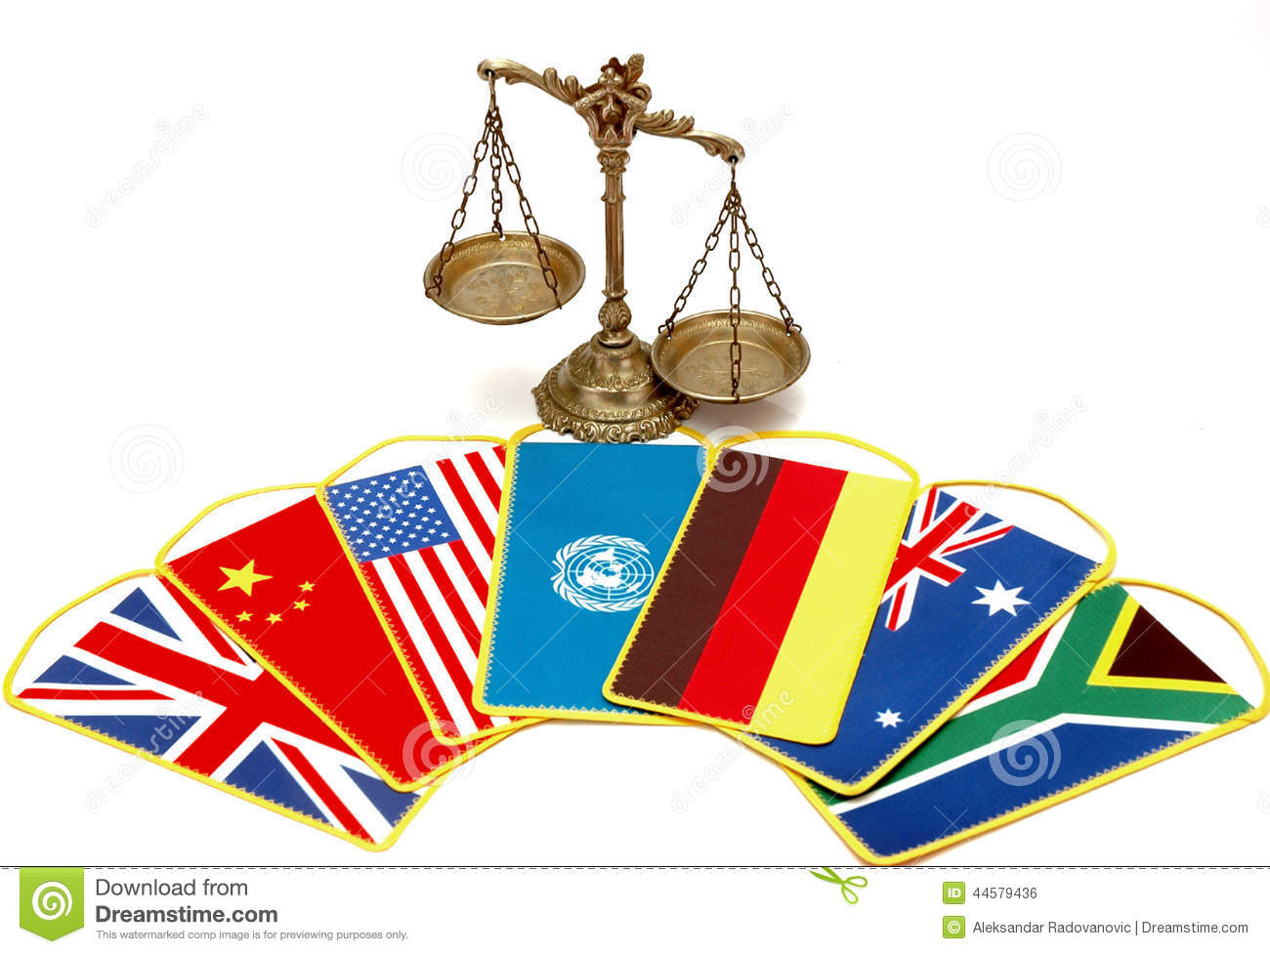
Introduction
“International monetary institutions are a recent development in human social organization, beginning only in the mid-19th century, if we count the Latin Monetary Union as such an organization. But as the development of warfare, political organization, rapid transportation, instant communications, and world trade advanced, the possibility of international law emerged; and the need and viability of international institutions to smooth the way in the monetary area became clear.” Zarlenga, LSM, p. 603

Slide 5

Introduction
The development of international monetary institutions has been made difficult by the “near religious enthrone-ment of the international gold standard in the 19th and early 20th centuries. Since the system was advertised as ‘automatic,’ little need was recognized (except by those who ran it) for organizations or government to administer it.” Zarlenga, LSM, p. 603-604
“The worse such breakdown, the Great Crash and
Depression of 1929-33…can be traced directly to
England’s gold standard moves from 1925 to 1931.
China was not on the gold standard and was hardly
affected at all by the Great Depression.”
Zarlenga, LSM, p. 604

Slide 6
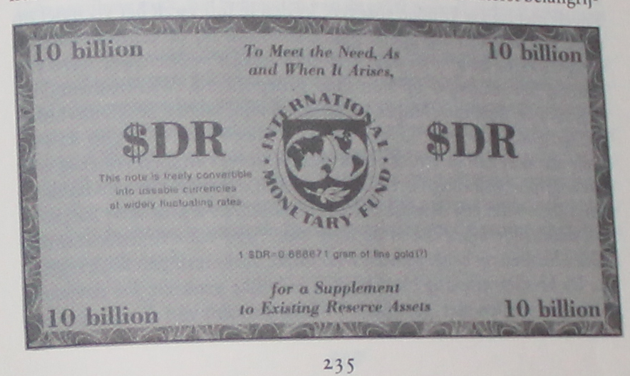
The Problem of International Payments
Money is a creature of the law.
This make money a national function, rather than international.
“There is no such thing as an international currency.” Schacht, The Magic of Money, pub. 1967, p. 75
“But just two years later [1969] the International Monetary Fund (the IMF) introduced the SDR (Special Drawing Rights), which is intended as a kind of international money reserve for governments.”
Zarlenga, LSM, p. 604

Slide 7
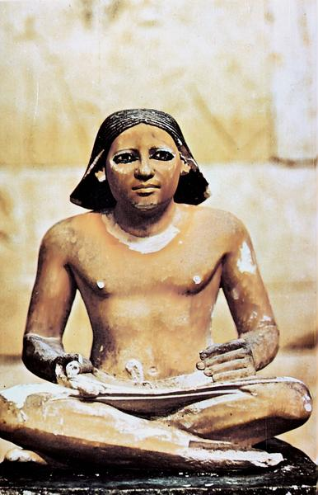
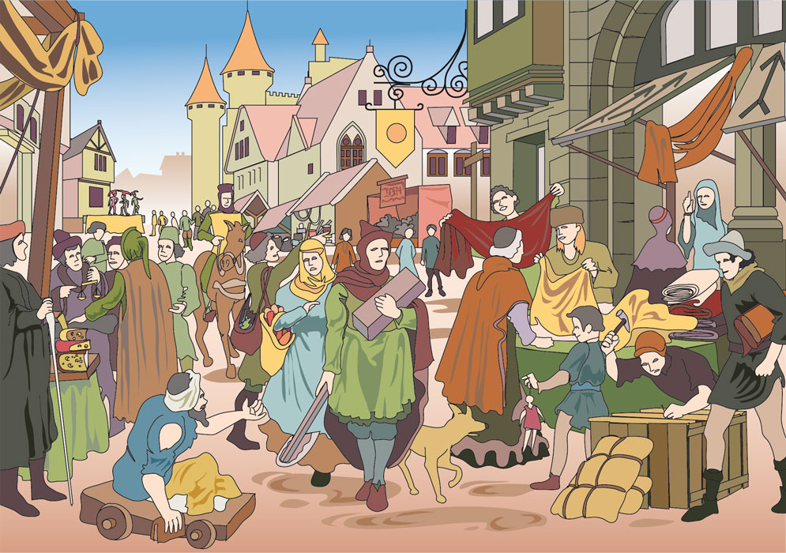

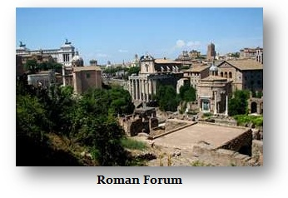
Earlier Examples of International Payments
Egypt had a central banking system
transferring payments through
branches in various cities.
Medieval Trade Fairs cleared bookkeeping
payments for merchants from many
countries and other trade fairs.
The Knights Templars cleared payments
across borders using the balancing of
debits and credits. They did not ship
metals.
Rome never used a central banking system.
International trade was carried on in kind,
or transported gold and silver.

Slide 8
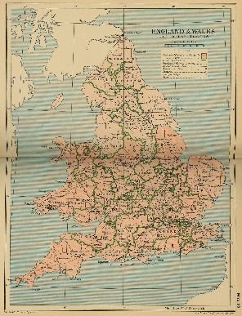
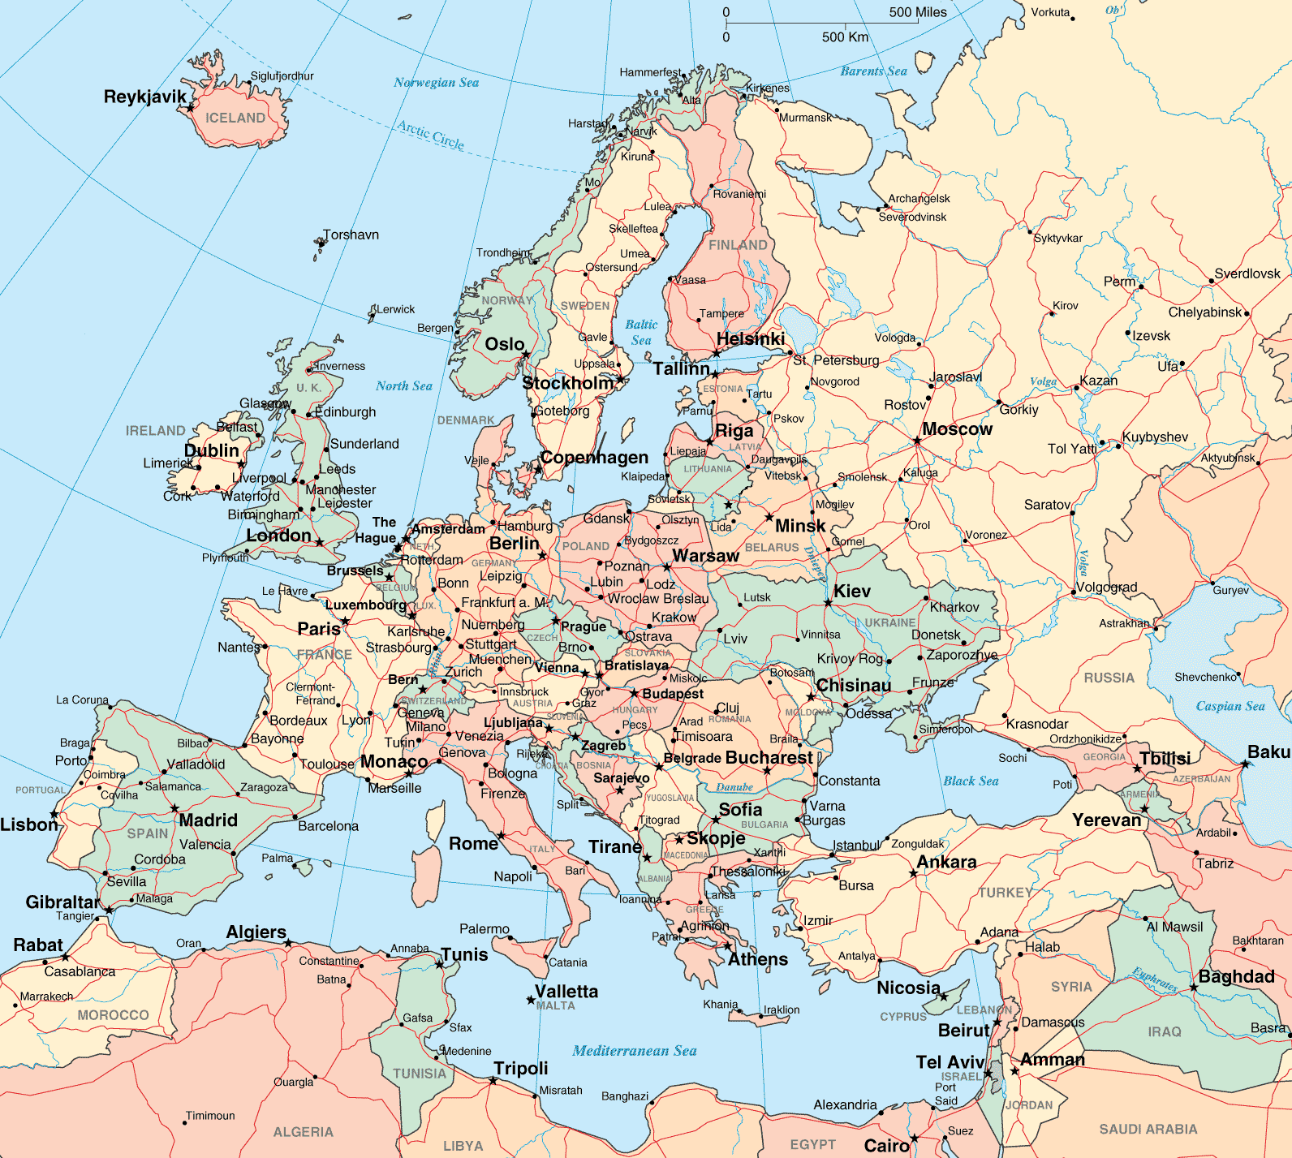
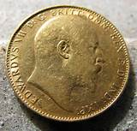

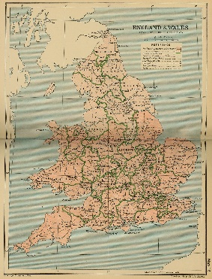
The International Gold Standard, 1860–1931: THE THEORY
“However, it was well recognized that international trade was almost entirely an exchange of goods.” Zarlenga, LSM, p. 605
1
If a country imported more goods than they exported, gold would flow out of the country.
EXPORTS
GOLD
IMPORTS MORE GOODS THAN EXPORT
2
PRICES FALL: with less gold in the country, prices would fall, causing exports to rise
3
a balance of trade would be restored and gold would flow back
EXPORTS MORE GOODS THAN IMPORT
IMPORTS
GOLD

Slide 9

The International Gold Standard, 1860–1931: THE THEORY
The Theory was Based on a False Concept of Money’s Nature
The theory had to be altered when it did not work as expected:
        when high prices went with high exports
        when levels of bank credit were increased to make up for gold exports
        the market value of gold itself varied
        legal actions affected the value of gold

Slide 10

The Gold Standard Gives Foreign Bankers Local Control
“There is one indisputable aspect of the international gold standard that economists recognized but ignored: the control of a country’s internal credit policy – whether there would be contraction or expansion – was ultimately in the hands of those who could move gold into or out of the nation... forces outside the country could quietly bring on a depression and thereby a (likely) change of government within the country.” Zarlenga, LSM, p. 606

Slide 11
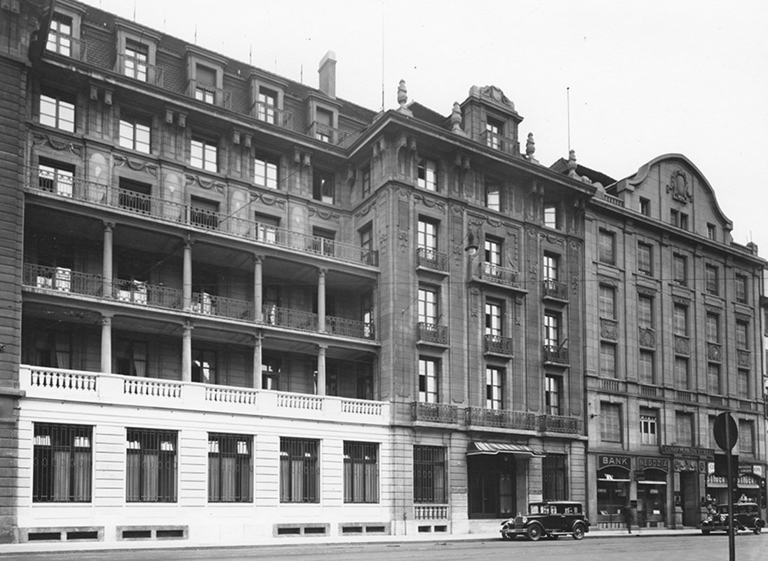
6a) 1930: BIS
  World War I Leads to the Bank for International Settlements
The Young Plan was a program for settling German reparation debts after World War 1, adopted in 1930. An Allied Reparations committee, headed by American industrialist Owen D. Young, creator and ex-first chairman of RCA Corp. and a trustee of the Rockefeller Foundation, created the Plan. Also on the Young committee were J.P. Morgan, Jr., and his partner Thomas W. Lamont.
The plan called for an international bank of settlements to handle the reparations transfers.
Soon after the acceptance of the Young Plan, the Great Crash and Great Depression ensued. Reparations were soon forgotten.
First building of the BIS (1930-77): the former
Hotel Savoy-Univers in Basel, Switzerland

Slide 12
6a) 1930: BIS
  World War I Leads to the Bank for International Settlements
First truly international monetary organization
BIS is chartered by Switzerland, but is under international law, not Swiss law
BIS’ purpose was (1) to reduce the actual gold shipments between members by balancing drs and crs and (2) to help members go back to the gold standard
FUNDERS/FOUNDERS:
6 central banks and 3 private U.S. international banks –
each got 16,000 shares of the bank:
Belgium
France J.P. Morgan & Company
Germany First National Bank of New York
Italy First National Bank of Chicago
Japan
United Kingdom
First building of the BIS (1930-77): the former
Hotel Savoy-Univers in Basel, Switzerland

Slide 13
6a) 1930: BIS
  World War I Leads to the Bank for International Settlements
Constituent Charter of the Bank for International Settlements (of 20 January 1930)
Whereas the Powers signatory to the Hague Agreement of January, 1930, have adopted a Plan which contemplates the founding by the central banks of Belgium, France, Germany, Great Britain, Italy and Japan and by a financial institution of the United States of America of an International Bank to be called the Bank for International Settlements;
And whereas the said central banks and a banking group including Messrs. J. P. Morgan & Company of New York, the First National Bank of New York, New York, and the First National Bank of Chicago, Chicago, have undertaken to found the said Bank and have guaranteed or arranged for the guarantee of the subscription of its authorised capital amounting to five hundred million Swiss francs equal to 145,161,290.32 grammes fine gold, divided into 200,000 shares;
And whereas the Swiss Federal Government has entered into a treaty with the Governments of Germany, Belgium, France, Great Britain, Italy and Japan whereby the said Federal Government has agreed to grant the present Constituent Charter of the Bank for International Settlements and not to repeal, amend or supplement the said Charter and not to sanction amendments to the Statutes of the Bank referred to in Paragraph 4 of the present Charter except in agreement with the said Powers;

Slide 14

6a) 1930: BIS
  World War I Leads to the Bank for International Settlements
Constituent Charter of the Bank for International Settlements (of 20 January 1930)
Some immunities given to BIS by its Swiss charter:
  The Bank shall be exempt and immune from all taxation.
  The Bank, its property and assets and all deposits and other funds entrusted to it, shall be immune in time of peace and in time of war from any measure such as expropriation, requisition, seizure, confiscation, prohibition or restriction of gold or currency export or import, and any other similar measures.

Slide 15
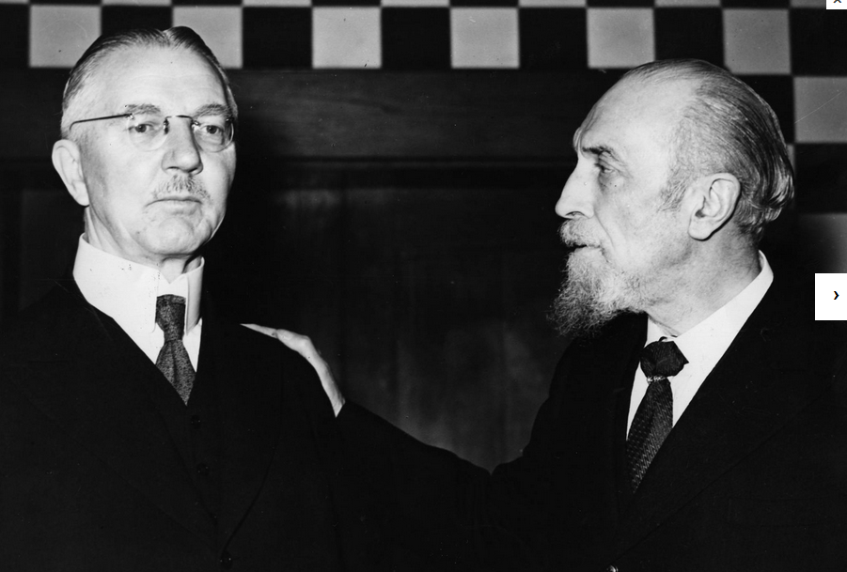
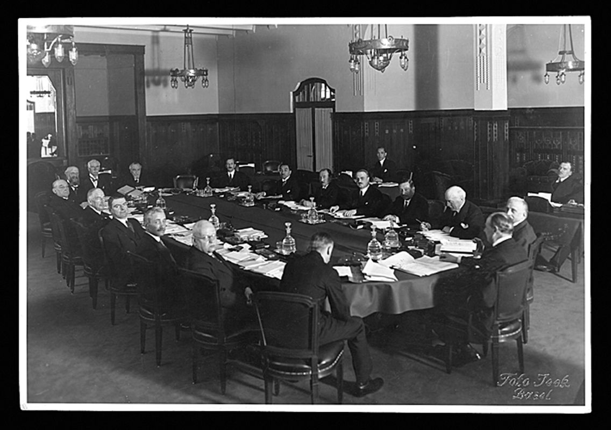
6a) 1930: BIS
  World War I Leads to the Bank for International Settlements
“… bankers and politicians insisted that the old prewar [WW1] system should be restored… to restore the gold standard as it had existed in 1914.
In addition to these pragmatic goals, the powers of financial capitalism had another far-reaching aim, nothing less than to create a world system of financial control in private hands able to dominate the political system of each country and the economy of the world as a whole. This system was to be controlled in a feudalist fashion by the central banks of the world acting in concert, by secret agreements arrived at in frequent private meetings and conferences. The apex of the system was to be the Bank for International Settlements in Basle, Switzerland, a private bank owned and controlled by the world’s central banks which were themselves private corporations.” Carroll Quigley, Tragedy and Hope: A History of the World In Our Time, pub. 1966, pp. 323-324
Central Bankers Hjalmar Schacht
(Reichsbank) and Montagu Norman (Bank of England)
First unofficial meeting of the BIS Board of Directors in Basel, April 1930

Slide 16
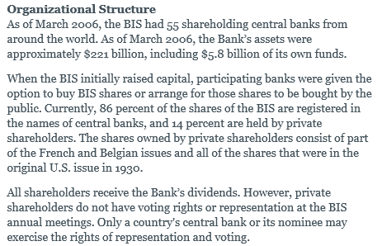
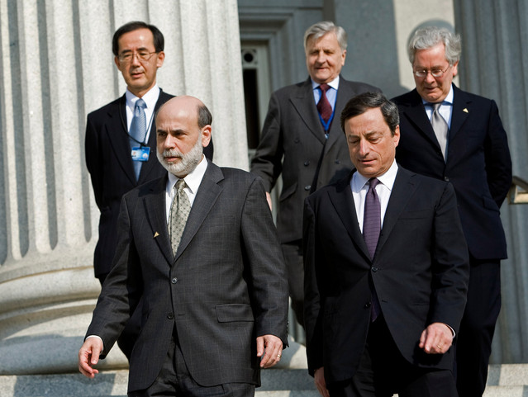
  6b) Ownership and Control of the BIS
WHO OWNS THE BIS?
WHO OWNS THE CENTRAL
BANKS?
WHO ARE THE OWNERS
OF THE CENTRAL BANKS?
From the website of the
New York Federal Reserve Bank

Slide 17
  6c) History of the BIS
The original reasons for the founding of the bank disappeared:
  countries went off the gold standard (1930’s)
  German WW1 reparations were buried at the League of Nations in Geneva
During WW2:
  July 1944 - The UN Conference in Bretton Woods agrees to the creation of the International Monetary Fund and the World Bank; it also adopts Resolution V calling for the liquidation of the BIS at “the earliest possible moment”
  May 1948 – Washington Agreement: the BIS reimburses looted gold it had inadvertently received from the German Reichsbank during the war to the Allied Tripartite Commission. The Bretton Woods resolution calling for the liquidation of the BIS is put aside.
1961+
  the BIS coordinated the “Gold Pool” whose members contributed gold to keep the US dollar redeemable at $35/ounce
  1967 – France pulled out
  1968 – the Gold Pool collapsed
2001+
  the BIS bought the outstanding shares held by all private shareholders

Slide 18


  6d) The BIS Undertakes Banking Supervision
April 1964 – Formal establishment of the Committee of Governors of the Central Banks of the Member States of the European Economic Community. The Committee decides to have its secretariat and meetings at the BIS in Basel.
The 10 main central banks represented at the BIS (G10) inaugurate regular meetings of gold and foreign exchange experts in Basel. The Gold and Foreign Exchange Experts’ Committee is renamed the Markets Committee in May 2002.
In response to international bank failures, the G10 Governors establish the Basel Committee on Banking Regulations and Supervisory Practices (renamed the Basel Committee on Banking Supervision in Sept 1989).
The BIS’ depositors are almost exclusively central banks. Their deposits include a significant part of the world’s foreign exchange reserves: as of 1997, the BIS held 113 billion dollars, representing 7% of all foreign exchange reserves; it probably holds the world’s largest amount of gold

Slide 19
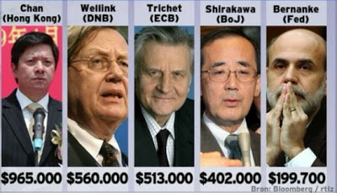

  6e) Money Creation Powers of the BIS
The BIS is not a bank of issue. It does not create credits for its central bank depositors.
BIS promotes itself as an important meeting place for central bankers.
BIS devotes a significant effort to research and statistical work in the area of international loans.
BIS services its central bank depositors. There are now 41 central banks in BIS.
“In the 1988-1992 period, it fostered an international agreement on how to evaluate the adequacy of a bank’s capital and set minimum requirements that internationally operating banks are expected to follow [Basel Framework]. These ‘regulations’ are now having a greater effect on how banks operate than is realized – arguably more than local regulators have.” Zarlenga, LSM, p. 608
CENTRAL BANKERS
SUPPORT THIS SYSTEM
central bank heads
salaries

Slide 20
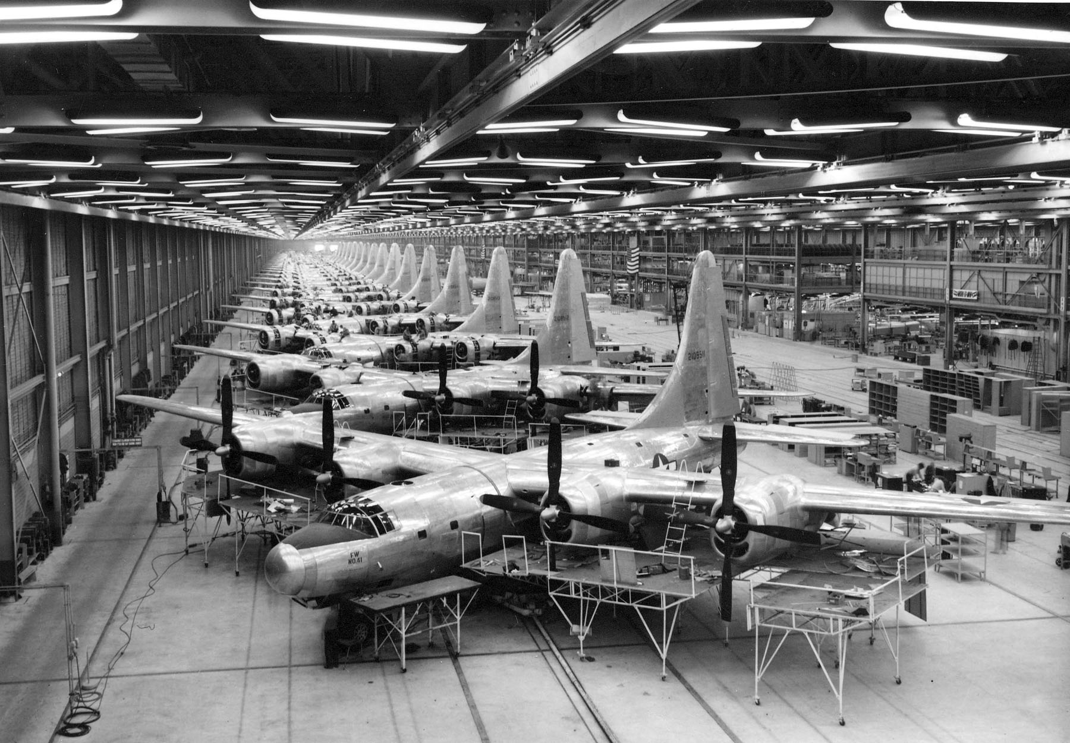
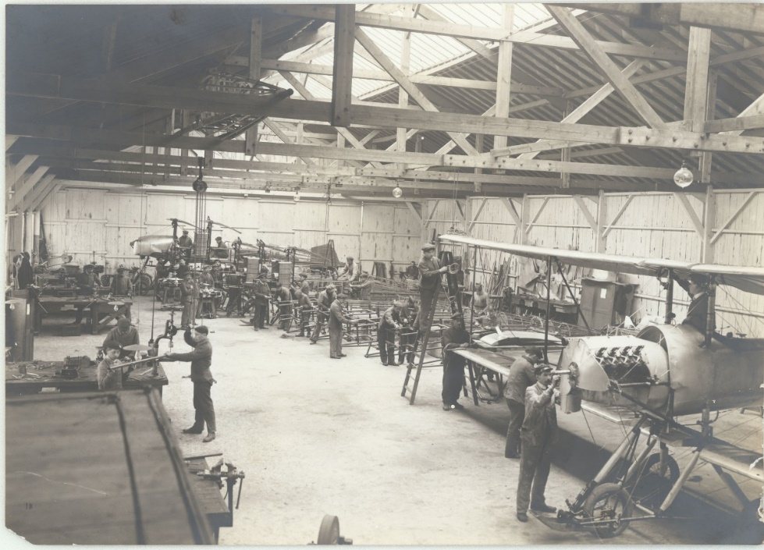
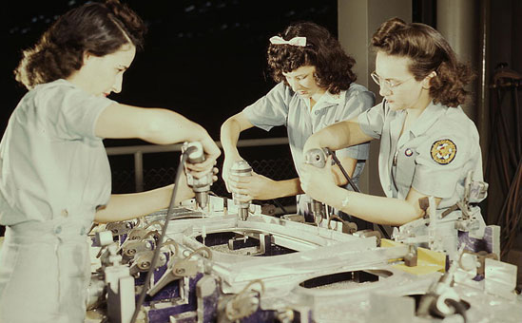
1944: BRETTON WOODS
Keynes’ Alternative to Our Current System
“Power over international finance flowed to the Federal Reserve System, as American industry supplied both sides during most of World War 1, and the Allies during World War 2.” Zarlenga, LSM, p. 609
WW 1
WW 2

Slide 21

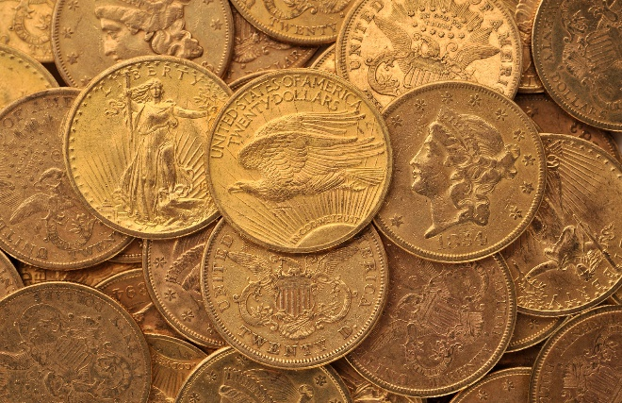
1944: BRETTON WOODS
Keynes’ Alternative to Our Current System
The 1930’s saw several important financial events:
    Exercise by governments, such as the United States, of deficit spending: government stimulated the economy by means of spending for infrastructure, the money coming from an increase in the national debt [national bonds]
    Countries, like the U.S. and Britain, left the gold standard, which no longer was the basis for commercial bank reserves, domestically: THE WORLD’S FINANCIAL SYSTEM WAS FUNDAMENTALLY CHANGED.
    “…all that dropping the gold standard ultimately achieved was to further enshrine
    the power of banking, and ensure the growth of debt. Prior to the abandonment
    of the gold standard, although it was a small amount, the annual supply of gold
    formed a credit [debt-free] input into the money supply. Now this was done.”
    Michael Rowbotham, The Grip of Death, pub. 1999, p. 240

Slide 22
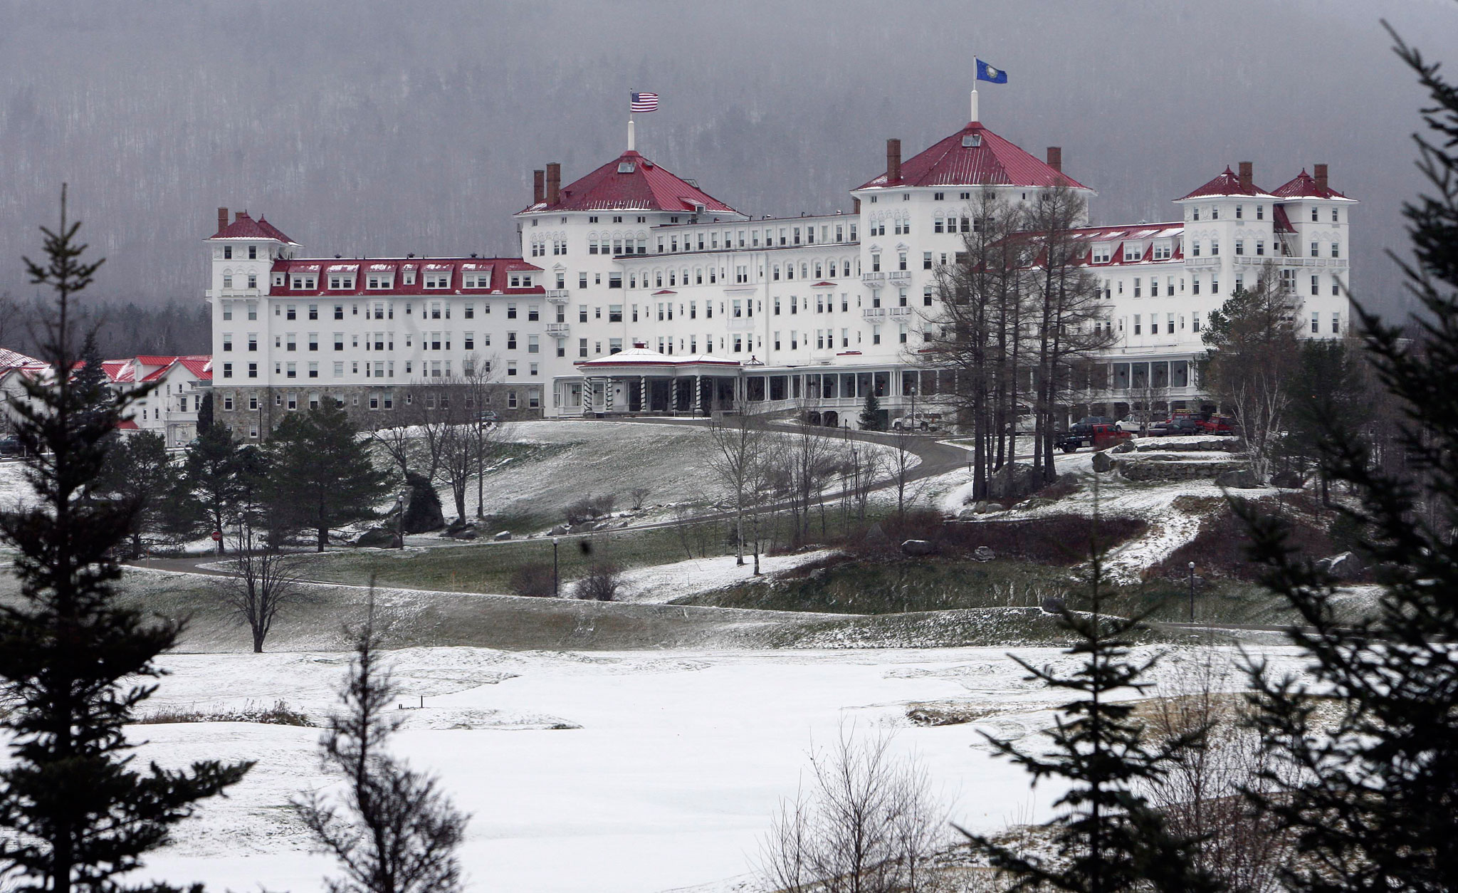
1944: BRETTON WOODS –
Keynes’ Alternative to Our Current System
“Towards the end of the war [WW2], the governments of the allied nations held the conference at Bretton Woods in America, which did more than anything else to determine the path of development which the world has since taken. This was when the constitution of the World Bank and the International Monetary Fund, and also the principles of postwar international trade, were decided.” Michael Rowbotham, The Grip of Death, pub. 1999, p. 241
Mt. Washington Hotel,
Bretton Woods,
New Hampshire, U.S. –
where the Bretton Woods
Conference of 1944 was held

Slide 23
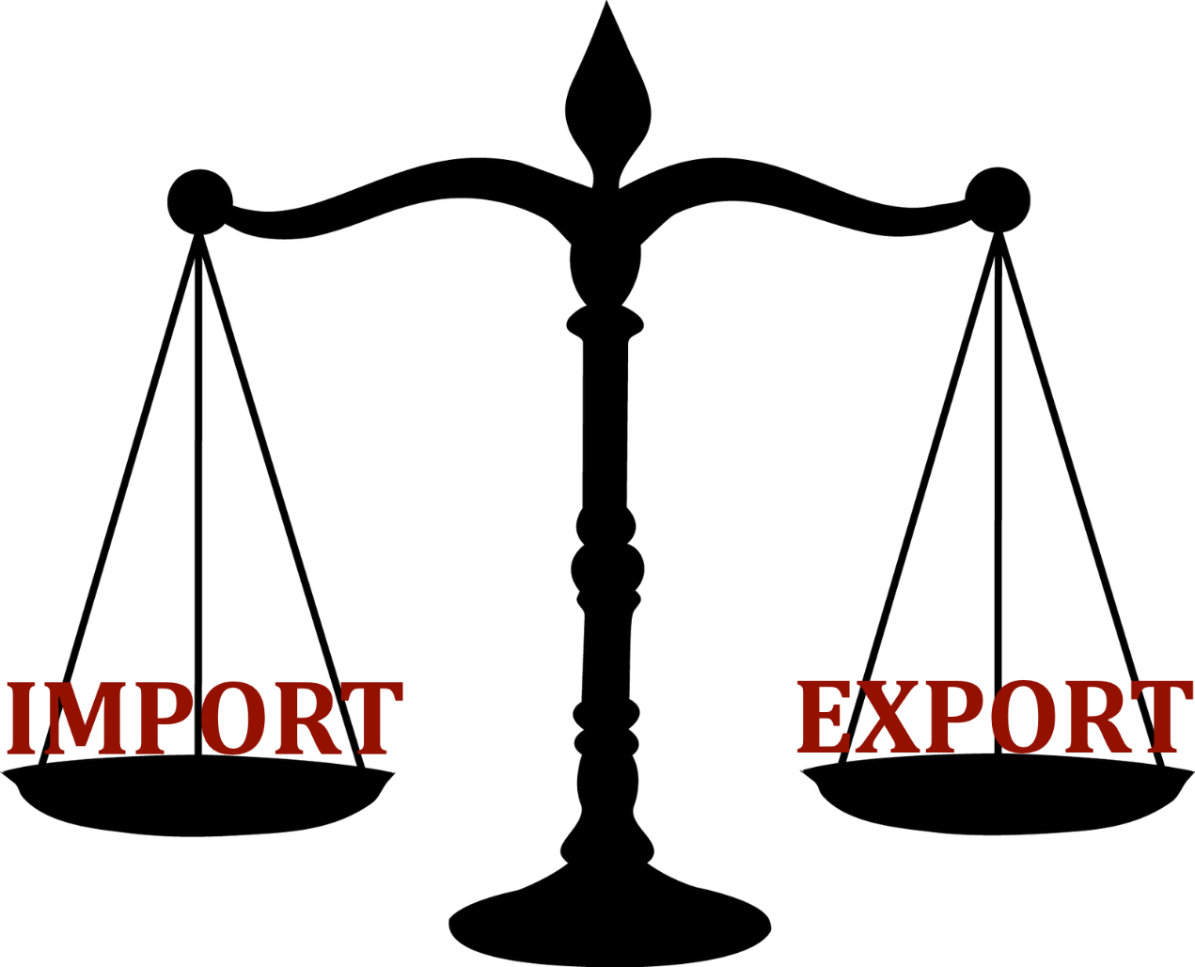
1944: BRETTON WOODS –
Keynes’ Alternative to Our Current System
At Bretton Woods, John Maynard Keynes put forward a scenario for international trade
that would structure BALANCED TRADE, involving a neutral international currency, “The Bancor”.
“He proposed that nations with a trading surplus should be required to spend any annual monetary balance they obtained back in the economies of nations with a trade deficit; failure to do this would lead to those creditor nations forfeiting part of their deposits with the World Bank. HAD THIS BEEN THE
POLICY OF THE WORLD BANK AND THE IMF, AND HAD THIS PRINCIPLE GOVERNED INTERNATIONAL TRADE, THERE WOULD BE NO THIRD WORLD DEBT TODAY [all caps not the authors’]”
Michael Rowbotham, The Grip of Death, pub. 1999, p. 242

Slide 24
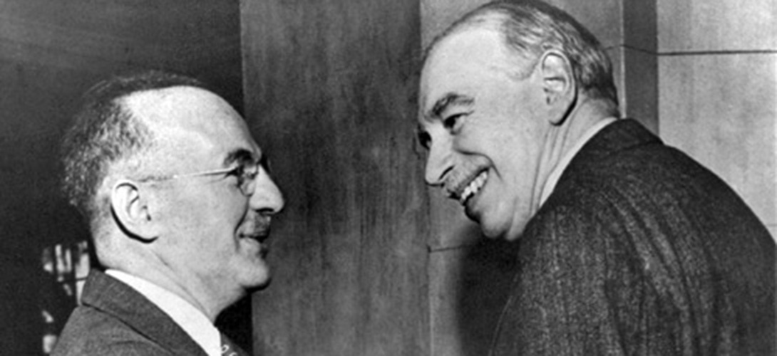
1944: BRETTON WOODS –
Keynes’ Alternative to Our Current System
“But it was the official American policy which prevailed and set the terms under which the World Bank, the IMF, international trading and financial settlements of trading should operate.”
“However, the American delegation lead by Harry Dexter-White presented a counter-plan, in which trade between nations would be based upon national currencies involving a system of fixed exchange rates. The American delegation also pushed for free world trade and a centre-stage role for the new monetary authorities. Critically, under the American proposal, there was to be no obligation on nations gaining revenues from an export surplus to spend them back in countries which had a trade deficit. The creditor countries would lend [italics is Rowbotham’s] this money to debtor nations, via the IMF and World Bank.”
“The American proposal meant that an imbalance of trade and money could develop, and lead to permanent debt between nations, and permanent debt to the World Bank and the IMF.” Michael Rowbotham, The Grip of Death, pub. 1999, p. 242
Harry Dexter White
(1892 – 1948) –
American economist
and senior U.S. Treasury
Dept. official
John Maynard Keynes
(1883 – 1946)

Slide 25
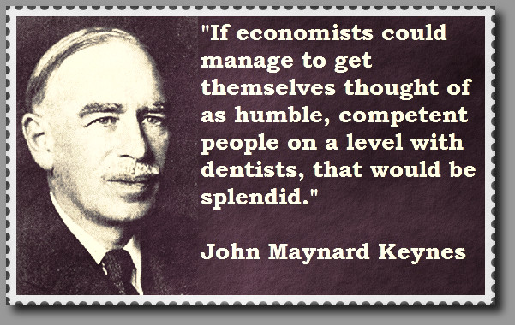
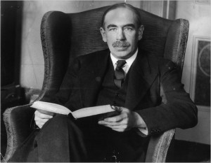
1944: BRETTON WOODS –
Keynes’ Alternative to Our Current System
“Keynes, who headed the British delegation, was implacably opposed to such a policy. In a famous statement he begged:”
“I sympathise, therefore, with those who would minimize, rather than those who would
maximize, economic entanglement between nations. Ideas, knowledge, art, hospitality, travel –
these are the things which should of their nature be international. But let goods be homespun
whenever it is reasonably and conveniently possible; and above all let finance be primarily
national.” Quoted in Herman Daly and John Cobb, For the Common Good, Green Print, 1989.

Slide 26

1944: BRETTON WOODS –
Keynes’ Alternative to Our Current System
“Those American politicians, financial advisers and corporate representatives who dictated the Bretton Woods agreements effectively determined that thereafter, trade would everywhere prosper over domestic need. The decline and eventual demise of democratic sovereignty throughout the world became only a matter of time, first crushed beneath the economic power of the strongest nation, America, and later by the power of international finance.”
Michael Rowbotham, The Grip of Death, pub. 1999, p. 242-3
Shanghai
International
Finance Centre

Slide 27
BRETTON WOODS, 1944: The International Monetary Fund
WHAT IS THE IMF:
Formed in 1944 at the Bretton Woods Conference, it came into formal existence in 1945 with 29 member countries and the goal of reconstructing the international payment system. Countries contribute funds to a pool through a quota system from which countries with payment imbalances can borrow.
As of 2010, the fund had SDR 476.8 billion, about US$ 755.7 billion at then-current exchange rates.

Slide 28
BRETTON WOODS, 1944: The International Monetary Fund
  Ambiguity of Organizational Status
The IMF is nominally a ‘special organ’ of the U.N. under Articles #57 and #63.
But the U.N. has no control over IMF policies.
CHARTER OF THE UNITED NATIONS
Article 57
The various specialized agencies, established by intergovernmental agreement and having wide international responsibilities, as defined in their basic instruments, in economic, social, cultural, educational, health, and related fields, shall be brought into relationship with the United Nations in accordance with the provisions of Article 63.
Such agencies thus brought into relationship with the United Nations are hereinafter referred to as specialized agencies.
Article 63
The Economic and Social Council may enter into agreements with any of the agencies referred to in Article 57, defining the terms on which the agency concerned shall be brought into relationship with the United Nations. Such agreements shall be subject to approval by the General Assembly.
It may co-ordinate the activities of the specialized agencies through consultation with and recommendations to such agencies and through recommendations to the General Assembly and to the Members of the United Nations.

Slide 29
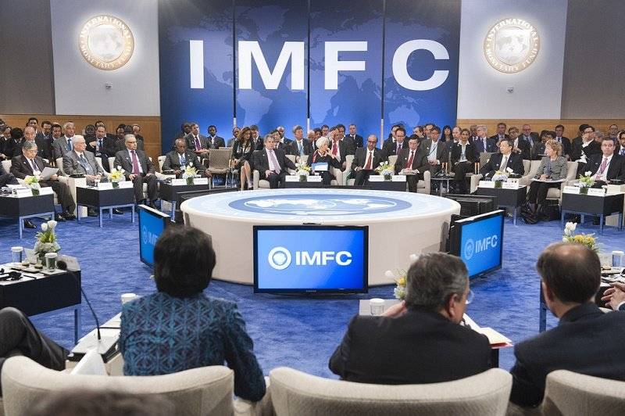
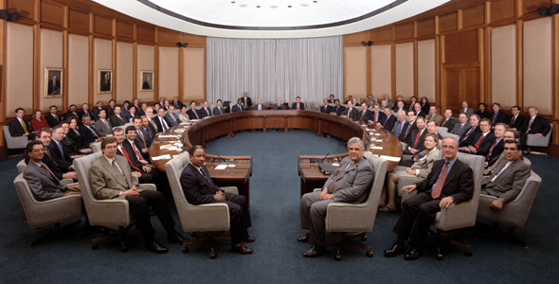
BRETTON WOODS, 1944: The International Monetary Fund
  Ambiguity of Organizational Status
The Board of Governors meets annually, with 1 representative from each member country
Run by 24-member Executive Board, meeting 3x week, with strong representation of major industrial nations
Staff takes an oath: “That I will accept no instruction in regard to the performance of my duties from any government or authority external to the Fund.” (IMF Rule N-11)
IMF BOARD OF GOVERNORS
IMF EXECUTIVE BOARD

Slide 30
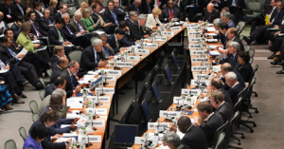
BRETTON WOODS, 1944: The International Monetary Fund
  IMF Objectives
Initial core activity: the IMF was charged with the maintenance of a system of fixed international currency exchange rates which became known as the Bretton Woods system. Each country was to establish a parity level (‘price’) between its currency and gold, and stay within 1% of it.
Later, currencies could move in a 10% band, as long as advance notice was given of changes.
IMF/WORLD BANK MEETING

Slide 31
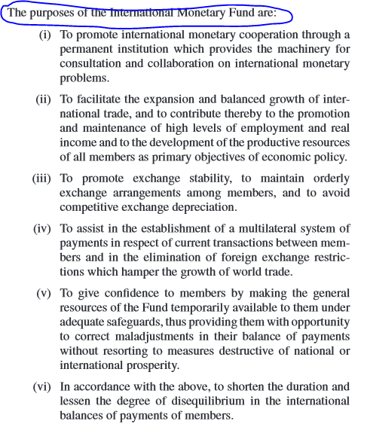
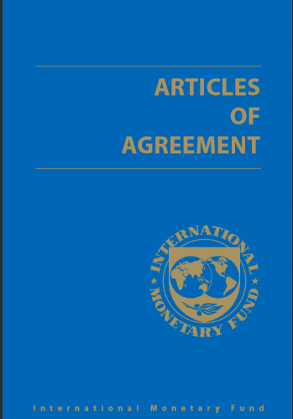
BRETTON WOODS, 1944: The International Monetary Fund
  IMF Objectives
The organization's objectives stated in the Articles of Agreement are: to promote international economic cooperation, international trade, employment, and exchange-rate stability, including by making financial resources available to member countries to meet balance-of-payments needs.

Slide 32
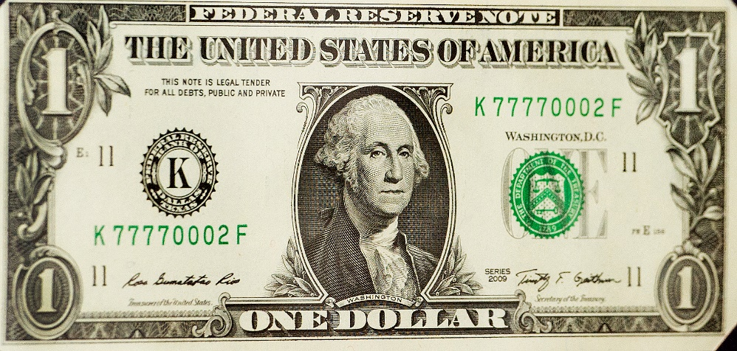
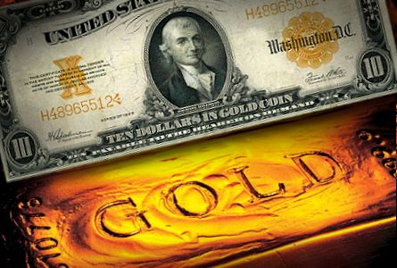
BRETTON WOODS, 1944: The International Monetary Fund
  c) The U.S. Dollar Rules
The U.S. Dollar was given special status:
equal status with gold, as reserves for currency creation.

Slide 33
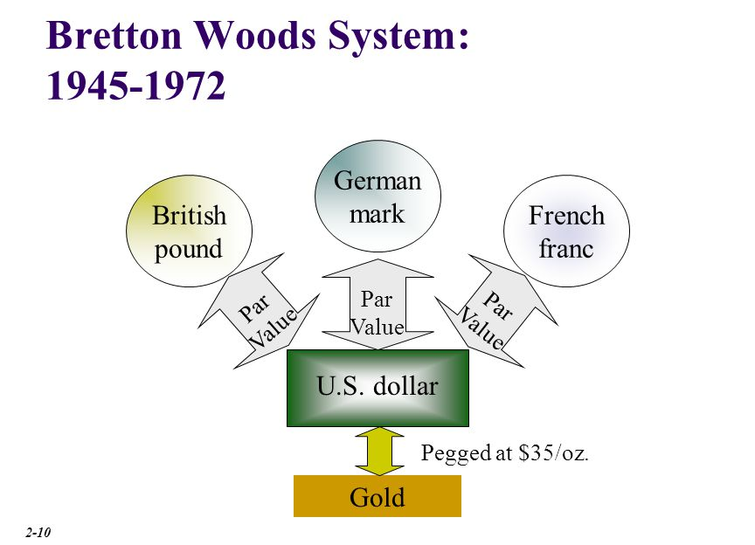
BRETTON WOODS, 1944: The International Monetary Fund
  c) The U.S. Dollar Rules
Other currencies were exchangeable for U.S. Dollars at a fixed rate.
The U.S. maintained the convertibility of 1 oz gold = $35

Slide 34
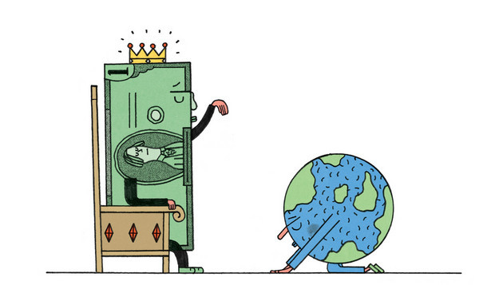
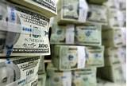
BRETTON WOODS, 1944: The International Monetary Fund
  c) The U.S. Dollar Rules
“…U.S. gold reserves counted twice in creating world reserves. First they could be used to create dollars, then those dollars could be used as reserves to create other currencies. So at least twice as much money would be created worldwide than if gold alone were the reserve. The IMF was a mixed system of gold and a privileged paper dollar.”
Zarlenga, LSM, p. 612

Slide 35


BRETTON WOODS, 1944: The International Monetary Fund
  c) The U.S. Dollar Rules
The use of the dollar for reserves by other central banks allowed the U.S. to run large balance of payments deficits.
U.S. $$$
IMPORTS MORE GOODS THAN EXPORT
EXPORTS

Slide 36
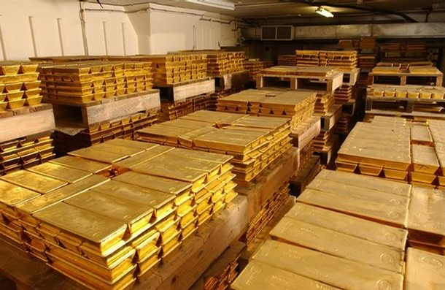
BRETTON WOODS, 1944: The International Monetary Fund
  d) The London Gold Pool
Critically important to maintaining US gold reserves was the London gold price. If it could be maintained at $35.20, it would be cheaper to purchase gold through London than across the Atlantic, where shipping and insurance would add another 20 cents or more. If the London price was above $35.20, nations would deal with internal economic crises by buying gold at the Bretton Woods price and selling it in the gold markets.
The U.S. Federal Reserve System, the Bank of England and the central banks of West Germany, France, Switzerland, Italy, Belgium, the Netherlands, and Luxembourg set up a sales consortium to prevent the market price of Gold from exceeding $US 35.20 per oz.
Under the "London Gold Pool" arrangement, member banks provided a quota of gold into a central pool, with the Federal Reserve matching the combined contributions on a one to one basis. During a time of rising prices, the Bank of England, the agent, could draw on the gold from the pool and sell into the market to cap or lower prices.
By February 1962, the gold pool was buying gold as the price dipped and selling as the price rose. This pattern continued over the next few years.

Slide 37

BRETTON WOODS, 1944: The International Monetary Fund
  d) The London Gold Pool
By 1965 the gold pool was consistently supplying more gold to cap prices than it was winning back. The beginning of the end for the London Gold Pool was the devaluation of the pound sterling in November 1967, causing yet another run to gold.
In a matter of weeks the pool had laid out in excess of 1000 ton, in those days valued at the not insignificant amount of over $1.1 billion.
Meanwhile France, led by outspoken Charles de Gaulle and his fiery economist Jacques Rueff, withdrew from the pool and confirmed their position to send dollars, earned by exporting to the U.S., back, in demand for US gold rather than US Treasury debt. At this point, the drain on U.S. gold became acute.
On Friday March 8th, London sold 100 ton of gold at market, up from around 5 ton on a normal day.
By midweek it had emergency airlifted several planeloads of gold from the US to London to meet demand. On Wednesday the London market sold 175 ton, 30 times its normal daily turnover, and by Thursday demand exceeded 225 tons.

Slide 38
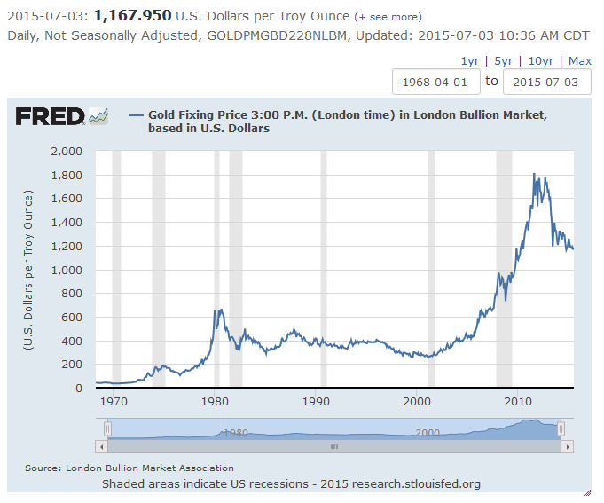
BRETTON WOODS, 1944: The International Monetary Fund
  d) The London Gold Pool
The London gold market remained closed for two weeks, during which time the London Gold Pool was officially disbanded.

Slide 39
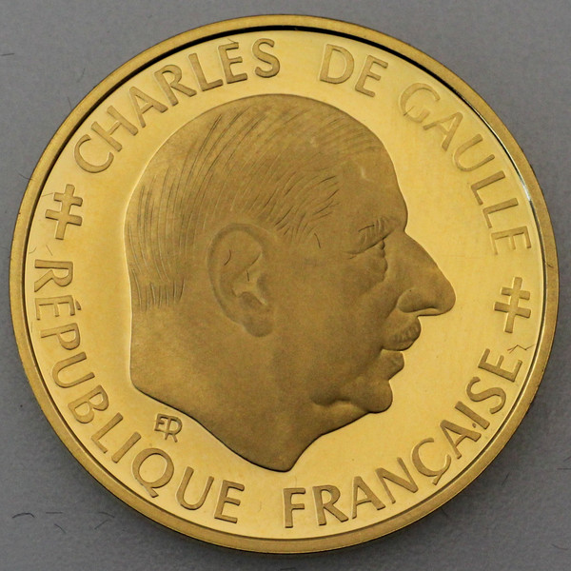

BRETTON WOODS, 1944: The International Monetary Fund
  d) The London Gold Pool
Starting in the 1959-69 administration of President Charles de Gaulle and continuing until 1970, the government of France exchanged it dollar reserves for gold at the official exchange rate.
De Gaulle decried Dollar Diplomacy, which allowed the U.S. to issue U.S. Dollars, used as worldwide reserves, and buy up European assets.

Slide 40
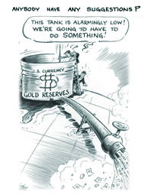
BRETTON WOODS, 1944: The International Monetary Fund
  d) The London Gold Pool
However, the U.S. gold holdings were in a downward trend until there were only 11 Billion dollars of gold in 1971 @ $35 oz.

Slide 41
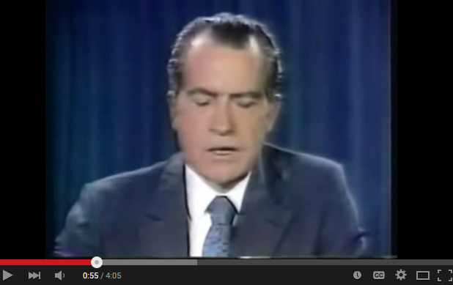

1971: NIXON -- Closes the Gold Window
“In 1971 there occurred one of the most significant but least understood changes to the world’s financial system.” Rowbotham, p. 243
“The commitment by the US to redeem international dollar holdings at the rate of $35 per ounce had formed the central foundation of the post-war international financial system set in place at the Bretton Woods conference of 1944. Nixon’s unilateral announcement dealt it a fatal blow.” www.wsws.org
“In recent weeks, the speculators have been waging an all-out war on the American dollar. The strength of a nation’s currency is based on the strength of that nation’s economy – and the American economy is by far the strongest in the world. Accordingly, I have directed the Secretary of the Treasury to take the action necessary to defend the dollar against the speculators.
I have directed Secretary Connally to suspend temporarily the convertibility of the American dollar except in amounts and conditions determined to be in the interest of monetary stability and in the best interests of the United States.”
President Richard Nixon, August 15, 1971

Slide 42
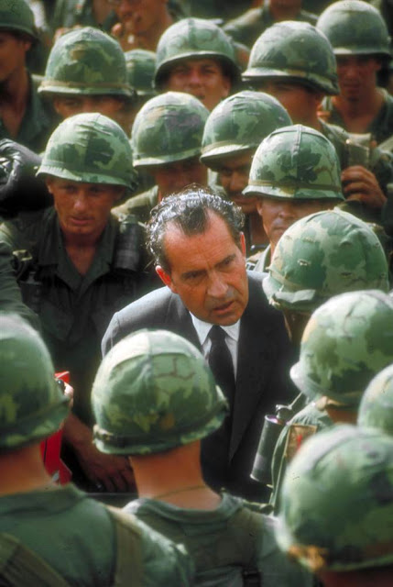

1971: NIXON -- Closes the Gold Window
Who were these speculators that Nixon said were attacking the U.S. Dollar?
“... over the decade from 1960-1970, there had been a large outflow of dollars from America… The Americans prevaricated until after the Vietnamese War, but finally had to accept that they did not hold nearly enough gold for all these dollars to be exchanged.” Rowbotham, p. 243
By the 1960s, a surplus of U.S. dollars caused by foreign aid, military spending, and foreign investment threatened this system, as the United States did not have enough gold to cover the volume of dollars in worldwide circulation at the rate of $35 per ounce

Slide 43
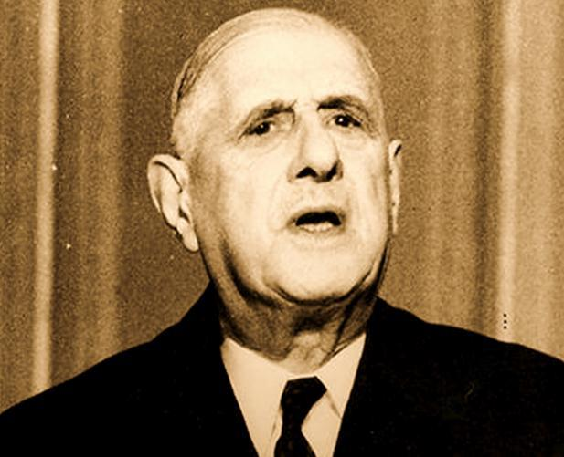


1971: NIXON -- Closes the Gold Window
“Prior to that date [August 15, 1971], holdings of one nation’s currency by another could be exchanged for gold.” Rowbotham, Grip of Death, p. 243
FRENCH GOVERNMENT
U.S. GOVERNMENT

Slide 44
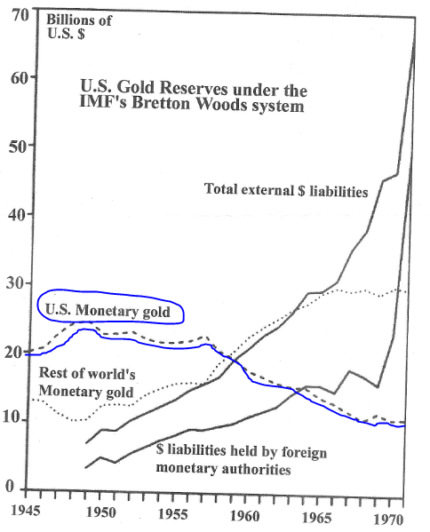
1971: NIXON -- Closes the Gold Window
“An examination of U.S. Gold reserves shows the system under pressure from 1949, near the beginning of Bretton Woods.

Slide 45
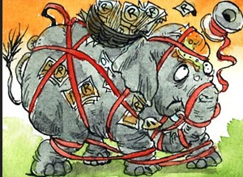
1971: NIXON -- Closes the Gold Window
Because gold was still the basis of international exchange in 1971, and governments could claim another country’s gold with the country’s currency, MOST NATIONS HAD CONTROLS OVER THE OUTFLOW OF INVESTMENT CAPITAL [MONEY].
Capital controls were an integral part of the Bretton Woods system which emerged after World War II and lasted until the early 1970s. This period was the first time capital controls had been endorsed by mainstream economics.
CAPITAL CONTROLS = KEEPING THE NATION’S MONEY AT HOME
exchange controls on buying and selling of a national currency at the market rate
caps on the allowed volume for the international sale or purchase of various financial assets
transaction taxes
minimum stay requirements
requirements for mandatory approval
limits on the amount of money a private citizen is allowed to remove from the country

Slide 46

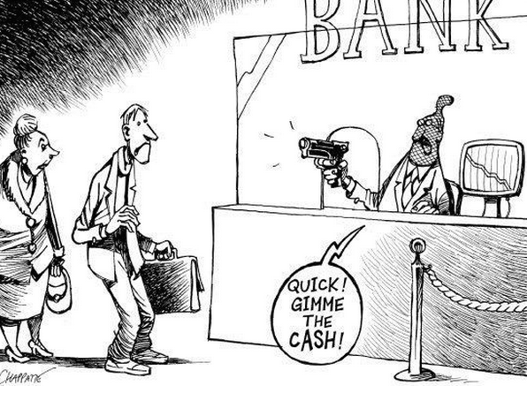
1971: NIXON -- Closes the Gold Window
Today, the country of Greece has imposed capital [money] controls on its citizens.
Greece has therefore been forced to turn to capital controls. The measures imposed on Greeks are not especially complicated. Banks will be closed until July 6th (the day after the referendum) at the earliest. ATMs reopened on June 29th, but depositors may withdraw no more than €60 per day. The Greek payment system is working as normal, but only for transactions within Greece (or between accounts held at Greek banks). Credit cards can be used for online purchases, so long as the shop has an account in Greece; money can be transferred via wire, so long as the recipient account is in Greece. Emergency foreign payments can be made (to pay a foreign tuition bill, for example) but only after receiving authorisation from a newly created banking-transactions approval committee.

Slide 47

1971: NIXON -- Closes the Gold Window
“This [U.S. going off the international gold standard] completely changed the conditions of the world’s monetary system, and removed one of the last elements tending to keep finance national. Once there was no fear that holdings of dollars or pounds by another nation might lead to a call for gold that America or Britain didn’t have, there was no need for the restrictions on an outflow of money for foreign investment.” Rowbotham, p. 243
In the 1970s free market economists became increasingly successful in persuading their colleagues that capital controls were in the main harmful.
The US, other western governments, the IMF and World Bank began to take an increasingly critical view of capital controls and persuaded many countries to abandon them to facilitate financial globalization.

Slide 48
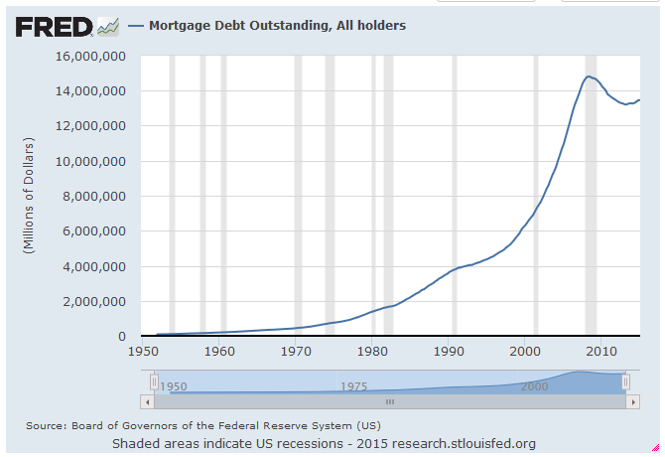
1971: NIXON -- Closes the Gold Window
“Domestic banking round the world began to be freed from all restraints to supply the necessary money. In other words, there was deregulation, not just of the rules governing the export of capital [money], but also the rules governing domestic banking, so that this additional money could be created.” Rowbotham, p. 244
“But a substantial part of this monetary outflow has
been money which ordinary people have been forced
to create by going into debt…
The period between 1975 and 1985 was when
mortgages suddenly leaped to heights never before
seen in all the developed nations and budget
deficits soared.” Rowbotham, p. 244

Slide 49
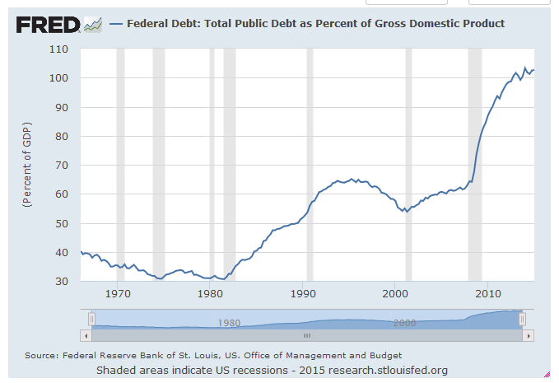
1971: NIXON -- Closes the Gold Window
“… money [loans]… created by the government increasing the national debt.” Rowbotham, p. 244

Slide 50
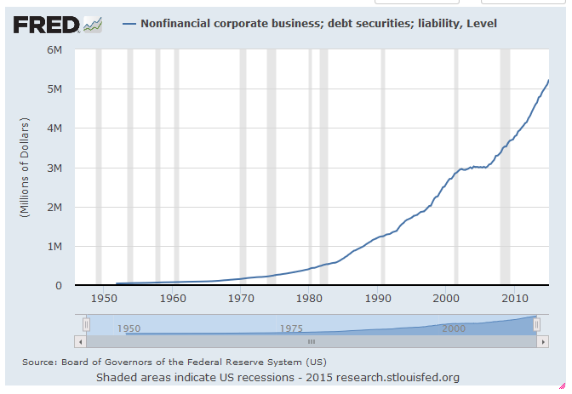
1971: NIXON -- Closes the Gold Window
Private commercial bank debt-money created by loans to American businesses.

Slide 51
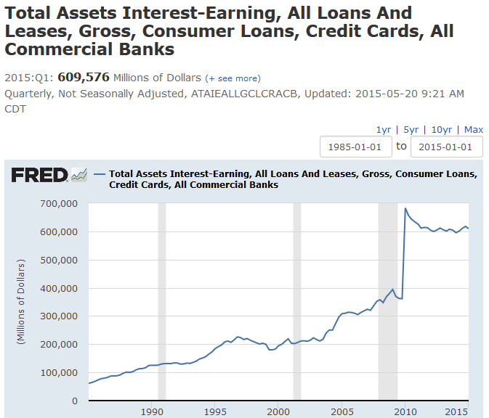
1971: NIXON -- Closes the Gold Window
Private bank debt-money created by loans to consumers.

Slide 52
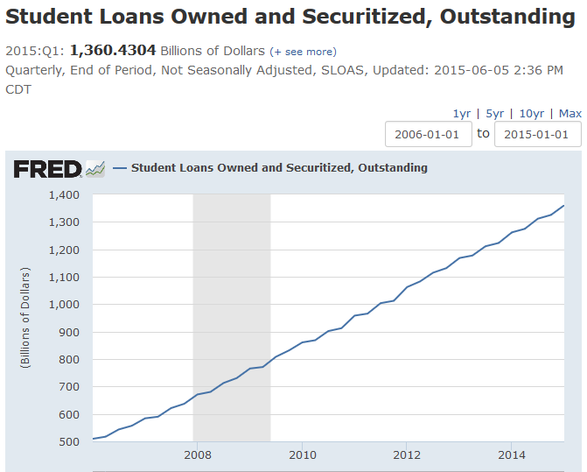
1971: NIXON -- Closes the Gold Window
Private bank debt-money created by loans to students.

Slide 53
END PART 1 – CHAPTER 22:
INTERNATIONAL MONETARY ORGANIZATIONS
Q & A
WILL DECKER’S CONCLUSION:
THE CONTROL OF MONEY -- WITHOUT CONTROL FROM THE PUBLIC -- LEADS TO
CORRUPTION … USURPATION … SLAVERY.

