Slide 1
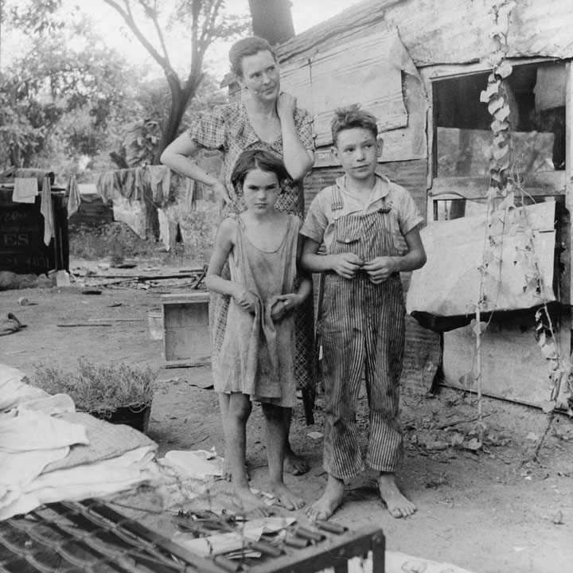
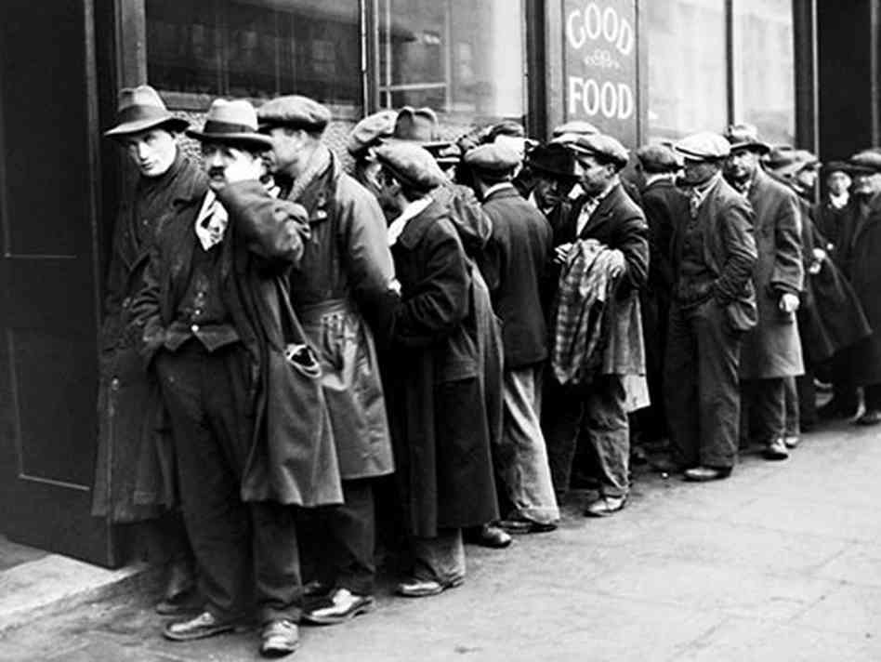
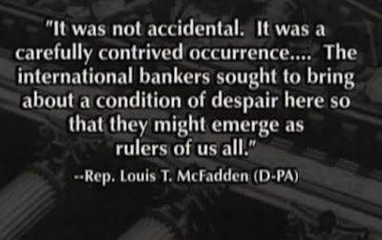
The Lost Science of Money
Cui bono ?
CHAPTER 20 – Part 2
THE FEDERAL RESERVE
WRECKS AMERICA
WHO KNEW THE MONETARY SYSTEM AND LET THIS HAPPEN?

Slide 2
THEMES OF LOST SCIENCE OF MONEY BOOK
Primary importance of the money power (power to create money and regulate it)
Nature of money purposely kept secret and confused
How a society defines money determines who controls the society
Battle over control of money has raged for millennia: public vs private
The misuse of the monetary system causes tremendous misery and suffering for the ordinary people. Will Decker & Martin Dunn, February 2014
Whenever the public has owned a significant fraction of the money power, great public benefit has ensued: Sparta, the Roman Republic, the American Colonies in the 18th century, GREENBACKS after the Civil War, Canada after the Great Depression, British experience after World War II. Martin Dunn, July 2014.

Slide 3
PARTS OF PRESENTATION
THE DEPRESSION:
  The Crash
  Bank Failures: Money Supply Plunges
  Britain Forced to Abandon Its Gold Standard Folly
  Depression – Some Descriptions
REACTIONS:
  The Bankers Didn’t Help End the Depression
  The Silent Economists
  But Some Congressmen Understood
  Some Economists Understood
  The “Pushing on a String” Argument
  Following Adam Smith to the Doors of Hell
THIRD BANKING CRISIS: ROOSEVELT “CLOSES” THE BANKS
KEYNES TO THE RESCUE?
FINANCIAL LOSSES: The Wreckage of the Economy
THE NEW DEAL
FARMERS CAUGHT IN DEBT TRAP
AT LEAST THE GOVERNMENT ACTED: Why Monetary Power Should Always Reside with the Government
Another Greenback is Needed

Slide 4
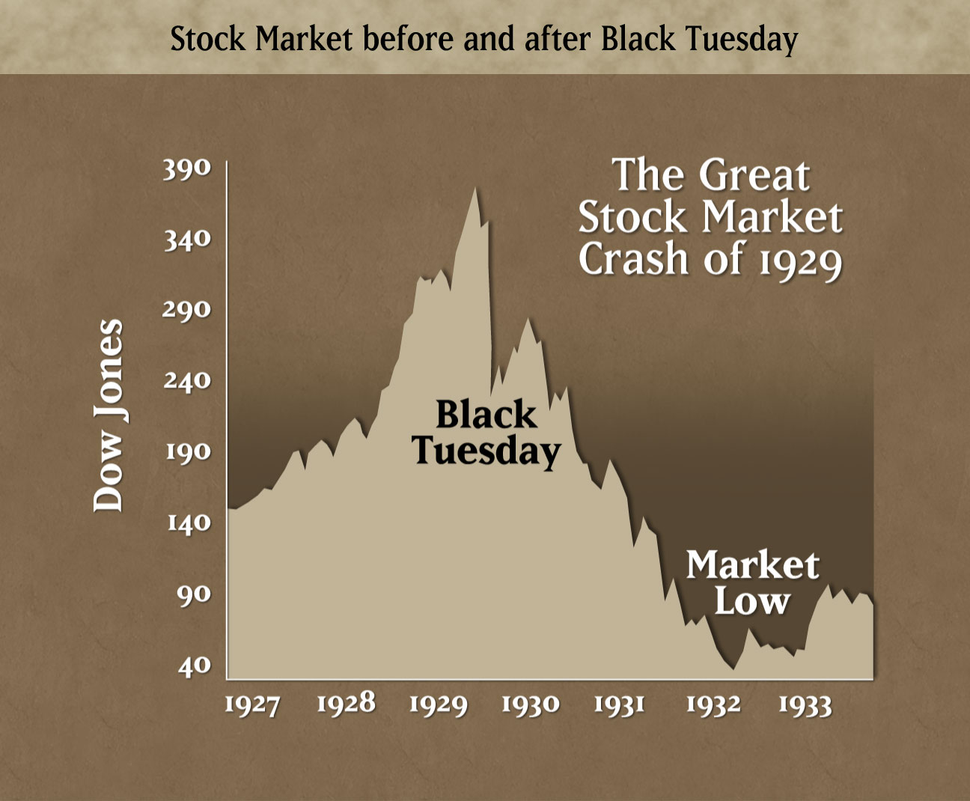
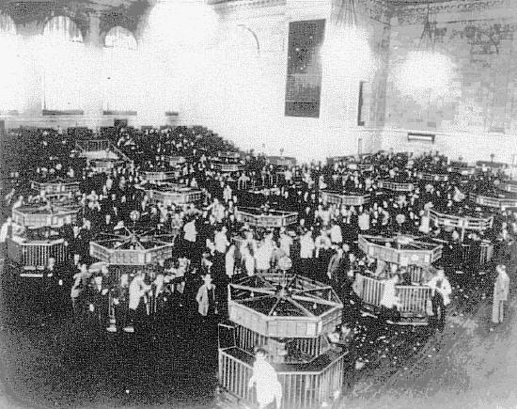
THE DEPRESSION: -- The Crash
Stocks reached their peak on September 7, 1929, and the decline in the following four weeks was orderly and produced no panic.
The decline then degenerated into a panic. On October 24, Black Thursday, a record 12,894,650 shares were traded. On Black Monday, October 28, the market went into free fall. Black Monday was followed by Black Tuesday (October 29), in which stock prices collapsed completely and 16,410,030 shares were traded on the NY Stock Exchange in a single day.
Billions of dollars were lost, wiping out thousands of investors,

Slide 5
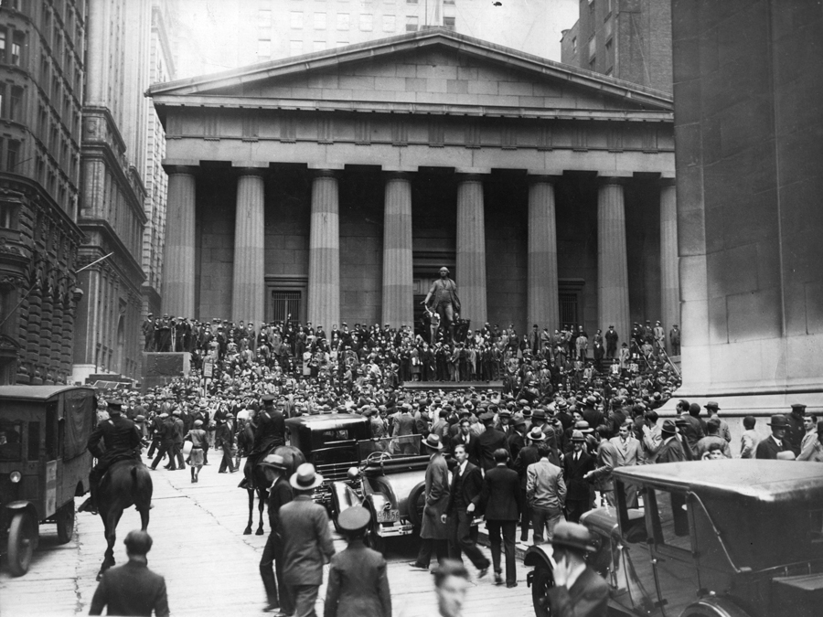
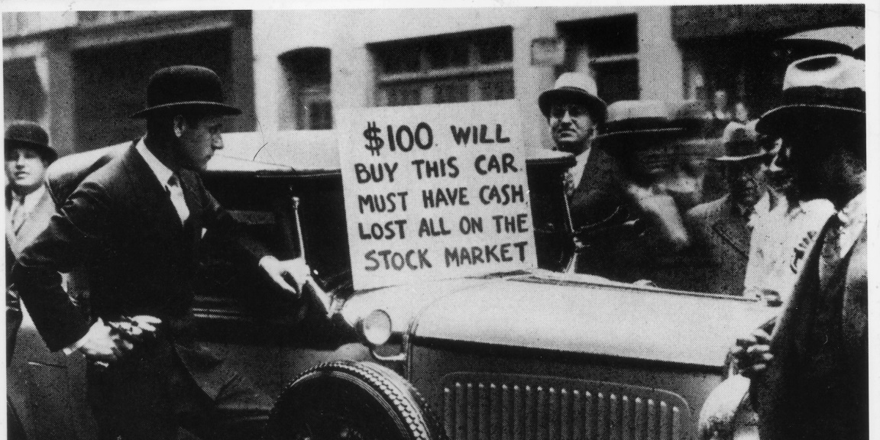
THE DEPRESSION: -- The Crash
“… the crash made clear to virtually everyone that ‘capitalism,’ to the extent it was defined by the American political, economic and market system, had fundamentally failed.
That is the history we have been in the process of unlearning; it is the history that we appear doomed to repeat once more.” Zarlenga, LSM, p. 548
CAPITALISM IS ALSO A MONETARY SYSTEM –
THE DEBT-MONEY SYSTEM.

Slide 6
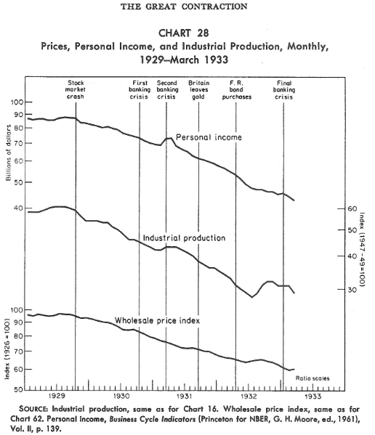
THE DEPRESSION: -- The Crash
“… the crash left no mark on currency held by the public. Its direct financial effect was confined to the stock market and did not arouse any distrust of banks by their depositors….
It changed the atmosphere within which businessmen and others were making their plans, and spread uncertainty… it decreased the amount they desired to spend on goods and services… it increased the amount they wanted to add to their money balances.”
Friedman & Schwartz, pp. 306-307

Slide 7
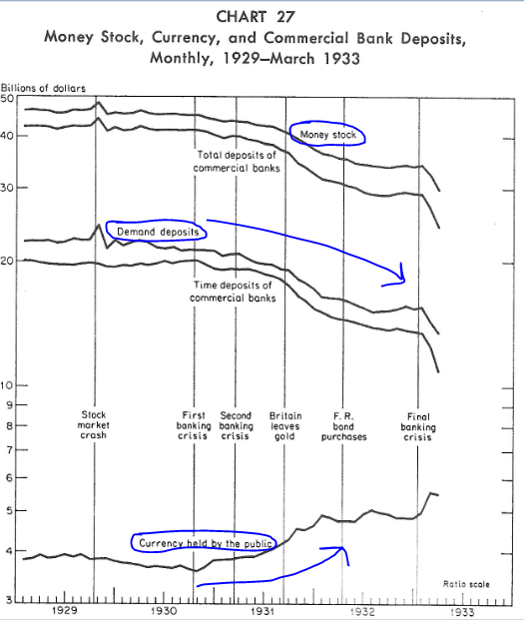
THE DEPRESSION - Money Supply Plunges
Throughout their analysis, Friedman & Schwartz divided the money stock of banks into two major components:
CURRENCY and DEPOSITS held by banks
“From the cyclical peak in August 1929 to the cyclical trough in March 1933, the stock of money fell by over a third. “ Friedman & Schwartz, p. 299

Slide 8
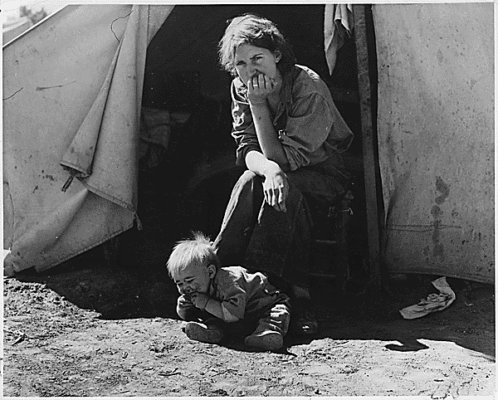
THE DEPRESSION - Money Supply Plunges
“The really crucial data – the money supply figures – were not being watched at the time. In fact, the figures were not being published in a timely way and were not readily available.” Zarlenga, LSM, p. 548
“The contraction is in fact a tragic testimonial to the importance of monetary forces.”
“…it is hardly conceivable that money income could have declined by over one-half and prices by over one-third in the course of four years if there had been no decline in the stock of money.”
Friedman & Schwartz, pp. 300-301

Slide 9
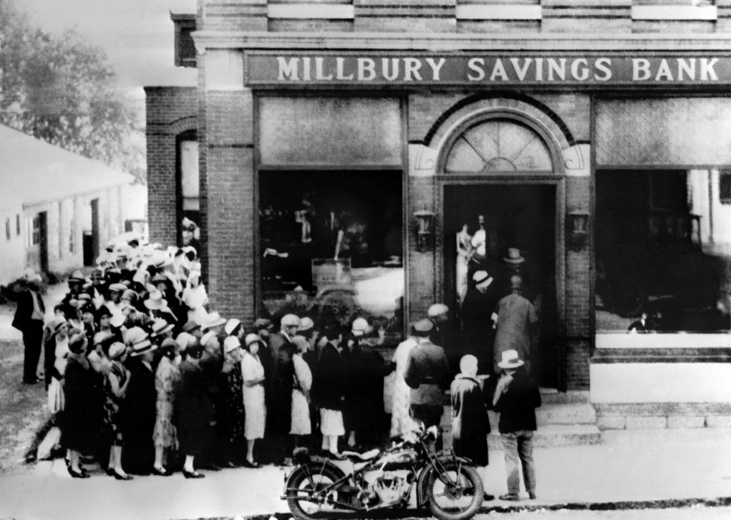
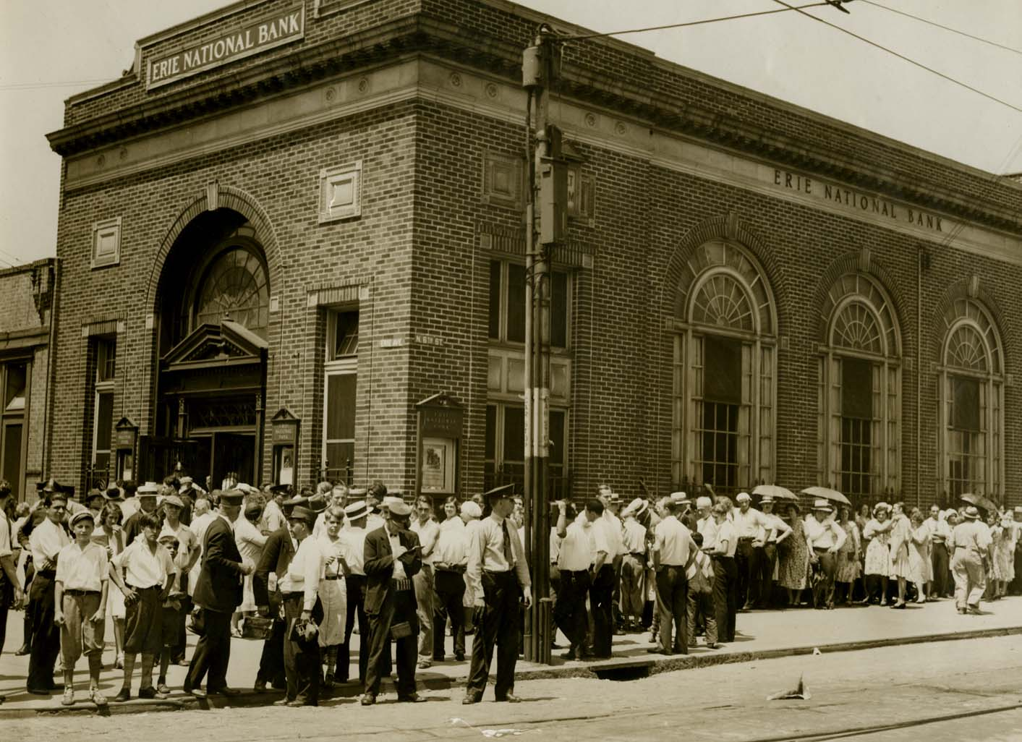
THE DEPRESSION - Money Supply Plunges
THE FIRST BANKING CRISIS, OCTOBER 1930
“In October 1930, the monetary character of the contraction changed dramatically…
A crop of bank failures, particularly in Missouri, Indiana, Illinois, Iowa, Arkansas, and North Carolina, led to wide-spread attempts to convert demand and time deposits into currency, and also, to a much lesser extent, into postal savings deposits.
A contagion of fear spread among depositors, starting from the agricultural areas, which had experienced the heaviest impact of bank failures in the twenties. But such contagion knows no geographical limits.” Friedman & Schwartz, p. 308

Slide 10
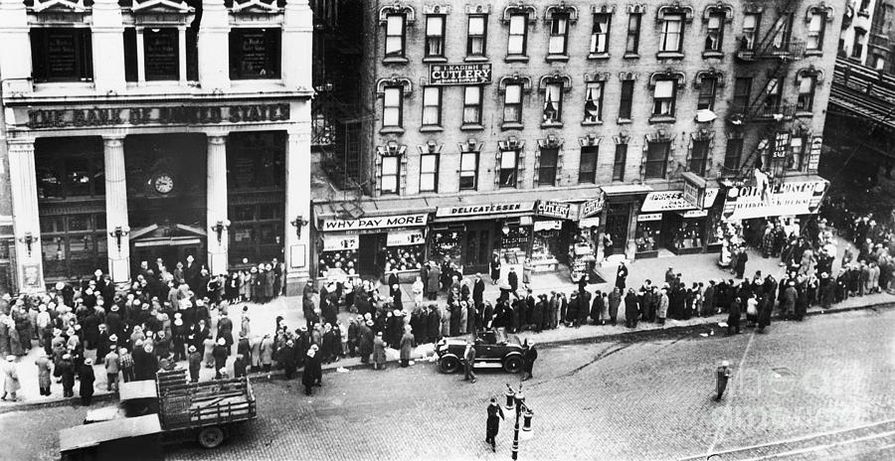
THE DEPRESSION - Money Supply Plunges
THE FIRST BANK FAILURES, OCTOBER 1930
“The failure of 256 banks with $180 million of deposits in November 1930 was followed by the failure of 352 with over $370 million of deposits in December… the most dramatic being the failure on December 11 of the Bank of the United States with over $200 million of deposits.”
“Currency held by the public stopped declining and started to rise.” Friedman & Schwartz, pp. 309-311
The Bank of the United States was the largest
deposit failure in U.S. history up to that time.
In addition, its name led many to regard it as an
official bank, which it was not, and was a further
blow to confidence.
It was a member of the Federal Reserve system,
but the Clearing House banks failed to support a plan,
devised by the NY Fed Bank, to reorganize it and save
its depositors.

Slide 11
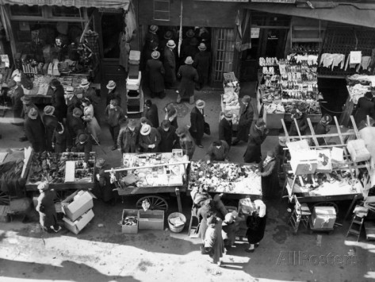
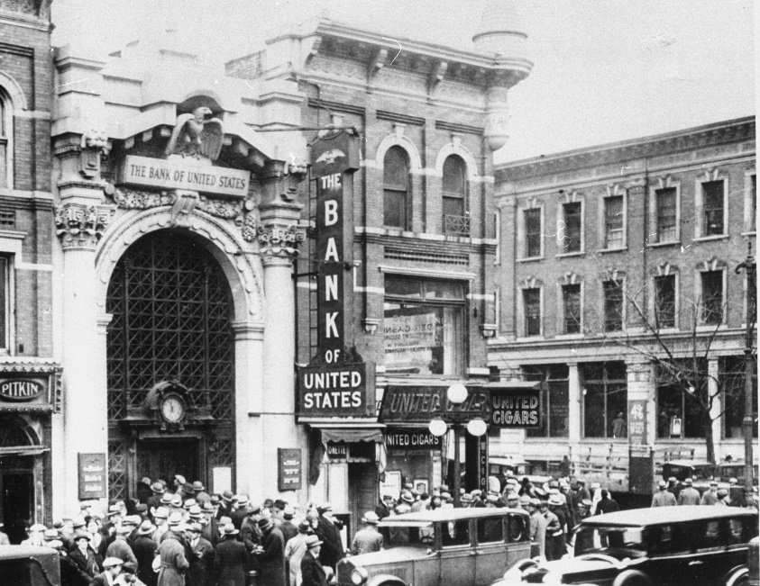
THE DEPRESSION - Money Supply Plunges
THE FIRST BANK FAILURES, OCTOBER 1930
NO HELP FROM THE BIG BANKS
“For two and a half months before its closing, Joseph A. Broderick, NY State Superintendent of Banks, had sponsored various merger plans… which would have saved the bank … The decision of the Clearing House banks not to save the Bank of United States was reached at a meeting held at the New York [Fed] Bank and was not changed despite personal appeals by Broderick and NYS Lieutenant Governor Herbert H. Lehman.
Broderick’s account of his statement of the bankers follows in part:
  I said it [the Bank of United States] had thousands of borrowers, that it financed small merchants, especially Jewish merchants, and that its closing might and probably would result in widespread bankruptcy among those it served. I warned that its closing would result in the closing of at least 10 other banks in the city and that it might even affect the savings banks. The influence of the closing might even extend outside the city, I told them.
  I reminded them that only two or three weeks before they had rescued two of the largest private bankers of the city and had willingly put up the money needed…
  I asked them if their decision to drop the plan was still final. They told me it was. Then I warned them that they were making the most colossal mistake in the banking history of New York.” Annual Report of Superintendent of Banks, State of New York, Part I, Dec. 31, 1930, p. 46
NYC Essex Street Market
Run on Bank of United States

Slide 12
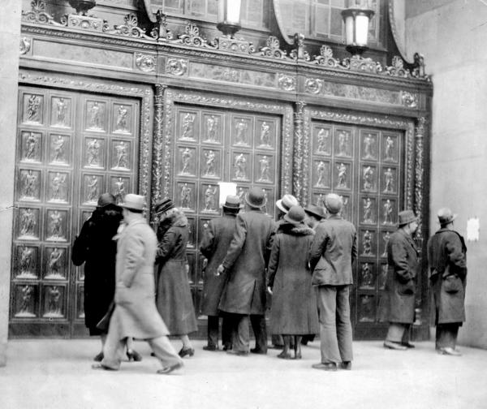
THE DEPRESSION - Money Supply Plunges
THE FIRST BANK FAILURES, OCTOBER 1930
NO RESTRICTION OF COVERTING DEPOSITS INTO CURRENCY!
“…Under the pre-Federal Reserve banking system, the final months of 1930 would probably have seen a restriction… of convertibility of deposits into currency…
… restriction would almost certainly have prevented the subsequent waves of bank failures that were destined to come in 1931, 1932, and 1933, just as restriction in 1893 and 1907 had quickly ended bank suspensions arising primarily from lack of liquidity.”
Friedman & Schwartz, p. 311
During the early years of the Great Depression, runs on deposits forced hundreds of banks throughout Pennsylvania to liquidate their affairs and close their doors. Allentown lost six of its ten banks, and in Philadelphia more than fifty banks, most of them small, also failed, taking with them all of their depositors" savings.
Run on the Erie National Bank
Sixth and Erie Avenue
Philadelphia, PA, 1931.

Slide 13
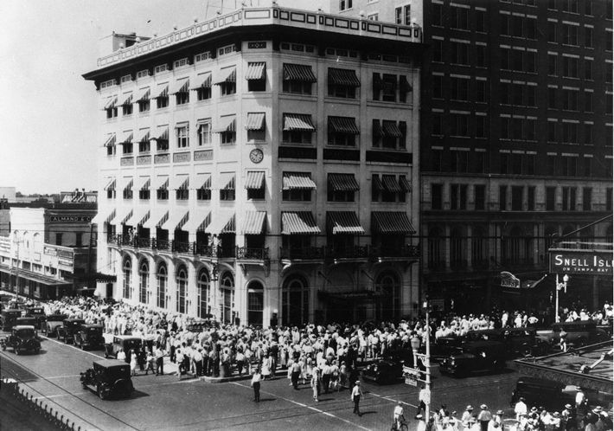
THE DEPRESSION - Money Supply Plunges
THE FIRST BANK FAILURES, OCTOBER 1930
“…the existence of the Reserve System prevented concerted restriction… by reducing the concern of stronger banks… since the System provided them with an escape mechanism in the form of discounting [borrowing from the Fed Bank]…and… by supporting the general assumption that such a move was made unnecessary by the establishment of the System.”
Friedman & Schwartz, p. 311
BANKS OUTSIDE THE SYSTEM FACED LIQUIDITY CRISES – NO ACCESS TO FED DISCOUNT WINDOW
St. Petersburg, Florida, 1931: there was panic in the streets and a real live run on a bank - Central National Bank and Trust is no more.

Slide 14
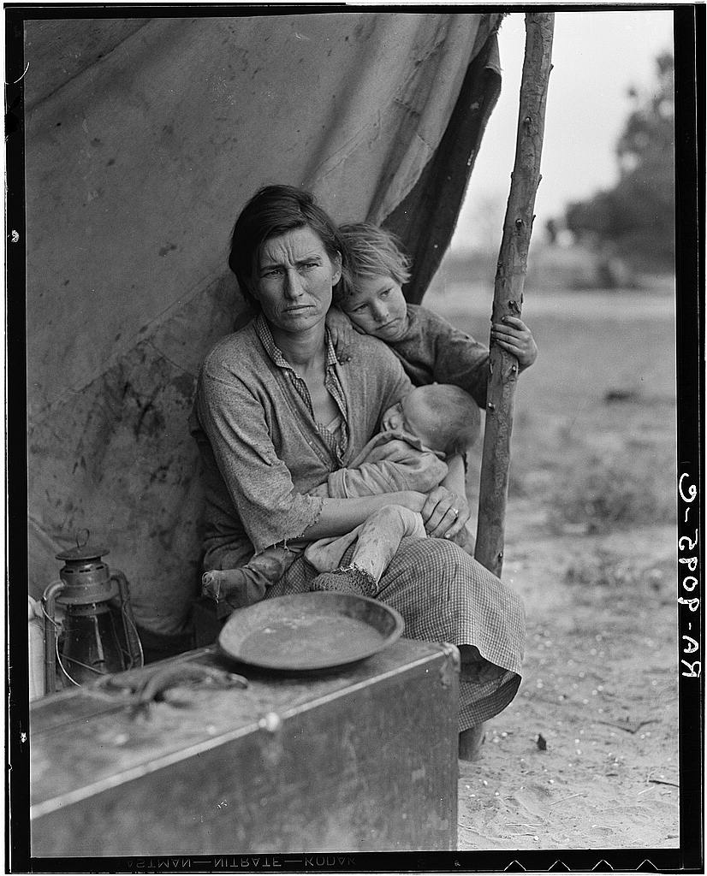
THE DEPRESSION - Money Supply Plunges
THE SECOND BANKING CRISIS – MARCH, 1931
“From March on, the public resumed converting deposits into currency, and from April on, banks started… liquidating available assets in order to meet both the public’s demand for currency and their own desire for liquidity…
Currency was being withdrawn internally by depositors justifiably fearful for the safety of banks, and gold was being withdrawn externally by foreigners fearful for the maintenance of the gold standard.” Friedman & Schwartz, p. 313
THE PUBLIC RESUMED WITHDRAWING CASH
BANK MONEY STOCK PLUMMETED: bank currency and deposits down.
As the stock of money declined, the prices of goods necessarily followed.
Deflation caused bankruptcies, unemployment, hunger, and human misery.

Slide 15
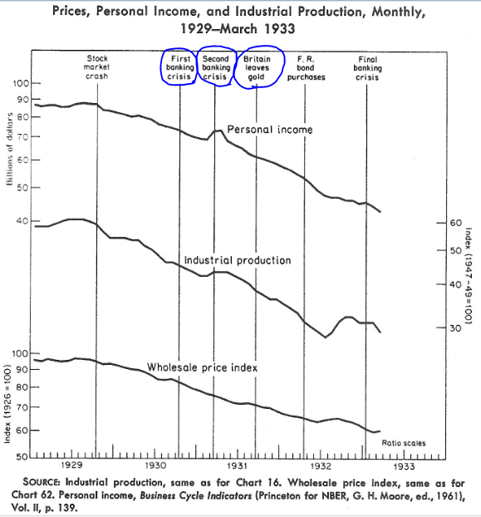
  THE DEPRESSION - Britain Forced to Abandon Its Gold Standard Folly
September 21, 1931
After runs on sterling precipitated by France and the Netherlands, Britain abandoned the gold standard.
“Even after the crash, up to mid-1931, the Fed continued to support the Bank of England’s failing gold standard, extending loans to European banks while denying them to domestic industry.
In mid-1931, the FRB of New York and other FRBs were buying commercial paper from the Bank of England and the central banks of Austria, Hungary and Germany, totaling $145 million.”
Zarlenga, LSM, pp. 548-549
Britain’s departure from gold had little effect on the continuous decline
of the country at an annual rate of:
    31% decline in personal income
    32% for production
    14% for wholesale prices

Slide 16
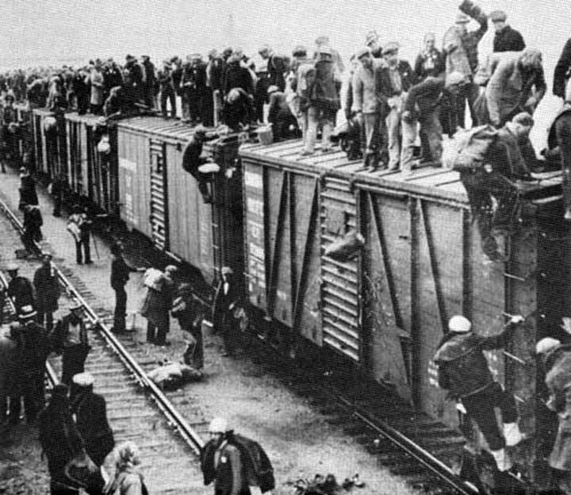
THE DEPRESSION - Hoboes
To support the family and decrease the financial burden, many teenagers left their home and hopped onto freight trains. They were called hoboes and they said they “ride the rails”... They made shelters with cardboard boxes, branches, and abandoned stuffs. In the camp, they shared food and slept.
… shacks were built near a town dump to make it easier to find food, clothes, and trash. They named themselves Hoovervilles because many people thought President Herbert Hoover didn’t try hard enough to solve the economic difficulties.

Slide 17
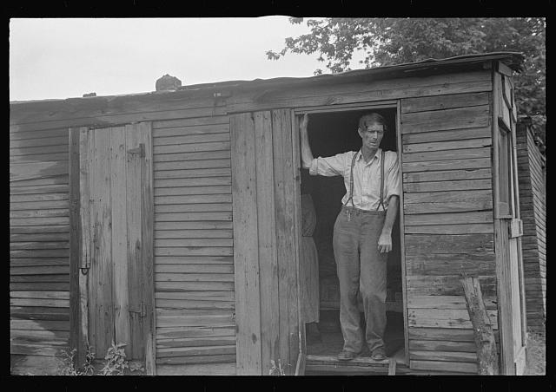
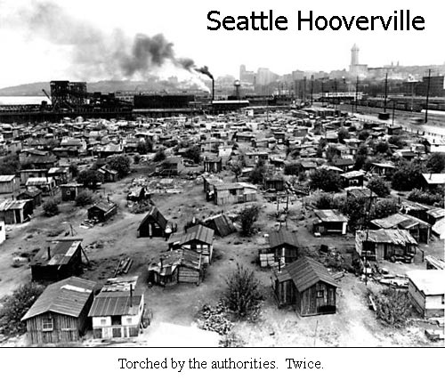
THE DEPRESSION - Hoovervilles
Every major town and city had a “Hooverville”, which was a collection of huts and shacks housing the homeless.
“Hooverville, Central Ohio, 1938.
Farm Security Administration/Office
By 1932, one of every four workers was unemployed. Banks failed and life savings were lost, leaving many Americans destitute. With no job and no savings, thousands of Americans lost their homes. The poor congregated in cardboard shacks in so-called Hoovervilles on the edges of cities across the nation; hundreds of thousands of the unemployed roamed the country on foot and in boxcars in futile search of jobs. Although few starved, hunger and malnutrition affected many.

Slide 18
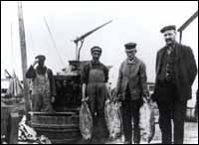
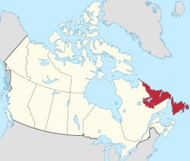
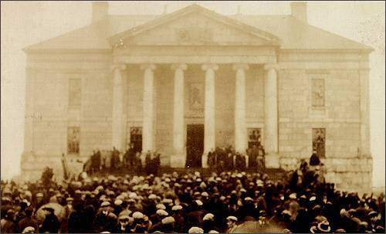
THE DEPRESSION – Around the World
“The collapse spread from the U.S. to Europe and the rest of the world, except China, which was on a silver standard, not a gold standard, and was hardly affected.” Zarlenga, LSM, p. 548
Poverty was common among Newfoundland and Labrador fishers during the Great Depression as prices for dried cod tumbled throughout the 1930s. Many became continuously indebted to merchants who loaned them gear, food, and other supplies on credit and took their catch as payment. Some fishers fell into such deep debt that merchants refused to give them any more supplies on credit.
As the Great Depression deepened, many people in Newfoundland and Labrador became increasingly dissatisfied with government efforts to relieve poverty and unemployment. On 5 April 1932, a public demonstration outside the Colonial Building in St. John’s escalated into a riot numbering 10,000 people. Prime Minister Sir Richard Squires escaped from the building with a police escort, but was voted out of office in an ensuing election.
Photographer unknown. Reproduced by permission of the Provincial Archives of Newfoundland and Labrador (PANL A2-160), St. John’s, Newfoundland.
Riot outside Colonial Building, 5 April 1932

Slide 19
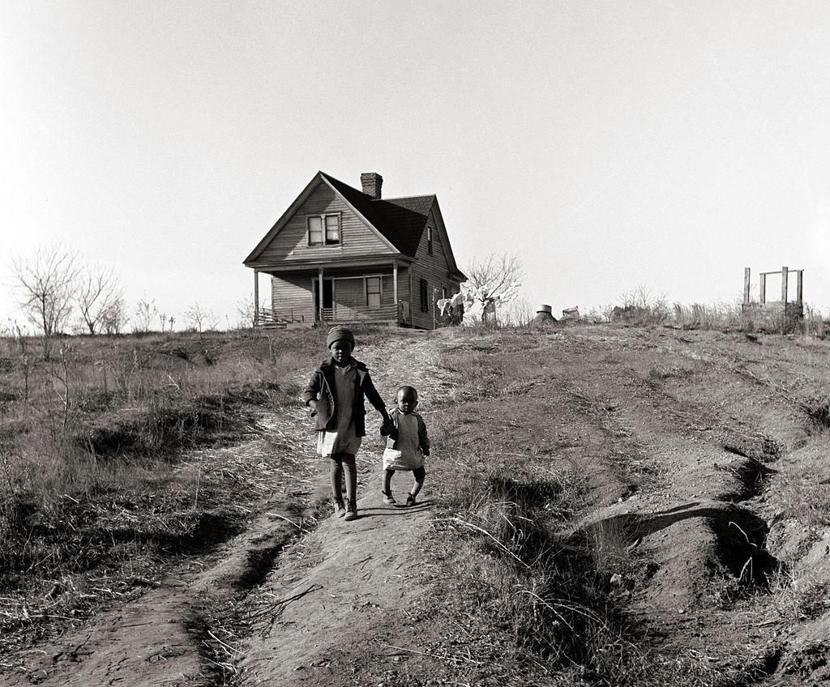
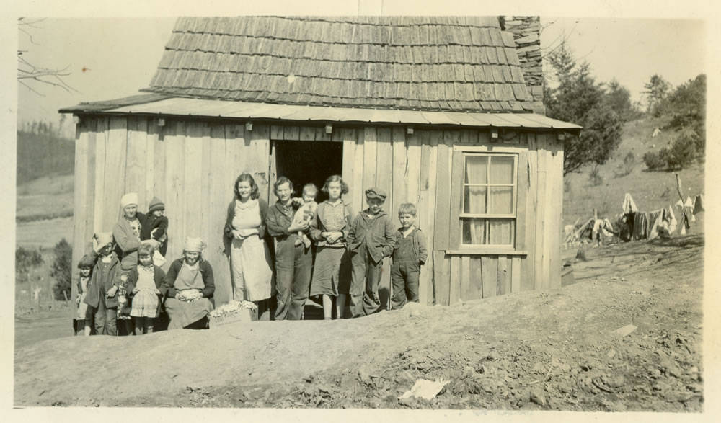
THE DEPRESSION – In the South
The Great Depression … hit the South hard. A report by the federal government described the South during the Depression as a "belt of sickness, misery, and unnecessary death.“ Out of 140,000 school children examined in 41 Carolina counties, 23,000 were malnourished.
During the Great Depression, Americans wondered how so many people could be hungry when the country's farmers were producing so much food. North Carolina's farmers were producing plenty of so-called "cash crops" like cotton and tobacco, but they were not making enough money from these crops to afford food. Food was available and cash crops were being grown, but many people simply could not afford it. Between 1929 and 1932, the total amount that North Carolinians made from agriculture plummeted from $310.5 million to less than half that, $144.3 million. With too much cotton and tobacco and too little money to buy food, one government study reported that "too many southern families have simply done without, and as a result they have suffered severely from malnutrition and dietary diseases.“
One of these diseases was pellagra, a devastating condition resulting from a chronic lack of niacin (vitamin B₃). Pellagra caused a person's skin to crack and boil up in a similar fashion to leprosy, and victims eventually succumbed to dementia and death. "The scourge of pellagra," wrote government officials, "that affects the South almost exclusively, is a disease chiefly due to inadequate diet; it responds to rather simple preventative measure, including suitable nourishing food."
http://history.ncsu.edu/projects/ncsuhistory/nceats/exhibits/show/consumerism/section2

Slide 20
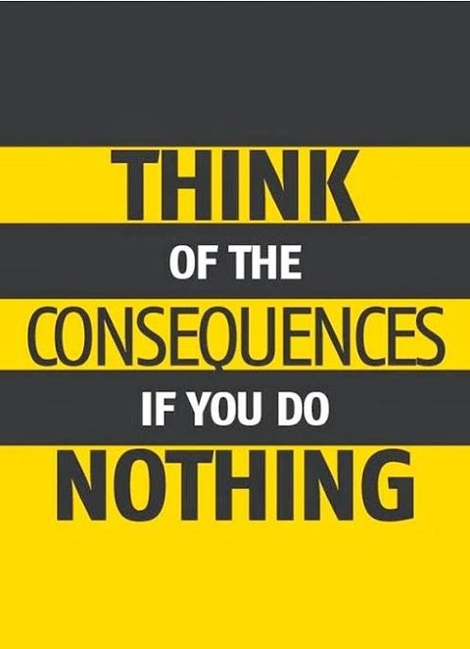
REACTIONS - The Bankers Didn’t Help End the Depression
The FED would not create reserves!
#1 The Fed was not set up to serve the nation
“… it was not really set up to serve the nation’s monetary needs. … The privately owned Fed was designed and set up to promote the short term profits of the largest bankers, while taking minimal risks… In the Great Depression the bankers demonstrated that they felt little or no responsibility towards the American people whose financial lives they controlled.” Zarlenga, LSM, p. 552
“The System’s holdings of government securities plus bills bought were nearly $200 million lower at the end of July 1930 than they were at the end of December 1929.” Friedman & Schwartz, p. 375
The Fed was not buying securities in the open market to create reserves!

Slide 21

REACTIONS - The Bankers Didn’t Help End the Depression
The FED would not create reserves!
#2 The Fed could not restore the public’s confidence in a fractional reserve system. Zarlenga, LSM, p. 552
“… the Board described its policy for the year 1930 as one of ‘monetary ease’… It seems paradoxical to describe as ‘monetary ease’ a policy which permitted the stock of money to decline in fourteen months by a percentage exceeded only four times in the preceding fifty-four years and then only during extremely severe business-cycle contractions.” Friedman & Schwartz, p. 375

Slide 22

REACTIONS - The Bankers Didn’t Help End the Depression
The NY FED Bank – Did Not Lead
“Years of primary and direct responsibility for the conduct of monetary policy in the central money market of the country and of cooperation with men similarly placed in the other leading money markets of the world had developed in the technical personnel, officers, and directors of the New York Bank a profound awareness of monetary relations and a sensitive recognition of the effects of monetary policy actions.
Those qualities were clearly absent at most other Reserve Banks, which had of necessity been concerned primarily with local and regional matters, or at the Federal Reserve Board, which had played only a minor role in the general conduct of policy and had had no important operating functions.” Friedman & Schwartz, p. 374
“At the time of the stock market crash, the New York Reserve Bank acted in the tradition of its earlier dominance, moving rapidly, decisively, and on its own. The adverse reaction of the Board greatly inhibited further independent measures by New York.” Friedman & Schwartz, p. 362

Slide 23

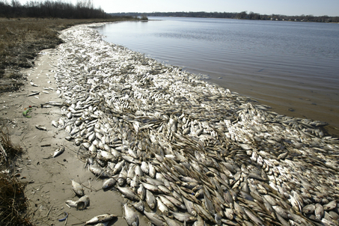

REACTIONS - The Bankers Didn’t Help End the Depression
Some Reasons the Fed Bankers Did Nothing
Federal Reserve officials had no feeling of responsibility for nonmember banks.
The bank failures were concentrated in smaller banks, and their disappearance were viewed with complacency by big-city bankers.
The relatively few large member banks that failed at the end of 1930 were regarded by many Reserve officials as unfortunate cases of bad management and therefore not subject to correction by central bank action.

Slide 24
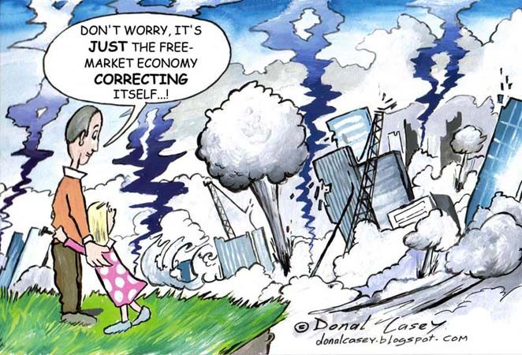
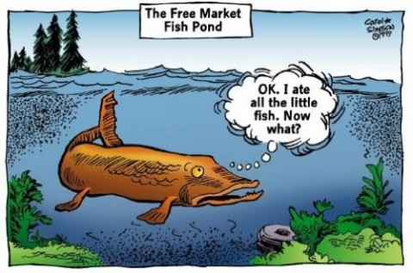
REACTIONS - The Bankers Didn’t Help End the Depression
The Free Market Ideology Dominated the 1920’s

Slide 25

REACTIONS - The Bankers Didn’t Help End the Depression
THE MONETARY SYSTEM WAS INHERENTLY UNSTABLE
“The existence of such a financial system is, of course the ultimate explanation for the financial collapse…” Friedman & Schwartz, p. 122
“… an active, vigorous, self-confident policy in the 1920's was followed by a passive, defensive, hesitant policy from 1929 to 1933… the System failed to meet an internal drain in the way intended by its founders.” Friedman & Schwartz, p. 115
“Until 1928, the New York Bank was the prime mover in Federal Reserve policy both at home and abroad, and Benjamin Strong, its governor from its inception, was the dominant figure in the Federal Reserve System.” [Upon his death, power shifted within the System to those with a lack of understanding and experience.] Friedman & Schwartz, p. 122

Slide 26
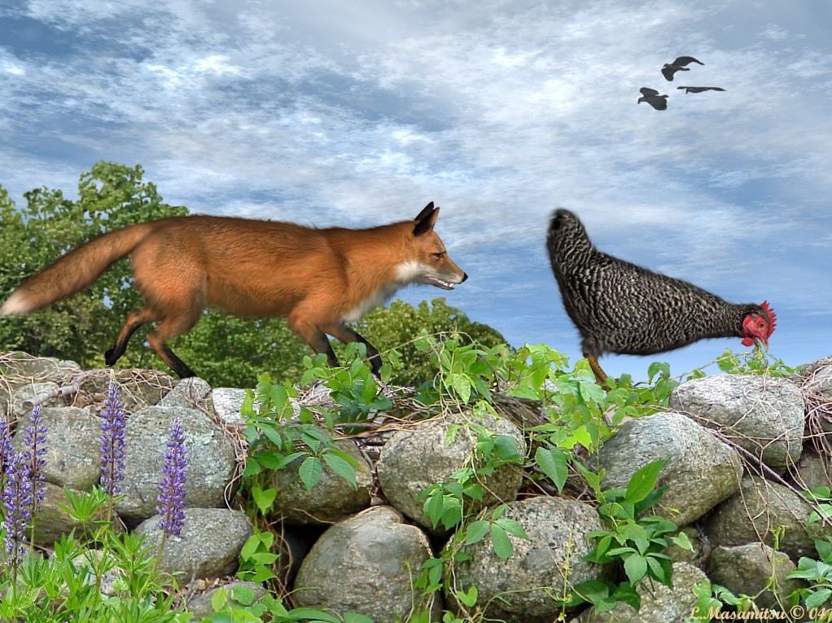
  REACTIONS - The Silent Economists
“One can read through the annual Proceedings of the American Economic Association or of the
Academy of Political Science and find only an occasional sign the academic world even knew about the unprecedented banking collapse in progress, let alone that it understood the cause and the remedy.” Friedman & Schwartz, p. 115
“That climate of intellectual opinion helps to explain why the behavior of the Federal Reserve System from 1929 to 1933 was not checked or reversed by vigorous and informed outside criticism.”
Friedman & Schwartz, p. 115
BANKING
CRISIS
ECONOMISTS

Slide 27
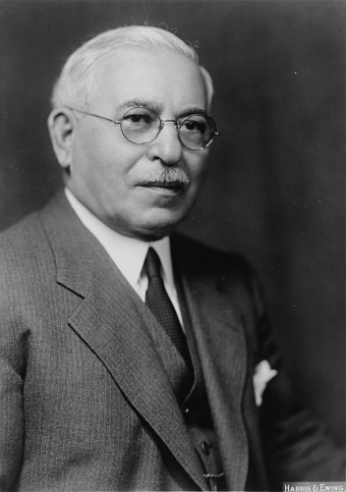
  REACTIONS - But Some Congressmen Understood
In January 1931 Congressman A.J. Sabath asked the Fed to be the lender of last resort
and relax discount window requirements.
“Congressman A.J. Sabath of Illinois wrote to Eugene Meyer in January, 1931: ‘Does the board maintain that there is no emergency existing at this time? To my mind if ever there was an emergency, it is now, and this I feel, no one can successfully deny. For while 439 banks closed their doors in 1929, during the year 1930, 934 banks were forced to suspend business.’
On the floor of the House, Sabath said, ‘I insist it is within the power of the Federal Reserve Board to relieve the financial and commercial distress.’ ” Friedman and Schwartz, pp. 113-114
Adolph Joachim Sabath
(1866 – 1952)

Slide 28
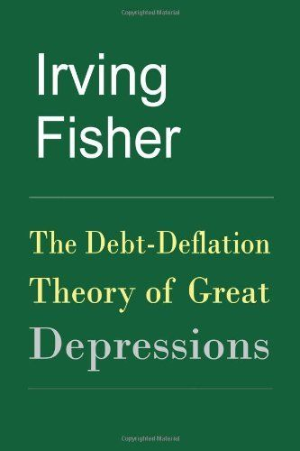
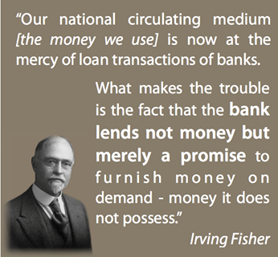
  REACTIONS - Some Economists Understood – Irving Fisher
“…over-investment and over-speculation are often important; but they would have far less serious results were they not
conducted with borrowed money…
…if debt and deflation are absent, other disturbances are powerless to bring on crises comparable in severity to those of 1837, 1773, or 1929-33.” Irving Fisher, The Debt-Deflation Theory of Great Depressions, p. 9
Originally Published in
Econometrica, Vol. 1, No. 4
(Oct 5., 1933) pp. 337-357

Slide 29
  REACTIONS - Some Economists Understood – Irving Fisher
“…it is always economically possible to stop or prevent such a
depression simply by reflating the price level…
In fact, under President Hoover, recovery was apparently well
started by the Federal Reserve open-market purchases, which
revived prices and business from May to September 1932.
The efforts were not kept up and recovery was stopped…”
Fisher, p. 20
“It would have been still easier to have prevented
the depression… had his [Gov. Strong] policies been
embraced… there would have been nothing worse than the first crash. We would have had the debt disease, but not the dollar disease – the bad cold but not the pneumonia.” Fisher, p. 20

Slide 30
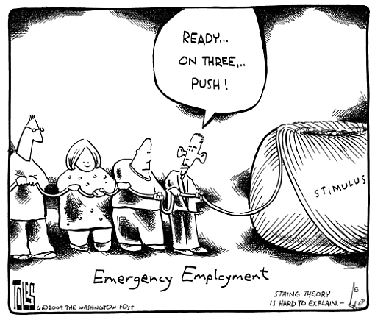
  REACTIONS
  The “Pushing on a String” Argument – Apology for the Bankers
“There was a widespread belief that just making reserves available in banks wouldn’t solve the problem because businessmen couldn’t be forced to borrow in such bad times.” Zarlenga, LSM, p. 550
BANKER: ‘NO GOOD LOANS TO BE MADE’
BANKER: ‘NO LOAN DEMAND’
Zarlenga: “We can rephrase their argument:
the destruction created by the bankers made
businessmen overly cautious.” LSM, p. 550

Slide 31
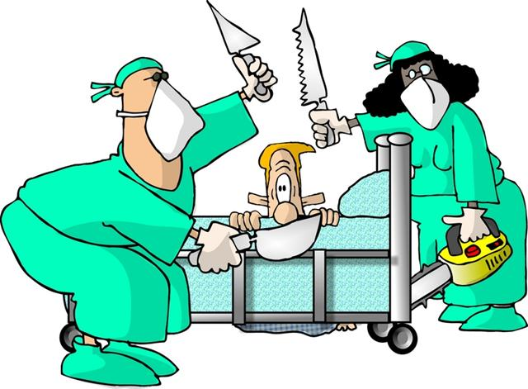
  REACTIONS
  The “Pushing on a String” Argument – Apology for the Bankers
“However, the 1935 study of C.C. Hardy and Jacob Viner showed there was loan demand…” Zarlenga, LSM, p. 550
“There exists a genuine unsatisfied demand for credit on the part of solvent borrowers… that one of the most serious aspects of this unsatisfied demand is the pressure for liquidation of old working-capital loans, even sound ones. That this pressure is partly due to a determination on the part of bankers to avoid a recurrence of the errors to which they attribute much of the responsibility for the recent wave of bank failures…”
Report on the Availability of Bank Credit in the Seventh Federal Reserve District, Submitted to the Sec of the Treasury, GPO, 1935, pp. vi, 3.
The bankers were not trying to make loans and were
calling in existing good loans!
The banking system confused credit with money, used
the credit to fuel a speculative bubble, and broke down
when panic set in.
The bankers were scared to death. Their fractional reserve
system had lost the confidence of the depositors.
BANKER

Slide 32
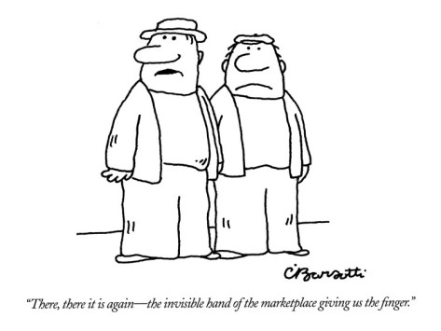
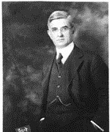
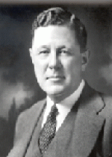
  REACTIONS
  Following Adam Smith to the Doors of Hell
ADAM SMITH’S FREE MARKET THINKING DOMINATED THE 1920’S:
GOVERNMENT SHOULD NOT INTERFERE WITH THE LAWS OF SUPPLY AND DEMAND
Here is a reaction of a Federal Reserve banker to the NY Fed Bank suggesting open market buying of government securities to relieve the ‘credit situation’:
July 10, 1030, James McDougal (Chicago Fed) to Harrison (NY Fed): “ …it seemed to him there was ‘an abundance of funds in the market, and under these circumstances, as a matter of prudence… it should be the policy of the Federal Reserve System to maintain a position of strength, in readiness to meet future demands,… rather than to put reserve funds into the market when not needed… speculation might easily arise in some other direction’ than the stock market.” Friedman & Schwartz, p. 371
James McDougal
First Governor,
Chicago Fed Bank,
1914 - 1934
George L. Harrison
Second Governor,
NY Fed Bank,
1928 - 1940
“There, there it is again – the invisible hand
of the marketplace giving us the finger.”

Slide 33
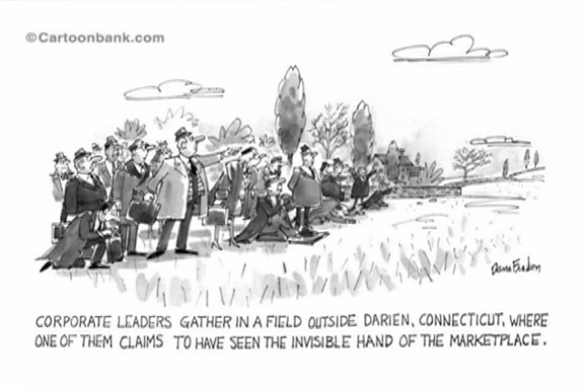
  REACTIONS
  Following Adam Smith to the Doors of Hell
ADAM SMITH’S FREE MARKET THINKING DOMINATED THE 1920’S:
GOVERNMENT SHOULD NOT INTERFERE WITH THE LAWS OF SUPPLY AND DEMAND
Other Fed bankers (from Friedman & Schwartz, pp. 372-373):
John U. Calkins of San Francisco Fed: June 16, 1930
“with credit cheap and redundant we do not believe that business recovery will be accelerated by making credit cheaper and more redundant.”
Lynn P. Talley of Dallas Fed: July 15, 1930
“… not ‘inclined to countenance much interference with economic trends through artificial methods…’ “
W.B. Geery of Minneapolis Fed: July 7, 1930
“… there is danger of stimulating financing which will lead to still more overproduction… “
George W. Norris of Philadelphia Fed: Sept. 25, 1930
“ ‘The Philadelphia Bank objected to ‘the present abnormally low rates for money’ as an interference ‘with the operation of the natural law of supply and demand in the money market…‘ “

Slide 34
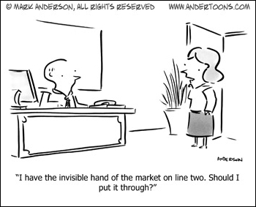

  REACTIONS
  Following Adam Smith to the Doors of Hell
ADAM SMITH’S FALSE ECONOMIC CONCEPTS WERE DANGEROUS TO THE NATION
Herbert Hoover believed orthodox economic theory: cut spending, balance the budget, but he made it worse:
  Hoover ran federal budget surpluses through 1931
  He put through a major tax increase in 1932
  He sent federal workers home one day a week to save money Zarlenga, LSM, p. 553
But, meanwhile, the need was for more money. Bank reserves and deposits were crashing – the money supply disappearing. And the sovereign responsibility of a government is to ensure a sufficient supply of money so people can survive and live decent lives, and the economy generate support for all the people!
“I have the invisible hand of the market
on line two. Should I put it through?”

Slide 35
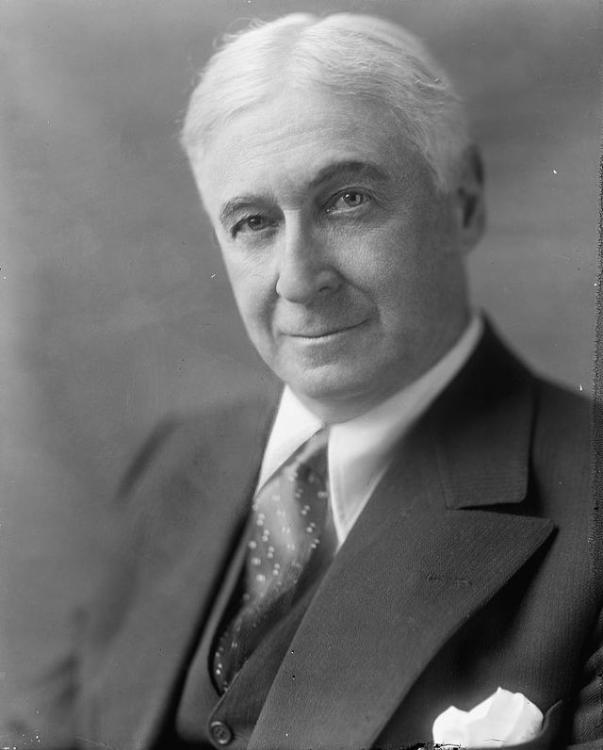
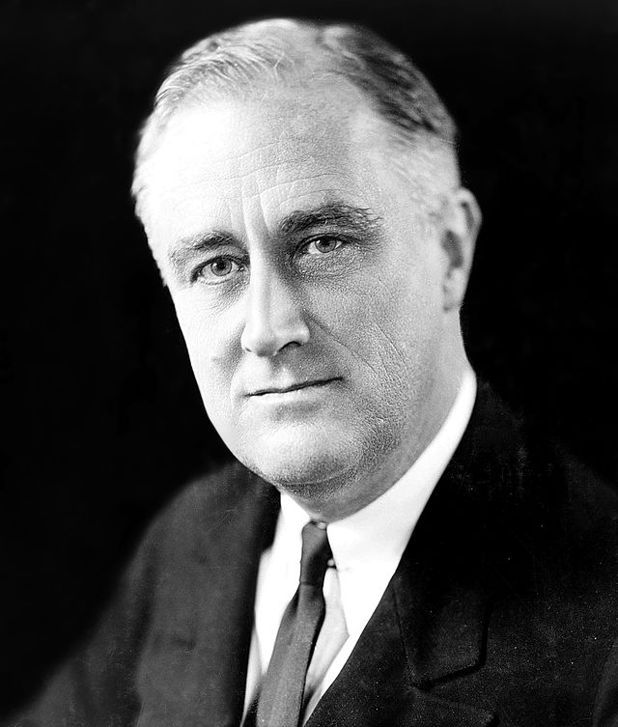
  REACTIONS
  Following Adam Smith to the Doors of Hell
ADAM SMITH’S FALSE ECONOMIC CONCEPTS WERE DANGEROUS TO THE NATION
Robert De Fremery, Money and Freedom, pub. 1957, p. 61:
“The orthodox banking theorists took the stand that a liquidation of bank credit would be a ‘wholesome’ thing… But obviously a contraction of the supply of money is not a wholesome thing in terms of the effect it has on human beings.”
Bernard Baruch advised President Roosevelt to “…balance the budget and let nature take its course.” Roosevelt, fortunately, did not take Baruch’s advice.
Bernard Mannes Baruch
(1870 – 1965)
Franklin D. Roosevelt in 1933
President, 1933-1945

Slide 36
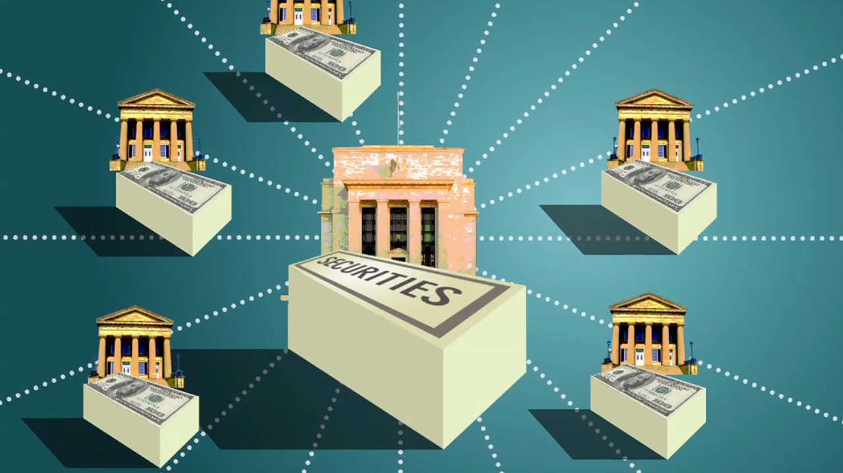
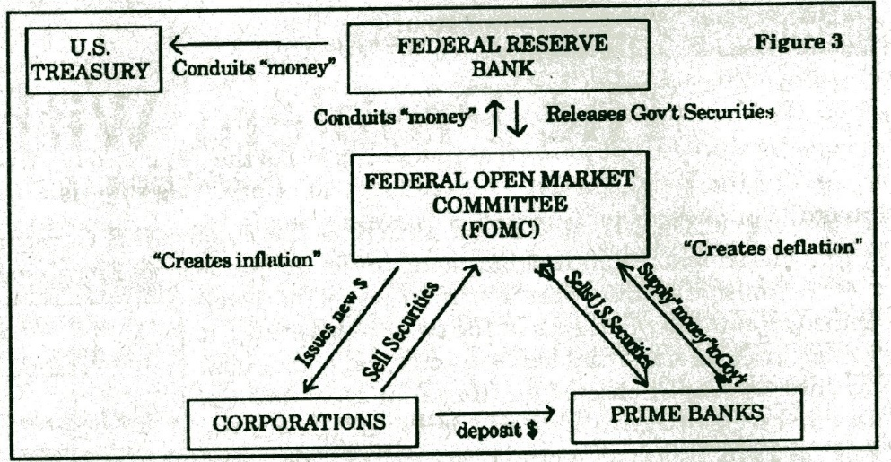
THIRD BANKING CRISIS: ROOSEVELT “CLOSES” THE BANKS
THE FED SYSTEM & THE BANKING HOLIDAY
“In the final two months prior to the banking holiday [March 6 to March 15, 1933], there was nothing that could be called a [Federal Reserve] System policy. The System was demoralized. Each Bank was operating on its own. All participated in the general atmosphere of panic that was spreading in the financial community and the community at large. The leadership which an independent central banking system was supposed to give the market … were conspicuous by their absence.”
Friedman & Schwartz, p. 391
“The state to which open market operations – the most potent monetary tool of the System – had fallen was graphically revealed when, as the banking difficulties mounted in February, Harrison [NY Fed President] ruled out a meeting of the Conference on grounds that it would be ‘difficult, if not impossible, to hold a meeting of the system Open Market Policy Conference at this time.’“ Friedman & Schwartz, p. 390

Slide 37
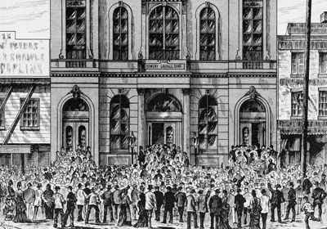
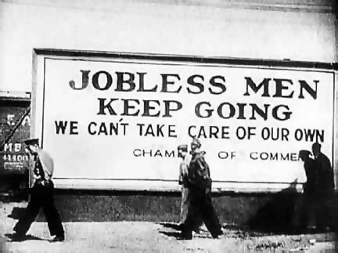
THIRD BANKING CRISIS: ROOSEVELT “CLOSES” THE BANKS
“One fiction put forward is that Roosevelt’s executive order closed many ‘unwilling’ banks. But most of them had already been closed when he took office.” Zarlenga, LSM, p. 556
In 1929 alone, 659 banks closed their doors. By 1932, an additional 5,096 banks went out of business. Families lost their life savings overnight.
Beginning on February 14, 1933, Michigan, which had been hit particularly hard by the Great Depression, declared an eight-day bank holiday. Fears of other bank closures spread from state to state as people rushed to withdraw their money just in case. Within weeks 36 other states held their own bank holidays in an attempt to stem the bank runs. The banking system seemed to be on the verge of collapse.
https://en.wikipedia.org/wiki/Emergency_Banking_Act
COMMERCIAL BANK SUSPENSIONS (FRIENDMAN & Schwartz, p. 438) [rounded]
YEAR # SUSPENSIONS DEPOSITS (THOUSANDS) LOSSES OF DEPOSITORS (THOUSANDS)
1921 506 173,000 57,000
1922 366 91,000 38,000
1923 646 150,000 62,000
1924 775 210,000 79,000
1925 617 167,000 61,000
1926 975 260,000 83,000
1927 669 199,000 61,000
1928 498 142,000 44,000
1929 659 231,000 77,000
1930 1,350 837,000 237,000
2,293 1,690,000 391,000
1,453 706,000 168,000
1933 4,000 3,597,000 540,000

Slide 38
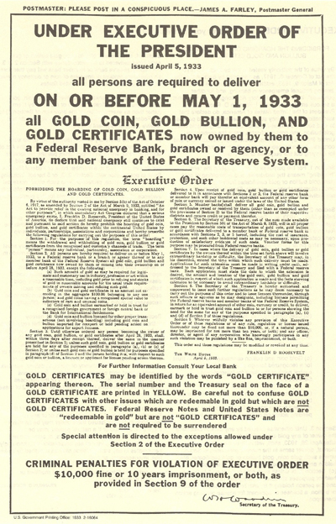
THIRD BANKING CRISIS: ROOSEVELT “CLOSES” THE BANKS
Roosevelt Declares Bank Holiday – March 6, 1933
At 1:00 a.m. on Monday, March 6, President Roosevelt issued Proclamation 2039 ordering the suspension of all banking transactions, effective immediately.
He had taken the oath of office only thirty-six hours earlier.
“ ‘Banking institutions’ included all Federal Reserve Banks, national banking associations, banks, trust companies, savings banks, building and loan associations, credit unions, or other corporations, partnerships, associations or persons, engaged in the business of receiving deposits, making loans, discounting business paper, or transacting any other form of banking business.‘’
Banking transactions included those dealing with “gold or silver coin or bullion or currency” and those that pay out “deposits, make loans or discounts, deal in foreign exchange, transfer credits from the United States to any place abroad, or transact any other banking business whatsoever.”
Robert Jabaily, Federal Reserve Bank of Boston
://www.federalreservehistory.org/Events/DetailView/22
PROCLAMATION 2039

Slide 39
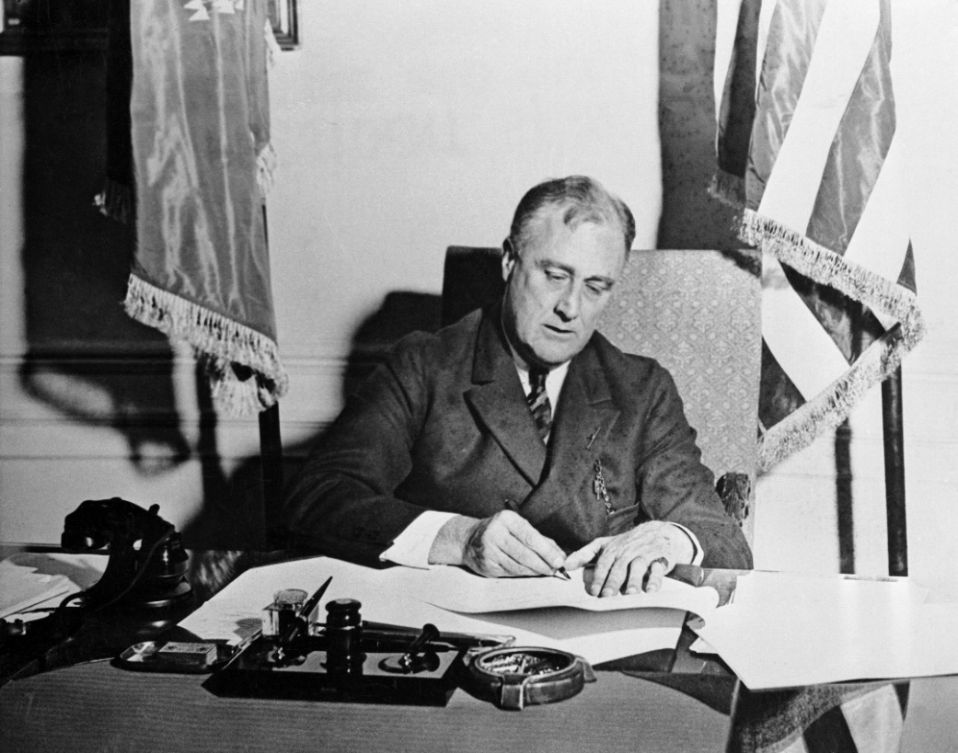
THIRD BANKING CRISIS: ROOSEVELT “CLOSES” THE BANKS
Congress Passes the Emergency Banking Act of March 9, 1933
Title I: TO CLOSE BANKS DURING THE EMERGENCY PERIOD [extended to March 15]: this act empowered the President to regulate or prohibit the payment of deposits by all banking institutions.
Title II: TO REORGANIZE FAILING BANKS: gave the Controller of the Currency the power to restrict the operations of national banks with impaired assets and to appoint a conservator
Title III: TO STRENGTHEN NATIONAL BANKS: empowered the RFC to either buy the stock of national banks, or grant loans with the bank’s stock as collateral
Title IV: EMERGENCY ISSUE OF FEDERAL RESERVE NOTES: gave the Federal Reserve Banks the power to issue emergency currency, backed by any assets of a commercial bank. Over $200 million of Federal Reserve Bank notes were issued in 1933.
Franklin Roosevelt Signs
Emergency Banking Act
1933, March 9

Slide 40


THIRD BANKING CRISIS: ROOSEVELT “CLOSES” THE BANKS
Emergency Banking Act of March 9, 1933
On the Sunday evening before the banks reopened, Roosevelt addressed the nation through one of his signature "fireside chats." With honest words in soothing tones, the President assured sixty million radio listeners that the crisis was over and the nation's banks were secure. On the first day back in business, deposits exceeded withdrawals.
By the beginning of April, Americans confidently returned a billion dollars to the banking system. The bank crisis was over.
http://www.ushistory.org/us/49a.asp
A description of banking from Roosevelt’s First Fireside Chat – is this true?
“First of all, let me state the simple fact that when you deposit money in a bank, the bank does not put the money into a safe deposit vault. It invests your money in many different forms of credit -- in bonds, in commercial paper, in mortgages and in many other kinds of loans. In other words, the bank puts your money to work to keep the wheels of industry and of agriculture turning around.”
The First Fireside Chat:
On the Bank Crisis
Sunday, March 12, 1933

Slide 41



KEYNES TO THE RESCUE?
IN DEC. 1933, ENGLISH ECONOMIST JOHN MAYNARD KEYNES WROTE
AN OPEN LETTER TO PRESIDENT ROOSEVELT
IN THE N.Y. TIMES
Hon. Franklin D. Roosevelt
Enc.
AN OPEN LETTER TO PRESIDENT ROOSEVELT
By John Maynard Keynes.
Dear Mr President,
You have made yourself the Trustee for those in every country who seek to mend the evils of our condition by reasoned experiment within the framework of the existing social system… reason why I should venture to lay my reflections before you…
With great respect,
Your obedient servant
J M Keynes

Slide 42



KEYNES TO THE RESCUE?
KEYNES advised Roosevelt that only “expenditures of public authority”
could bring recovery.
THAT WAS OBVIOUS ENOUGH!
JOHN MAYNARD
KEYNES
FRANKLIN D.
ROOSEVELT

Slide 43
KEYNES TO THE RESCUE?
KEYNES WARNED ROOSEVELT TO BORROW THE MONEY
I lay overwhelming emphasis on the increase
of national purchasing power resulting from
governmental expenditure which is financed
by Loans… Nothing else counts in comparison with this…
“In the past, orthodox finance has regarded a war as the only legitimate excuse for creating employment by governmental expenditure [borrowed money]. You, Mr President, having cast off such fetters, are free to engage in the interests of peace and prosperity …
JOHN MAYNARD
KEYNES
FRANKLIN D.
ROOSEVELT

Slide 44
KEYNES TO THE RESCUE?
KEYNES WARNED ROOSEVELT NOT TO CREATE THE MONEY
“Some people seem to infer from this that output and income can be raised by increasing the quantity of money. But this is like trying to get fat by buying a larger belt. In the United States to-day your belt is plenty big enough for your belly.”
JOHN MAYNARD
KEYNES
FRANKLIN D.
ROOSEVELT

Slide 45

KEYNES TO THE RESCUE?
KEYNES ATTEMPTED TO INFLUENCE ROOSEVELT
TO DROP HIS PROGRAM OF NECESSARY REFORMS – THE NEW DEAL
  “Now I am not clear … that the order of urgency between measures of Recovery and measures of Reform has been duly observed… In particular, I cannot detect any material aid to recovery in N.I.R.A… [part of Roosevelt’s New Deal]… That is my first reflection--that N.I.R.A., which is essentially Reform and probably impedes Recovery, has been put across too hastily, in the false guise of being part of the technique of Recovery.”
The NIRA called on private businesses, organized in trade associations, to propose industrial "Codes of Fair Competition" for their industries. During the two years of the program's existence, more than 500 codes were enacted. The standard code contained wage and hours provisions…
JOHN MAYNARD
KEYNES
ELEANOR
ROOSEVELT

Slide 46


KEYNES TO THE RESCUE?
“Keynes was therefore not ‘revolutionary’ except in relation to the utter backwardness of the financial establishment and their economists.”
Stephen Zarlenga, LSM, p. 555
“He did not come close to a real solution. That would have been another issue of Greenbacks, through which the U.S. government would have taken back the monetary power from those who had abused it.” Stephen Zarlenga, LSM, p. 555
THE AMERICAN GREENBACK

Slide 47



KEYNES TO THE RESCUE?
The debate over Keynesianism is another false monetary debate…
“The real question has always been whether the nation’s money should be created under law, by government, or under the private caprice of bankers.”
Stephen Zarlenga, LSM, p. 555

Slide 48





FINANCIAL LOSSES: The Wreckage of the Economy
BANK FAILURES WERE THE MAIN CAUSE OF THE DECLINE IN THE MONEY STOCK
THIS BROUGHT ON THE GREAT DEPRESSION
COMMERCIAL BANK
SUSPENSIONS
YEAR # SUSPENSIONS
1,350
2,293
1,453
4,000
“The losses of depositors of the 9,000 American banks that suspended operations during the four years from 1930 through 1933 were $2.5 billion.” Zarlenga, LSM, p. 556
This was the cause of the decline of money stock and thus the cause of the Great Depression.
“Though losses on stocks were 34 times the losses on bank deposits, it was the banking and money system that had caused the debacle.” Zarlenga, LSM, p. 556
“But the financial losses can’t measure the full cost of the lives damaged or destroyed in the depression.”
Zarlenga, p. 556

Slide 49
FINANCIAL LOSSES: The Wreckage of the Economy
“In less than two decades under the Federal Reserve System, 5,096 banks went bankrupt;
88% of them had less than $100,000 capital
94% of them were in the South, the Midwest, and the West” Zarlenga, p. 556
“They took the nation down with them:”
Item 1929 1932 Change
National Income $87.8 billion $42.5 billion - 52%
Industrial Production $110 billion $58 billion - 47%
D.J. Industrial Average 381.17 (Sept. ‘29 high) 41.22 (July ‘32 low) - 89%
Wholesale price index 95.3 64.8 - 32%
Unemployed 3.5 million 15 million + 329%
Value of International Trade - 63%

Slide 50





THE NEW DEAL
Roosevelt began direct relief programs (FERA) and started work programs (CWA,WPA) that hired people to build roads, dams, national parks and other projects.
The New Deal expenditures, based on government borrowing, would benefit the bankers, but some of the money would also build real infrastructure. Under a government money system, the U.S. could have created the money itself and not been saddled with debt. However, the country was so starved for money, this small government deficit helped.
Harry Hopkins wrote: "Long after the workers of CWA are dead and gone and these hard times forgotten, their effort will be remembered by permanent useful works in every county of every state. People will ride over bridges they made, travel on their highways, attend schools they built, navigate waterways they improved, do their public business in courthouses and state capitols which workers from CWA rescued from disrepair.“
Harry Hopkins, Spending to Save, pub. 1936, p. 120
SAN FRANCISCO
DENVER

Slide 51
THE NEW DEAL
The following New Deal programs spent $15.5 billion between 1933 and 1940, only a sixth of the financial losses of the depression.
Roosevelt was blocked “by conservatives worried about inflation in the middle of the Great Depression! The financial establishment finally allowed the creation of bank credit for warfare, when it was certain the new products of industry would be blown up or sunk,” not increasing the nation’s wealth and independence. Zarlenga, p. 557
TOTAL COST
RFC – Reconstruction Finance Corp. – set up by Hoover, loaned $3 billion to distressed financial institutions $283 million
FERA – Federal Emergency Relief Administration – made grants to states and local governments for $3.1 billion
direct relief of $34 per family per month 1933-1935
CWA – Civil Works Administration – for work programs to create manual labor constructing and $818 million
repairing buildings and bridges, Nov 1933 to March 1934
WPA – Works Progress Administration – paid $80/month per person employed; employed $8.12 billion
2 million annually; It tried to provide one paid job for all families in which the breadwinner
suffered long-term unemployment

Slide 52
FARMERS’ DEBT TRAP
A rise in commodity prices from 1914 to 1920 had enticed farmers into too much debt.
From 1920, farm income and value dropped dramatically, but debt, interest payments, and taxes remained high.
The farmers were caught in a debt trap!
YEAR AVG. FARM VALUE NET INCOME TOTAL DEBT MORTGAGE INT TAXES PER FARM
$ 10,295 $ 1,199 $ 8,448 $ 574 $483
8,107 781 10,785 679 516
7,764 1,041 9,912 612 517
1930 7,524 651 9,630 570 567
1933 4,569 304 8,466 472 398
DOWN
DOWN
HIGH
HIGH
HIGH

Slide 53



FARMERS’ DEBT TRAP
Roosevelt’s Programs to Help Farmers
1935-33 Resettlement Administration - relocated struggling
urban and rural families to communities planned by the federal government;
built relief camps in California for migratory workers, especially refugees
from the drought-struck Dust Bowl of the Southwest.

Slide 54





FARMERS’ DEBT TRAP
Roosevelt’s Programs to Help Farmers
Bankhead–Jones Farm Tenant Act of 1937 (July 22, 1937)
Supervised Credit of $2 billion offered to bankrupt farmers – modest credit to assist tenant farmers to purchase land
TENANT FARMERS IN U.S.

Slide 55



AT LEAST THE GOVERNMENT ACTED !
MONETARY POWER SHOULD ALWAYS RESIDE IN THE GOVERNMENT
The cause of the Great Depression was monetary and its solution needed to be monetary.
Because monetary control was exercised by the private Federal Reserve System, the government had to “borrow money” created by the Federal Reserve System to pay for its programs, instead of creating money itself. But at least the government acted!

Slide 56
AT LEAST THE GOVERNMENT ACTED !
WHY MONETARY POWER SHOULD ALWAYS RESIDE IN THE GOVERNMENT
AN EXAMPLE FROM 1932
In 1932, with the state of credit and banks deteriorating, the private Federal Reserve System began to speak of buying securities through the Open Market Purchase Program. This would create bank reserves. Approval of buying $25 million a week was authorized by the Open Market Policy Conference. This was indeed modest.
“That modest program would very likely never have been expanded into a major one, or perhaps even carried out, if it had not been for direct and indirect pressure from Congress. Harrison [Pres., NY Fed Bank] told the executive committee of his directors on April 4 that apparently ‘the only way to forestall some sort of radical financial legislation by Congress, is to go further and faster with our own program.’
Governor Meyer [of the Fed Reserve Board] ‘called attention, merely as a matter of information, to the fact that a resolution had been offered in the Senate asking the Federal Reserve Board to state its program… he believed the time had come when the System might be expected to use its powers more fully in an effort to stop the credit decline.
After the initial program was voted on April 12 [1932], the System bought $100 million of government securities per week for five week…
Freed from Congressional pressure – Congress adjourned on July 16 – the Conference lapsed into its earlier pattern. The program adopted was a minimum face-saving program, and was carried out at nearly the minimum level consistent with the letter of the recommendation. ’ “ Friedman & Schwarz, pp. 384-385

Slide 57



Another Greenback is Needed
ECONOMISTS WERE UNAWARE OF THE HISTORY OF GREENBACK DEBT-FREE MONEY
John Maynard Keynes had a small excuse for his ignorance of government money – England had hardly any history of it since 1694.
Because of the “purposeful neglect of the historical study of economics and economic thought, most of them were (and still are) as ignorant of the history of the Greenbacks as the English economists are.” Zarlenga, p. 560

Slide 58

Another Greenback is Needed
BUT NOT ALL AMERICAN ECONOMISTS WERE IGNORANT
The CHICAGO PLAN was a banking reform for full-reserve banking, suggested by University of Chicago economists in the wake of the Great Depression. A six-page memorandum was given limited and confidential distribution to about 40 individuals on March 16, 1933; it was also given to President Roosevelt as a way to reform the fractional reserve system with full reserves, doing away with private, debt-money creation. The plan was supported by such notable economists as Frank Knight, Lloyd W. Mints, Henry Schultz, Henry Simons, Paul Douglas and more.
Full reserve banks are required to keep the full amount of each depositor’s funds in cash, ready for immediate withdrawal on demand.
Today’s plan for
full reserve banking….
THE CHICAGO PLAN REVISITED

Slide 59
Q & A
WILL DECKER’S CONCLUSION:
THE CONTROL OF MONEY -- WITHOUT CONTROL FROM THE PUBLIC -- LEADS TO
CORRUPTION … USURPATION … SLAVERY.

