Slide 1

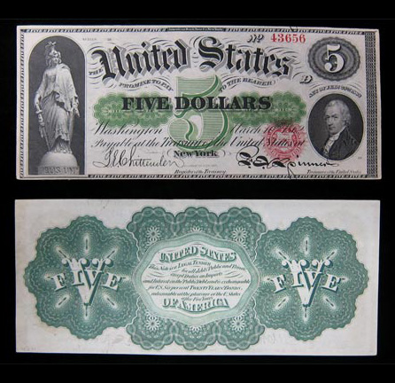

The Lost Science of Money
CHAPTER 17 – Part 2
THE GREENBACKS: REAL AMERICAN MONEY

Slide 2
THEMES OF LOST SCIENCE OF MONEY BOOK
Primary importance of the money power (power to create money and regulate it)
Nature of money purposely kept secret and confused
How a society defines money determines who controls the society
Battle over control of money has raged for millennia: public vs private
The misuse of the monetary system causes tremendous misery and suffering for the ordinary people. Will Decker & Martin Dunn, February 2014
Whenever the public has owned a significant fraction of the money power, great public benefit has ensued: Sparta, the Roman Republic, the American Colonies in the 18th century, GREENBACKS after the Civil War, Canada after the Great Depression, British experience after World War II. Martin Dunn, July 2014.

Slide 3
PARTS OF PRESENTATION
Comments on the Wartime Inflation: What If?
Confederacy’s Paper Money Fails
Were the Greenbacks Unfair to Creditors?
The National Banking Act of 1863/64: The Act Restricts Operational Fraud
The Act Entrenches Structural Fraud
Battle Over the Greenbacks: The Supreme Court Decisions
Battle Over the Greenbacks: Pastor and Professor Against the Greenbacks
The Greenback Defenders
  Lyman Dewolf
  Benjamin Butler Understood

Slide 4
PART 1
Comments on the Wartime Inflation: What If?

Slide 5
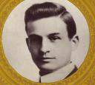
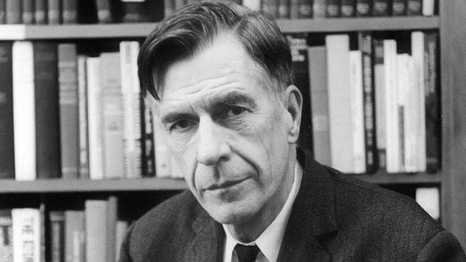
PART 1
THE GREENBACKS FUNCTIONED BETTER THAN THE BANKERS’ CREDIT SYSTEM IN WAR
Civil War Historian J.G. Randall (The Civil War and Reconstruction, 1937) compared the Civil War Greenback economy to the WW1 bankers’ credit economy:
James G. Randall (1881-1953)
“The threat of inflation was more effectively curbed during the Civil War than during the First World War. Indeed as John K. Galbraith has observed, ‘it is remarkable that without rationing, price controls, or central banking, Chase could have managed the federal economy so well during the Civil War.’ “ p. 354
Martin Dunn, 2014: “The Civil War was a lot longer than the American
participation in World War 1. So this statement is even more striking.”
John K. Galbraith
(1908 – 2006)

Slide 6
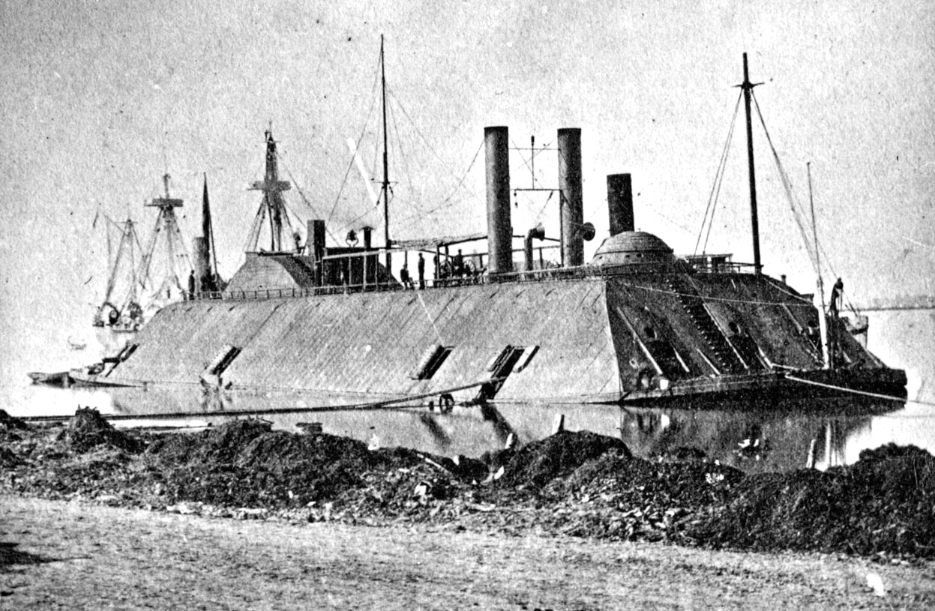
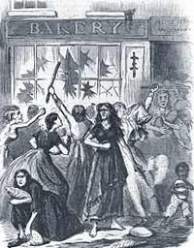
PART 1
WAR CANNOT HAPPEN WITHOUT MONEY
“…inflation would have occurred even without the Greenback issue.” Irwin Unger
“Even if the greenbacks had not been issued and bonds had been sold at whatever price they would bring in the market, inflation would have taken place. It would merely have taken another form – that of the monetization of debt through the issue of bank currency or the creation of bank credit.” Studenski & Kroos, Financial History of the U.S., 1952
WEAPONS COST MONEY
BREAD RIOT IN RICHMOND, VA.

Slide 7
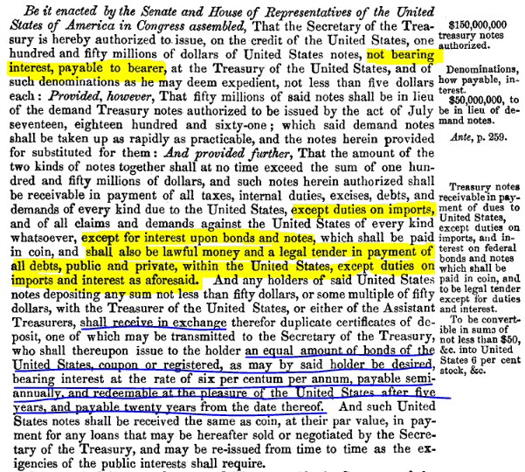
Part 2
THE EXCEPTION CLAUSE CAUSED THE GREENBACK
TO LOSE VALUE AGAINST GOLD
FEB 25, 1862
LEGAL TENDER ACT
EXCEPTION CLAUSE
5-20 BONDS could
be bought with Greenbacks
All U.S. BONDS bought with Greenbacks

Slide 8
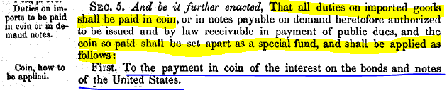
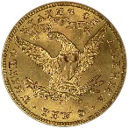
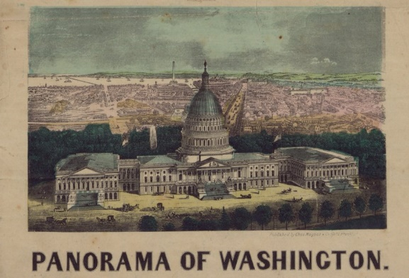

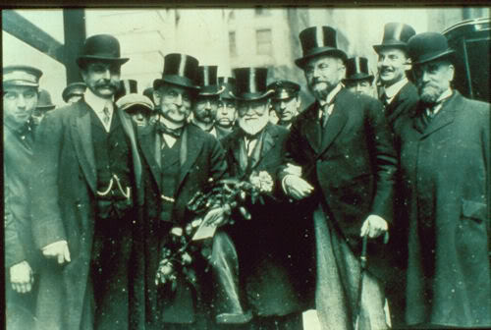
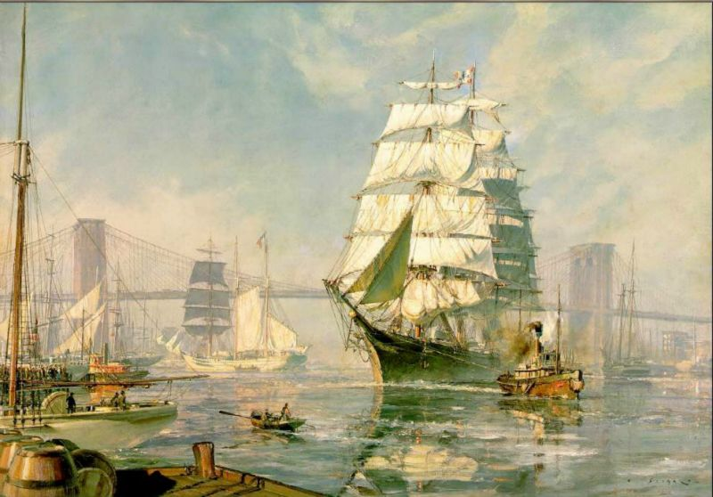

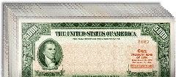
PART 1
THE EXCEPTION CLAUSE DEPRECIATED THE GREENBACK. WHY DID THE BANKERS WANT THIS?
THE BANKER COULD USE THE DEPRECIATED GREENBACKS TO BUY GOVERNMENT BOND, PAYING INTEREST IN GOLD.
CUSTOMS DUTIES
IN GOLD
3
DEPRECIATED
GREENBACK
DEPRECIATED
GREENBACK
4
1
5
CHEAP
BONDS
6
2
BOND INTEREST IN GOLD

Slide 9

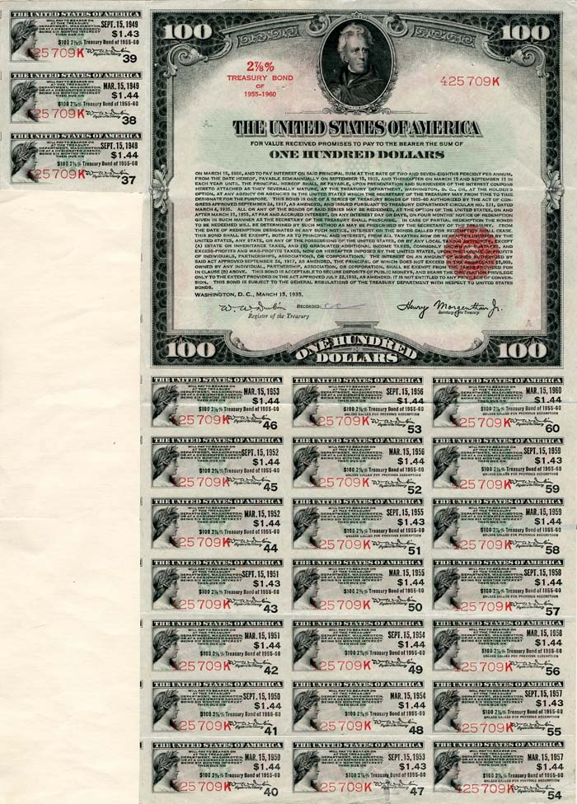
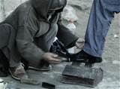
PART 1
THE EXCEPTION CLAUSE DEPRECIATED THE GREENBACK. WHY DID THE BANKERS WANT THIS?
THE BANKER COULD USE THE DEPRECIATED GREENBACKS TO BUY GOVERNMENT BONDS, PAYING NO TAX!
…..

Slide 10
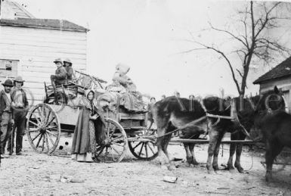
PART 1
“…if interest payments on government bonds had been paid in Greenbacks instead of gold, a large part of the demand for gold would have disappeared.” Zarlenga, LSM, pp. 464-465
…if customs duties had been paid in Greenbacks instead of gold, not only would the demand for gold have disappeared even more, but the price of imports would have been reduced. The importer had to trade cheaper Greenbacks for dearer gold, and the additional cost to the importer was added on to the cost of the imported goods.
The soldier facing death on the battlefield for $16 per month, sends that money to his sorrow stricken family to be used in supplying them with the necessaries of life; and in the purchase of their food and clothing with this blood-bought treasure, they pay indirectly to the gold gamblers of Wall Street from 25 to 50 per cent.” Sarah Emery, Seven Financial Conspiracies Which Have Enslaved the American People, 1894, p. 20

Slide 11
Part 2
Confederacy’s Paper Money Fails

Slide 12
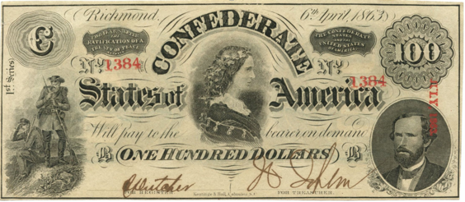
Confederacy’s Paper Money Fails
MISTAKE #1:
The South never made the Confederate money a legal tender.
This was a monetary/military error of great magnitude.

Slide 13
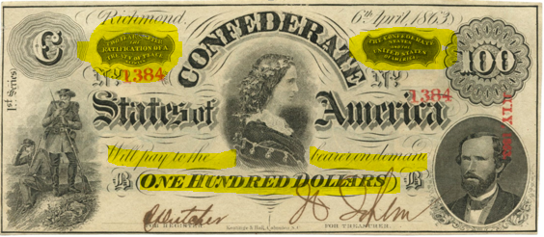
Confederacy’s Paper Money Fails
MISTAKE #2:
The Confederate paper money was not money in itself but merely a promise to pay money later.
“Two years after the ratification of a treaty of peace, the Confederate States and the United States of America will pay to the bearer on demand – ONE HUNDRED DOLLARS”

Slide 14
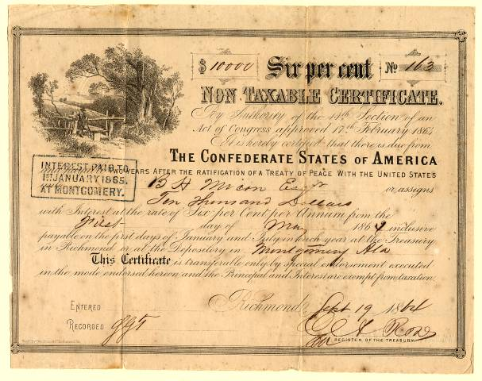
Confederacy’s Paper Money Fails
MISTAKE #3:
“In Feb, 1864, the Confederate Congress forced the conversion of the currency into a 20-year bond paying 4%. Confederate currency not tendered for this conversion was devalued one-third after one and a half months and two-thirds after about a year.” Zarlenga, LSM, p. 466

Slide 15
Confederacy’s Paper Money Fails
MISTAKE #4:
Unlike the North, the South placed no limit on its issue of paper notes.
1861 $1 Confederate = .90 of gold
early 1862 “ .83 “
early 1863 “ .29 “
early 1864 “ .05 “
early 1865 “ .017 “

Slide 16
Part 3
Were the Greenbacks Unfair to Creditors?

Slide 17
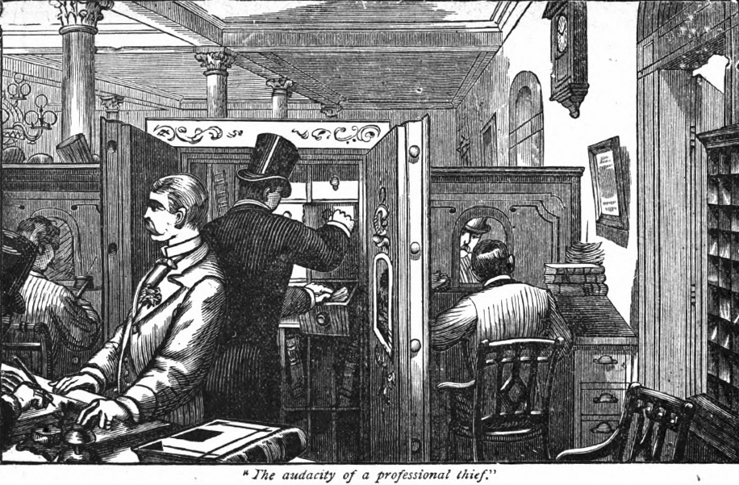
Were the Greenbacks Unfair to Creditors?
The Greenback was recognized as a superior means of exchange for private as well as public transactions. The case was made, however, that creditors who had lent gold were being paid back in less valuable paper.
In most cases, the borrower had been lent, not gold and silver, but bank notes or bank credit, supposedly backed by gold and silver in the bank’s vault.
SYSTEM-WIDE, GOLD BACKING WAS A FICTION.

Slide 18
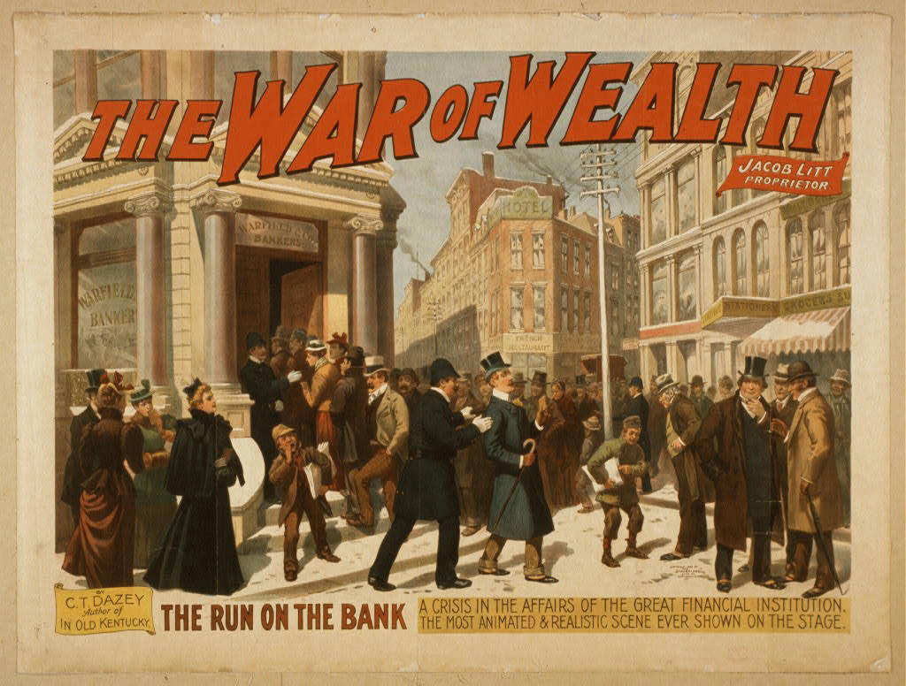
Were the Greenbacks Unfair to Creditors?
How were debtors to pay in coinage after the specie suspension of bank notes in December 1861?
System-wide, the debtors had been loaned paper, not metal. And how many of the lenders were banks?

Slide 19
PART 4
The National Banking Act of 1863/64:
The Act Restricts Operational Fraud

Slide 20
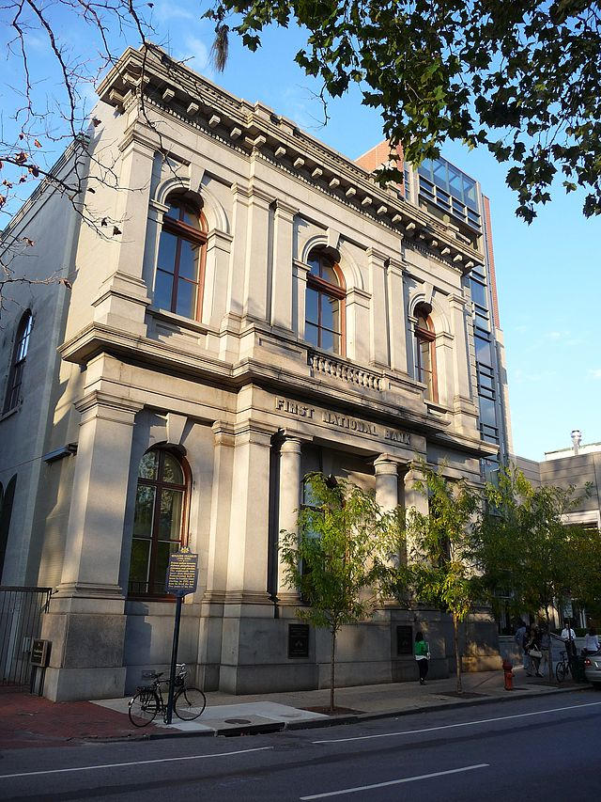
The Act Restricts Operational Fraud
February 1863 & June 1864
The reasons given for the passage of the National Banking Act:
  create a uniform currency
  more effective bank supervision
  create a market for government bonds
The 1st National Bank of Philadelphia was the
first bank to get a national charter – June 30, 1863.
FIRST NATIONAL BANK, PHILADELPHIA

Slide 21
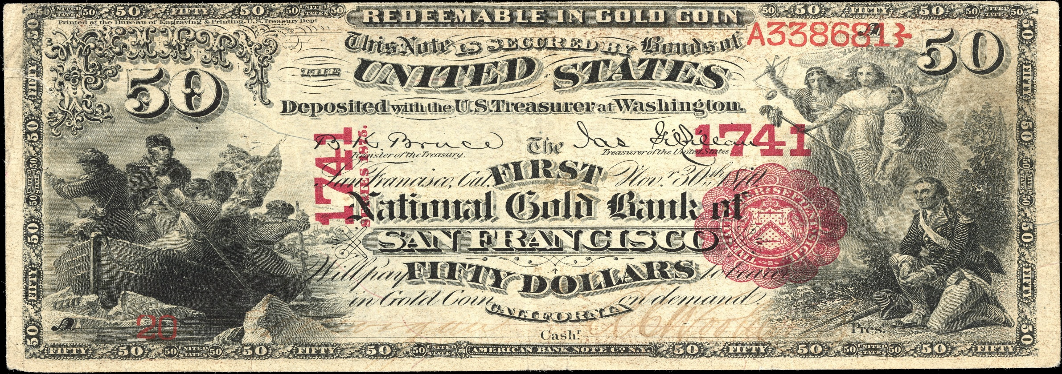
The Act Restricts Operational Fraud
A later act, passed March 1865, imposed a tax of 10 percent on the notes of State banks to take effect on July 1866. The tax effectively forced all non-federal currency from circulation: state bank note circulation dropped from $179.2 million to $19.9 million. By October 1866, there were 1,644 national banks, and 300 state banks (down from 1600 in 1860).
Previously, only two banks had national charters, through Congressional Act: the first and second Bank of the United States. Now, obtaining a national charter would be a routine matter, through the Treasury’s Controller of the Currency.
FIRST NATIONAL GOLD BANK AT SAN FRANCISCO

Slide 22
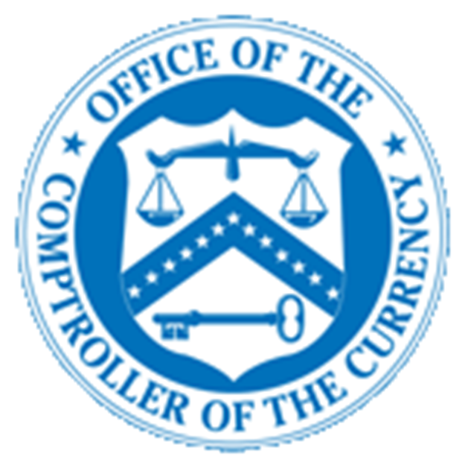
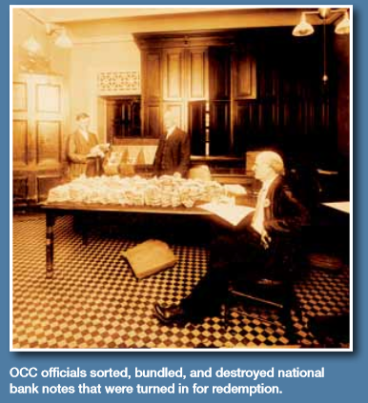
The Act Restricts Operational Fraud
The act created a National Banking Association under the supervision of the newly created
Controller of the Currency in the Treasury Department.
quarterly reports were required to be published
bank notes were printed by the controller of the currency: under tight security, the currency had to be cut, registered, bundled, and shipped to the issuing national bank, where each note was supposed to be signed by hand.
notes of national banks were made acceptable for most U.S. dues
notes were to be received by all member banks at full value
a maximum of $300 million of notes, system-wide, was decreed

Slide 23
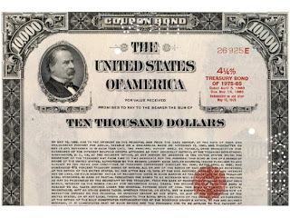
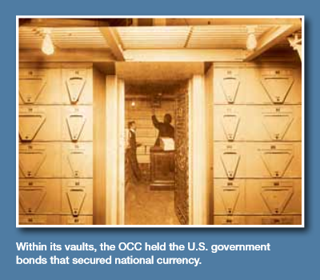
The Act Restricts Operational Fraud
The national bank notes were backed by U.S. government bonds:
Each bank was required to purchase Treasury bonds in the amount of 1/3 of its paid in capital ($30,000 minimum).
The bank’s U.S. Treasury bonds must be deposited with the Treasurer of the U.S., before commencing business.

Slide 24
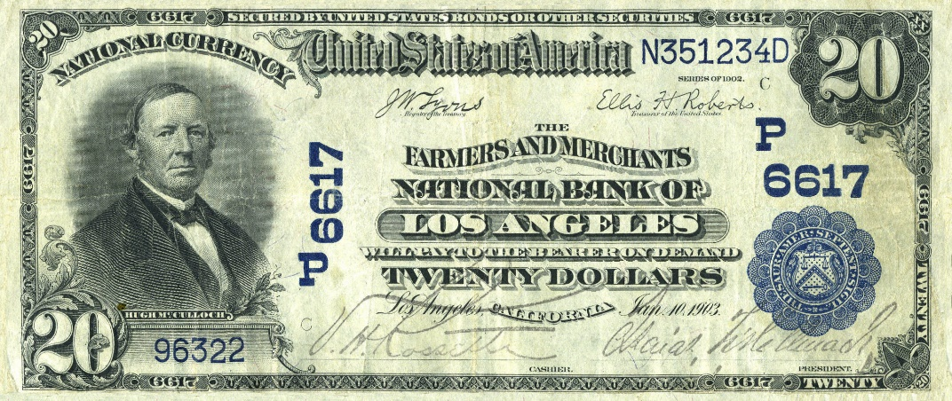
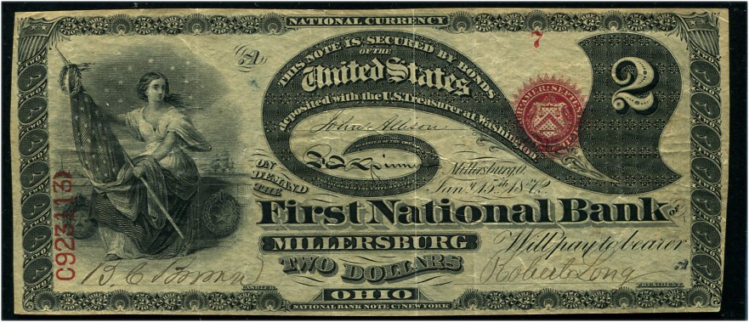
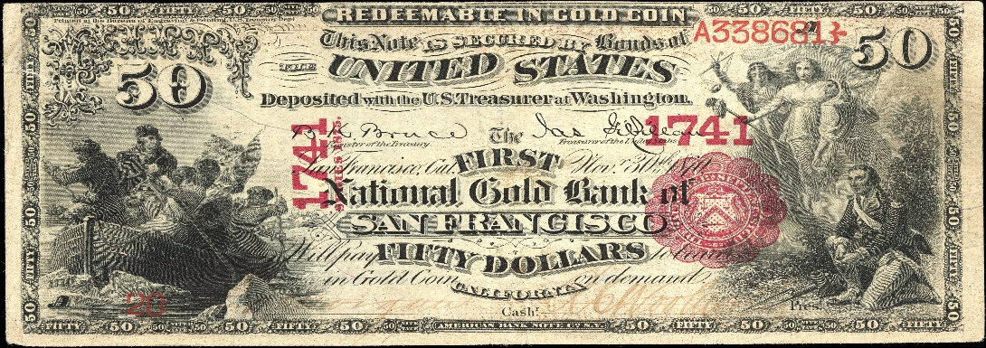
The Act Restricts Operational Fraud
Each bank is entitled to receive from the Controller of the Currency an amount of circulating notes
equal to 90% of the par value of the bonds deposited by the bank at the Controller.
&
NATIONAL BANK NOTES
TREASURY BOND
A NATIONAL BANK BUYS U.S. TREASURY BONDS
TO BACK ITS CIRCULATING BANK NOTES
THE TREASURY GIVES TO THE BANK
NATIONAL BANK NOTES WORTH 90% OF THE PAR VALUE
OF ITS DEPOSITED TREASURY BONDS

Slide 25

The Act Restricts Operational Fraud

Slide 26
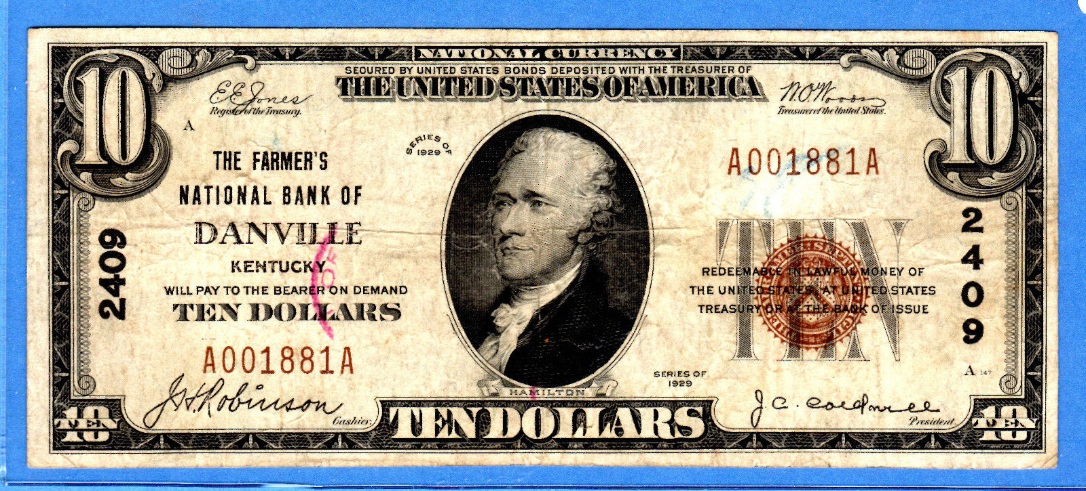
The Act Restricts Operational Fraud

Slide 27
The Act Restricts Operational Fraud

Slide 28
The Act Restricts Operational Fraud
The National Bank Act required national banks to submit regular reports of condition for the OCC’s use in verifying their safety and soundness. The Act also required the OCC to conduct an on-site examination of every national bank and to prepare “a full and detailed report” on its condition.
Although the OCC’s headquarters operations were initially funded by Congress, national bank examiners were more akin to independent contractors, paid directly by the banks they examined at a rate of $5.00 a day plus $2.00 for every 25 miles traveled…
…designed to insulate examiners from the pressures of the federal budgeting and appropriations process.
Many examiners were overwhelmed by the number of banks in their supervisory portfolios and by the challenge of getting from one to the next. One OCC examiner in 1887 had responsibility for 90 banks scattered throughout seven states. He could have hired an assistant to help, but that would have been an out-of-pocket expense. Nineteenth-century rail travel was physically grueling; schedules and connections were erratic. Examiners were sometimes tempted to rush through their work to avoid missing the train that could leave them stranded—and unpaid—for days. The examiners became regular salaried employees only in 1913.

Slide 29
PART 5
The Act Entrenches Structural Fraud

Slide 30

The Act Entrenches Structural Fraud
#1 STRUCTURAL FRAUD: Each bank is entitled to receive from the Controller of the Currency
an amount of circulating notes equal to 90% of the par value of the bonds deposited by it.
&
“… [the banker is] permitted to invest his greenbacks in government bonds at face value; upon these bonds he not only drew gold interest in advance, but by means of the bank scheme he actually had 90 per cent of their value returned to him. .. in the form of national bank notes, and it is with these he carries on his banking business, loaning them out upon the most advantageous terms. On the one hand he draws interest from the government; on the other, from the same investment he draws interest from his individual debtors.” Sarah Emery, Seven Financial Conspiracies Which Have Enslaved The American People, p. 25

Slide 31

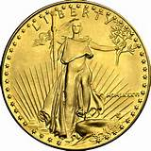

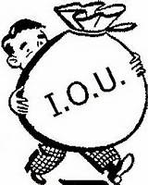
The Act Entrenches Structural Fraud
What does this structural fraud look like?
AT MATURITY OF BOND (20 YEARS),
BANK GETS BACK ITS MONEY LOANED
TO GOVERNMENT
CONTROLLER OF
CURRENCY STORES BONDS
THE BANK BUYS TREASURY BONDS WITH DEPRECIATED GREENBACKS & STORES THEM AT CONTROLLER OF CURRENCY
5
1
2
BANK GETS INTEREST IN GOLD COIN ON THE BONDS,
20-YEAR MATURITY,
GOOD RATE OF INTEREST,
FULLY SECURED
$$ INTEREST #1
$$ INTEREST
$$ INTEREST #2
3
NATIONAL BANK NOTES VALUED AT 90% OF THE BANK’S DEPOSITED BONDS ARE LOANED FREE TO BANKER, FOR TWENTY YEARS
THE BANK LOANS OUT THE BANK
NOTES FOR 20 YEARS, KEEPING ALL
THE INTEREST.
4

Slide 32

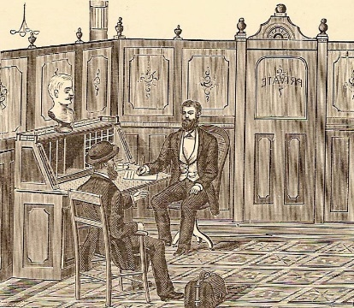
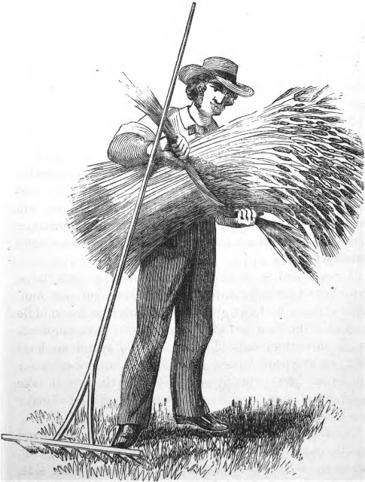
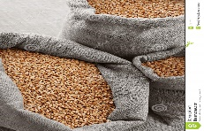
The Act Entrenches Structural Fraud
What would it look like for other classes of the country to have the same legal privileges as these banks?
THE FARMER SELLS
1000 BUSHELS
OF WHEAT
COMMODITIES BROKER
FARMER
1
2
BROKER BUYS CROP WITH LONG-TIME NOTE, HAVING GOOD RATE OF INTEREST, FULLY SECURED
$$ INTEREST
$$ INTEREST
3
900 BUSHELS OF WHEAT ARE LOANED
FREE TO FARMER, FOR TWENTY YEARS,
FOR NO COST, TO BE LOANED OUT
BY FARMER
THE FARMER, BY JUDICIOUSLY LOANING
TO HIS NEIGHBORS, TWENTY FOLD HAS
BEEN RETURNED TO HIM.
4

Slide 33
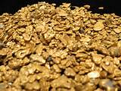
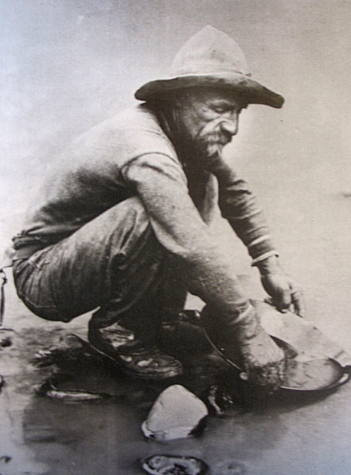
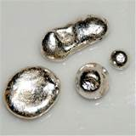
The Act Entrenches Structural Fraud
“… we do in most unqualified terms, denounce such a system of public robbery. None but the wealthy classes are able to enter upon this profitable banking business. If it is proper for the government to make the business of the wealthy thus lucrative, is it not equally just to give like advantages to the poorer classes?” Sarah Emery, Seven Financial Conspiracies Which Have Enslaved The American People, p. 26
THE GOLD MINER SELLS
100 GOLD NUGGETS
GOLD DEALER
1
GOLD MINER
FARMER
2
GOLD DEALER BUYS NUGGETS WITH 20-YEAR NOTE, HAVING GOOD RATE OF INTEREST, FULLY SECURED
$$ INTEREST
3
GOLD DEALER LOANS 90 SILVER NUGGETS FREE TO GOLD MINER, FOR TWENTY YEARS, FOR NO COST, TO BE LOANED OUT BY THE GOLD MINER
THE GOLD MINER, BY JUDICIOUSLY LOANING
TO HIS NEIGHBORS, TWENTY FOLD HAS
BEEN RETURNED TO HIM.
4

Slide 34
The Act Entrenches Structural Fraud
The more dangerous bankers were the ones who don’t break the law, but prey upon society from behind the cover of laws, WHICH GRANT THEM SPECIAL PRIVILEGES.
+
Banks are allowed to loan out the national bank notes and charge such rates of interest as are allowed by state law. They have this privilege for 20 years.
Banks will be paid the Treasury bond interest IN ADVANCE and IN GOLD. The bonds are good for 20 years.
INTEREST #1
INTEREST #2

Slide 35
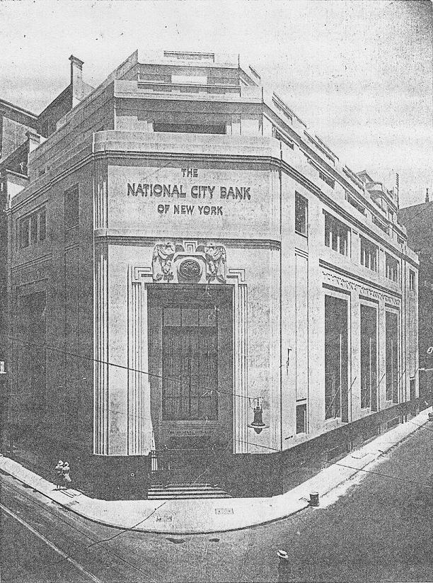
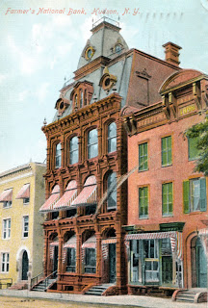
The Act Entrenches Structural Fraud
#2 STRUCTURAL FRAUD: the National Banking System was a fractional reserve system: the bank needed to maintain reserves proportional to their liabilities (notes and deposits).
NATIONAL CITY BANK OF NEW YORK
“A step of great evolutionary significance was taken, also in half-conscious, incidental fashion, by providing that required reserves might be partly in the form of bank credit. Thus banks outside New York and other reserve centers might count the deposit balances they maintained with banks in those centers as part of their reserves, the remaining part to be in gold in their own vaults. The banks in the centers, however, must maintain their reserves wholly in gold.” Bray Hammond, Banks and Politics in America, pp. 731-732
FARMER’S NATIONAL
BANK, HUDSON, NY

Slide 36
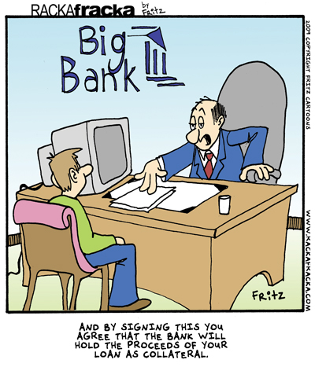
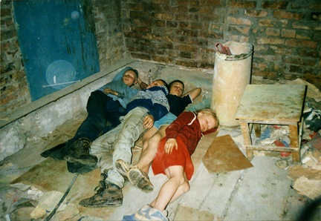
The Act Entrenches Structural Fraud
#3 STRUCTURAL FRAUD: “…the charging of interest by banks on money they create out of thin air. Such interest, if it is to be charged, belongs to society.
Even more important is the control over the flow of credit in the society – the favoritism practices in directing the flow of newly created money into the hands of privileged special interests.” Zarlenga, LSM, p. 470
HOMELESS
CHILDREN

Slide 37
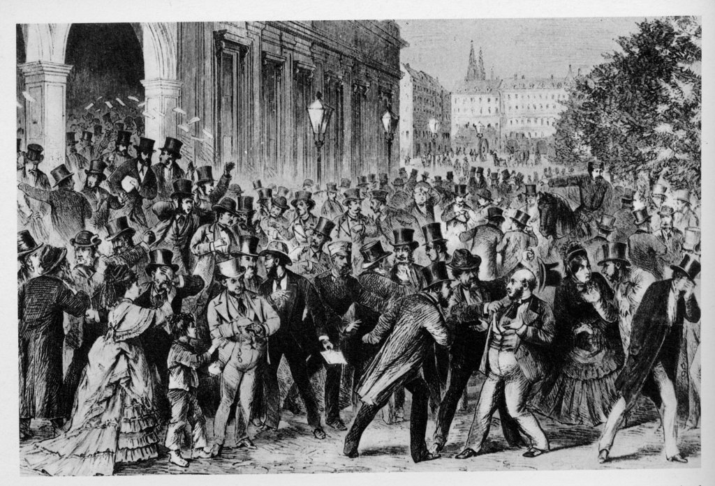
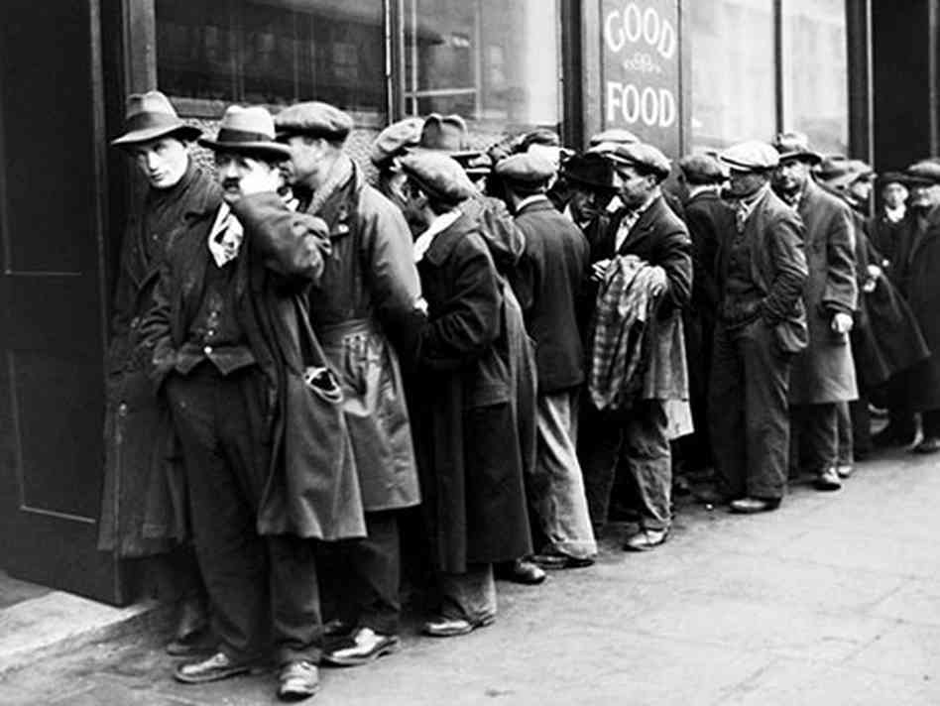
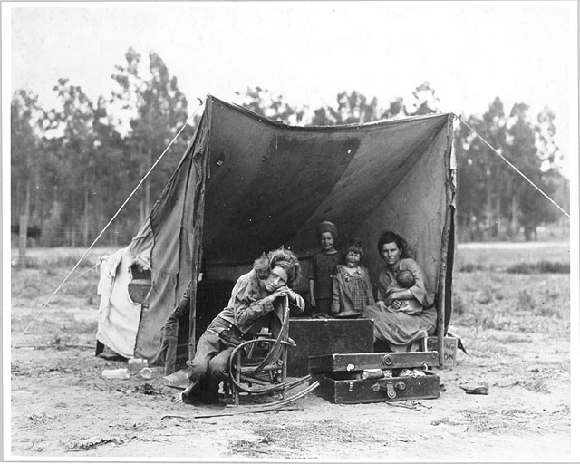
The Act Entrenches Structural Fraud
“THOSE USING STRUCTURAL FRAUD ARE MORE DIFFICULT TO STOP THAN THE COMMON THIEVES. INDEED, WITH FEW EXCEPTIONS, SOCIETIES HAVE BEEN UNABLE TO STOP THEM AND HAVE WATCHED HELPLESSLY AS THE BANKERS’ SYSTEMS PERIODICALLY AND ‘LEGALLY’ DESTROYED THEIR ECONOMIES, AND SOMETIMES THEIR NATIONS.” Zarlenga, LSM, p. 470

Slide 38
PART 6
Battle Over the Greenbacks;
The Supreme Court Decisions

Slide 39
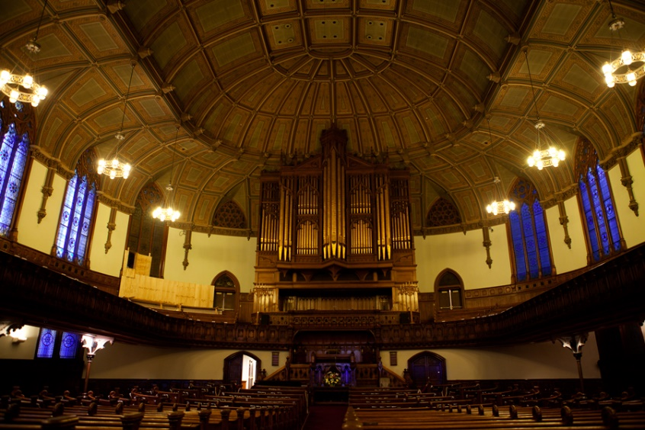

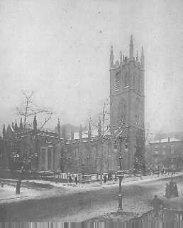
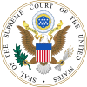
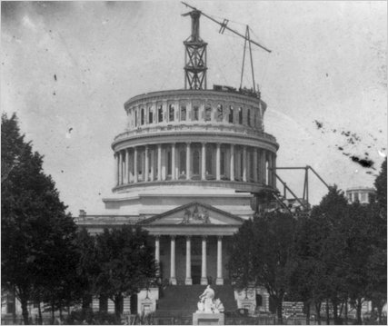
Battle Over the Greenbacks: The Supreme Court Decisions
When the Civil War ended, attacks began on the Greenbacks from two sources:
    those with financial privileges
    religious groups, especially Calvinist religious sects
5TH AVENUE PRESBYTERIAN
(CALVINIST) CHURCH, NYC
First Presbyterian Church
in the City of New York

Slide 40
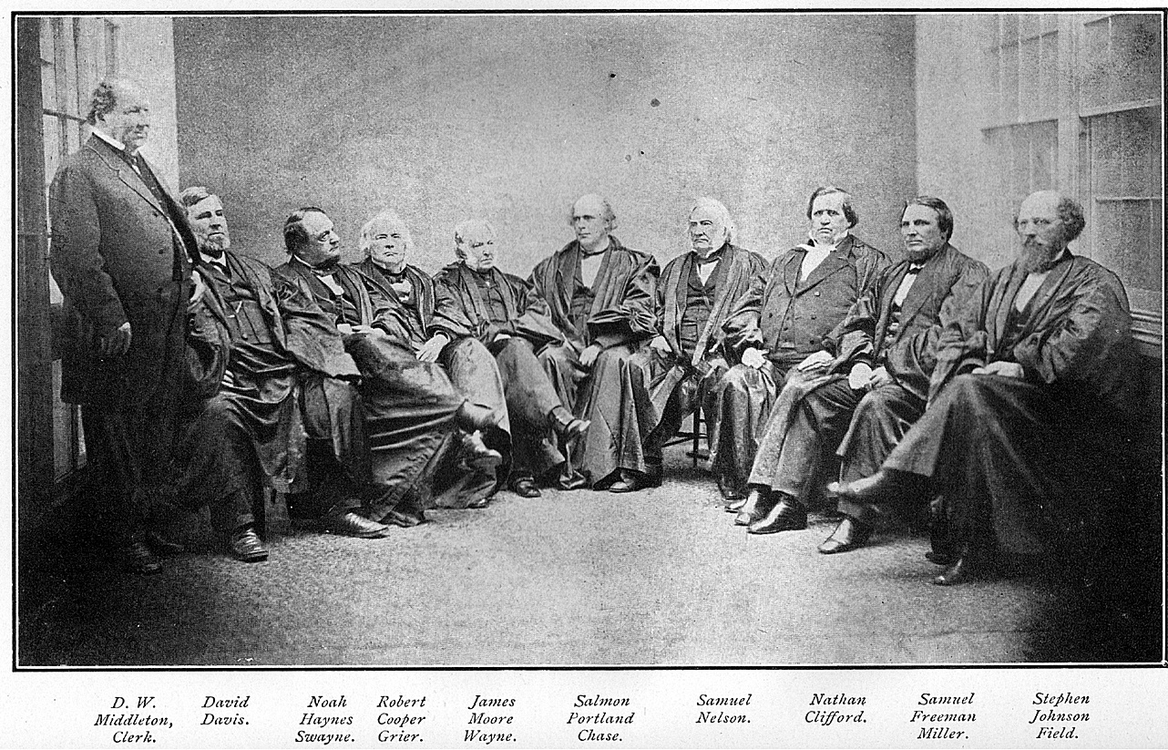
Battle Over the Greenbacks: The Supreme Court Decisions
Chase as Head Justice,
Supreme Court of U.S., 1868

Slide 41
Battle Over the Greenbacks: The Supreme Court Decisions
December, 1868
Lane County vs. Oregon
The Supreme Court held unanimously that the legal-tender acts of 1862 and 1863 did not apply to taxes imposed by the authority of a state. If a state made its taxes payable in gold, the taxpayer’s obligation could not be discharged with legal-tender notes.
December, 1868
Bronson vs. Rodes
The Supreme Court held that a contract specifically payable in gold and silver coin could not be discharged by a tender of United States notes.

Slide 42


Battle Over the Greenbacks: The Supreme Court Decisions
February, 1870
Hepburn vs. Griswold
A majority of the Court held the legal-tender law to be in violation of the Constitution. The Court reasoned that the U.S. government, having only those powers which were enumerated in the Constitution, did not have the power to issue paper money and enact legal-tender laws. The ruling was delivered by Supreme Court Justice Salmon Chase, the former Treasury Secretary!
Griswold was demanding payment in gold, from a contract entered into with Hepburn, before the legal tender law had been passed. Hepburn wished to pay in U.S. notes. The court ruled against Hepburn.

Slide 43

Battle Over the Greenbacks: The Supreme Court Decisions
May, 1871
Knox vs. Lee
The Court reversed Hepburn and upheld the constitutionality of the Greenback legal tender act. Paper money as issued by the Legal Tender Act did not conflict with Article One of the U.S. Constitution.
Said Justice Bradley, in his opinion: “But the creditor group will lose some of its gold! … Is gold the only thing needful? Is it worse for the creditor to lose a little by depreciation than everything by the bankruptcy of his debtor?”
Justice Joseph Bradley
(1813 – 1892)

Slide 44
PART 7
Battle Over the Greenbacks:
Pastor and Professor Against the Greenbacks

Slide 45

Battle Over the Greenbacks: Pastor and Professor Against the Greenbacks
The fight against the Greenbacks was not only financial, political, and legal, but also a religious effort.
“But the real damage to the Greenback came from the incessant attacks and smearing by the religious establishment through their churches and universities.” Zarlenga, LSM, p. 471
The issue of ‘Hard Money’ was infused with the values of American Protestantism.
‘Hard Money’ was honest and moral. Soft money was dishonest and caused immorality
in business and government.
“To the ministry, contemporary economic issues were moral issues, and they never doubted that the postwar money question came within their purview as moral guardians of the nation.”
“Among public issues of the day, only the fate of the freedman was to engage the Protestant, and particularly the Calvinist, clergy and religious press so completely as the money issue.”
Irwin Unger,
The Greenback Era: A Social, and Political History of American Finance, 1865-1879
pub. 1964
5th Avenue
Presbyterian Church,
NYC

Slide 46


Battle Over the Greenbacks: Pastor and Professor Against the Greenbacks
“The Calvinist denominations took the lead in the religious attack on heretical financial ideas.”
Unger, The Greenback Era
“… throughout the debate, the
Calvinist voice is heard most
loudly.” Unger, The Greenback Era
backs

Slide 47


Battle Over the Greenbacks: Pastor and Professor Against the Greenbacks
The religious indictment of soft money had two parts:
  “specie resumption was a question of common honesty”
  “The paper system was also a danger to public morality…. causes dishonesty in mercantile circle… causes corruption in public offices”
The bond question was also a moral question:
  the national debt represented the “national conscience”
  the first duty of a nation was to make its word good – “adhere to sacred obligations”
April 9, 1870 Harper’s Weekly: anticipating
the resumption of government payments
in precious-metal coins.

Slide 48

Battle Over the Greenbacks: Pastor and Professor Against the Greenbacks
“The religious sects… smear the Greenbacks as immoral. Their method was a double pretense: first, to pretend that money had to be gold and silver; second, to pretend the bankers’ notes were really convertible to gold and silver.” Zarlenga, LSM, p. 472
Industrial Age magazine, October 31, 1874:
“The religious press has almost without exception been the allies of the bondholders and bankers in their endless schemes to fleece the public, and the mouthpiece of the monopolists and the defender of the soulless corporations, that fill their pockets by robbing the toiling people.”
Industrial Age magazine, May 1, 1876:
“The religious press has almost universally wheeled into line in support of the Shylocks and the Sharpers.”
backs

Slide 49


Battle Over the Greenbacks: Pastor and Professor Against the Greenbacks
Higher education in America was dominated by religious organizations
“…practically all the colleges founded between the Revolution and the Civil War were organized, supported and in most cases controlled by religious interests.” D.S. Tewksbury, The Founding of American Colleges and Universities Before the Civil War, 1965, pp. 50-57
Except for the 21 state colleges and a few other exceptions, before 1860 colleges in America were primarily religious institutions:
Denomination # of colleges
Presbyterian (Calvinist) 49
Methodist 34
Baptist 29
Congregationalist (generally Calvinist) 21
Catholic 14
Lutheran 5

Slide 50

Battle Over the Greenbacks: Pastor and Professor Against the Greenbacks
“Before the Civil War,… at most American colleges ‘political economy’ was taught by a minister, as a branch of ‘moral philosophy’… Pastor (and) professor… helped erect a formidable psychological barrier against greenbackerism.” Unger, The Greenback Era
On the specific question of fiat money … the text writers … Walker’s 1866 text condemned the issue of a legal tender as “a great usury,” never “justified except in the most extreme case of national peril.” Perry declared that “a paper money is only tolerable when it is actually and instantly convertible on demand into gold and silver.” Unger, The Greenback Era
HARVARD COLLEGE

Slide 51
PART 8
THE GREENBACK DEFENDERS

Slide 52

THE GREENBACK DEFENDERS
“ ‘The Greenback appeal was more abstract than has been realized,’ wrote Unger, surprised. But it had to be abstract; money in its ultimate form is abstract rather than concrete.” Zarlenga, LSM, p. 473
Facing the attack of financial, political, legal, and religious sectors, men of courage, understanding and patriotism put forward reasoned defenses of the Greenback system.
They made proposals for its permanency, and they proposed to remove the privilege of the new National Banking Act.

Slide 53

THE GREENBACK DEFENDERS
LYMAN DEWOLF
“Take away from gold and silver the shield of law contained in these various mint regulations in the uses of those metals … and it would be difficult to determine either their value or ultimate use.”
“The unit in money can have no invariable determinate proportion to any part of value, that is to say it cannot be fixed in perpetuity to any particular quantity of gold and silver or any other commodity.” Lyman E. Dewolf, Money – its Use and Abuse, 1869, pp. 33, 170

Slide 54

THE GREENBACK DEFENDERS
BENJAMIN F. BUTLER
Benjamin Butler was the rare Republican among the Greenback defenders. He had been born a Calvinist, but then rejected it. He had been a Civil War general, a congressman from Massachusetts, a contender for the Governor on the Democratic ticket, and later for President on an Independent paper money platform.
Butler had always been a student of finance and had kept a close eye on the activities of moneychangers within his military jurisdictions for indications of how the war was going.

Slide 55

THE GREENBACK DEFENDERS
BENJAMIN F. BUTLER
The currency, he said, should be: “Uniform, sound, cheap, stable and elastic.”
“…But what I desire is that the currency shall not be redeemable in gold and silver… In other words the value of the currency of this country, its volume, its stability, the values of all property of the country, shall no longer be at the mercy of the panics, the caprice, the speculations, or the needs of the bankers of Europe or the traders of Asia…”
“My… proposition is to take from the national banks all power to issue notes to circulate as money, leaving them as they are now banks of deposit, loans and discounts, but not of issue.”

Slide 56

THE GREENBACK DEFENDERS
BENJAMIN F. BUTLER
“This is one of the outstanding speeches of American political history.”
Zarlenga, LSM, p. 477

Slide 57
Q & A
WILL DECKER’S CONCLUSION:
THE CONTROL OF MONEY -- WITHOUT CONTROL FROM THE PUBLIC -- LEADS TO
CORRUPTION … USURPATION … SLAVERY.

