Slide 1
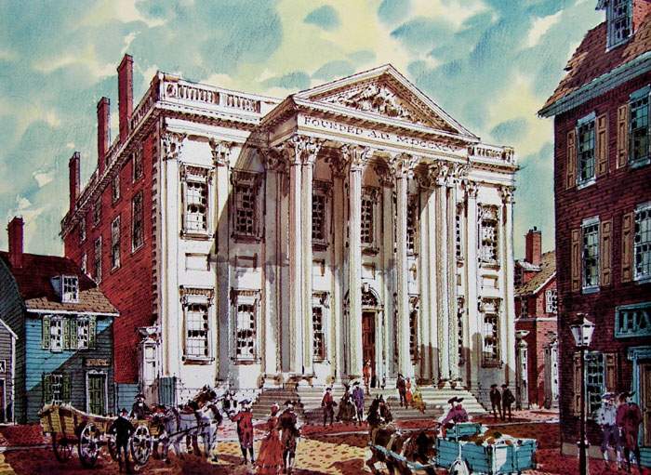
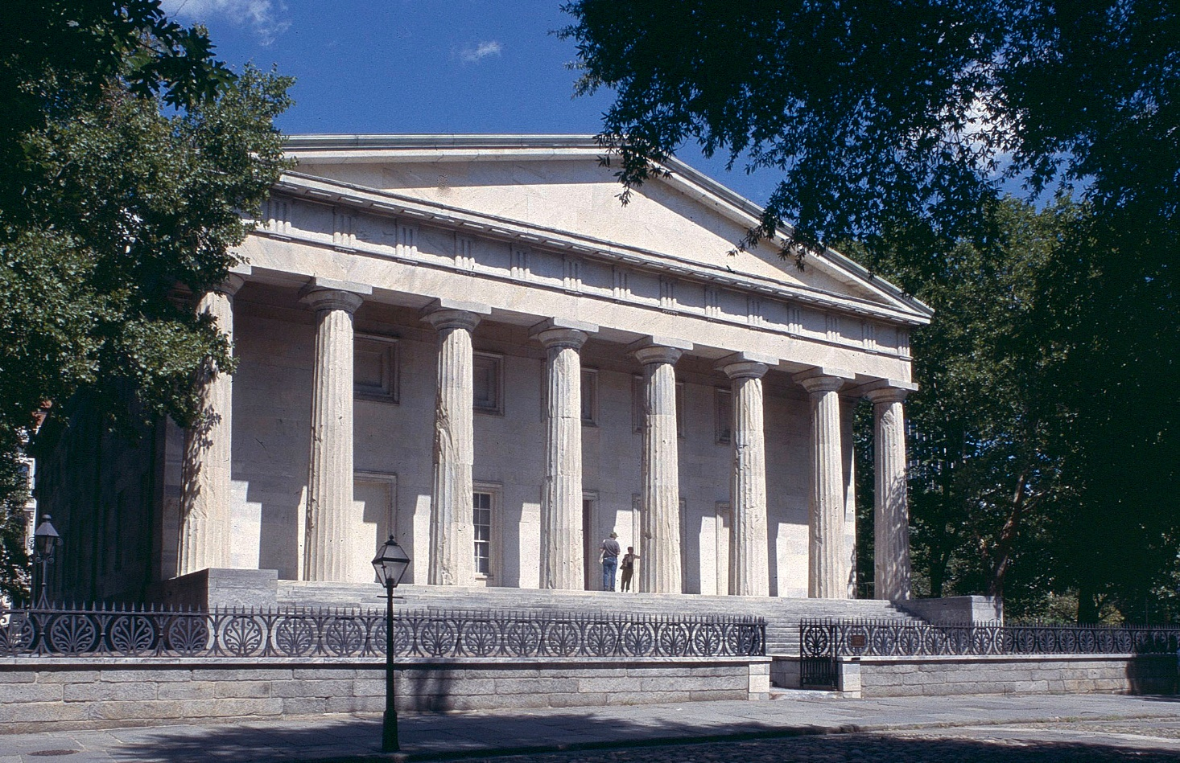
The Lost Science of Money
CHAPTER 15 – PART 2
THE MONEY POWER VS THE U.S. CONSTITUTION
PHILADELPHIA, PA
FIRST BANK OF THE UNITED STATES:
SECOND PRIVATE U.S. BANK OF ISSUE (1791-1811)
SECOND BANK OF THE UNITED STATES:
PRIVATE U.S. BANK OF ISSUE (1816-1836)

Slide 2
THEMES OF LOST SCIENCE OF MONEY BOOK
Primary importance of the money power (power to create money and regulate it)
Nature of money purposely kept secret and confused
How a society defines money determines who controls the society
Battle over control of money has raged for millennia: public vs private
The misuse of the monetary system causes tremendous misery and suffering for the ordinary working people. Will Decker & Martin Dunn, February 2014
Whenever the public has owned a significant fraction of the money power, great public benefit has ensued: British experience after World War II, or Sparta, or the Roman Republic, or Canada after the Great Depression, or the American Colonies in the 18th century. Martin Dunn, July 2014.

Slide 3
PARTS OF PRESENTATION
FEDERALIST VS. REPUBLICAN STATE CHARTERED BANKS: BURR SHOOTS HAMILTON
OUR FIRST BANKING SYSTEM
TAKING THE 1ST BANK OF THE U.S. DOWN
THE FIRST PAPER MONEY ISSUED BY THE U.S.
REAL NEED FOR A CENTRAL BANK
MADISON’S DALLAS PLAN BLOCKED
OPPOSITION FROM THE STATE BANKS EVAPORATED
THE 2ND BANK OF THE U.S. – THE BANK FROM HELL
REGRESSING AMERICAN MONETARY THOUGHT
PRESIDENT JACKSON WANTS A GOVERNMENT BANK
JACKSON’S WAR WITH THE BANK
MARTIN VAN BUREN AT THE HELM

Slide 4
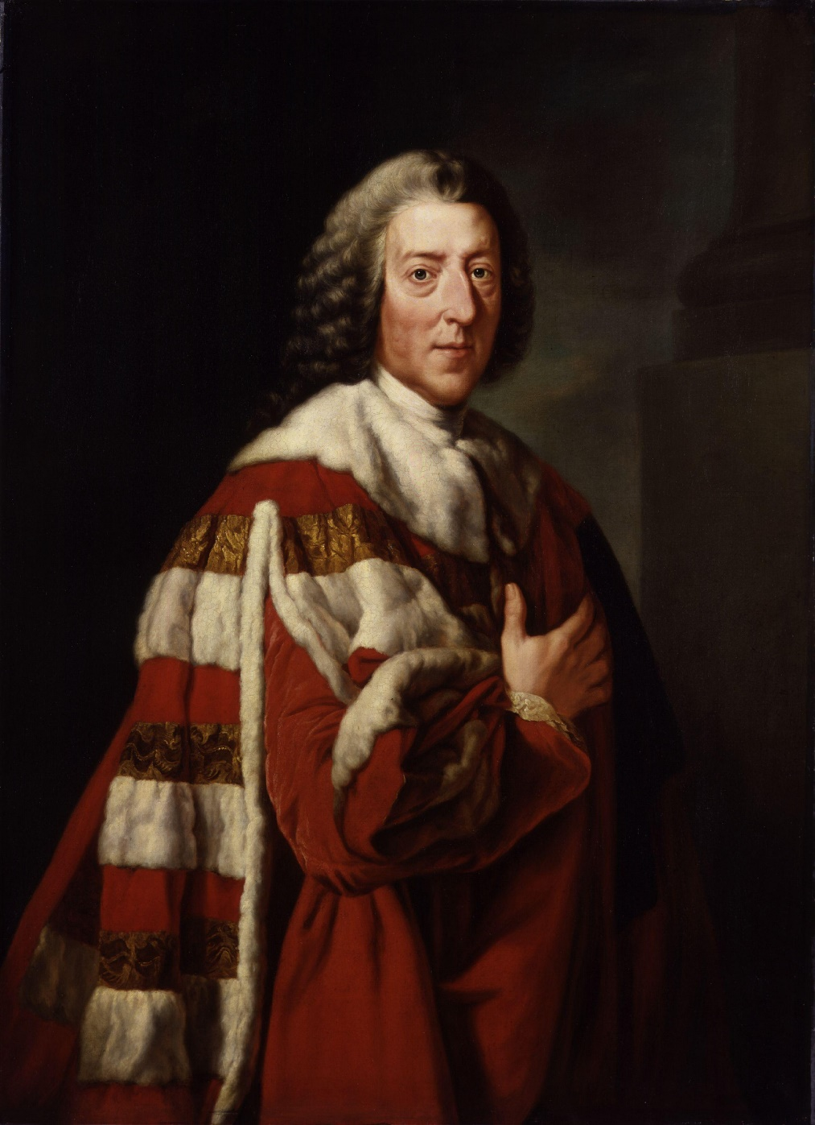
THE MONEY POWER VS THE U.S. CONSTITUTION
WILLIAM PITT, FIRST EARL OF CHATHAM
“Let the Americans adopt their funding
system, and go into their Banking institutions,
and their boasted independence will be
a mere phantom.”

Slide 5
PART 1
FEDERALIST VS. REPUBLICAN -
STATE CHARTERED BANKS:
BURR SHOOTS HAMILTON

Slide 6
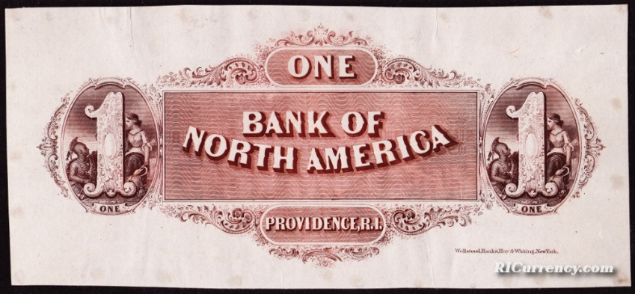
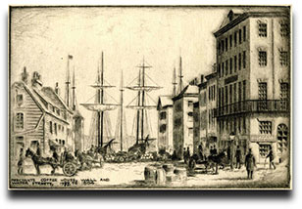
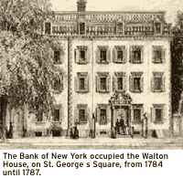
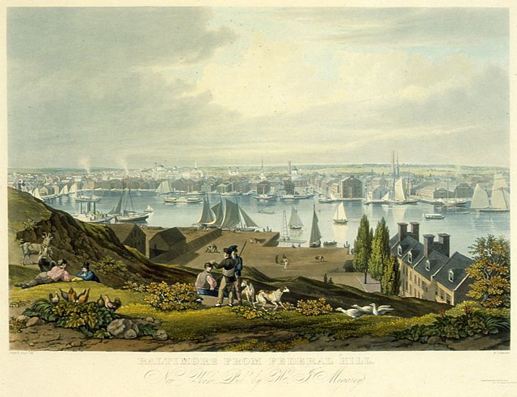
FEDERALIST VS. REPUBLICAN STATE CHARTERED BANKS: BURR SHOOTS HAMILTON
“In 1791, when the Bank of the United States was chartered, the Federalists, a monied minority of the population, were in control of the government, and there were three banks {and soon a fourth} in operation.” Bray Hammond, Banks and Politics in America, 1957
BANK OF NORTH AMERICA
PHILADELPHIA, PA.
Hamilton, Morris
1
BOSTON HARBOR
THE BANK OF MASS
BOSTON, MASS
3
BANK OF NEW YORK
NEW YORK CITY
HAMILTON
2
BALTIMORE HARBOR
BANK OF MARYLAND
4

Slide 7
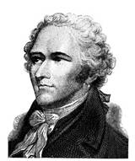
FEDERALIST VS. REPUBLICAN STATE CHARTERED BANKS: BURR SHOOTS HAMILTON
Each bank had been chartered by the state’s legislature, but the management was private.
How the public viewed ‘the Bank’: “The jaundiced view was that private interests had wormed their way into official favor and usurped privileges they should not have. The realistic view was that the community, whether shrewdly or not, had adapted private initiative and wealth to public purposes, granting privileges and exacting duties in return… To the agrarians, the multiplication of bank charters was an extension of privilege rather than a division of it.” Bray Hammond, p. 67
Alexander Hamilton’s definition of a bank to President Washington in 1791 - Hammond, p. 69:
“For the simplest and most precise idea of a bank is a deposit of coin or other property as a fund for circulating a credit upon it which is to answer the purpose of money.”
HAMILTON

Slide 8
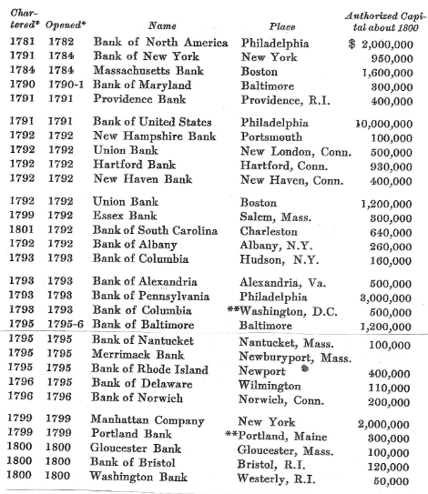
FEDERALIST VS. REPUBLICAN STATE CHARTERED BANKS: BURR SHOOTS HAMILTON
“The decade of 1781 to 1791 was followed by one in which the number {of banks} grew so rapidly that contemporaries spoke of a rage for banks – a ‘bancomania.’ “ Hammond, p. 72
← 29 BANKS IN BUSINESS IN 1800
“That banking flourished with the decline of Hamilton’s
party and the ascendancy of Jefferson’s connotes the fact
that business was becoming democratic. It was no longer
a select and innumerous aristocracy – business
opportunities were falling open to everyone.” Hammond,
p. 145
“The success of the Republican party in retaining the loyalty
of the older agrarians while it recruited among the newer
entrepreneurial masses was possible … it came to include both
the conspicuous opponents of banking and the conspicuous
advocates of it”. Hammond, p. 145-146

Slide 9
FEDERALIST VS. REPUBLICAN STATE CHARTERED BANKS: BURR SHOOTS HAMILTON
“Soon … banks were serving not only merchants but “mechanics,” on whose skills the Industrial Revolution was progressing, and farmers.” Hammond, p. 147
“In 1791 American business had been concerned mainly with foreign commerce;
by 1816 it was concerned mainly with a greatly diversified internal economy …
The population, which in 1790 had been 3,900,000, became 9,600,000 by 1810 …
and by 1812 the original thirteen states had become eighteen …
In 1793 the cotton gin had been invented and the way cleared for Cotton to
become King and the leading means of payment for the goods required from
Europe for the building up of American industry … By 1810, manufacturing
with water power had suddenly become common; the number of cotton mills
in 1807 was fifteen and of spindles 8,000, but in 1811 those numbers had grown
to eighty-seven and 80,000.” Hammond, pp. 148-149
YEAR #STATE
CHARTERED
____ ____BANKS___
1791 3
29
90
250 !!!
300
1837 788

Slide 10
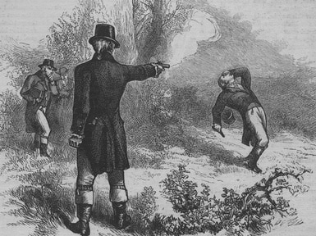
FEDERALIST VS. REPUBLICAN STATE CHARTERED BANKS: BURR SHOOTS HAMILTON
Hamilton and Burr were rivals in New York over banking power …
“In NYC, from 1784 to 1791 there was no bank but the Bank of New York, and from 1791 to 1799 there was no other but the local office of the Bank of the United States. Both were Federalist …
But in 1799, through a skilful stratagem of Aaron Burr’s, a corporate charter was obtained under which a new bank was set up, the Bank of the Manhattan Company, of far greater size than the Bank of New York, of much wider proprietorship, and Jeffersonian in its political ties.” Hammond, pp. 149-150
“In 1803 Alexander Hamilton helped organize the fourth bank in New York City, the Merchants Bank … The Republicans now had a majority in the Assembly and on behalf of their Bank of the Manhattan Company refused the Merchants a charter.” Hammond, p. 158
BURR KILLS HAMILTON:
Burr rejected Hamilton’s attempts to apologize
1804

Slide 11
PART 2
OUR FIRST BANKING SYSTEM

Slide 12
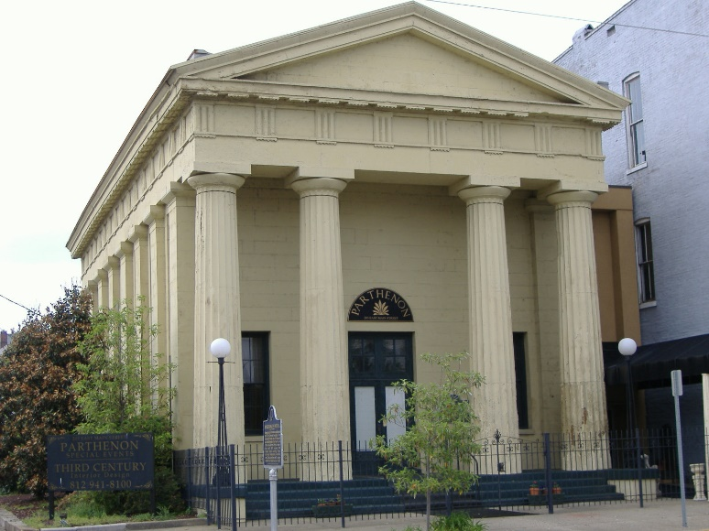
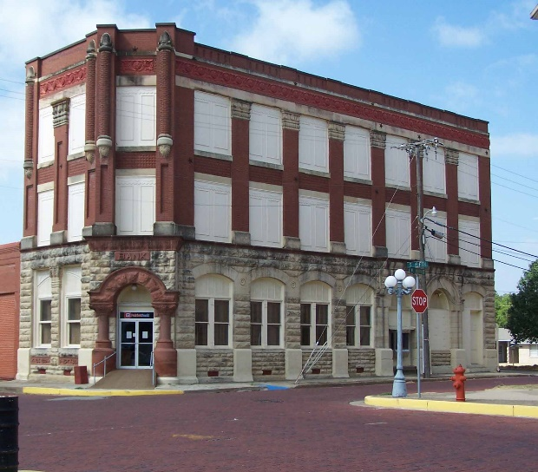
OUR FIRST BANKING SYSTEM
As banks became numerous, banks opened reciprocal accounts with each other. This allowed them to make payments on behalf of the other’s customers and settle the amounts between each other.
CHECKS DRAWN ON
BANK OF NEW YORK
& DEPOSITED IN
MANHATTAN BANK
$10,000
CHECKS DRAWN ON
MANHATTAN BANK
& DEPOSITED IN
BANK OF NEW YORK
$15,000
MANHATTAN BANK
BANK OF NEW YORK
RESULT OF SETTLEMENT:
MANHATTAN BANK OWES BANK OF NEW YORK
$5,000 (IN SPECIE?)

Slide 13


OUR FIRST BANKING SYSTEM
As banks became numerous, each was affected by the credit practice of others. When one bank enlarged their loans, funds would turn up in other banks and encourage more lending – credit expansion (inflation). Alternatively, when one bank reduced their loans, funds would be drained from other banks – credit contraction (deflation).

Slide 14

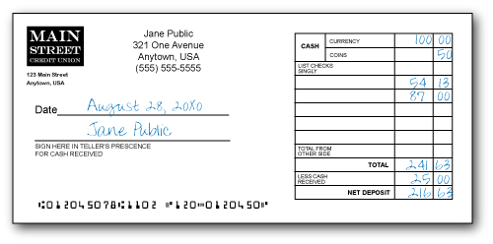
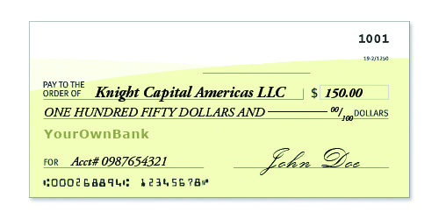
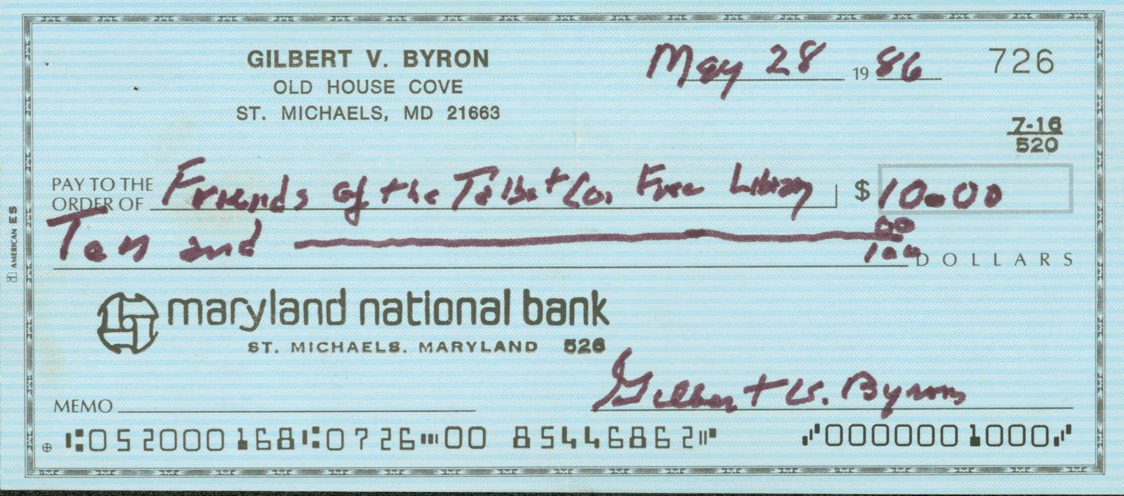
OUR FIRST BANKING SYSTEM
The movement of bank notes into circulation in consequence of lending went on tangibly before one’s eyes, but not so the increase in loan deposits.

Slide 15

OUR FIRST BANKING SYSTEM
“Being the main government depository and having offices in the principal commercial cities, the Bank {of the United States} was the general creditor of the other banks. It had the account of the largest single transactor in the economy – the federal government – and the receipts of the government being mostly in the notes of state{-chartered} banks and these notes being deposited in the Bank, it could not help being their creditor.
By pressing them for payment of the notes and checks received against them, the Bank automatically exercised a general restraint upon the banking system.” Hammond, p. 198

Slide 16
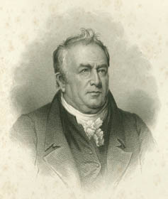
OUR FIRST BANKING SYSTEM
As an example of this system, in 1796 the Bank of New York lent the Treasury $200,000, and gave it deposit credit for that amount.
The Treasury wanted the funds in the Bank {of the United States} and therefore deposited checks against this credit in the Bank.
The Bank asked to be paid $100,000 in specie from the Bank of New York, which did not have it.
Oliver Walcott, Jr., Secretary of the Treasury wrote:
“These institutions have all been mismanaged. I look upon them with terror. They are at present the curse, and I fear they will prove the ruin of the government.”
Hammond, p. 201

Slide 17
PART 3
TAKING THE 1ST BANK OF THE U.S. DOWN

Slide 18
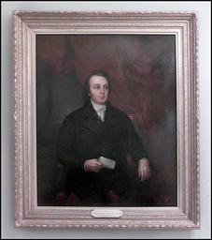
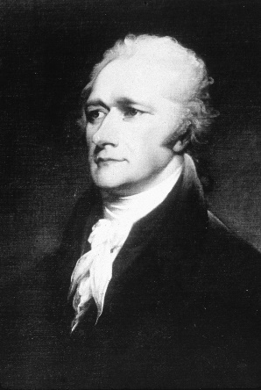
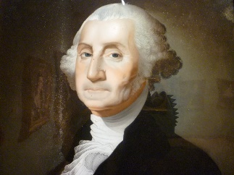
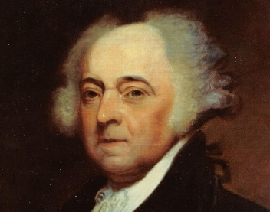
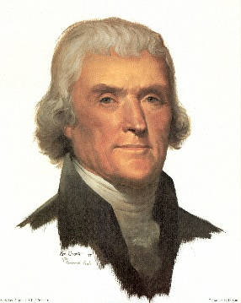
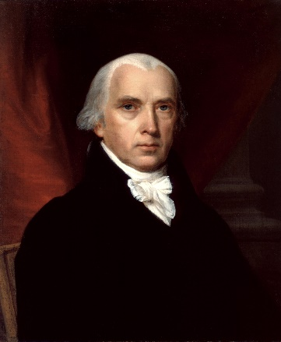
TAKING THE 1ST BANK OF THE U.S. DOWN
BRIEF HISTORY OF FIRST BANK OF U.S.
1791-1797 Federalists in power:
          President Washington (1789-1797)
          Alexander Hamilton, then Oliver Wolcott, Secretary of Treasury
1797-1801 Federalists in power:
          President John Adams neutral towards federal Bank though still abhorring all banks (1797-1801)
1801-1811 Republican in power:
          Presidents Jefferson (1801-1809) and Madison (1809-1817) resist Bank:
            Bank was largest corporation in the country
            its stockholders included Congressmen and other public officials
            Bank’s offices were in leading cities which was evidence of its ubiquitous power
            Jefferson: “The Bank penetrating by its branches every part of the Union, acting by command
            and in phalanx, may, in a critical moment, upset the government.” Hammond, p. 206

Slide 19
TAKING THE 1ST BANK OF THE U.S. DOWN
WHAT DID THE BANK DO FOR THE GOVERNMENT?
Paid government’s interest on the public debt
Received subscriptions to new government securities issues
Paid salaries of government officials
Facilitated foreign exchange operations of Treasury
Moderated outflow of specie
Supplied bullion and foreign coins to Mint
Helped collect customs bonds (bulk of government income) – discounted them very largely for importers
Bank’s notes were a uniform currency receivable for all payments due government

Slide 20
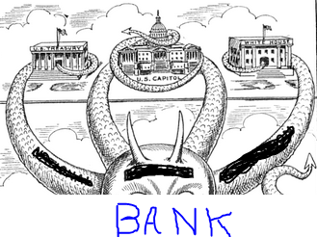
TAKING THE 1ST BANK OF THE U.S. DOWN
JEFFERSON’S FEARS OF THE BANK
“ While the government remained at Philadelphia, a selection of members of both Houses were constantly kept as directors who on every question interesting to that institution or to the views of the federal head, voted at the will of that head; and together with the stockholding members could always make the federal vote that of the majority.” Hammond, p. 206

Slide 21
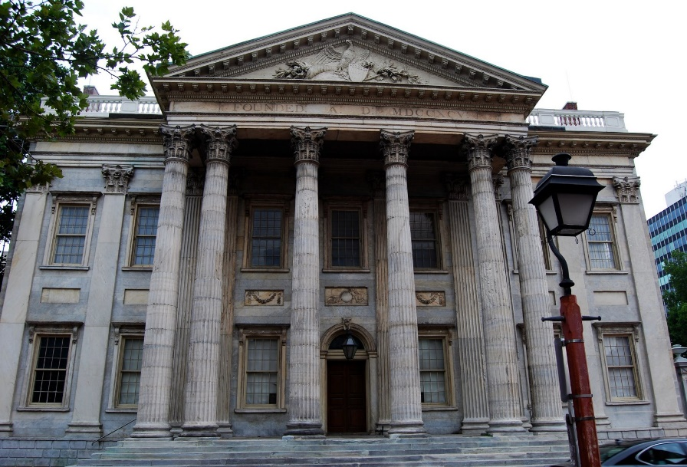

TAKING THE 1ST BANK OF THE U.S. DOWN
THE REPUBLICAN OPPOSITION TO THE BANK
The Republican Party of Jefferson was no longer overwhelmingly agrarian and also contained a large number of businessmen
  businessmen lauded state-chartered private banks
  agrarians were split -- for and against the Bank
    FOR: believed the Bank regulated and minimized evils of state banks;
    believed government had some control over the Bank
    AGAINST: state banks can be tolerated;
    the Bank was British-owned and the majority of directors were Federalists
  Bank was unconstitutional
80 Pittsburghers wrote Feb 4, 1811: “ {the Bank} held in bondage thousands
of our citizens who dared not to act according to their consciences from fear
of offending the British stockholders and Federal directors.” Hammond, p. 213
Legislatures of Mass., PA., Maryland, VA., Kentucky instructed their Senators
to vote against the renewal of the Bank’s charter because “the Bank was
unconstitutional and encroached dangerously on the sovereignty of the
states.” Hammond, p. 213

Slide 22

TAKING THE 1ST BANK OF THE U.S. DOWN
STATE BANKS & SPECULATORS
OPPOSED RE-CHARTER OF THE BANK
  State Bank opposed re-charter of the Bank
    wanted government deposits for themselves
    wanted to remove the competition of the Bank’s notes
    did not want regulation of their currency
  Speculators opposed re-charter of the Bank
    wanted easy loans

Slide 23

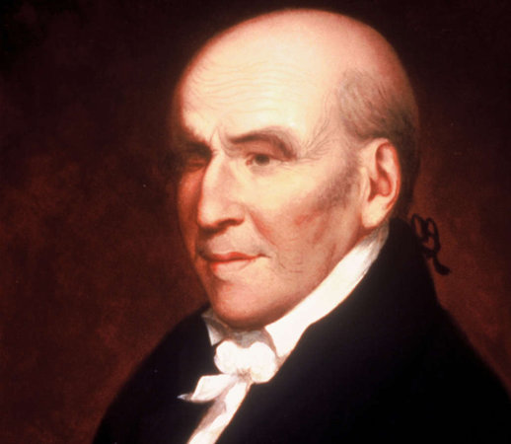
TAKING THE 1ST BANK OF THE U.S. DOWN
BANK’S RENEWAL FAILED
2-5-2811
DEFEATED IN SENATE BY VOTE: 18-17
DECIDING VOTE AGAINST -- CAST BY JEFFERSON’S VICE PRESIDENT GEORGE CLINTON
On liquidation, it was found that 18,000 of the bank’s 25,000 shares were owned by foreigners, mostly Dutch and English
“… Stephen Girard, then the foremost merchant and the wealthiest man in the country, was the largest stockholder”. Holdsworth and Dewey, The First and Second Banks of the United States, p. 104
STEPHEN GIRARD
(1750-1831)

Slide 24
TAKING THE 1ST BANK OF THE U.S. DOWN
THE BANK’S DEMISE WAS NOT REALLY A GREAT VICTORY AGAINST THE PRIVATE MONEY ISSUERS,
FOR BY THEN OVER 100 PRIVATE BANKS HAD BEEN CHARTERED BY THE STATE GOVERNMENTS.
THE CONSTITUTION FORBADE THE STATES FROM ISSUING MONEY –
BUT ALLOWED STATE-CHARTERED BANKS TO ISSUE MONEY!
“There was straightaway a mushroom growth of new state banks to fill the void,
so that one hundred and twenty were chartered and put in operation within three years.”
Horace White, Money and Banking: Illustrated By American History, 5th Ed., 1911, p. 264

Slide 25
PART 4
THE FIRST PAPER MONEY ISSUED BY THE U.S.

Slide 26
THE FIRST PAPER MONEY ISSUED BY THE U.S.
A SPIRIT OF SPECULATION TAKES OVER –1810+
YEAR #STATE
CHARTERED
____ ____BANKS___
1791 3
29
90
250 !!!
1820 300
“It was supposed that the mere establishment of Banks would of itself create capital, that a bare promise to pay money, was money itself, and that a nominal rise of the price of land and commodities, ever attendant upon a plenty of money, was a real increase of substantial wealth.” William Gouge, A Short History of Paper-Money and Banking in the United States, 1833, p. 56
“… even companies incorporated for the purpose of constructing bridges, departed from the spirit of their charters, converted themselves into Banks, and emitted notes for circulation.” Gouge, p. 56
August/September 1814 – general stoppage of specie by state banks in south and west,
except New England … “after which the country wallowed in
irredeemable paper for several years.”
White, Money and Banking, p. 264

Slide 27
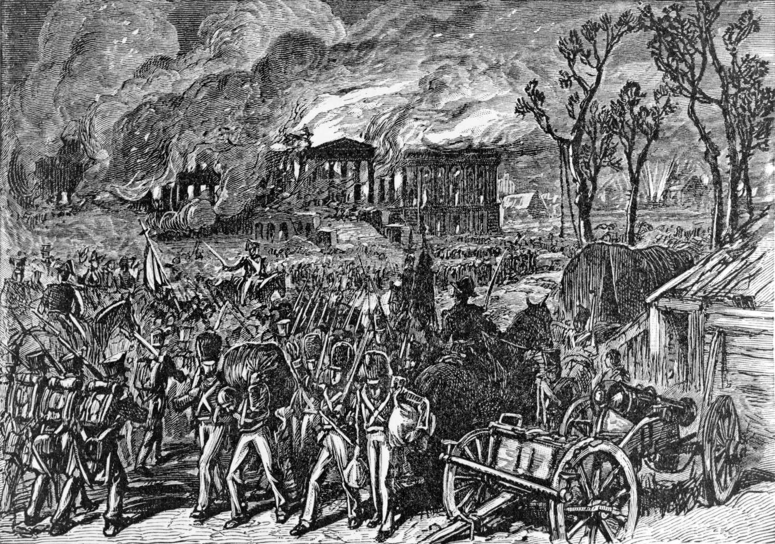
THE FIRST PAPER MONEY ISSUED BY THE U.S.
U.S. DECLARES WAR AGAINST GREAT BRITAIN – WAR OF 1812
June 18, 1812 – February 18, 1815
August 24, 1814 - a British force occupies Washington and sets fire
to the Capitol and White House and many other public buildings

Slide 28
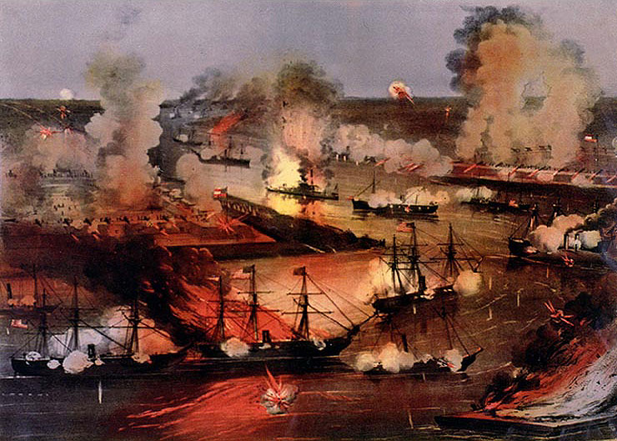
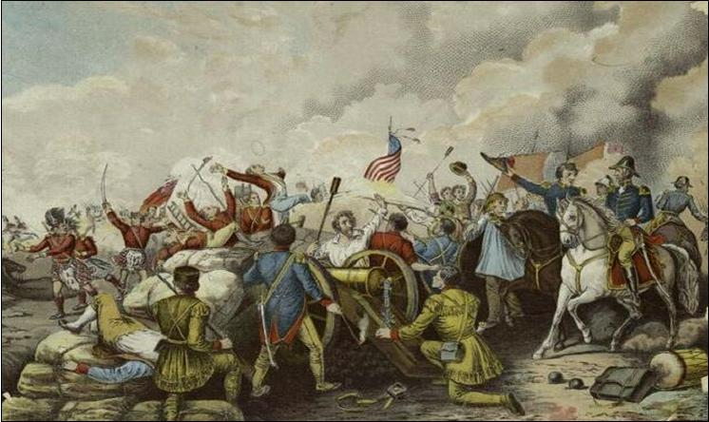
THE FIRST PAPER MONEY ISSUED BY THE U.S.
U.S. DECLARES WAR AGAINST GREAT BRITAIN – WAR OF 1812
June 18, 1812 – February 18, 1815
The Battle of New Orleans was fought on January 8, 1815 and was the final major battle of the War of 1812. Commanded by Major General Andrew Jackson, who became
nationally known.

Slide 29
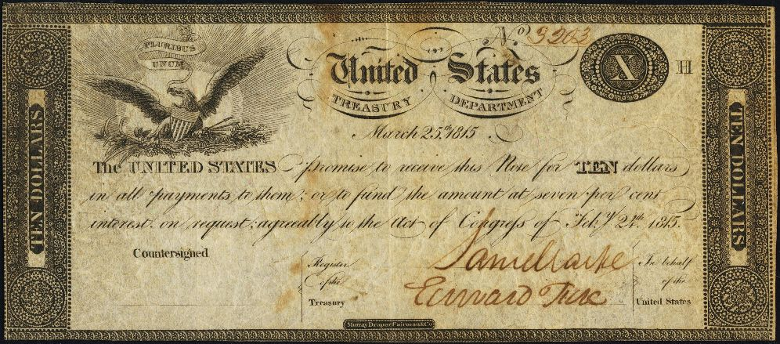
THE FIRST PAPER MONEY ISSUED BY THE U.S.
NO FINANCIAL CALAMITY FOLLOWED LIQUIDATION OF THE BANK -
TREASURY NOTES ISSUED BY FEDERAL GOVERNMENT TO REPLACE MONEY SUPPLY OF BANK
June 30, 1812 $5,000,000 one-year Treasury notes, denominations over $100
                paid 5.4% interest
                payable in metal on demand
                transferable from one party to another by assignment
                redeemed after one year
                spent into circulation to government creditors at full face value
                receivable for taxes and fees (not legal tender)
February, 1813 denominations as low as $20
March, 1814 denominations as low as $20
February, 1815 bearer certificates paying no interest
                no transfer formalities
                no date for repayment
                denominated under $100
                very close to true money
SEE NEXT SLIDE

Slide 30
THE FIRST PAPER MONEY ISSUED BY THE U.S.
“THE UNITED STATES PROMISE TO RECEIVE THIS NOTE FOR TEN DOLLARS IN ALL PAYMENTS TO THEM;
OR TO FUND THE AMOUNT AT 7% INTEREST ON REQUEST; AGREEABLY TO THE ACT OF CONGRESS OF Feb 24, 1815”

Slide 31
THE FIRST PAPER MONEY ISSUED BY THE U.S.
NO FINANCIAL CALAMITY FOLLOWED LIQUIDATION OF THE BANK -
TREASURY NOTES ISSUED BY FEDERAL GOVERNMENT TO REPLACE MONEY SUPPLY OF BANK
“The amount of all such notes authorized was $60.5 million,
of which only $36.7 million were actually issued,
about $3.5 million in small notes.”
“Thus our government didn’t abuse this note issuing process,
and didn’t even issue the full amounts authorized,
but acted responsibly in its first ever creation of money.”
Stephen Zarlenga, LSM, p. 415

Slide 32
THE FIRST PAPER MONEY ISSUED BY THE U.S.
“CLEARLY THE UNITED STATES WAS COMING ‘DANGEROUSLY’ CLOSE (FROM THE BANKERS VIEWPOINT) TO ESTABLISHING ITS OWN CURRENCY. ALL THAT WAS NEEDED WAS TO SEVER THE CONNECTION TO GOLD AND SILVER.” Zarlenga, LSM, p. 415
Representative Hall of Georgia, 1814, introduced the following into Congress:
“That the treasury notes which may be issued – would become legal tender among citizens or between a citizen of the U.S. and a citizen of any foreign country.”
President Madison in his message to Congress, December 5, 1815:
“It is, however, essential … that the benefits of an uniform national currency should be restored to the community… it may become necessary to ascertain the terms upon which the notes of the Government … shall be issued … as a common medium of circulation.”

Slide 33
PART 5
REAL NEED FOR A CENTRAL BANK

Slide 34
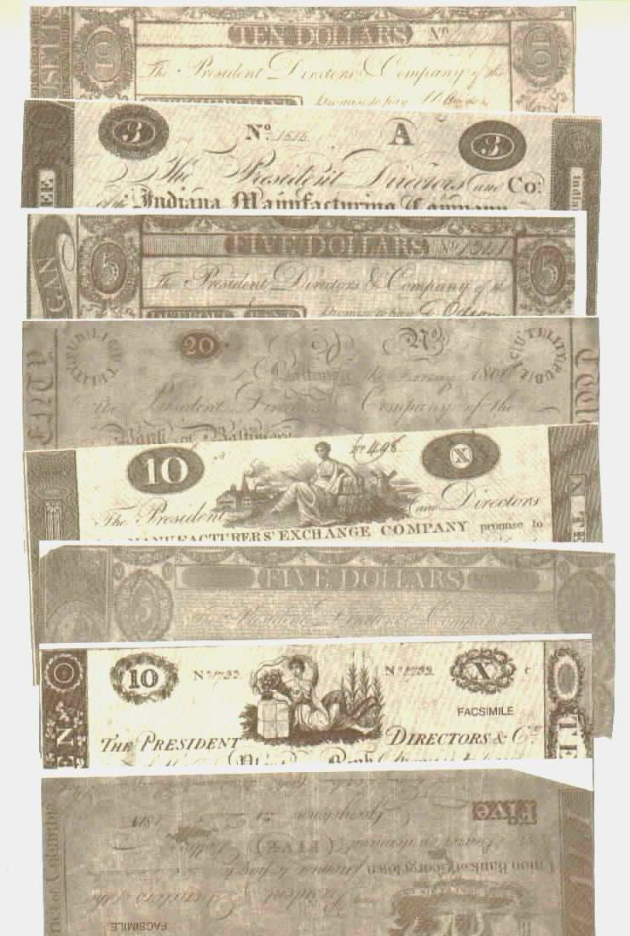
REAL NEED FOR A CENTRAL BANK
1815 -- THE CONDITION OF THE COUNTRY’S CURRENCY
a large proportion of the circulating currency were bank notes of the hundreds of state-chartered private banks
state bank notes were theoretically exchangeable for coin, but coinage was never really there and redemption had been widely suspended
state bank notes maintained value because the government accepted them in payments
STATE BANK NOTES, c. 1812

Slide 35
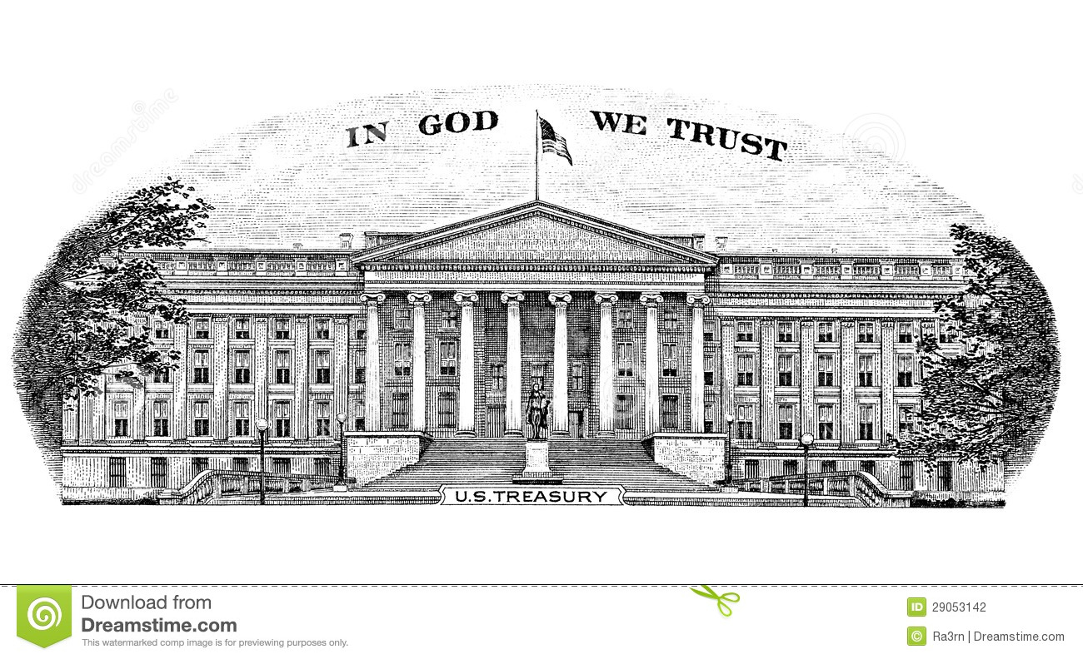
REAL NEED FOR A CENTRAL BANK
1815 -- THE CONDITION OF THE COUNTRY’S CURRENCY
The Treasury of the United States would exchange treasury notes, many of which bore interest, for inconvertible bank notes which bore no interest.
“But little of the money with which the treasury overflowed would pass current thirty miles from the seat of the Banks that had issued it, and paying the discount was a clear loss to Government or the creditors of Government.” Gouge, p. 73
The government had accounts in 94 banks, keeping 4 different accounts in each:
local bank notes
out of state bank notes
treasury notes
treasury notes
So much of the Treasury’s revenue
was useless!
U.S. TREASURY
WASHINGTON, D.C.

Slide 36
REAL NEED FOR A CENTRAL BANK
A CENTRAL BANK OF ISSUE WAS NEEDED

Slide 37
PART 6
MADISON’S DALLAS PLAN BLOCKED

Slide 38

MADISON’S DALLAS PLAN BLOCKED
IN 1814, PRESIDENT MADISON TRIED TO SET UP A CENTRAL BANK OF ISSUE, OWNED 40% BY THE GOVERNMENT -
KNOWN AS DALLAS PLAN, AFTER TREASURY SECRETARY DALLAS
A National Bank
$50,000,000 capital
  $20,000,000 subscribed by government and paid in 6% stock
  $30,000,000 subscribed by individuals:
    $6 million gold and silver coin
    $6 million Treasury notes
    $18 million 6% stock
Bank was bound to lend thirty millions to government
Bank was authorized to suspend specie payment, on advice of President of U.S.
MADISON VETOED THE VERSION THAT WAS PASSED BY CONGRESS

Slide 39
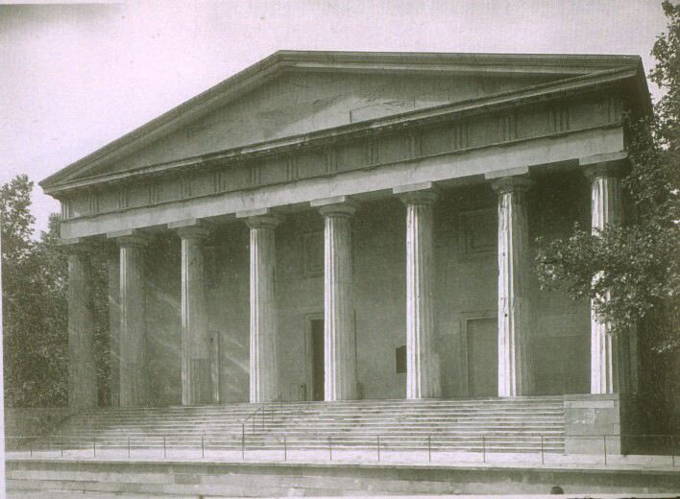
MADISON’S DALLAS PLAN BLOCKED
IN 1814, PRESIDENT MADISON TRIED TO SET UP A CENTRAL BANK OF ISSUE, OWNED 40% BY THE GOVERNMENT -
KNOWN AS DALLAS PLAN, AFTER TREASURY SECRETARY DALLAS
In the chaotic state bank currency atmosphere, aware that a central bank was crucial to the nation,
Madison signed a bill allowing another privately dominated bank – April 10, 1816
The Second Bank of the United States
20-year charter:
(1816 – 1836)

Slide 40
MADISON’S DALLAS PLAN BLOCKED
Charter of Second Bank of the United States
charter for 20 years
capital = $35 million (1/5 government and 4/5 private persons)
25 directors – 5 appointed by President
foreign stockholders could not vote
both notes and deposits of Bank were to be paid in specie
no bank notes issued less than $5
bank’s notes received by U.S. Government
bank forbidden to purchase any public debt
bank to pay government $1.5 million bonus for charter
NOTES ON CURRENCY
no other legal tender money than gold and silver coin
universal conception: a bank should pay its notes in specie on demand, but might properly pay its deposits in notes of other banks, near or remote, provided these banks paid notes in specie
2 kinds of circulating currency:
  specie and local bank notes at par
  bank notes of other cities and states at discount according to difficulty redeeming
The discount on state bank notes was not observed by masses who saw one dollar as good as another; but discount was an expense to merchant who recouped his loss by charging more on his goods.

Slide 41
PART 7
OPPOSITION FROM THE STATE BANKS EVAPORATED

Slide 42
OPPOSITION FROM THE STATE BANKS EVAPORATED
REDEEMABILITY RETURNS
Opposition from state-chartered banks was removed by the Second Bank promising to take over the government’s holdings of their irredeemable notes.
The state banks were given 10 months to re-establish redeemability for their notes.
After “February 20, 1817, all payments to Government were to be made in coin, Treasury notes, notes of the U.S. bank, or bank notes payable on demand in specie.”
Studenski and Kroos, Financial History of the U.S., 1952

Slide 43
PART 8
THE 2ND BANK OF THE U.S. – THE BANK FROM HELL

Slide 44

THE 2ND BANK OF THE U.S. – THE BANK FROM HELL
BANK BEGINS WITH SPECULATION IN ITS OWN STOCK
The second payment of the Bank’s capital was paid by the Bank discounting the notes of its stockholders. The Bank loaned them the money to buy the stock!
The Bank encouraged speculative buying and selling of its own stock in the market by giving loans at full market value to the owners of the stock.
“It was only necessary to apply for a loan upon the security of the shares to be bought, and pay for the stock with the proceeds. When the price of shares rose sufficiently a sale could be made and the difference pocketed.” John Jay Knox, A History of Banking in the United States, 1900, p. 58

Slide 45




THE 2ND BANK OF THE U.S. – THE BANK FROM HELL
BANK CREATED CRIMINALLY INSANE EXPANSION!
… AND THEN CRIMINALLY INSANE CONTRACTION!
EXPANSION
April 1817 Bank begins
July 1817 19 branch offices
$52.0 mill in loans (60% Phily/Baltimore)
9.0 mill in circ currency
2.5 mill in gold/silver reserves
WILD, SPECULATIVE BOOM
CONTRACTION
1819 $12.0 mill in loans (cut 40.0 mill)
3.5 mill in circ currency (cut 5.5 mill)
PANIC OF 1819
bankruptcies
South & West hit hardest
real assets seized as collateral
farmers & artisans moved West
public outrage

Slide 46
Part 9
REGRESSING AMERICAN MONETARY THOUGHT

Slide 47
REGRESSING AMERICAN MONETARY THOUGHT
MONEY POWER CONTROLLED DEBATE:
Not Private versus Public Control of Monetary System
But Inflationary versus ‘Sound’ Money
BANKER’S THEORY: The debate reverted to Adam Smith’s belief in metallism as true money. This was essential to the bankers in their theory BUT NOT THEIR PRACTICE!
The economist Condy Raguet:
  supported Smith’s anti-government position which insisted on private control of the money supply; however, he put forth an honest proposal to establish the individual liability of the officers of the bank. Their personal risk should not be protected by a corporate charter.
  supported the quantity theory of money: “Every emission … of these bank notes and credits is an augmentation of the currency and depreciates it below the general level.”
After 1810, Ricardo’s views on the public control of the nation’s money supply began to be known.
Zarlenga, LSM, p. 421

Slide 48
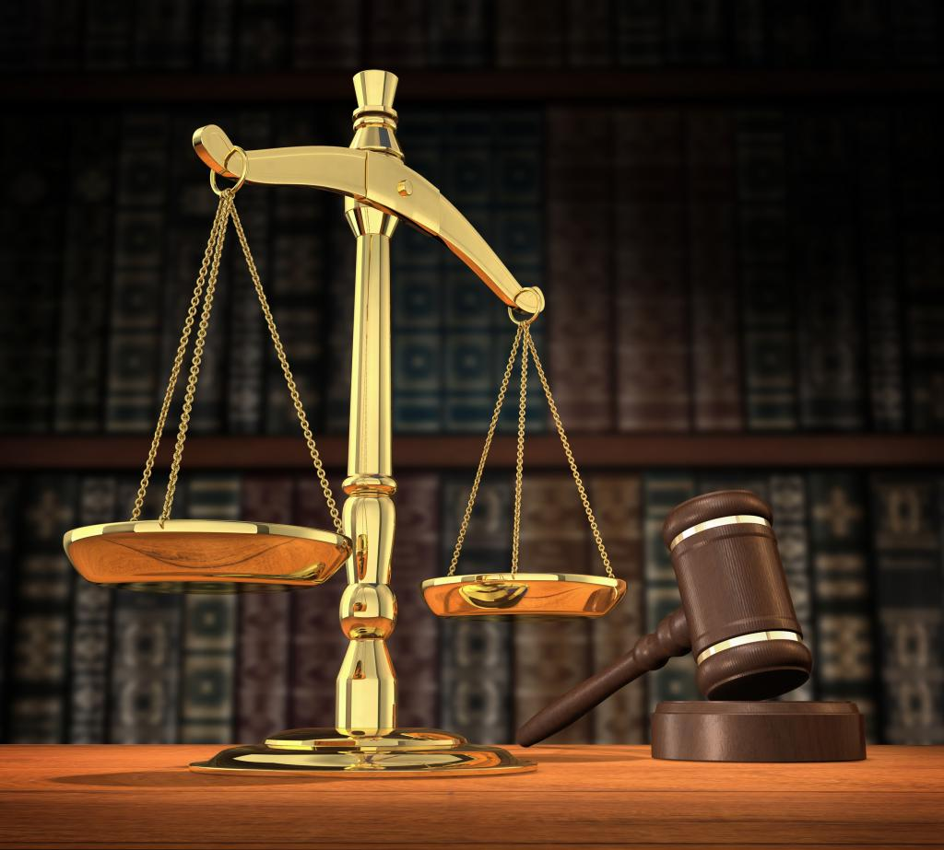
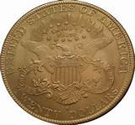
REGRESSING AMERICAN MONETARY THOUGHT
MONEY POWER CONTROLLED DEBATE
BUT ALL FAILED TO DISTINGUISH DIFFERENCE BETWEEN WEALTH AND MONEY:
The abstract monetary awareness achieved by Jefferson
was being lost to easy-to-grasp concretes like gold and silver.

Slide 49
Part 10
PRESIDENT JACKSON WANTS A GOVERNMENT BANK

Slide 50
PRESIDENT JACKSON WANTS A GOVERNMENT BANK
JACKSON WANTED A GOVERNMENT-OWNED BANK OF ISSUE
BUT HIS ADVISORS FAILED TO COME UP WITH PROPOSALS
Marquis James, The Life of Andrew Jackson, 1938, pp. 559-65
“He suggested that if a National bank was deemed necessary that one
might be devised founded upon the credit of the Government and its
revenues, which would avoid the constitutional question.” Knox, p. 63

Slide 51
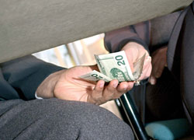
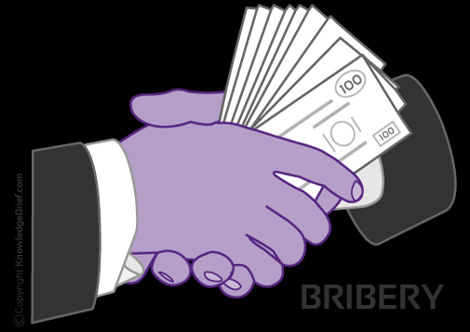
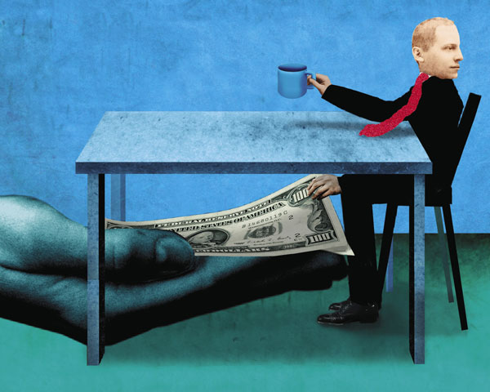
PRESIDENT JACKSON WANTS A GOVERNMENT BANK
JACKSON WAS CONVINCED OF THE DANGER OF PRIVATE OWNERSHIP
Jackson:
  “When I came into this administration … I had a majority of 75. Since then it is now believed (the bank) has bought over by loans, discounts, etc. until … there were 2/3 for re-chartering it.” Ralph Catterall, The 2nd Bank of the U.S., 1902
Senator Benton estimated “advocates of Bank spent $3 million in bribing Senators, members of the House of Representatives and editors of Newspapers.” Peter Cooper, A Paper Currency (pamphlet), 1870
Biddle made huge “loans” to newspaper editors, to stifle opposition:
  “Duff Green (Washington Telegraph) ceased to oppose; while Webb & Noah (New York Courier and Enquirer) became active supporters instead of bitter opponents … a $15,000 loan did it … then another $20,000, then another $15,000.” Catterall, p. 331

Slide 52
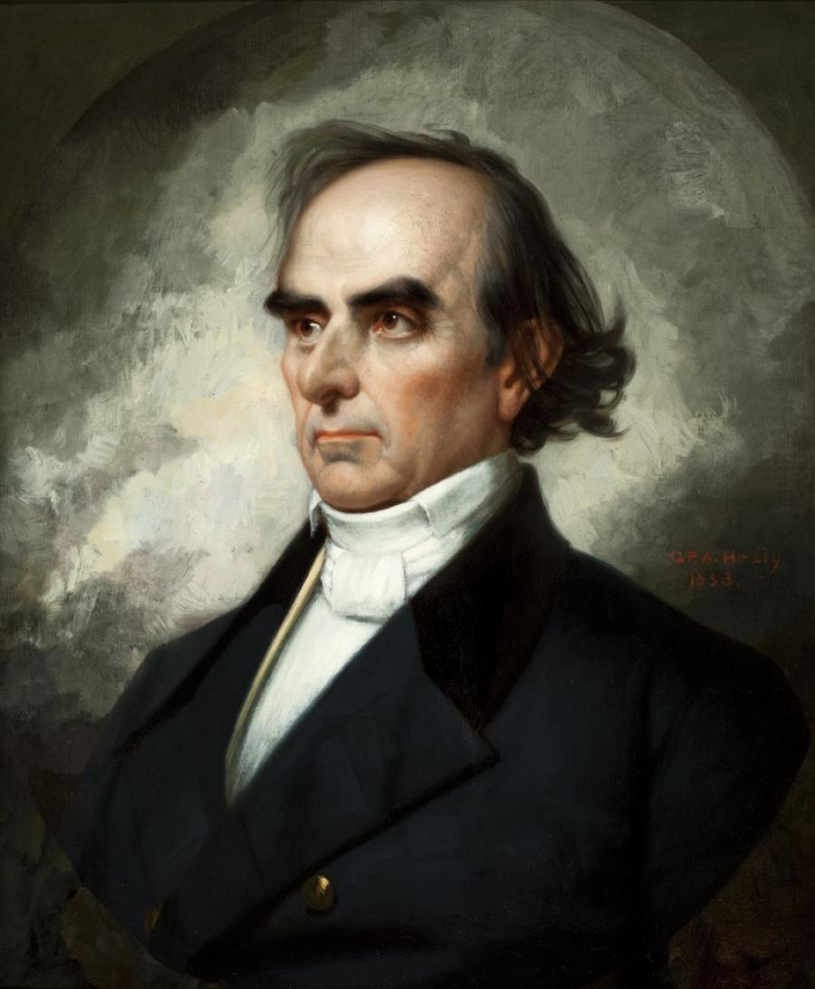
PRESIDENT JACKSON WANTS A GOVERNMENT BANK
EVEN THE “GREAT” DANIEL WEBSTER IS CORRUPTED
Biddle paid Webster $32,000 in “loans,” and then stopped. He received this note:
“I believe my retainer has not been renewed or refreshed as usual. If it be wished that my relation to the bank should be continued it may be well to send the usual retainers, yours with regard, Danl Webster.” Marquis James, The Life of Andrew Jackson, 1938, p 658
DANIEL WEBSTER
(1782 – 1852)
one of the most famous orators
and influential leaders during his
40 years in national politics

Slide 53
Part 11
JACKSON’S WAR WITH THE BANK

Slide 54

JACKSON’S WAR WITH THE BANK
THE BANK IN 1829
The Bank was a powerful institution:
capital
  1/4 of all banking capital in the country
  1/5 of all loans, circulating notes, deposits in the country
25 branches
500 employees, all liberally salaried
1/5 bank stock owned by foreigners
bank notes “as good as gold” everywhere in country and in foreign commercial cities

Slide 55
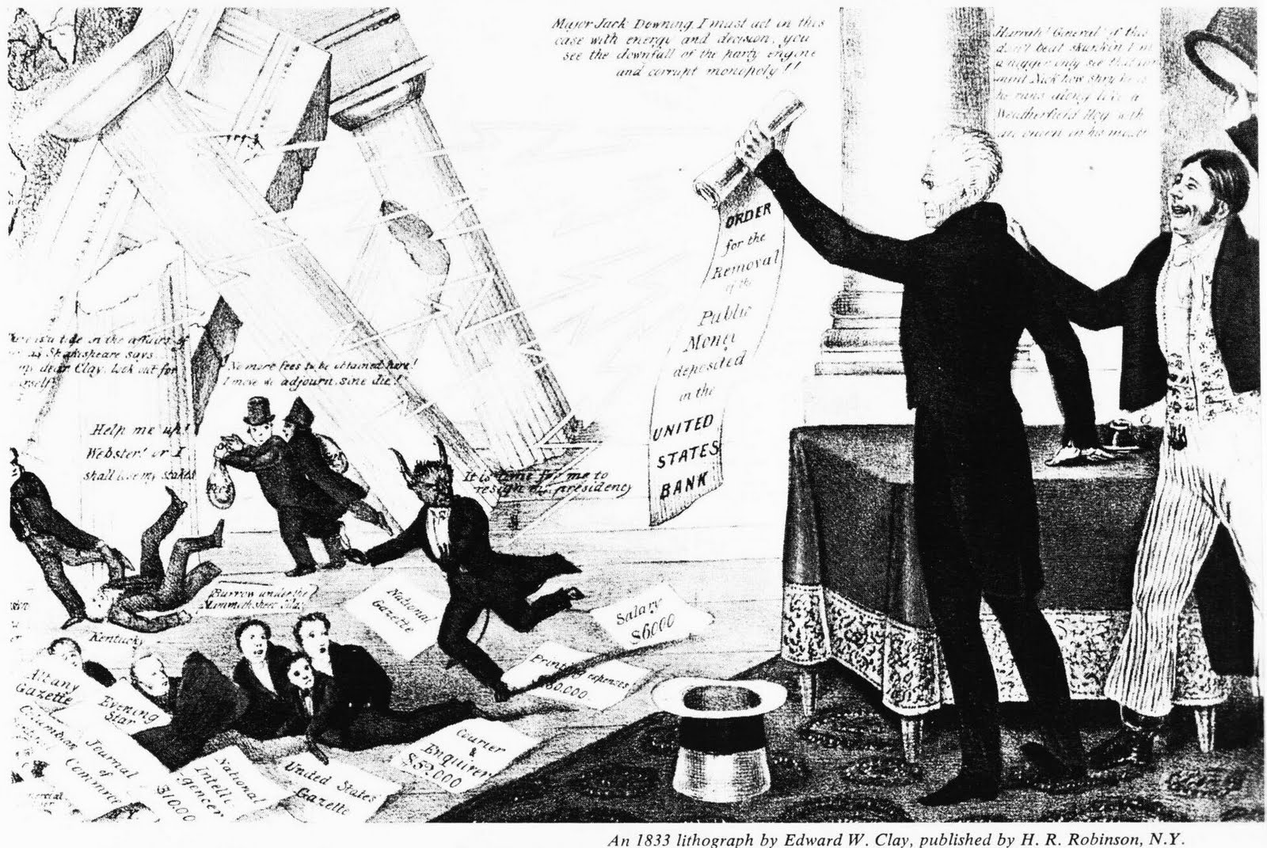
2 EVENTS PRECIPITATED JACKSON’S WAR WITH BANK
JACKSON’S WAR WITH THE BANK

Slide 56
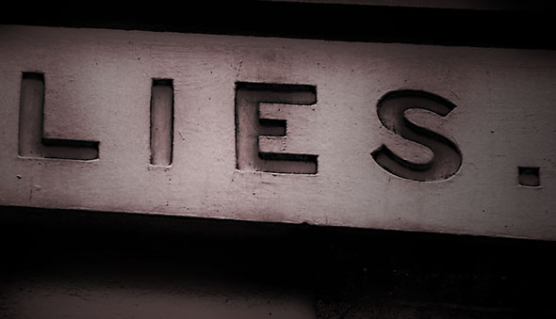
JACKSON’S WAR WITH THE BANK
1832: THE BANK’S ILLEGAL ARRANGEMENT WITH BARING BROTHERS, LONDON
The Bank was instructed by the Treasury to buy back the 3% U.S. Government bonds owned by Baring Brothers in London.
The Bank kept the Government’s money, earning 7% interest on it for themselves, while only having to pay Baring Brothers 3% interest on the bonds.

Slide 57
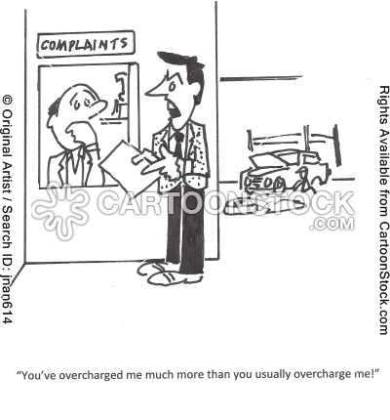
JACKSON’S WAR WITH THE BANK
1832: FRENCH BILL OF EXCHANGE BOUNCES TEMPORARILY –
BANK DEDUCTS 15% DAMAGE FEE FROM GOVERNMENT’S ACCOUNT
A French post-dated check for $961,240 failed to clear and the Bank had to use its own money
The U.S. government already had returned the money to the Bank and offered to pay the actual costs
The Bank refused the government and charged 15% of the check amount – the government had to sue the Bank to get back this excessive charge

Slide 58
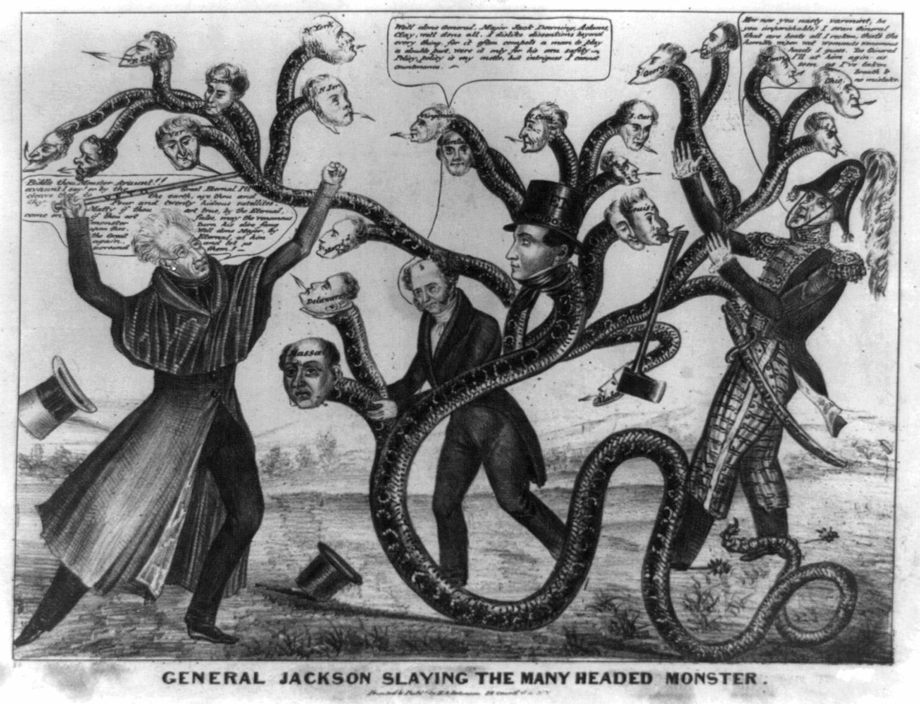
JACKSON’S WAR WITH THE BANK
1832: BANK RE-CHARTER BILL PASSES CONGRESS - JACKSON VETOES IT
Jackson’s veto message aroused popular feeling and he was re-elected for a second term on the issue of re-chartering the Bank.
The veto was based on:
the bank’s monopoly was unfair
of $28 million in bank stock, $8.4 million were owned by foreigners

Slide 59

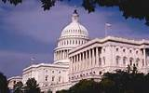
JACKSON’S WAR WITH THE BANK
JACKSON BEGINS TO REMOVE PUBLIC MONIES FROM THE BANK
Jackson requested his Treasury Secretary to slowly remove public funds from the Bank. This was done as they were spent for public expenses. New government revenues were to be deposited in state banks.
Two Treasury Secretaries refused. Both were removed.
Finally, Roger Taney agreed to do so.
“From the first week in December, 1833, to the last day in June, 1834, says Parton, almost the only topic of debate in Congress, in the newspapers and among the people, was the removal of the deposits.” Knox, p. 71

Slide 60
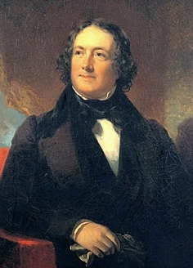
JACKSON’S WAR WITH THE BANK
BIDDLE AND BANK CREATE DEFLATION
From August 1833 to February 1834, Biddle called in $18 million in the Bank’s loans!
“Petitions for the return of the deposits and re-charter poured in” to Jackson. Knox, p. 75
Biddle makes rash statements: “My course is decided … all the other banks and all the merchants may break, but the Bank of the U.S. shall not break!” Catterall, p. 331
In 1836, the Bank was re-chartered in Pennsylvania after its federal
charter expired. Speculation caused the bank to fail
and its shareholders to lose their entire investment.
Biddle died penniless.
NICHOLAS BIDDLE
(1786 – 1844)

Slide 61
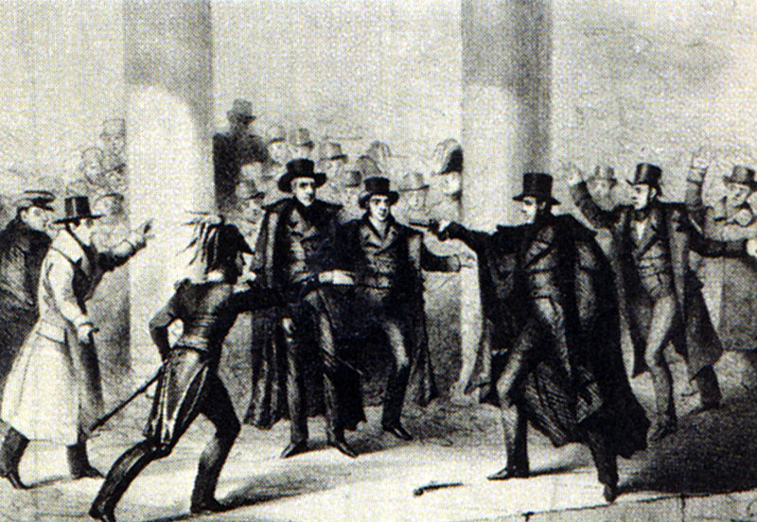
JACKSON’S WAR WITH THE BANK
1835 JACKSON ASSASSINATION ATTEMPTED

Slide 62
Part 12
MARTIN VAN BUREN AT THE HELM

Slide 63
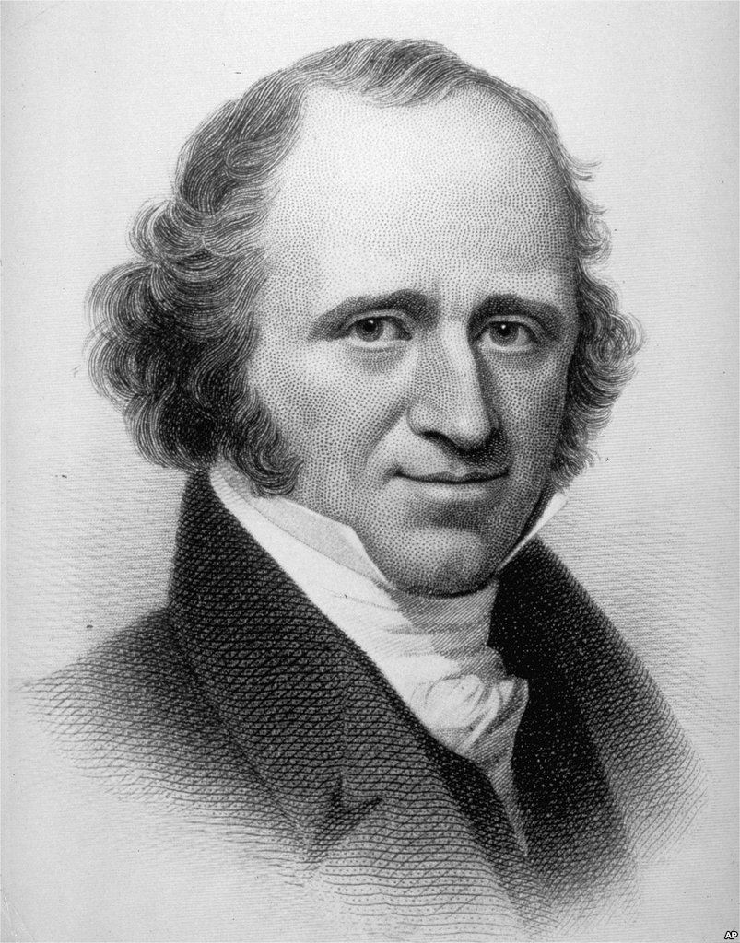
MARTIN VAN BUREN AT THE HELM
VAN BUREN HAD FOUGHT THE BANKER’S POWER,
BUT HE NOR HIS ADVISORS ACHIEVED A FULL CONCEPT OF MONEY
Jackson and Van Buren removed the monetary power from the private bankers … but did not re-establish it in the hands of the nation.
“Operating under the commodity theory of money, Van Buren, who truly cared for the Republic, helped to bring on the worst depression the Nation had ever seen, starting in 1837.” Zarlenga, p. 426
MARTIN VAN BUREN
(1782 – 1862)

Slide 64
MARTIN VAN BUREN AT THE HELM
VAN BUREN IMPLEMENTS GOLD/SILVER STANDARD IN GOVERNMENT PAYMENTS
BAD AS STATE BANK NOTES WERE, THEY STILL FUNCTIONED AS MONEY
The state banks had issued the following circulating notes from 1830 to 1837:
1830 $61 million
1837 $149 million
Beginning December, 1836 – the government moved toward making and receiving all payments in coinage, or truly convertible bank notes, starting with subscriptions for public lands. Once the state bank notes were no longer accepted by the government, their circulation was cut back dramatically. This caused a huge deflation.
The state bank notes, not backed by specie, fluctuated and depreciated:
1837 $149 million
1843 58 million

Slide 65
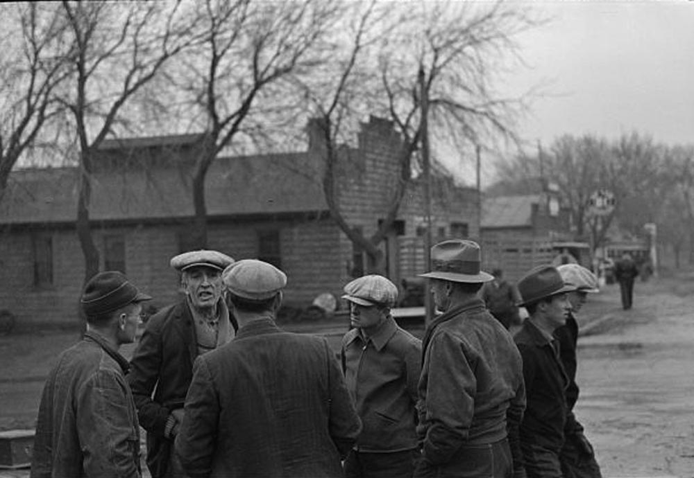
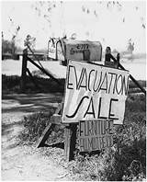
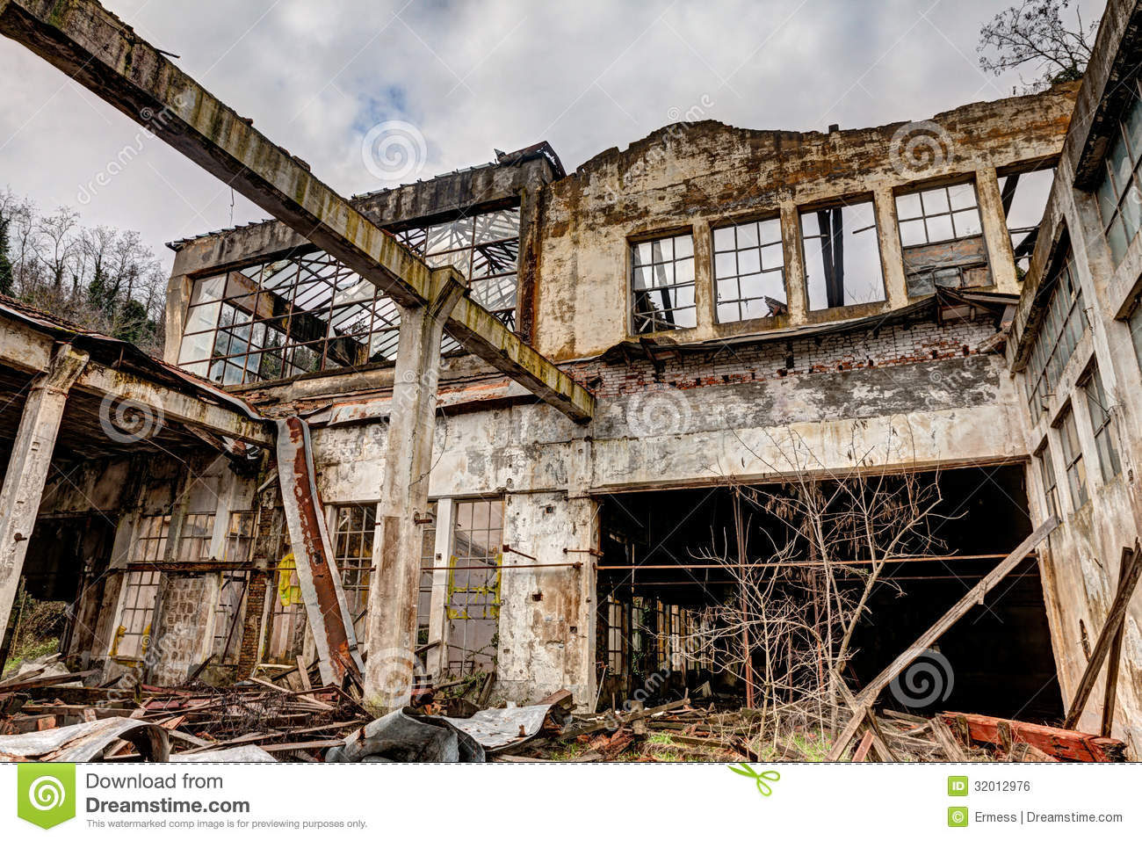
MARTIN VAN BUREN AT THE HELM
THIS GOLD AND SILVER STANDARD FAILED.
FARMERS LOST FARMS.
FACTORIES CLOSED.

Slide 66
MARTIN VAN BUREN AT THE HELM
1837: VAN BUREN ALLEVIATES DEFLATION – ISSUES GOVERNMENT PAPER MONEY
The last time the government had issued its own notes was 22 years ago under Madison.
Congress authorized the issue of $10 million.
  denominated over $50
  paid 0.1% to 5% interest
  transferable only by assignmet
  to be redeemed in a year
They functioned excellently as money. 1837-38: 60% of government revenue collected in them.
Congress authorized their re-issuance every year up to 1843.

Slide 67
MARTIN VAN BUREN AT THE HELM
From 1787 to 1863,
the U.S. Government handled its money power well,
issuing notes in an orderly, responsible manner.

Slide 68
MARTIN VAN BUREN AT THE HELM
1840: VAN BUREN ORGANIZES INDEPENDENT TREASURY SYSTEM:
ORGANIZES 15 SUB-BRANCHES OF TREASURY
TO HOLD/HANDLE GOVERNMENT MONEY

Slide 69
Q & A
WILL DECKER’S CONCLUSION:
THE CONTROL OF MONEY -- WITHOUT CONTROL FROM THE PUBLIC -- LEADS TO
CORRUPTION … USURPATION … SLAVERY.

