Slide 1
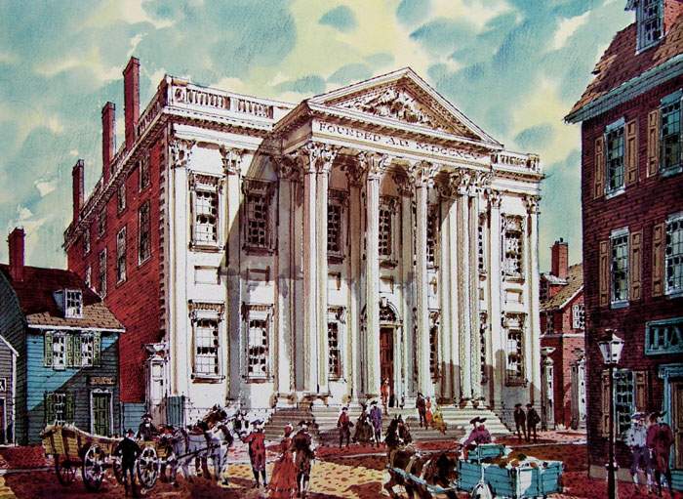
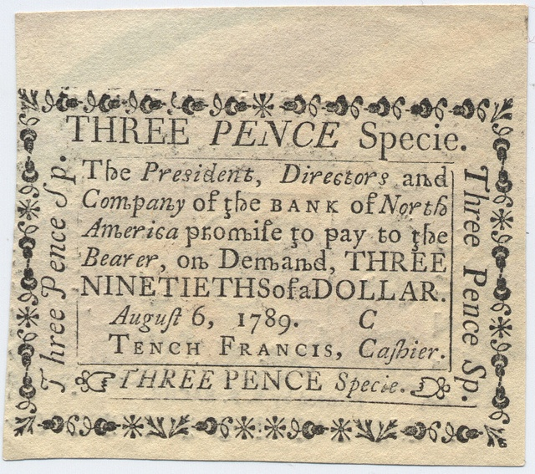
The Lost Science of Money
CHAPTER 15 – PART 1
THE MONEY POWER VS THE U.S. CONSTITUTION
BANK OF NORTH AMERICA:
FIRST PRIVATE U.S. BANK OF ISSUE
FIRST BANK OF THE UNITED STATES:
SECOND PRIVATE U.S. BANK OF ISSUE

Slide 2
THEMES OF LOST SCIENCE OF MONEY BOOK
Primary importance of the money power (power to create money and regulate it)
Nature of money purposely kept secret and confused
How a society defines money determines who controls the society
Battle over control of money has raged for millennia: public vs private
The misuse of the monetary system causes tremendous misery and suffering for the ordinary working people. Will Decker & Martin Dunn, February 2014

Slide 3
PARTS OF PRESENTATION
Bank of North America: Early Moves to Usurp the U.S. Monetary Power
The Constitutional Convention: The Nature of Man & The Nature of Money
Monetary Power Left Undefined:
  Confusion Over the Nature of Money
  Constitutional Convention Downplayed US Experience, Avoided Money Question
  The Abuse of Monetary Theory
  Some Merchants Understood: “To Emit Bills of Credit”
  Limited US Money Powers
  Federalist Papers Ignored Money Debates: Hamilton and the Money Power Attack
1st Bank of the United States
First U.S. Coinage
The Return of Thomas Paine
Jefferson Finally Understands Money

Slide 4
PART 1
Bank of North America:
Early Moves to Usurp the U.S. Monetary Power

Slide 5
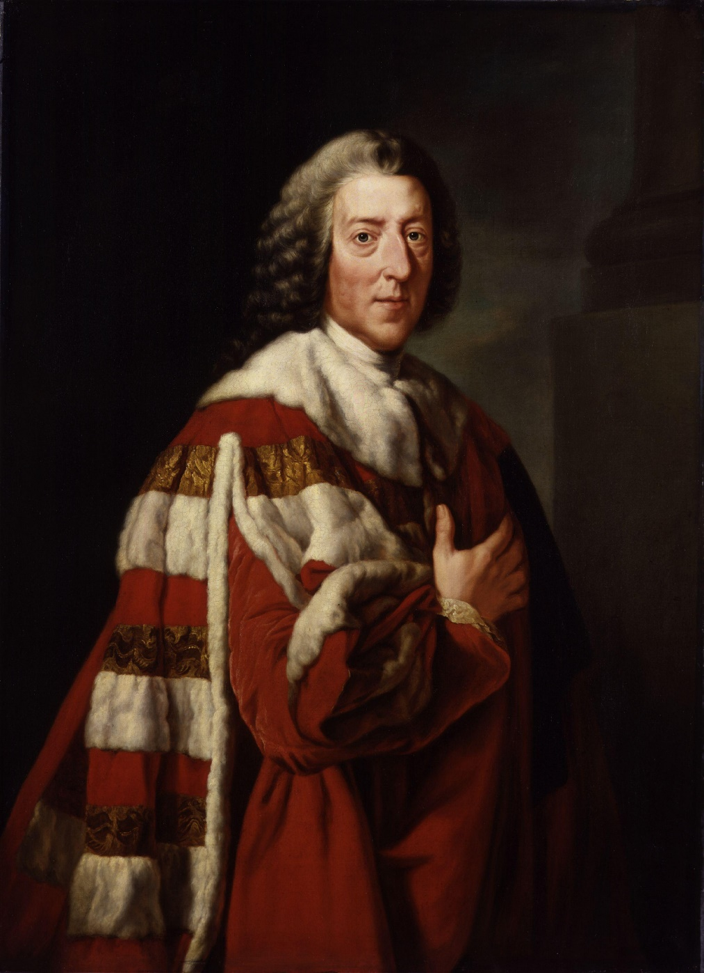
Bank of North America: Early Moves to Usurp the U.S. Monetary Power
WILLIAM PITT, FIRST EARL OF CHATHAM
“Let the Americans adopt their funding
system, and go into their Banking institutions,
and their boasted independence will be
a mere phantom.”

Slide 6
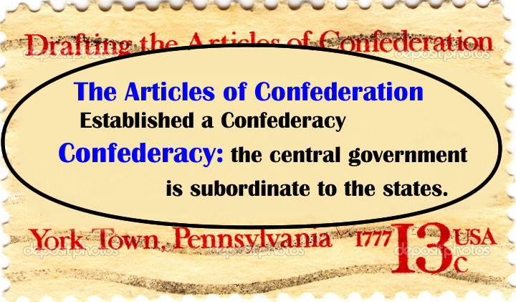
Bank of North America: Early Moves to Usurp the U.S. Monetary Power
The Continental Congress adopted the Articles of Confederation, the first constitution of the United States, on November 15, 1777. Ratification of the Articles of Confederation by all thirteen states was completed on March 1, 1781. This was our constitution until 1789.
“To all to whom these Presents shall come, we the undersigned Delegates of the States affixed to our Names send greeting.
Articles of Confederation and perpetual Union between the states of New Hampshire, Massachusetts-bay Rhode Island and Providence Plantations, Connecticut, New York, New Jersey, Pennsylvania, Delaware, Maryland, Virginia, North Carolina, South Carolina and Georgia.
  I.
  The Stile of this Confederacy shall be
  "The United States of America".

Slide 7
Bank of North America: Early Moves to Usurp the U.S. Monetary Power
THE MONEY POWER was in ARTICLE 9 of the ARTICLES OF CONFEDERATION
“The United States in Congress assembled shall have authority …
to borrow money, or emit bills on the credit of the United States, transmitting every half-year to the respective States an account of the sums of money so borrowed or emitted”
                Article 9
HOW WAS THE CONGRESS TO PAY THE DEBTS OF THE CONFEDERATION?
ARTICLE 12, ARTICLES OF CONFEDERATION
“Article XII. All bills of credit emitted, monies borrowed, and debts contracted by, or under the authority of congress, before the assembling of the united States, in pursuance of the present confederation, shall be deemed and considered as a charge against the United States, for payment and satisfaction whereof the said united States, and the public faith are hereby solemnly pledged.”
The War of Independence saddled the country with an enormous debt. In 1784, the total Confederation debt was nearly $40 million:
  $ 8.0 million -- owed to French and Dutch
  $11.5 million - government bonds, known as loan-office certificates
  $ 3.1 million - certificates on interest indebtedness
  $16.7 million - continental certificates -- non-interest bearing notes issued for supplies purchased or impressed, and to pay soldiers and officers

Slide 8
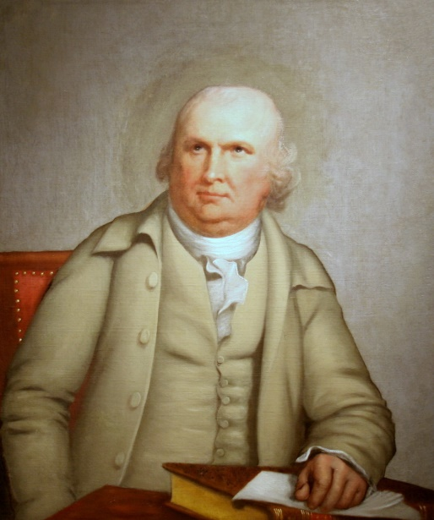
Bank of North America: Early Moves to Usurp the U.S. Monetary Power
Robert Morris (of the firm of Willing and Morris) became the richest merchant in America –
from revolutionary war profits.
ROBERT MORRIS
(1734-1806)
Robert Morris:
signed Declaration of Independence, Articles of Confederation, US Constitution
elected to Penn Assembly and chosen a delegate to the Second Continental Congress
1781-1784, served as Superintendent of Finance for Congress
bankrupt in 1798, spending several months in debtors’ prison
Did Robert Morris finance the Revolution or did the Revolution finance Robert Morris?
As a member of the Continental Congress, Morris voted against independence in July 1776. He was a pragmatic businessman, and did not want to disrupt his many English trading relationships. But changes in the political winds resulted in his signature on the Declaration of Independence the following month.
From 1775 to 1777, nearly $500,000 in contracts went to Willing and Morris . Another $290,000 in contracts went to other Morris partnerships.
Robert Morris's ethics are summed up by this message to his partner, Silas Deane; "It seems to me the opportunities of improving our Fortunes ought not to be lost, especially as the very means of doing it will contribute to the service of our country at the same time."

Slide 9
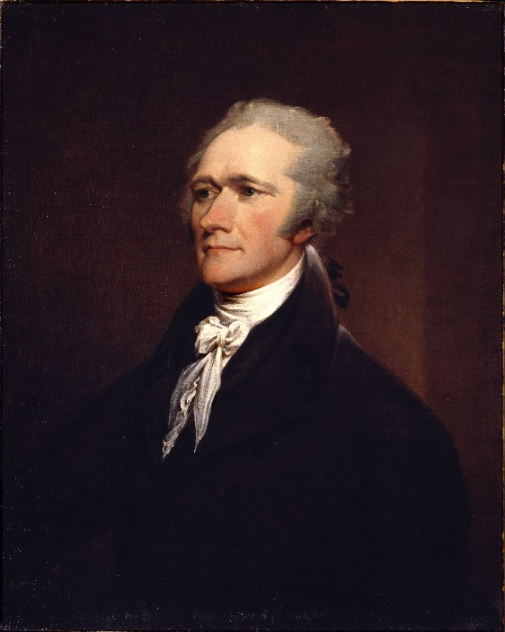
Bank of North America: Early Moves to Usurp the U.S. Monetary Power
The Pennsylvania Bank 1780-1784 was not a bank of issue
Alexander Hamilton: “It does not seem to be at all conducted on the true principles of a bank … must turn out to be a mere subscription of a particular sum of money for a particular purpose.” p. 45, Bray Hammond, Banks and Politics in America from the Revolution to the Civil War
Robert Morris: “… in fact nothing more than a patriotic subscription of continental money … for the purpose of purchasing provisions for a starving army.” p. 45, Bray Hammond, Banks and Politics in America from the Revolution to the Civil War
But a Bank of Issue Was Planned
Feb., 1781 Congress made Robert Morris its Superintendent of Finance, or Financier
April, 1781 Hamilton writes to Morris: “… a public bank which would supply the defect of monied capital and answer
all the purposes of cash … a corporation whose principal powers were to lend, to issue notes and accept
deposits, and to act as fiscal agency of the government.” p. 48, Bray Hammond, Banks and Politics
in America from the Revolution to the Civil War

Slide 10

Bank of North America: Early Moves to Usurp the U.S. Monetary Power
ROBERT MORRIS WANTED A CENTRAL BANK BASED ON THE BANK OF ENGLAND MODEL
Three days after he become Superintendent of Finance, Morris submitted a plan to establish a central bank. He proposed a bank of issue which could create money.
May, 1781: Congress passed the proposal by one vote, with Madison vehemently against it.
Dec., 1781: Congress passed an act of incorporation - a perpetual charter and the right to hold property to the amount of 10 million Spanish milled dollars.
Jan., 1782: The Bank started operations. Morris wrote to the 13 states “to pass such laws as they may judge necessary.” The existence of the new institution was recognized by Connecticut, Rhode Island, New York and Massachusetts.
Its notes were not legal tender but were accepted for state taxes and duties, the same formula used by the Bank of England in 1694.

Slide 11
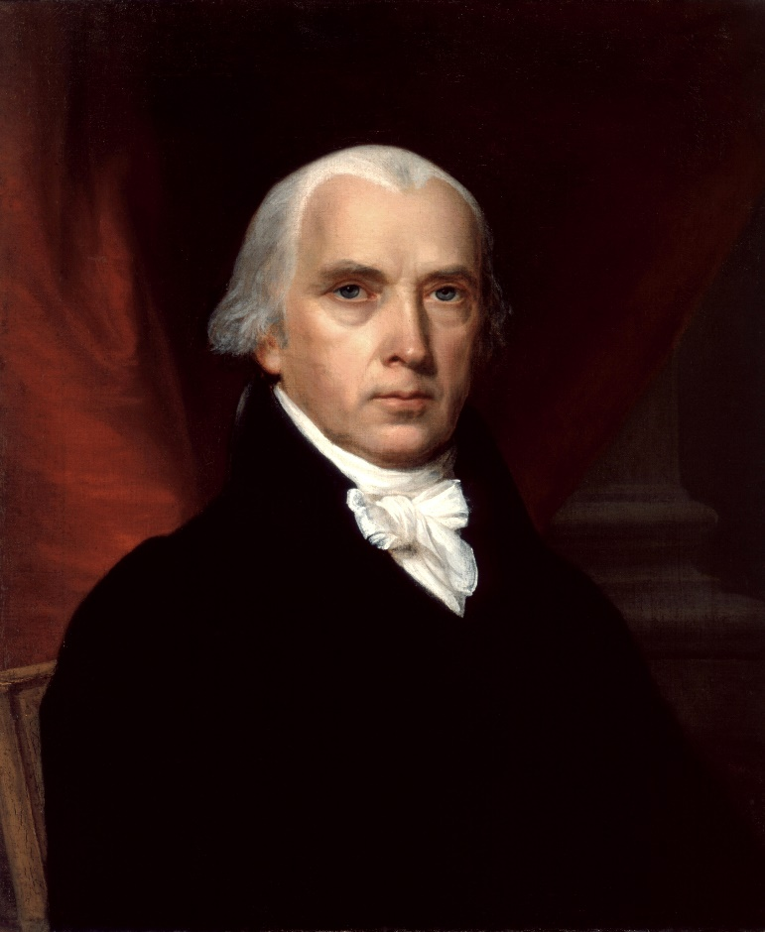
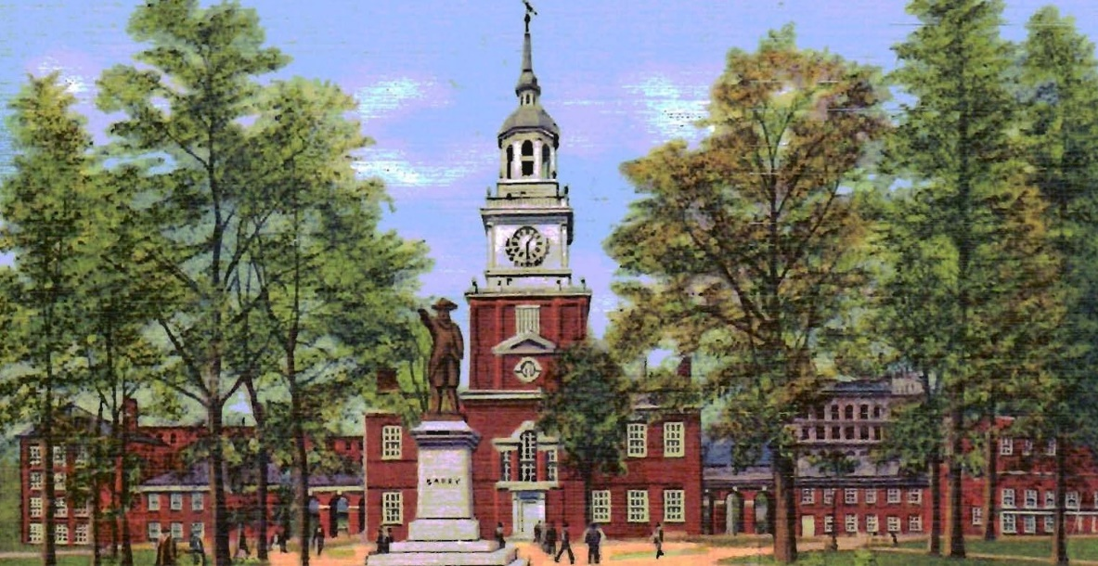
Bank of North America: Early Moves to Usurp the U.S. Monetary Power
But the Bank sought a charter from the Pennsylvania Assembly,
since several Congressional members, particularly James Madison, did not agree
that the Congress had the power to “create bodies politic or grant letters of incorporation”
April 1, 1782 – an identical charter to Congress was accepted by the Bank from Pennsylvania,
as the authority under which its operations were to be conducted.
PHILADELPHIA HALL, PENN
JAMES MADISON
(1751 – 1836)

Slide 12
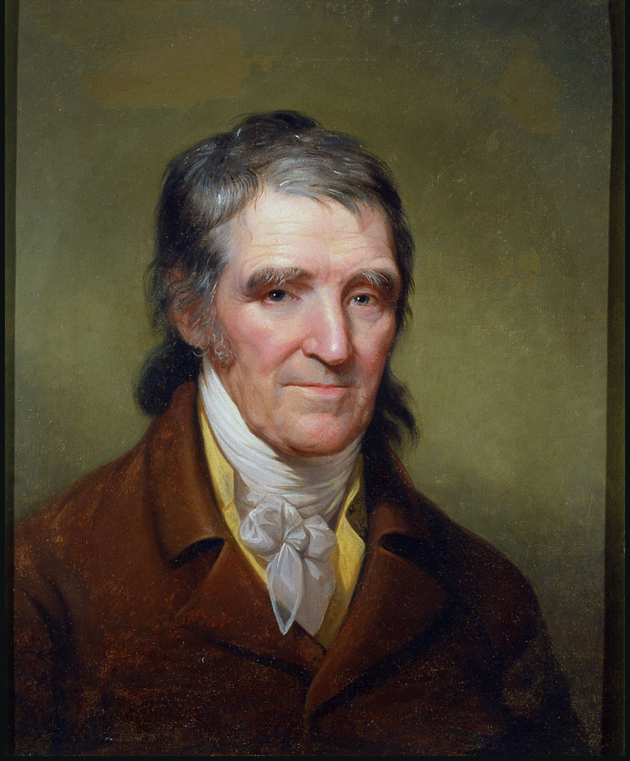
Bank of North America: Early Moves to Usurp the U.S. Monetary Power
March 1785 – the Pennsylvania Assembly was petitioned for an appeal of the Bank’s Charter
September 1785 – Bank of North America charter repealed
CHARGES: usury, favoritism, interference with state’s prerogative of monetary issue, refusal to lend to farmers on long term, discrimination ….
William Findley - Penn Assembly,
& one of the opponent of Bank
WHAT THE OPPONENTS OF BANKS SAID:
“… the bank was a monstrosity, an artificial creature endowed with powers
not possessed by human beings and incompatible with the principles of a democratic
social order”
“… the accumulation of enormous wealth in the hands of a society who claim perpetual
duration will necessarily produce a degree of influence and power which can not be
entrusted in the hands of any set of men whatsoever without endangering the
public safety”
p. 54, Bray Hammond, Banks and Politics in America from the Revolution to the Civil War

Slide 13
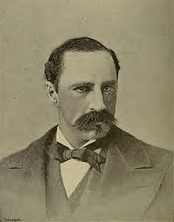
Bank of North America: Early Moves to Usurp the U.S. Monetary Power
Morris sold the Bank’s government stock – and the bank became a private business only
The Bank was ultimately merged into modern-day Wells Fargo
“On October 19th, 1781, Lord Cornwallis surrendered his forces to the American army before Yorktown, Va., and this event virtually ended the war … On May 26th, 1781, a bill was passed in Congress to incorporate the Bank of North America with privilege to issue notes … on January 7th, 1782, the Bank commenced operations.
Never was a great historical event followed by a more feeble sequel. A nation arises to claim for itself liberty and sovereignty. It gains both of these ends by an immense sacrifice of blood and treasure. Then, when victory is gained and secured, it hands the national credit – that is to say, a national treasure – over to private individuals, to do as they please with it.” p 109, Alexander Del Mar, The History of Money in America
ALEXANDER DEL MAR
(1836 – 1926)

Slide 14

Bank of North America: Early Moves to Usurp the U.S. Monetary Power
“The Colonists had practically an entire continent to themselves. They had only to take care that the seed they planted was genuine and uncontaminated. Nature was certain to do the rest.
Well, they planted; and now look at the fruit and see what it is that they planted!
  They planted financial corporations, a rotten seed …
  they planted private money … germs of social decay …
  they planted financial exemptions from public burdens … a tree so mighty that it casts a threatening shadow over the land …
In a word they planted another revolution.”

Slide 15
PART 2
The Constitutional Convention:
The Nature of Man & The Nature of Money

Slide 16
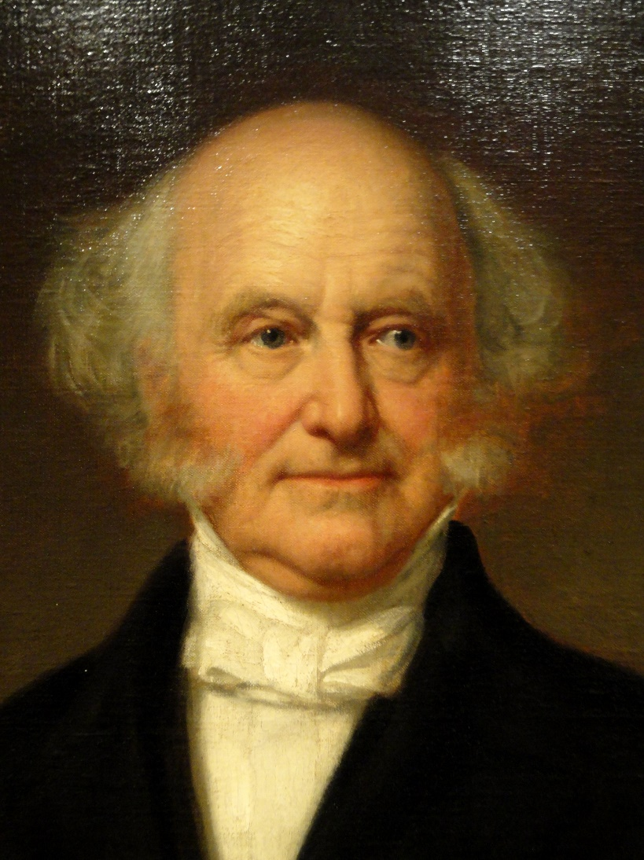
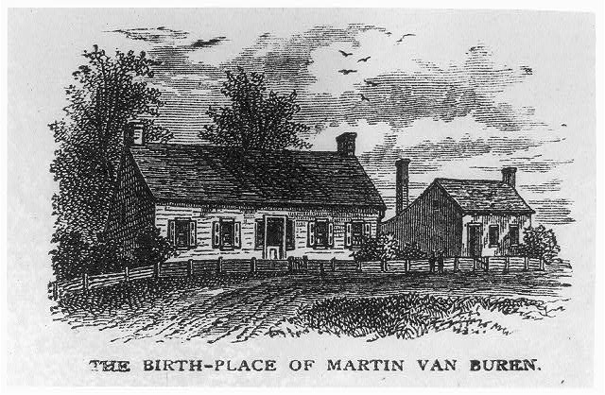
The Constitutional Convention: The Nature of Man & The Nature of Money
Martin Van Buren, 8th President of the U.S., played a big role in the formative years of our nation. He waged a conscious war against THE MONEY POWER. This battle is described in his book, Inquiry into the Origin and Course of Political Parties in the United States.
KINDERHOOK N.Y.

Slide 17
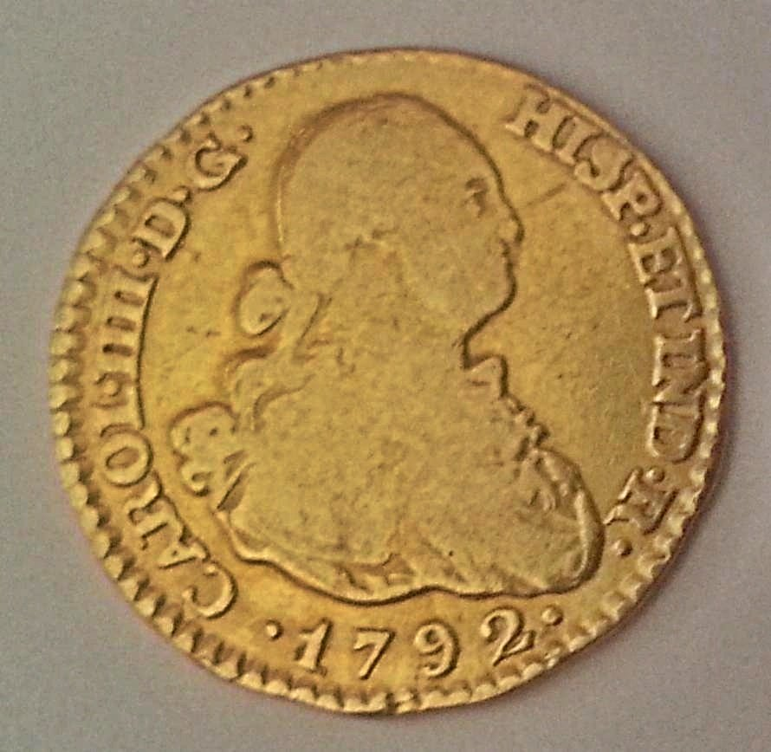
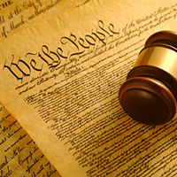
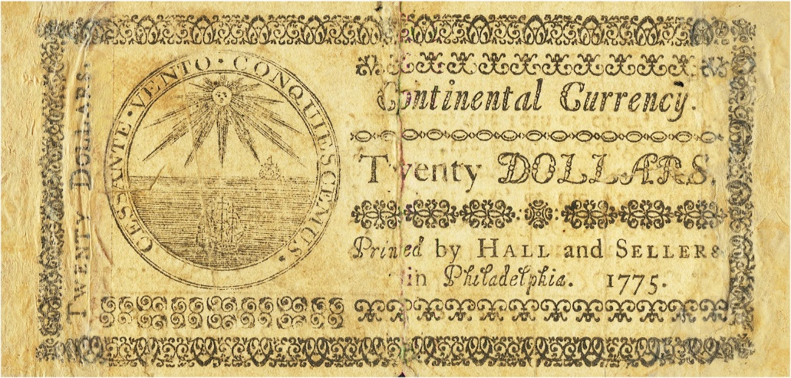
The Constitutional Convention: The Nature of Man & The Nature of Money
The battles in the Constitutional Convention could be divided into two themes:
    The Nature of Man -- are men capable of self government?
    The Nature of Money -- is money a concrete power like gold or an
    abstract social invention, an institution of law?
SELF GOVERNMENT?
COMMODITY OR FIAT OF LAW?

Slide 18
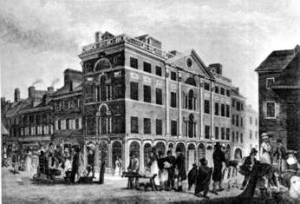
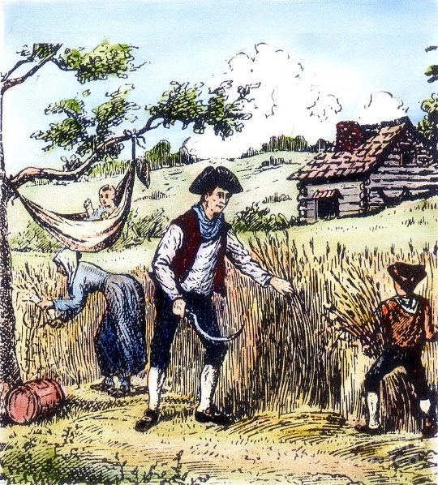
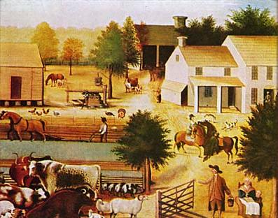
The Constitutional Convention: The Nature of Man & The Nature of Money
POLITICAL PARTIES AROSE FROM THE VERY BEGINNING OF THE NATION –
IN RESPONSE TO THE FEDERALISM OF THE ARTICLES OF CONFEDERATION
“It became at once evident that great differences of opinion existed … as to the character of the government that should be substituted for that which had been overthrown.” Martin Van Buren, Inquiry into the Origin and Course of Political Parties in the United States.
Alexander Hamilton led the party bent upon the
overthrown of the Articles. This party all agreed
that a “strong government” was needed, composed
of executive, legislative, and judicial departments.
The great body of people felt “veneration and affection for their local governments as safeguards of their liberties and adequate to most of their wants, endeared to them as their refuge from the persecutions of arbitrary power … distrust … of … an overshadowing general government.” Van Buren, p. 35
WEALTHY MERCHANTS
LANDOWNING FARMERS

Slide 19
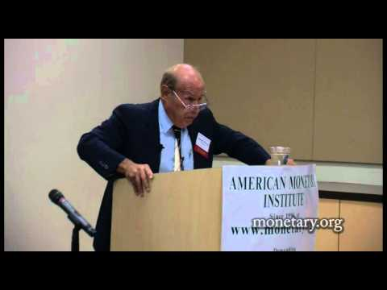
The Constitutional Convention: The Nature of Man & The Nature of Money
THE NATURE OF MAN – AUTHORITARIANISM OR SELF-GOVERNMENT
“By 1787, in a famous calculation by Thomas Jefferson, the new states had had eleven times thirteen, or nearly 150 years of experience in republican government. On the whole Jefferson thought the experiments remarkably successful, proving that the people were capable of governing themselves.” p. 3, Ralph Ketcham, The Anti-Federalist Papers
“Many leaders, however, including at times John Adams and Alexander Hamilton, continued to think (constitutional monarchy) theoretically the form most likely to insure freedom and good government.” p. 6, Ralph Ketcham
“The battle … does mankind need to be ruled by authority or are men capable of self government? The outcome of the fight … could influence the way humanity would develop.
For if authoritarianism were applied, distrusting men to make the correct choices, many might then act that way, damaging their spirits. If on the other hand self government was expected, many men could rise to it and set an example for the world.” p. 393, LSM

Slide 20
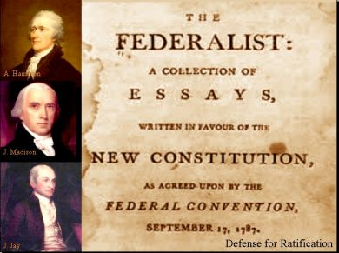
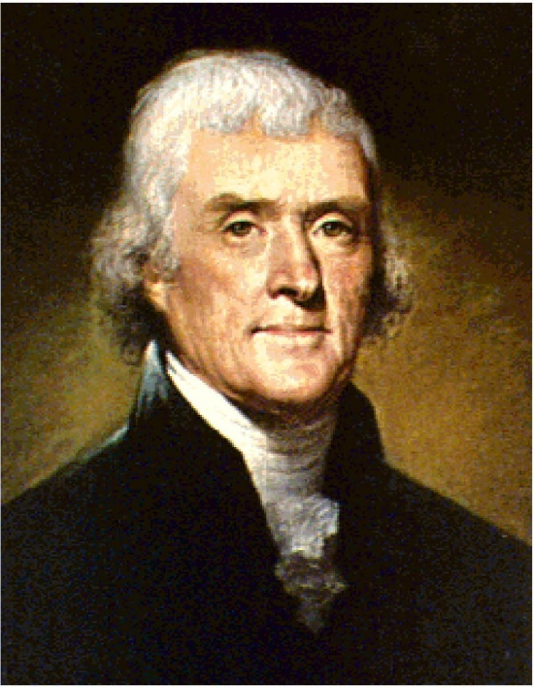
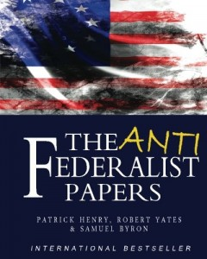
The Constitutional Convention: The Nature of Man & The Nature of Money
THE MERCHANT PARTY ASSUMED THE NAME OF ‘FEDERALIST’
AND GAVE TO ITS OPPONENTS THE NAME OF ‘ANTI-FEDERALIST’
“…the facility with which one party has, through its superior address or its greater activity, succeeded in attaching to its adversary an unsuitable and unwelcome name …
The motive which operated in thus denying to men whose principles were federal the name which indicated them, and in giving it to their opponents, must be looked for in the fact that federal principles were at that time favored by the mass of the people.” Van Buren, pp. 36-37
THOMAS JEFFERSON
(1743 – 1826)
HAMILTON, MADISON, JAY

Slide 21
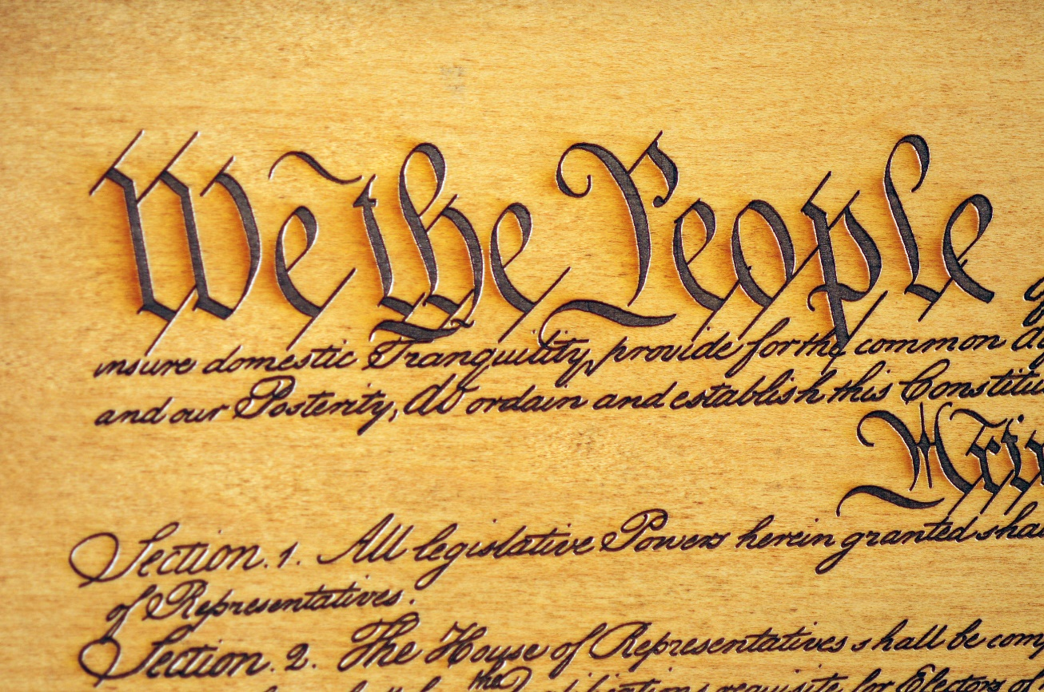
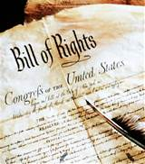
The Constitutional Convention: The Nature of Man & The Nature of Money
THE COMPROMISE OF THE CONSTITUTION:
A STRONG CENTRAL GOVERNMENT, WITH CHECKS AND BALANCES AND A BILL OF RIGHTS,
WHICH APPEARED TO BLOCK AUTHORITARIAN RULE.
BUT DID IT?

Slide 22

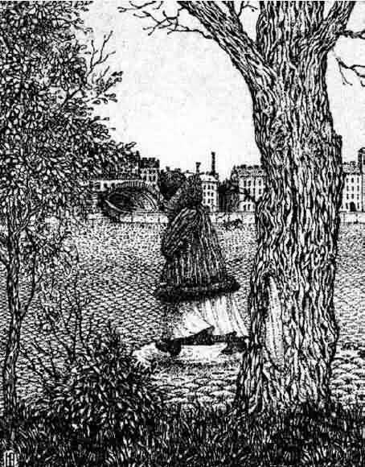
The Constitutional Convention: The Nature of Man & The Nature of Money
THE MONEY POWER WAS IGNORED IN THE US CONSTITUTION
“The Constitution left open a back door through which a form of authoritarian rule could enter, a form more dangerous than monarchy because it was less visible and not understood; and more threatening still because its center of power was outside the nation, to the east … the money power…” Stephen Zarlenga, LSM, p. 394
HIDDEN

Slide 23
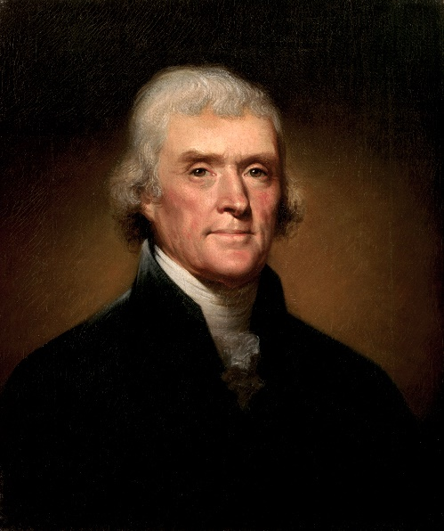

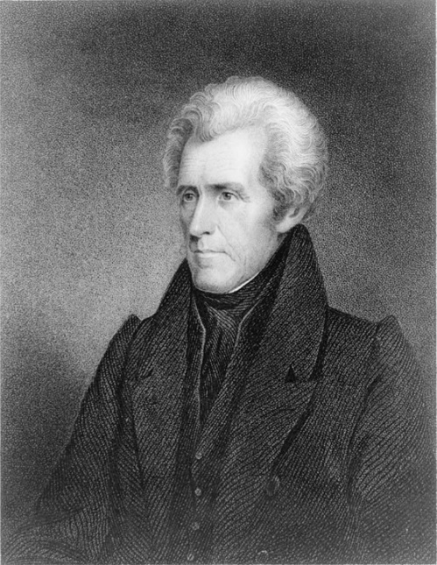
The Constitutional Convention: The Nature of Man & The Nature of Money
“The MONEY POWER” (Van Buren always capitalized it) “… when firmly established, was destined to become the only kind of an Aristocracy that could exist in our political system.” Martin Van Buren
It would take Jefferson almost twenty years to understand what had been ignored in the
Constitution and he would spend the rest of his life doing battle against the MONEY POWER.
Jackson’s Presidency became literally a life
and death struggle with the bankers.
Van Buren thought he finally finished
them off in 1840, but he was overly
optimistic.

Slide 24
The Constitutional Convention: The Nature of Man & The Nature of Money
Why did the framers of a document so far advanced in its day regarding the balance between legislative, judicial, and executive power, not realize that the monetary power, if left unchecked, could endanger and ultimately overwhelm the whole structure
? ? ? ? ?

Slide 25
PART 3-a
Monetary Power Left Undefined:
Confusion Over the Nature of Money

Slide 26
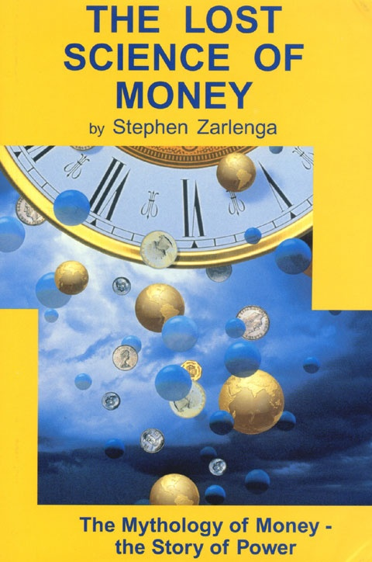
Monetary Power Left Undefined: Confusion Over the Nature of Money
THE MAIN EXPLANATION: AS A GROUP, THE FOUNDING FATHERS DID
NOT HAVE A GOOD UNDERSTANDING OF THE NATURE OF MONEY
IS MONEY A COMMODITY LIKE GOLD
WITH INTRINSIC VALUE? … THEN IT IS
A CREATURE OF MERCHANTS AND
BANKERS, AND NOT GOVERNMENTS
IS MONEY AN ABSTRACT SOCIAL INVENTION –
AN INSTITUTION OF LAW?
If Money is a legal institution, AS LSM HAS BEEN DEMONSTRATING, then it is a creature of government, and the Constitution had better deal with it – how a uniform currency is to be provided, controlled, and kept reasonably stable, in a just manner.

Slide 27
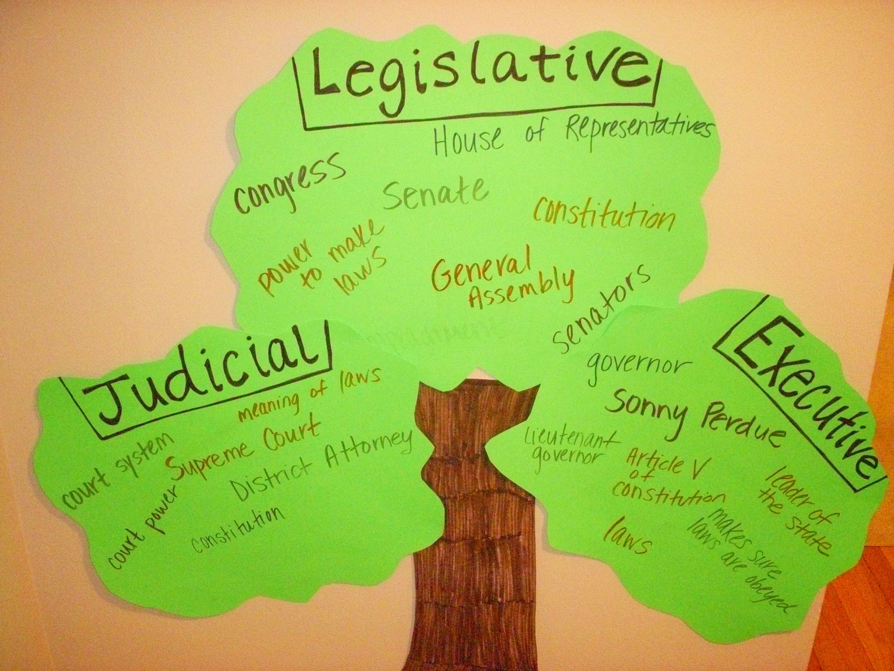

Monetary Power Left Undefined: Confusion Over the Nature of Money
The nature of human affairs requires government to have four branches, not three:
the fourth branch to embody and administer the monetary power.
MONETARY

Slide 28
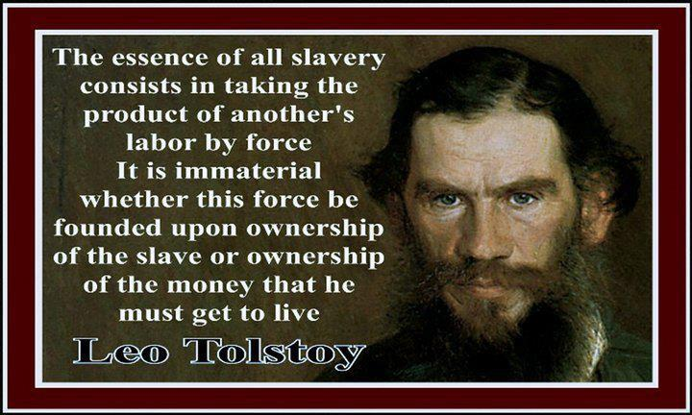

Monetary Power Left Undefined: Confusion Over the Nature of Money
THE STAKES ARE ENORMOUS !
JUSTICE
VERSUS
ECONOMIC SLAVERY

Slide 29
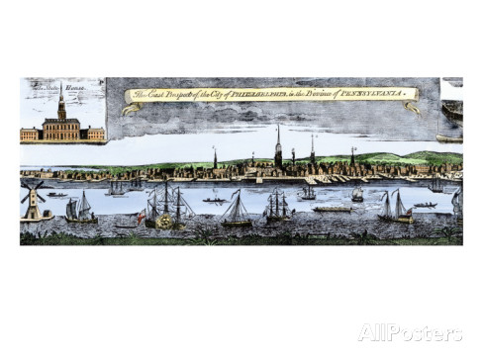
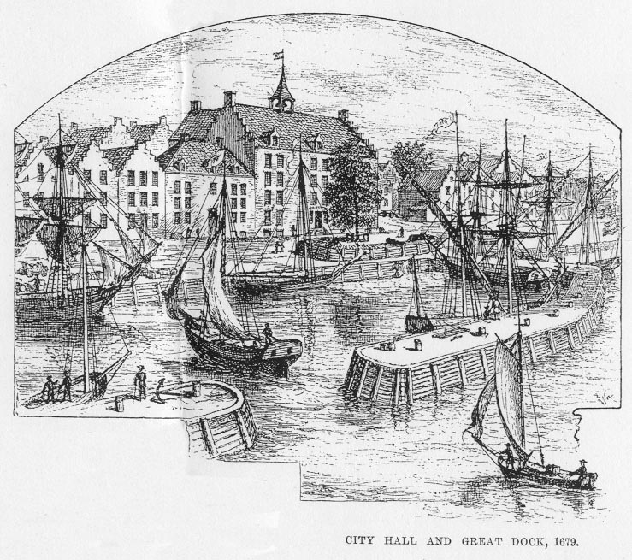
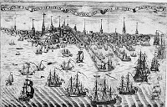
Monetary Power Left Undefined: Confusion Over the Nature of Money
KNOWLEDGE OF THE NATURE OF MONEY IS GAINED BY LOOKING AT HISTORY – EXPERIENCE
– WITH A TRUTHFUL INTERPRETATION.
THE OTHER APPROACH IS LOGICAL OR THEORETICAL, WHICH CAN BECOME DIVORCED FROM REALITY.
The Colonists discovered that abstract paper money – PUBLIC FIAT MONEY – builds real infrastructure and wealth; that money works as a medium of exchange and need not be an object of value in itself.
COLONIAL PHILADELPHIA
NEW YORK
BOSTON

Slide 30
PART 3-b
Monetary Power Left Undefined:
The Constitutional Convention Downplayed U.S. Experience,
Avoided Money Question

Slide 31
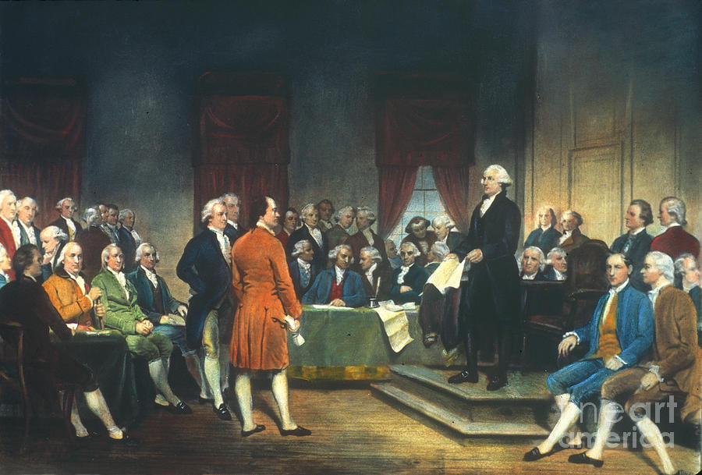

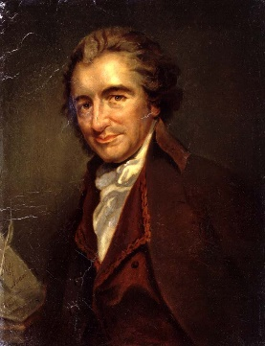
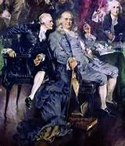
Monetary Power Left Undefined: The Constitutional Convention Downplayed U.S. Experience, Avoided Money Question
The Convention met from May to September, 1787.
There was almost no discussion of coinage or money powers until August 16th.
JEFFERSON & PAINE NOT THERE
Franklin was 81 and had all
his speeches read by fellow
Pennsylvania delegate
James Wilson

Slide 32
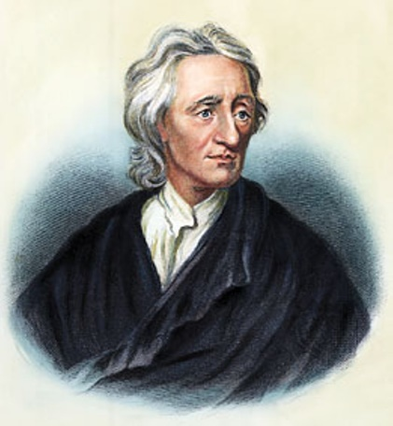
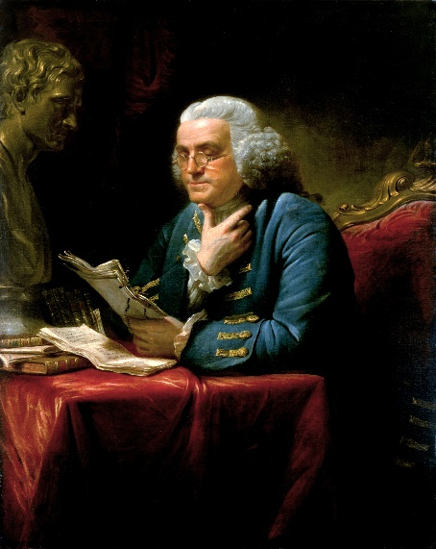
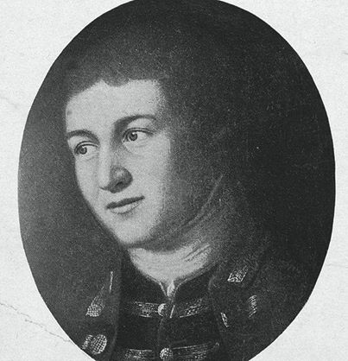
Monetary Power Left Undefined: The Constitutional Convention Downplayed U.S. Experience, Avoided Money Question
THE CONVENTION IGNORED THE NATION’S RICH PRACTICAL EXPERIENCE WITH PUBLIC FIAT MONEY
AND THEY IGNORED THE WRITINGS OF JOHN LOCKE, BENJAMIN FRANKLIN, AND OTHERS ON MONEY
Locke viewed money as a pledge for wealth, rather than wealth itself. “… mankind agreed to put
an imaginary value on gold and silver because of their durableness, scarcity and not being likely
to be counterfeited … it is evident that the intrinsic value of silver and gold, used in commerce
depends on their quantity.” John Locke, Essay on Money and Bullion, pp. 1-15
“Silver and gold … of no certain permanent value … We must
distinguish between money as it is bullion, which is merchandise,
and as by being coined it is made a currency; for it value as
merchandise, and its value as a currency are two different things.”
B. Franklin, Modest Inquiry into the Nature and Necessity of Paper
Currency
WILLIAM BARTON (1754 – 1815)
William Barton proposed a united American paper currency, based on
the highly successful Pennsylvania system. “… we judge very
erroneously when we suppose intrinsic value to be inseparably connected
with (money) …” The True Interest of the United States and Particularly
Pennsylvania Resulting from a State Paper Money, 1786

Slide 33
PART 3-c
Monetary Power Left Undefined:
The Abuse of Monetary Theory

Slide 34
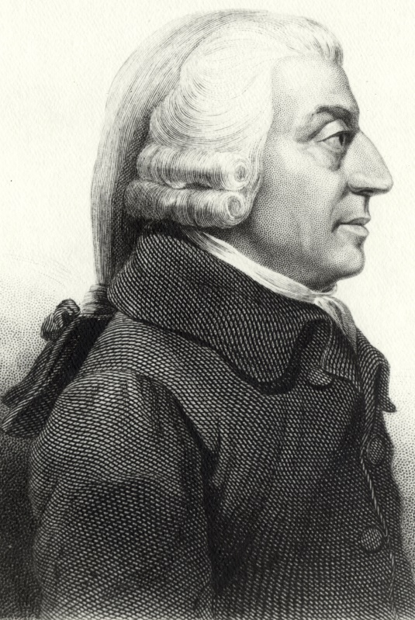
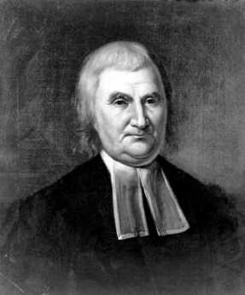
Monetary Power Left Undefined: The Abuse of Monetary Theory
Delegates were more influenced by Adam Smith, whose theories heavily supported the
Bank of England and contained crucial monetary errors … Smith was quoted by delegates.
Smith never mentioned the legal concept of money, put forward by Berkeley, Raithby, Locke,
Julius Paulus, Plato, Aristotle, etc.
In 1786, anticipating the Convention, a very curious book Essays on Money was published anonymously. Its entire thrust as to “theoretically” attack the idea of government paper money: “State bills are an absurd form of money and not money at all.”
It turned out to be written by the Calvinist Clergyman, John Witherspoon, who misrepresented Locke and Franklin’s point on money: “They seem to deny the intrinsic value of gold and silver.”
He was the only clergyman to sign the Declaration of Independence.
Witherspoon’s influence and book did as much damage as any merchant, leaving the back door open for the MONEY POWER to rule. A recurring theme – Calvinism and our flawed money system.

Slide 35
PART 3-d
Monetary Power Left Undefined:
Some Merchants Understood:
“To Emit Bills of Credit”

Slide 36
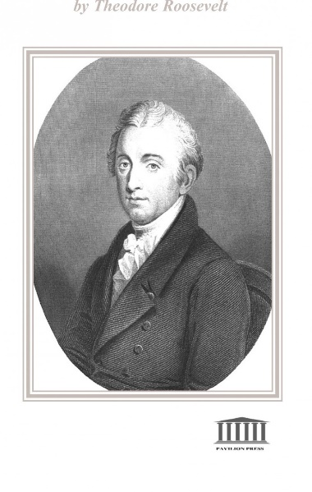
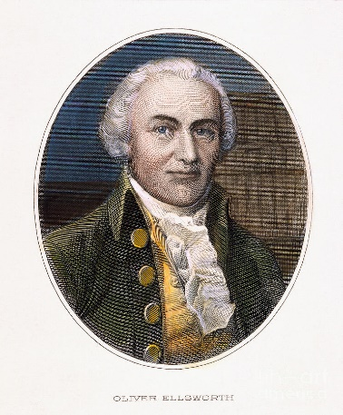
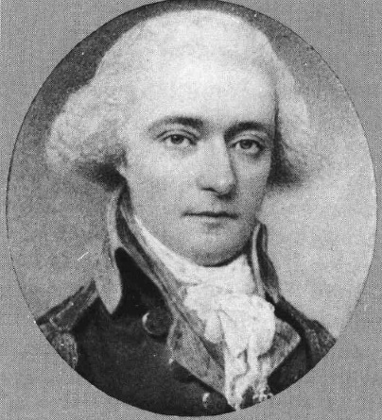
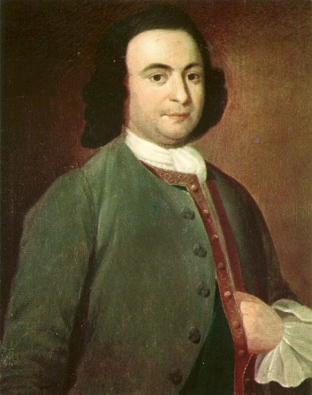
Monetary Power Left Undefined: Some Merchants Understood: “To Emit Bills of Credit”
The Convention’s committee voted 9 to 2 against including the phrase “to emit bills of credit.
Here is the recorded arguments on the provision of whether “to emit bills of credit” should be included in the new Constitution:
Gov. Morris(Pa) “The moneyed interest will oppose the plan of government if paper emissions are not prohibited.”
Mr. Mason(Va) “The Revolutionary war could not
have been carried on had such a prohibition existed.”
Mr. Ellsworth(CT) “By withholding the power from the new government, more friends of influence would be gained to it than by almost anything else.”
Mr. Butler(S.C.) remarked that paper money was not legal tender in any European country.
Mr. Mason(Va) countered that neither was any
European country forbidden from making paper
money a legal tender.
Oliver Ellsworth
Gouverneur Morris
Pierce Butler
GEORGE MASON –
“FATHER OF THE BILL OF RIGHT”
with James Madison

Slide 37
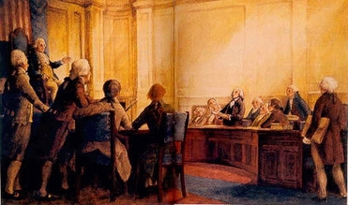
Monetary Power Left Undefined: Some Merchants Understood: “To Emit Bills of Credit”
This key element of sovereignty – the power to create money – was not solidly placed in the new government by the “Moneyed interest,” while they hypocritically proclaimed the need to strengthen the national government.
Merchants like Robert Morris and Alexander Hamilton did not want the nation to have the money power. They were to put forward a funding system upon the Bank of English plan as one of the first measures of the new government.
THEY TRIED TO GET A CLAUSE FORBIDDING IT, BUT FAILED.
THE CONSTITUTION IS SILENT ON THE POWER, NEITHER CONFERRING OR FORBIDDING IT.

Slide 38
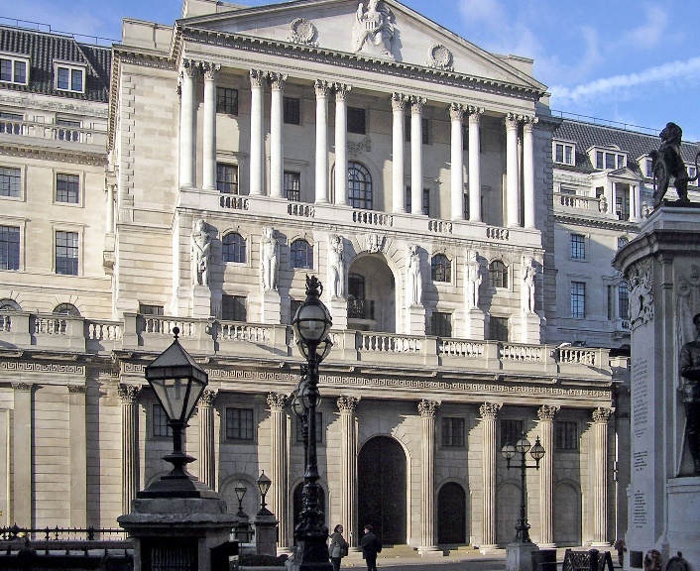

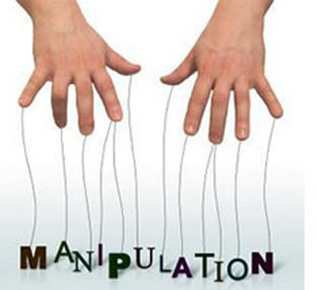
Monetary Power Left Undefined: Some Merchants Understood: “To Emit Bills of Credit”
WHAT WOULD BE THE EFFECT OF IGNORING THIS POWER?
Delegate Gorham(MASS): “The power so far as it is necessary or safe, is involved in that of borrowing.” IN OTHER WORDS, THE GOVERNMENT WOULD BE FORCED INTO BORROWING “MONEY” INSTEAD OF CREATING IT.
The merchants knew that the government would soon be borrowing from their private bank –
which would create these ‘bills of credit’ out of thin air and charge interest on them, as was being done by the Bank of England at the time. Their private bank would be allowed to do
what they had blocked the government from doing – create paper money. But this was for the
benefit of the few, and it came with debt.
BANK OF ENGLAND

Slide 39
PART 3-e
Monetary Power Left Undefined:
Limited U.S. Money Powers

Slide 40
Monetary Power Left Undefined: Limited U.S. Money Powers
THE ENTIRE FEDERAL MONETARY POWERS IN THE CONSTITUTION ARE:
ARTICLE 1, SECTION 8 …
To borrow Money on the credit of the United States;
To coin Money, regulate the Value thereof, and of foreign Coin, and fix the Standard of Weights and Measures;
To provide for the Punishment of counterfeiting the Securities and current Coin of the United States;

Slide 41
Monetary Power Left Undefined: Limited U.S. Money Powers
THE MONETARY POWER WAS CONSIDERED SO IMPORTANT THAT IT WAS
EXPLICITLY DENIED TO THE STATES
(YET WOULD BE HANDED TO A PRIVATE GANG OF BANKERS!)
ARTICLE 1, SECTION 10 …
No State shall … coin Money; emit Bills of Credit; make any Thing but gold and silver Coin a Tender in Payment of Debts …

Slide 42
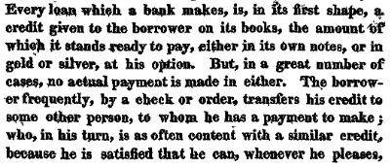
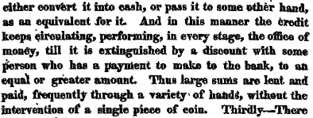
Although the Convention had been sold the idea of money as a commodity, the financiers knew that private banks created money out of thin air by the accounting entries on its books. A loan from the private bank was a credit entered on the books of the bank into the borrower’s account. This account credit would be transferred by the borrower by check or order, requiring no intervention of gold or silver.
Monetary Power Left Undefined: Limited U.S. Money Powers
December 14, 1790, Secretary of the Treasury, Alexander Hamilton, submitted to Congress the
Second Report on the Public Credit, calling for the establishment of a National Bank. In this report
Hamilton describes how the private bank creates money, using the bank’s accounting. There was
no need of bank notes or gold or silver.

Slide 43


Slide 44
PART 4-f
Monetary Power Left Undefined:
Federalist Papers Ignored Money Debates -- Hamilton and the Money Power Attack

Slide 45

Monetary Power Left Undefined:
Federalist Papers Ignored Money Debates -- Hamilton and the Money Power Attack
The 85 articles urging adoption of the Constitution by the States are known as
the Federalist Papers and entirely ignore the monetary question.
Most delegates viewed money as a commodity, rather than an institution of law.
An advertisement for The Federalist,
1787, using the pseudonym
"Philo-Publius"

Slide 46
Monetary Power Left Undefined:
Federalist Papers Ignored Money Debates -- Hamilton and the Money Power Attack
HAMILTON AND HIS ASSOCIATES MOVED TO ASSUME THE MONETARY POWER
Hamilton’s First Report on the Public Credit (January 9, 1790)
                FUNDING ACT: Passed by a vote of 34 to 28 (July 26, 1790)
REDEMPTION OF DOMESTIC DEBT
REDEMPTION: the report called for full federal payment at face value to current holders of government securities.
The owners would get new federal securities, backed by tariff and tonnage duties.
A significant portion of the nation's $40 million domestic debt was owed to American patriots
who had supported the War of Independence through loans or personal service,
and the farmers, manufacturers and merchants who furnished supplies for their support.
They were paid with IOUs – “certificates of indebtedness” or “securities” (not to be confused
with worthless Continental currency or bills of credit) and redeemable when the government’s
fiscal order had been restored.
When it became known to members of Congress, which sat behind closed doors, that the bill would pass …
every part of the country was overrun by speculators, by horse, and boat, buying up large portions of the
certificates for pennies on the dollar. Hamilton hid the fact that these buyers were given privileged
political information. Van Buren tells us: “(Many) believed that the scramble which ensured was foreseen
and counted upon as a source of influence to enlist Congress on the side of the administration.”

Slide 47
Monetary Power Left Undefined:
Federalist Papers Ignored Money Debates -- Hamilton and the Money Power Attack
HAMILTON AND HIS ASSOCIATES MOVED TO ASSUME THE MONETARY POWER
Hamilton’s First Report on the Public Credit (January 9, 1790)
                FUNDING ACT: Passed by a vote of 34 to 28 (July 26, 1790)
ASSUMPTION OF STATE DEBTS
ASSUMPTION: the national government to assume funding of all state debt, by the issue of federal securities
“Hamilton assumed some $15 million of the state debt … an act … neither asked nor desired
by the states … unconstitutional and inexpedient, and caused as much unpopularity to his
administration … as any other act it made.” Van Buren
One of the effects of “assumption” would be to distribute the collective debt burden among all the states –
the more solvent members paying a share of the more indebted ones. Most of the southern states,
with the exception of South Carolina, had successfully paid down the bulk of their wartime debt.
At the heart of the opposition lay a political fear of “consolidation”, where power and wealth
was concentrated in fewer hands and the states “absorbed by the new federal government”.

Slide 48
Part 4
1st Bank of the United States

Slide 49

1st Bank of the United States
Hamilton’s Report on a National Bank (December 14, 1790)
Bill Passed House 37-20 (Feb 2, 1791) & Senate 39-19 (Feb 8, 1791)
Hamilton established bank credit as a major device of monetary settlement.
a bank of issue – on the Bank of England model – with the following convertible at will to gold and silver:
  creating paper money (‘note circulation’)
  creating bank loan liabilities (‘book credit’)
bank’s notes accepted for taxes (not legal tender)
source of loans to Treasury
the bank’s liabilities (notes and book credits) would not be more than 3 to 5 times its gold/silver capital (‘fractional reserve’)
accepted specie deposits for safekeeping of customers
20 year charter
collect taxes and administer public finances for government
FIRST BANK OF THE UNITED STATES
Philadelphia, Pennsylvania

Slide 50



1st Bank of the United States
THE FIGHT OVER THE NATIONAL BANK ACT
JEFFERSON MADISON
HAMILTON
the government possesses only powers specifically given to it
the federal government does not have the power to form a bank or any other corporation
‘doctrine of implied powers’ - powers not explicitly given by the Constitution itself but necessary and proper to execute the explicit powers given to the government
true necessity for emergencies such as war
real money was gold and silver, which could be withdrawn by private parties from nation at any time; therefore, nation needed private bank as source of gold/silver in these times

Slide 51
1st Bank of the United States
          Feb. 25, 1791: Washington signed the "bank bill" into law
          -- and appointed a committee to take SUBSCRIPTIONS
WHO OWNED THE BANK: THE DAY OF SUBSCRIPTION
Bank had a capital stock of $10 million: $2 million by the federal government;
$8 million by private individuals
subscribers could pay ¼ in gold/silver and ¾ in government bonds (created by Funding Act of 1790): this meant the bulk of the expense to set up the bank was coming from the nation
On the day of subscription, the $8 million for public subscription was OVERSUBSCRIBED WITHIN AN HOUR!
Subscribers included: merchants, professional men, politicians, speculators in public securities,
over one-third of members of Congress,
over one-half of members of Congress who voted for the bank

Slide 52
1st Bank of the United States
SPECULATION IN THE BANK’S STOCK BEGAN IMMEDIATELY
Within two days after the subscription books were closed, $35 was paid for a right to the certificate… then $50 within
a week … broker offices sprang up on all sides advertising the purchase and sale of bank certificates. August 1791 –
45…60…100 in two more days…from 100 to 150 on a single day.
HOW WAS THE BANK STOCK PAID?
Various monetary historians have concluded: “No more or little more than the first installment, $675,000 can be
considered as having been received by the bank actually in hard money.” Holdsworth, The First and Second Banks
of the United States, 1910
“In a debate in the Pennsylvania legislature in 1793, it was stated that one great source of profit to the Bank .. was in the
discounting of notes for stockholders, to enable them to pay subsequent installments (on their bank stock).” Holdsworth
Thus the buyers of the shares paid for them with their own paper notes (iou’s).

Slide 53


1st Bank of the United States
THE REAL QUESTION?
NOT WHETHER MONEY WAS A LEGAL POWER – OR A COMMODITY
BUT WHO WOULD CREATE MONEY – PRIVATE BANKS OR THE GOVERNMENT?
Would the immense power and profit of issuing currency go to
the benefit of the whole nation or to the private bankers?
1st BANK OF UNITED STATES
UNITED STATES, 1790

Slide 54
1st Bank of the United States
THE BANKERS LACKED ARGUMENTS FOR HAVING THIS PRIVILEGE
HAMILTON: “… should the credit of the bank be at the disposal of the government …
… a calamitous abuse of it” This was a smear of government which could not
be trusted with this power.
HAMILTON: if the government needed a loan of gold/silver, it would have to tax or borrow
to get the money, since it did not itself have gold and silver money
But this argument was based on money as a commodity. There is no reference
to government legally creating the money… AS THE BANKERS WOULD SOON BE
DOING THROUGH THE BANK

Slide 55
1st Bank of the United States
THE BANK OPERATED CONSERVATIVELY AT ITS BEGINNING &
A VEIL OF MYSTERY WAS THROWN OVER THE OPERATIONS OF THE BANK
The bank’s loans were made generally to importers.
Under Hamilton, the government’s debt grew to $6 million by 1795.
Hamilton obscured the nation’s financial situation:
Jefferson to Madison, March 6, 1790: “Dear Sir: I do not all wonder at the condition in which the finances of the United States are found. Hamilton’s object from the beginning was to throw them into forms which should be utterly indecipherable.” Thomas Jefferson, Letters and Addresses, edit. William Parker, 1905
Financial textbook writers Studenski and Kroos: “It was impossible to ascertain from (Hamilton’s) accounts the exact amount of government receipts or expenditures or national debt. Indeed no clear statement of the debt was ever presented by Hamilton …” Studenski & Kroos, Financial History of the U.S., 1952
“Even the bank of the United States, semi-public institution though it was, published no reports … A careful search has failed to reveal any trace of the original books and records of the bank.” Holdsworth, The First and Second Banks of the United States, 1910

Slide 56
1st Bank of the United States
GOVERNMENT FORCED OUT OF ITS SHARES
The government earned $1,101,720 in dividends from the Bank’s stock. Therefore …
1796-97 – the Bank forced the Government to sell over half of its 5,000 shares … to “reduce its debt” to the bank
1802 – the Government’s remaining 2,200 shares were sold to Baring Brothers in London … “to reduce its debt”.
To his credit, Hamilton is reputed to have opposed the sales. Why?

Slide 57
Part 5
First U.S. Coinage

Slide 58
First U.S. Coinage
1794 – the U.S. minted its first silver dollar
1795 – the U.S. minted its first gold coin, the $10 Eagle

Slide 59
PART 6
The Return of Thomas Paine

Slide 60

The Return of Thomas Paine
THOMAS PAINE RETURNS 1802
“A faction (the Federalists) acting in disguise, was rising in America: they had lost sight of principles.
They were beginning to regard government as a profitable monopoly, and the people as hereditary property.”
Thomas Paine, Writings of Thomas Paine, vol. 3, p. 383
“A war in some shape or other seems to have been the great object with Hamilton’s people. First they would have war with the northern Indians … Britain at one time seemed their target … with Algiers … a point to differ with the French.” William Maclay, a member of the first Congress, in his daily journal
A war with our ally France over New Orleans and the Mississippi basin would have caused a huge increase in the U.S. debt and forever entrenched the Bank. Paine blocked it, suggesting to Jefferson that he ask the French about buying the land.
THOMAS PAINE, 1737 - 1809

Slide 61
The Return of Thomas Paine
PAINE’S MONETARY VIEWS GROW
Tom Paine at first held a commodity view of money.
“As to the assumed authority of any assembly in making paper money … a legal tender … there can be no such power in a Republican government …” Thomas Paine, Dissertation on Government, the Affairs of the Bank, and Paper Money
In 1796 in France, Paine launched an attack against the Bank of England: The Decline and Fall of the English System of Finance. He became aware that quantity and not intrinsic qualities determined the value of money. “The same fate would have happened to gold and silver, could gold and silver have been issued in the same abundant manner that paper had been, and confined within the country as paper money always is.” Paine, Writings of Thomas Paine
In Agrarian Justice, 1797, Paine came close to inventing a fiat money system while putting forward the first proposal for a social security system. This pamphlet advocated the use of an estate tax and a tax on land values to fund a universal old-age and disability pension, as well as a fixed sum to be paid to all citizens on reaching maturity.

Slide 62
PART 7
Jefferson Finally Understands Money

Slide 63
Jefferson Finally Understands Money
THE PROBLEM WAS THE PRIVATE ISSUANCE OF MONEY – NOT ITS SUBSTANCE.
Jefferson, Paine, and others were at a real disadvantage fighting Hamilton and the bankers, for in their earlier years they held a commodity view of money as gold and silver.
They saw their enemies – the bankers – creating paper money, and this reinforced their view that it was evil!
It took Jefferson years to realize that it was not paper money, but the private issuance of it that was the problem – the circulation of private debt as money.
Nov 1798, Jefferson to John Taylor:
“I wish it were possible to obtain a single amendment to our constitution … taking from the federal government the power of borrowing money. I now deny their power of making paper money or anything else a legal tender.”
Dec 1803, Jefferson to Gallatin:
“Could we start toward independently using our own money to form our own bank …?”
June 1813, Jefferson to John Eppes:
“Although we have so foolishly allowed the field of circulating medium to be filched from us by private individuals, I think we may recover it … The states should be asked to transfer the right of issuing paper money to Congress, in perpetuity.”

Slide 64
Jefferson Finally Understands Money
JEFFERSON BECAME AWARE OF THE GOVERNMENT, NOT PRIVATE BANKS,
TO CONTROL THE MONEY SYSTEM
OCT, 1815: JEFFERSON TO GALLATIN
“The treasury, lacking confidence in the country, delivered itself bound hand and foot to bold and bankrupt adventurers and bankers pretending to have money … for it was … the lack of all other money, which induced … people to take their paper.
We are now without any common measure of value of property, and private fortunes are up or down at the will of the worst of our citizens … As little seems to be known of the principles of political economy as if nothing had ever been written or practiced on the subject, or as was known in old times, when the Jews had their rulers under the hammer.” Thomas Jefferson, Letters and Addresses

Slide 65
Q & A
WILL DECKER’S CONCLUSION:
THE CONTROL OF MONEY -- WITHOUT CONTROL FROM THE PUBLIC -- LEADS TO
CORRUPTION … USURPATION … SLAVERY.

