Slide 1
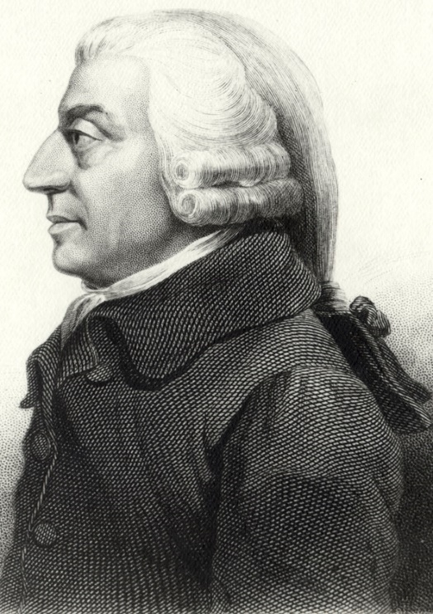


The Lost Science of Money
CHAPTER 13 – PART 2
THE USURY DEBATE CONTINUES
MARXISM + CAPITALISM
+ MONEY POWER
Karl Heinrich Marx (1818 –1883)
Adam Smith (1723 – 1790)
“THE BANK”

Slide 2
THEMES OF LOST SCIENCE OF MONEY BOOK
Primary importance of the money power (power to create money and regulate it)
Nature of money purposely kept secret and confused
How a society defines money determines who controls the society
Battle over control of money has raged for millennia: public vs private
The misuse of the monetary system causes tremendous misery and suffering for the ordinary working people. Will Decker & Martin Dunn, February 2014

Slide 3
MEMO
It is very interesting your observations about the continental monarchies.
They would periodically recast the coinage so that the basis wasn't lost for example to prevent deflation and unemployment. This their critics call "debasing" the currency! Yet, it was done to prevent the shrinkage of supply relative to the population that is the deflationary phase of the monetary cycle.
The Whigs and "liberals" were the ones pushing "democratic" governments because they could manipulate them. They had to remove the prerogatives of Kings who might as you say do something to preserve social stability.
There is a reason the Brits pushed out "liberal democracies". So they could coopt elites into their debt money system, and know they will get repaid from the tax coffers for public debts at the heart of their debt money systems.
B.B., NEW YORK 2014

Slide 4
PARTS OF PRESENTATION
The Monetary Reforms of 1844
Thesis, Antithesis and Synthesis
Marx and Anti-Thesis Appear
  Marx in Tradition of English Political Economy
  Marx’s Concept of Money Mirrors Adam Smith’s
  On the Quantity of Money
  On Central Banking and the Public Debt
  On Private Control of Money Creation
  The War Between Industry and Labor
  Marx’s Historical Progression to Socialism
The Synthesis of Smith and Marx
Stanley Jevons’ Synthesis
Jevons: Re-Burying the Science of Money
Jevons: The Right Quantity of Money
How Bankers Influence Monetary Theory
Summary

Slide 5
PART 1
The Monetary Reforms of 1844

Slide 6
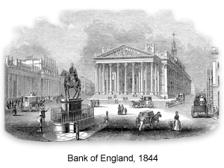
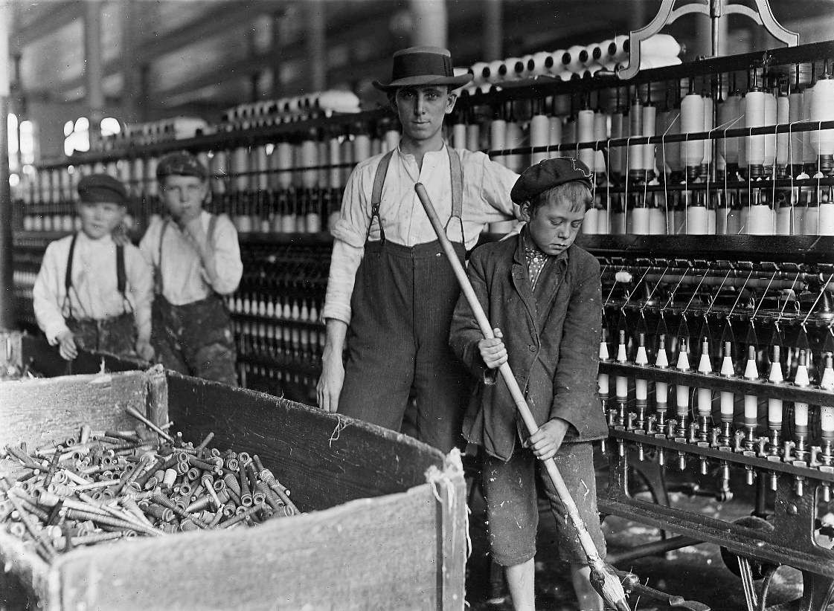
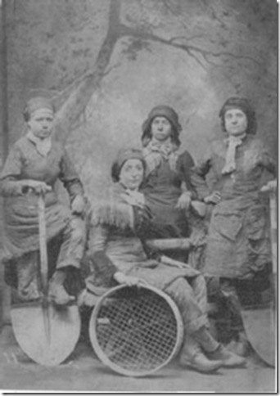
The Monetary Reforms of 1844
THE BANK CHARTER ACT OF 1844:
Financial crises aroused an active movement for reform
From 1811 the Bank’s policies had not only continued to impoverish the lower levels of English society but had put the squeeze on many wealthier elements as well.

Slide 7
The Monetary Reforms of 1844
BANK CHARTER ACT 1844
‘An Act to regulate the Issue of Bank Notes, and for giving to the Bank of England certain Privileges for a limited period [19 July 1844] …
WHEREAS it is expedient to regulate the Issue of Bills or Notes payable on Demand’ … the BANK …
stop charging interest on the Government’s debt
divided into two departments: issue and banking
issue department could issue notes against securities up to 14 millions; beyond this sum, the bank must back all notes with 100% metallic backing
silver could be up to 20% of the metallic backing
note issue of country banks fixed at the average during the prior 12 months; going forward, the Bank had the exclusive privilege of note issue

Slide 8
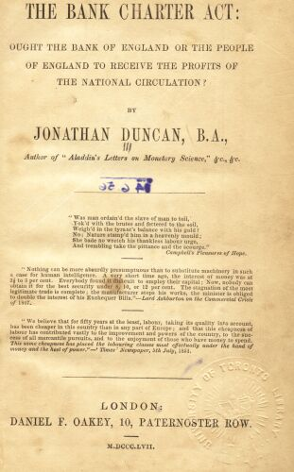
The Monetary Reforms of 1844
Jonathan Duncan (1799-1865) wrote about the monetary science. No information on him is available via the internet. Professor Yamaguchi has saved his book online at:
www.yamaguchy.com/library/duncan/charter_index.html
It is also scanned on my website.

Slide 9
The Monetary Reforms of 1844
From Jonathan Duncan, The Bank Charter Act of 1844:
Ought the Bank of England or the People of England to Receive the Profits of the National Circulation?
“In all the efforts made by philanthropists to remove or mitigate the evils of society,
the question of money has been ignored; and hence their lamentable failures.
It has never occurred to them that money is the half of every bargain, or that modern usury
is extorted, not for the legitimate use of money, but for its artificial scarcity.
Interest at 3 per cent. replaces capital in 33 years.
4 25
5 20
10 10
20 5
Is it surprising, then, under the Acts of 1819 and 1844, that the rich grew richer, and the poor poorer?
The people should be made to understand that their labour alone supplies the country with gold,
and that cupidity exports that gold to foreign nations, in loans to governments, or to sustain foreign
speculations, that usurious interest may be perpetuated at home. The currency question is emphatically
a labour question, and till the working classes study it, and master it, they will never obtain any efficient
relief from social evils or political grievances. It would be well also for the rich to study and to master it;
for all history proves to those who can look beneath the surface, that usury is the precursor of revolution,
and extinguishes nationality.”

Slide 10
The Monetary Reforms of 1844
The Bank Charter Act of 1844 ignored the role of bank deposits as money.
Only private Bank Notes were regulated.
‘The banks got round the Act by issuing cheque-money instead of note-money.
Where previously they had printed a note and lent it out as money to their client,
now instead they made a book-entry, gave him a cheque-book and authority to write
cheques to those with whom he did business up to the amount of the book-entry.
The Act entrenched the private issuance of money more firmly.’
Christopher Hollis, Two Nations, p. 111
YEAR
PRIVATE BANK NOTES
DEPOSITS
1844 11 MILLION £ 50 MILLION £
1846 7.75 MILLION £ 55 MILLION £
1928 0 MILLION £ 2,231 MILLION £

Slide 11
PART 2
Thesis, Antithesis and Synthesis

Slide 12
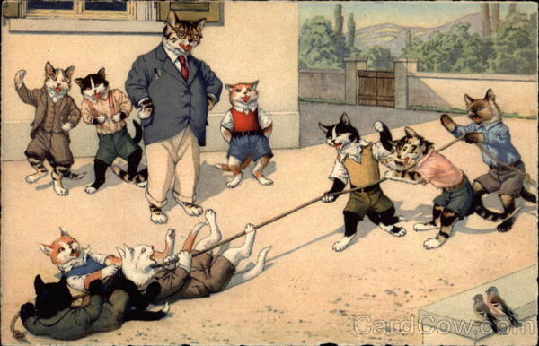
Thesis, Antithesis and Synthesis
The note issuing power of the Bank had been curtailed.
The deposit creation power had not been identified and was still active.
How to keep the bank’s power active but safely hidden?
Control the public with a debate between a false THESIS and a false ANTI-THESIS.

Slide 13
PART 3
Marx and Anti-Thesis Appear

Slide 14
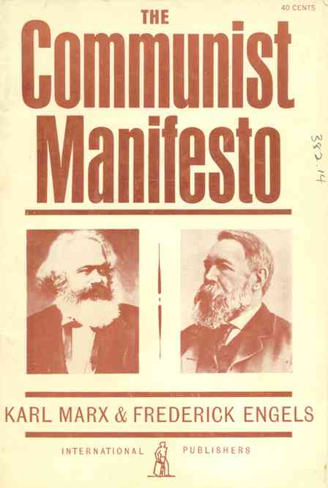
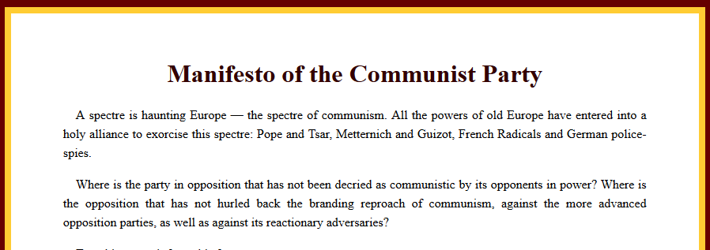
Marx and Anti-Thesis Appear
1848, THE COMMUNIST MANIFESTO:
PERCEIVED THREAT? REAL THREAT?

Slide 15
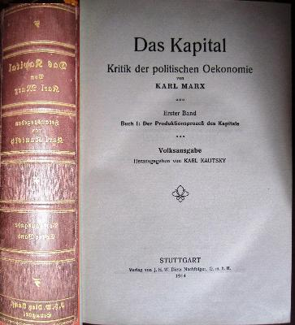
  Marx and Anti-Thesis Appear:
  3.1 Marx in Tradition of English Political Economy
REVOLUTIONARY?
“Adam Smith was the overwhelming influence upon the mature Marx.”
T. McCarthy, translator, Karl Kautsky, editor,
HISTORY OF ECONOMIC THEORIES FROM THE PHYSIOCRATS
TO ADAM SMITH, by Karl Marx
BOTH SMITH AND MARX:
  method was primarily theoretical analysis
  internationalist rather than nationalist
  largely ignored the role played by the Jews in financial history
  money defined as gold and silver commodities
  ignored how the quantity of money could affect prices

Slide 16

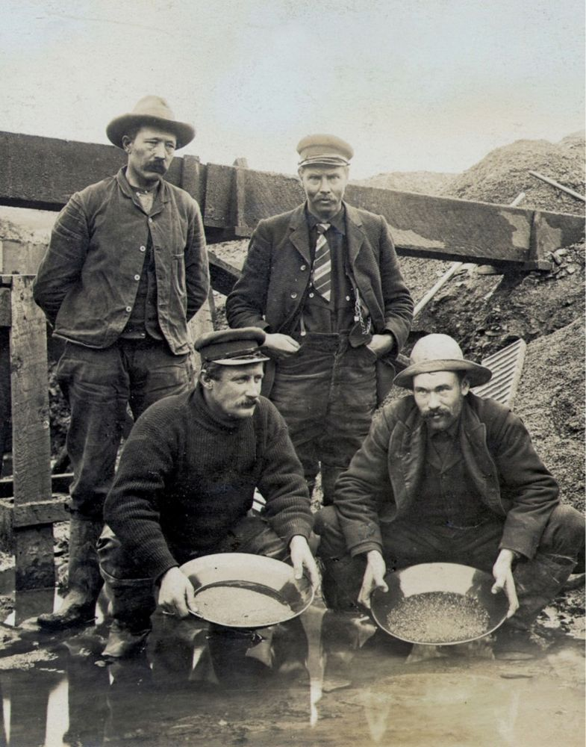
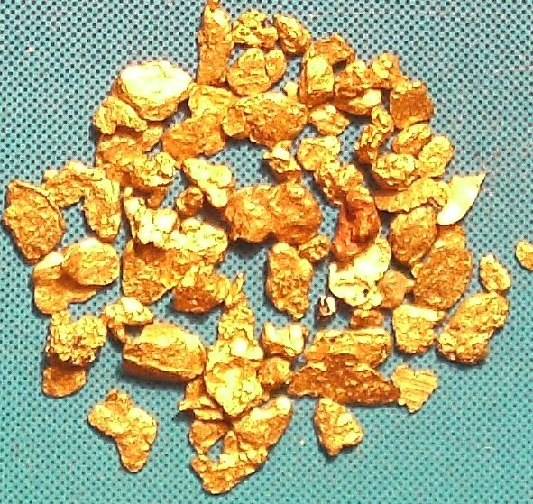
  Marx and Anti-Thesis Appear:
  3.2 Marx’s Concept of Money Mirrors Adam Smith’s
Adam Smith: “By the money price of goods it is to be observed … the quantity of pure gold or silver for which they are sold, without any regard to denomination of the coin …” (pure metal by weight)
Marx: “… Throughout this work, I assume for the sake of simplicity gold as the money-commodity. Gold, the equivalent money par excellence … remains the foundation from which the credit system, by its very nature can never detach itself”

Slide 17


  Marx and Anti-Thesis Appear:
  3.2 Marx’s Concept of Money Mirrors Adam Smith’s
Neither Smith nor Marx mentions the Mixt Moneys of Ireland case of 1601:
Money as an abstract power defined by the law!
“The Case of Mixt Monies: Confirming Nominalism in the Common Law of Monetary Obligations”, David Fox, University of Cambridge Faculty of Law Legal Studies , Feb., 2011
“ … the court in the Case linked back to the monetary analyses of the medieval doctors of the civil law, and ultimately to the works of the Roman jurists preserved in Justinian’s Digest. Underlying this entire tradition, and cited in the report, is Aristotle’s definition of money. The Aristotelian conception of money as a measure of value was a lynch-pin of medieval economic thought.
“Aristotle was clear in affirming that the monetary standard was not something naturally established but that it was determined by law or conventional acceptance of society at large … ‘because it exists not by nature but by law and it is in our power to change it and make it useless’ …”
“enabled the court to identify the Aristotelian analysis of money with the Sovereign’s common law prerogative to proclaim the current legal tender values of coin. “

Slide 18

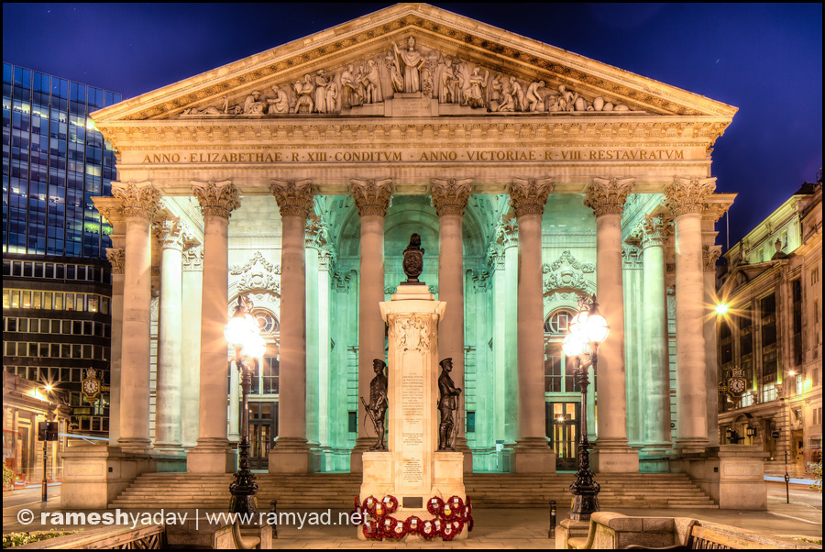
  Marx and Anti-Thesis Appear:
  3.2 Marx’s Concept of Money Mirrors Adam Smith’s
Because Marx’s faulty concept of money did not differ much from Smith’s, ‘Marxism’ never really threatened the basis of capitalism’s power –
THE CONTROL OVER SOCIETY’S MONETARY SYSTEM.

Slide 19
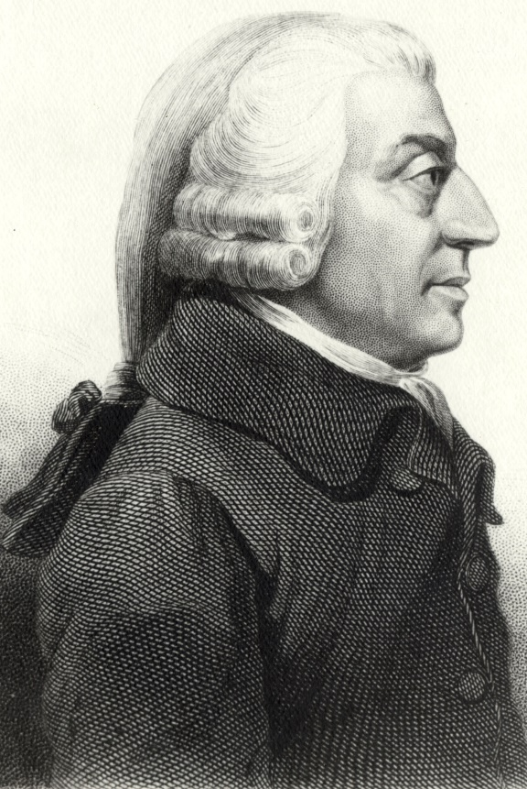
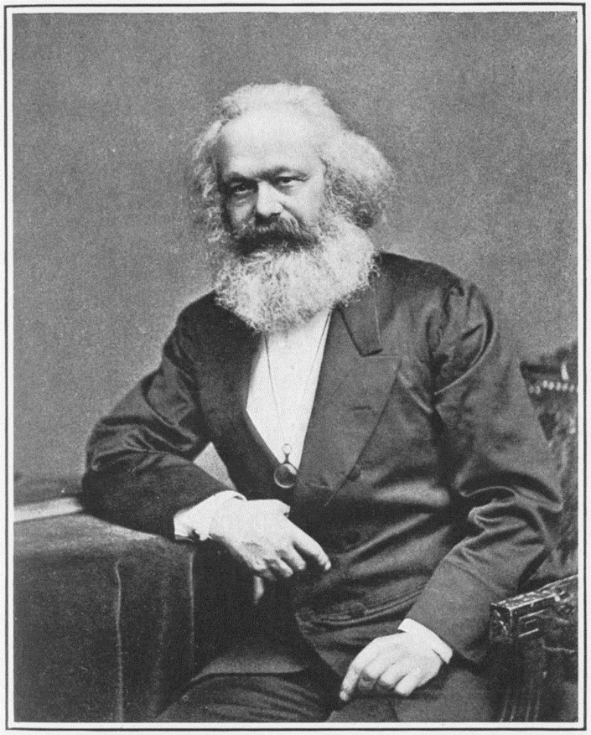
  Marx and Anti-Thesis Appear:
  3.3 On the Quantity of Money
BOTH MARX AND SMITH IGNORED
HOW THE QUANTITY OF MONEY COULD AFFECT PRICES.
SMITH: the value of gold and silver as commodities
and money is determined by the labor involved…
MARX: This value (of money) is determined by
the labour-time required for its production.
BOTH IGNORED THE COSTS OF MINING, WHICH WERE REPORTED
HIGHER THAN THE VALUES ASSIGNED TO THE METAL AS MONEY.
BOTH IGNORED THE INCREASE IN PRICES DUE TO THE GREAT QUANTITIES OF GOLD & SILVER FROM THE PLUNDER OF THE AMERICAS … from slave labor

Slide 20
  Marx and Anti-Thesis Appear:
  3.3 On the Quantity of Money
MARX: PRICES DETERMINE MONEY SUPPLY
MARX: “The quantity of the medium of circulation is determined
by the sum of the prices that have to be realized.”
This view fits into his general view of
industrialists vs proletariat.
The industrialists’ setting of prices (rather than the banks
creating money) is easier to blame.

Slide 21
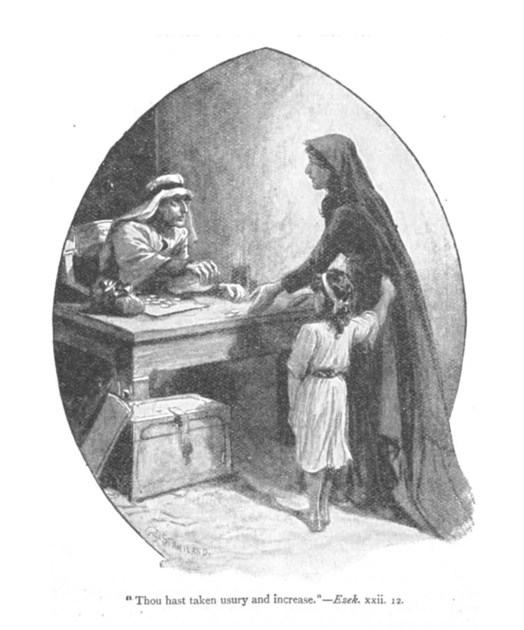
  Marx and Anti-Thesis Appear:
  3.4 On Central Banking and the Public Debt
MARX ACCURATELY DESCRIBED THE BANK OF ENGLAND AND PUBLIC DEBT &
SHOWED A GREATER UNDERSTANDING OF MONEY!!
Marx, DAS CAPITAL, v. 1
“… The Bank of England began with lending its money to the government at 8%; at the same time it was empowered by Parliament to coin money out of the same capital, by lending it again to the public in the form of bank notes … it remained … the eternal creditor of the nation down to the last shilling advanced.
The public debt becomes one of the most powerful levers of primitive accumulation. As with the stroke of an enchanter’s wand (power of legal tender status), it endows barren money (Aristotle’s concepts of money) with the power of breeding … without the necessity … and risks inseparable from its employment in industry or even in usury.”

Slide 22
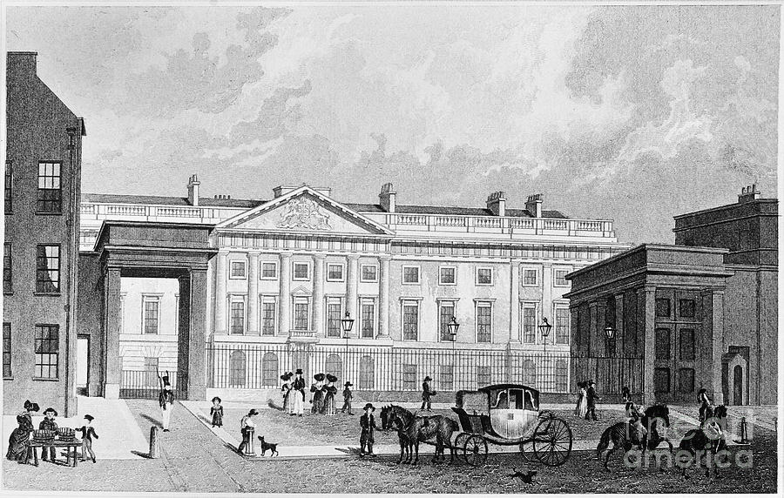
  Marx and Anti-Thesis Appear:
  3.5 On Private Control of Money Creation
Marx showed progress over Smith:
“… the standard of money … is in the end regulated by law… Coining … is the business of the State.” Das Capital, v. 1
“Centralization of credit in the hands of the state by means of a national bank with state capital and an exclusive monopoly.” plank #5, Communist Manifesto
THERE WAS NO CALL FOR MONETARY REFORM FROM MARX
LONDON TOWER OF LONDON MINT
BUT … Marx’s commodity view of money was not consistent. It relinquished control over money to the ‘financiers’ who had the power to pass gold from bullion to coin, from the English Free Coinage Act of 1666.

Slide 23
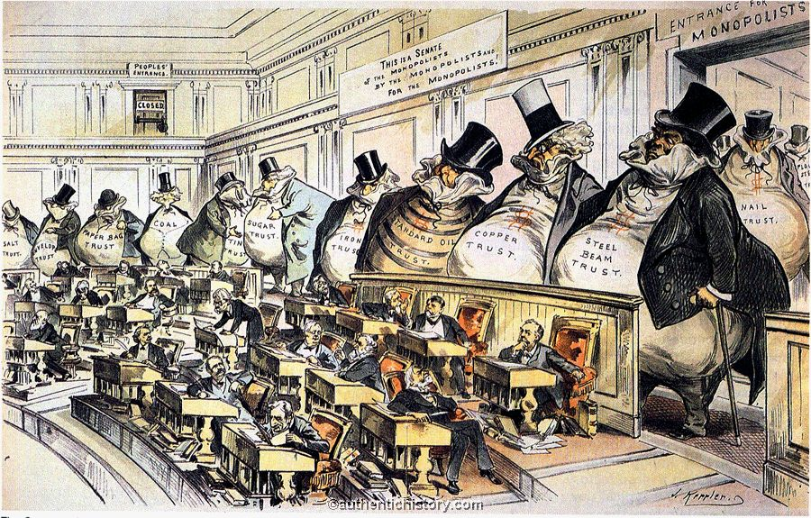

  Marx and Anti-Thesis Appear:
  3.6 The War Between Industry and Labor
MARX: THE FUNDAMENTAL STRUGGLE WAS BETWEEN CAPITAL AND LABOR
MARX FOCUSED ON CAPITAL MAINLY AS INDUSTRIALISTS –
RATHER THAN PRIVATE CENTRAL BANKING

Slide 24


  Marx and Anti-Thesis Appear:
  3.6 The War Between Industry and Labor
MARX: THE FUNDAMENTAL STRUGGLE BETWEEN CAPITAL AND LABOR
There can be a mutual cooperation and advantage to capital and labor working together. Marx devoted little attention to the visionary, planning, organizational, and risk taking skills of the entrepreneur.
Parasitic finance (private banking), however, preys on and harms both labor and industry.

Slide 25


  Marx and Anti-Thesis Appear:
  3.6 The War Between Industry and Labor
MARX: THE FUNDAMENTAL STRUGGLE BETWEEN CAPITAL AND LABOR
Marx focused on the exponentially growing capital in the hands of the industrialists. But the industrialists were within natural limits since they were producing real goods, they took risks and could lose their assets. (Unless they were monopolists.)
The nightmare of unnatural exponential risk-free growth does exist in another area that Marx was well aware of – the interest on the national debt. He de-emphasized the problem:
“The great part that the public debt, and the fiscal system corresponding with it, has played in the capitalization of wealth and the expropriation of the masses, has led many writers … to seek in this, incorrectly, the fundamental cause of the misery of the modern peoples.” Das Capital, v. 1.
DETROIT

Slide 26
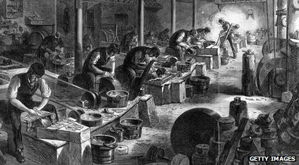
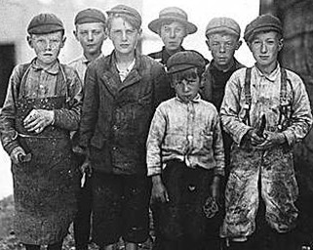
  Marx and Anti-Thesis Appear:
  3.7 Marx’s Historical Progression to Socialism
One of Marx’s paramount themes was the brutally honest description of the establishment of original capital in society.
He swept away the nursery-version of history, the record of the rise and fall of dynasties, or the mock-figures of party politicians.
History’s one reality was the unceasing struggle between rival economic classes.

Slide 27
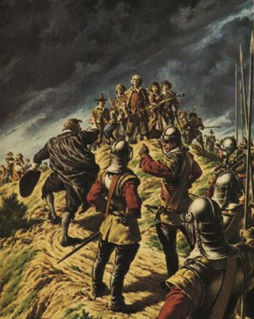
  Marx and Anti-Thesis Appear:
  3.7 Marx’s Historical Progression to Socialism
HISTORY AS CLASS STRUGGLE
Before the capitalist system could start, the means of production owned by the people had to be taken from them. Citing several sources, Marx accurately described how the English peasants were ruthlessly dispossessed of their traditional land rights starting in the 16th century, and were pushed into the labor force where they could only survive by selling their labor to capitalists. The capitalists took everything they produced (‘surplus labor’).that was not needed for their bare survival.
THE DIGGERS, 1649:
…they had invited "all
to come in and help
them, and promise
them meat, drink, and clothes." They
intended to pull down all enclosures and cause the local
populace to come
and work with them…

Slide 28
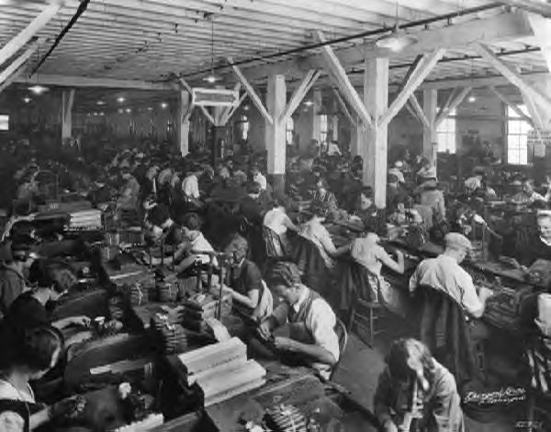
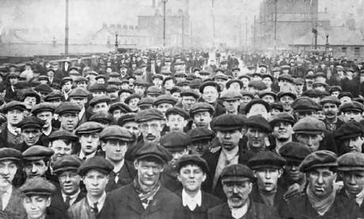
  Marx and Anti-Thesis Appear:
  3.7 Marx’s Historical Progression to Socialism
HISTORY AS CLASS STRUGGLE
“The starting point … was the servitude of the labourer … the expropriation of the agricultural producer, of the peasant, from the soil is the basis of the whole process… by the 18th century … the law itself becomes now the instrument of the theft of the peoples land…” (Das Capital, v. 1)
ENGLISH FACTORY:
…the factory system that began around 1800 brought great changes. The employer no longer worked beside his employees. In fact, it became rare if an employer actually saw his workers. He was concerned less with their welfare and more concerned with the cost of their labor.

Slide 29
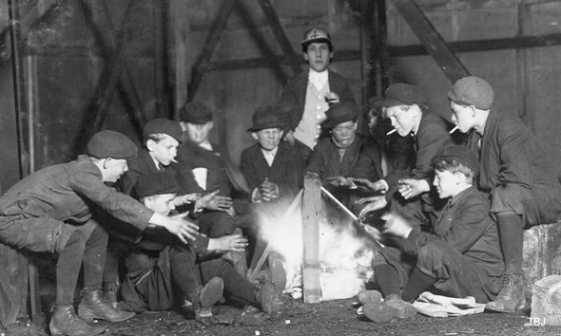

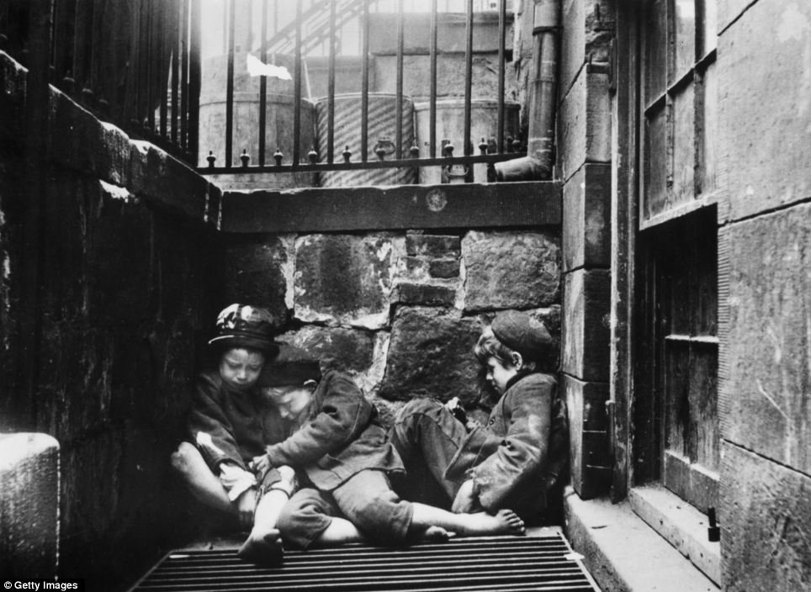
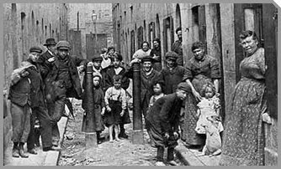
  Marx and Anti-Thesis Appear:
  3.7 Marx’s Historical Progression to Socialism
Along with the constantly diminishing number of magnates of capital who usurp and monopolize all advantages of this process … grows the mass of misery, oppression, slavery, degradation, exploitation; but with this too grows the revolt of the working class … the expropriators are expropriated … by the mass of the people.” Das Capital, v. 1.
“The author (Stephen Zarlenga) thinks that many good people could see the injustice,
even the viciousness of the prevailing economic system. Marxism offered political
relevance and hope to them.” LSM, p. 354

Slide 30
PART 4
The Synthesis of Smith and Marx

Slide 31



The Synthesis of Smith and Marx
The synthesis of Marx and Smith led to a world where labor and business are at each others throats, with the body politic polarized into “right wing” and “left wing.”
This split could be managed by the “financiers” operating behind the scenes. Rarely did either the right or the left, labor or industry, identify the “financiers” as their true problem.

Slide 32

The Synthesis of Smith and Marx
FINANCIAL POWERS CONFUSE MONETARY IDEAS
The synthesis promoted the idea of commodity money … at the same time it advanced a private central banking system creating abstract money (bank credit) for profit and power.
Their theory would always be in conflict with the actual practice … rendering monetary concepts a morass of confusion to the present day.
Bank of England - Quarterly Bulletin 2014 Q1
Money in the modern economy: an introduction
“Far more important for the creation of bank
deposits is the act of making new loans by banks. When a bank makes a loan to one of its customers it simply credits the customer’s account with a higher deposit balance. At that instant, new money is created.”

Slide 33
The Synthesis of Smith and Marx
THE FINANCIERS OPERATING BEHIND THE SCENES……one example …
December 01, 2010
The Fed delivered a huge data dump today, revealing information about the boatload of loans it made during and after the financial crisis. But the data also showed smaller loans to some companies that aren't usually associated with the workings of the Fed; companies like McDonald’s.
These companies used an emergency program the Fed set up to keep a key financial market going in the teeth of the crisis — commercial paper. The commercial paper market is basically like a credit card for giant companies in every major industry; it's something they use every day to borrow money that they plan to pay back very soon.
During the crisis, when people were afraid that Wall Street would collapse, the commercial paper market basically shut down.
The dealer market for commercial paper involves large securities firms
and subsidiaries of bank holding companies.

Slide 34
PART 5
Stanley Jevons’ Synthesis

Slide 35
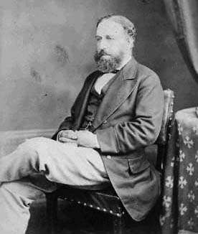
Stanley Jevons’ Synthesis
The main elements of this synthesis can be seen in Stanley Jevons’ (1835-82) work.
Jevons no longer discussed whether privately owned banks should control money; it was assumed. He did not discuss whether the government or a private bank should control money.
Jevons does not discuss the supposed opposition between business and labor. It is assumed.
He guaranteed continuing confusion of money as a commodity, by expanding money’s functions to include acting as a longer term store of value.
(1835–1882)

Slide 36
PART 6
Re-Burying the Science of Money

Slide 37
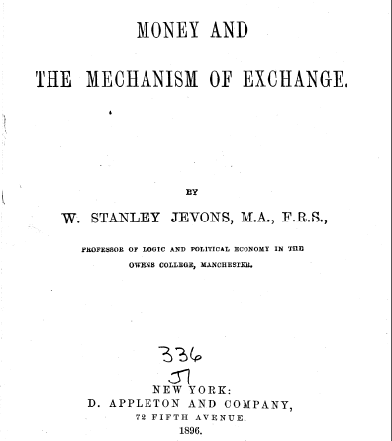
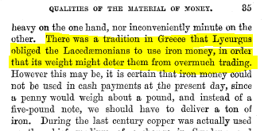
Jevons tooks pain to obscure the nature of money
Re-Burying the Science of Money
Jevons ignored Sparta’s legal concept of
money, and treated it as a commodity!
1896

Slide 38
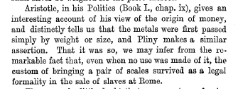
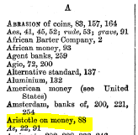
Jevons ignored the legal concept of money discussed in detail by Aristotle, Plato, Paulus, Locke, Berkeley, Franklin, Raithby and others.
Re-Burying the Science of Money
Jevons took pain to obscure the nature of money
This is the only reference
to Aristotle in Jevons’ index.
Aristotle appears to justify money
as a certain weight of metal!
Money and the Mechanism of Exchange, p 88

Slide 39
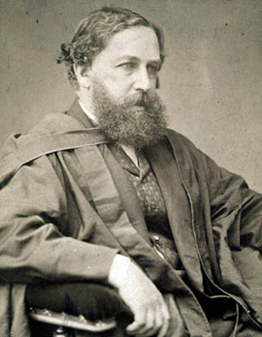

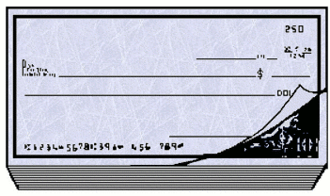
Just like Adam Smith, Jevons influenced his readers to think of money as a commodity, when he was aware that the private banks were issuing abstract money.
This trick, used repeatedly, is how the nomisma concept of money has come to be erased from the collective memory of mankind – from the dominant written works on money.
Re-Burying the Science of Money
Jevons took pain to obscure the nature of money

Slide 40
PART 7
The Right Quantity of Money

Slide 41


The Right Quantity of Money
Jevons promoted one private bank holding the money power
Jevons asserted the amount of money necessary was proportional to population, industrial activity, complexity of organization and (like Marx) the price of goods. Since few of these were accurately known, the quantity should be left in perfect freedom to regulate itself. “Money (like Smith) must find its own level – like water.”
Jevons advocated that the only attempt to control the money supply be by regulating the issue of Bank notes, i.e., bank reserves.
VERY CONVENIENT FOR THE MONEY POWER!
‘THE CITY’

Slide 42
PART 8
How Bankers Influence Monetary Theory

Slide 43
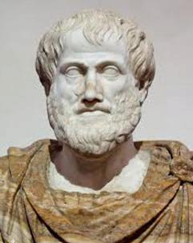
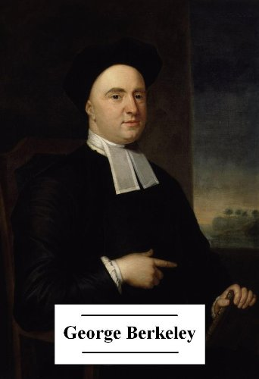
THE MONEY POWER SUPPORTS THOSE THEORIES BENEFICIAL TO ITS ACTIVITIES
How Bankers Influence Monetary Theory
Financial institutions endow many economic chairs at universities. The money from financial institutions support those professors with ‘correct’ theories. Truth is ignored.
Important alternative works are lost and destroyed simply by ignoring them.
Old books are lost.
ARISTOTLE

Slide 44
PART 9
Summary

Slide 45
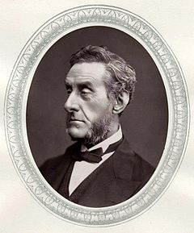
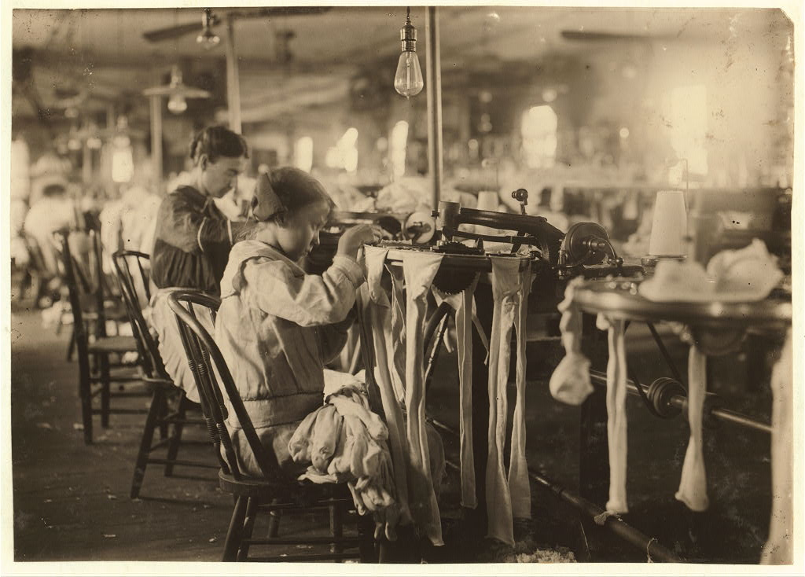
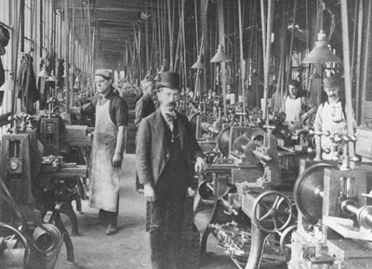
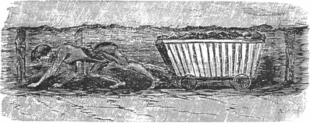
Summary
Adam Smith’s system of private money and Bentham’s justifications of usury were theoretical arguments, and could not stand a test of the facts.
Thorold Rogers’ work demonstrated the regression of the English workman, but were difficult to carry out.
Finally, in the mid-1800’s, justice and religion combined in England to produce a degree of social and banking reform.
Lord
Shaftsbury

Slide 46
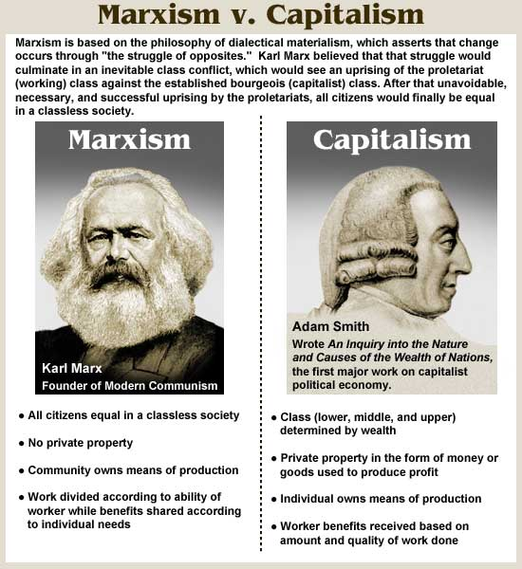
Summary
The debate shifted away from usury and the injustice of private central banking to the struggle of worker against industrialist.
Marx’s ‘antithesis’ of communism in opposition to Smith’s ‘thesis’ of capitalism was not fundamental in monetary terms. Marx and Smith presented the same identical errors on the nature of money.

Slide 47
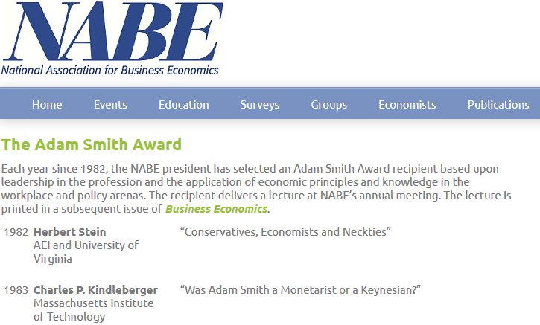
Summary
The political economists have re-buried the science of money by:
  smothering it in indecipherable jargon
  obfuscating it behind walls of mathematical theorizing
The financial establishment supports the confusion of the public by influencing the teaching and rewarding of economists.

Slide 48
Q & A
WILL DECKER’S CONCLUSION:
THE CONTROL OF MONEY -- WITHOUT CONTROL FROM THE PUBLIC -- LEADS TO
CORRUPTION … USURPATION … SLAVERY.

