Slide 1
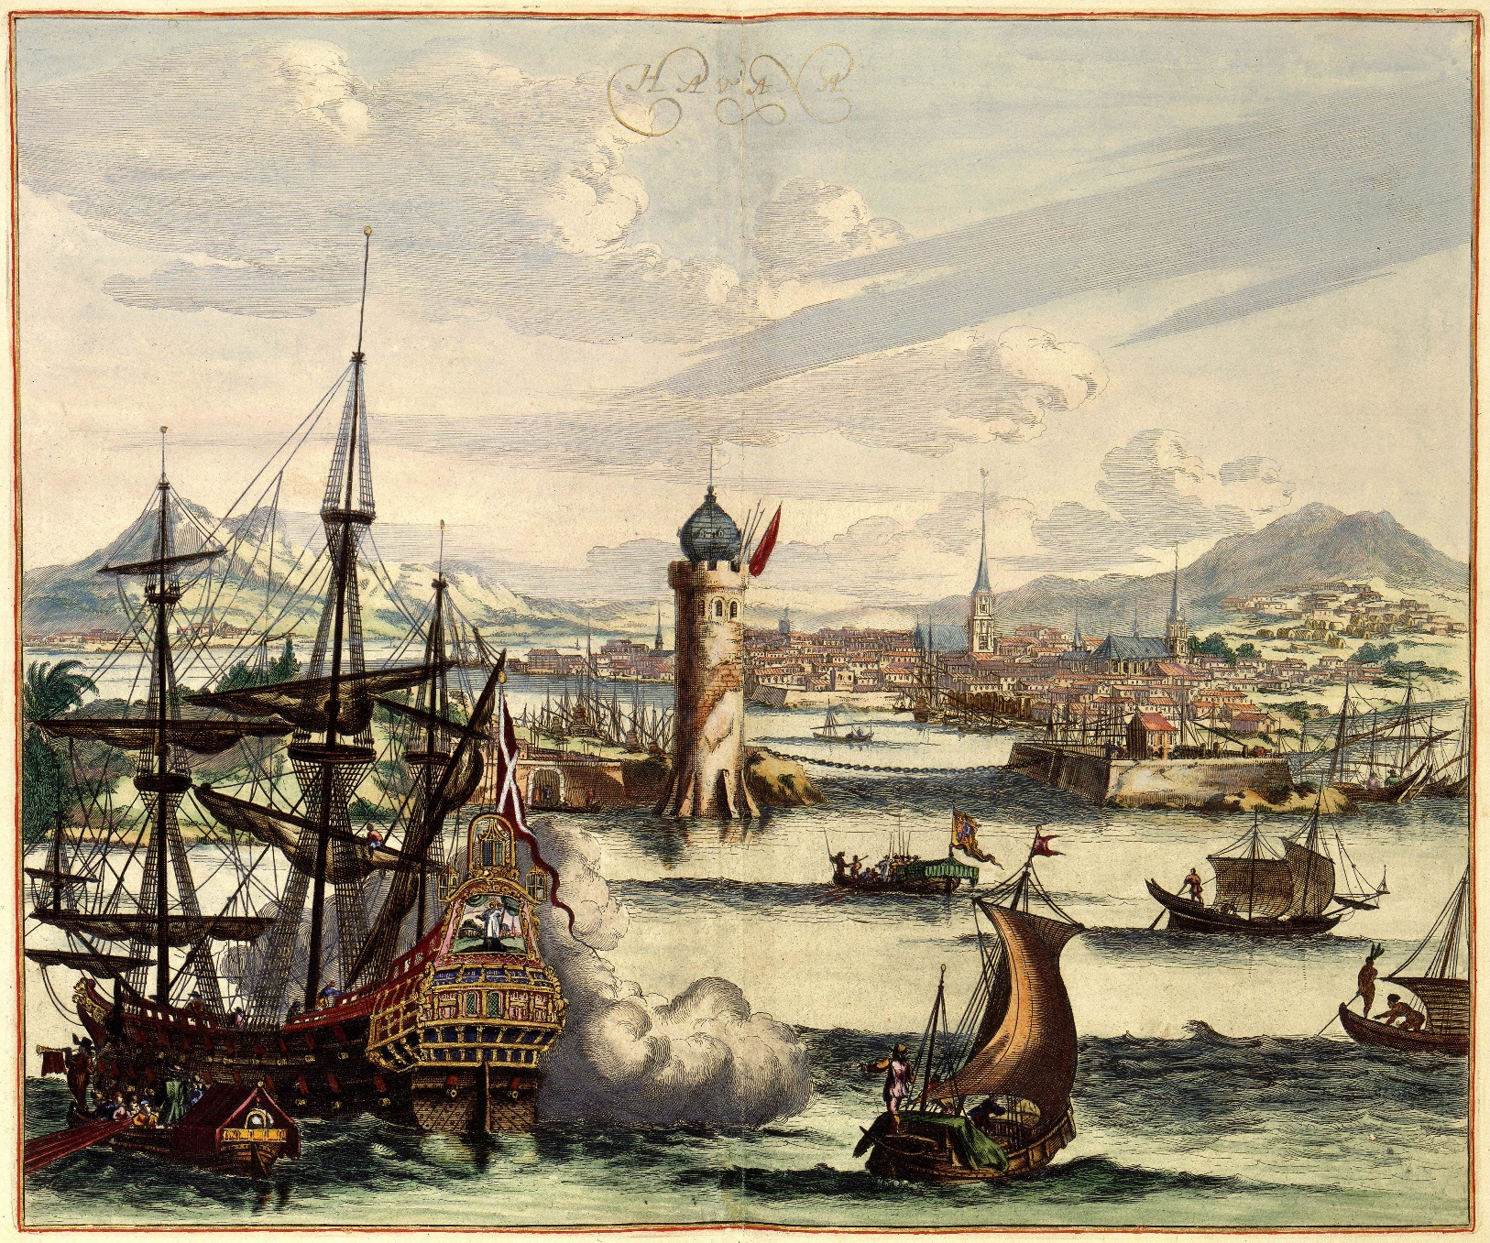
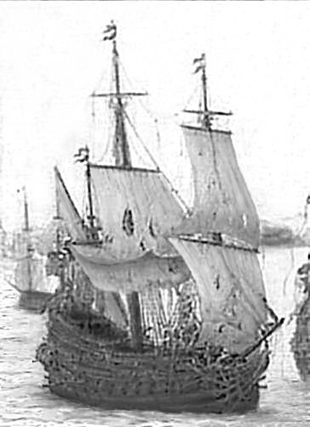
The Lost Science of Money
CHAPTER 9 (Part 2):
THE RISE OF CAPITALISM IN AMSTERDAM

Slide 2
THEMES OF LOST SCIENCE OF MONEY BOOK
Primary importance of the money power
Nature of money purposely kept secret and confused
How a society defines money determines who controls the society
Battle over control of money has raged for millennia: public vs private
The misuse of the monetary system causes tremendous misery and suffering for the ordinary working people.

Slide 3
PARTS OF PRESENTATION
Nature of Capitalism
Merchant Jews of Amsterdam
Amsterdam Stock Exchange
Manipulations on the Stock Exchange
Timeline of Wars with the Dutch
Dutch neglected real economy for Speculation and Financial Economy
Holland financed England

Slide 4
PART 1
Nature of Capitalism

Slide 5
Nature of Capitalism
Capitalism is based on usury –
a structural misuse of the monetary mechanism.

Slide 6
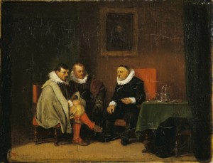
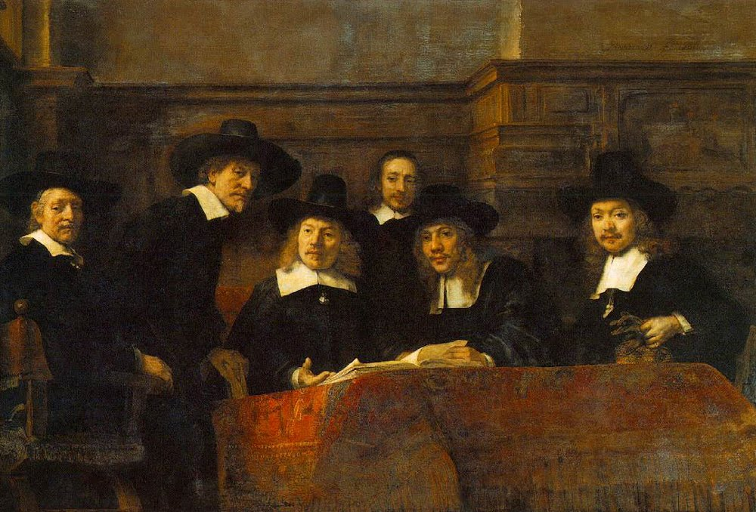
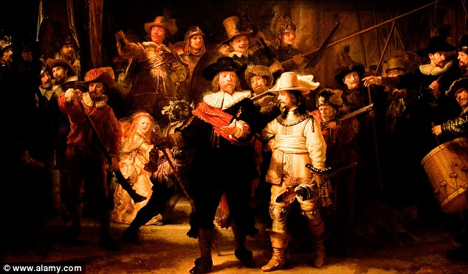
Nature of Capitalism
Alexander Del Mar, HISTORY OF MONETARY SYSTEMS, p. 330-331, published 1901
“The control of money,” says an eloquent writer on the subject, “is the ground upon which an international or cosmopolitan combination ‘finances’ the world and ‘farms’ humanity.“
“… the enrichment of a class, who know only how to scheme, to undermine and to appropriate the earnings of mankind…

Slide 7
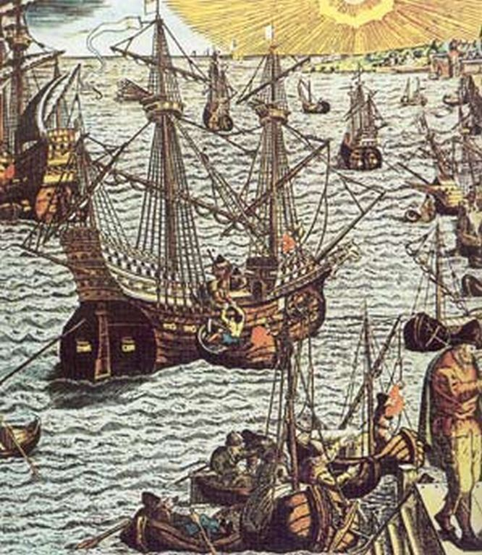
Nature of Capitalism
THE BANK OF AMSTERDAM GAVE POWERFUL SUPPORT TO THE METALS TRADE:
Amsterdam became the principal market for international trade in specie and bullion.
The Bank’s advances of bank money upon specie, valued by its metal content only, destroyed it as money, and made a market for precious metals:
The large profits found in the books of the Bank indicate other sources of income than money changing. In the 1620’s the Bank of Amsterdam carried on illegal trade in precious metals.
…every autumn, the Spanish silver fleet of 30-50 ships,
escorted by war vessels, from Cadix, Spain, arrived at Amsterdam.
From England came Brazilian gold and Spanish American silver, plundered from the Spanish and Portuguese.

Slide 8
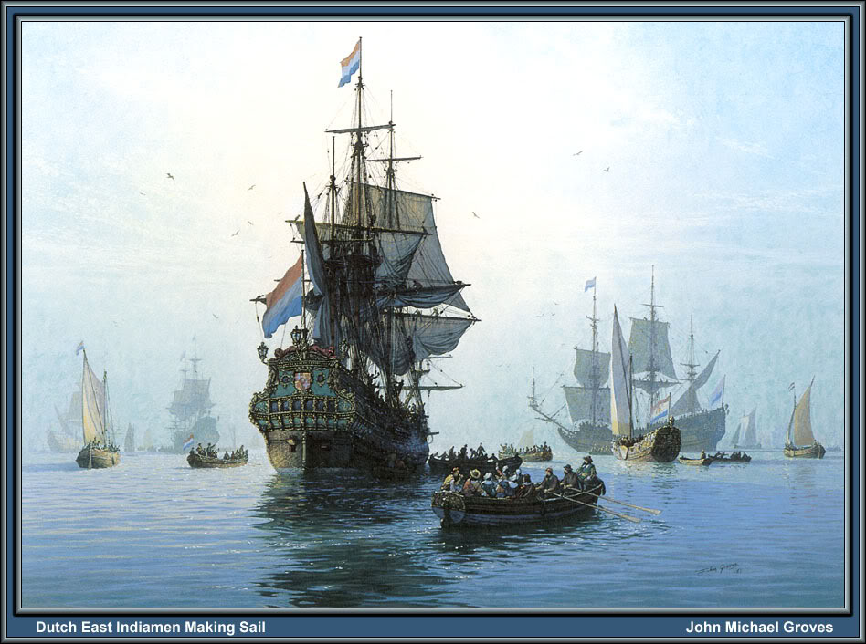
THE BANK CARRIES ON PROHIBITED TRADE IN PRECIOUS METALS
Nature of Capitalism
Throughout the 17th century, the General Masters of the Mint complained of this illegal trade, which resulted in less metals being sold to the mint and at higher prices.
In a memorial of the General Masters of 1680-12-09:
…the Banks of Exchange – especially that of Amsterdam –
purchase nearly all imported minting material,
whereas they deliver only a very small quantity
to the Mints, but sell the greater part for export
to the Indies.
Dutch East Indiamen
making sail.

Slide 9
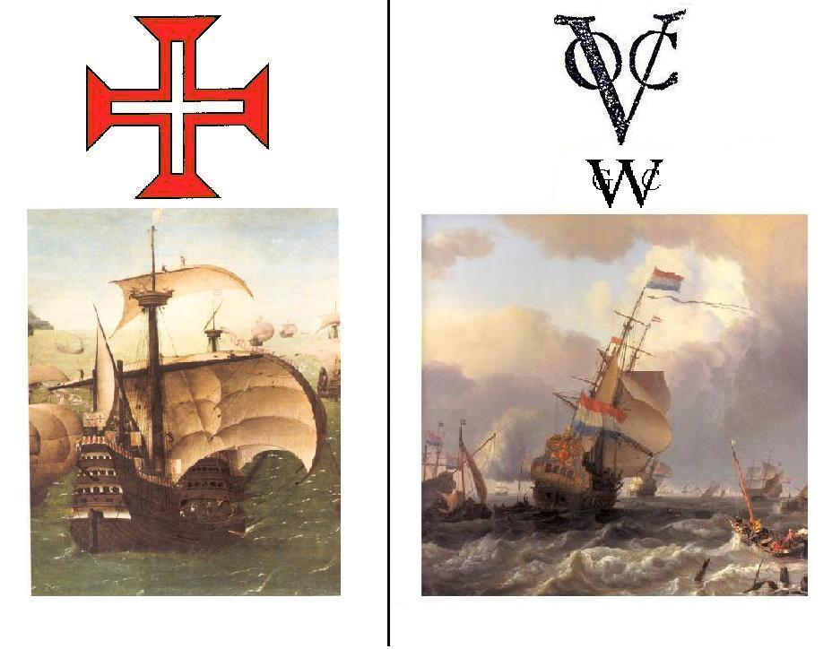
Nature of Capitalism
THE DUTCH STOLE THE GOLD/SILVER RATIO TRADE FROM THE PORTUGUESE

Slide 10
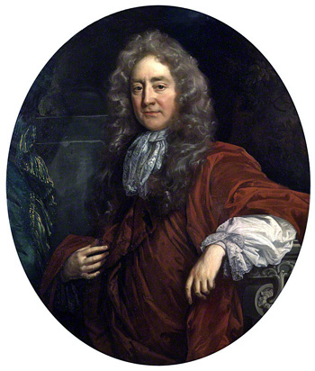

Nature of Capitalism
Sir Josiah Child, an Englishman, commenting on Amsterdam’s success:
Most miraculous of all, however, they had succeeded in reducing their
rate of interest to three per cent (as against six per cent. In England).
How?

Slide 11
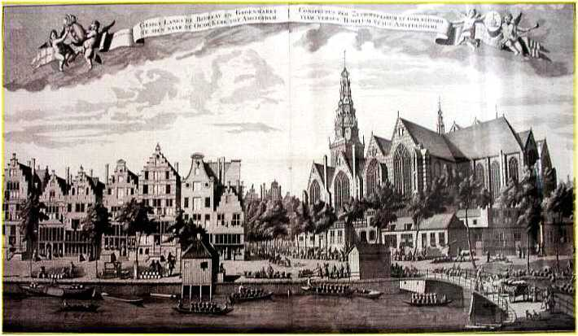
Nature of Capitalism
THE DUTCH FINANCIAL APPARATUS HAD ALL BEEN USED EARLIER BY ITALY, ANTWERP, ETC.
BOURSE
JOINT-STOCK COMPANY
CARTEL
BANKING
EXCHANGE
BROKERAGE
INSURANCE

Slide 12
PART 2
Merchant Jews of Amsterdam

Slide 13
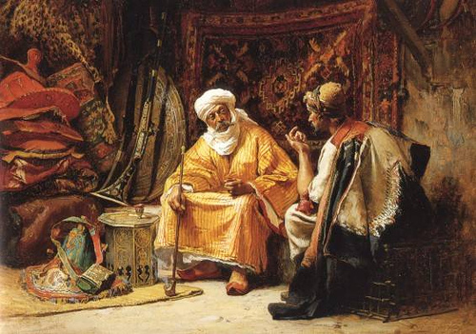
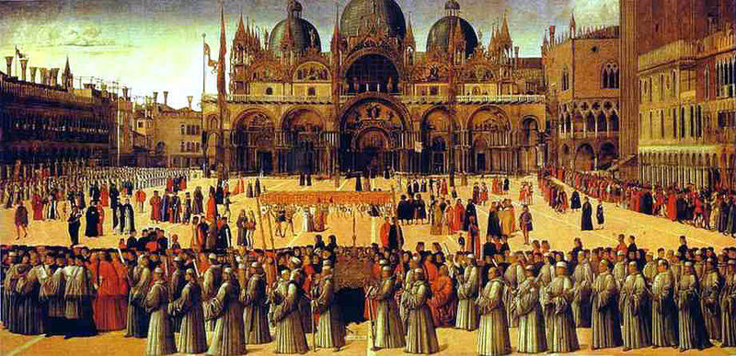
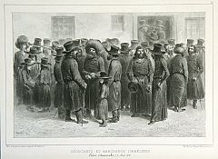
Merchant Jews of Amsterdam
Amsterdam’s Jews played key roles in developing the present form
of capitalism and spreading it westward to England.
The merchant from earliest times was not attached
to the ethical sanctions of any given community, but
was free to carry on trade for profit in an impersonal
‘capitalistic’ way.
Prior to the Reformation, many Christians entered upon
great trading enterprises. Italian merchant-bankers
developed complex banking and credit mechanisms that
fostered large-scale trade.
In Amsterdam in the 16th century, international trade and
business dominated. Holland was a stronghold of Protestantism,
and the Church no longer dictated commercial policies.
Persecuted Jews were welcomed. Many Jews were traders with
wide international connections.

Slide 14
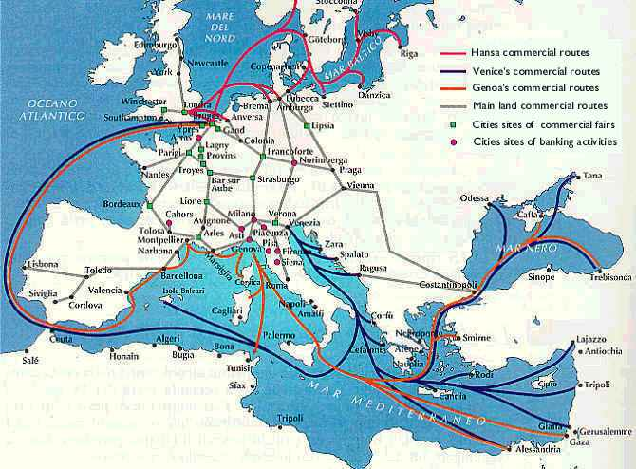
Merchant Jews of Amsterdam
8TH – 11TH CENTURIES – SLAVE TRADE WITH MOSLEMS
Jewish medieval merchants were known as “Radanites.”
They included western European Jews from France and Germany, as well as those from Arab Spain. The term “Radanites” was derived from the name of the
Arab-Christian border along the river Rhone because of an intense slave trade which was conducted across it.
The slaves were castrated in Verdun, Venice, and Lyon
and sold by Jewish Radanite slave-traders
to the Arabs of Spain.

Slide 15
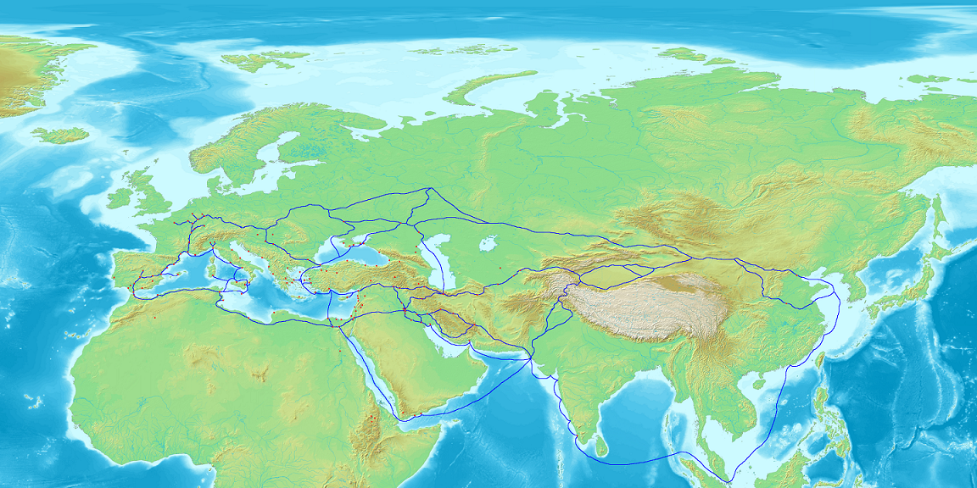
Merchant Jews of Amsterdam
8TH – 11TH CENTURIES
THE JEWS HAD A LONG HISTORY OF BEING TRADERS AND MERCHANTS
All along the Radhanite
trade route were Jewish
culture and the credit
that made trade
possible.
Map of Eurasia showing the trade network of Radhanites, c. 870 CE

Slide 16
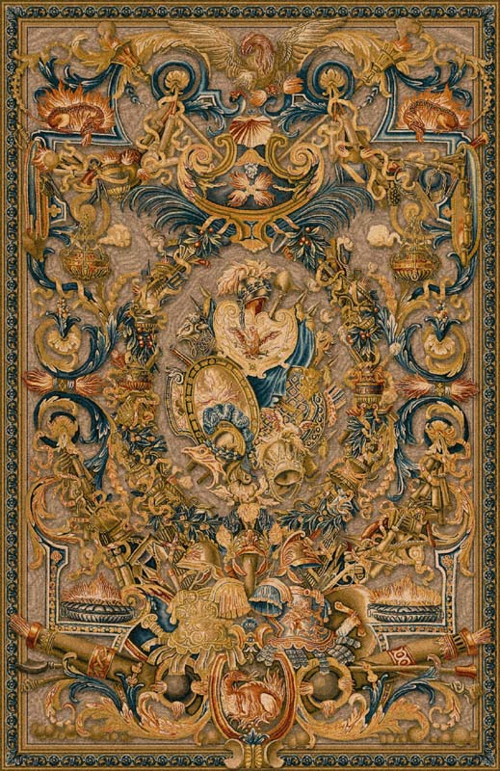
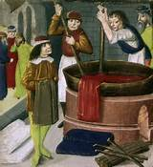
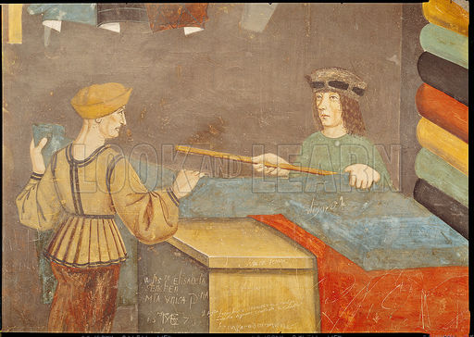
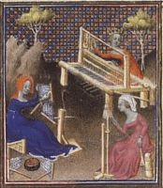
Merchant Jews of Amsterdam
1290 & 1306 Jews expulsed from England and France
Some went to Flanders and Brabent where commerce left to foreign merchants.

Slide 17
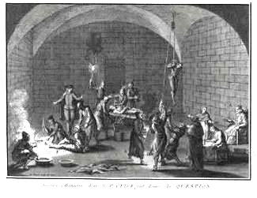
NEW CHRISTIANS and SEPHARDIC JEWS flee from Portugal to Antwerp, Hamburg, Amsterdam
Merchant Jews of Amsterdam
… Jewish involvement in banking proper really begins with the activities of those Conversos who, fleeing the Inquisition in Portugal and Spain, settled in *Antwerp, *Hamburg, and *Amsterdam, some remaining nominally Christian and some openly returning to Judaism.
In Antwerp the Ximenes and Rodrigues d'Evora families were outstanding among an important group of merchant bankers who had commercial relations extending as far as the East Indies and Brazil. While they remained Catholics (like the Mendes de Brito group in Portugal), those who emigrated to Hamburg and Amsterdam formed Sephardi communities.
In Hamburg they participated in the founding of the bank in 1619; 30 (by 1623, 46) local Jews were among its first shareholders, and some of them were financial agents for various North European courts, especially those of Denmark and Schleswig-Holstein
Most famous in Antwerp were Diego Teixeira de Sampaio (Abraham *Senior), consul and paymaster general for the Spanish government, and his son Manuel (Isaac Ḥayyim Senior), who succeeded him as financial agent of Christina of Sweden. Manuel Teixeira was an outstanding member of the Hamburg exchange and participated actively in the transfer of Western European subsidies to the German or Scandinavian courts.
JEWISH VIRTUAL LIBRARY, Banks and Banking
Portuguese Inquisition

Slide 18
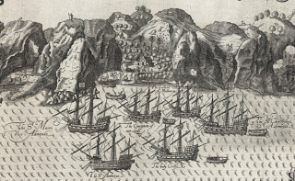
Merchant Jews of Amsterdam
JEWS IN ANTWERP & PORTUGUESE SPICE TRADE
…for the period, 1548-58, which are preserved in the Municipal Archives of Antwerp, furnish some details on the spice trade in Antwerp, because the Affaitadi together with the Portuguese Jew, Diego Mendes and few other merchants had the monopoly in Antwerp of the spices brought by the Portuguese fleets during most of the first half of the sixteenth century.
The Market for Spices in Antwerp, 1538-1544, Florence Edler-De Roover
The Rodrigues d’Evora dynasty is an example of such a New Christian merchant family with a worldwide network centred in
Antwerp. In the late sixteenth century, Manuel Rodrigues d’ Evora settled in Antwerp, where he traded in pepper and spice. His son Simao established a trading company in Antwerp with
his son-in-law Francisco. They dealt with local agents in Goa (these agents included various New Christians and Hindus) and shipped their cargo with the Carreira ships.
Shifting trajectories of diamond processing: from India to Europe and back, from the fifteenth century to the twentieth*, Karin Hofmeester

Slide 19
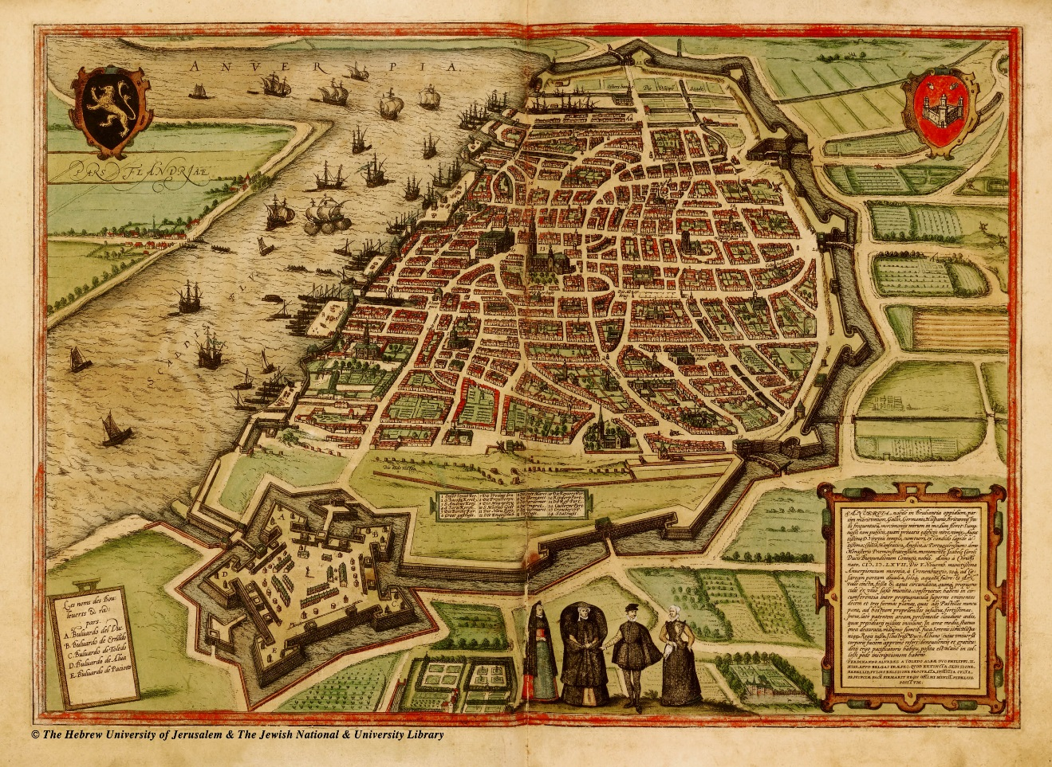
Merchant Jews of Amsterdam
1579 – the northern Dutch provinces united with the Treaty of Utrecht.
Article XIII was revolutionary – no one was to be persecuted for religious reasons.
1585 – Antwerp fell. 19,000 merchants (some Marrano Jews) fled to Amsterdam
SIEGE OF ANTWERP, 1585

Slide 20
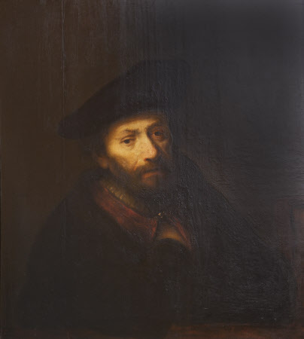
Merchant Jews of Amsterdam
AMSTERDAM ENCOURAGED JEWS TO COME THERE,
FOR THEIR WEALTH AND INFLUENCE
Jurist Hugo Grotius set out rules for Jews, which were adopted but not binding to Dutch counties
Jews should be tolerated in Holland
Jews should be granted freedom of religion
To avoid difficulties:
No distinguishing marks
No more than 300 families of Jews
Not hold political or judicial office
Not to intermarry
Right to live in any part of the city
Could not carry on retail business or join retail guilds
Rodrigues d’Evora

Slide 21
Merchant Jews of Amsterdam
JEWS IN AMSTERDAM
Growth of Amsterdam’s Jewish Population:
1609 1630 1655 1674 1743* 1780
Sephardic 200 1,000 1,800 2,500 3,000* 3,000
Ashkenazi 0 0 0 5,000 10,000* 19,000
Amsterdam Totals 115,000 241,000 217,000

Slide 22
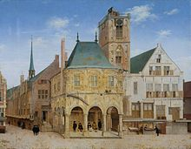
Merchant Jews of Amsterdam
In 1631 the Bank of Amsterdam had a total of 1,348 accounts, representing 1.1% of the population.
89 accounts were held by Jews, 9% of the Jewish population, underscoring their economic activity.
The indigenous families of Amsterdam included the
regents and patricians. They had the largest fortunes
or largest financial transactions.
But Portuguese Jews’ percent in the economic life
was greater in the population than other ethnic groups.

Slide 23
Merchant Jews of Amsterdam
*Although large numbers of Jews lived in poverty, there was an appreciable number of well-off.
Of the total 13,000 Jews living in Amsterdam in 1743, 442 had an annual income exceeding 800 guilders.
110 living on income from
interest on capital
96 merchants
6 clothing merchants
16 cotton merchants
10 tea merchants
6 tobacco merchants
1 bamboo merchant
1 merchant in cottonthread
10 owners of tobacco stores
6 owners of clothing stores
3 owners of cotton goods stores
2 owners of textile stores
3 owners of carpet and rug stores
2 owners of lace stores
1 owner of china store
2 owners of cheese stores
2 owners of coffee shops
10 brewers
6 wine cellar proprietors
2 butchers
9 booksellers
5 porters
20 brokers
100 unsworn brokers
40 money changers
5 bankers
2 commission agents
1 shipping broker
4 tobacco brokers
2 solicitors
23 jewelers
7 diamond polishers
1 distiller
1 woolwasher
1 lacquer worker
2 wigmakers
1 printer
12 medical doctors
5 surgeons
5 apothecaries
3 teachers
6 cantors
1 ritual butcher
1 instructor
This list shows that the ruling which prohibited Jews from carrying on retail trade was not strictly enforced. Besides these 442 on this list, there were many more store-keepers and artisans with incomes below 800 guilders.
In 1631 the Bank of Amsterdam had a total of 1,348 accounts, representing 1.1% of the population.
89 accounts were held by Jews, 9% of the Jewish population, underscoring their economic activity.

Slide 24
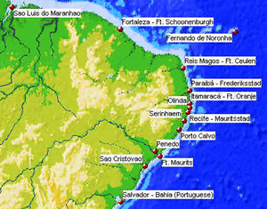
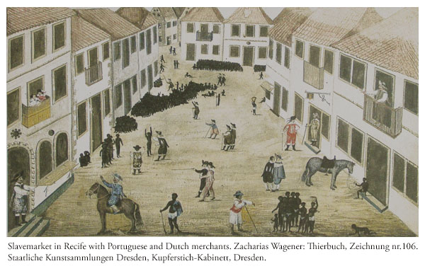
Merchant Jews of Amsterdam
JEWS IN BRAZIL
NEW HOLLAND
(DUTCH BRAZIL)
Jewish merchants had established relations with Levant trade.
However, after first using the Jews as mentors, the Christians
took over the business.
Probably the most important economic activity of Dutch Jewry
was that in the West Indies. The Jewish community did
dominate New Holland, the Dutch colony in Brazil 1630–1654.
Jews acquired much personal wealth, fostered the sugar
industry, stimulated international trade.
The Jewish merchants participated in the slave trade
with the Dutch West India Company.
Slavemarket in Recife, New Holland.

Slide 25
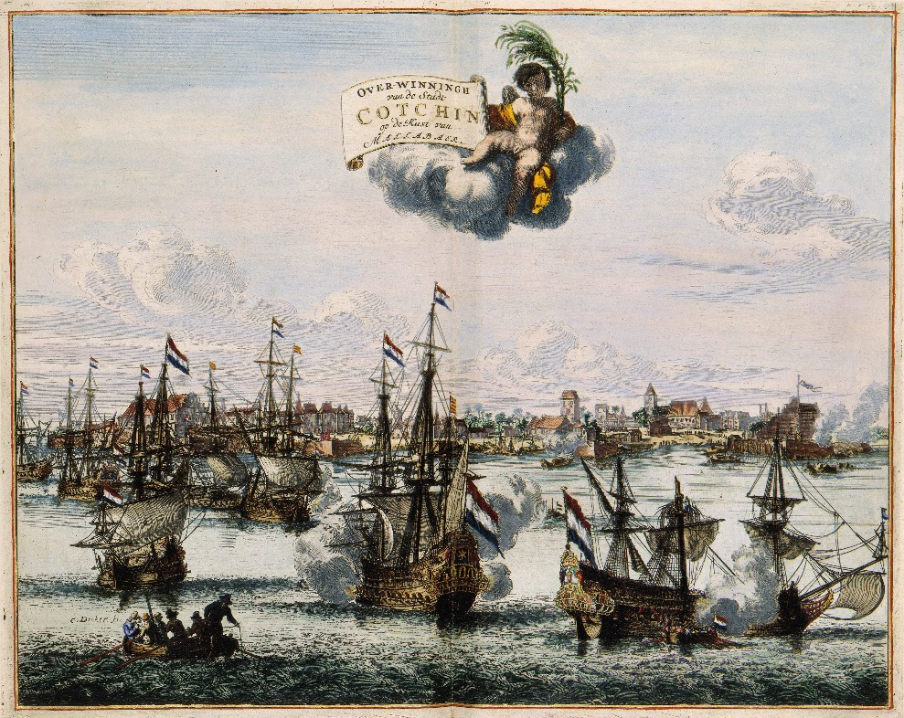
Merchant Jews of Amsterdam
JEWS AND THE DUTCH EAST INDIA COMPANY
In the early days of the East India Company the Jewish investments were very small, but by 1652 a Jewish community tax in Amsterdam on Jewish incomes from East India Company shares was so considerable that it formed one of the principal sources of revenues to the community both at that time and for long afterwards. HUMBLE ADDRESSES, Menasseh ben Israel
In the eighteenth century, the period of greatest speculation, one-quarter of all the Company’s stockholders were Jews.

Slide 26
PART 3
Amsterdam Stock Exchange

Slide 27
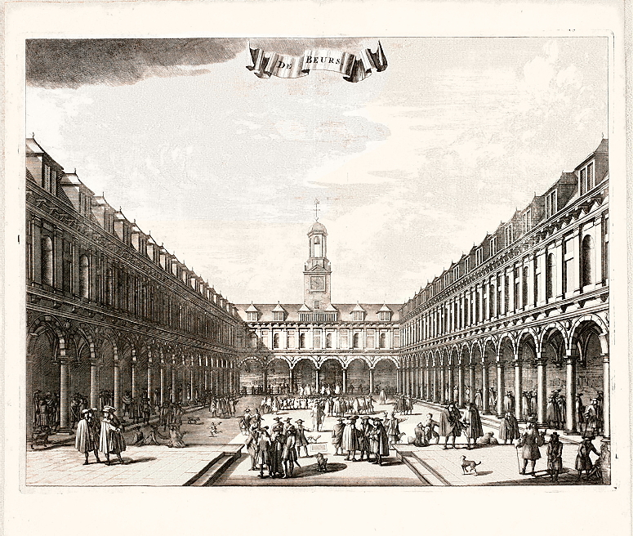
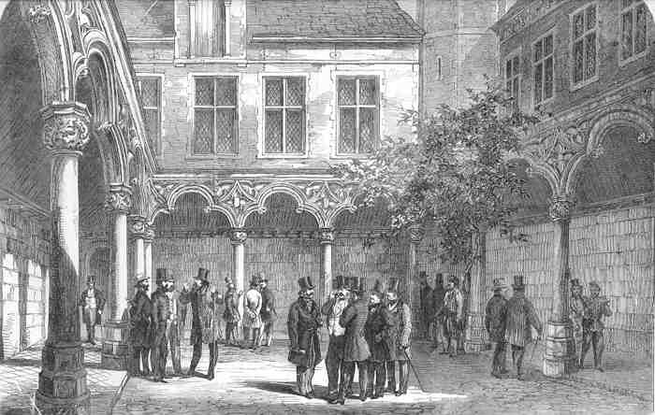
Amsterdam Stock Exchange
The Amsterdam Exchange was built in 1611. It was modeled on that of Antwerp from 1531,
which is said to have gotten it from the Levant.
Amsterdam Exchange
Antwerp Exchange

Slide 28
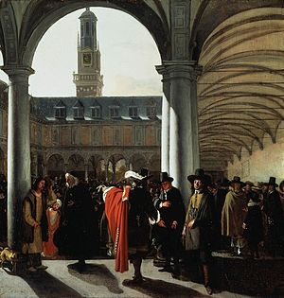
Amsterdam Stock Exchange
The Amsterdam Bourse shows the nature and scope of this world-wide economy.
…each of the many pillars round Neville’s Court represents the meeting-place
of a particular group of merchants – the Russia merchants congregating round one,
the Levant traders round the next, the East India merchants round a third, and so on,
while in the open Court the brokers and financiers haggle over the day’s share quotations –
The Bourse was … the hub of a gigantic network of world trade, shipping and finance.
The official brokers were ‘sworn’. There were
375 Christians and 20 Jews. They could not trade on
their own account. There were 700 ‘unsworn’ brokers
- mainly Jewish. They were not prohibited from
trading on their own account.

Slide 29
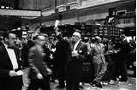
Amsterdam Stock Exchange
The Amsterdam Stock Exchange was the direct origin of our present exchange mechanisms and procedures.
The Derivative Innovations from today were all practiced on the Amsterdam Exchange:
Same contracts
Same rules of trading
Same cheating of public and manipulating markets
Types of transactions:
Stock sold for immediate cash
Stock sold on margin up to 80%
Monthly settlement dates
Future settlement dates
Put and call options, premiums payable immediately at Bank of Amsterdam
The Ducatoon, imaginary share representing 1/10 of Dutch East India Co Share, with monthly settlement date

Slide 30
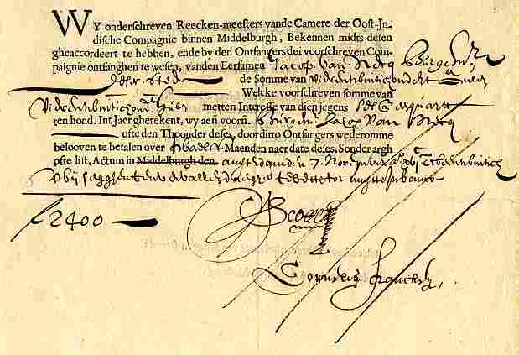
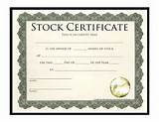
Amsterdam Stock Exchange
The primary security traded in Holland was the Dutch East India Company (DEIC).
This was the first company to issue stock to the public.
1602 – company formed
1607 – share price rose to 100% over their original par value
1688 – share price rose to 580% over their original par value
Dividends paid on the stock - totaled 1,482% of the par value
Stock of DEIC

Slide 31
PART 4
Manipulations on the Stock Exchange
Short Selling
Dual Trading
Bear Raids
Structural Market Flaws

Slide 32
Manipulations on the Stock Exchange
SHORT SELLING:
Selling something you do not own… to manipulate prices
Short selling attempts to drive the share price down -- by selling large quantities of shares on the market.
A larger supply will bring down the price in the market.
1609 - a group of well-connected Dutch businessmen, led by one of the
original subscribers to the Dutch East India Company, Isaac Le Maire, formed a secret
association, a “Groote Companie, ” to short the shares in the East India Company in anticipation
of the incorporation of a rival French-chartered trading firm.
Le Maire and his colleagues sold shares forward in a “blanco” transaction promising future delivery
in one or two years. Over the next twelve months, their profits mounted, as East India Company shares
dropped by 12%, angering shareholders who inevitably learned of their plan.
1610 - the States-General decided to prohibit the sale of shares not in possession

Slide 33

Manipulations on the Stock Exchange
HOW SHORT SELLING WORKS
INCREASE SUPPLY
FALLING PRICE
SELL!
SELL!
SELL!
SELL!
SELL!
(SHORT)
(SHORT)
(SHORT)
(SHORT)
(SHORT)

Slide 34
Manipulations on the Stock Exchange
DUAL TRADING: FLEECING THE PUBLIC
A broker, allowed to trade for himself at the same time as for his client, is able to sell from his account with very little risk. This is called ‘front running’.
Example: a broker has an order from his customer to buy at $50 market price. Current market price is $55.
market price $55
market starts down
Broker makes his own order: buy at $55.01
if market starts up, broker will profit on his own account
if market continues down
Broker executes client’s order: broker sells his own shares (newly bought at $55.01) to his client @ $55,
preventing loss to himself
THE BROKER HAS POSSIBILITY
OF GREAT GAIN WITH LITTLE RISK
OF LOSS.

Slide 35
Manipulations on the Stock Exchange
THE AMSTERDAM EXCHANGE COULD NOT STOP
SHORT SELLING OR DUAL TRADING
Who makes the rules?

Slide 36
Manipulations on the Stock Exchange
BEAR RAIDS – DRIVING PRICES DOWN
MANIPULATION OF MARKET BY A SYNDICATE
The syndicate does the following:
Borrow all available money
Purchase all shares offered (drives up prices)
Start selling the shares, to cause price to drop:
Sell call options (right to buy in future)
Sell put options (right to sell in future)
Loan bulls money, taking their shares as collateral and sell these shares
Spread false news
Whisper loud enough to be heard
Sell government bonds for shock effect
Make up gossip to feed to crowds of speculators

Slide 37
Manipulations on the Stock Exchange
DUCATOON TRADING
STRUCTURAL MARKET FLAW
Ducatoons were imaginary units (1/10) of a DEIC share, kept as account book entries by the market maker.
Their market price fluctuated independently of the DEIC share price, and they were settled monthly by the market maker. Settlement price was 1/10 of the price of the DEIC share on settlement day.
Today’s example would be stock index future trading:
“The turnover for the global market in exchange-traded equity index futures is
notionally valued, for 2008, by the Bank for International Settlements,
at USD 130 trillion.”

Slide 38
Manipulations on the Stock Exchange
DUCATOON TRADING
STRUCTURAL MARKET FLAW
There was no risk for the market maker – he was fleecing the public:
SCENARIO #1
He sold Ducatoons to speculators at premium over the DEIC share price –
and at same time purchased the DEIC share.
This locked in his profit with no risk. Broker Account: In Out Profit
sale of ducatoons 110
purchase of share 100 10
On settlement day –
If DEIC share price higher, he could sell his share for the money to pay his Ducatoon customers,
without incurring a loss.
If DEIC share price lower, he owed his Ducatoon customers less and made more profit.

Slide 39
Manipulations on the Stock Exchange
DUCATOON TRADING
STRUCTURAL MARKET FLAW
There was no risk for the market maker – he was fleecing the public:
SCENARIO #2
He buys Ducatoons to speculators at discount over the DEIC share price –
and at same time sells short the DEIC share.
This locked in his profit with no risk. Broker Account: In Out Profit
buy of ducatoons 90
sell share short 100 10
On settlement day –
If DEIC share price higher or lower, he could settle his Ducatoons and buy share to cover short,
without incurring a loss.

Slide 40

Manipulations on the Stock Exchange
DUCATOON TRADING
STRUCTURAL MARKET FLAW
There was no risk for the market maker – he was fleecing the public.
But since the Ducatoons settled for cash, these ‘index futures’ encouraged speculators to manipulate of the underlying share price.

Slide 41
PART 5
Timeline of Wars of Dutch

Slide 42
Timeline of Wars of Dutch
1579 Union of Utrecht –
union of northern provinces
80 YEARS’ WAR or DUTCH REVOLT
(1568 – 1648)
1579
|_______________|____|_________|_______|__________________________________________________________|
1568
1581
1583
1585
1648
1585
Fall of Antwerp
Peace of Munster
De jure
Dutch Independence
1581
De facto
Dutch Independence
1583
States-General decides to rule as republican body, after no Protestant ruler will assume head of state
12 Years’ Truce (1609-1621)
(ceasefire between Spain & Dutch
– Dutch build navy)
|____________________|
1609
1621
30 Years’ War (1618-1648)
(general European war, merged with
final stage of Dutch Revolt (1621-1648)
|________|__________________________|
1618
1621
1648

Slide 43
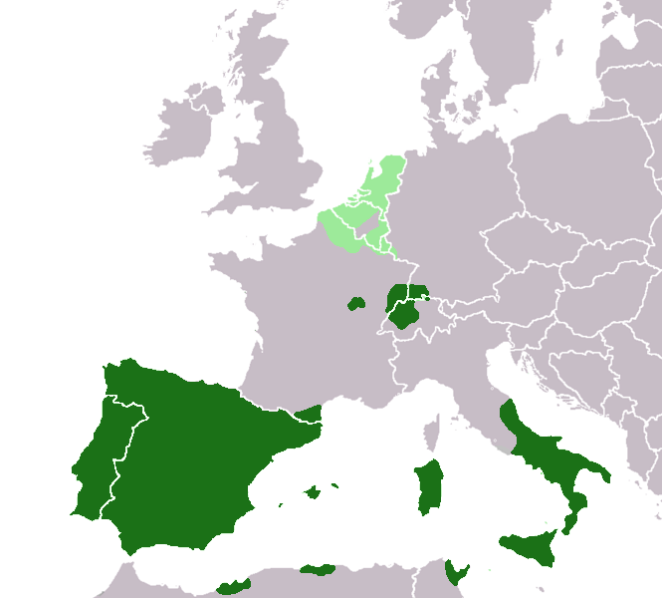
Timeline of Wars of Dutch
European territories under the rule of the
Spanish king around 1580
(the Netherlands in light green)

Slide 44
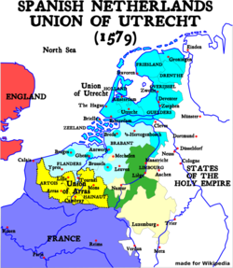
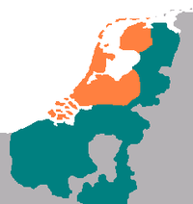
Timeline of Wars of Dutch
Northern Provinces unite 1579
(bright blue)
Territory of the
United Provinces c. 1590
(orange)

Slide 45
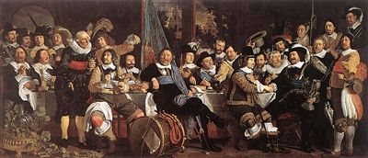
Timeline of Wars of Dutch
Amsterdam citizens celebrating the Peace of Münster, 1648

Slide 46
Timeline of Wars of Dutch
ANGLO-DUTCH WARS -- Navigation Wars
For control of seas and trade routes
|_____|________|______|____________|_______|_____________________|___________|_________________|_______|
1652
1654
1665
1667
1672
1674
1701
1714
1780
1784
1652-1654
First
Anglo-Dutch
War
1665-1667
Second
Anglo-Dutch
War
1672-1674
Third
Anglo-Dutch
War
1780-1784
Fourth
Anglo-Dutch
War –
war disastrous
for Dutch
Franco-Dutch War
(or Dutch War)
(1672-1678)
|______________|
1672
1678
War of Spanish Succession
(1701-1714)
general European war
Dutch open dykes, flood country,
and halt French land campaign
|______________|
Dutch defeat combined
Anglo-French fleet
1701
1714, Treaty of Utrecht

Slide 47
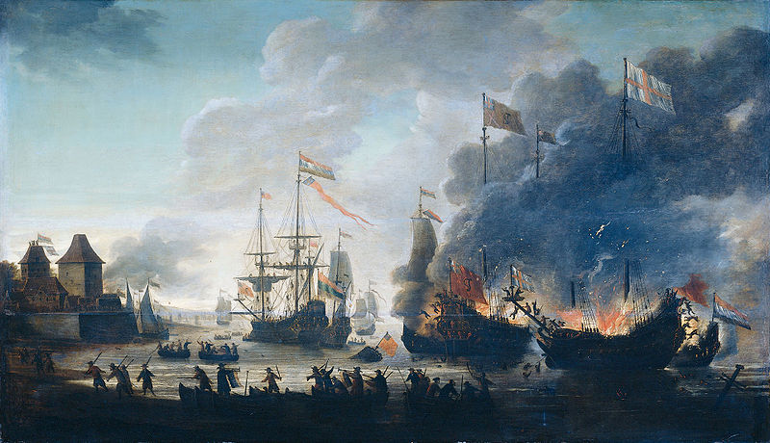
Timeline of Wars of Dutch
1667: The Raid on the Medway was a successful Dutch attack on the largest English naval ships, laid up in the dockyards
of their main naval base Chatham. The Dutch sailed up the River Thames to the River Medway to Chatham, where they burned
three capital ships and ten lesser naval vessels, towing away two others, pride and normal flagship of the English fleet.
The raid led to a quick end to the war and a favourable peace for the Dutch.
It was the worst defeat in the Royal Navy’s history, and one of the worst suffered by the British military.
1667 Raid on the Medway
Second Anglo-Dutch War

Slide 48
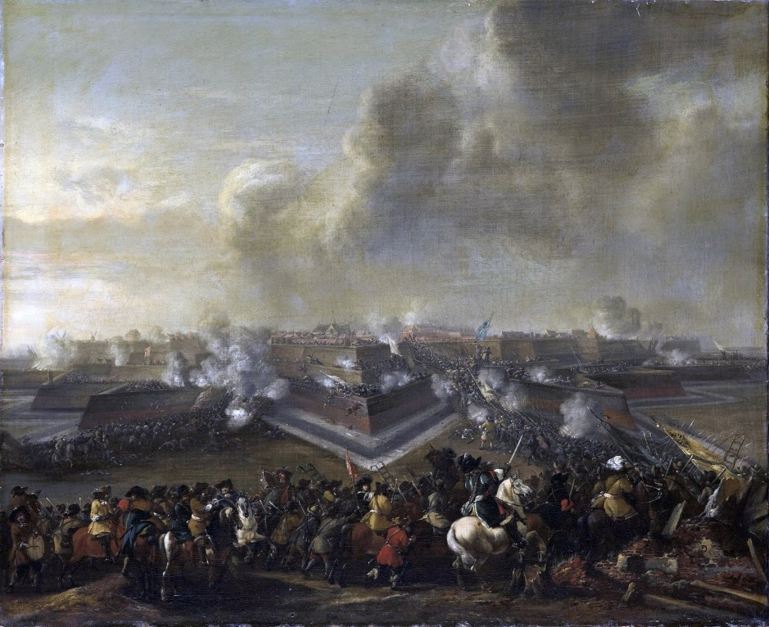
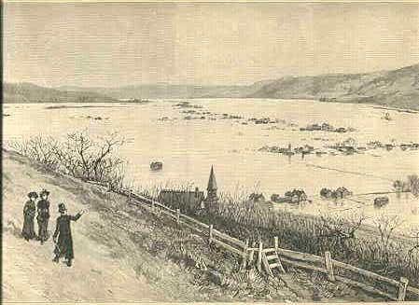
Timeline of Wars of Dutch
FRANCO-DUTCH WAR
(1672-1678)
Dutch flooded their land in
Franco-Dutch War,
ending the French land campaign.

Slide 49
PART 6
Dutch Neglected Real Economy for Speculation and Financial Economy

Slide 50
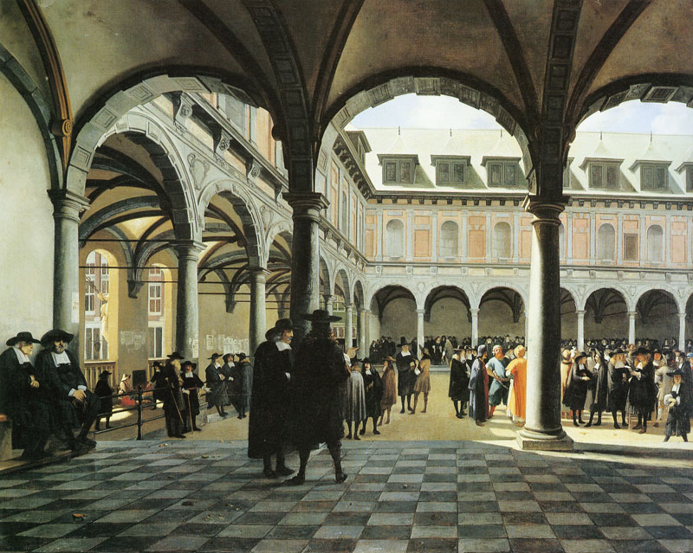
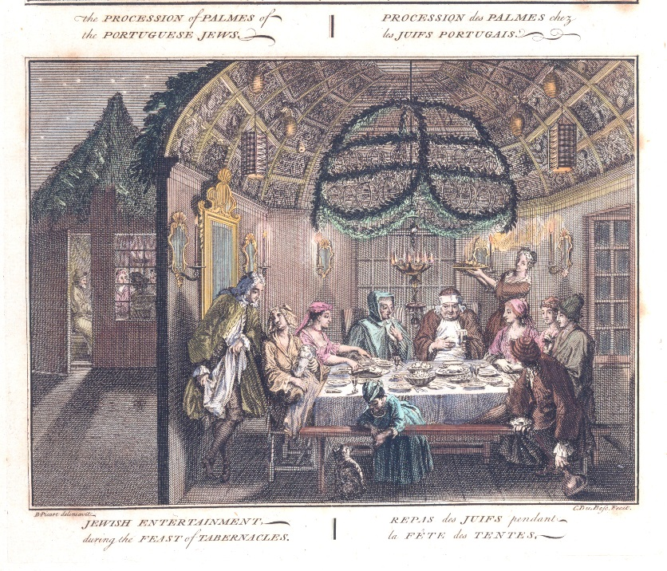
Dutch Neglected Real Economy for Speculation and Financial Economy
Concentration on Gambling in the Stock Market.
The largest speculators were Christian.
But, in the 18th century, the Portuguese Jews dominated the broker’s guild.
They concentrated on the stock exchange, and gave up trade and commerce.

Slide 51
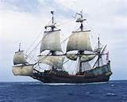
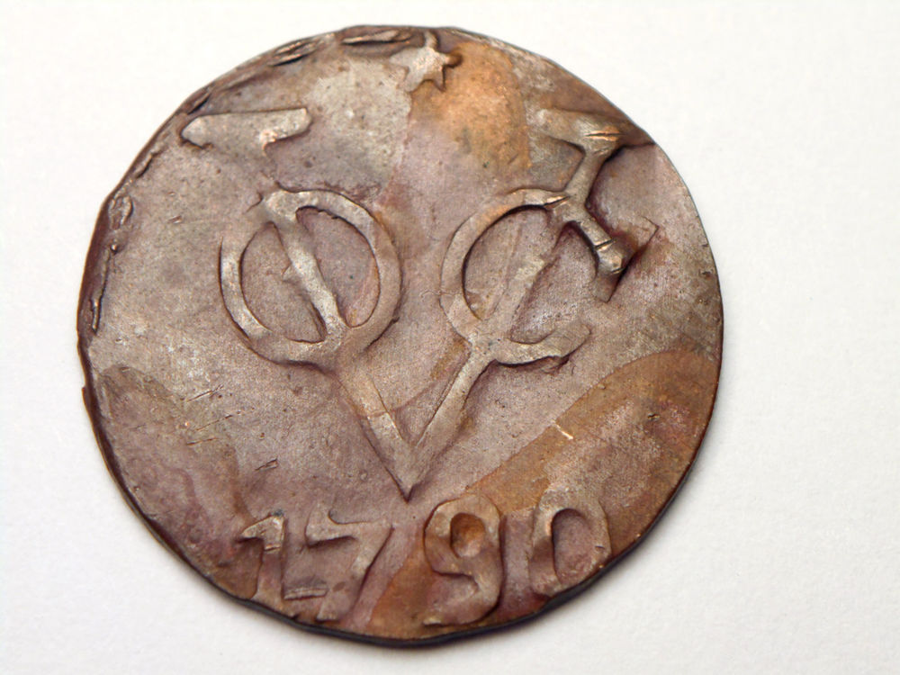
Dutch Neglected Real Economy for Speculation and Financial Economy
DUTCH EAST INDIA COMPANY DECLINED
The competition with European and Asiatic powers grew keener. Corruption of colonial officials aided decline.
Natives were consistently suppressed, a short-sighted attitude which nullified their purchasing power. The Company’s ships were forced to leave Holland virtually empty because the natives were unable to purchase European goods.
The competition of other nations made trading in European wares with Eastern ports very difficult.
The cost of both East and West Indian voyages was therefore so great that much of the profit was lost.

Slide 52
Dutch Neglected Real Economy for Speculation and Financial Economy
DIRECTORS OF DEIC MANIPULATED STOCK AND STOCK DIVIDENDS
The Director began declaring dividends when there was no profit!
When the stock depreciated, the directors bought the depreciated stock.
The Directors would then declare dividends, which raised the stock price.
The Directors then sold their shares.
By 1724, they had used up a reserve fund of 40,000,000 guilders.
Later, they paid dividends on borrowed capital.
1780-1784 Disasters of fourth Anglo-Dutch War in the Asian colonies forced the company to appeal to the States-General.
1799 -- the company ended.

Slide 53
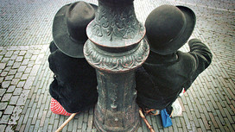
Dutch Neglected Real Economy for Speculation and Financial Economy
INCREASING IMPORTANCE OF FINANCIAL SECTOR BROUGHT
CONCENTRATION OF WEATH INTO A SMALL GROUP OF WEALTHY FINANCIERS
The wealthier classes were interested in foreign investment.
They dissociated from the needs of the Dutch people.
Large-scale structural unemployment grew.
Parasitic investor class – taxed common people, not wealthy.
STRUCTURAL
UNEMPLOYMENT
APPEARED

Slide 54
PART 7
Holland financed England

Slide 55
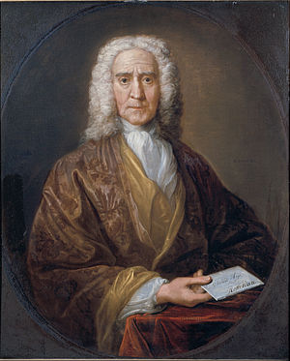
Holland financed England
DUTCH LOANS INDISPENSABLE TO GOVERNMENT OF ENGLAND
1680 TO 1780
Biggest Dutch financiers were the Christian houses of Hope and Pelse, which specialized in bill brokering.
The Jews made more political loans, such as to the Dutch House of Orange to enable William III to become King of England.
Hope & Co. is the name of a famous Dutch bank
that spanned two and a half centuries. Though the
founders were Scotsmen, the bank was located in
Amsterdam, and at the close of the 18th century
it had offices in London as well.

Slide 56
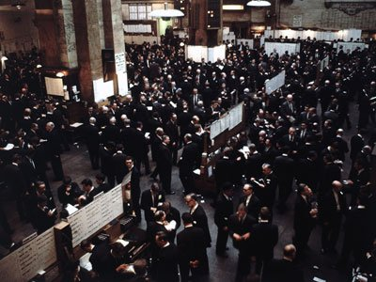
Holland financed England
From 1750 on, Dutch capital (money) penetrated everywhere.
About one-third of the British national debt was held in Holland,
paying 1.4 million pounds annual interest.
Portuguese Jews from Amsterdam introduced the shares system on the London Exchange towards end of 17th century.

Slide 57
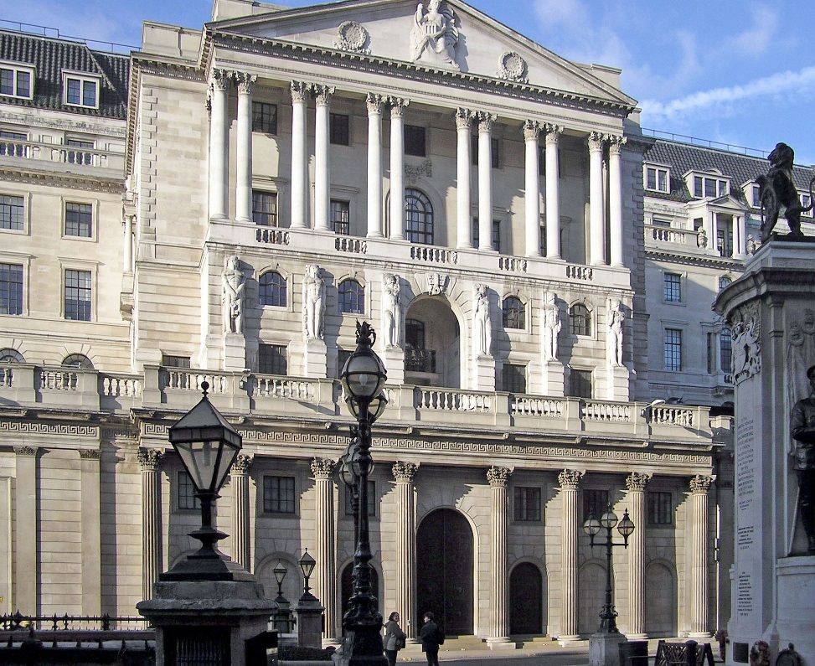
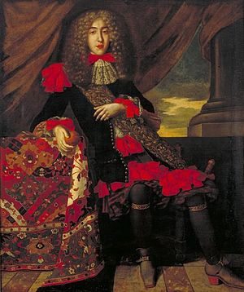
Holland financed England
THE BANK OF ENGLAND (1694) WAS FLOATED WITH DUTCH CAPITAL
DUTCH BANKERS WERE ITS LARGEST STOCKHOLDERS AND CUSTOMERS IN 1760
A SMALL BUT IMPORTANT GROUP OF Dutch traders and financiers, migrated to London:
Christian, Jew, Huguenot
via Holland
with international financial expertise
Some of the Jewish families were: Medinas, Suassos, Pintos, and Dutch Christian names:
Van Neckers, Von Nottens, Van Hemerts.
Francisco Lopes Suassos, 1657 –1710,
was a banker and financier of the Dutch
Republic. He was also known within
the Sephardic community as
Abraham Israel Suasso.
BANK OF ENGLAND

Slide 58
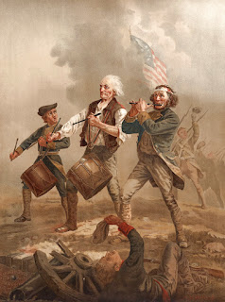
Holland financed England
DUTCH SHIFTED SUPPORT TO U.S.
AND LOST OUT FINANCIALLY
1780 – Dutch held 3/7 of English national debt
But Dutch began shifting money from England to the U.S.:
Gave loans to U.S.
Sold off English debt
1802 American securities were most active on Amsterdam Stock exchange

Slide 59
Q & A
WILL DECKER’S CONCLUSION:
THE CONTROL OF MONEY -- WITHOUT CONTROL FROM THE PUBLIC -- LEADS TO
CORRUPTION … USURPATION … SLAVERY.

