Slide 1
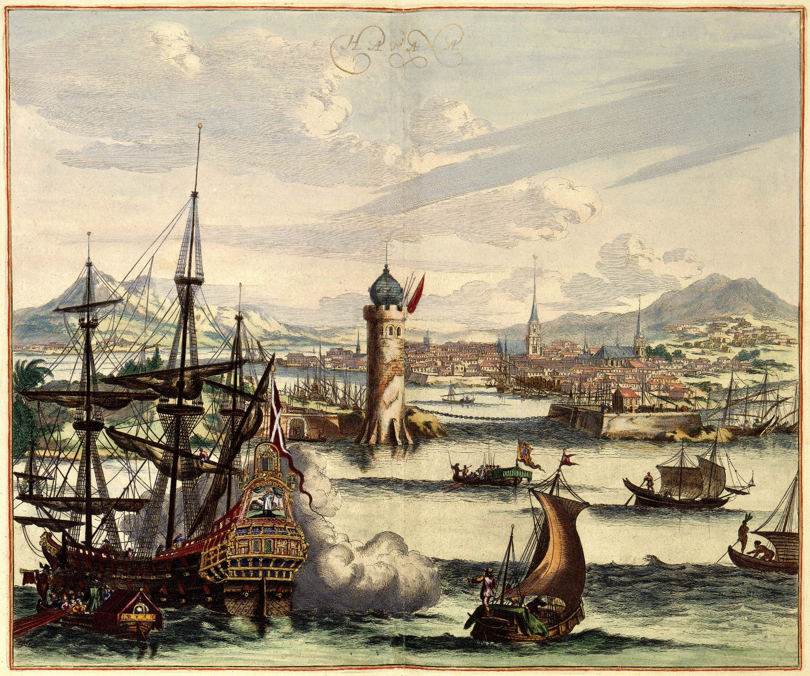
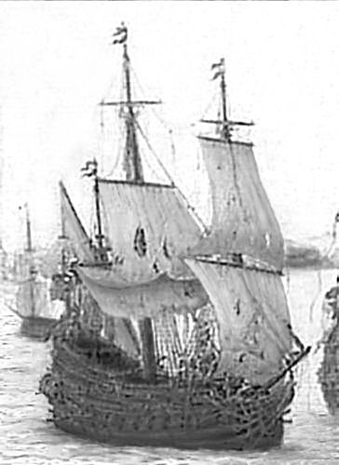
The Lost Science of Money
CHAPTER 9 (Part 1):
THE RISE OF CAPITALISM IN AMSTERDAM

Slide 2
THEMES OF LOST SCIENCE OF MONEY BOOK
Primary importance of the money power
Nature of money purposely kept secret and confused
How a society defines money determines who controls the society
Battle over control of money has raged for millennia: public vs private

Slide 3
PARTS OF PRESENTATION
ROOTS OF ‘MODERN CAPITALISM’
HISTORY OF FINANCIALLY POWERFUL CITIES: EMPIRES OF TRADE & CREDIT
VENICE
BRUGE
ANTWERP
AMSTERDAM
AMSTERDAM’S INFRASTRUCTURE PRIOR TO 1585
AMSTERDAM’S FINANCIAL SYSTEM (CAPITALISM)
BANK OF AMSTERDAM
THE BANK ISSUES SECRET CREDIT
THE BANK CARRIES ON PROHIBITED TRADE IN PRECIOUS METALS
DUTCH COLONIES: WEST & EAST

Slide 4
PART 1
ROOTS OF MODERN ‘CAPITALISM’

Slide 5
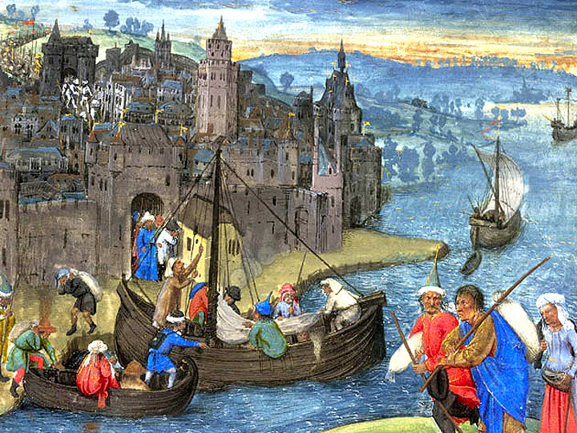
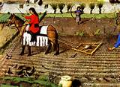
TO THE ORDINARY PERSON, IT WAS SIMPLY ASSUMED THAT HUMAN RELATIONS CAME FIRST….BUT….
ROOTS OF MODERN ‘CAPITALISM’
THE MEDIEVAL COMMERCIAL REVOLUTION: GOLD & SILVER MONEY
CHANGED THE RELATIONS BETWEEN PEOPLE
Commodification of land, land rents, labor, and wealth – everything valued in money terms
Removal of manorial responsibilities for tenants and serfs
Growth of trade in luxury goods and free towns – new class of merchants and artisans governed by town’s commercial laws
Development of rentier class – collect money for rents on land and buildings
Direct money taxation of peasants – on larger scale than ever before
CULTIVATABLE LAND &
CASH CROPS –
not for eating
or dues
FREE TOWNS
OF MERCHANTS &
ARTISANS –
MONEY MARKETS

Slide 6
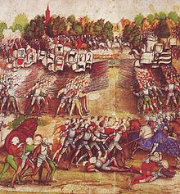
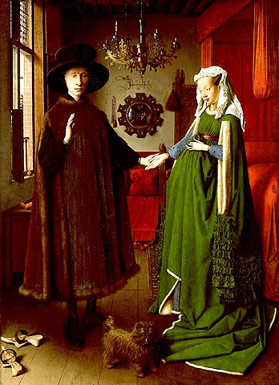
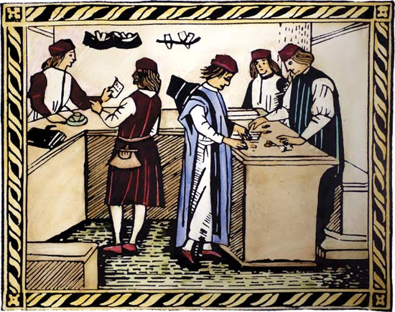
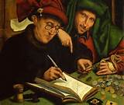
THE MEDIEVAL COMMERCIAL REVOLUTION IN MONEY, BANKING & CREDIT --
ROOTS OF MODERN ‘CAPITALISM’
THE EARLY FOUNDATION OF ‘CAPITALISM’
Public minted coins supplemented with private bank credit
(merchant banks, bills of exchange aka checks, current accounts, letters of credit)
Growth of international trade for luxury goods using money and credit – trade fairs, clearing mechanisms, Italian private merchant banking partnerships, private shares, commodity & money markets
Use of money and credit to fund larger wars

Slide 7
PART 2
HISTORY OF FINANCIALLY POWERFUL CITIES:
EMPIRES OF TRADE & CREDIT
VENICE
BRUGE
ANTWERP
AMSTERDAM

Slide 8
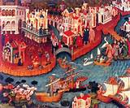

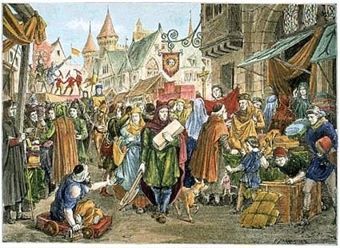
HISTORY OF FINANCIALLY POWERFUL CITIES
RISE OF POWERFUL CITIES – CAUSED BY MONEY, TRADE, BANKING, CREDIT
800------------------------------------1100---------------------------1200-----------------------------------------1389---------------------------1500
VENICE (‘first capitalistic city’)
800-1500 harnesses East-West gold/silver ratio trade: silver drains to East; prosperity built on trade
1173 first ‘bond market’ – Republic’s forced loan (‘Imprestiti’) became investment, bought and sold
1204 plundered Constantinople -- Europe flooded with gold and silver
1200’s + – merchant banking funds international trade
1345 – Alexandria trade to East opened to Venice
KNIGHTS TEMPLARS (1118-1307)
first bankers of Europe: loans, letters of credit, double-entry bookkeeping
controlled East-West gold/silver ratio trade thru Levant
BRUGE (1128-1500)
town life re-awakens: Flemish wool trade and cloth fairs, Hansa ships
intl trade: Italian merchant bankers bring luxury trade from Levant (1277 Genoa, 1314 Venice)
credit creation: deposit banking (current account transfers), merchant banking (bills of credit)
1309 first commodity exchange
1389-1540 HANSA war on credit causes severe deflation in Bruge; 1433 banking prohibited

Slide 9
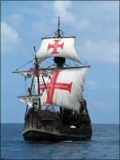
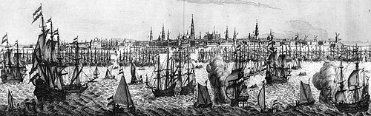
HISTORY OF FINANCIALLY POWERFUL CITIES
RISE OF POWERFUL CITIES – CAUSED BY TRADE, BANKING, CREDIT
1492------1500-----------------1585-------------------1600-----------------------------------1700-----------------------1750---------------1800
1492 + PLUNDER OF AMERICA AND THE EAST FOR GOLD AND SILVER MONEY
ANTWERP (1500-1585) – Flemish city
Portugal sails around Africa to India – grabs East-West gold/silver ratio trade 1500-1640
Portugal wages war for Eastern trade
ANTWERP trading center for Portuguese Eastern spice fleets and luxuries – European entrepot using foreign ships
commodity exchange
merchant bankers, money lenders, financiers, loans to England (1544-1574)
AMSTERDAM (first modern capitalistic city, 1585-1750)
Dutch Republic wins freedom from Spain (1572-1600 and final Treaty of Munster 1648)
Dutch rebels strangled Antwerp in 1585 by blocking city’s sea access; merchants move in mass to Amsterdam
Earlier in 16th century: importance of Dutch herring fisheries and trade, shipped bulk trade in grain etc. between Baltic and southern Europe in Dutch ships, trade moved on payment of coin
International trade in hands of Dutch merchants and Dutch ships: warred and won Eastern spice and gold/silver trade from Portugal
Development of industries in sugar-refining, working of tobacco, ship-building, rope & sail-makers, etc. : trade stimulated industry

Slide 10
PART 3
AMSTERDAM’S INFRASTRUCTURE PRIOR TO 1585

Slide 11
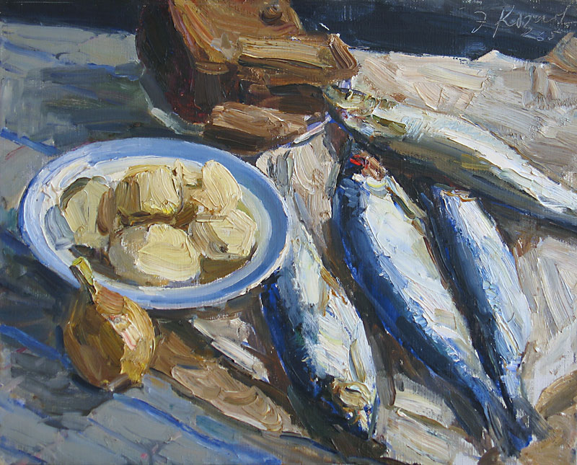
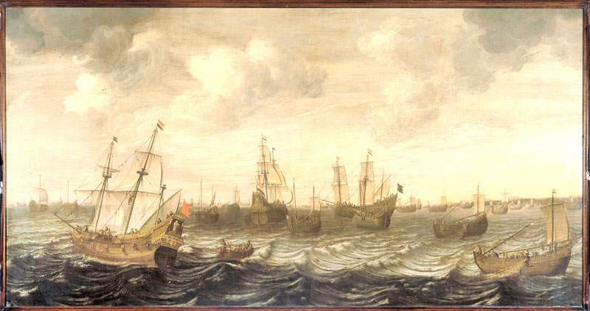
AMSTERDAM’S INFRASTRUCTURE IN 16TH CENTURY
FISHING INCOME WAS BACKBONE OF HOLLAND’S COMMERCIAL RISE.
DUTCH TECHNOLOGY EXCELLED IN PRESERVING HERRING CATCH IN SALT
DUTCH HERRING FLEET

Slide 12
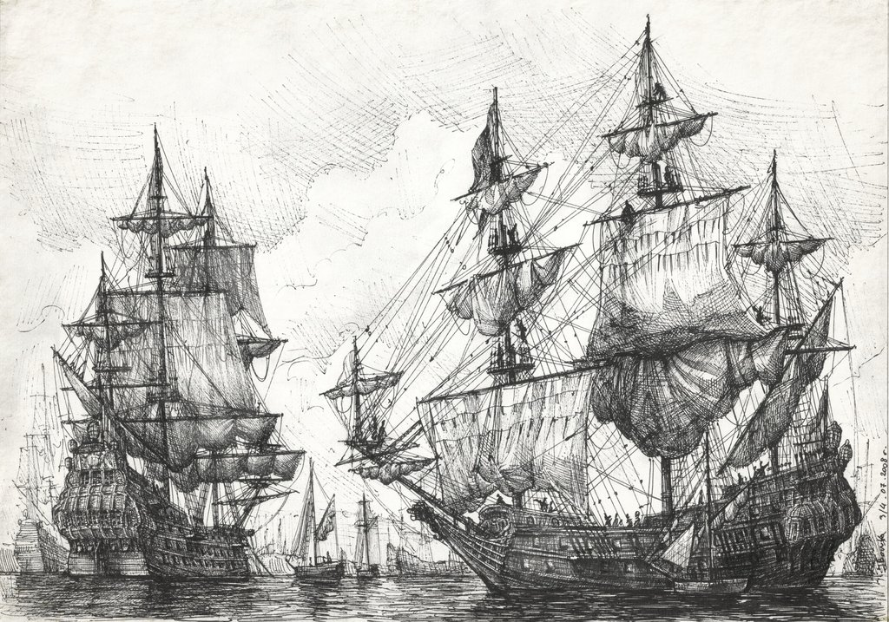
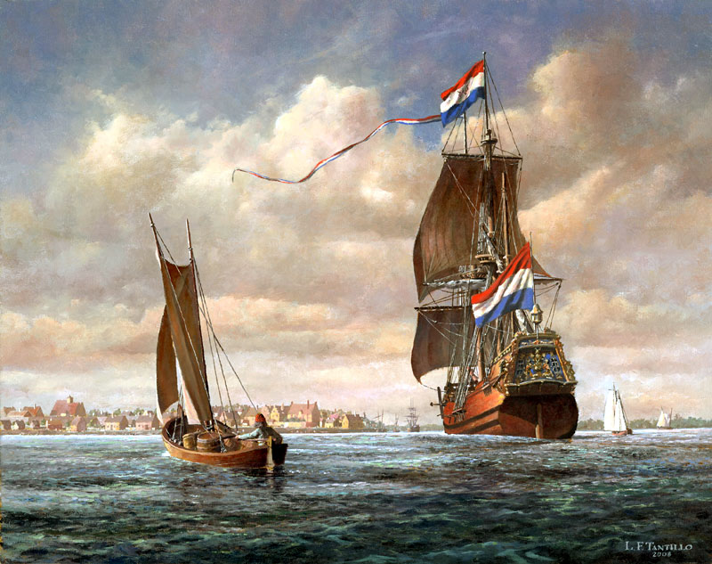
AMSTERDAM’S INFRASTRUCTURE IN 16TH CENTURY
DUTCH ZAANDAM BECAME EUROPE’S PREMIER SHIPBUILDING CENTER.

Slide 13
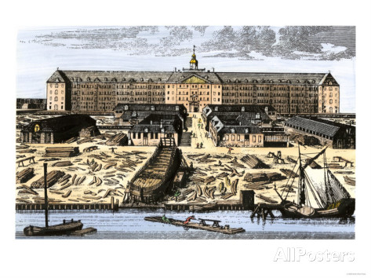
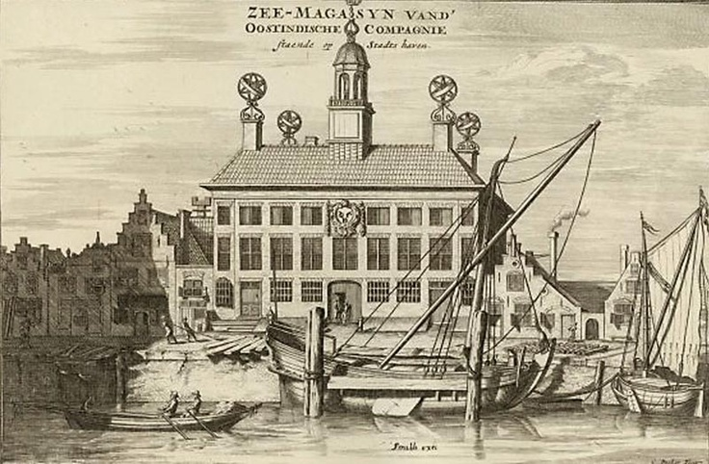
AMSTERDAM’S INFRASTRUCTURE IN 16TH CENTURY
WAREHOUSES WERE AS IMPORTANT TO DUTCH SUCCESS AS SHIPS –
THEY BOUGHT AT SEASONS WHEN PRICES WERE LOWEST AND
STORED MERCHANDISE TO AWAIT A SELLERS MARKET.
Dutch West India Co.
Dutch East India Co.

Slide 14
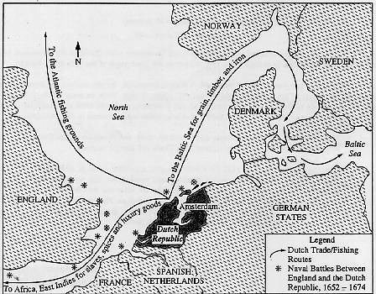
AMSTERDAM’S INFRASTRUCTURE IN 16TH CENTURY
DUTCH SHIPS CARRIED BULK TRADE GOODS FROM THE BALTIC (GRAIN, WOOD, ETC.)
AND MET AT AMSTERDAM WITH FRENCH TRADE IN WINE AND SALT
PRIOR TO 1585 –
THERE WAS NO BOURSE, NO BANK, LITTLE SURPLUS
MONEY.
THE BURGHER CLASS PROSPERED BUT THERE WAS
NO GROUP OF CONSPICUOUSLY WEALTHY MEN.

Slide 15
AMSTERDAM’S INFRASTRUCTURE IN 16TH CENTURY
THEN, IN 1585, ANTWERP LOST ITS ACCESS TO THE SEA –
PRACTICALLY OVERNIGHT, NINETEEN THOUSAND MERCHANTS MIGRATED TO AMSTERDAM FROM ANTWERP.
THE TO-BE DUTCH REPUBLIC BECAME THE COMMERCIAL CENTER OF EUROPE ‘OVERNIGHT’.
CAPITALISM IN AMSTERDAM IN THE 17TH CENTURY, Violet Barbour
“In Holland and Zeeland we find these newcomers organizing or participating in joint-stock ventures, which opened the Russian, Mediterranean, and East-Indian trades, sought northeast and northwest passages, amassed fortunes in the munitions trade, and initiated speculative trading in company stocks.
Of the 320 greatest depositors in the exchange bank of Amsterdam in its early years, 1609-1611, more than half had come from the southern provinces.
The tax returns from the levy of the 200th penny in 1631, indicate that about one-third of the richest Amsterdammers were of southern origin. “

Slide 16
AMSTERDAM’S INFRASTRUCTURE IN 16TH CENTURY
1598 - founding of a "chamber of assurances,“
which provided marine insurance policies
1602 – creation of Dutch East India Company
1608 – new stock and commodities exchange
1609 - founding of municipal Bank of Amsterdam
1610 – approval of Plan of the Three Canals, to
expand the size of the city from 450 to 1,800 acres,
necessary for dramatic growth of population
1589 – 1611 revenue doubled

Slide 17
PART 4
AMSTERDAM’S FINANCIAL SYSTEM (CAPITALISM)

Slide 18
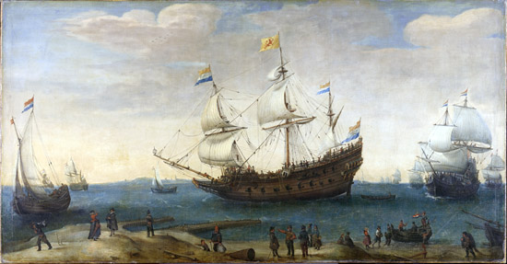
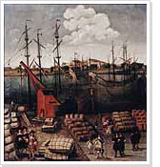
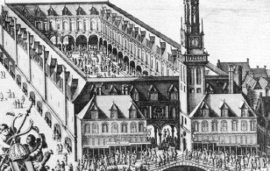
AMSTERDAM’S FINANCIAL SYSTEM (CAPITALISM)
THE PRIMACY OF THE CITY WAS THREEFOLD:
1. SHIPPING CENTER
About 1650, the Dutch owned 50% of the merchant ships in Europe.
2. COMMODITY MARKET
3. MARKET FOR MONEY (CAPITAL)
SHIPPING
TRADING
AMSTERDAM STOCK EXCHANGE

Slide 19
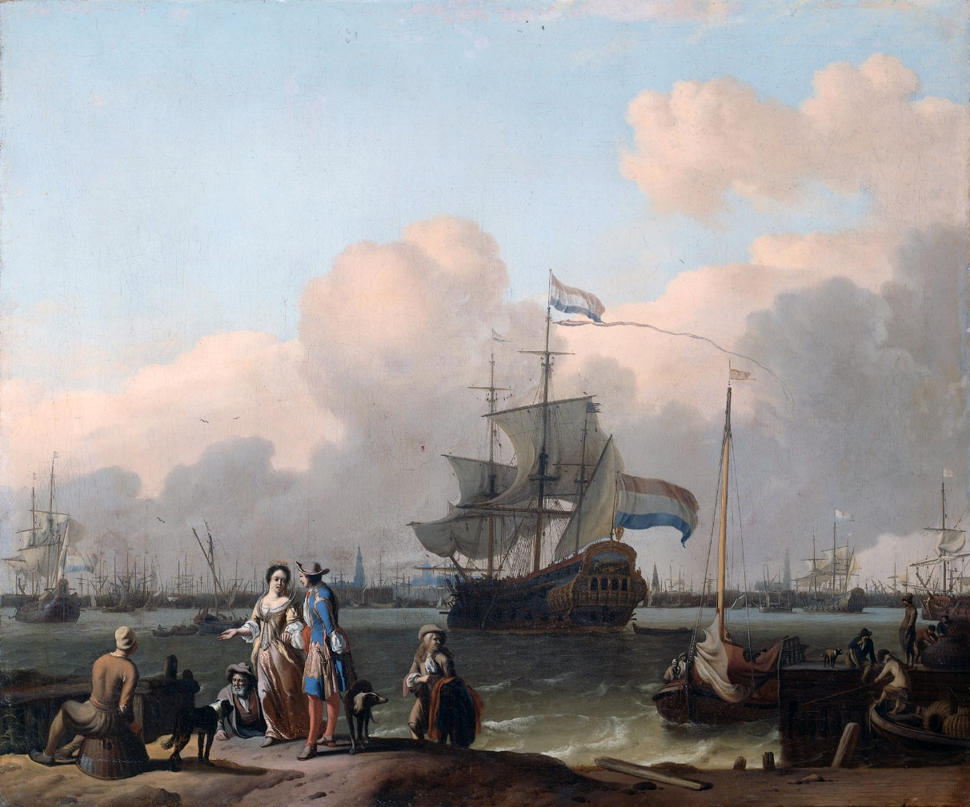
AMSTERDAM’S FINANCIAL SYSTEM (CAPITALISM)
HOLLAND AND ENGLAND, by Charles Wilson
“…the laws which governed trade were made by merchants for merchants and were not permanently subject to the overriding authority of a government whose main preoccupations were military or dynastic and the raising of money to carry out their plans.”
The Frigate "De Ploeg" on the Ij Bay with
Amsterdam in the background.

Slide 20
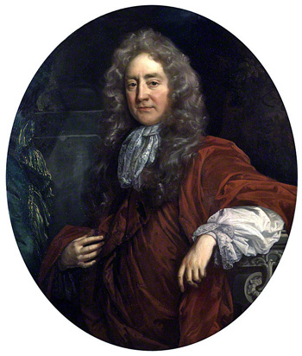

AMSTERDAM’S FINANCIAL SYSTEM (CAPITALISM)
Sir Josiah Child, an Englishman, commenting on Amsterdam’s success:
Most miraculous of all, however, they had succeeded in reducing their
rate of interest to three per cent (as against six per cent. In England).
How?

Slide 21
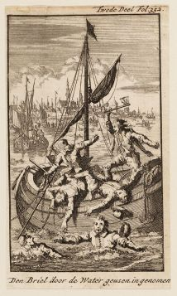
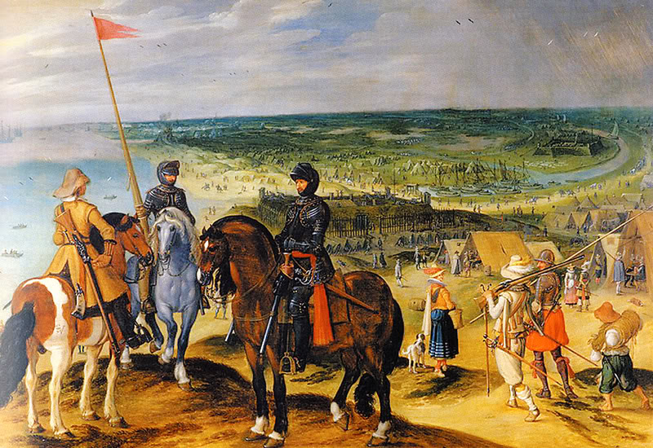
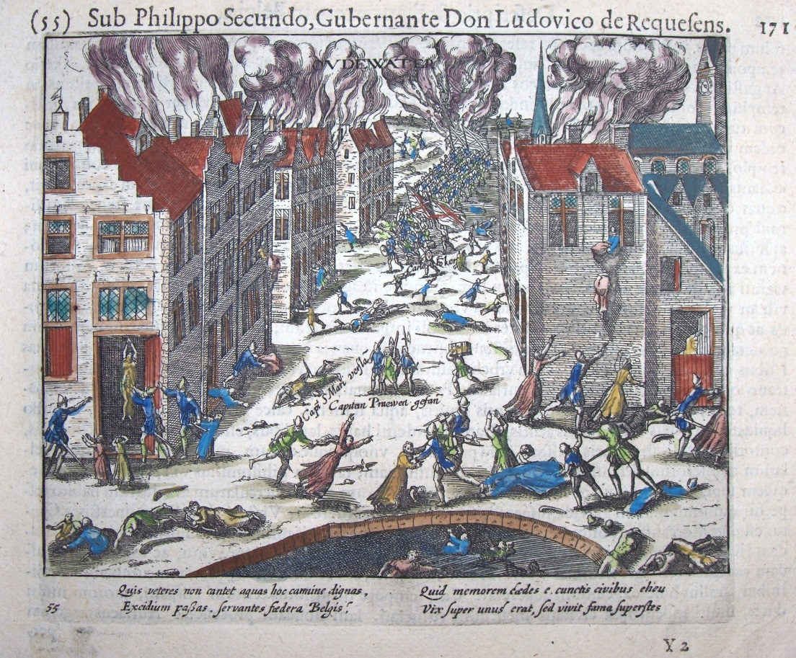
AMSTERDAM’S FINANCIAL SYSTEM (CAPITALISM)
TRADING WITH THE ENEMY:
NO CONSIDERATION OF PATRIOTISM OR NATIONALISM – THEY WERE INTERNATIONALIST
DURING WAR WITH SPAIN:
AMSTERDAM MERCHANTS TRADED WITH THE ENEMY
AMSTERDAM MERCHANTS INVESTED IN PRIVATEERS
WHICH PREYED ON DUTCH SHIPPING

Slide 22
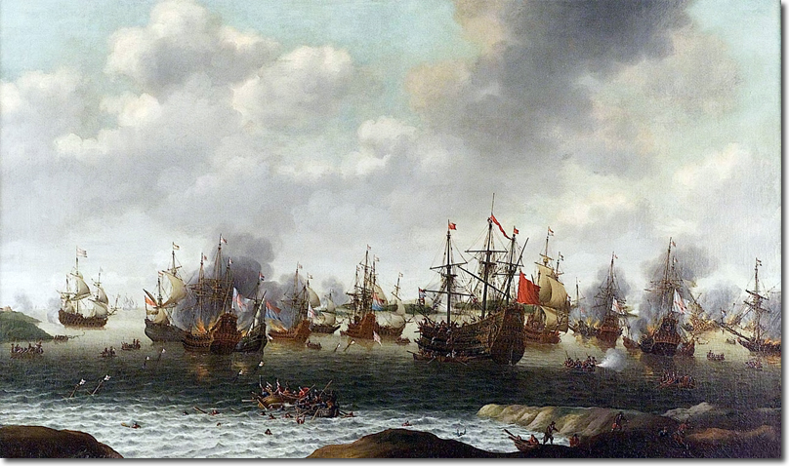
AMSTERDAM’S FINANCIAL SYSTEM (CAPITALISM)
TRADING WITH THE ENEMY:
NO CONSIDERATION OF PATRIOTISM OR NATIONALISM – THEY WERE INTERNATIONALIST
DURING WAR WITH ENGLISH:
SOLD MUNITIONS TO ENEMY
PROVIDED CORDAGE AND SAILCLOTH TO ENGLISH

Slide 23
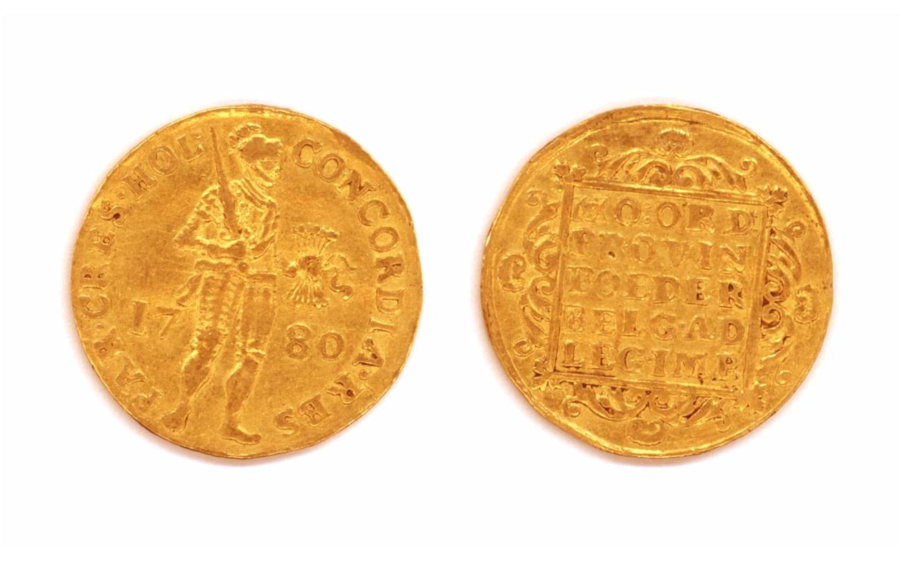
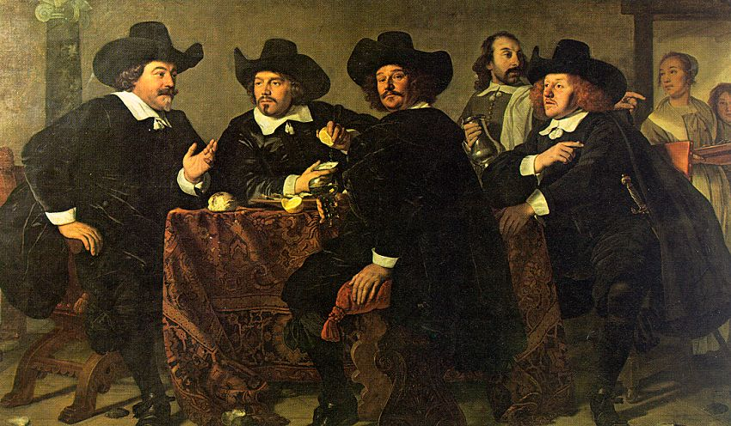
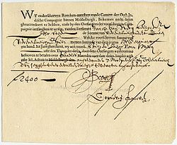
AMSTERDAM’S FINANCIAL SYSTEM (CAPITALISM)
TRADING WITH THE ENEMY:
NO CONSIDERATION OF PATRIOTISM OR NATIONALISM – THEY WERE INTERNATIONALIST
FINANCING THE ENEMY WAS EASIER THAN TRADING WITH THE ENEMY
DUTCH MERCHANTS ALSO WITHHELD SUPPLIES FROM HOLLAND,
EXCEPT AT MONOPOLY PRICES……

Slide 24
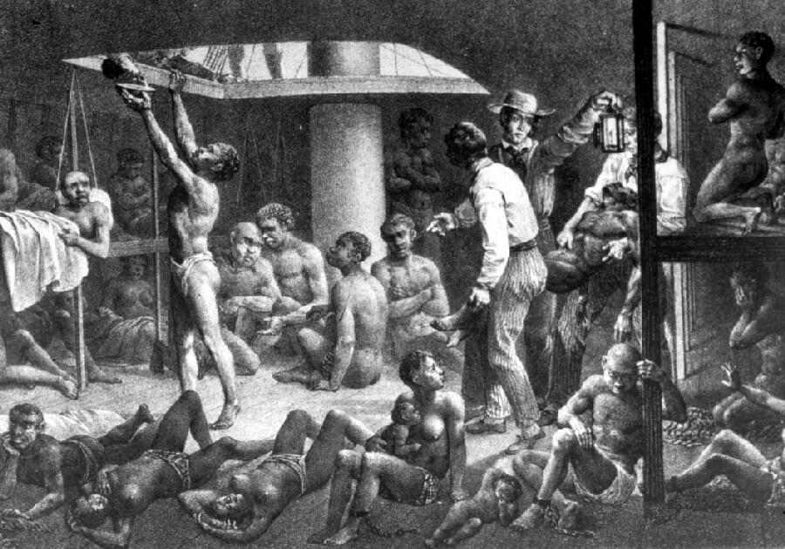
AMSTERDAM’S FINANCIAL SYSTEM (CAPITALISM)
DUTCH FIRMS FUNDED RIVAL COUNTRY’S COMPETITORS
THE DUTCH FUNDED DANISH AND SWEDISH COMPANIES COMPETING
WITH THE DUTCH WEST INDIA COMPANY FOR THE PRIMACY OF THE SLAVE TRADE

Slide 25
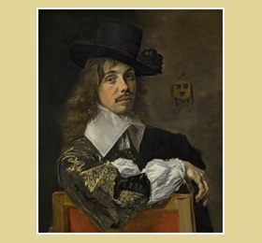
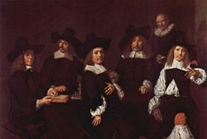
AMSTERDAM’S FINANCIAL SYSTEM (CAPITALISM)
THE BUSINESS ORGANIZATION WAS USUALLY A FAMILY PARTNERSHIP OR COMPANY.
INTERMARRIAGE BETWEEN FAMILIES WAS COMMON; ALSO, MARRIAGES OF CONVENIENCE.
Willem Coymans, a member of
one of Holland's wealthiest merchant families
Since the late Middle Ages, Dutch cities had been run
by the richer merchant families, who gradually
formed a closed group.

Slide 26
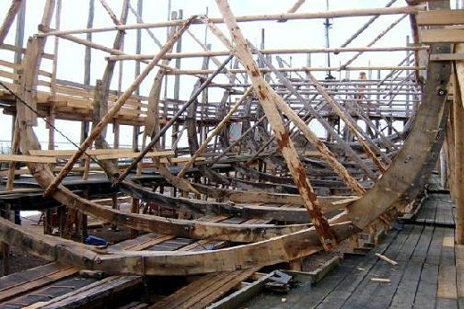
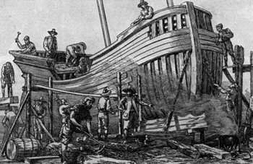
AMSTERDAM’S FINANCIAL SYSTEM (CAPITALISM)
THE DUTCH COOPERATED IN JOINT ENTERPRISES
TO COMBINE MONEY AND CREDIT FOR A LIMITED PURPOSE,
SUCH AS BUILDING A SHIP OR FINANCING A VOYAGE.

Slide 27
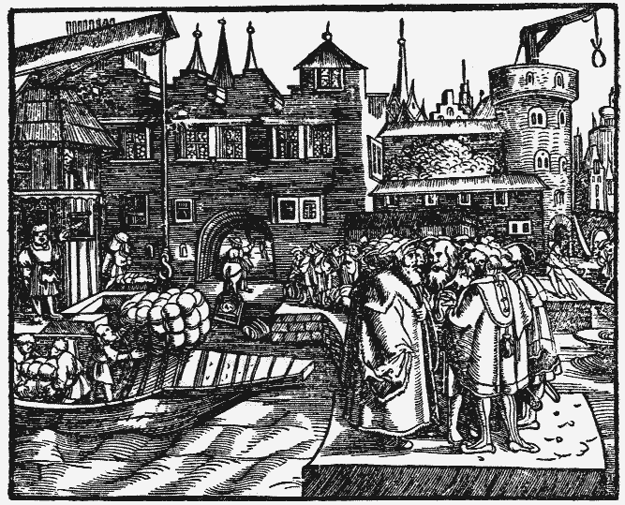
AMSTERDAM’S FINANCIAL SYSTEM (CAPITALISM)
PRICE FIXING:
THE DUTCH MERCHANTS FORMED TEMPORARY COMBINATIONS
OF BUYERS AND SELLERS OF SOME PARTICULAR COMMODITY OR
GROUP OF COMMODITIES IN A PARTICULAR MARKET……
TO INFLUENCE PRICES

Slide 28
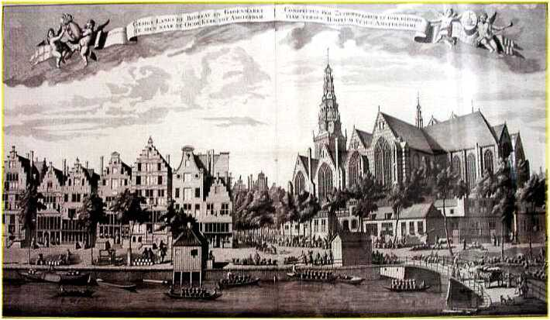
AMSTERDAM’S FINANCIAL SYSTEM (CAPITALISM)
THE DUTCH FINANCIAL APPARATUS HAD ALL BEEN USED EARLIER BY ITALY, ANTWERP, ETC.
BOURSE
JOINT-STOCK COMPANY
CARTEL
BANKING
EXCHANGE
BROKERAGE
INSURANCE

Slide 29
PART 5
BANK OF AMSTERDAM

Slide 30
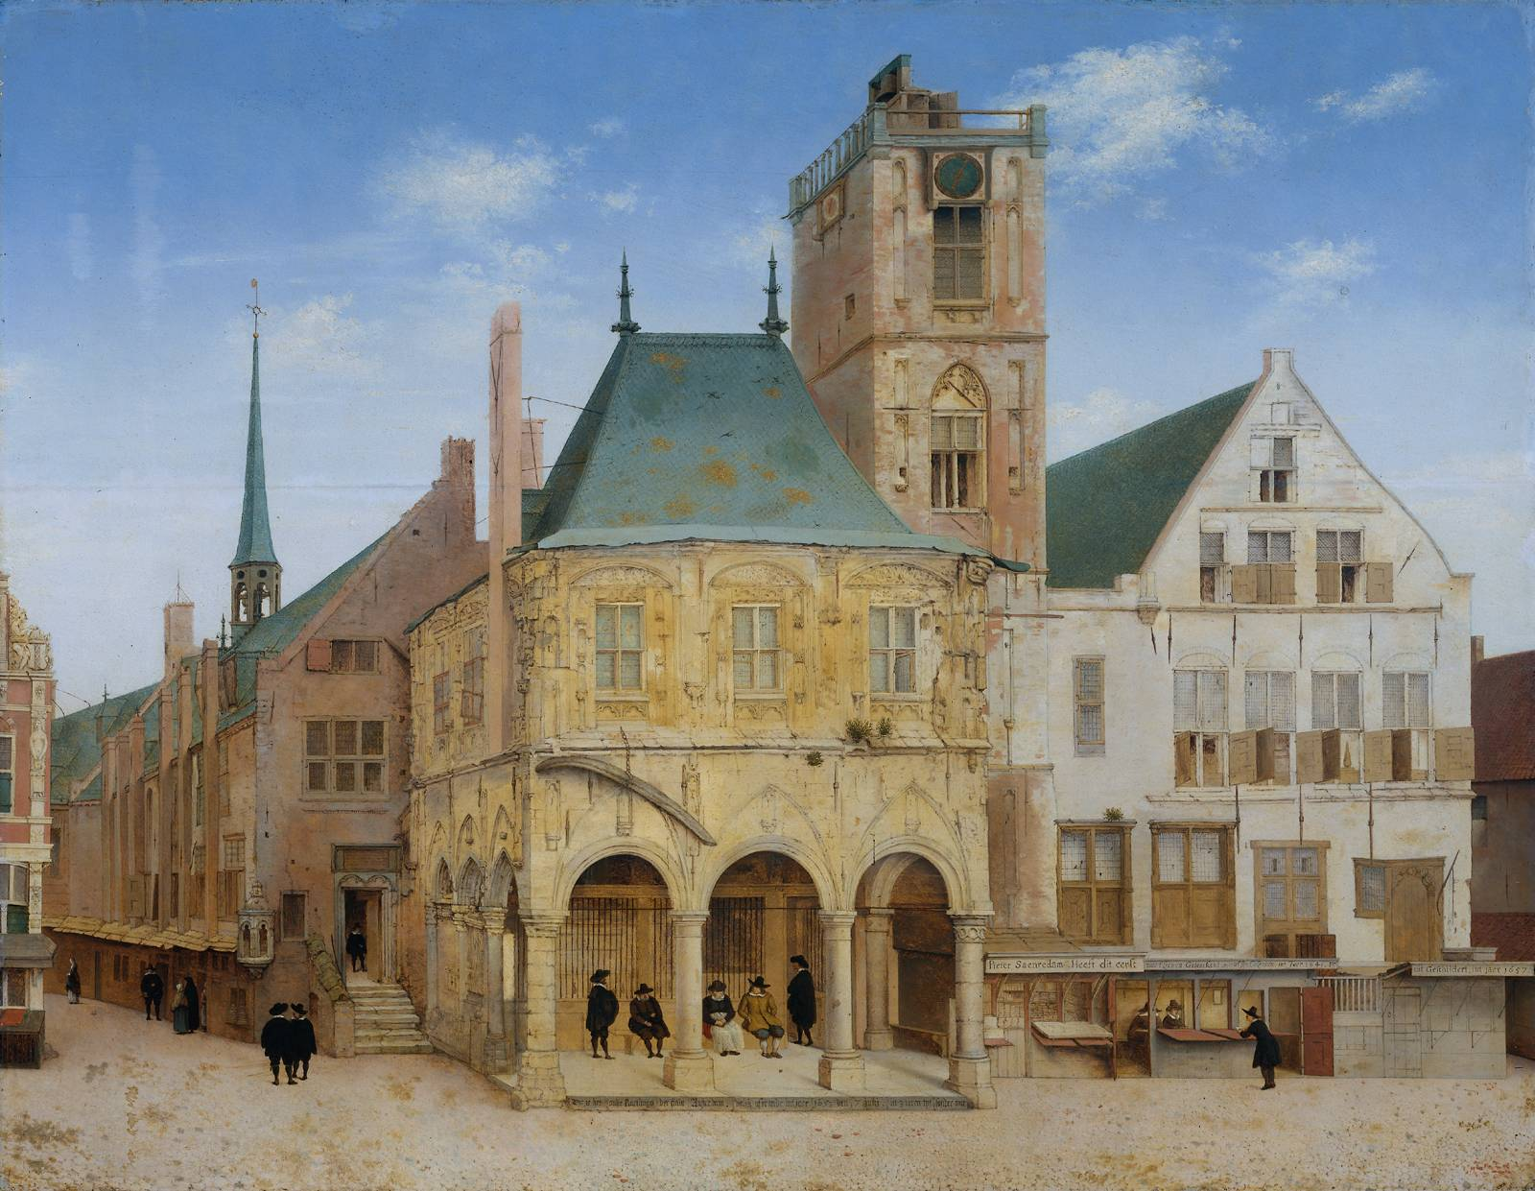
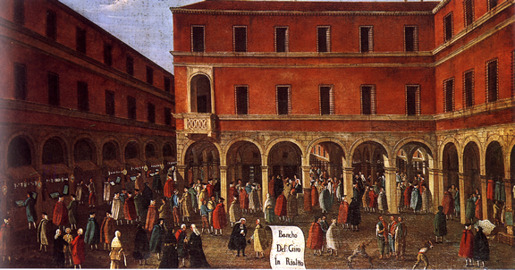
BANK OF AMSTERDAM
1609 – THE MUNICIPAL BANK OF AMSTERDAM WAS CREATED.
ALL OTHERS WERE FORBIDDEN TO ENGAGE IN BANKING.
IT WAS COPIED FROM THE PUBLIC BANKS OF SEVILLA AND VENICE.
PUBLIC BANK OF AMSTERDAM
VENETIAN PUBLIC BANCO DI RIALTO

Slide 31
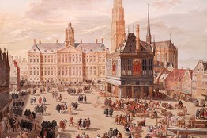
BANK OF AMSTERDAM
Wrote an English nobleman:
… the bank's reputation was "another invitation for People to come, and lodge that part of their Money they could transport, and knew no means of securing at home. Nor did [only] those people lodge Moneys here, who came over into the Country; but many more, who never left their own; Though they provided for a retreat, or against a storm, and though no place so secure as this, nor from when they might so easily draw their Money into any parts of the World."
The city also founded the Amsterdam Lending Bank,
which offered 3% loans to its best customers.

Slide 32
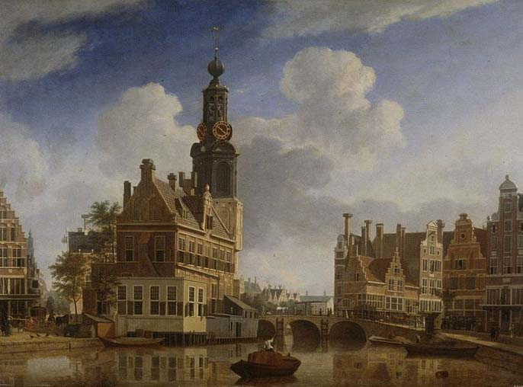
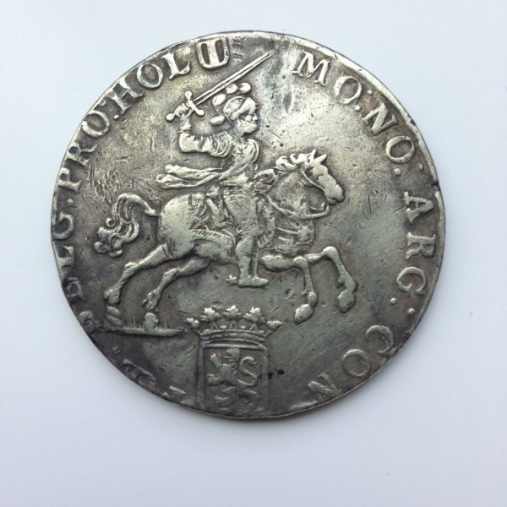
BANK OF AMSTERDAM
Instability was caused by:
14 Dutch mints competed with each other,
encouraging corrupt practices
Because a considerable number of foreign worn-down, clipped, illegal, counterfeit coins circulated, any newly minted coins were collected, melted down, and exported as bullion.
Minted money was necessary for foreign trade to Baltic states and Levant, but money changing practices kept back full-weight coins
THE PURPOSE OF THE BANK OF AMSTERDAM WAS TO STABILIZE THE MONEY SYSTEM,
NOT TO BE A BANK OF ISSUE
AMSTERDAM MINT TOWER
Dutch
silver
coin

Slide 33
BANK OF AMSTERDAM
FUNCTION OF BANK: CREATE UNIFORM CURRENCY CALLED BANK MONEY
Coins were taken in as deposits, with credits, known as bank money, issued against these deposits,
based not on the face value of the coins, but on the metal weight or intrinsic value of the coins.
Thus, a perfectly uniform currency was created. This feature of the new money, along with its convenience,
security and the city of Amsterdam's guarantee, caused the bank money to trade at an agio, or premium over coins.
In 1683, this activity of the Bank was extended: it issued receipts to the depositors of metals which retained
the right to withdraw the metal, in the event of a rise of specie value:
The bank would give credit (bank money in its books) for gold and silver bullion deposited,
at roughly 5 percent below the bullion's then-current mint value.
The depositor would receive a receipt that entitled the depositor, or bearer, to draw the amount of bullion
deposited from the bank, within six months of the deposit. The bearer needed an amount of bank money equal to
the book entry, and payment of a 1/4 percent fee for silver deposits, or 1/2 percent fee for gold deposits.
Should the six month term expire with no redemption, or without payment of a fee to extend
for an additional six months, "the deposit should belong to the bank at the price at which it had
been received, or which credit had been given in the transfer books." Thus, the bank would make the 5 percent fee
for warehousing the deposit, if not redeemed within the six-month time frame.
A receipt for bullion was rarely allowed to expire. The receipt would be sold.

Slide 34
BANK OF AMSTERDAM
FUNCTION OF BANK: TRANSFER BANK MONEY
One of the services that the bank provided was to transfer, upon order from a depositor,
sums (deposits) to the account of creditors, by book entry. This is called a giro banking operation.
This service was so popular that the withdrawal of deposits from the bank became a very rare occurrence.
The city of Amsterdam required that all bills drawn upon or negotiated in Amsterdam,
in the amount of six hundred guilders or more, must be paid in bank money. This
took away all uncertainty in the value of the bills and forced all merchants to keep an account
at the bank, creating a demand for bank money.

Slide 35
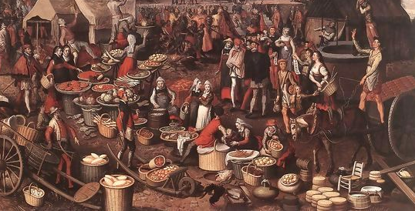
BANK OF AMSTERDAM
MORE FUNCTIONS OF BANK
1. The Bank was strictly a deposit bank, with all bank money backed 100 percent by specie.
Bank rendered great service to commerce with free transfer between accounts.
Bank safeguarded money from theft and attachment.
Bank changed coins for merchants at slight charge. It bought base coins and uncoined gold and silver, had it
minted, and placed the desired commercial coinage at the disposal of the merchants.
The Bank removed the uncertainty in trade of the quality of payment. The Bank removed the possibility
to clip Dutch coinage.

Slide 36
BANK OF AMSTERDAM
WHAT THE BANK DID NOT DO
NO INTEREST WAS PAID
NO OVERDRAFTS OR LOANS WERE MADE
NO DISCOUNTING OF BILLS WAS PERFORMED – that is, accept bills
on other institutions or merchants at discount and then send them for collection

Slide 37
PART 6
THE BANK ISSUES SECRET CREDIT

Slide 38
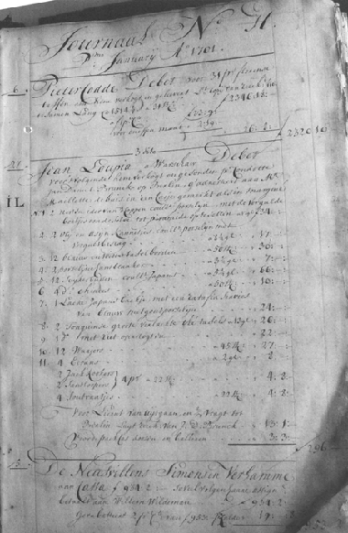
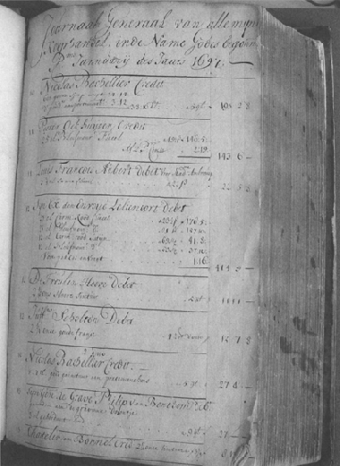
THE BANK ISSUES SECRET CREDIT
1614-1640 – to City’s Bank von Leeming which issued consumptive and
trade loans
1615 + to the Dutch East India Company, which was constantly short of cash
1624 + to the municipal treasury; by 1685 debt of 2,976,222 florins.
This debt equaled the profit made by the Bank but never collected.
THE BANK REGULARLY GRANTED CREDIT TO CERTAIN ACCOUNTS, EVEN THOUGH PROHIBITED TO ISSUE CREDIT.
THIS CHANGED THE NATURE OF THE BANK INTO A COVERT BANK OF ISSUE.
CREDIT CREATED IN THE LEDGER OF THE BANK

Slide 39
In 1790, the “agio” on bank money went to a discount to coinage
THE BANK ISSUES SECRET CREDIT
During the 4th Anglo Dutch war, war losses caused the Bank to extend a 7.5 million florin loan based on a pledge of its bonds to the Dutch East India Company. Also, loans were extended to Amsterdam’s Municipal Loan Chamber.
Neither could repay.
People wanted coinage instead of bank money.
Bank resumed paying out coinage on demand, for the first time since the
early 1700’s; redemption suspended after a few weeks.
Forced loan by City and New Batavian Republic re-established full coinage
coverage for the deposits.
1814 King William I of Holland founds bank of issue on Bank of England model -
Bank of the Netherlands; Bank of Amsterdam dissolved 1820

Slide 40
Part 7
THE BANK CARRIES ON PROHIBITED TRADE IN PRECIOUS METALS

Slide 41
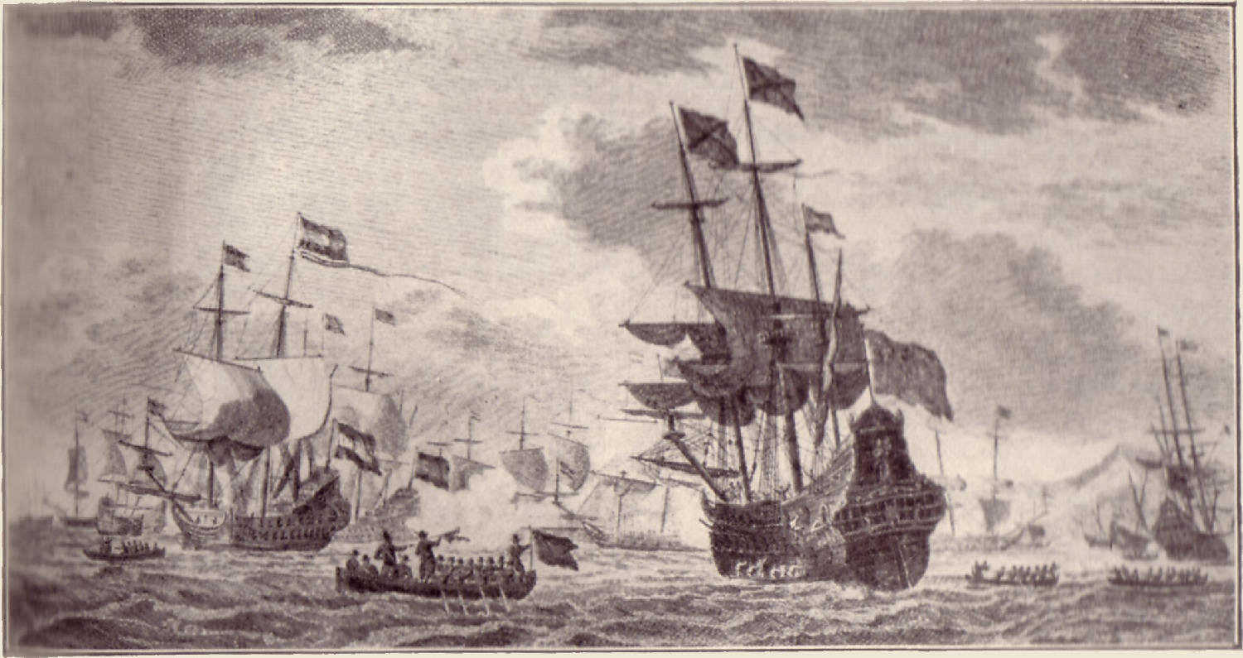
THE BANK CARRIES ON PROHIBITED TRADE IN PRECIOUS METALS
Imported gold and silver and foreign commercial coinage (Spanish reals, etc.) had to be sent to the mints; selling to others was strictly prohibited….
The large profits found in the books of the Bank indicate other sources of income than money changing. In the 1620’s the Bank of Amsterdam carried on illegal trade in precious metals.
Piet Hein capturing the Spanish silver fleet. He captured 11,509,524 guilders of booty in gold, silver, and other expensive trade goods, such as indigo and cochineal, without any bloodshed.
After capture of the silver fleet, the Estates General issued warning to Banks of Exchange and West Indies Company to remind them of metals laws.

Slide 42
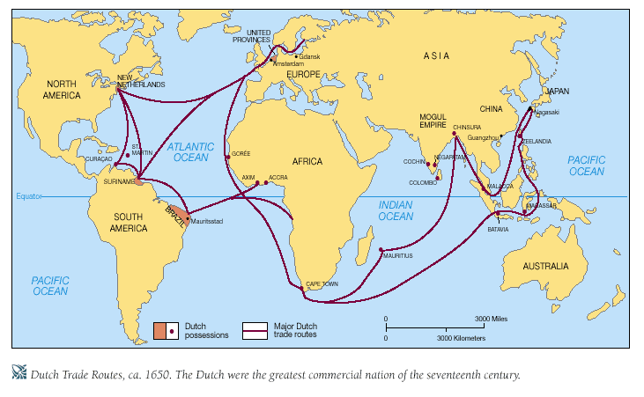
THE BANK CARRIES ON PROHIBITED TRADE IN PRECIOUS METALS
The Bank bought metals from the Dutch West Indies Company to sell it to the East Indies Company, uncoined, for profit. Prices were dependent on the world market.
Bank sells uncoined silver to Dutch East
Indies Co., for transport
to East for gold/silver
ratio trade.
Silver from America
travels back to
Amsterdam via
Dutch West Indies Co.

Slide 43
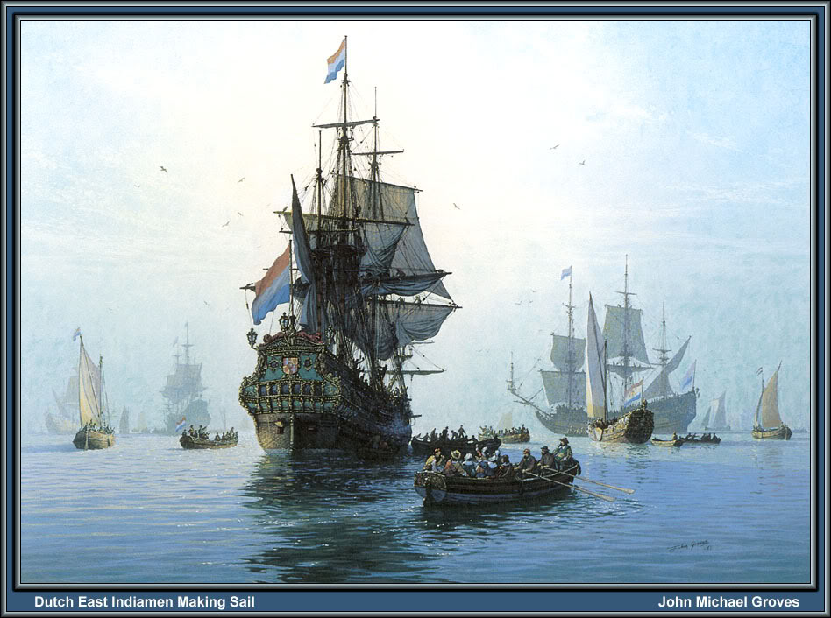
THE BANK CARRIES ON PROHIBITED TRADE IN PRECIOUS METALS
THE BANK CARRIES ON PROHIBITED TRADE IN PRECIOUS METALS
Throughout the 17th century, the General Masters of the Mint complained of this illegal trade, which resulted in less metals being sold to the mint and at higher prices.
In a memorial of the General Masters of 1680-12-09:
…the Banks of Exchange – especially that of Amsterdam –
purchase nearly all imported minting material,
whereas they deliver only a very small quantity
to the Mints, but sell the greater part for export
to the Indies.
Dutch East Indiamen
making sail.

Slide 44
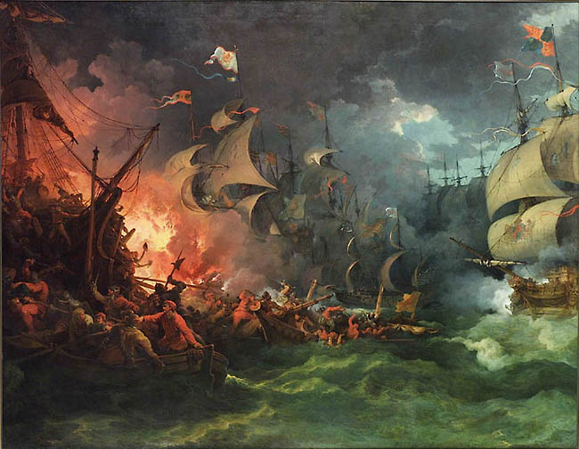
THE BANK CARRIES ON PROHIBITED TRADE IN PRECIOUS METALS
THE BANK CARRIES ON PROHIBITED TRADE IN PRECIOUS METALS
THE BANK OF AMSTERDAM GAVE POWERFUL SUPPORT TO THE METALS TRADE
AMSTERDAM BECAME THE PRINCIPAL MARKET
FOR INTERNATIONAL TRADE IN SPECIE AND BULLION.
The Bank’s advances of bank money upon specie, valued by its metal content
only, destroyed it as money, and made a market for precious metals:
…every autumn, the Spanish silver fleet of 30-50 ships,
escorted by war vessels, from Cadix, Spain, arrived at Amsterdam.
From England came Brazilian gold and Spanish American silver, plundered
from the Spanish and Portuguese.
Alexander Del Mar, HISTORY OF MONETARY SYSTEMS, p. 317
“But there was still another motive behind this revolution {Revolt of the Netherlands from Spain in 16th century).
The learned Abbe Raynal disclosed this motive, in alluding to the disgust of the Netherlands with that edict
of Ferdinand which had forbidden them to take part in the gainful commerce of the East and West Indies, by
restricting it to ‘subjects of Castile.’ Religion may have swayed the noble and even the common people, it was
commerce that swayed the burghers.”

Slide 45



THE BANK CARRIES ON PROHIBITED TRADE IN PRECIOUS METALS
THE BANK CARRIES ON PROHIBITED TRADE IN PRECIOUS METALS
Alexander Del Mar, HISTORY OF MONETARY SYSTEMS, p. 330-331, published 1901
“The Emperors of Rome controlled the emissions of European money for thirteen centuries, and the kings and dukes
for nearly two centuries. It is not too much to say that during these two centuries great monetary changes have been made and more losses have been occasioned to the industrial classes of the European world than were made by all the degradations and debasements of the Imperial and regal periods put together…
…the entire product of industry have been seized and perverted to the enrichment of a class, who know only how to scheme, to undermine and to appropriate the earnings of mankind…
‘The control of money,’ says an eloquent writer on the subject, ‘is the ground upon which an international or cosmopolitan combination ‘finances’ the world and ‘farms’ humanity.’ “

Slide 46

THE BANK CARRIES ON PROHIBITED TRADE IN PRECIOUS METALS
THE BANK CARRIES ON PROHIBITED TRADE IN PRECIOUS METALS
QUESTION: GIVEN THE RULING WEALTHY CLASS OF AMSTERDAM, WOULD YOU SAY THE BANK OF AMSTERDAM WAS TRULY A PUBLIC INSTITUTION?
Alexander Del Mar, HISTORY OF MONETARY SYSTEMS, p. 332
“…in 1790, the French again invaded Holland, they found the bank empty and insolvent. Even whilst Adam Smith was penning his panegyrics, it was secretly loaning away bullion which belonged to its depositors and noteholders. Its pious burgomasters were forsworn, the City was dishonored, and the world received its hundredth useless lesson on the folly of trusting to the stability of a monetary system which is not absolutely under the thumb of the State.”
Interior of the burgomasters council chamber.

Slide 47
Part 8
DUTCH COLONIES: WEST & EAST

Slide 48


DUTCH COLONIES: WEST & EAST
1602 The Dutch East India Company was capitalized at 6,500,000. Half was
supplied by a single Amsterdam firm, that of Lambert van Tweenhuysen,
which included Netherlanders from both northern and southern
provinces.
It is often considered to have been the first multinational
corporation in the world and it was the first company
to issue stock. It was also arguably the first mega-
corporation, possessing quasi-governmental powers,
including the ability to wage war, imprison and execute
convicts, negotiate treaties, coin money, and
establish colonies.^{[5]}

Slide 49

DUTCH COLONIES: WEST & EAST
Statistically, the Dutch East India Company (VOC: Verenigde Oost-Indische Compagnie) eclipsed all of its rivals in the Asia trade.
Between 1602 and 1796 the VOC sent almost a million Europeans to work in the Asia trade
on 4,785 ships, and netted for their efforts more than 2.5 million tons of Asian trade goods.
By contrast, the rest of Europe combined sent only 882,412 people from 1500 to 1795, and the fleet of the
English (later British) East India Company, the VOC's nearest competitor, was a distant second to its total traffic
with 2,690 ships and a mere one-fifth the tonnage of goods carried by the VOC.
The VOC enjoyed huge profits from its spice monopoly through most of the 17th century
VOC Headquarters in Amsterstam

Slide 50

DUTCH COLONIES: WEST & EAST
Dutch Batavia in the 17th Century, built in what is now North Jakarta

Slide 51

DUTCH COLONIES: WEST & EAST
DUTCH & PORTUGUESE

Slide 52

DUTCH IN JAPAN
DUTCH COLONIES: WEST & EAST

Slide 53


DUTCH COLONIES: WEST & EAST
The Dutch West Indian Company (GWIC) was granted a charter for a trade monopoly in the West Indies
and given jurisdiction over the Atlantic slave trade, Brazil, the Caribbean, and the North America.
WEST INDIA HOUSE, AMSTERDAM

Slide 54


DUTCH COLONIES: WEST & EAST
The Atlantic slave traders, ordered by trade volume, were: the Portuguese, the British, the French, the Spanish,
the Dutch, and the Americans. They had established outposts on the African coast where they purchased slaves
from local African tribal leaders. Current estimates are that about 12 million were shipped across the Atlantic,
although the actual number purchased by the traders is considerably higher.

Slide 55
Q & A
WILL’S CONCLUSION:
THE CONTROL OF MONEY -- WITHOUT CONTROL FROM THE PUBLIC -- LEADS TO CORRUPTION,
USURPATION, SLAVERY.

