Slide 1
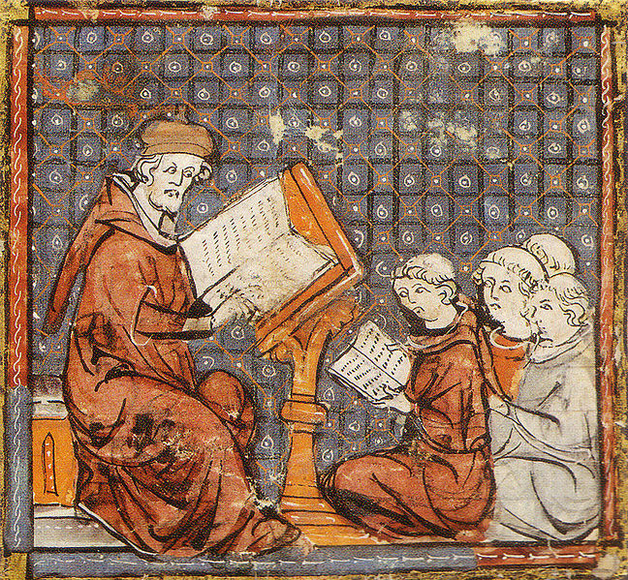
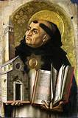
The Lost Science of Money
CHAPTER 7:
THE SCHOLASTICS: THE MORAL ECONOMISTS
ST. THOMAS AQUINAS
(1225-1274)
Scholastics thought critically about the economy and money
and taught in medieval universities in Europe from about 1100–1500

Slide 2
THEMES OF LOST SCIENCE OF MONEY BOOK
THE SCHOLASTICS: THE MORAL ECONOMISTS
Primary importance of the money power
Nature of money purposely kept secret and confused
How a society defines money determines who controls the society
Battle over control of money has raged for millennia: public vs private

Slide 3
THE SCHOLASTICS: THE MORAL ECONOMISTS
PRESENTATION
WHO WERE THE SCHOLASTICS?
THEIR VIEW OF MONEY
THEIR ARGUMENTS AGAINST USURY
Authority, Church Laws
Human Law
Natural Law
Aristotle
FALL OF USURY PROHIBITION: LUTHER, CALVIN
CHURCH’S LASTING CONTRIBUTION
SUMMARY

Slide 4
THE SCHOLASTICS: THE MORAL ECONOMISTS
WHO WERE THE SCHOLASTICS?

Slide 5
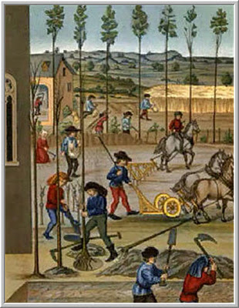
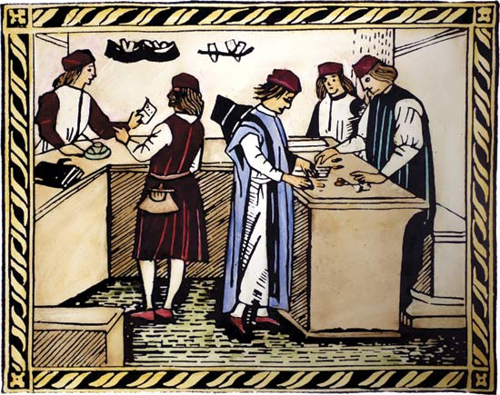
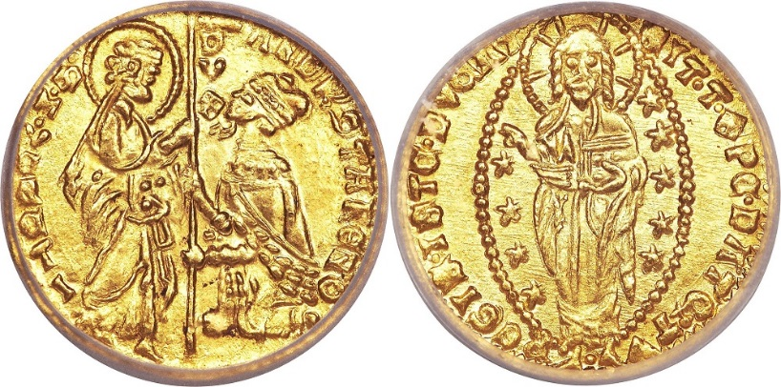
THE COMMERCIAL REVOLUTION OF THE 13TH CENTURY 1160 - 1330
THE SCHOLASTICS: THE MORAL ECONOMISTS
The ‘long thirteenth century’ saw fundamental changes in money, credit, business practices, relations in society.

Slide 6
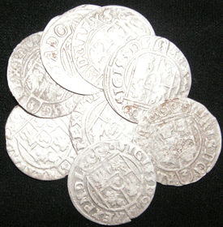
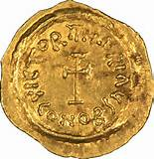
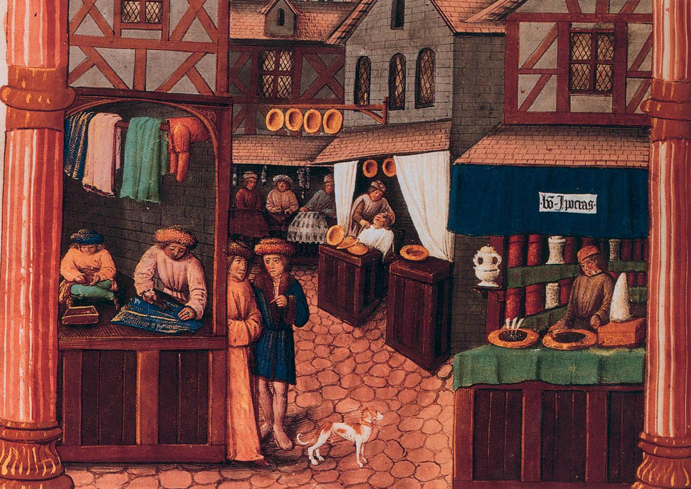
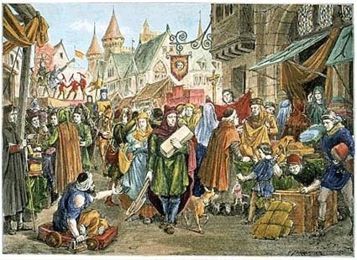
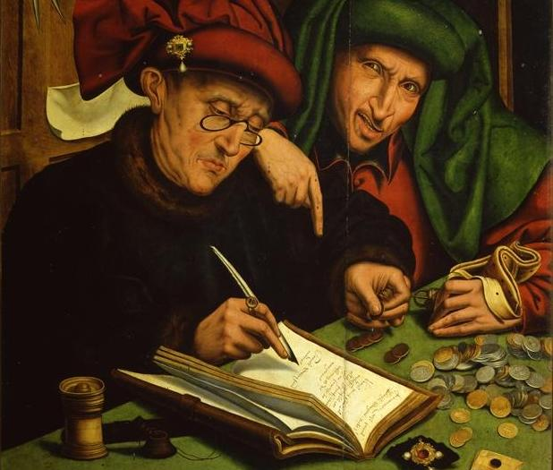
THE SCHOLASTICS: THE MORAL ECONOMISTS
More money…..
Increase in intl trade….
Rise of towns…..
Rise of credit….

Slide 7
THE SCHOLASTICS: THE MORAL ECONOMISTS
The Scholastics were Churchmen
who created a moral code of
business behavior, using reason & law.
They discussed the ‘just price’.
They discussed a market without monopoly.

Slide 8
THE SCHOLASTICS: THE MORAL ECONOMISTS
The Scholastics reasoned:
“Money is medium in exchange,
and not terminus.”
Money is not an end in itself.
A loan has no risk to the lender;
therefore usury is unearned income.
The lender cannot gain from the
advantage accruing to the borrower.

Slide 9
THE SCHOLASTICS: THE MORAL ECONOMISTS
They identified the immorality
of usury.

Slide 10
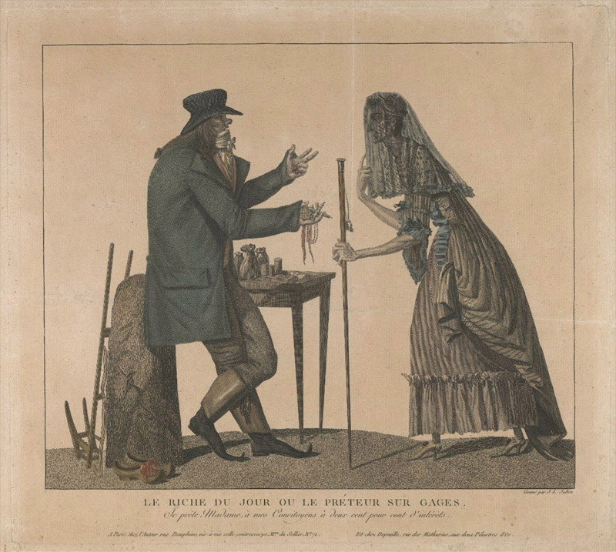
THE SCHOLASTICS: Identified the Immorality in usury
When the lender exploits the
immature and the mentally
deficient.

Slide 11
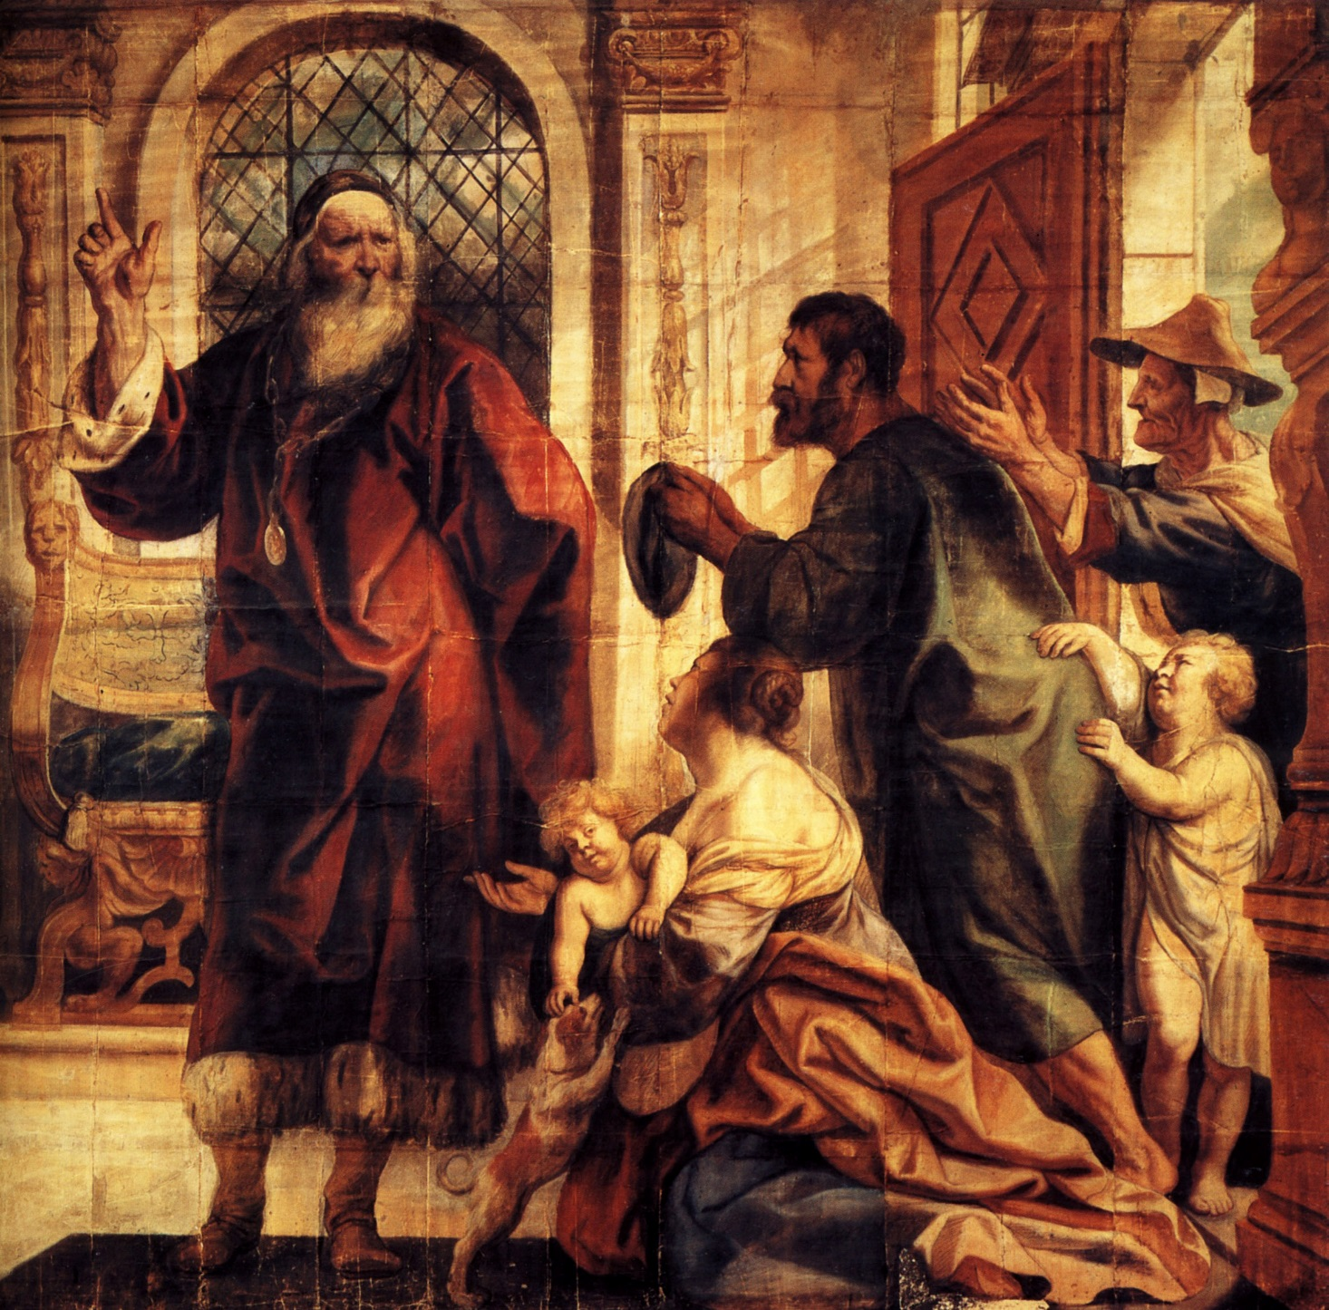
THE SCHOLASTICS: Identified the Immorality in usury
When the borrower is in the power
of the lender.

Slide 12
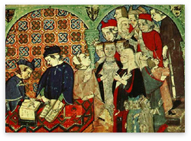
THE SCHOLASTICS: Identified the Immorality in usury
When the lender is causing or
applying duress.

Slide 13
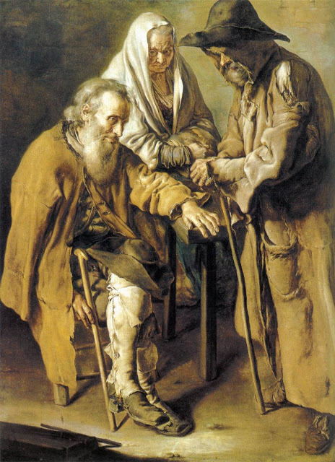
THE SCHOLASTICS: Identified the Immorality in usury
When the borrower is in the
utmost need.

Slide 14
THE SCHOLASTICS: THE MORAL ECONOMISTS
The Scholastics were not against all usury.
They allowed usury if the lender
took risk without certain gain.

Slide 15
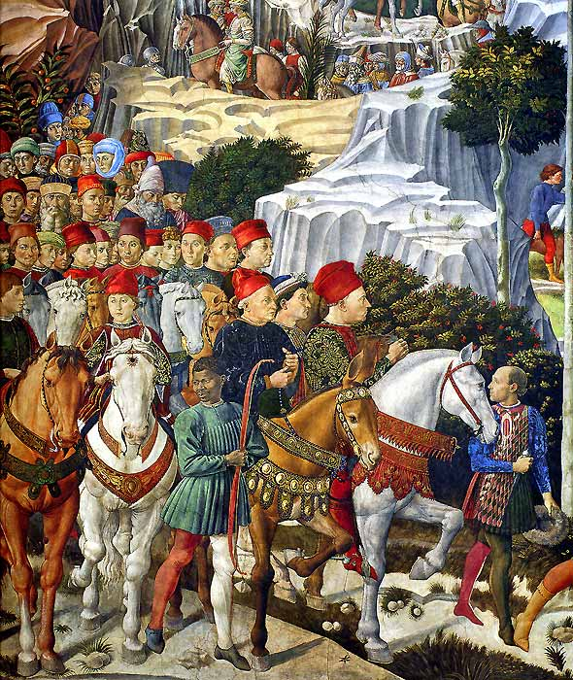
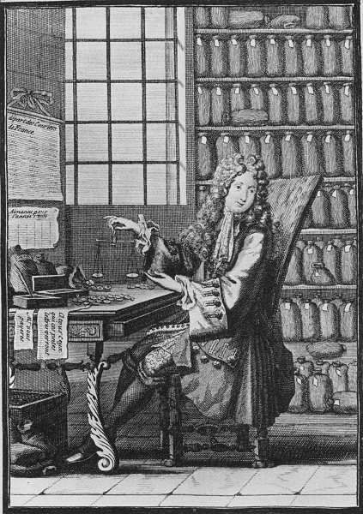
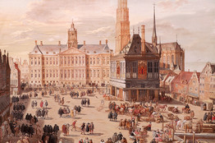
THE SCHOLASTICS: THE MORAL ECONOMISTS
‘SOCIETAS’
The lender could earn interest if actually taking some risk, without a guaranteed gain.
Partnerships could be formed if profitable investment opportunities existed. There was no objection to
seeking profit. One partner could supply labor and the other money.
Venice, the ‘first capitalistic city’ used partnerships in this category
for their banking activities.

Slide 16
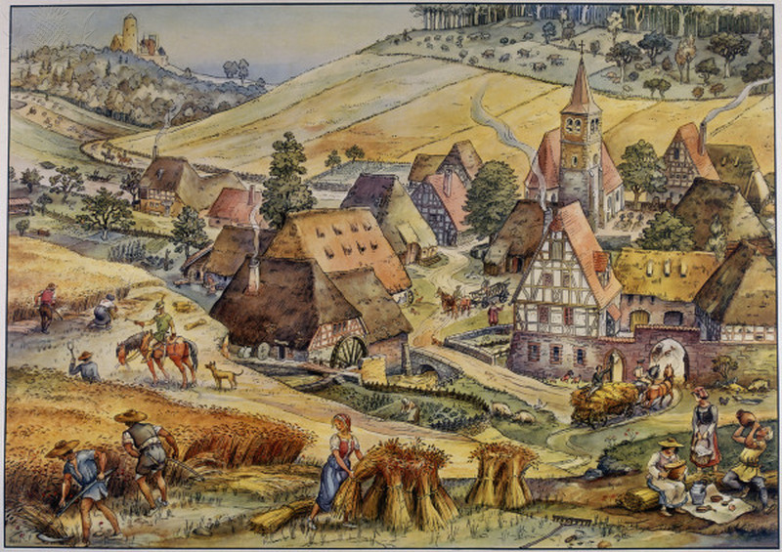
THE SCHOLASTICS: THE MORAL ECONOMISTS
‘CENSUS’
The obligation to pay an annual return based on some ‘fruitful’ property.
The lender took a risk, since if the crop was destroyed by weather, the
borrower had no obligation that year.

Slide 17
THE SCHOLASTICS: THE MORAL ECONOMISTS
2. THEIR VIEW OF MONEY

Slide 18
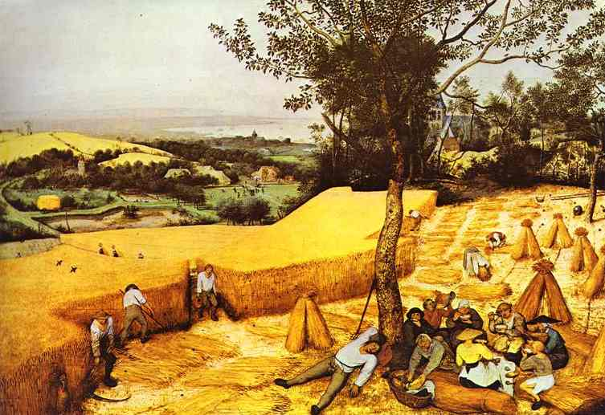
THE SCHOLASTICS: View of Money
They saw a distinction between money and capital goods,
like Aristotle.

Slide 19
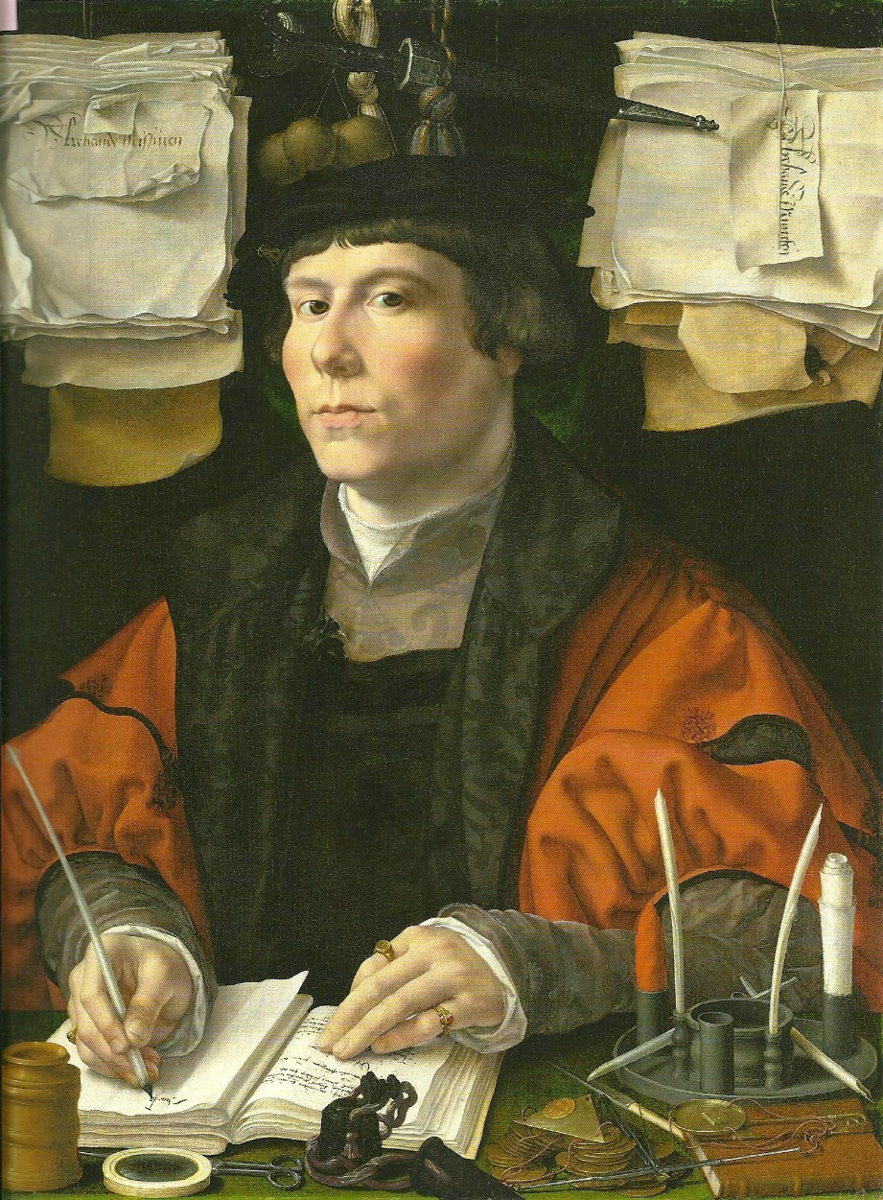
THE SCHOLASTICS: View of Money
But they were wrong in a very important way.
They saw money as exempt
from supply and demand laws.
They didn’t recognize
private bank credit as money,
conjured up out of thin air
by private banks !

Slide 20
BANKING – MONEY OF ACCOUNT: BANKING’S SECRET
THE SCHOLASTICS: View of Money
Early banking had developed a money of account, based on handwritten entries.
The Knights Templars brought back to Europe from the Crusades the knowledge of double-entry bookkeeping. This method was implemented by the banks.
“It must have soon become apparent to the Templars, the Italian merchant bankers and the great German lending houses that they possessed the power to CREATE MONEY in the form of bookkeeping credits on their books.” Stephen Zarlenga, THE LOST SCIENCE OF MONEY

Slide 21
BANKING – MONEY OF ACCOUNT: BANKING’S SECRET
THE SCHOLASTICS: View of Money
Loans would not have to be made in coinage.
Loans could be made by WRITING IN CREDITS TO THE BORROWER’S ACCOUNT. The borrower would have the ability to write checks on that account.
Once the borrowers got in the habit of using checks (back then, called bills of exchange), the banker could increase the money supply with these credits. The credits would be used as a means of exchange, as money. But the new accounting money came with usury – these were loans. The Church scholars, the Scholastics, had not known about this sleight of hand – and thus could not shine the sin of usury on it!
Today it is legal and the basis of our banking system. But it is a well-kept secret.

Slide 22
THE SCHOLASTICS: Arguments Against Usury
3. THEIR ARGUMENTS AGAINST USURY
Authority, Church Laws
Human Law
Natural Law
Aristotle

Slide 23
THE SCHOLASTICS: Authority, Church Laws
Authority, Church Laws

Slide 24

JEWISH RELIGION: OLD TESTAMENT
THE SCHOLASTICS: Authority, Church Laws
Deuteronomy 23:19
Thou shalt not lend upon interest to thy brother.
Leviticus 25:36-37
Take thou no interest from him or increase; but fear thy God, that thy brother may live with thee. Thou shalt not give him thy money upon interest, nor lend him thy victuals for increase.

Slide 25
CHRISTIANITY
THE SCHOLASTICS: Authority, Church Laws
JESUS – ALL MEN ARE BROTHERS
Luke 6:34-35
But love ye your enemies, and do good, and lend, hoping for nothing again; and your reward shall be great, and ye shall be the children of the Highest: for he is kind unto the unthankful and to the evil.

Slide 26
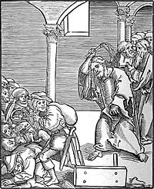
CATHOLIC CHURCH
THE SCHOLASTICS: Authority, Church Laws
4TH century AD – First Council of Nicaea (325) – church prohibited taking
usury by clergy under pain of expulsion from clergy
5th century AD – church prohibited taking of usury by laity
8th century AD – church declared usury to be a general criminal offence
850 – Synod of Paris – excommunicated all usurers
1179 – Third Lateran Council - excommunicated those who engage in usury – “notorious usurers should not be admitted to communion of the altar or receive Christian burial if they die in this sin.”
1311 – ban on usury absolute – Pope Clement V declared all secular legislation in its favor null and void
1515 – Lateran Council – “gain is sought from use of a thing not itself fruitful (=‘barren’) without labour, expense, risk on part of lender”
1586 - Pope Sixtus V would call the practice of usury, "most detestable to God and man, damned by the sacred canons and contrary to Christian charity."
Christ drives the Usurers out of the Temple,
a woodcut by Lucas Cranach the Elder

Slide 27
THE SCHOLASTICS: Human Law
Human Law

Slide 28
CODES THROUGHOUT HISTORY HAVE RESTRICTED USURY
THE SCHOLASTICS: Human Law
2130-2088 BC CODE OF HAMMURABI LIMIT TO 33%
2000-1400 BC VEDIC TEXTS OF ANCIENT INDIA - HINDU LAW BANNED USURY
600- 400 BC BUDDHIST JATAKAS: ‘USURERS..FOUL-TOOTHED…’ CONTEMPT FOR USURY
342 BC REPUBLICAN ROME BANNED USURY
49-44 BC rule of JULIUS CAESAR, ROMAN EMPIRE LIMIT TO 12 ½ %
306–337 AD rule of CONSTANTINE, THE GREAT LIMIT FROM 4-8%,
interest could not be
greater than principal
7th century AD Muslim Koran BANNED USURY
806 AD Charlemagne BANNED USURY
1981 AD United States Individual state usury laws
were sidestepped.

Slide 29
THE SCHOLASTICS: Natural Law
Natural Law – from principle and evil effects
Logical Reasoning

Slide 30
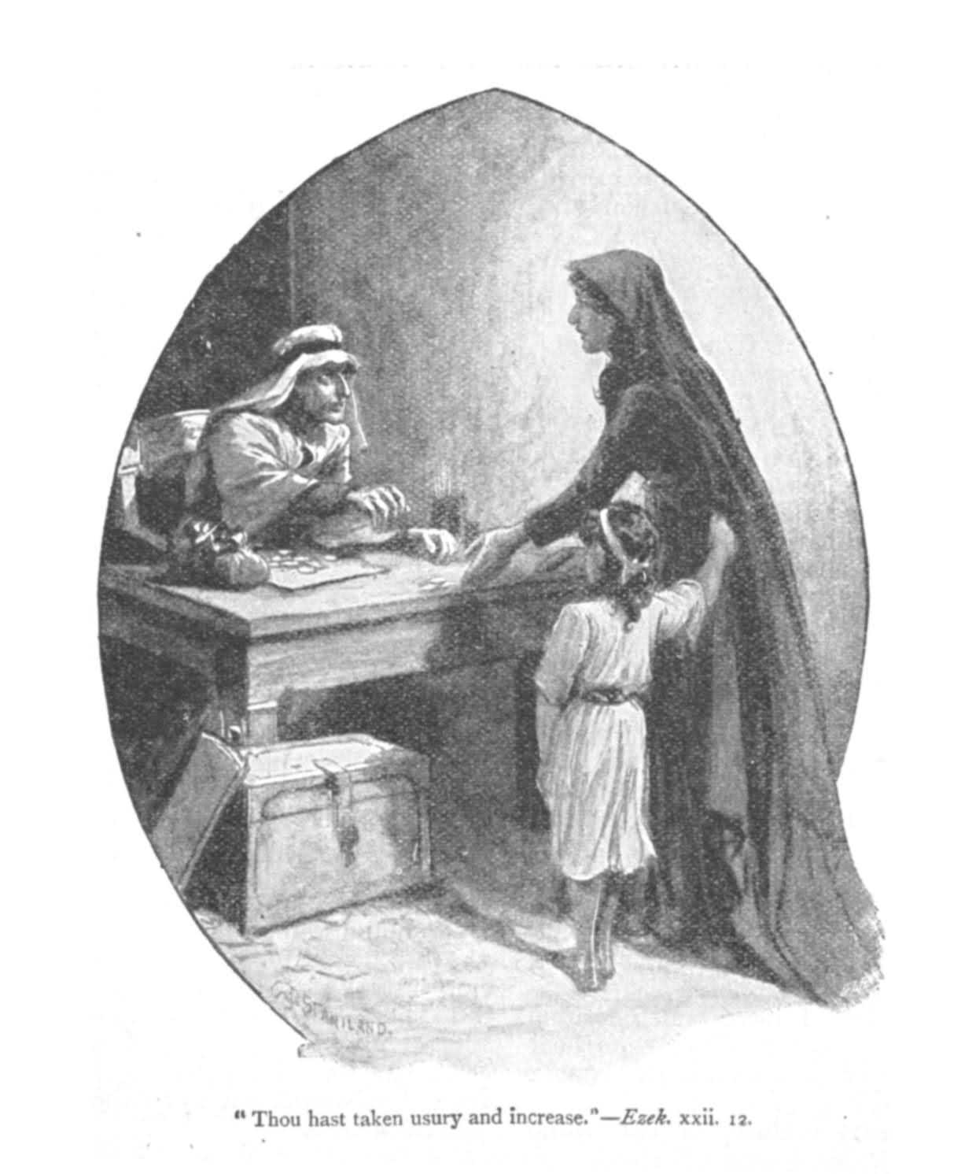
THE SCHOLASTICS: Natural Law
ABANDONMENT OF INDUSTRY
The rich will abandon industry,
and put money into usurious
loans rather than invest in agriculture.

Slide 31
THE SCHOLASTICS: Natural Law
THE INFINITE APPETITE
Over time, money system will be
destroyed, since there is no finite limit
to greed.

Slide 32
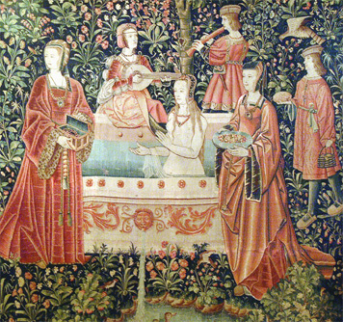
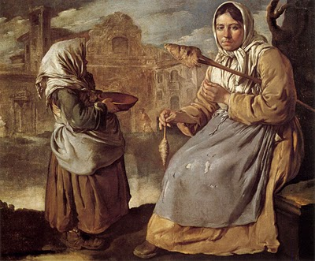
THE SCHOLASTICS: Natural Law
CONCENTRATION OF WEALTH
Usury concentrates money of the
community into hands of few.

Slide 33
THE SCHOLASTICS: Aristotle
Aristotle

Slide 34
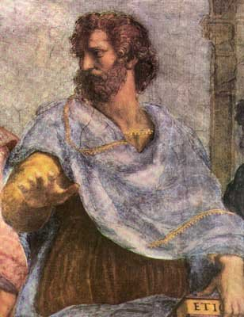
ANCIENT WESTERN PHILOSOPHERS: ARISTOTLE
THE SCHOLASTICS: Aristotle
“…The most hated sort, and with the greatest reason, is usury, which makes a gain out of money itself, and not from the natural object of it. For money was intended to be used in exchange, but not to increase at interest….
…And this term interest,
which means the birth of money from money…
this is the most unnatural.” - Politics, by Aristotle, Book 1
384 BC – 322 BC

Slide 35
BASED ON RELIGION AND MORALITY How do you treat your brother? Practically all important ethical teachers -- Moses, Aristotle, Jesus, Mohammed, and Saint Thomas Aquinas, for instance -- have denounced lending at interest as usury and as morally wrong.
THE SCHOLASTICS AND TODAY
Stephen Zarlenga, the Author
Today usury is the structural misuse of the money mechanism. It is genocidal, anti-social, and is the manipulation of money, banking, and the credit system.

Slide 36
THE SCHOLASTICS: FALL OF USURY PROHIBITION
FALL OF THE USURY PROHIBITION:
LUTHER, CALVIN

Slide 37
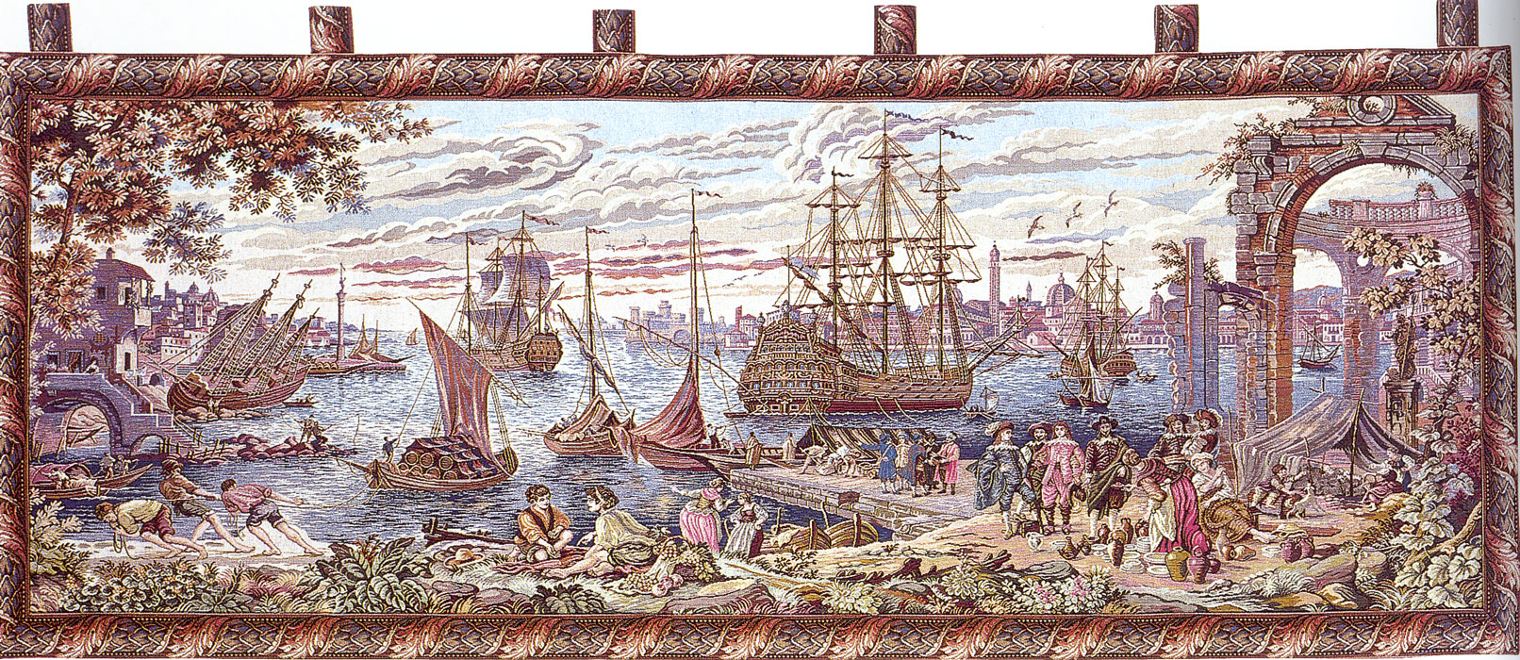
THE SCHOLASTICS: FALL OF USURY PROHIBITION
ECONOMIES WERE GROWING –
COMMERCIAL LOANS INCREASING

Slide 38
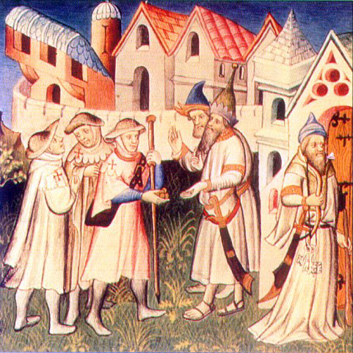
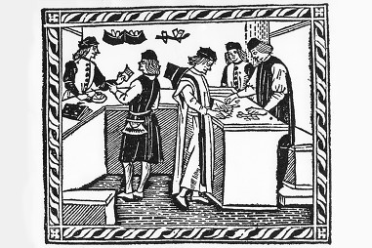
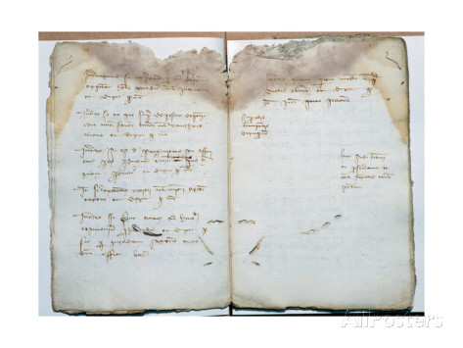
THE SCHOLASTICS: FALL OF USURY PROHIBITION
SEMANTIC AVOIDANCE OF USURY PRACTICED BY MERCHANTS
Credit sales > money sales
‘DRY EXCHANGE BILLS’ – SOLD TO BORROWER IN HOME COUNTRY WITH ‘FX FEE’

Slide 39
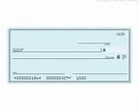
THE COMMERCIAL REVOLUTION OF THE 13TH CENTURY: 1160 - 1330
THE SCHOLASTICS: FALL OF USURY PROHIBITION
THE BILL OF EXCHANGE: POST-DATED CHECK
BILL: ORDER TO PAY $$ AMOUNT → TO AGENT OF BANKER
AS
BORROWER –
MAKER OF BILL
AGENT OF
BORROWER
<IN RELATIONSHIP>
GOLD
COIN
LOANED
AGENT OF
BANKER
GOLD COIN
REPAID WITH
AGIO (PREMIUM)
BANKER
<IN RELATIONSHIP>
GENOA, ITALY
AGENT OF BORROWER, BRUGES
FUTURE
BRUGES, FLANDERS
AGENT OF BANKER, BRUGES
$$
$$ foreign coin
BORROWER, GENOA

Slide 40
THE COMMERCIAL REVOLUTION OF THE 13TH CENTURY: 1160 - 1330
THE SCHOLASTICS: FALL OF USURY PROHIBITION
THE “DRY” EXCHANGE
BILL: NEVER SENT TO AGENT IN OTHER CITY
AS
BORROWER –
MAKER OF BILL
GOLD COIN
REPAID WITH
AGIO (PREMIUM=FX FEE)
GOLD
COIN
LOANED
BANKER
GENOA, ITALY
AGENT OF BORROWER, BRUGES
FUTURE
AGENT OF BANKER, BRUGES
$$
$$ foreign coin
BORROWER, GENOA

Slide 41

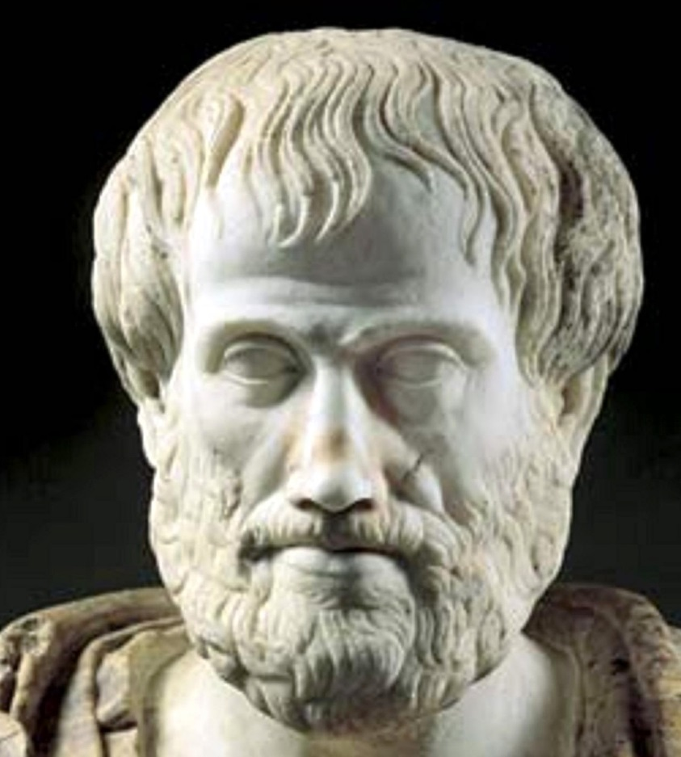
THE SCHOLASTICS: FALL OF USURY PROHIBITION
BY THE END OF THE MEDIEVAL PERIOD, THERE WERE TWO
ARGUMENTS LEFT AGAINST USURY
ARISTOTLE – money is sterile and usury
is against its purpose
AQUINAS – usurer cannot sell both
money and use of it;
lender unfairly transferring all
risks to borrower

Slide 42
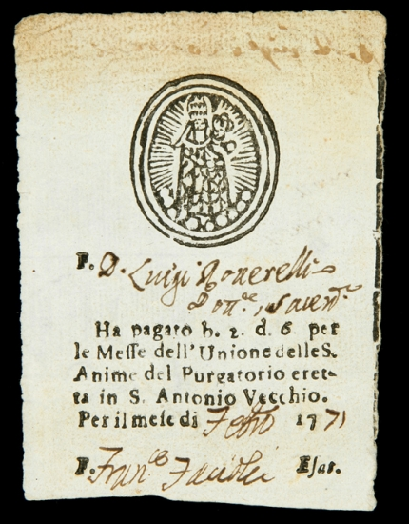
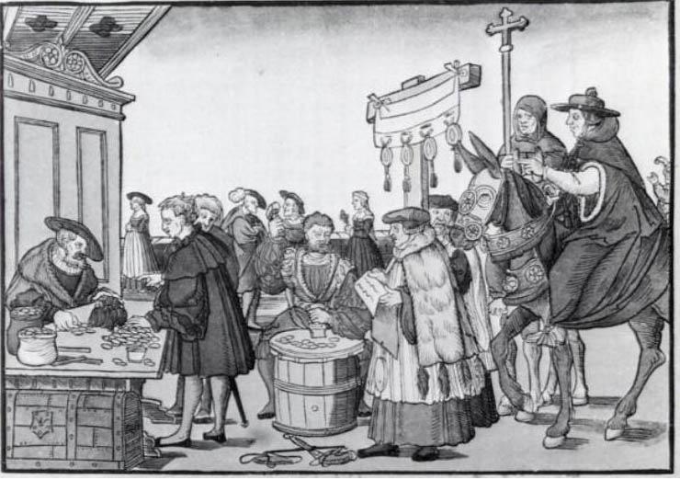
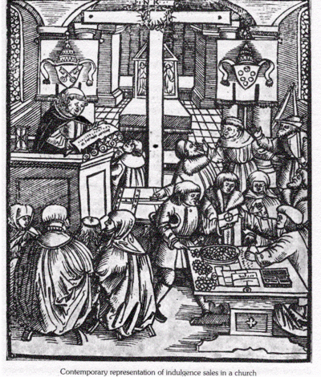
THE SCHOLASTICS: FALL OF USURY PROHIBITION
THE CHURCH’S MORAL POWER WAS WEAKENED BY CORRUPTION
It was claimed that the Catholic Church invented the doctrine on indulgences in order to extract money from the faithful.
Protestants argued that this was one of the major abuses and signs of corruption in the Catholic Church

Slide 43
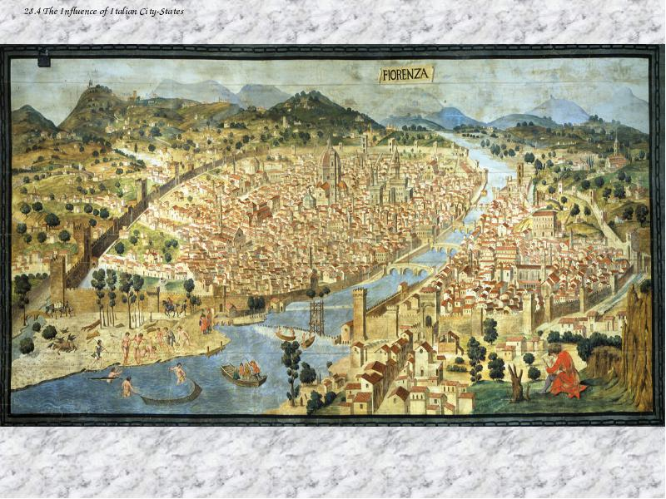
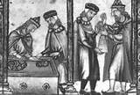
THE SCHOLASTICS: FALL OF USURY PROHIBITION
POWERFUL MONEY LENDING CLASS DEVELOPED
AND BY 1516 WERE CHARGING INTEREST

Slide 44
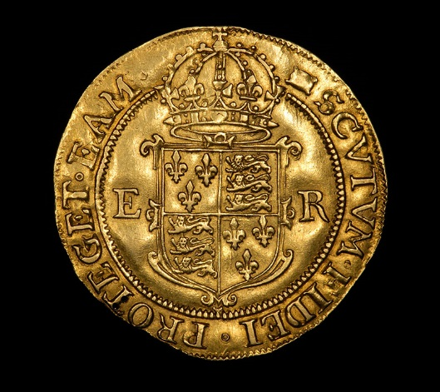
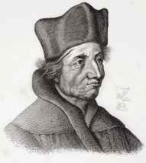
THE SCHOLASTICS: FALL OF USURY PROHIBITION
CONFUSION OF WEALTH WITH MONEY –
MONEY AS A COMMODITY
SUMMENHART (1455-1502) –
Money is a commodity and wealth
It was okay to use something
in a way it was not intended.
ECK (1486 – 1543) – student of Summenhart,
and FINANCED BY THE POWERFUL FUGGER
BANKING FAMILY, became famous defending
five percent as a harmless and therefore legal rate
of interest as long as the loan was for a bona fide
business opportunity. The ‘investor’ gave up all
further gain.

Slide 45
BANKING, TRADE AND CAPITALISM: Weakening of the Usury Laws
THE SCHOLASTICS: FALL OF USURY PROHIBITION
GROWTH OF TRADE AND FINANCE (BANKING) forced change upon a society. This push came first from the city of Venice (1100-1600) and other Italian cities with their banking companies. The profits of trade finance brought rapid wealth accumulation.
The ecclesiastical doctrine of interest was the greatest obstacle to modern banking, but now the pro-usury counter-movement began to grow. The new demands for goods from all across the globe created an environment that was simply too rich for the practice of usury not to flourish.
The 16th century Protestant Reformation, initiated by Martin Luther, John Calvin, and other early Protestants, allowed the split between secular society (the laws of the Princes) and the religious society (the law of the church), weakening the usury laws.

Slide 46
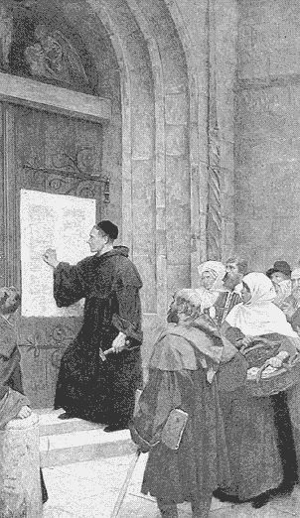
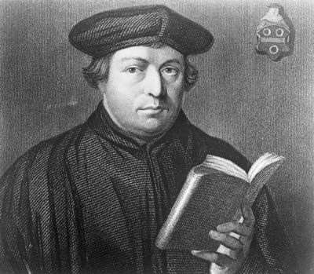
THE SCHOLASTICS: FALL OF USURY PROHIBITION
MARTIN LUTHER: GERMAN REFORMER OF THE CHURCH’S CORRUPTION
1517, LUTHER’S 95 THESES, Wittenberg, Saxony:
Thesis 67: The indulgences, which the merchants extol
as the greatest of favours, are seen to be, in fact,
a favourite means for money-getting.
On business: “If companies are to go on,
then that will be the end of law and honesty…”
On usury: his ultimate teaching was a complete
ban on all gain on loans. This could not be lived
up to in modern life.

Slide 47
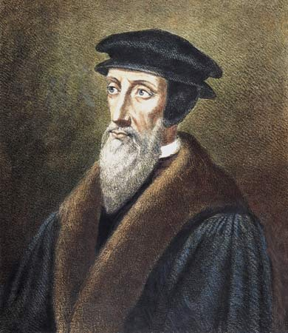
THE SCHOLASTICS: FALL OF USURY PROHIBITION
JOHN CALVIN (1509-1564): REVOLUTIONARY OF THE REFORMATION
Weakened Church and Its Ban on Usury
Calvin –The knowledge of God is obtained only by one
studying scripture. Priests were not needed.
Calvin’s Chosen People:
There is no free will. Good works don’t matter.
"All are not created on equal terms, but some are
preordained to eternal life, others to eternal damnation…”
Calvin – accepted usury
Calvin – material wealth was the supreme good.
This eliminated Christian social morality for commerce.

Slide 48
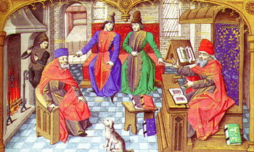
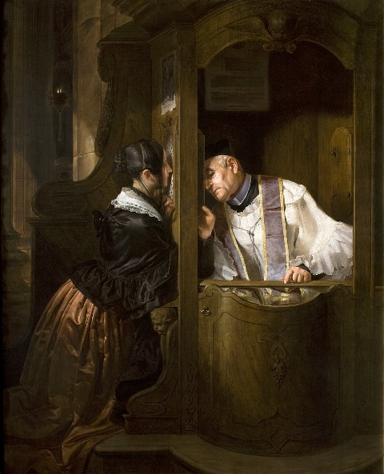
THE SCHOLASTICS: FALL OF USURY PROHIBITION
ECONOMIC RESULTS OF CALVINISM
Calvinism widened the gap between morality and law.
The contents of the contract were not important
“but performance of the contract as ‘commercial justice’ “.
LAW OFFICE
Isolation of the soul by eliminating private confession.

Slide 49
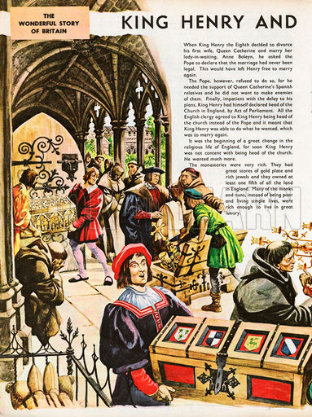
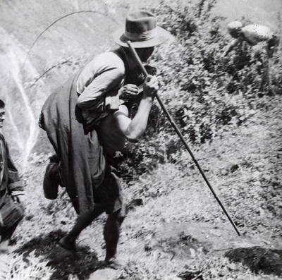
THE SCHOLASTICS: FALL OF USURY PROHIBITION
ECONOMIC RESULTS OF CALVINISM:
Church Land Seizures – serfs pushed off land
ENGLAND: Invited rulers to seize church lands.
1536-53 English Tudors seize church lands.
GRASPING FOR PRIVILEGE
WHILE REJECTING
RESPONSIBILITY HAS
BECOME THE HALLMARK
OF MODERN CAPITALISM.
FRANCE: French nobles seized monasteries of France.
Serfs were increasingly expelled without any means
of survival as lands were enclosed.
Nobles extended legal rights of ownership while
repudiating legal obligations.
This has led to a theory of land ownership
without idea of the owner as steward or trustee.

Slide 50
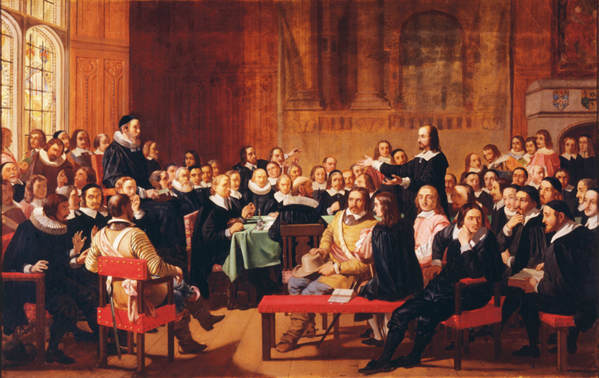
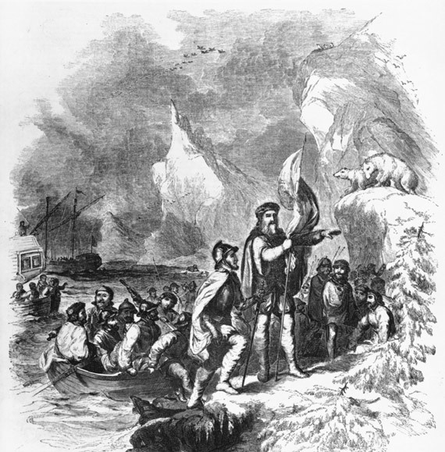
THE SCHOLASTICS: FALL OF USURY PROHIBITION
ENGLISH CALVINISM: PURITANISM
The English Calvinists were called Puritans.
They were encouraged by the City of London,
the merchants.
Local deposit and transfer bankers invested depositor’s funds
for the profit of the bank. The international merchants
generated commercial credit by routine dealings
in foreign exchange.
WORSHIPPING THE BIBLE
AS THE ABSOLUTE WORD
OF GOD…. REDUCES
CRITICAL THOUGHT,
LOGIC,
REASON,
OBSERVATION.
The voyage made by the Venetian John Cabot
under the patent of Henry VII of England
was financed by Italian bankers
(the London-based Florentine company of the Bardi).

Slide 51
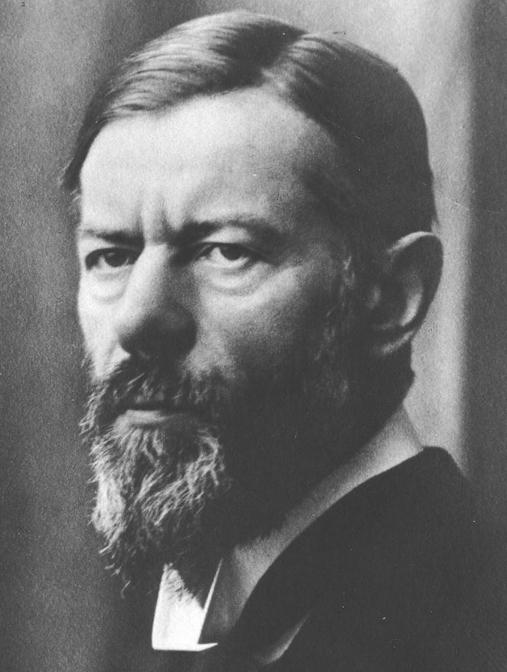

THE SCHOLASTICS: FALL OF USURY PROHIBITION
MAX WEBER (1864 – 1920): REFORMATION THEORIST
Weber’s "Protestant Ethic thesis“ -- capitalism in northern Europe
evolved when the Protestant (particularly Calvinist) ethic influenced
large numbers of people to develop their own enterprises and engage
in trade and the accumulation of wealth for investment.
Author, Stephen Zarlenga
Weber largely excluded the problem of usury by defining
modern capitalism as a benign rational industrial organization,
different from the pariah capitalism of war, government
contracts, speculative promotions, etc.
He did not live to see that the money power, in control
around the world, is the essence of pariah capitalism.

Slide 52
THE SCHOLASTICS: CHURCH’S LASTING CONTRIBUTION
PRESENTATION
5. CHURCH’S LASTING CONTRIBUTION

Slide 53
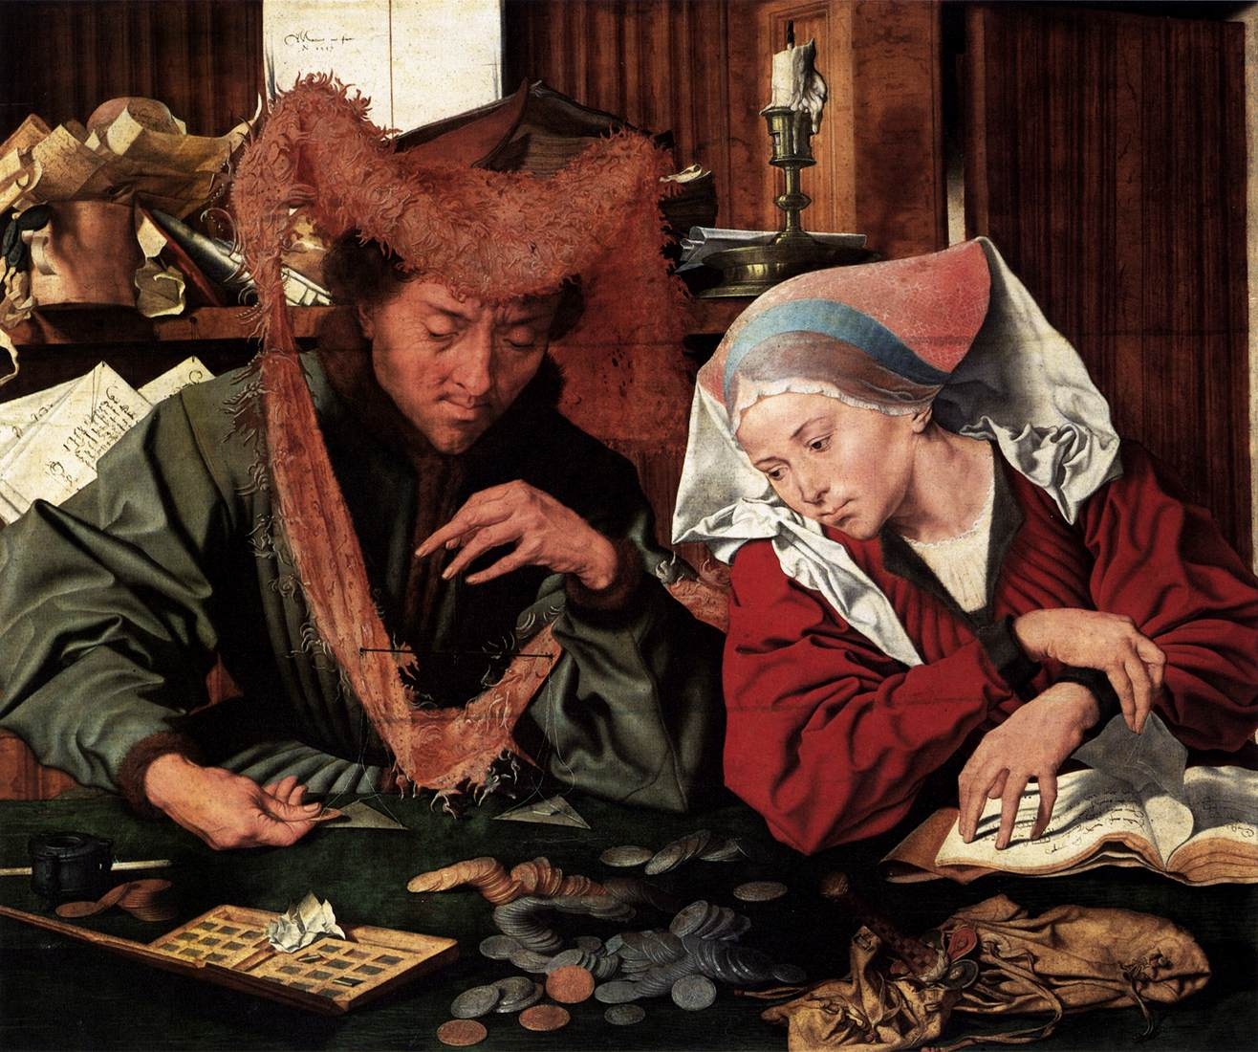
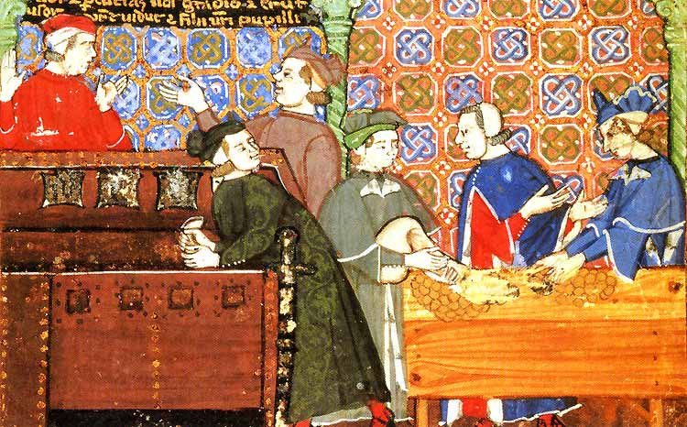
THE SCHOLASTICS: CHURCH’S LASTING CONTRIBUTION
The Church identified monetary and economic issues as profoundly moral issues.

Slide 54


THE SCHOLASTICS: CHURCH’S LASTING CONTRIBUTION
The Church’s greatest intellectual talent insisted on morally based business
structure and focused on the usury problem raised by Aristotle.
The Scholastics’ logic condemned usury.

Slide 55
THE SCHOLASTICS: SUMMARY
PRESENTATION
6. SUMMARY

Slide 56
THE SCHOLASTICS: SUMMARY
MISREPRESENTATION OF CHURCH TEACHING: the complete ban of interest attributed to the church is not correct.
PROTESTANT POLICIES:
Luther adopted an over simplified, unworkable ban on usury.
Calvin elevated the Jews, the Chosen People, and deified Bible over reason and critical thinking.
Usury was acceptable.
Both a complete ban on interest and a laissez-faire approach is not workable.

Slide 57







THE SCHOLASTICS: SUMMARY
The Scholastics inability to understand the monetary importance of bank-created credits was a major oversight.
Others, following the Scholastics, could not identify and limit the use of bank credits as money.
Understanding the monetary concepts is necessary to resolve the usury problem!

Slide 58
Q & A

