Slide 1
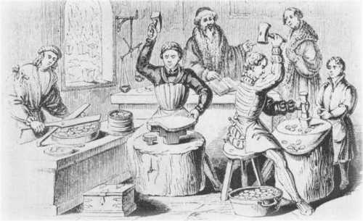
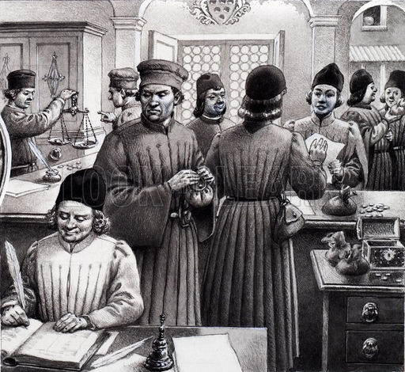
The Lost Science of Money
CHAPTER 6:
RENAISSANCE STRUGGLES FOR MONETARY SUPREMACY
The King’s Mint
A busy scene in a 15th century Medici bank.

Slide 2
THEMES OF LOST SCIENCE OF MONEY BOOK
Primary importance of the money power
Nature of money purposely kept secret and confused
How a society defines money determines who controls the society
Battle over control of money has raged for millennia: public vs private

Slide 3
PARTS OF PRESENTATION
The 13th Century Revolution in Money
The 13th Century Revolution in Trade
The King’s Mint
The International Merchant-Bankers
BRUGGE, BELGIUM: CREDIT
  The Money Changers: Local Deposit Banking
  The Italian Merchant-Bankers: International Banking
THE HANSEATIC LEAGUE: WAR ON CREDIT

Slide 4
PART 1
The 13th Century Revolution in Money

Slide 5
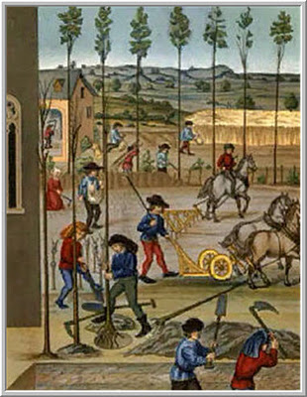
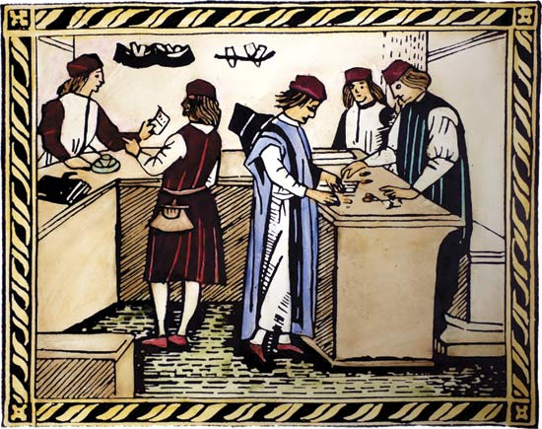
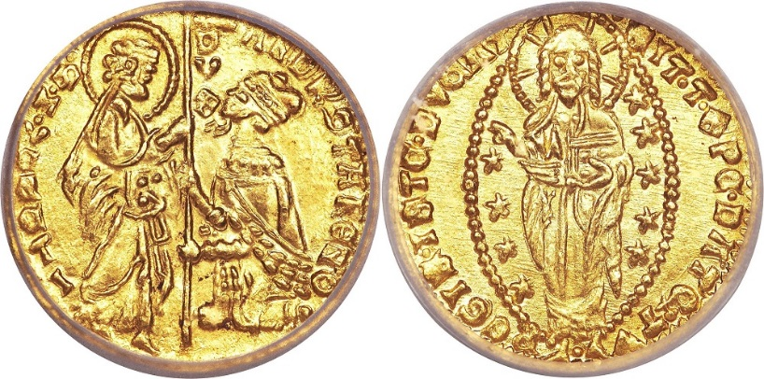
THE COMMERCIAL REVOLUTION OF THE 13TH CENTURY
1160 - 1330
The ‘long thirteenth century’ saw fundamental changes in money, credit, business practices, relations in society.

Slide 6
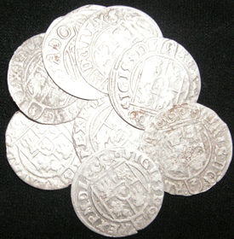
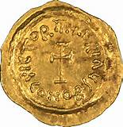
MORE MONEY…..

Slide 7
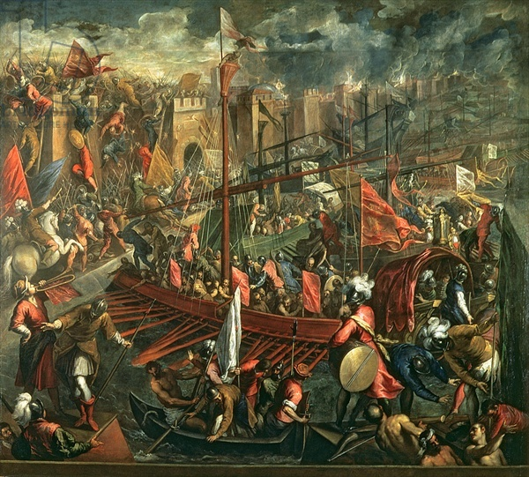
THE COMMERCIAL REVOLUTION OF THE 13TH CENTURY: 1160 - 1330
THE QUANTITY OF MONEY IN CIRCULATION INCREASED: Plunder of Constantinople
“The plunder of Constantinople by the Venetians and other
of the Crusaders probably transferred more metallic
wealth to western Europe than all the commerce of the
centuries that preceded it.” William Jacobs, THE PRECIOUS
METALS, 1831, p. 354
THE MONEY POWER WAS DISPURSED
FROM THE RELIGIOUS TO THE SECULAR.
It was said that the total amount looted
from Constantinople was about 900,000 silver marks.

Slide 8
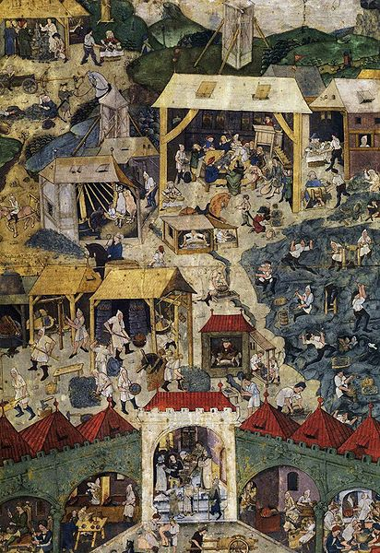
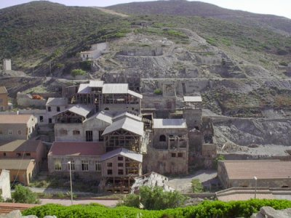
THE COMMERCIAL REVOLUTION OF THE 13TH CENTURY: 1160 - 1330
THE QUANTITY OF MONEY IN CIRCULATION INCREASED: new wave of silver mining
Kutna Hora mine,
Bohemia
By 1260 German
miners began to
mine for silver in
the mountain region
Argentiera mine, Sardinia
It has been calculated that Sardinian mines have supplied Pisa
with almost 15 tons a year of the valuable metal in the period
stretching from the end of the 12th century to the beginning
of the 14th century.

Slide 9
LAND & MONEY…..

Slide 10
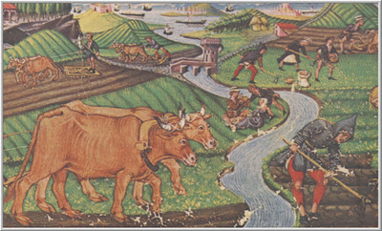
THE COMMERCIAL REVOLUTION OF THE 13TH CENTURY: 1160 - 1330
REVOLUTION IN RENTS: Landlords demand money-rents
More and more land was let for money
and replaced rent in labor or rent in kind.
This benefited the wealthier peasant who could
sell his produce for money, pay his rent easily, and
even begin to buy land for himself.
For their poorer neighbour, money-rent forced
him to work additional jobs off the land for money,
forced him to sell food meant to be eaten by
his family, and meant a radical lowering of his
standard of living.

Slide 11
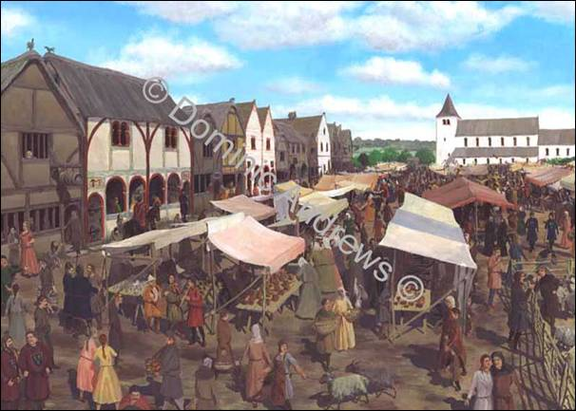
THE COMMERCIAL REVOLUTION OF THE 13TH CENTURY: 1160 - 1330
The money-rent system could always advantage the landlord
Tenants assumed the risks of a poor harvest
or a low sale-price for their crops.
The increase in both money and Europe’s population
meant the landlord had the advantage of
competition for tenancies.
Inflation diminished the value of the money-rents
for the landlord, but the landlord had many options.
He could take back his land farming it himself with
low-paid workers, demand his current tenants pay
part of their rent in kind, give shorter and shorter
leases, rent for the prevailing market price of half the
produce, etc.
A Medieval Market

Slide 12

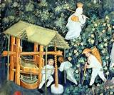
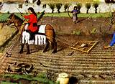

THE COMMERCIAL REVOLUTION OF THE 13TH CENTURY: 1160 - 1330
A Change in Attitude to Money:
Resources were judged for money-income
FORESTS -
not for hunting
or food
WINE PRESS –
to generate income
GRAIN MILL –
to generate income
CULTIVATABLE LAND &
CASH CROPS –
not for eating
or dues

Slide 13
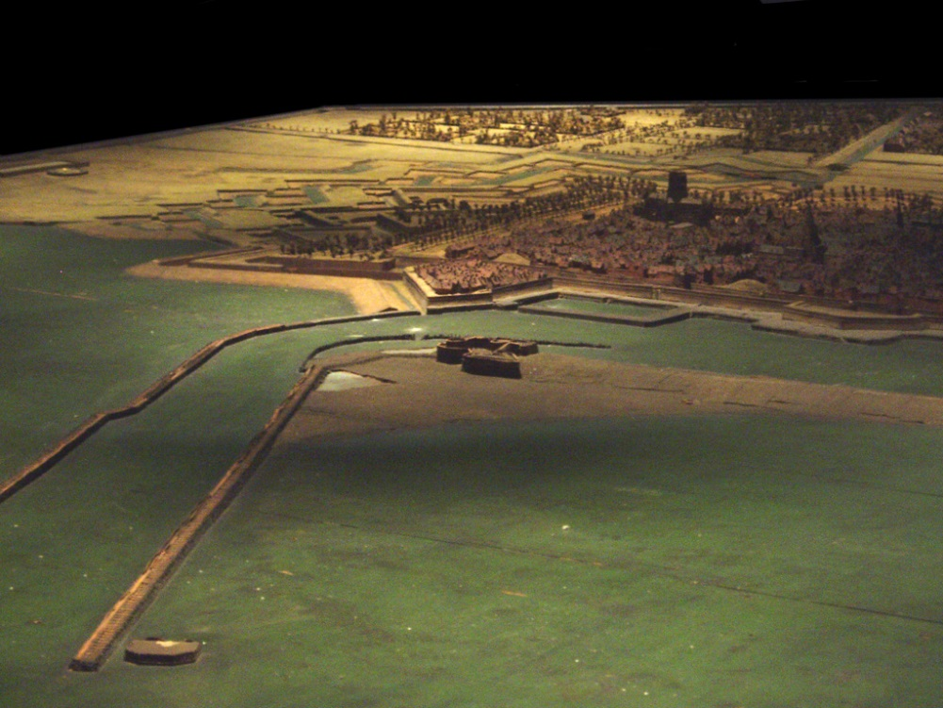
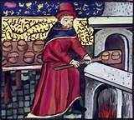
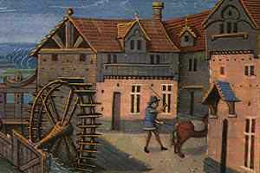
THE COMMERCIAL REVOLUTION OF THE 13TH CENTURY: 1160 - 1330
A Change in Attitude to Money:
Resources were judged for money-income
Philip of Alsace, Count of Flanders from 1168, whose mints were among the first to actively provide more coin at this time,
invested in drainage schemes to reclaim fresh land for cultivation and sold his reserves of peat for fuel. The same count
and his brother Matthew, Count of Boulogne, were among the earliest founders of new towns for profit: Calais, Dunkirk,
Nieuwpoort, Damme, Gravelines.
The men of Bruges and St. Omer almost at once organized the cutting of channels suitable to bring sea-going vessels inland.
The bakers and millers themselves made so much profit that they joined the village elites of the richer peasants.
MEDIEVAL CALAIS

Slide 14
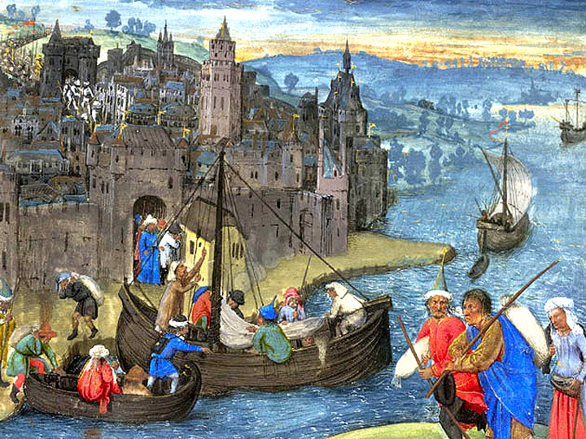
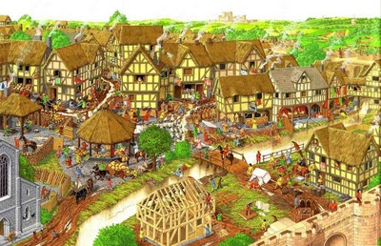
THE COMMERCIAL REVOLUTION OF THE 13TH CENTURY: 1160 - 1330
Town Merchants become RENTIERS
The town merchants acquired more of the land in the towns. The steady rise in population
encouraged building sites. The steady rise in rents caused many of them to give up trade
and becomes rentiers.

Slide 15
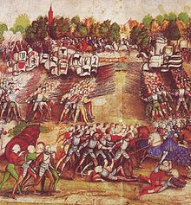
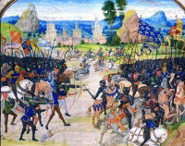
THE COMMERCIAL REVOLUTION OF THE 13TH CENTURY: 1160 - 1330
REVOLUTION IN RENTS ➔ ➔ ➔ ➔
increased income for princes: WAR
Rulers used their money
incomes to hire mercenaries
on a scale never before
known.
Rulers used their money
incomes as security for loans
from the bankers for even
larger armies.
Huge armies could now be
amassed.

Slide 16
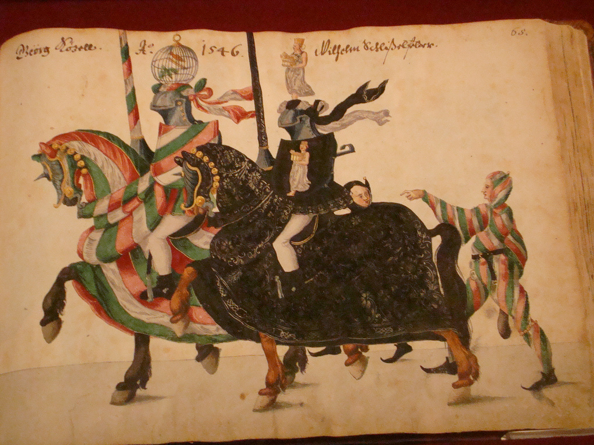
THE COMMERCIAL REVOLUTION OF THE 13TH CENTURY: 1160 - 1330
REVOLUTION IN RENTS ➔ ➔ ➔ ➔
Revolution in the governing of states: SALARIES
Knights could be paid with money-fiefs
rather than giving them a feudal estate.
The King could pay salaries to non-military
officials in his service. He was free to hire and fire
them.
This was the beginning of a post-feudal civil service.

Slide 17
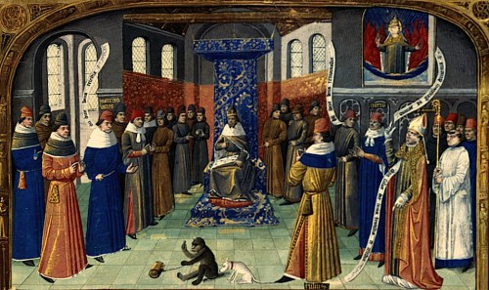
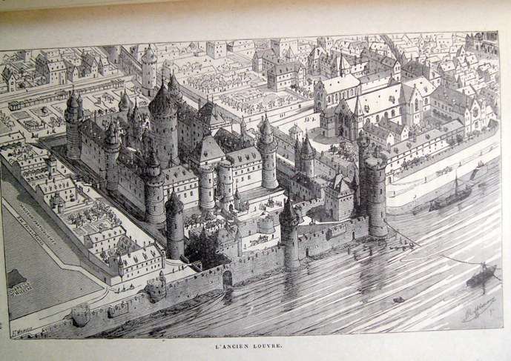
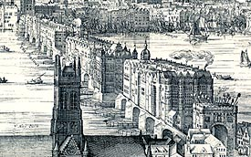
THE COMMERCIAL REVOLUTION OF THE 13TH CENTURY: 1160 - 1330
REVOLUTION IN RENTS ➔ ➔ ➔ ➔
Development of town courts in CAPITALS
Medieval Paris
Medieval London
Both king and nobles were no longer tied to their estates. ‘Capitals’ developed where the king’s administration could
remain permanently. The king’s court attracted the landowning classes, who build noble town houses near the court.

Slide 18
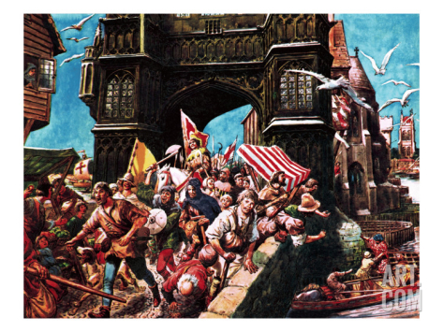
THE COMMERCIAL REVOLUTION OF THE 13TH CENTURY: 1160 - 1330
REVOLUTION IN RENTS ➔ ➔ ➔ ➔
Direct taxation in money on peasantry – on much larger scale than ever before
A major cause of the English Peasant’s Revolt of 1380
was the heavy money taxation of the peasants. The money
was needed by the crown to wage the 100 Years’ War
With France.
The direct taxation of the countryside was vastly greater
than the indirect taxation of the cities. The countryside
fell into long-term debt to the city.
Farmers were compelled to concentrate on cash crops, and
a cycle of deprivation set up, not unlike the Third World
today.

Slide 19
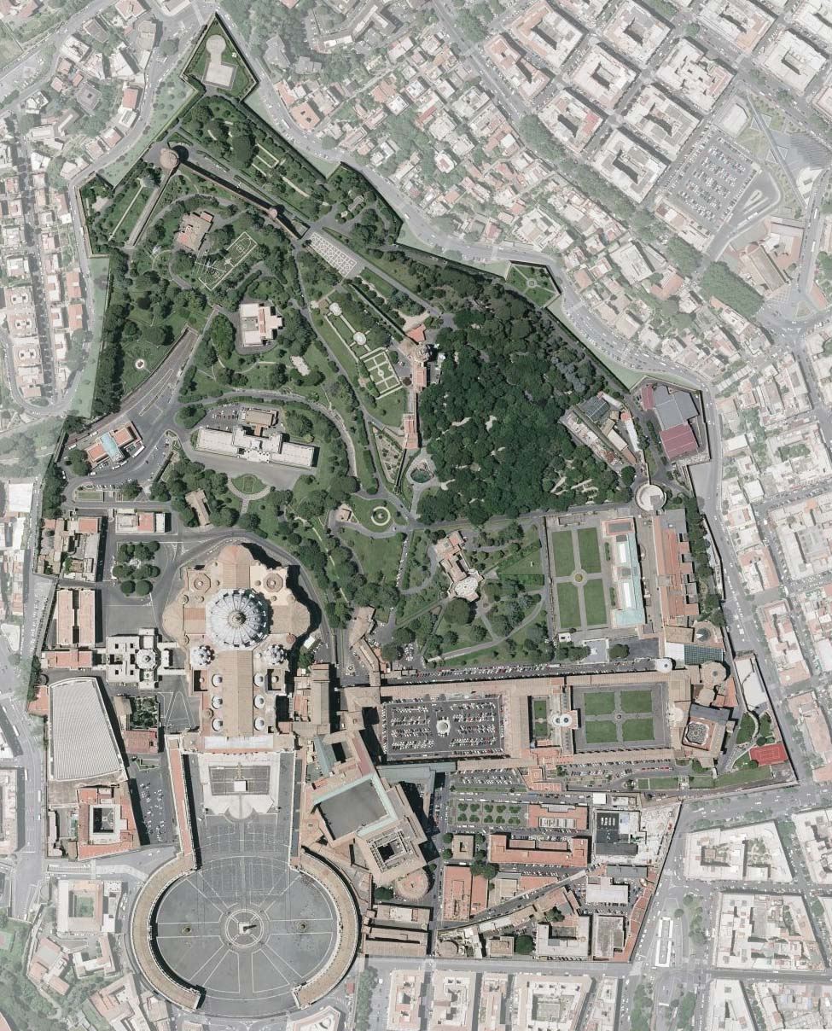
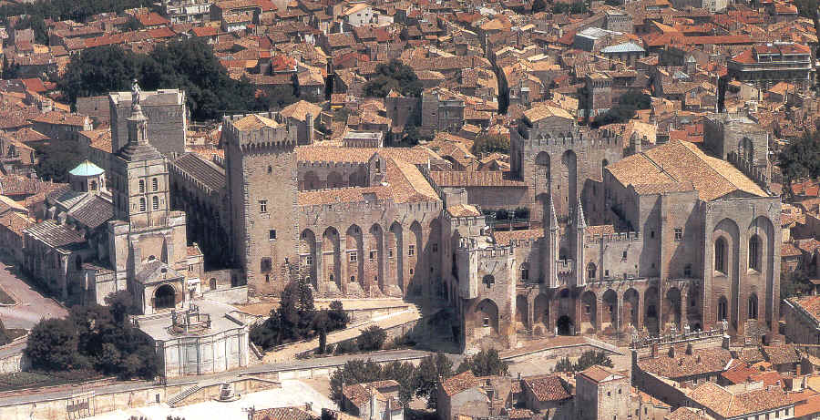
THE COMMERCIAL REVOLUTION OF THE 13TH CENTURY: 1160 - 1330
REVOLUTION IN RENTS ➔ ➔ ➔ ➔
Increased money income for the church – Avignon and Rome as church capitals
Avignon, France – Papal Palace
Vatican City, Rome –
Papal Estate

Slide 20
THE COMMERCIAL REVOLUTION OF THE 13TH CENTURY: 1160 - 1330
THE REVOLUTION IN MONEY
“The flow of silver around Europe from the mining-areas to the ports
by which it left Europe for the Levant was thus not a simple flow, but
one with complex eddies of diffusion into the countryside and
re-concentration in the towns. The places on which it concentrated
were primarily those of political importance where the nobility
increasingly congregated.”
Peter Spufford, MONEY AND ITS USE IN MEDIEVAL EUROPE
p. 249.

Slide 21
PART 2
The 13th Century Revolution in Trade

Slide 22
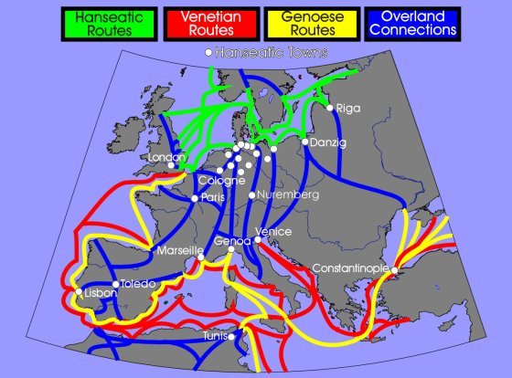
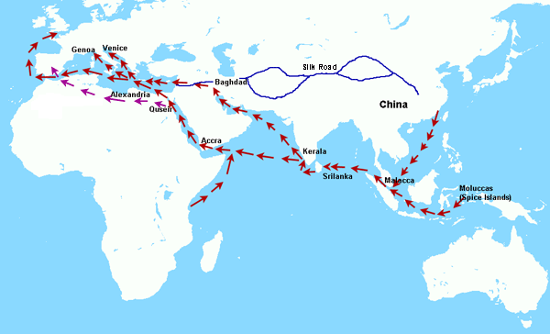
THE COMMERCIAL REVOLUTION OF THE 13TH CENTURY: 1160 - 1330
THE REVOLUTION IN TRADE
“The increase in the demand for luxury goods, backed up by the newly liberated quantities of ready cash (from money rents) brought about an enormous quantitative change in the volume of international trade.”
Peter Spufford, MONEY AND ITS USE IN MEDIEVAL EUROPE
p. 251.

Slide 23
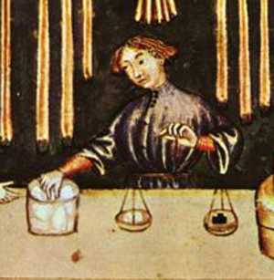
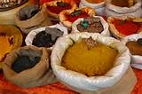
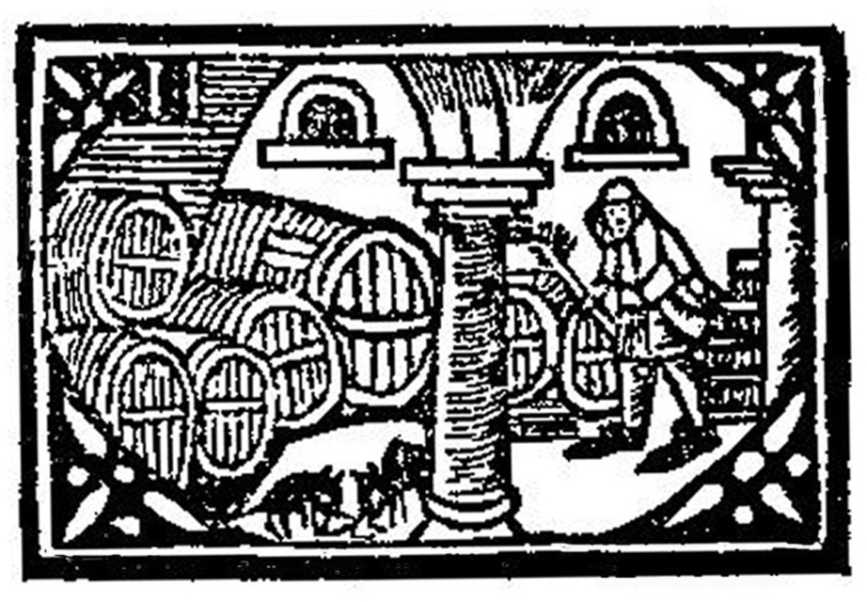
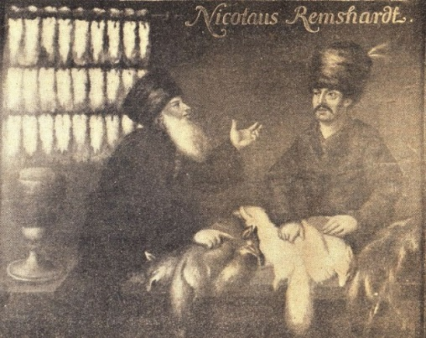


THE COMMERCIAL REVOLUTION OF THE 13TH CENTURY: 1160 - 1330
THE INCREASE OF DEMAND FOR LUXURY GOODS
The courts and nobles moved to the towns and cities.
They wanted luxury goods and they had the money to pay for them.
Sugar in place of honey
Pepper, cloves, other Asian spices
Luxury drinks like Rhineland wine
Pearls
High quality
furs
Diamonds

Slide 24
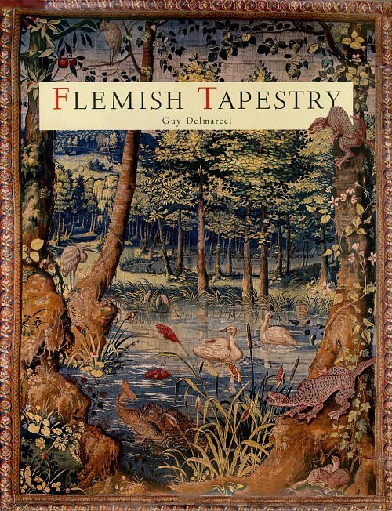
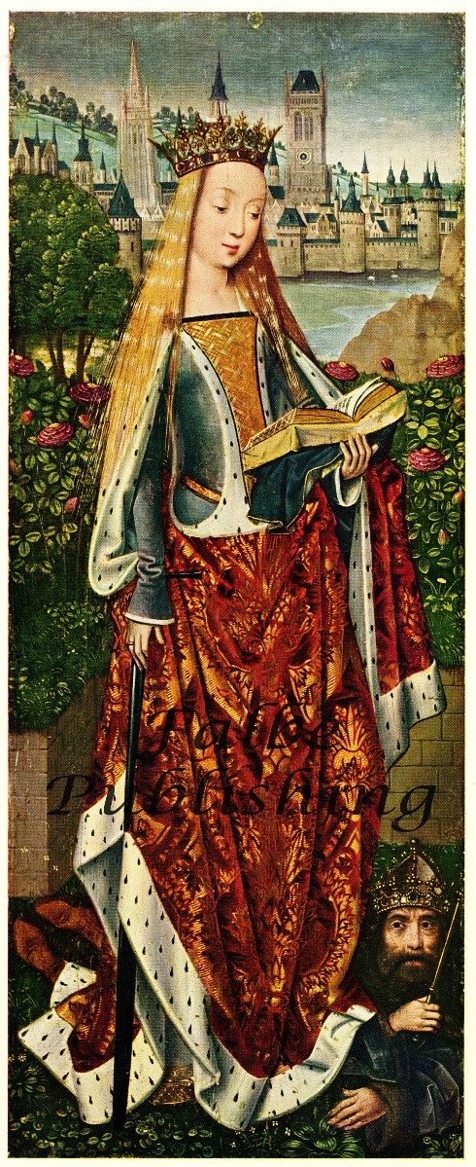
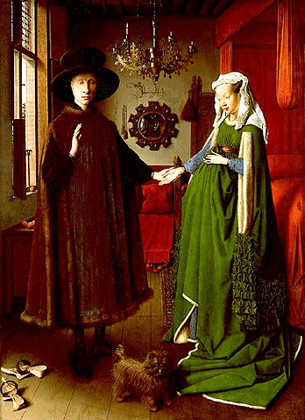
THE COMMERCIAL REVOLUTION OF THE 13TH CENTURY: 1160 - 1330
THE INCREASE OF DEMAND FOR LUXURY GOODS
The largest market of all
was for clothing and
furnishings.

Slide 25
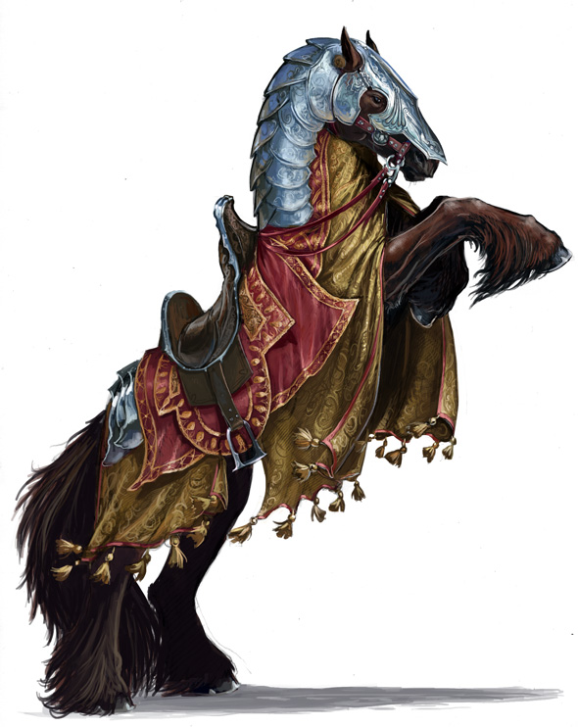
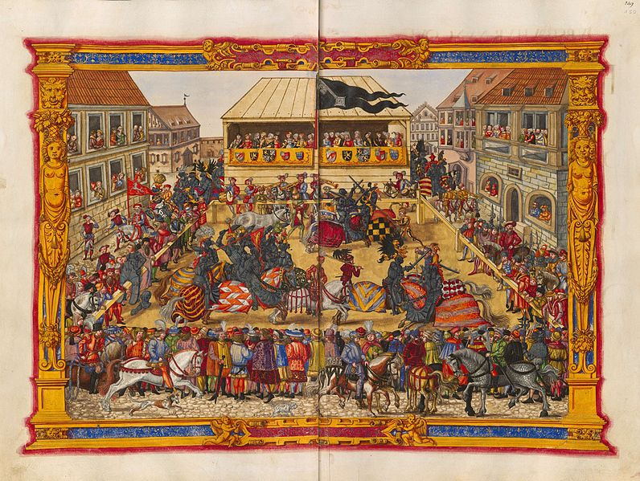
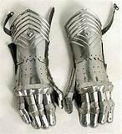
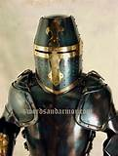
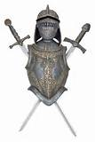
THE COMMERCIAL REVOLUTION OF THE 13TH CENTURY: 1160 - 1330
THE INCREASE OF DEMAND FOR LUXURY GOODS
There was a huge market for commodities for the military.

Slide 26
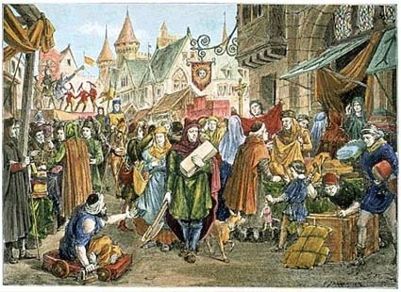
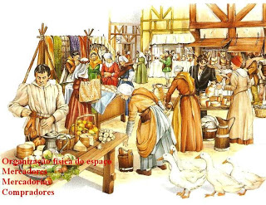
THE COMMERCIAL REVOLUTION OF THE 13TH CENTURY: 1160 - 1330
THE TRADE FAIRS
Princes sponsored great fairs to promote trade.
Fairs were a free trade zone:
taxes were waived, disputes were set aside, regulations were lifted.

Slide 27
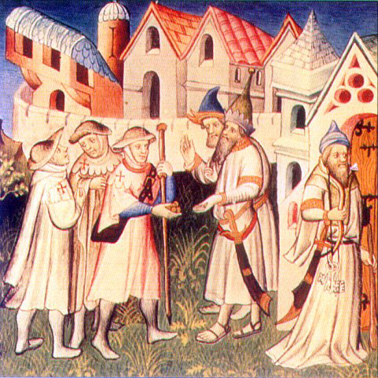
THE COMMERCIAL REVOLUTION OF THE 13TH CENTURY: 1160 - 1330
THE TRADE FAIRS
The merchants used payment clearing within the fair or between fairs.
Merchant #1:
I have added up everything
you bought from me.
It is 300 gold coins.
Merchant #2:
I have added up everything
you bought from me.
It is 200 gold coins.
CLEARANCE:
Merchant #1 will receive
100 gold coins from #2, or,
merchant #1 will offer credit
to #2 until the next fair.

Slide 28
PART 3
THE INTERNATIONAL MERCHANT BANKERS

Slide 29
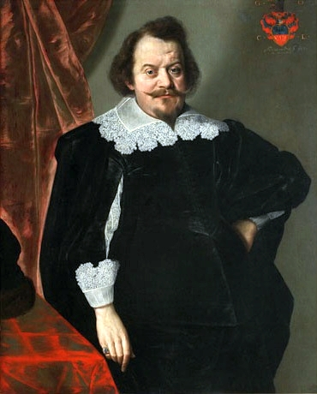
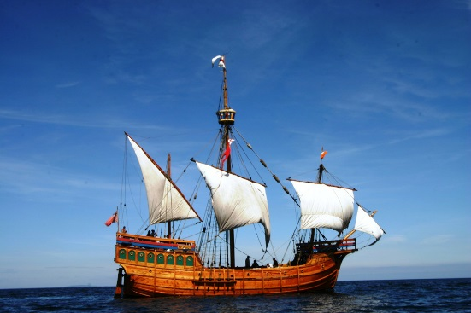
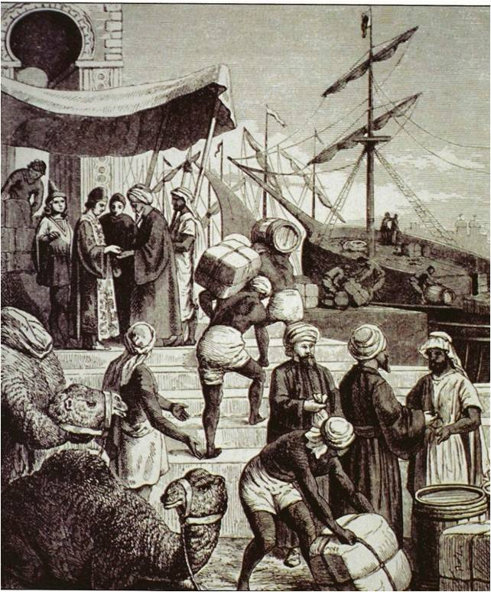
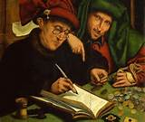
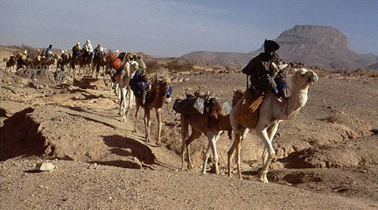
THE COMMERCIAL REVOLUTION OF THE 13TH CENTURY: 1160 - 1330
When the concentration of demand and trade in particular places passed a critical mass,
qualitative changes in the ways of doing business occurred. Traveling merchants were replaced by several different men with specialized functions:
THE INTERNATIONAL MERCHANT BANKERS
1
RESIDENT MERCHANT-BANKERS
IN NORTHERN ITALY
2
SPECIALIST CARRIERS
BY LAND OR SEA
3
FULL-TIME AGENTS
OVERSEAS OR OVERLAND

Slide 30




THE COMMERCIAL REVOLUTION OF THE 13TH CENTURY: 1160 - 1330
THE INTERNATIONAL MERCHANT BANKERS
LONDON
BRUGES
CONSTANTINOPLE
LIGHTHOUSE
1100’s: Agents to the Levant
Later, agents to the Italian peninsula
and the Trade Fairs.
1300: Agents to the Northern capitals and major ports.

Slide 31


THE COMMERCIAL REVOLUTION OF THE 13TH CENTURY: 1160 - 1330
PARTNERSHIPS BECOME MORE PERMANENT
Partnerships extended for many years
The capital of the company was divided into many shares
Shares were transmissible
Shares were owned by families of the founders, principal
employees, and investors
The sedentary merchant was responsible to his shareholders
Florentine bank branches
14th & 15th centuries

Slide 32
THE COMMERCIAL REVOLUTION OF THE 13TH CENTURY: 1160 - 1330
GROWTH OF MUTUAL CONFIDENCE
AMONG INTERNATIONAL BANKERS – SUPPLIERS – CUSTOMERS …..
USE
CREDIT
SALES
ANTICIPATE
INCREASING
MONEY
CREATE
MONEY!

Slide 33
THE COMMERCIAL REVOLUTION OF THE 13TH CENTURY: 1160 - 1330
GROWTH OF MUTUAL CONFIDENCE
AMONG INTERNATIONAL BANKERS – SUPPLIERS – CUSTOMERS …..
BILLS OF EXCHANGE
BUYERS & SELLERS NO LONGER HAVE TO CARRY PRECIOUS METALS.
STATIC MANAGER SENDS & RECEIVES PAYMENTS FROM HIS AGENTS BY BILLS OF EXCHANGE.

Slide 34

THE COMMERCIAL REVOLUTION OF THE 13TH CENTURY: 1160 - 1330
THE BILL OF EXCHANGE: POST-DATED CHECK
BILL: ORDER TO PAY $$ AMOUNT → TO AGENT OF BANKER
AS
BORROWER –
MAKER OF BILL
AGENT OF
BORROWER
<IN RELATIONSHIP>
GOLD
COIN
LOANED
AGENT OF
BANKER
GOLD COIN
REPAID WITH
AGIO (difference)
BANKER
<IN RELATIONSHIP>
GENOA, ITALY
AGENT OF BORROWER, BRUGES
FUTURE
BRUGES, FLANDERS
AGENT OF BANKER, BRUGES
$$
$$ foreign coin
BORROWER, GENOA

Slide 35
THE COMMERCIAL REVOLUTION OF THE 13TH CENTURY: 1160 - 1330
THE BILL OF EXCHANGE: POST-DATED CHECK
BILL: ORDER TO PAY $$ AMOUNT → TO AGENT OF BANKER
AS
BORROWER –
MAKER OF BILL
AGENT OF
BORROWER
<IN RELATIONSHIP>
CR
GIVEN
AGENT OF
BANKER
CR REPAID WITH
AGIO (difference)
BANKER
<IN RELATIONSHIP>
GENOA, ITALY
BRUGES, FLANDERS
EVENTUALLY, LOANS AND REPAYMENTS WOULD BOTH BE DONE WITH BOOKKEEPING ENTRIES –
NO METALS WOULD BE INVOLVED

Slide 36

THE COMMERCIAL REVOLUTION OF THE 13TH CENTURY: 1160 - 1330
BANKERS & BOOKKEEPING MONEY
“In many ways this was a monetary power greater than the King’s control over the mint.
This bank money was a more true fiat money form and further removed from crude barter
than the “precious metals” coins.
But the bankers were usurping a power that derives from and belongs to society,
and using it for personal benefit.”
Stephen Zarlenga, THE LOST SCIENCE OF MONEY, p. 162

Slide 37




THE COMMERCIAL REVOLUTION OF THE 13TH CENTURY: 1160 - 1330
BANKERS CONTROL SOCIETY: THE SILVER FAMINE
1130-1307
THE KNIGHTS TEMPLAR WERE THE FIRST
MODERN BANKERS AND CONTROLLED THE
EXPORT OF SILVER FROM EUROPE TO THE EAST.
1345+
VENICE CONTINUED THE EXPORT OF SILVER
FROM EUROPE TO THE EAST:
Venice applies to Egyptian government
for reduction in tariff on silver imported
by Venice into Alexandria from 10% to 2%,
and taps into Eastern ratio: silver famine
in Europe.

Slide 38
PART 4
The King’s Mint

Slide 39


THE KING’S MINT
THE PRINCES ‘CONTROLLED MONEY’:
The minting of coin and spending into circulation
WITH THE POWER TO MINT COINS, THE PRINCES WERE
GIVEN THE POWER TO CONTROL THE AMOUNT OF MONEY
IN CIRCULATION.
HOWEVER, IF BULLION WAS LEAVING THE COUNTRY,
THE MARKET PRICE OF GOLD OR SILVER WOULD RISE
ABOVE THE MINT PRICE, AND BULLION WOULD CEASE
TO FLOW TO THE MINT.
THIS STOPPAGE OF WORK AT THE MINT WAS ONE
OF THE MAIN CAUSES OF PRINCELY DEBASEMENT OF THE COIN.
BY LAW, THE MONEY-CHANGERS WERE SUPPOSED
TO DELIVER ALL THEIR BULLION TO THE MINT. THIS
DID NOT HAPPEN IF THEY COULD SELL IT FOR A
BETTER PRICE ELSEWHERE.

Slide 40


THE KING’S MINT
THE PRINCES DEBASEMENT OF THE COIN:
A Solution for Deflation
The debasement (or devaluation) of the silver groat by the prince was
a help to the money changers. They would have their cash reserves
recoined into a greater number of silver groats and still owe to their
customers the same number of groats as before the debasement.
The debasement meant the prince would have greater seignorage
(the profit from spending newly minted coin, after subtracting the cost
of bullion).
However, the increase of the prince’s seignorage profit was decreased
by the loss of income from other revenue sources which did not keep
up with the rise in prices.
Silver Penny Coin
of Henry III - 1216 AD

Slide 41
PART 5
BRUGES, BELGIUM: CREDIT
  The Money Changers Local Deposit Banking
  The Italian Merchant-Bankers International Banking

Slide 42

BRUGGE, BELGIUM: CREDIT
PAWNBROKERING DID NOT CREATE MONEY (CREDIT)
BUT IT WAS USURY
PAWNBROKERS – lending at interest on the security of personal property
Because pawnbrokers gave consumptive loans, the church considered them usury. However, many of the poor needed these loans to survive, and the government’s fees were a source of revenue, so in many places the government legalized them.

Slide 43
LOCAL DEPOSIT BANKS CREATED MONEY
  The Money Changers
  Local Deposit Banking

Slide 44

BRUGGE, BELGIUM: CREDIT
Money changers had two
original functions:
#1 Exchange current coins
for a fee (agio or commission)
#2 Purchase bullion from
public and sell to
prince’s mint (if profitable)
  The Money Changers Local Deposit Banking

Slide 45

BRUGGE, BELGIUM: CREDIT
Money changers assumed a third function:
#3 CREDIT MONEY CREATION
They began to accept deposits of coin, called giro (deposit) banking.
DEPOSITS: A deposit was transformed into bank money – bookkeeping credit to the depositor’s current account.
The deposit did not earn interest, but could be transferred to
other accounts in the same or a different bank.
At the same time, the bank used the deposits to invest in or
loaned to business ventures, with interest in a concealed form.
Money was created: purchasing power. Risk was taken.
OVERDRAFTS: The depositor’s current account could also go into overdraft, a bookkeeping loan. No interest was charged.
Money was created: purchasing power.
  The Money Changers Local Deposit Banking

Slide 46

BRUGGE, BELGIUM: CREDIT
“…the exchange banks created purchasing power,
or money, as effectively as if they had been
granted the privilege of issuing notes.”
De Roover,
MONEY, BANKING AND CREDIT
IN MEDIAEVAL BRUGES, p. 321
“By tacit understanding, the depositor permitted
the banker to use the money that he had deposited or that was credited to his account by transfer, in return for safety and the service of transfer.” p. 81
Lane and Mueller,
MONEY AND BANKING IN MEDIEVAL
AND RENAISSANCE VENICE, p. 81
  The Money Changers Local Deposit Banking

Slide 47
INTERNATIONAL MERCHANT-BANKS CREATED MONEY
  The Italian Merchant-Bankers
  International Banking

Slide 48



BRUGGE, BELGIUM: CREDIT
INTERNATIONAL BANKING CREATED SHORT-TERM CREDIT (MONEY)
….AS PART OF THE INTERNATIONAL TRANSFER OF FUNDS

Slide 49


BRUGGE, BELGIUM: CREDIT
INTERNATIONAL BANKING CREATED LONG-TERM CREDIT (MONEY)
….TO FUND WARS

Slide 50
PART 6
THE HANSEATIC LEAGUE: WAR ON CREDIT

Slide 51


THE HANSEATIC LEAGUE: 1179 - 1648
HANSA: a commercial and defensive confederation
of 180 northern and central German merchant guilds
and their market towns that dominated trade
along the coast of Northern Europe; peaked 1450
Their methods with trading partners included:
negotiation
suppression of trade
blockage (resulting in famine)
war

Slide 52

THE HANSEATIC LEAGUE: 1179 - 1648
HANSA
TRADE

Slide 53

THE HANSEATIC LEAGUE: 1179 - 1648
HANSA
VESSALS

Slide 54

THE HANSEATIC LEAGUE: 1179 - 1648
The Hanseatic League
Judges Rule-Breaking Traders

Slide 55

THE HANSEATIC LEAGUE: 1179 - 1648
WAREHOUSE OF HANSA IN LONDON

Slide 56
THE HANSEATIC LEAGUE: 1179 - 1648
THE HANSA HAD NO MONETARY POWER
THE HANSA WOULD NOT USE CREDIT IN TRADE
CREDIT ACCUSED OF:
  Instability of prices
  Increased risk taking
  Unscrupulous schemes

Slide 57

THE HANSEATIC LEAGUE: 1179 - 1648
STRUGGLE OVER THE MONEY POWER:
THE HANSA’S WAR ON CREDIT
Credit war begun: Duke of Burgundy adopted hard money
and caused a severe DEFLATION in Bruges:
  bills of exchange were ordered to be paid in coinage
  and not by crediting accounts at the bank
  +
  silver was demonetized since bills had to be paid in gold
  The decreased volume of money benefited landed gentry, clergy, rentiers, since rents remained constant. But the Bruges Treasurer was nearly killed by an angry mob – this resulted in the rents being scaled back.
1401 Repealed

Slide 58

THE HANSEATIC LEAGUE: 1179 - 1648
STRUGGLE OVER THE MONEY POWER:
THE HANSA’S WAR ON CREDIT FAILED
THE HANSA:
1401 - obtained abolition of all credit transactions in Flanders
for 3 years on buying/selling with foreigners
1433 - BRUGES SUPPRESSED ALL BANKERS, FOREIGN & DOMESTIC
1488 – Medici branch liquidated in Bruges
Largest banks were international and moved
to Antwerp to capture the trade around the
Cape of Good Hope.
Bruges went into decline.

Slide 59
Q & A

