Slide 1
TIMELINE: DAWN OF MAN THRU ‘ANCIENT ORIENTAL’ CITY CIVLIZATIONS
BEFORE THE GREEK CITY STATES APPEAR ……

Slide 2
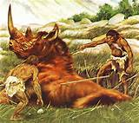
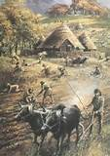
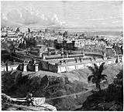
TIMELINE 30,000 to 10,000 BC PALEOLITHIC AGE - HOM0 SAPIENS APPEAR 10,000 to 3,500 BC NEOLITHIC AGE 3,500 to 1,400 BC BRONZE AGE
HUNTER-GATHERERS
PEASANTS
CITY CIVILIZATIONS

Slide 3
PALEOLITHIC

Slide 4
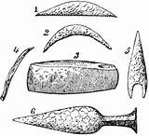
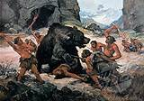
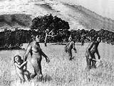
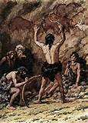
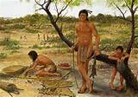
PALEOLITHIC AGE: 300,000 TO 10,000 BC
STONE AGE TOOLS
HUNTERS, GATHERERS
ROVING BANDS AND TRIBES

Slide 5
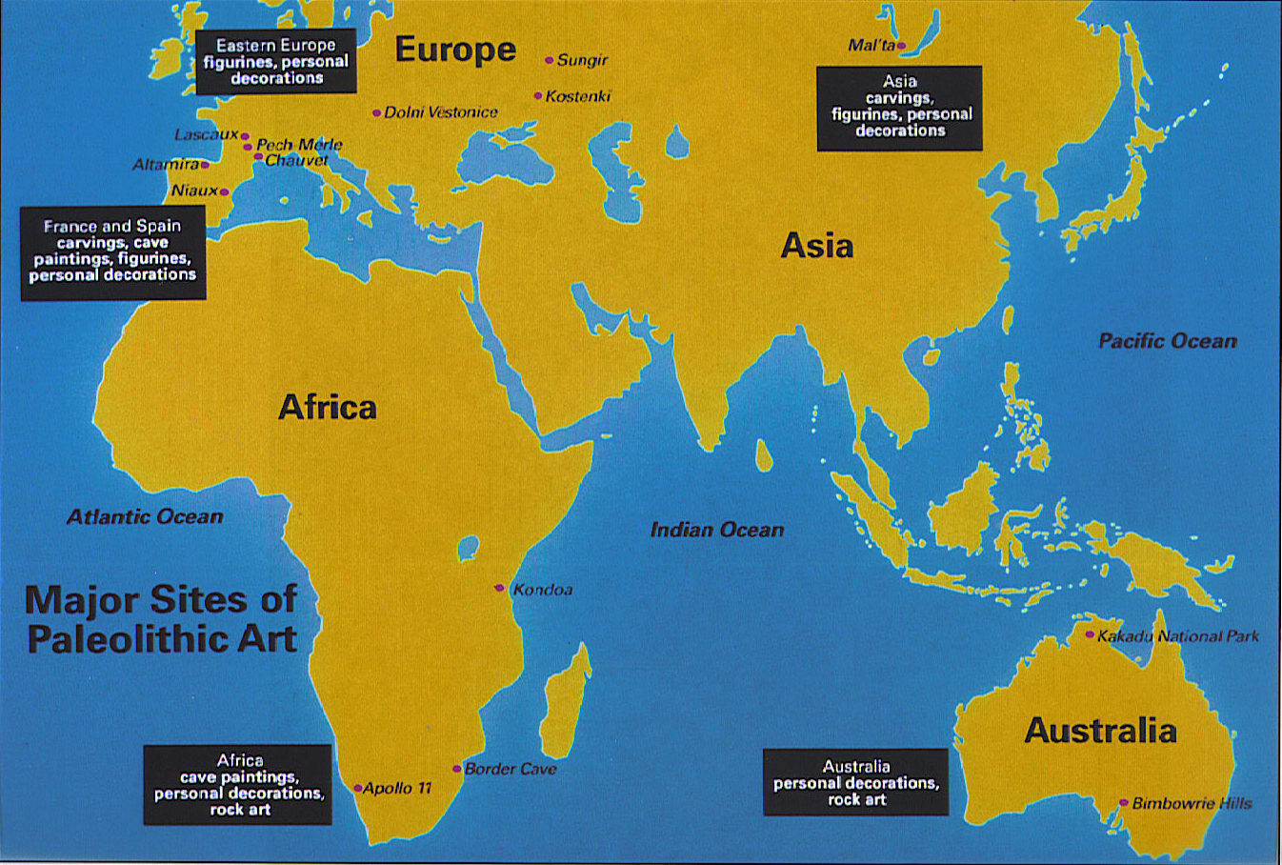
PALEOLITHIC AGE: 300,000 TO 10,000 BC

Slide 6
NEOLITHIC

Slide 7
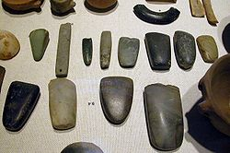

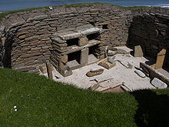

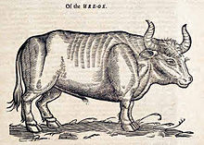
NEOLITHIC AGE: 10,000 TO 5,000 BC
Domesticated plants & animals
Creation of plow
Peasant villages (sedentary life)
Some loans of seeds, animals, tools … with interest

Slide 8
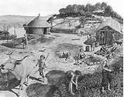
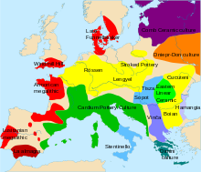

NEOLITHIC AGE: 10,000 TO 3,500 BC

Slide 9
BRONZE

Slide 10
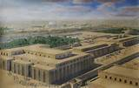
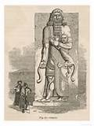
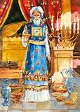
BRONZE AGE: RISE OF CITY CIVILIZATIONS 3,500 – 1,400 BC
Rise of first urban civilizations - Ancient Oriental City Civilizations
First writing - ‘history’ begins
Loans of silver by weight … with interest

Slide 11
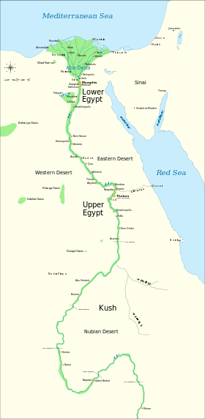
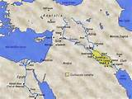
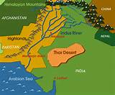
CITY CIVILIZATIONS: 3,500 – 300 BC SOME, NOT ALL, CITY CIVILIZATIONS ROSE ON RIVERS
EGYPT
BABYLONIA, SUMER, ASSYRIA
INDUS VALLEY - INDIA

Slide 12
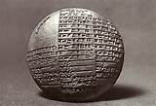
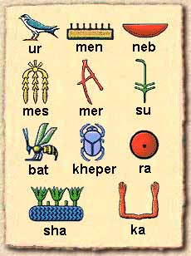
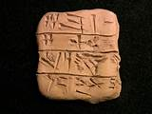
CITY CIVILIZATIONS: 3,500 – 300 BC CITY CIVILIZATIONS HAD WRITTEN RECORDS – THE ACCOUNTS OF KING AND TEMPLE
SUMERIAN CLAY TABLETS –
ACCOUNTS OF KINGS AND TEMPLES
EGYPTIAN
HIEROGLYPHICS

Slide 13
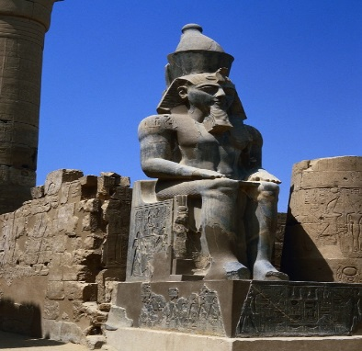
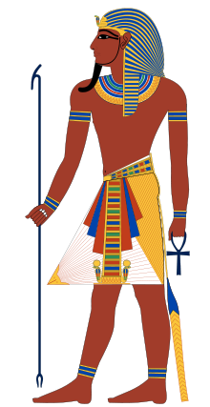

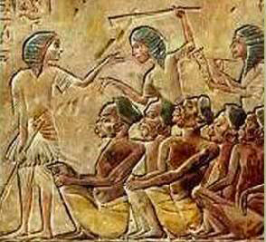

FIRST CITY CIVILIZATIONS: ANCIENT ORIENTAL SYSTEM
Living King as divine representative
Temple hierarchy, with temple at heart of city
Compulsory labor services for public works
Pharaohs instructed what and
how much to plant, how much to go into storage
The Goddess in Sumer

