Slide 1
CHAPTER 1
THE ORIGINS OF MONEY SYSTEMS
Part 1

Slide 2
LET’S REVIEW THE THEMES OF THIS BOOK
KEEP LSM’S THEMES IN MIND WHEN READING EVERY CHAPTER
Primary importance of the money power
Nature of money purposely kept secret and confused
How a society defines money determines who controls the society
Battle over control of money has raged for millennia: public vs private

Slide 3
# 1
WHAT ARE THE THEORIES OF THE ORIGIN OF MONEY?

Slide 4
# 1
WHAT ARE THE THEORIES OF THE ORIGIN OF MONEY?
“The origins of money are shrouded in uncertainty.” Stephen Zarlenga, LSM
“Any attempts to explain the origins of money before the invention of writing must be speculation.” Bob Poteat, AMI

Slide 5
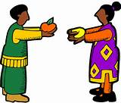
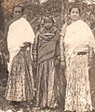
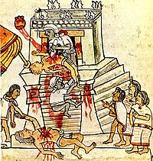
#1
WHAT ARE THE THEORIES OF THE ORIGIN OF MONEY?
ECONOMISTS: ‘Trading origin’
First there was barter of commodities,
and then came a money commodity.
ANTHROPOLOGISTS: ‘Social origin’
Standardized payments for brides and blood money for injuries and deaths
were the main uses for money in primitive societies.
HISTORIANS: ‘Religious origin’
Primitive man believed in and feared supernatural forces.
There was a need for uniform sacrifices or dues to the gods,
and fees to the priests.

Slide 6
#1
WHAT ARE THE THEORIES OF THE ORIGIN OF MONEY?
ECONOMISTS: ‘Trading origin’
The dominant theory today:
economic profession’s ORIGIN FROM BARTER in trade and markets.
Economists have no evidence for this theory.
Their textbooks say…”imagine a barter economy”

Slide 7
#1
WHAT ARE THE THEORIES OF THE ORIGIN OF MONEY?
ECONOMISTS: ‘Trading origin’
Adam Smith, the ‘father of economics’, wrote the book,
WEALTH OF NATIONS, in 1776. He wrote about the land of barter –
the founding myth of economics.
David Graeber, anthropologist: “…we anthropologists have long known this is a myth simply because if there were places where everyday transactions took the form of: “I’ll give you twenty chickens for that cow,” we’d have found one or two by now. After all, people have been looking since 1776, when the Wealth of Nations first came out. “

Slide 8
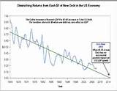



#1
WHAT ARE THE THEORIES OF THE ORIGIN OF MONEY?
ECONOMISTS: ‘Trading origin’
The economics profession is based on theories that
from ‘the economy.’
They reduce living to a monetary calculation that eliminates
all social obligations to each other. Supposedly, humans only
want to buy and sell.
But ‘the economy’ is really human activities that are needed for:
  Meeting people’s needs
  Working to create wealth and distributing it fairly
  Lifeblood of a society
remove moral & political life

Slide 9
PALEOLITHIC MONEY –
A MEANS OF VALUATION
A MEANS OF EXCHANGE

Slide 10
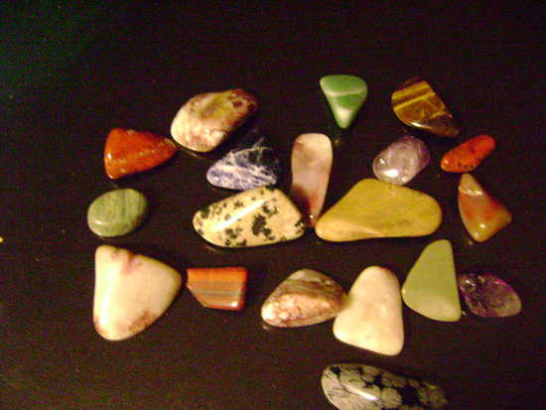
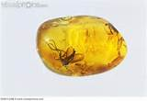
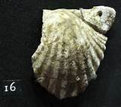
PALEOLITHIC MONEY
Within the band/tribe or when the bands/tribes met each other:
Present-giving
Expressions of friendship
Gift-exchange
Bride’s price
Some monies (preferred means of exchange and valuation) :
shells
amber
stones
tusks

Slide 11
NEOLITHIC MONEY –
A MEANS OF VALUATION
A MEANS OF EXCHANGE

Slide 12
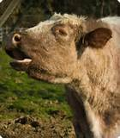
NEOLITHIC MONEY
COW STANDARD
The most widely used standard of value was the COW.
It was the measuring unit and means of exchange
for large transactions.

Slide 13
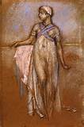
NEOLITHIC MONEY
COW STANDARD
1 slave woman = 3 or 4 cows

Slide 14
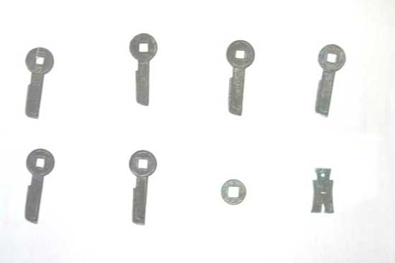
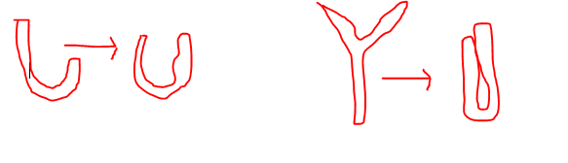
NEOLITHIC MONEY
TOOL MONEY
used by villagers to pay wages, buy, and value
shapes of fish hooks, axes, knives - tokens

Slide 15
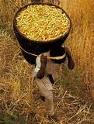
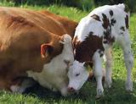
NEOLITHIC MONEY
FOOD MONEY, ANIMAL MONEY
*** Beginning of lending with interest ***
  Loans without interest were more common
  Seeds lent at interest would be returned with more seed from the harvest
  A cow lent out would be returned with its offspring
What was loaned had the power of generation.

Slide 16
NEOLITHIC MONEY
FOOD MONEY, ANIMAL MONEY
*** Beginning of lending with interest ***
NOTE:
This lending was not in general use:
  Risky due to nature’s unpredictability
  Restricted by social and religious taboos

Slide 17
FIRST CITY CIVILIZATIONS:
THE ANCIENT ORIENTAL MONEY SYSTEM

Slide 18
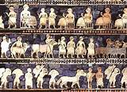
ANCIENT ORIENTAL MONEY SYSTEM
The temples were huge industrial complexes with their own land, flocks and factories.
The palace and especially the temple made loans from their own assets.

Slide 19
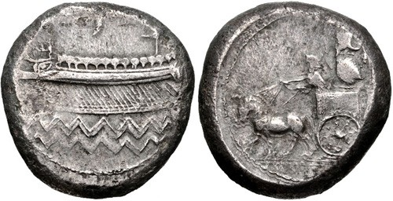
ANCIENT ORIENTAL MONEY SYSTEM
SILVER SHEKELS
(weighted silver)
FOR THE FIRST TIME, THE LEGAL SYSTEM SUPPORTED INTEREST ON METALS !!!

Slide 20
ANCIENT ORIENTAL MONEY SYSTEM
SILVER SHEKELS
(weighted silver)
THE ANCIENT ORIENTAL THEOLOGY SAW ALL OF NATURE AS ALIVE – ANIMATE.

Slide 21
ANCIENT ORIENTAL MONEY SYSTEM
SILVER SHEKELS
(weighted silver)
This was a major conceptual error!
Inorganic materials were being treated as if they were living organisms with the means of reproduction.

Slide 22
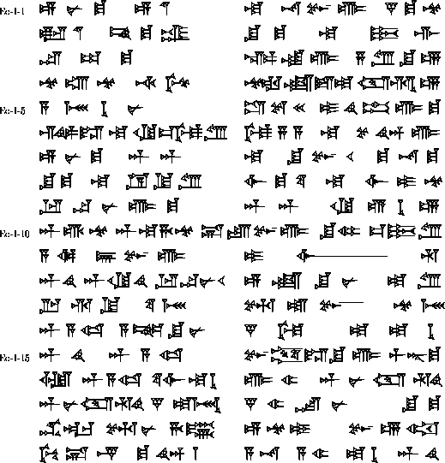
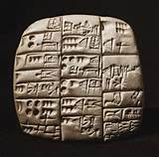
ANCIENT ORIENTAL MONEY SYSTEM
The money power became the prerogative of the temples.
Baked clay tablets written in cuneiform were accounting records,
recording loans and money transactions.

Slide 23
ANCIENT ORIENTAL MONEY SYSTEM
The money power became the prerogative of the temples.
According to law, a person could be put
to death for not recording a financial
transaction.

Slide 24
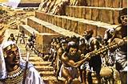
# 2 ANCIENT ORIENTAL MONEY SYSTEM
THE RESULT OF THE USURY ERROR
If say the harvest was bad, everybody would start falling into debt-traps.
Families would have to start pawning off their flocks, fields and before long,
their wives and children would be taken off into debt peonage.

Slide 25

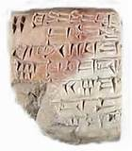
# 2 ANCIENT ORIENTAL MONEY SYSTEM
ALLEVIATION OF THE USURY ERROR
The King took decisive action to minimize the harmful effects of usury
Declared periodic debt forgiveness – ‘washing of the tablets’
Set official prices for farm commodities (monetized them)
EXAMPLE OF SUMERIAN LAW:
“He cleared and cancelled obligations
for those indentured families, citizens of Lagash
living as debtors because of grain taxes, barley
payments, theft or murder.”
HANNURABI CODE OF LAW:
“A debtor must be allowed to pay in produce
according to statutory scale.”

Slide 26
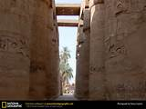
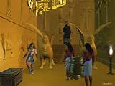

# 2 ANCIENT ORIENTAL MONEY SYSTEM
THE TEMPLE CULTS OF THE CITY CIVILIZATIONS CONTINUED GREAT MONEY POWER, even as the introduction of iron around 1400 BC spurred great migrations into areas like Greece, Italy, and other parts of Europe..
518 BC:
From accountancy documents generated by the temple bureaucracy, preserved in the cuneiform collections
of the British Museum:
“38 shekels of silver for Samas-iddin and his horsemen who have come back from Egypt.”

Slide 27
Q & A

